Slide 1
LET IT WAG – SAVE THE WORLD OF PAWS
By
LAKSHIT TALREJA
RISHI JATANIA
SURAJ NAIR

Slide 2
Introduction
There is currently is no platform for any individual to report a stray animal.
There is urgent need to provide society with the means to lead stray animals to a safer place than the streets.
Our application intends to solve this problem using Java Swing technology

Slide 3
Approach
The app has a report stray animal form, wherein the user can mention the last spotted location of the pet.
It is then upon the NGO administration to start a work flow to pickup the pet and later provide medical treatment for the pet.
Since there are a lot of stray animals, we have implemented the ordering of supplies at the pet shelter after the necessary administrative approvals.ss

Slide 4
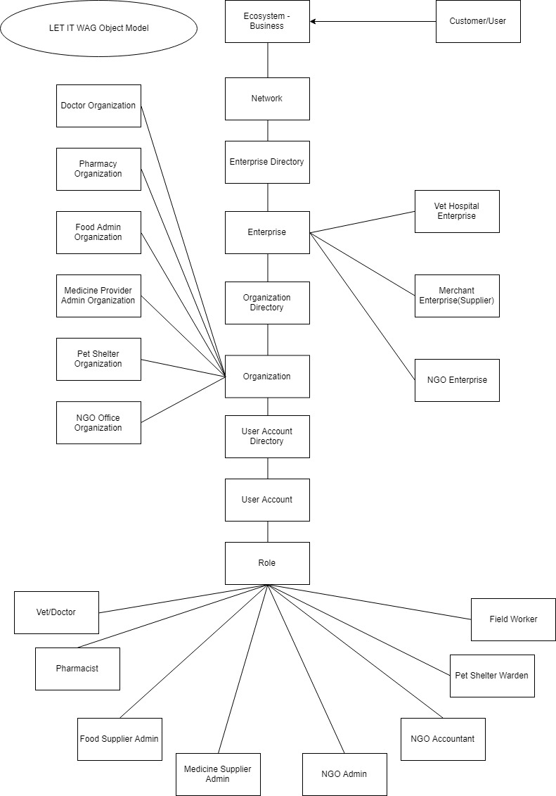
Object Model

Slide 5
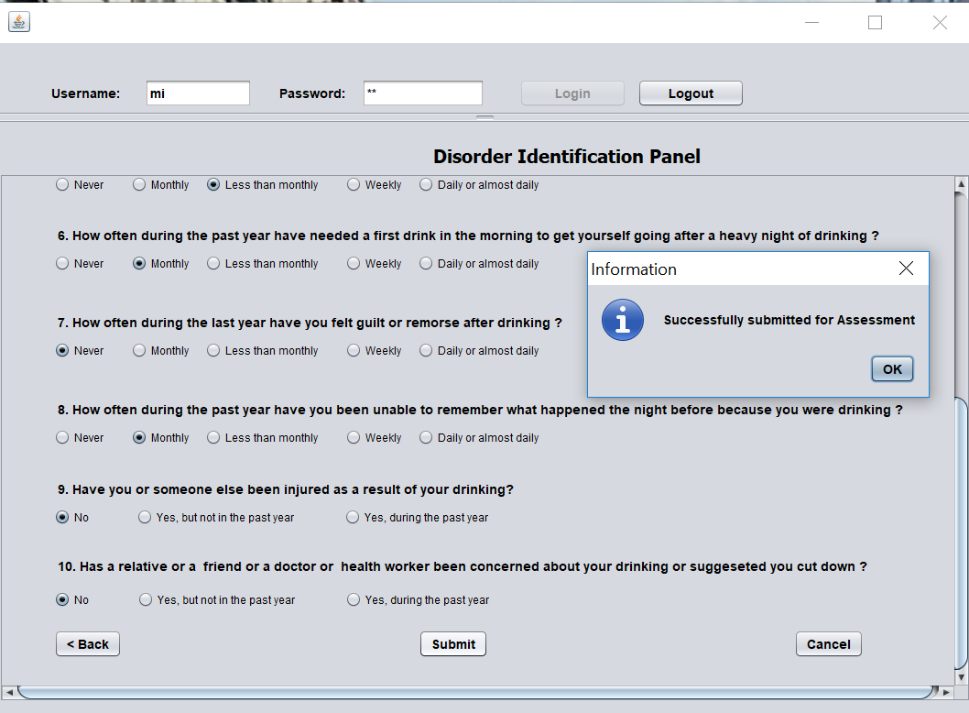
Patient Assessment

Slide 6
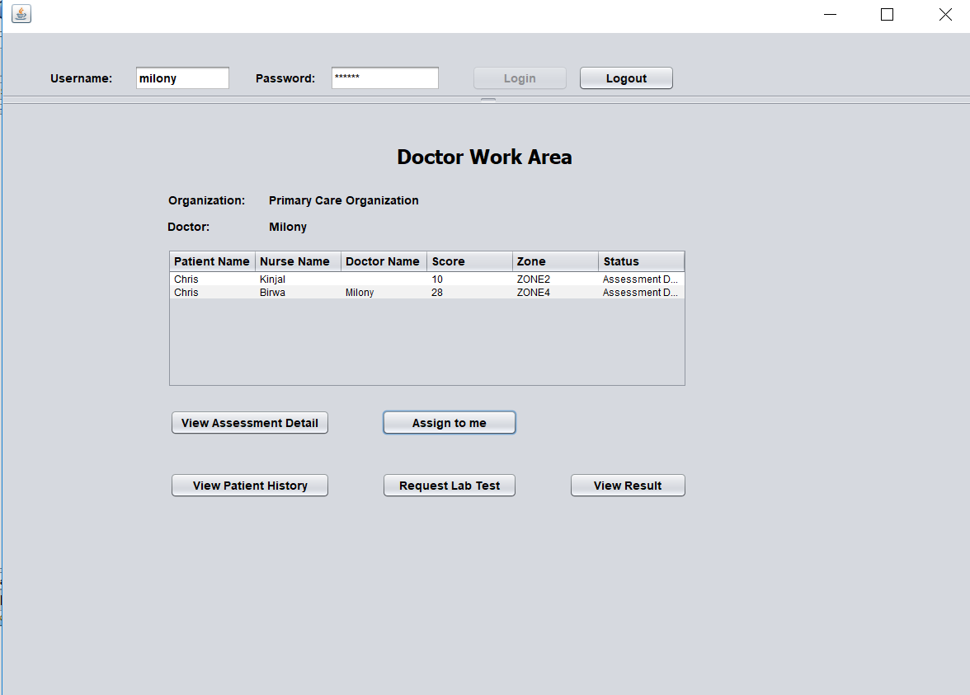
Doctor Assessment for Patient

Slide 7
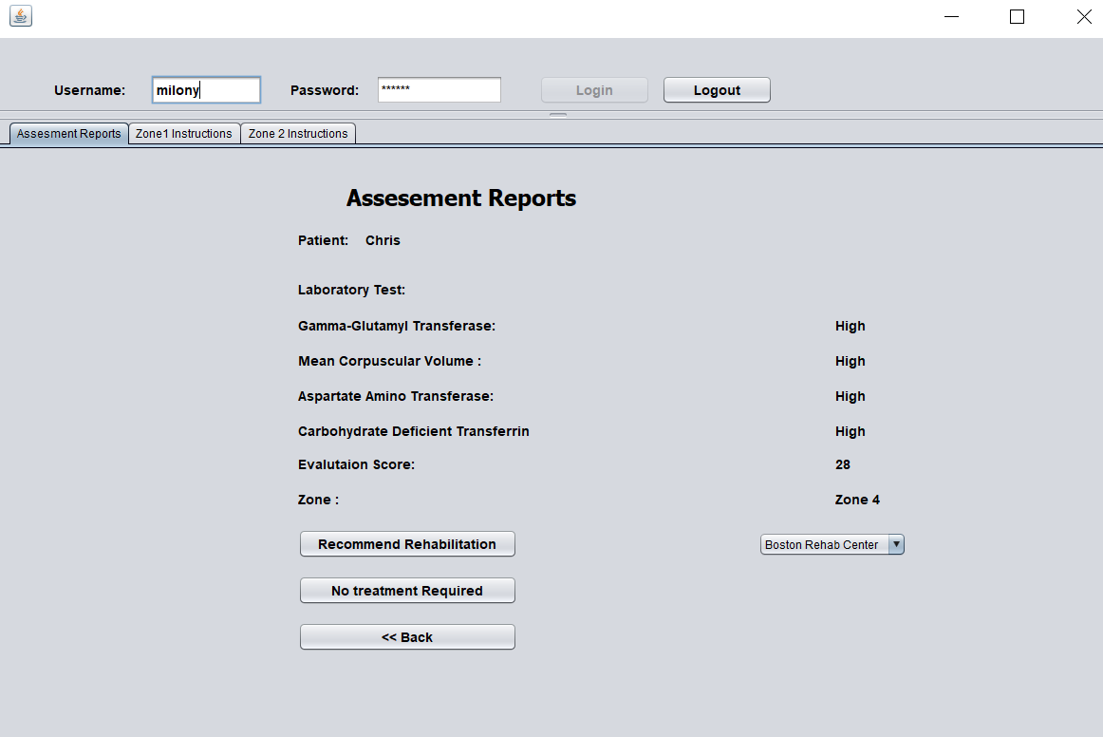
Recommendations provided by doctor

Slide 8
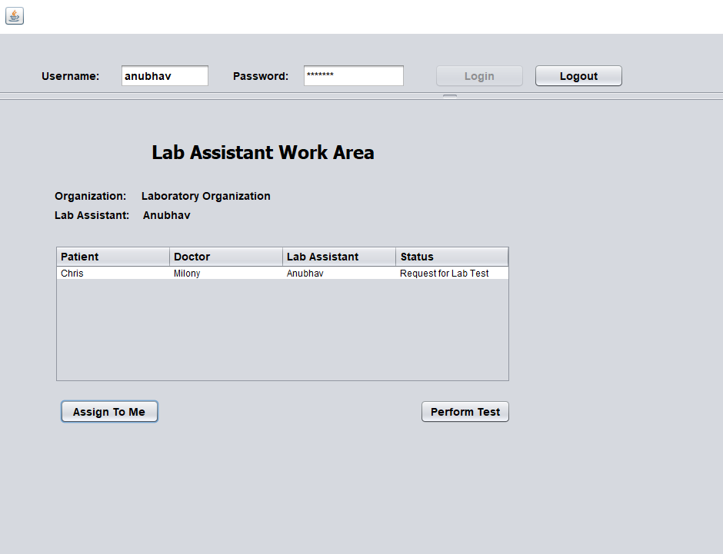
Lab Test Assessment for patient

Slide 9
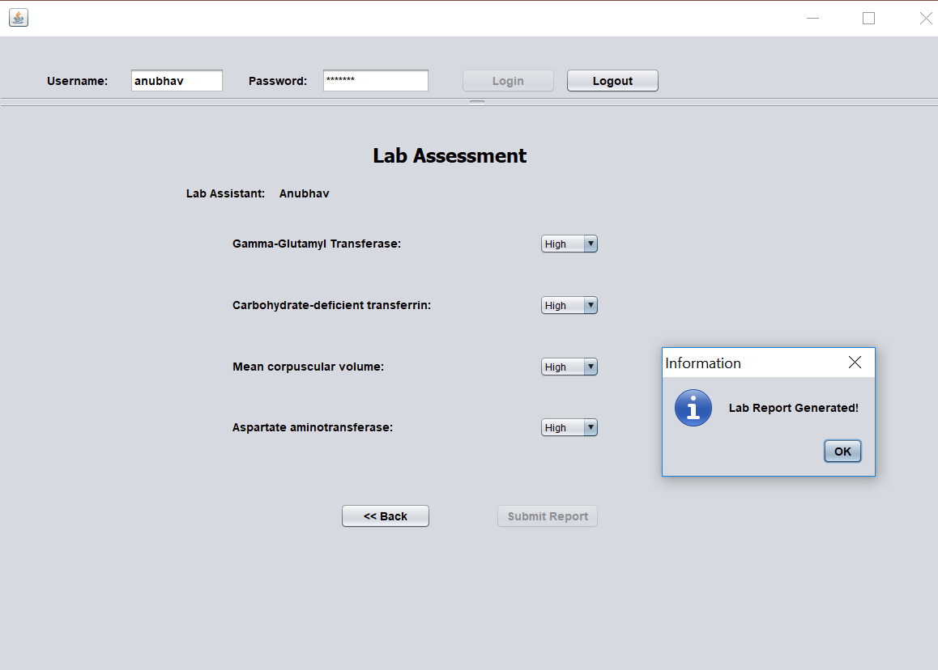

Slide 10
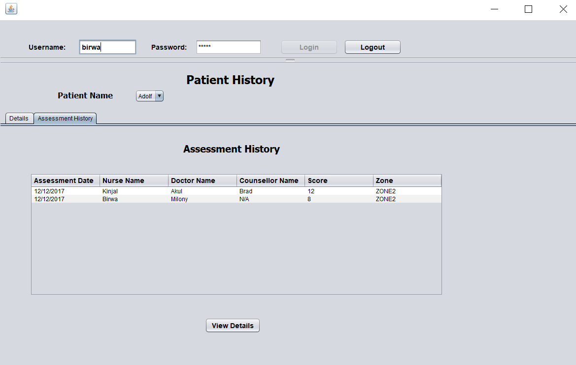
Keeping Track of Patient History

Slide 11
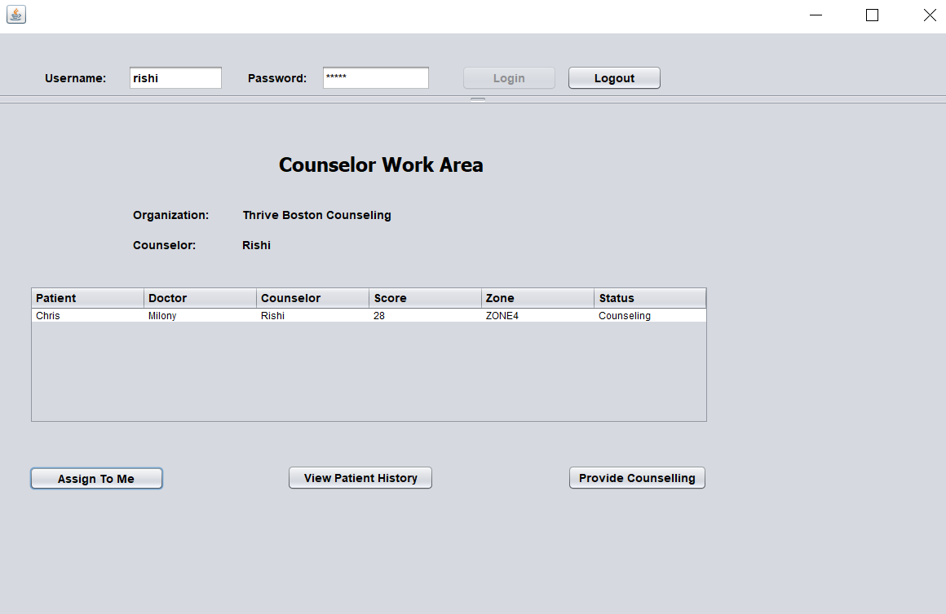
Counselor Assessment for Patient

Slide 12
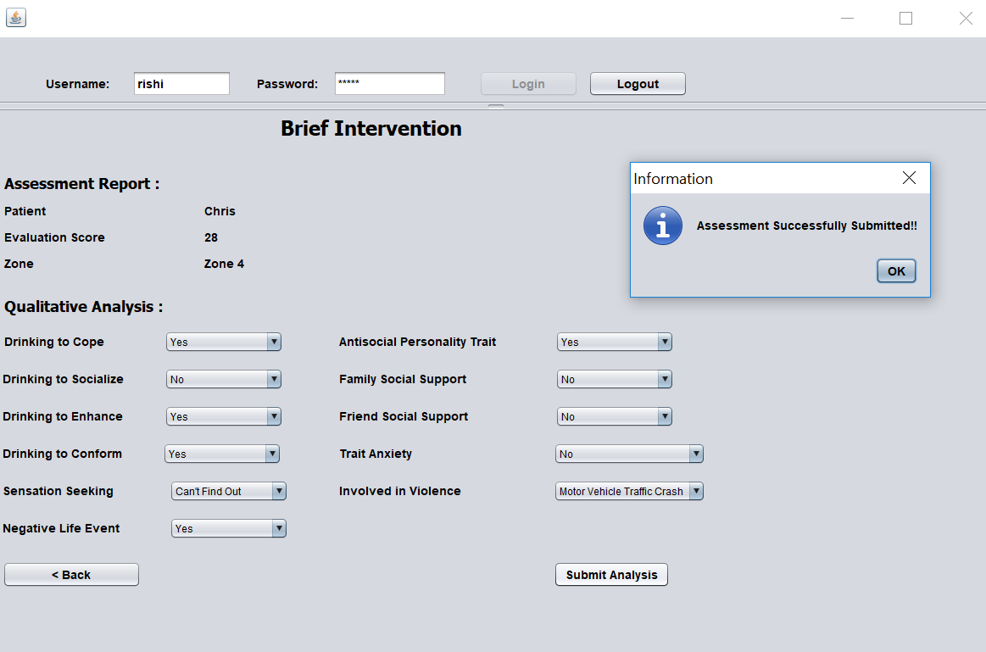

Slide 13
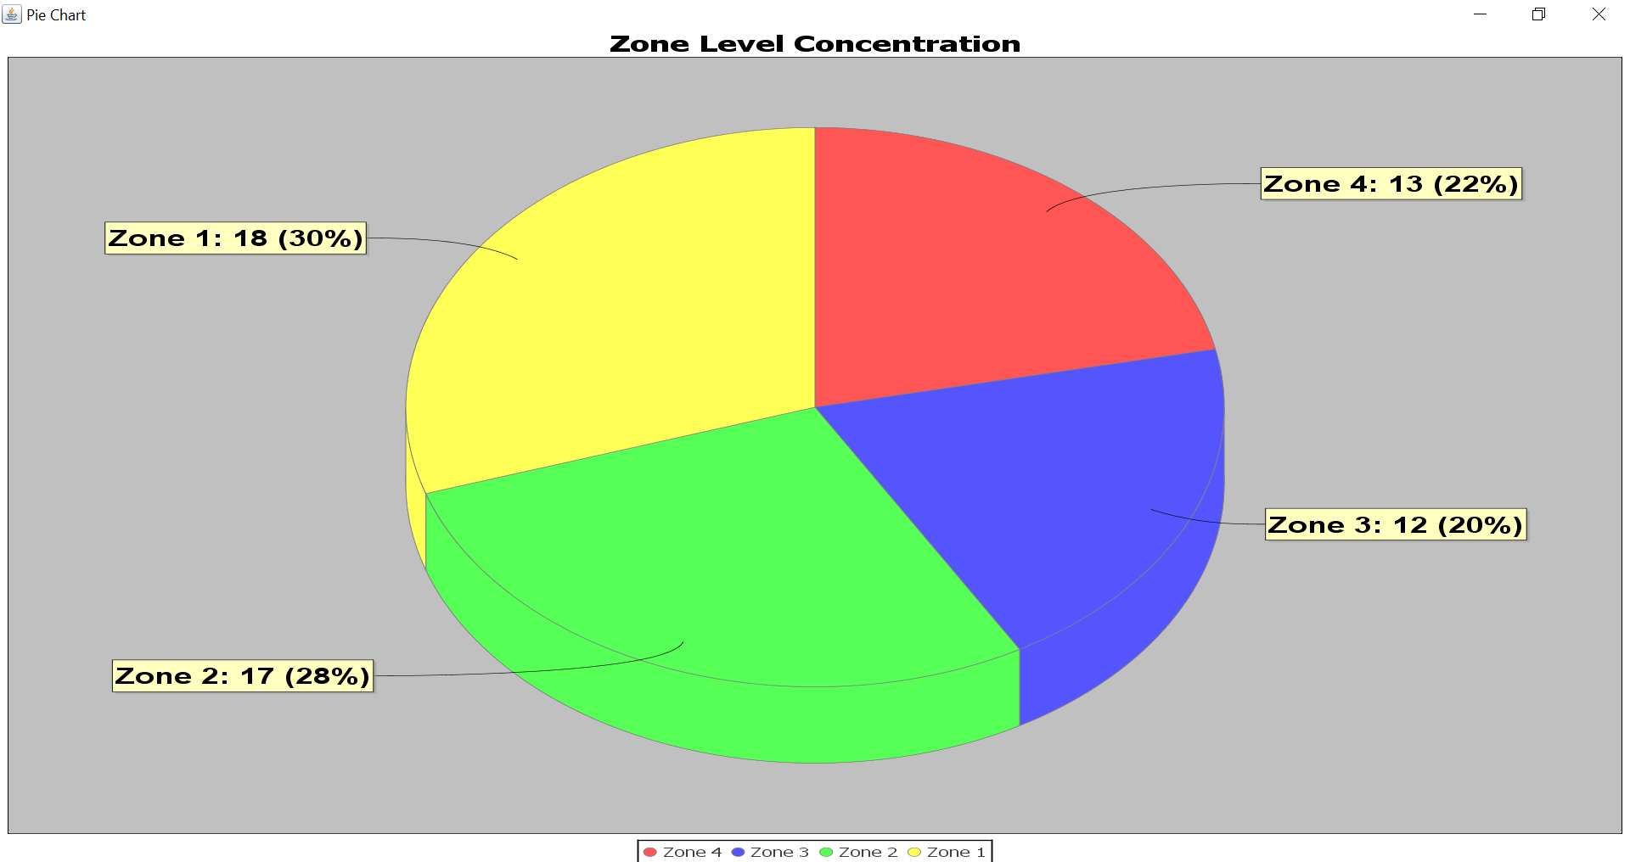
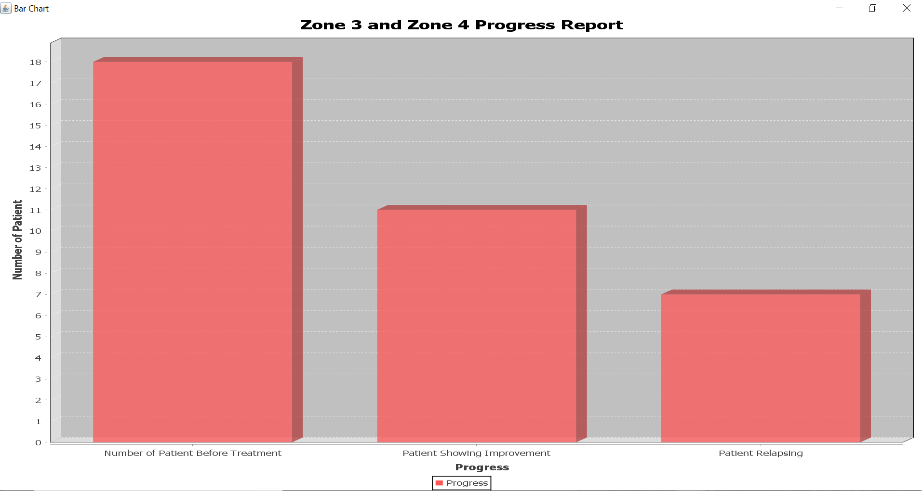
Report Generation at System Level

Slide 14
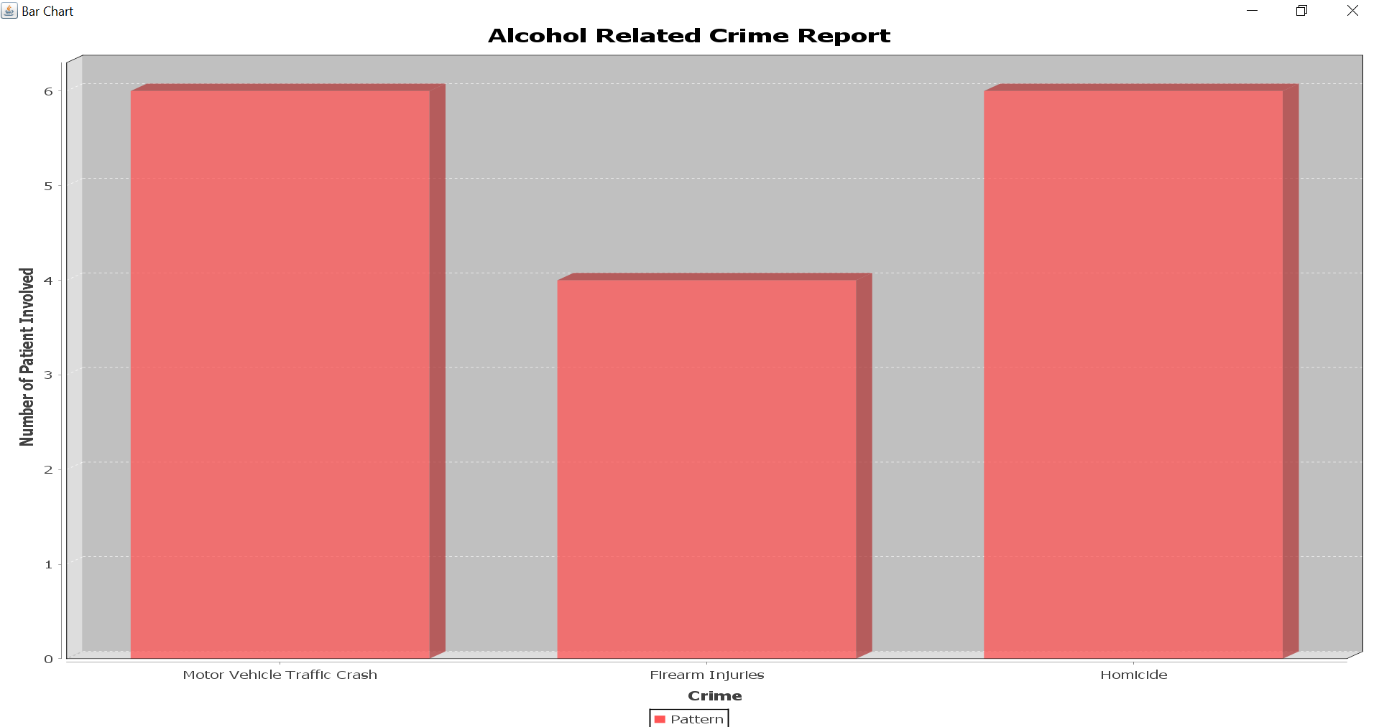
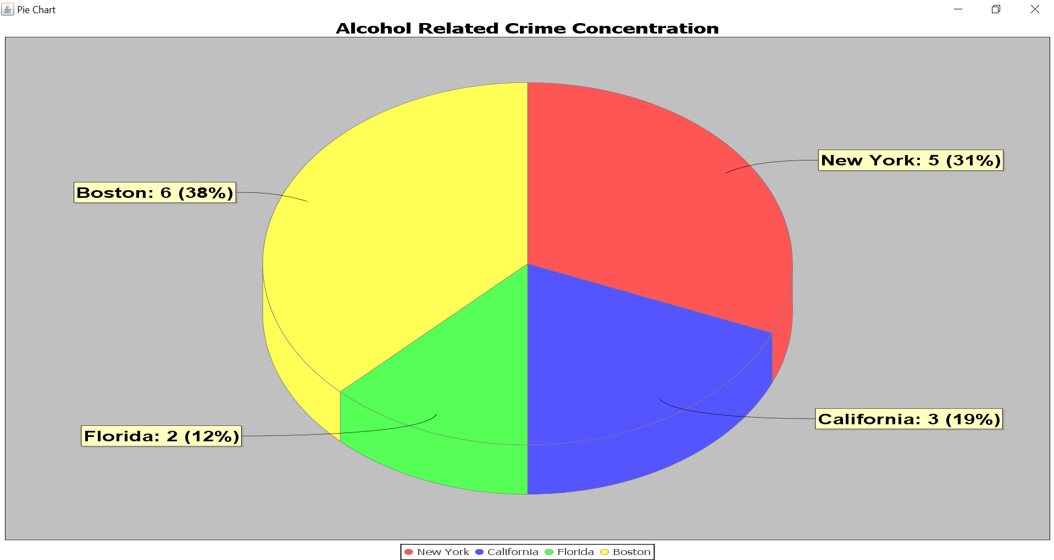

Slide 15
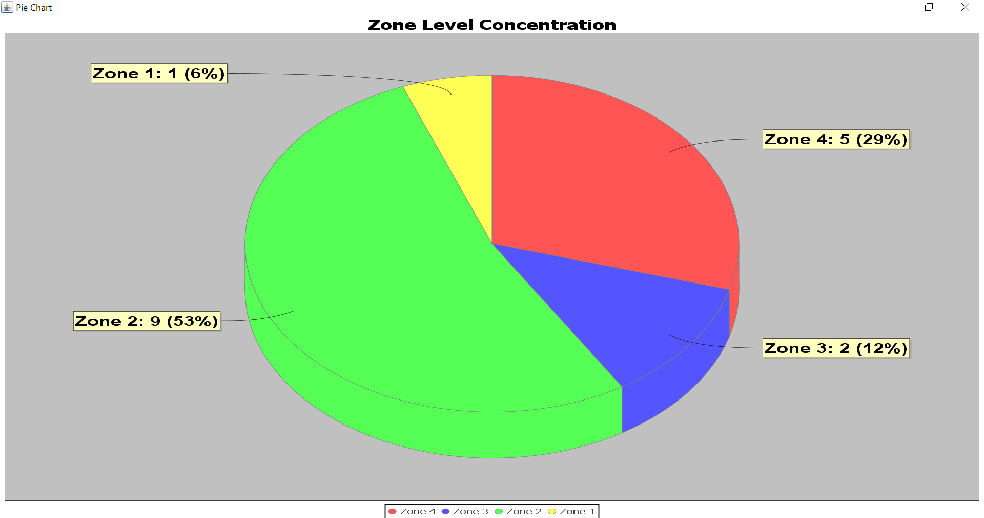
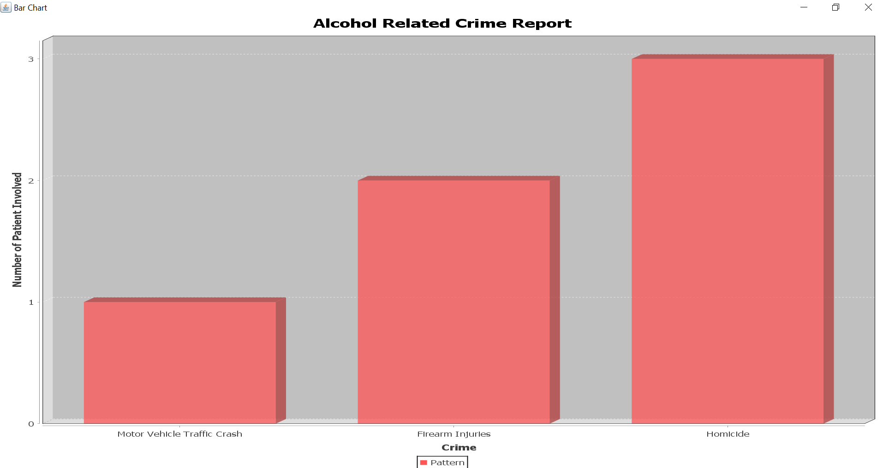
Report Generation at Network Level

Slide 16
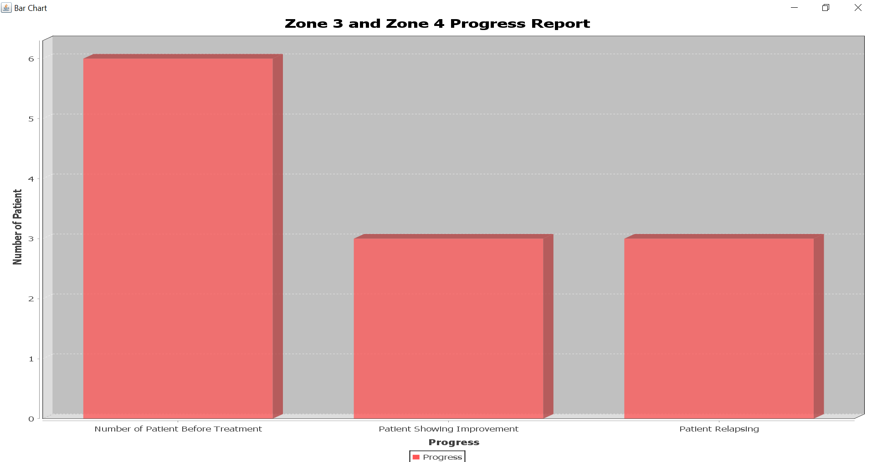
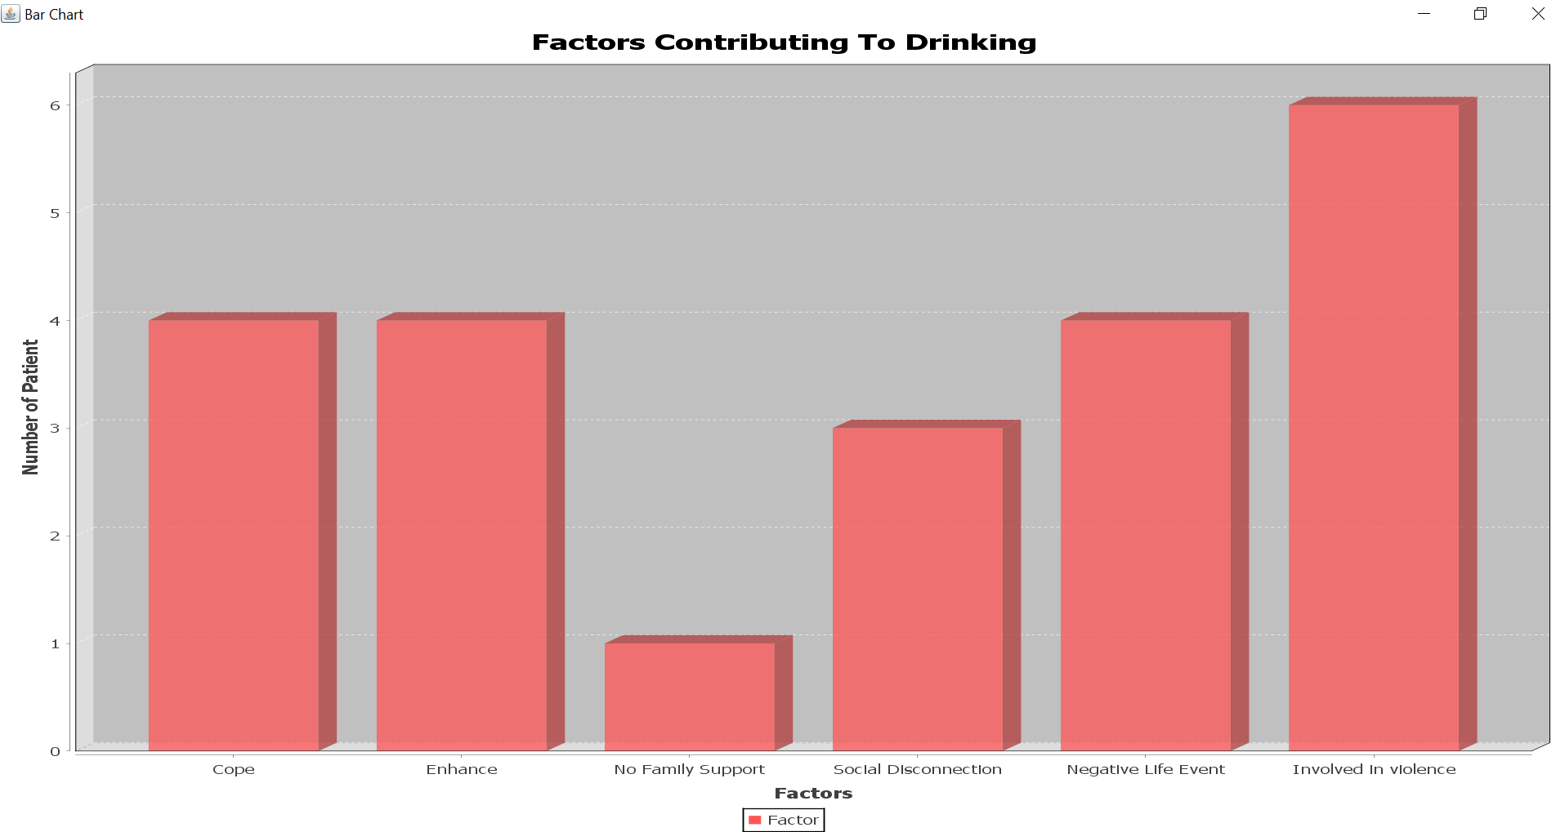

Slide 17
Actors
System Admin
Hospital Admin
Rehab Center Admin
Nurse
Doctor
Lab Assistant
Counselor
Health Inspector

Slide 18
Demo

Slide 19
Thank You

