Slide 1
MovStream: An Efficient Algorithm for Monitoring Clusters Evolving in Data Streams
Liang Tang, Chang-jie Tang, Lei Duan, Chuan Li, Ye-xi jiang, Chun-qiu Zeng and Jun Zhu
^{Sichuan University}
Database & Knowledge Engineering Lab.
<number>/26

Slide 2
Outline
Introduction
Related Work
Monitoring Clusters Evolving
Experimental Study
Conclusions and Future Work
Database & Knowledge Engineering Lab.
<number>/26

Slide 3
Introduction
Data stream is the source of continuous data collected from sensor network, satellite...
The amount of data is unlimited, which cannot be entirely stored, and should be processed quickly.
Database & Knowledge Engineering Lab.
<number>/26

Slide 4
Introduction(motivation)
The evolution of data clusters can be used to analyze the trends of the continuous data streams.
Each individual data cluster represents the distinct group of the data.
Database & Knowledge Engineering Lab.
<number>/26

Slide 5
Introduction(motivation)
The evolving behavior of each cluster is treated as a movement of the cluster
We refer significant movements to movement events.
Database & Knowledge Engineering Lab.
<number>/26

Slide 6
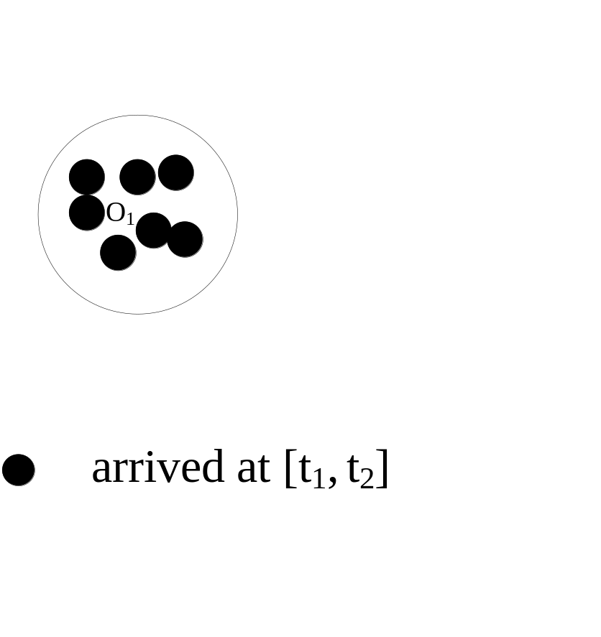
Introduction
Fig.1 The drift to a cluster
Database & Knowledge Engineering Lab.
<number>/26

Slide 7
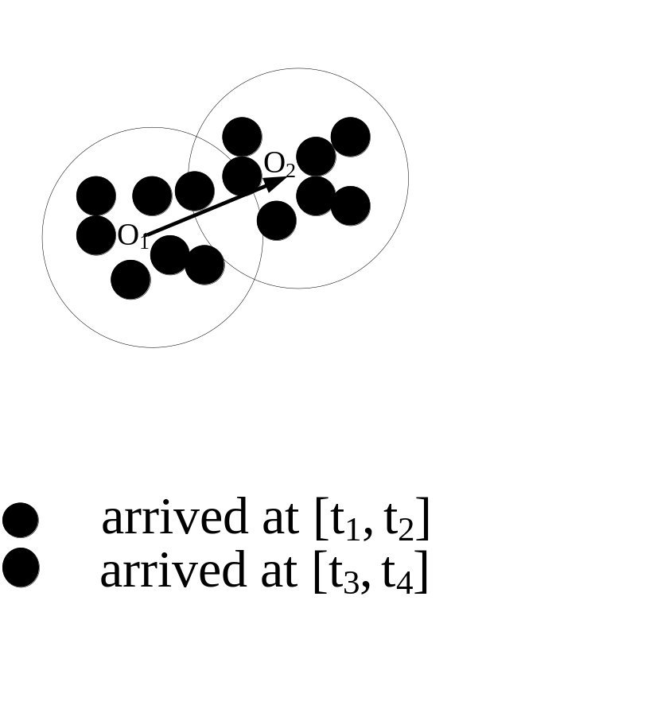
Introduction
Fig.1 The drift to a cluster
Database & Knowledge Engineering Lab.
<number>/26

Slide 8
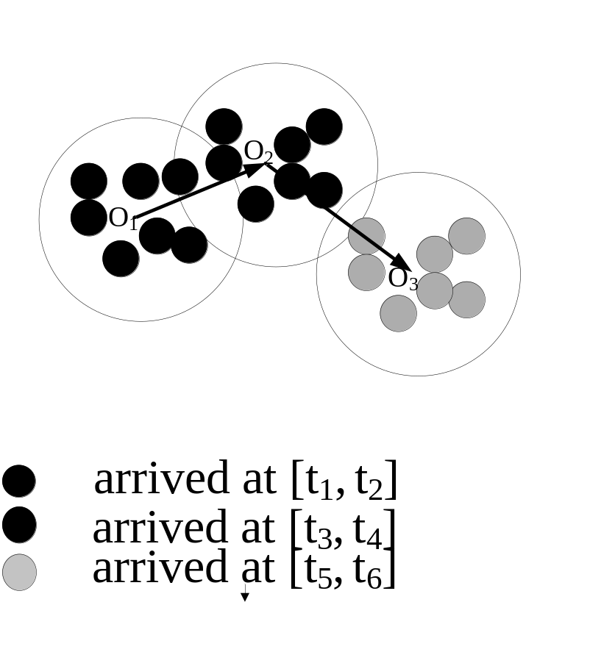
Introduction
Fig.1 The drift to a cluster
Database & Knowledge Engineering Lab.
<number>/26

Slide 9
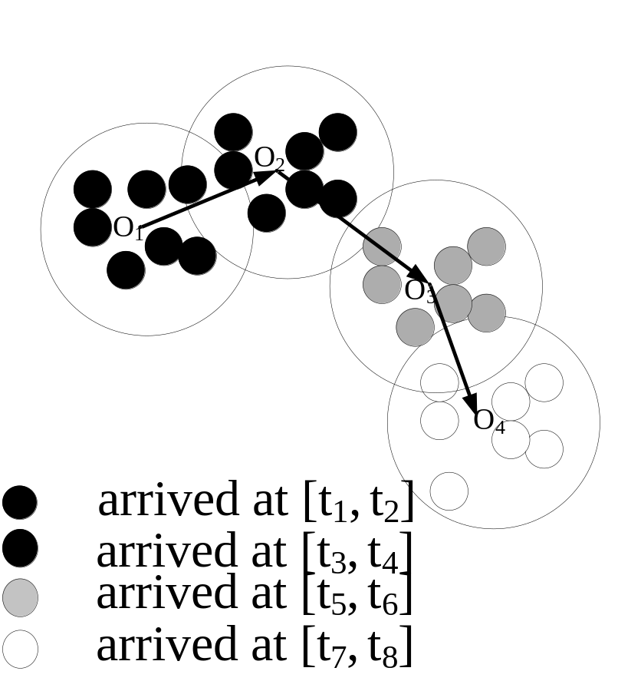
Introduction
Fig.1 The drift to a cluster
Database & Knowledge Engineering Lab.
<number>/26

Slide 10
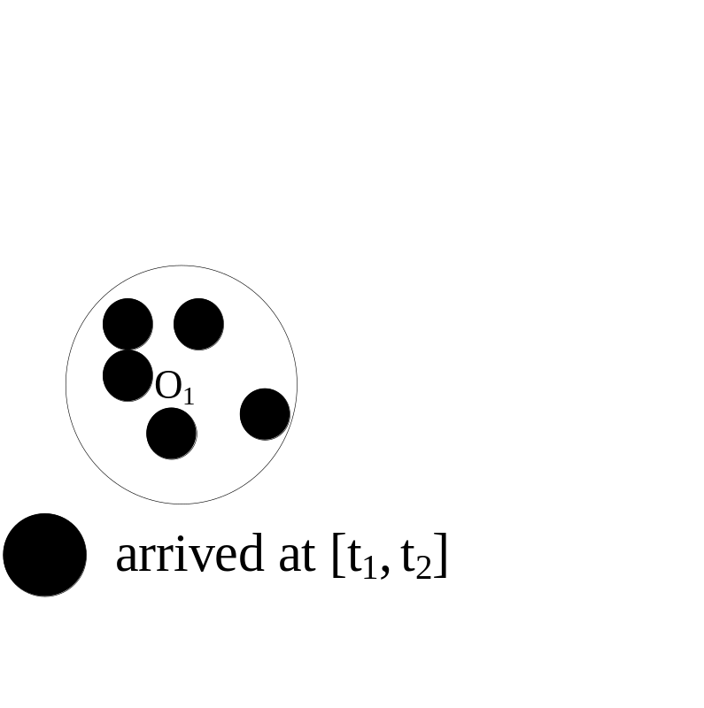
Introduction
Fig.2 The expand to a cluster
Database & Knowledge Engineering Lab.
<number>/26

Slide 11
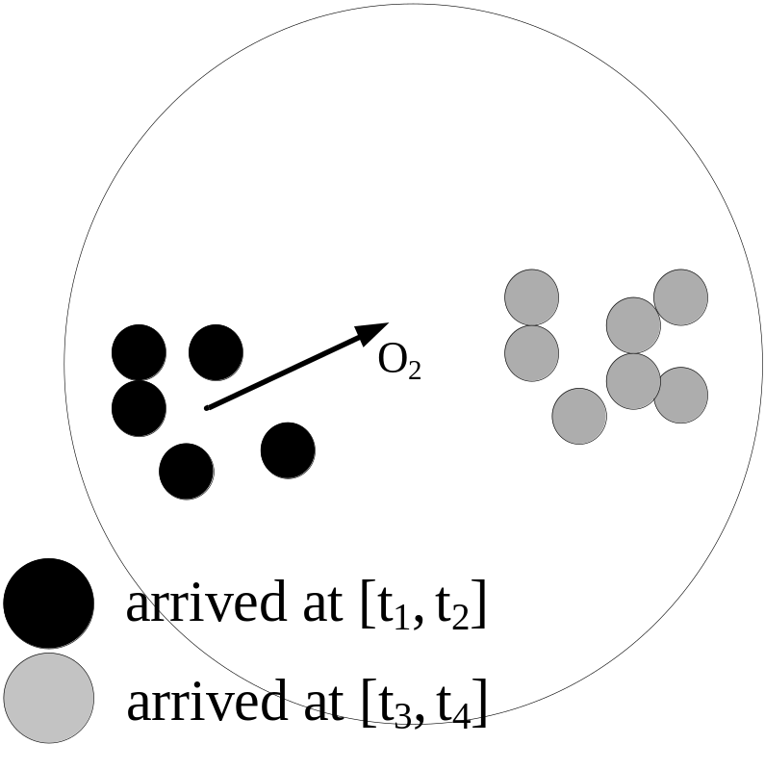
Introduction
Fig.2 The expand to a cluster
Database & Knowledge Engineering Lab.
<number>/26

Slide 12
Contributions
Propose the movement event with the measurement to the cluster
We design a novel data stream clustering method : MovStream
Database & Knowledge Engineering Lab.
<number>/26

Slide 13
Contributions
Propose the movement event with the measurement to the cluster
We design a novel data stream clustering method : MovStream
Refine the clusters through the detected movement event of each cluster during data streaming.
Database & Knowledge Engineering Lab.
<number>/26

Slide 14
Related Work
Guha et al. proposed a k-means based algorithm for clustering data streams.
O’Chalaghan et al proposed the STREAM algorithm to cluster data streams
Nasraoui et al. proposed an artiﬁcial immune system (AIS) based clustering approach TECNO-STREAMS.
Aggarwal et al. proposed CluStream algorithm.
Database & Knowledge Engineering Lab.
<number>/26

Slide 15
Related Work
Guha et al. proposed a k-means based algorithm for clustering data streams.
O’Chalaghan et al proposed the STREAM algorithm to cluster data streams
Nasraoui et al. proposed an artiﬁcial immune system (AIS) based clustering approach TECNO-STREAMS.
Aggarwal et al. proposed CluStream algorithm.
Which is the comparative algorithm in our paper.
Database & Knowledge Engineering Lab.
<number>/26

Slide 16
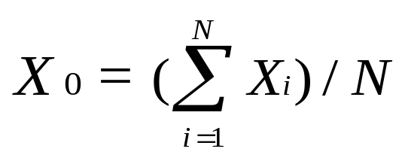
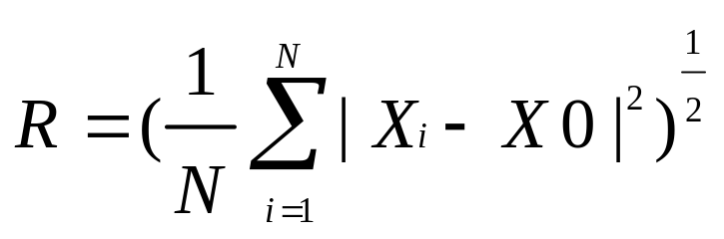
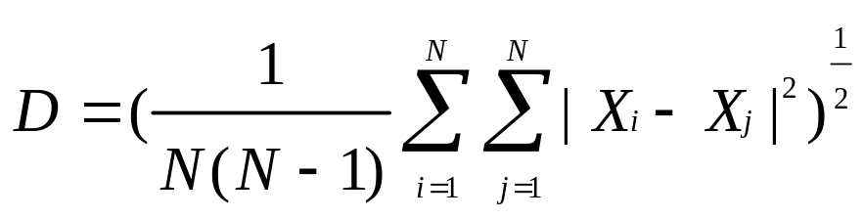
Monitoring Clusters Evolving
Given a cluster C of data points {X_{i}}, where i = 1, 2…, N, the centroid X₀, the radius R and the diameter D of the cluster are defined as follows.
Database & Knowledge Engineering Lab.
<number>/26

Slide 17
Monitoring Clusters Evolving
Given two clusters C_{i} and C_{j}, let X0_{i} and X0_{j} be the centroids of C_{i} and C_{j}. Then the mean distance of C_{i} and C_{j} is defined as
d_{mean} (C_{i} , C_{j} ) = | X0_{i}– X0_{j} |
Database & Knowledge Engineering Lab.
<number>/26

Slide 18
Sliding Window of individual cluster
Each cluster has a sliding window to maintain recent data points: SW
X_{i-1}
X_{i+n+1}
X_{i} | X_{i+1} | X_{i+2} | … | X_{i+n-1} | X_{i+n}
Database & Knowledge Engineering Lab.
<number>/26

Slide 19
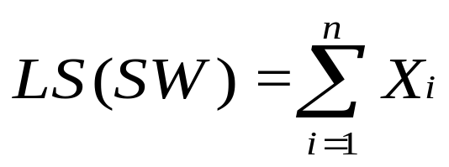
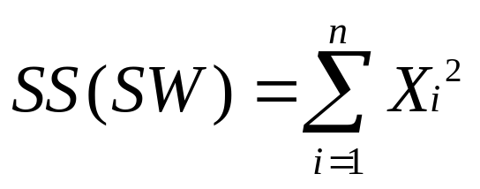
Sliding Window of individual cluster
Each cluster has a sliding window to maintain recent data points: SW
X_{i-1}
X_{i+n+1}
X_{i} | X_{i+1} | X_{i+2} | … | X_{i+n-1} | X_{i+n}
Cluster Feature Variables:
Database & Knowledge Engineering Lab.
<number>/26

Slide 20
Sliding Window of individual cluster
Each cluster has a sliding window to maintain recent data points: SW
Time costs of updating are both O(1) when new data arrives.
X_{i-1}
X_{i+n+1}
X_{i} | X_{i+1} | X_{i+2} | … | X_{i+n-1} | X_{i+n}
Cluster Feature Variables:
Database & Knowledge Engineering Lab.
<number>/26

Slide 21
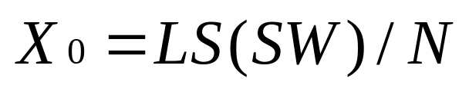
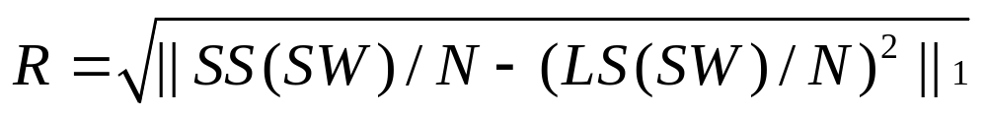
Sliding Window of individual cluster
Lemma 1: Get the centroid X₀ and radius R from cluster feature variables.
Database & Knowledge Engineering Lab.
<number>/26

Slide 22
Sliding Window of individual cluster
Lemma 1: Get the centroid X₀ and radius R from cluster feature variables.
All the movement events are detected by centroid and radius of a cluster.
Database & Knowledge Engineering Lab.
<number>/26

Slide 23
Measurement of Cluster Movement
Given a sliding window SW of a cluster C and two time stamp t and t’ ,t < t’, let R_{t} and R_{t’} be the radiuses of C(SW)_{t} and C(SW)_{t’}.
drift_{C} (t, t’) = d_{mean}( C(SW)_{t}, C(SW)_{t’} )
expand_{C} (t, t’)= R_{t’} - R_{t}
shrink_{C} (t, t’)= R_{t} - R_{t’} = -expand_{C} (t, t’)
decline _{C} (t, t’)= 1- |S(SW)_{t’}|/ |S(SW)_{t}|
Database & Knowledge Engineering Lab.
<number>/26

Slide 24
Definition of Cluster Movement Event
Let the user-defined sensitivity parameter set be {δ_{i}} (δ_{i} > 0) where i = 1 … 3, and R_{t} be the radius of cluster C at time stamp t.
Drift event: drift_{C} (t, t’) > R_{t} ∙ δ₁.
Expand event: expand_{C} (t, t’) > R_{t} ∙ δ₂.
Shrink event: shrink_{C} (t, t’) > R_{t} ∙ δ₂.
Die-out event: decline _{C} (t, t’) > δ₃.(0 < δ₃ < 1)
Database & Knowledge Engineering Lab.
<number>/26

Slide 25
Initial Clusters Creation
Cache the first InitNumber data points
Adopt k-means to cluster the first InitNumber data points to k clusters.
Database & Knowledge Engineering Lab.
<number>/26

Slide 26
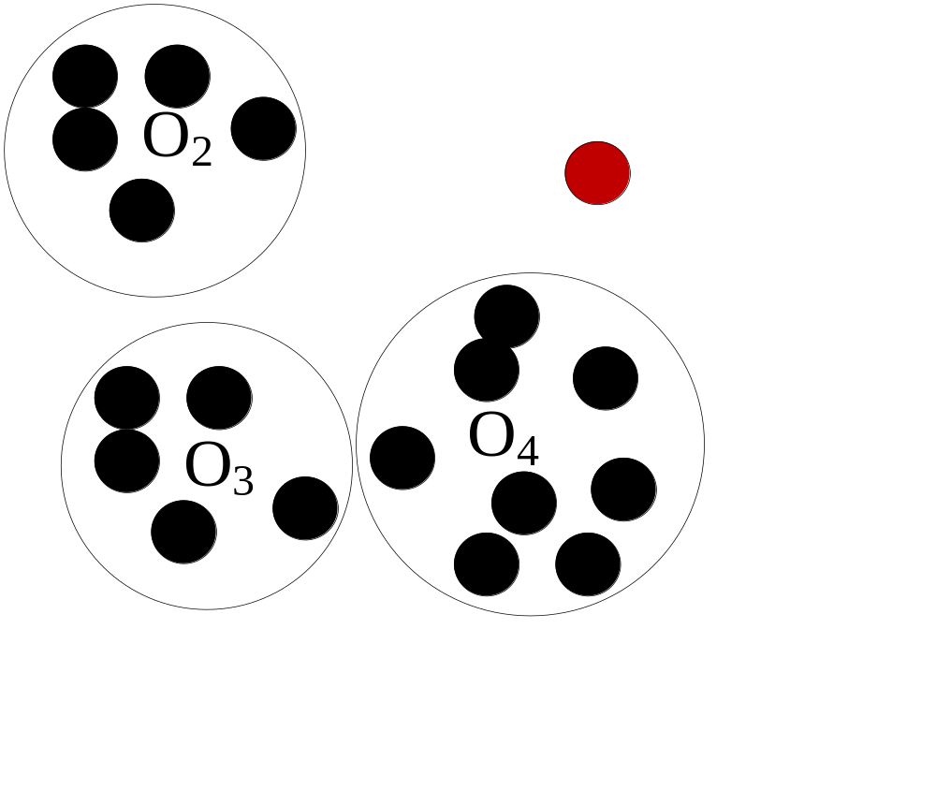
Processing New Data
New arrived data point will be absorbed by the nearest cluster.
New arrived data point
Database & Knowledge Engineering Lab.
<number>/26

Slide 27

Processing New Data
New arrived data point will be absorbed by the nearest cluster.
Absorbed by cluster O₄
Database & Knowledge Engineering Lab.
<number>/26

Slide 28
Processing New Data
Algorithm 2 ProcessNewData (X_{new})
1 Find the nearest cluster i in ClusterTable to X_{new}.
2 Add X_{new} and X_{new} ∙ X_{new} to LS and SS of ClusterTable[i]
3 Push X_{new} in ClusterTable[i].SW
4 Find the cluster j contains X_{last} in ClusterTable.
5 Pop out X_{last} from ClusterTable[j].SW.
6 Subtract X_{last} and X_{last} ∙ X_{last} from LS and SS of ClusterTable[j]
Database & Knowledge Engineering Lab.
<number>/26

Slide 29
Processing New Data
store all clusters’ information
Algorithm 2 ProcessNewData (X_{new})
1 Find the nearest cluster i in ClusterTable to X_{new}.
2 Add X_{new} and X_{new} ∙ X_{new} to LS and SS of ClusterTable[i]
3 Push X_{new} in ClusterTable[i].SW
4 Find the cluster j contains X_{last} in ClusterTable.
5 Pop out X_{last} from ClusterTable[j].SW.
6 Subtract X_{last} and X_{last} ∙ X_{last} from LS and SS of ClusterTable[j]
Pop out the oldest data point
Database & Knowledge Engineering Lab.
<number>/26

Slide 30
Maintaining clusters for streaming
Algorithm 3 Maintain({δ_{i}}, MaxNumCluster, MinNumCluster)
for each cluster i do
while exist any movement event of cluster i is triggered do
event = the movement event triggered
Invoke corresponding operations to event
if the number of clusters < MinNumCluster
Invoke split to the maximal radius cluster.
if the number of clusters > MaxNumCluster
Invoke merge to the two closest clusters.
Database & Knowledge Engineering Lab.
<number>/26

Slide 31
Refinement for evolution of clusters
Refinement | Condition | Method
Move | drift event | Update centroid by LS
Stretch | shrink event or expand event | Update radius by LS and SS
Delete | die-out event | Delete it from ClusterTable
Split | radius > δ₄ | Find out the farthest data point to make a seed for another new cluster
Merge | (R_{i} + R_{j}) ∙δ₅ > |X_{0i} – X_{0j}| | Combine two sets of data points and recreate SW.
Database & Knowledge Engineering Lab.
<number>/26

Slide 32
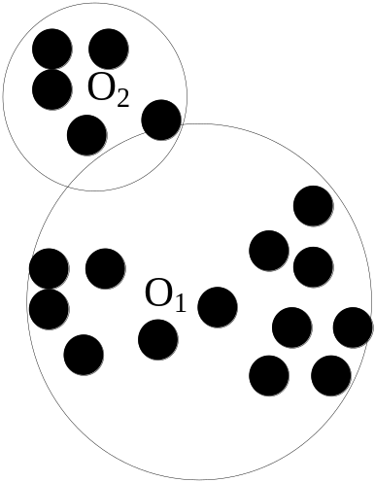
Split and Merge
Database & Knowledge Engineering Lab.
<number>/26

Slide 33
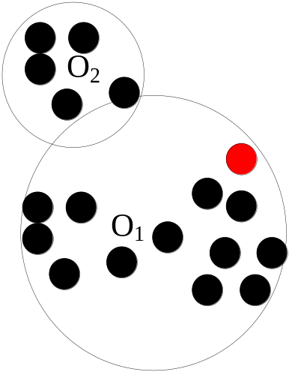
Split and Merge
Choose the farthest point as the new seed to absorb points.
Database & Knowledge Engineering Lab.
<number>/26

Slide 34
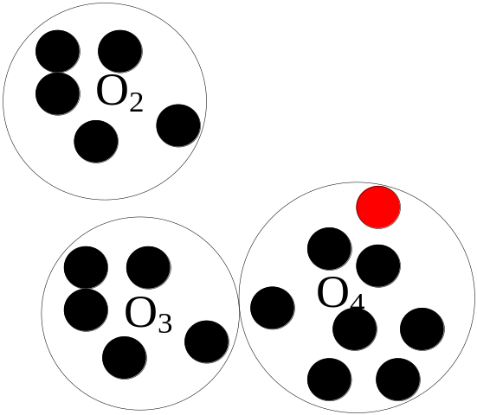
Split and Merge
Split
Database & Knowledge Engineering Lab.
<number>/26

Slide 35
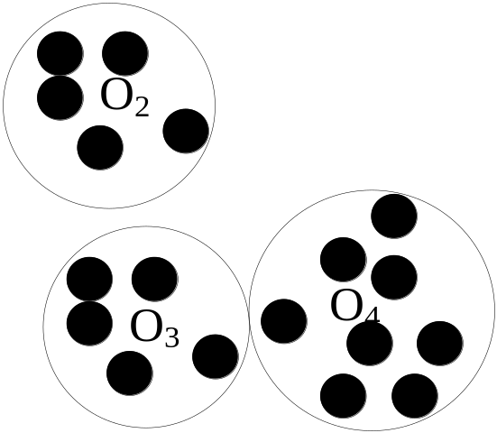
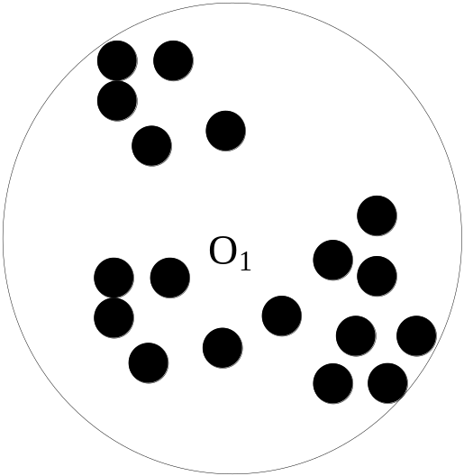
Split and Merge
Split
Merge
Database & Knowledge Engineering Lab.
<number>/26

Slide 36
Split and Merge
Both split and Merge operations time complexity cost is at most O(N)
Split
Merge
Database & Knowledge Engineering Lab.
<number>/26

Slide 37
Experimental Study
1. Real datasets: the KDD-CUP’99 Network Intrusion Detection data set, contains the network connection records.
2. Synthetic datasets: generated several synthetic dataset which follows a series of Gaussian distributions. The size of dataset varies from 100K to 400K, the number of clusters varies from 5 to 20, and the dimensionality of data points varies from 4 to 50.
Database & Knowledge Engineering Lab.
<number>/26

Slide 38
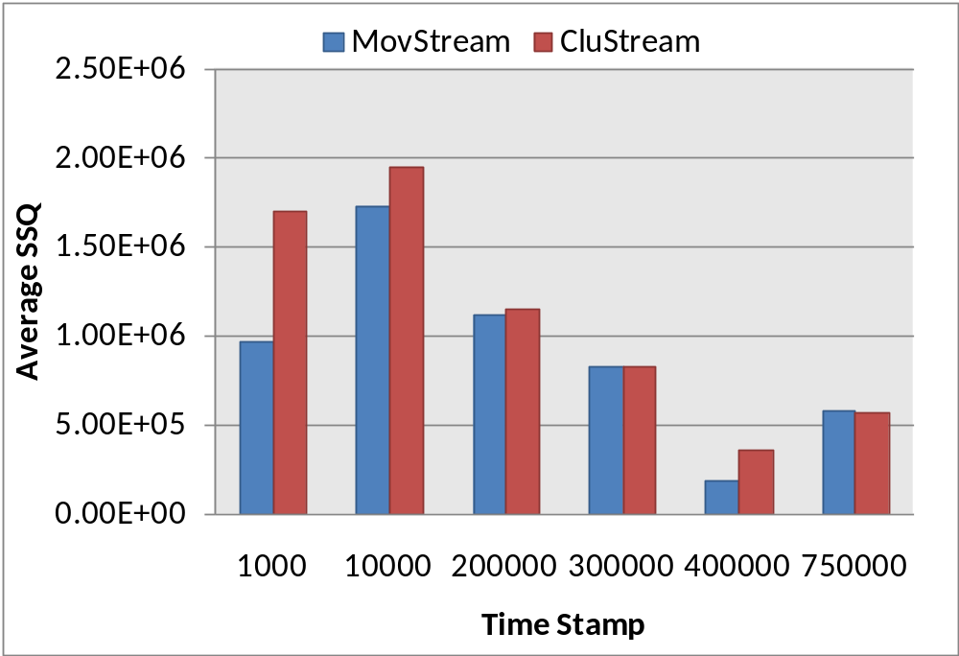
Experimental Study
Fig.6 Network Intrusion dataset (horizon time=1000)
Database & Knowledge Engineering Lab.
<number>/26

Slide 39
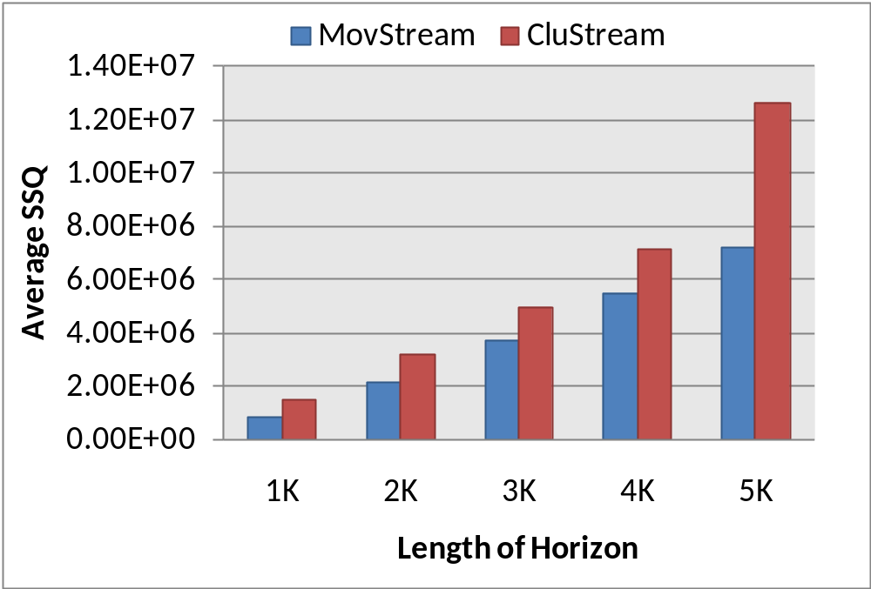
Experimental Study
Fig.8 Network Intrusion dataset total Average SSQs on different lengths of horizon
Database & Knowledge Engineering Lab.
<number>/26

Slide 40
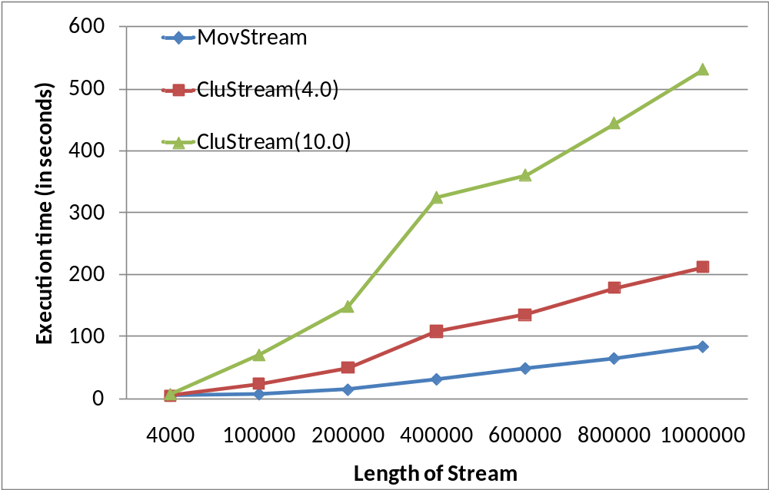
Experimental Study
Fig.9 Network Intrusion dataset (horizon time=2000, monitor-period=2000)
Database & Knowledge Engineering Lab.
<number>/26

Slide 41
Experimental Study
Calling maintain procedure per 2000 data points
Fig.9 Network Intrusion dataset (horizon time=2000, monitor-period=2000)
Database & Knowledge Engineering Lab.
<number>/26

Slide 42
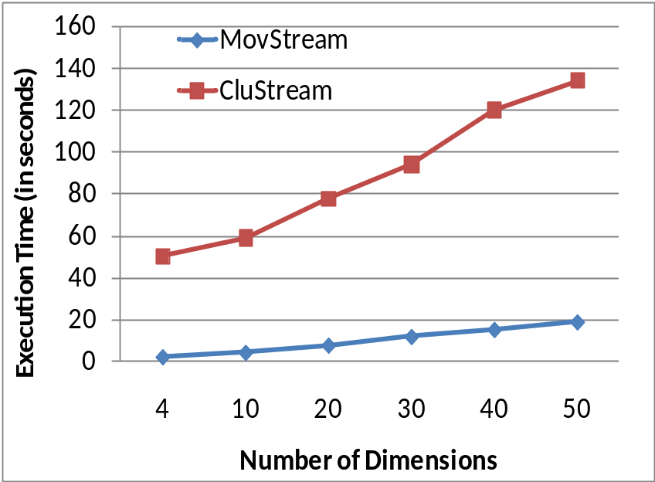
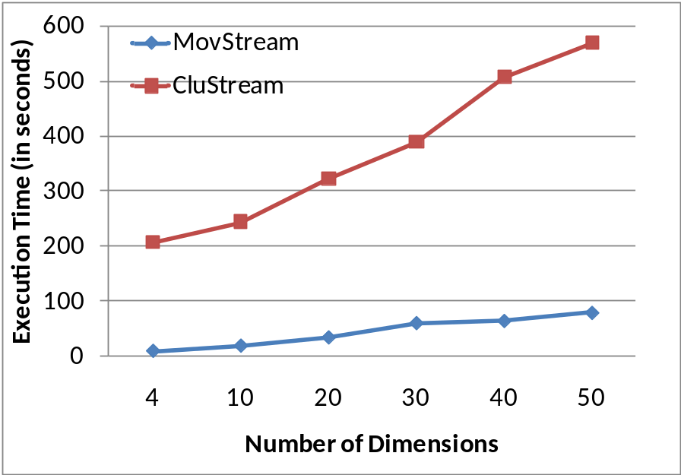
Experimental Study
Fig.10 (B100C5 horizon time=2000, monitor-period=2000)
Fig.11 (B400C20 horizon time=5000, monitor-period=5000)
Database & Knowledge Engineering Lab.
<number>/26

Slide 43
Conclusions
Introducing basic movements of the cluster with the measurement for them
Proposing an effective and efficient cluster monitoring method named MovStream based on the measurements.
Giving extensive experiments to show that MovStream can achieve more accurate by 25-50% than that of highest clustering quality of CluStream.
Database & Knowledge Engineering Lab.
<number>/36

Slide 44

Any Questions?
Thanks
Database & Knowledge Engineering Lab.
<number>/36

