Slide 1
Learning based Web Recommendation
Presenter: Liang Tang
Advisor: Tao Li

Slide 2
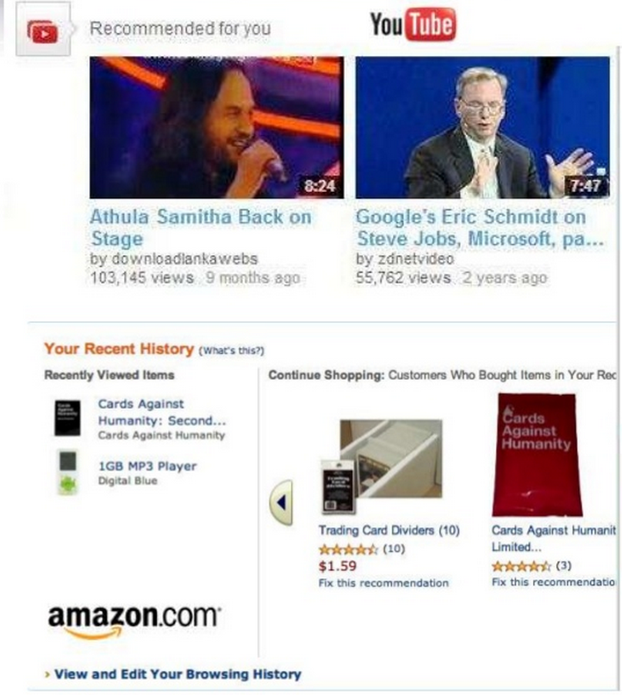

Recommender Systems

Slide 3
Outline
KDD CUP 2012 Competition
Learning based Recommendation
Ensemble Model
Large Scale Implementation
Exploration vs Exploitation
Evaluation Method

Slide 4

What is KDD Cup Competition?
KDD Cup is the annual Data Mining and Knowledge Discovery competition organized by ACM Special Interest Group on Knowledge Discovery and Data Mining, the leading professional organization of data miners.

Slide 5
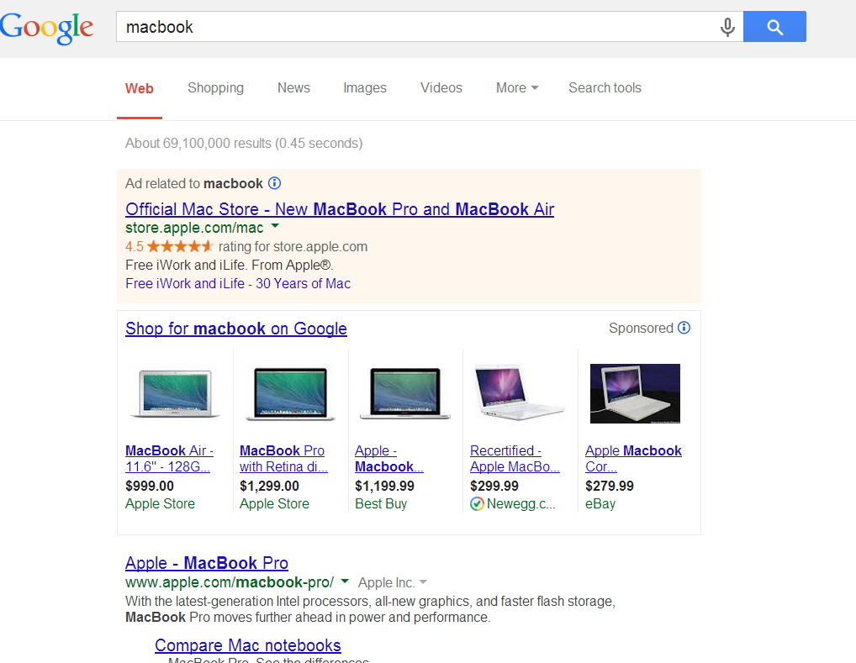
KDD Cup 2012 Track 2
Predict the CTR (click-through rate) of search ads.
Given a user profile (age, gender…), search keywords, and an ad(ad description, title…), predict whether the user will click this ad or not.
First place gets $8,000.
Search ads

Slide 6

KDD Cup 2012 Track 2(Cont.)
Why predict the CTR of ads?
Select the ad that has the highest CTR to display (solve the recommendation problem).
Increase the number of user clicks : earn more money (one click =0.1~10 dollars).

Slide 7
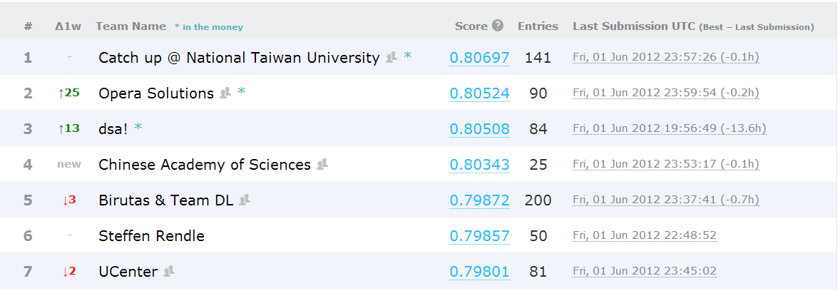
KDD Cup 2012 Track 2(Cont.)
AUC
(AUC=0.80697 is that, we randomly pick a clicked ad and a non-clicked ad, the probability of the clicked ad is ranked higher than the non-clicked ad is 80.697%)
Who wins?

Slide 8
Outline
KDD CUP 2012 Competition
Learning based Recommendation
Ensemble Model
Large Scale Implementation
Exploration vs Exploitation
Evaluation Method

Slide 9
What are the algorithms used by the winner?
Report
“A Two-Stage Ensemble of Diverse Models for Advertisement Ranking in KDD Cup 2012”
An ensemble methods
“two heads being better than one”.
Build several CTR predictors, and combine each method’s result to decide the final result.
Prediction vs Recommendation
Prediction which ad will have the highest CTR, then recommend that one.

Slide 10
What is learning based recommendation?
CTR = F(user_features, ad_features)
The parameters in this function are learned from the data (user feedback).
Some methods, such as compute the similarity between user and ad, are not learning based.
Ads and users have similar features. It does NOT mean that the user will click the ad that he (or she) is already familiar with.

Slide 11
Individual Model Used by the Winner
Naïve Bayes
Logistic Regression
Linear Regression (Ridge Regression)
Support Vector Regression
Rank Logistic Regression
Combination of Linear Regression and Ranking
Regression based Matrix Factorization
Ranking based Matrix Factorization

Slide 12
What are the features?
Features:
UserID, AdID, user gender, ad’s position(in web page), query token ID,…
Convert to binary features:
Convert all features into binary features. Each instance has a feature vector (0,1,1,0,…)^{T} .
The label is 1 (clicked) or 0 (not clicked)

Slide 13

Naïve Bayes
Two class labels (1=“clicked”, 0=“not clicked”)
Assuming all binary features are conditional independent by given the label.
AUC = 0.7760 (public test).

Slide 14
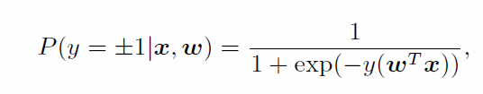
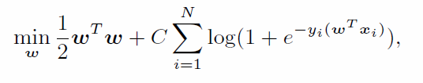
Logistic Regression
Logistic Regression
Binary feature vector, (0,1,1,0,…)^{T}
Logistic Regression with regularization
Parameters to learn
Regularization
AUC = 0.7888 (public test).

Slide 15
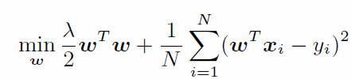
Ridge Regression
Regularization
Linear Regression
If the number of features is greater than the number of training instances, there is an infinite number of optimal parameter w.
AUC = 0.7351 (public test).

Slide 16
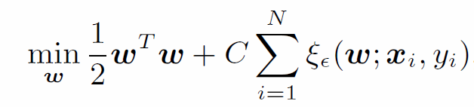
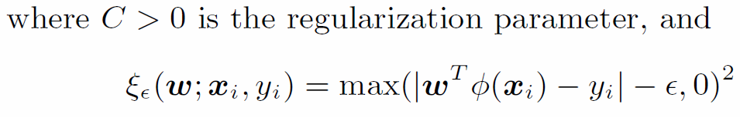
Support Vector Regression
SVR is an extension from support vector classification.
Similar to Ridge Regression.
Regularization
AUC = 0.7610 to 0.7705 (public test).

Slide 17
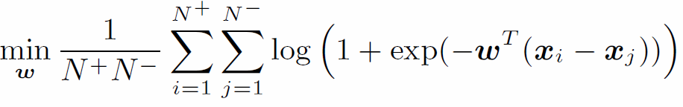
Rank Logistic Regression
User clicked x_{i} just because x_{i} is better than x_{j}. (Maybe x_{i}, x_{j} are both negative or positive)
Positive label(clicked)
Negative label(not clicked)
Number of positive instances
Number of negative instances
AUC = 0.7220 (public test).

Slide 18
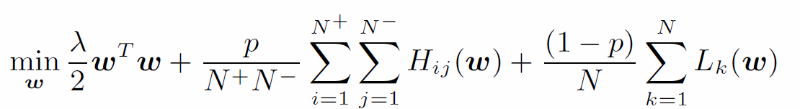


Combing Regression and Ranking
p is a tuning parameter p is chosen from 0 to 1.
Error from pairs of positive and negative instances.
Error from single instance
AUC = 0.7818 (public test).

Slide 19
Matrix Factorization
What is the problem with previous model?
They all learn the weight for each individual features (the contribution to CTR).
Lose the CTR contribution from interaction between the ad feature and user feature.
What is the interaction?
Players “A” and “B” may not be good individually, but their corporation is very good. We cannot predict the team power just considering the linear combination of each player’s power.
User feature ‘A’ and ad feature ‘B’ may NOT be strong indicator of user clicking. But if ‘A’ and ‘B’ appear at the same time, this combination will be a strong indicator.

Slide 20

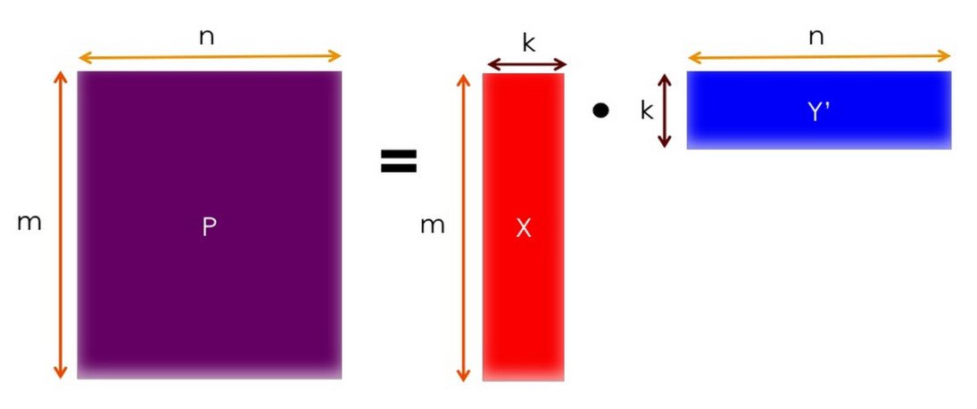
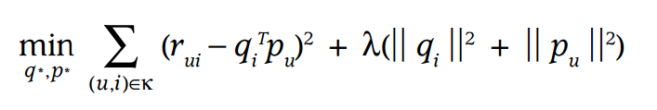
A Basic Matrix Factorization
Use a vector p_{u} (latent factor) to represent a user (k dimension), representing k aspects that can have interaction.
Use a vector q_{i} (latent factor) to represent an item (k dimension), representing k aspects that can have interaction.
r is the label value.
users
(p₁,…, p_{n})
items
(q₁^{T},…, q_{m}^{T})^{T}
There are (k*m+k*n) parameters to learn.
Regularization
See detail at http://www.slideshare.net/srowen/matrix-factorization

Slide 21
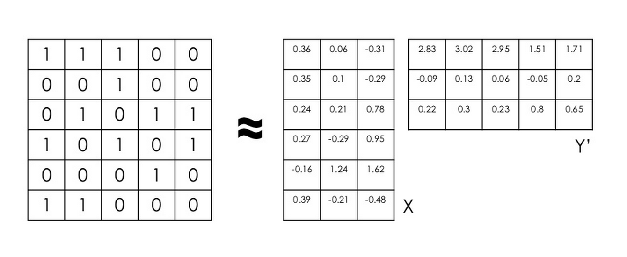
A Basic Matrix Factorization (Example)
Not click
click
users
?
ads
?
?
?

Slide 22


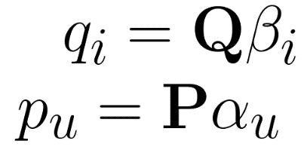
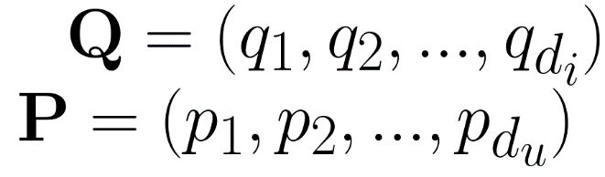
Regression based Matrix Factorization (I)
The latent factor is built from the features of users and items
Item latent factor
User latent factor
is a user feature vector.
is an item feature vector.
Projection
P is a k x d_{u} matrix, Q is a k x d_{i} matrix.
Every entry of P and Q are unknown parameters to learn.

Slide 23
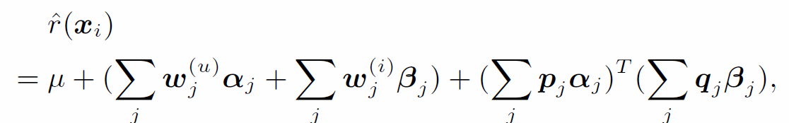
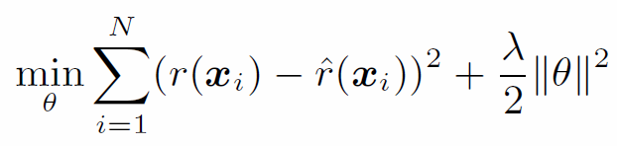
Regression based Matrix Factorization (II)
Interaction between user and item latent factors
Linear regression on user features
Linear regression on item features
is a user feature vector.
is an item feature vector.
AUC = 0.7775 (public test).

Slide 24
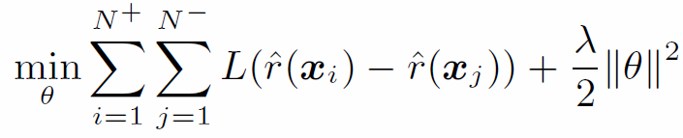
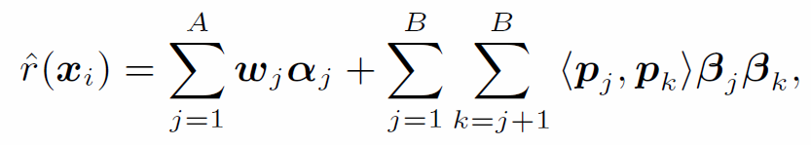
Ranking based Matrix Factorization
Positive instance
Negative instance
AUC = 0.7968 (public test).

Slide 25
Come up with your own algorithm?
Come up with a prediction function (from your intuition, no mathematical trick).
Linear combination?
Logistic Function?
Sin/Cos function?
….
Find the objective function to minimize the training error, by the prediction function and training data.
Difference between observed value and predicted value?
Pairwise difference (for ranking models) ?
….

Slide 26
Outline
KDD CUP 2012 Competition
Learning based Recommendation
Ensemble Model
Large Scale Implementation
Exploration vs Exploitation
Evaluation Method

Slide 27
Why Ensemble Individual Models?
“Two heads being better than one”
We don’t know what is the real relation between the features and the class label.
Linear regression, matrix factorization and other models express this relation from one aspect (may be totally wrong).
Ensemble models can have multiple aspects to express.

Slide 28
How to ensemble models?
Majority vote
Each individual model votes to 1 or 0. If 1 has the majority votes, the prediction is 1, otherwise it is 0.
Hyper learning model
The prediction results of individual models are the features. The click count is the label. Build another layer of learning model.
Good models have more votes. Poor models have less votes.

Slide 29
Outline
KDD CUP 2012 Competition
Learning based Recommendation
Ensemble Model
Large Scale Implementation
Exploration vs Exploitation
Evaluation Method

Slide 30
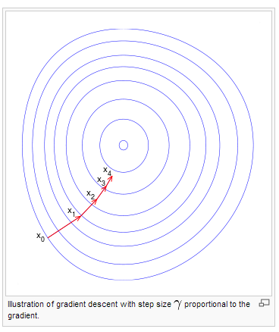
Gradient Descent
Gradient Descent
New variable
Derivative of objective function
Current variable
Step size ( or learning rate)
Outside circle has larger training errors

Slide 31
Stochastic Gradient Descent
Gradient Descent
New variable
Derivative of objective function
Current variable
Step size ( or learning rate)
It is too slow to substitute all training instances. Stochastic Gradient Descent only uses one instance for each step.
Outside circle has larger training errors

Slide 32

Stochastic Approximation
Difficult to minimize f over x. But we can find another function F. F and f are not exactly the same, but the expectation is the same. We can use F to guide us to find the minimum (although the giudeness is not precise for every step)
Average error of all training instances
error of one training instance
Average error of all training instances $≈\text{E}\text{[}\text{error} \text{of} \text{one} \text{training} \text{instance}\text{]}$

Slide 33
Alternating Least Squares
In Matrix Factorization, the objective function has product of two variables, such as f(x,y) = x*y.
Usually, this objective function is not convex (some local optimum is NOT the global optimum).
Alternating Least squares algorithm (No guarantee finding the optimal solution)
Keep x fixed, y is the only variable. Find minimizer y_{min.}
Keep y=y_{min} fixed, x is the only variable. Find minimizer x_{min.}
Go back to 1 until the training error does not change.

Slide 34
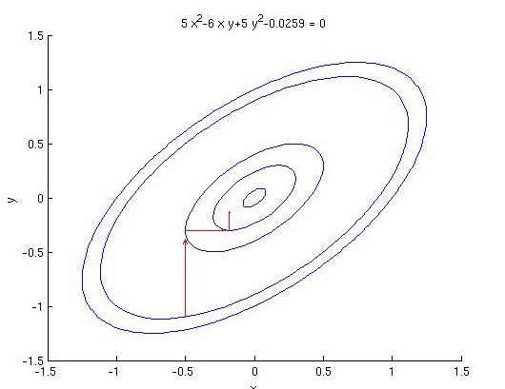
Coordinate Descent
The variable is a multi-dimensional vector: x=(x₁,x₂,….,x_{d}). The coordinate Descent is :
Fix x₂,….,x_{d}, optimize along with x_{1.}
Fix x₁,….,x_{d}, optimize along with x_{2.}
….
Fix x₁,….,x_{d-1}, optimize along with x_{d.}
Go step 1 until the training error does not change.
Benefits:
Only store one dimension’s variable in the memory (save memory).
Different machine can optimize different dimension at the same time.

Slide 35
Mixture Weight Method For Distributed Learning
If we have a huge amount of data. We split the data into K machines (K partitions).
Run the optimizer on each partition k in parallel to obtain a local estimate of the parameter of interest w^{k}, k = 1,… ,K
The final global estimate w is taken as the average

Slide 36
Alternating Direction Method of Multipliers (ADMM)
Basic idea:
Split the data into K partitions
Solve the following optimization problem
The resulting ADMM algorithm
Regularization function
Loss function
The weight vector of each partition weight vector should
1) minimize the errors on this partition data.
2) meanwhile, it should be close to the last global weight vector.
The global weight vector should be close to each partition’s weight vector.

Slide 37
Outline
KDD CUP 2012 Competition
Learning based Recommendation
Ensemble Model
Large Scale Implementation
Exploration vs Exploitation
Evaluation Method

Slide 38
What is Exploration vs Exploitation?
In online recommendation, the training data is collected from the user feedback. The user feedback is only available when the ad is recommended.
Exploration: display a new ad.
Exploitation: display the ad that has the highest CTR in the past.
Tradeoff between Exploration and Exploitation:
If you only do exploitation, you don’t know which ad has the highest CTR.
If you only do exploration, it becomes randomly display ads, the overall CTR is not improved.
Cold-start:
New users and new ads, we do not have training data for them.

Slide 39

Multi-armed Bandit Problem (1)
For now, we are attacking the problem of choosing best article/arm for all users
Bandit “arms”
(unknown payoff probabilities)
p₁
p₂
p₃
“Pulling” arm i yields a reward:
reward = 1 with probability p_{i} (success)
reward = 0 otherwise (failure)

Slide 40
Multi-armed Bandit Problem (2)
Bandit “arms”
(unknown payoff probabilities)
p₁
p₂
p₃
Goal: Pull arms sequentially to maximize the total reward
Bandit scheme/policy: Sequential algorithm to play arms (items)
Regret of a scheme = Expected loss relative to the “oracle” optimal scheme that always plays the best arm
“best” means highest success probability
But, the best arm is not known … unless you have an oracle
Regret is the price of exploration
Low regret implies quick convergence to the best

Slide 41
Simple Solutions
Epsilon-greedy: The best lever is selected for a proportion of the trials, and another lever is randomly selected (with uniform probability) for a proportion.
Epsilon-first strategy: A pure exploration phase is followed by a pure exploitation phase. For trials in total, the exploration phase occupies trials and the exploitation phase trials.
Epsilon-decreasing strategy: Similar to the epsilon-greedy strategy, except that the value of decreases as the experiment progresses, resulting in highly explorative behavior at the start and highly exploitative behavior at the finish.

Slide 42
Probability Matching(I)
The number of pulls for an arm should match its actual probability of being the optimal arm.
Example:
Two arms, A and B.
In the past 100 trials,
60 trials that A’s reward is greater than B’s
40 trails that B’s reward is greater than A’s.
In the next trial, we should have 60% chance to pull A and 40% chance to pull B (by random)

Slide 43
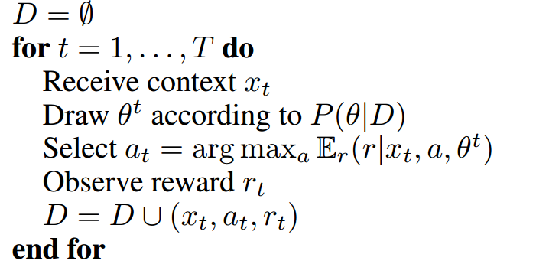
Probability Matching(II)
Thompson Sampling (Bayesian Bandits)
Sample form Posterior distribution
Selected the arm having the largest reward using sampled theta.
(This is related to Bayesian learning, please refer to Machine Learning class)
http://papers.nips.cc/paper/4321-an-empirical-evaluation-of-thompson-sampling.pdf

Slide 44
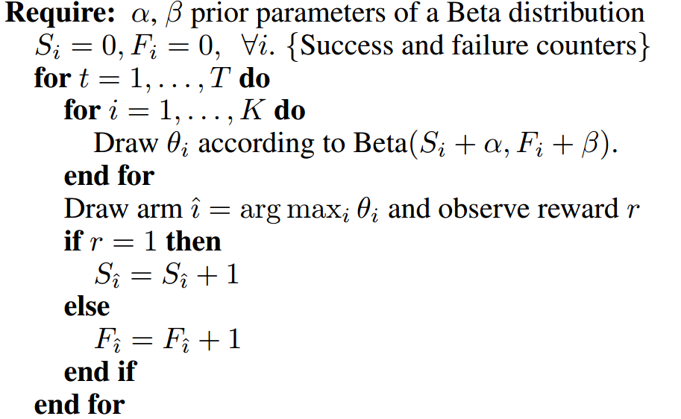
Probability Matching (III)
Thompson Sampling For Bernoulli bandit
Beta describes the distribution of
the parameter of Bernoulli distribution

Slide 45
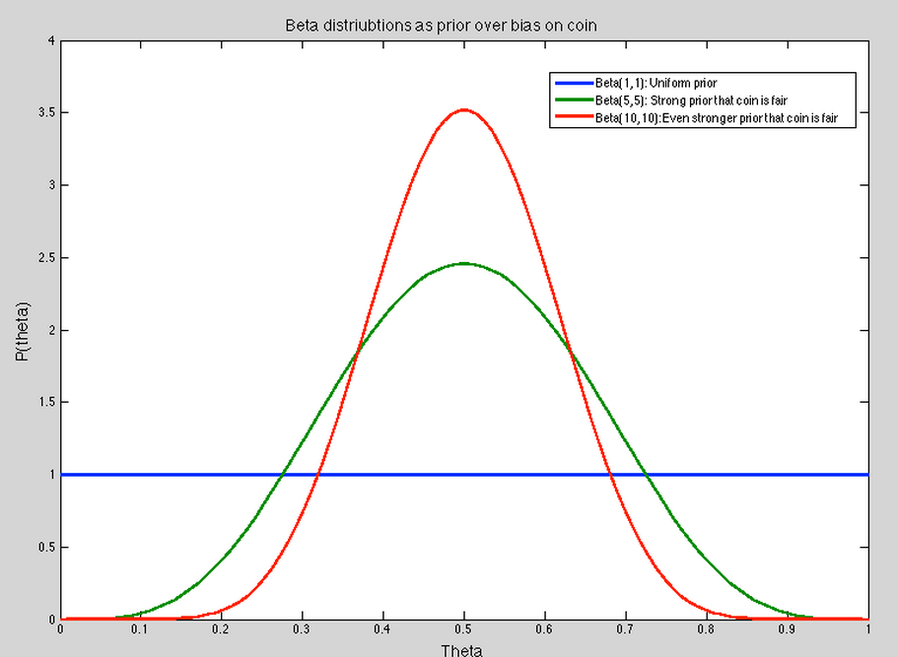
What is the Beta Distribution?
The distribution of the parameter of Bernoulli distribution
For example
I toss 10 coins and find 7 heads and 3 tails. p is the probability of the head for a toss. (p is a value from [0,1]). The distribution of p is Beta(7,3).
When you have more tosses, the variance is smaller, the uncertainty of p is smaller, the bell curve is more narrow.

Slide 46
Outline
KDD CUP 2012 Competition
Learning based Recommendation
Ensemble Model
Large Scale Implementation
Exploration vs Exploitation
Evaluation Method

Slide 47
Evaluation Methods
Online Evaluation
A/B testing
Offline Evaluation
Measure Prediction Accuracy
Measuring Ratings Prediction
Precision at N
Replay

Slide 48
A/B testing
For example, for Facebook ads, we and randomly (uniformly) split incoming users into 2 buckets (Bucket A and Bucket B).
Bucket A, use A algorithm for selecting ads
Bucket B, use B algorithm for selecting ads.
After one week, the bucket that has more clicks is better.

Slide 49
Measure Rating Prediction Accuracy
Only care the accuracy of the prediction model
Split the data into training set and testing set.
Compute the testing errors (difference between predicted rating and actual rating)
Root Mean Squared Error.

Slide 50
Precision at N (biased)
In online system
We tracked the set of items D that are displayed to the user, N=|D|.
We tracked the set of items C that user actually clicked.
In offline evaluation
For each item in D
Ask the testing algorithm whether the user will click it or not.
Track the precision based on C.
Biased, some items are not in D, but the user may be very interested in them.

Slide 51
Replay (unbiased)
In online system
The ads are uniformly and randomly displayed.
We track each user visit (user profile, input keywords, displayed ad, click or not).
In offline evaluation
For each user visit
Give user profile, keywords to the testing algorithm.
If the testing algorithm’s recommended ad is equal to the displayed ad, this user visit is a match, and then track the click. Otherwise, ignore this user visit.
CTR is approximate to the average click per match.

Slide 52
A good survey for evaluating recommender system
“Evaluating Recommendation Systems” http://research.microsoft.com/pubs/115396/evaluationmetrics.tr.pdf

Slide 53
References
WU, Kuan-Wei et al. A Two-Stage Ensemble of Diverse Models for Advertisement Ranking in KDD Cup 2012, in KDD 2012.
Y Koren, R Bell, C Volinsky. Matrix factorization techniques for recommender systems, Computer 42(8), 30-37.
D. Agarwal and B.-C. Chen. Regression based Latent Factor Models. In KDD, 2009.
O. Chapelle and L. Li. An empirical evaluation of Thompson sampling. In NIPS, pages 2249–2257, 2011.
L. Li, W. Chu, J. Langford, and R. E. Schapire. A contextual-bandit approach to personalized news article recommendation. In WWW, pages 661–670. ACM, 2010.
Stephen Boyd et al. Distributed Optimization and Statistical Learning via the Alternating Direction Method of Multipliers. In Foundations and Trends in Machine Learning, 3(1):1–122, 2011.
L. Li, W. Chu, J. Langford, and X. Wang. Unbiased offline evaluation of contextual-bandit-based news article recommendation algorithms. In WSDM, pages 297–306, 2011.

Slide 54
Thank you!
Question?

