Slide 1
A Survey for Active Learning
Presenter : Liang Tang

Slide 2
Outline
Passive Learning vs. Active Learning
Active Learning for SVM
Active Learning for Neural network
Query by Committee
Active Learning using pre-clustering

Slide 3
Passive Learning
Learner
Human Being
Labeled data
classifier

Slide 4
Active Learning
Learner
Human Being
Small Labeled data
Query (an unlabeled data)
Answer
Query (an unlabeled data)
……

Slide 5
General Active Learning Procedure
Initialize Model M
while( Stop(M,D) == false) {
Result = Query(D);
Update(M, Result);
}
Two categories of Active Learning:
How to construct the next query ?
How to selective query a sample’s label?

Slide 6
General Active Learning Procedure
Initialize Model M
while( Stop(M,D) == false) {
Result = Query(D);
Update(M, Result);
}
Two categories of Active Learning:
How to construct the next query ?
How to selective query a sample’s label?
Most Papers

Slide 7
General Active Learning Procedure
Initialize Model M
while( Stop(M,D) == false) {
Result = Query(D);
Update(M, Result);
}
Two categories of Active Learning:
How to construct the next query ?
How to selective query a sample’s label?
Most Papers

Slide 8
Selective Active Learning
Negative
Which data point’s label do you want to know mostly?
Classifier
Positive
Unlabeled

Slide 9
Selective Active Learning
Negative
Which data point’s label do you want to know mostly?
Classifier
Positive
Unlabeled

Slide 10
Advantages of Active Learning
Labeled Training dataset doesn’t need to be large.
Labeled data is expensive, unlabeled data is cheap.

Slide 11
Outline
Passive Learning vs. Active Learning
Active Learning for SVM
Active Learning for Neural network
Query by Committee
Active Learning using pre-clustering

Slide 12
About this work
“Active Learning: Theory and Applications”,
Authors: Simon Tong, 2001.

Slide 13
Active Learning for SVM

Slide 14
Active Learning for SVM

Slide 15
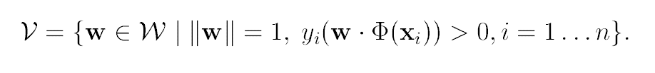
Version Space
Intuitively , version space 𝓥 ={w₁,w₂,w₃,…}

Slide 16
Version Space
The true w* is in the version space 𝓥.
Larger size(𝓥 ), larger possibility of incorrect estimation of w

Slide 17
Version Space
The true w* is in the version space 𝓥.
Larger size(𝓥 ), larger possibility of incorrect estimation of w

Slide 18
The Goal of Sample Query
Reduce size(𝓥 ) as much as possible when selecting the next labeled data

Slide 19
An Example of Version Space Reduction

Slide 20
An Example of Version Space Reduction
New Labeled Data

Slide 21
An Example of Version Space Reduction
New Labeled Data

Slide 22
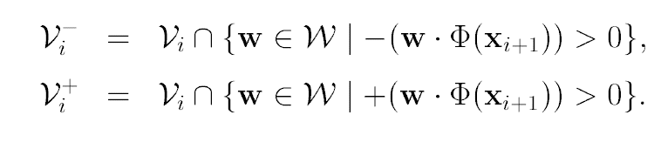
Partition Version Space
Current version space : 𝓥_{i.}
The next query point x_{i+1} will partition the version space to two parts.
The next version space 𝓥_{i+1} is 𝓥_{i}⁻ or 𝓥_{i}⁺, based on the actual label of x_{i+1.}

Slide 23
Partition Version Space
Current version space : 𝓥_{i.}
The next query point x_{i+1} will partition the version space to two parts.
The next version space 𝓥_{i+1} is 𝓥_{i}⁻ or 𝓥_{i}⁺, based on the actual label of x_{i+1.}

Slide 24
Partition Version Space
The next version space 𝓥_{i+1} is 𝓥_{i}⁻ or 𝓥_{i}⁺, based on the actual label of x_{i+1.}
If the data distribution is uniform, the ideal case :
Area(𝓥_{i}⁻ )= Area(𝓥_{i}⁺ )= Area(𝓥_{i})/2

Slide 25
Three Version Space Cutting Approaches
Simple Margin
MaxMin Margin
Ratio Margin

Slide 26
Simple Margin
Assumption that version space is symmetric and w₁ is centrally placed.
Query the point closet to the w₁

Slide 27
MaxMin Margin
For each unlabeled x, find min(m⁻,m⁺) is maximum.
x is positive
x is negative

Slide 28
Ratio Margin
For each unlabeled x, find min(m⁻/m⁺, m⁺/m⁻) is maximum.
m⁺, m⁻ are proportional to Area(𝓥⁺ ) and Area(𝓥⁻).

Slide 29
Outline
Passive Learning vs. Active Learning
Active Learning for SVM
Active Learning for Neural network
Query by Committee
Active Learning using pre-clustering

Slide 30
About this work
“Improving Generalization with Active Learning”,
Authors: David Cohn, Les Atlas, Richard Ladner, 1992.

Slide 31
The Simple Classification Problem
Label, y : {0,1}
Input data : x
Network classifier: c(x) ∈ [0,1]

Slide 32
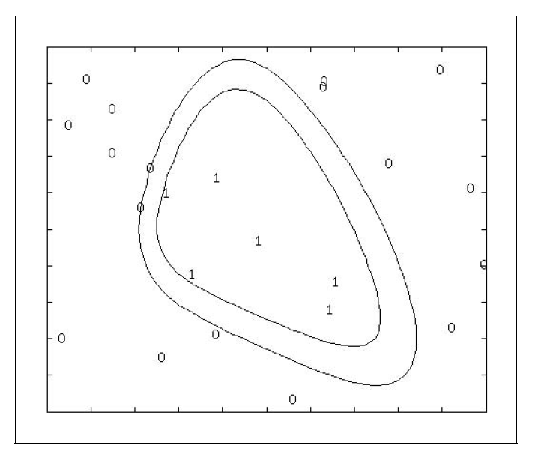
Most “General” and “Specific” networks
Most General (Positive)
Most Specific (Positive)
Figure 6

Slide 33
Version Space
Most General (Positive)
Version Space
Most Specific (Positive)
Figure 6

Slide 34
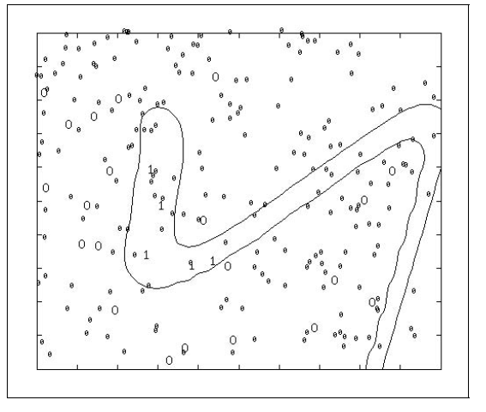
SG-net Algorithm
General idea: Introducing negative “background” points find the positive “specific” network.
“Background” point
Original point
Figure 8

Slide 35
SG-net Algorithm
Also, introducing positive “background” points find the negative “specific” network.
negative “specific” network = positive “general” network
The selective query point is between positive “specific” network and positive “general” network (two estimated labels are not equal)
Figure 8

Slide 36
SG-net Algorithm
Also, introducing positive “background” points find the negative “specific” network.
negative “specific” network = positive “general” network
The selective query point is between positive “specific” network and positive “general” network (two estimated labels are not equal)
Figure 8

Slide 37
Outline
Passive Learning vs. Active Learning
Active Learning for SVM
Active Learning for Neural network
Query by Committee
Active Learning using pre-clustering

Slide 38
About this work
“Query by Committee”,
Authors: H. S. Seung, M. Opper, H. Sompolinsky, 1992.

Slide 39
How much information of a query?
Motivation: Labeling data is expensive.
Therefore, we want to get information as much as possible for a query.

Slide 40
Information Gain of A Query
Query: q_{i+1}
Current Version Space: V_{i}
New Version Space: V_{i+1}
Information Gain: I(q_{i+1}) =-log(V_{i+1}/V_{i})

Slide 41
Information Gain of A Query
Information Gain: I(q_{i+1}) =-log(V_{i+1}/V_{i})
Maximum I(q_{i+1})=1 (bit), when version space V_{i} is bisected.

Slide 42
Which unlabeled data can bisect Version Space ?
Unfortunately, the geometry of the version space is complex, cannot practically calculate V⁺,V⁻.

Slide 43
Make the Decision by Committee
Randomly pick 2k classifiers w₁,w₂,…,w_{2k} from current version space. Find the maximal disagreement point.
Maximal Disagreement, k=2

Slide 44
Outline
Passive Learning vs. Active Learning
Active Learning for SVM
Active Learning for Neural network
Query by Committee
Active Learning using pre-clustering

Slide 45
About this work
“Active Learning Using Pre-clustering”,
Authors: Hieu T. Nguyen, Arnold Smeulders, ICML 2004.

Slide 46
Example
Closet point to boundary, but sparse
Close to boundary, and very dense (better choice)

Slide 47
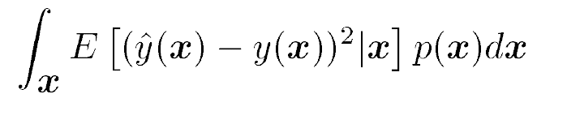
Expected future classification error
Problem: if p(x) is not uniform?
Predicted label of x
True label of x

Slide 48
Expected future classification error
Problem: if p(x) is not uniform?
Predicted label of x
True label of x

Slide 49
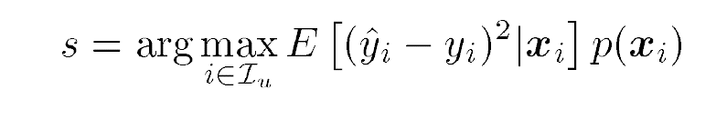
Criterion for data selection
unlabeled data set

Slide 50
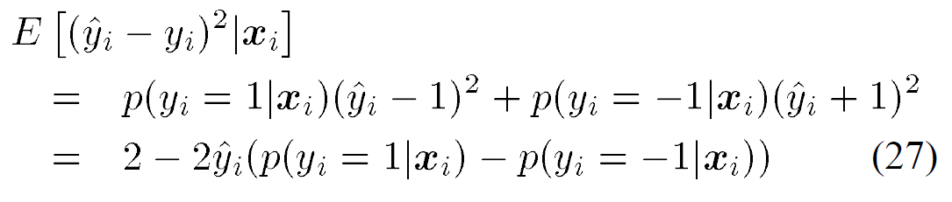
Criterion for data selection
unlabeled data set
x_{i} lies on the classification boundary, it achieves minimum.

Slide 51
Criterion for data selection
If p(x_{i}) is not uniform, we also prefer to choose x_{i} with larger p(x_{i})
x_{i} lies on the classification boundary, it achieves minimum

Slide 52
How to estimate p(x)?
Soft Clustering: Using Multiply Gaussian Models to estimate the density of p(x)

Slide 53
How to Select Data to Query
For each unlabeled data x_{i}

Slide 54
End
Thank you!
Any question?

