Slide 1
Distributed Optimization and Statistical Learning via ADMM(Alternating Direction Method of Multipliers)
Presenter: Liang Tang
(Many slides are borrowed from the original authors and other people)

Slide 2
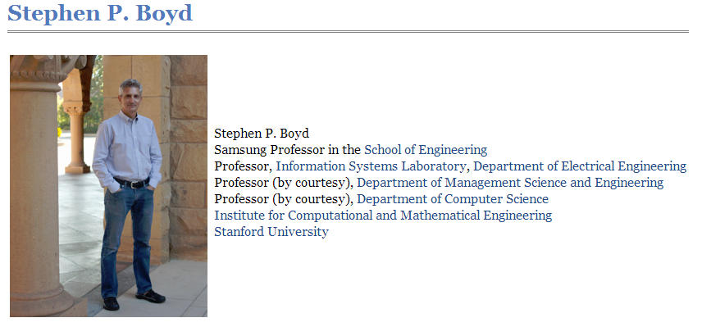
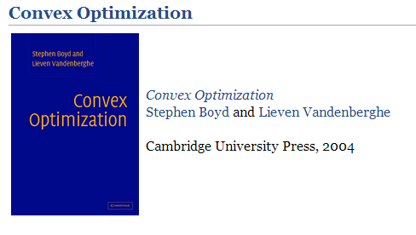
Authors
Stephen Boyd, Neal Parikh, Eric Chu, Borja Peleato and Jonathan Eckstein

Slide 3
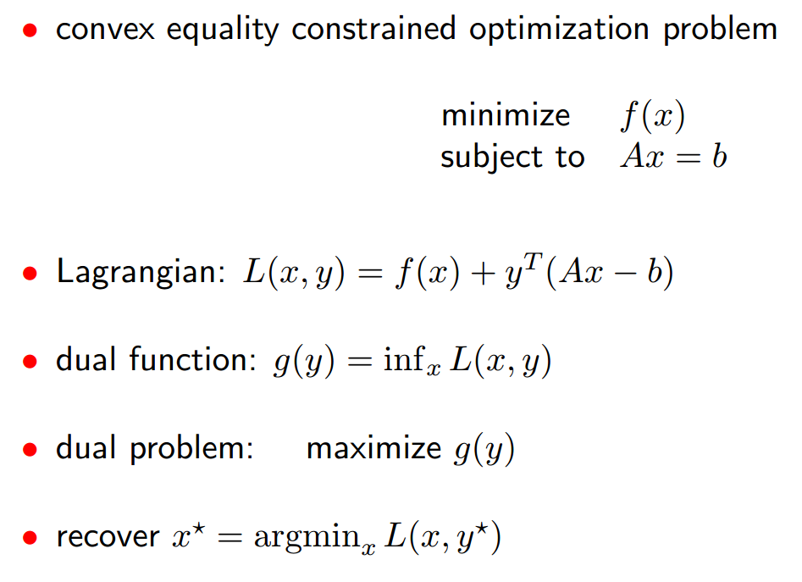
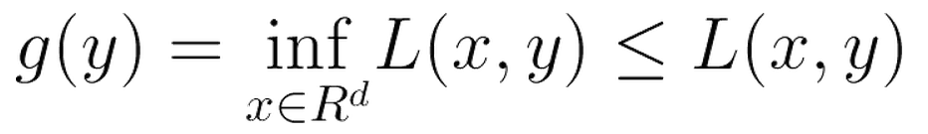
Dual Problem
g is concave even if L is not convex.
If L is convex, strong duality holds: maximum of g(y) = minimum of L(x,y)

Slide 4
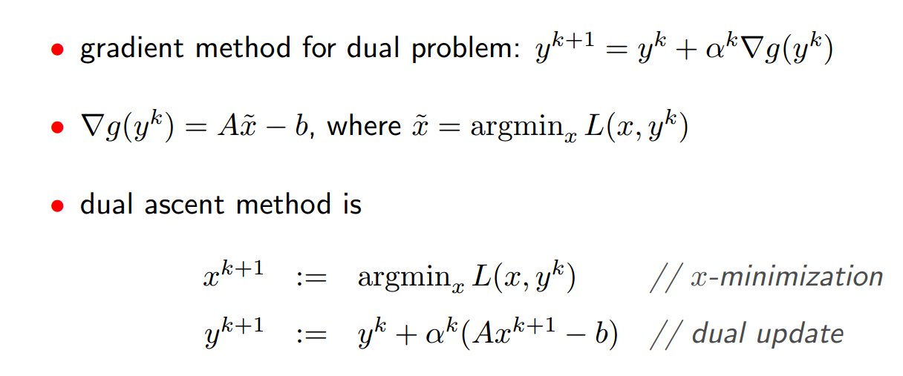
Dual Ascent

Slide 5
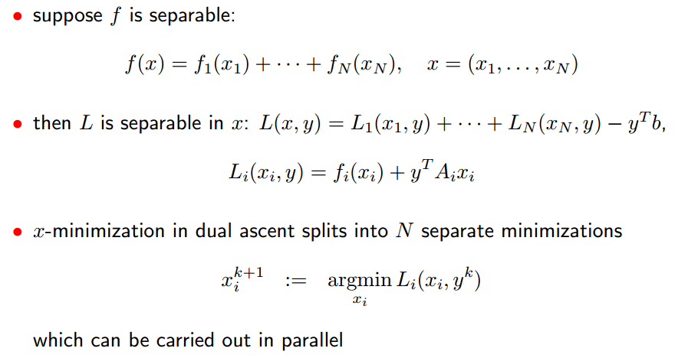
Dual Decomposition

Slide 6
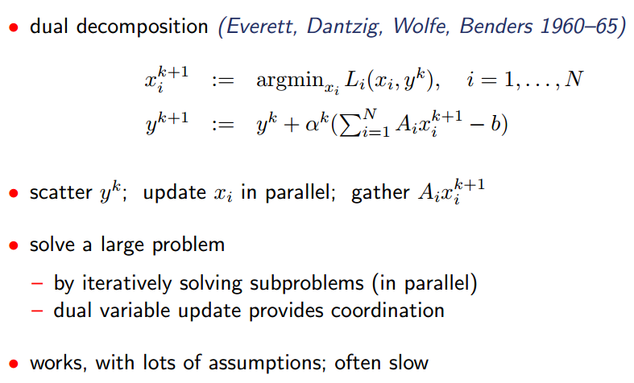
Dual Decomposition(Cont.)

Slide 7
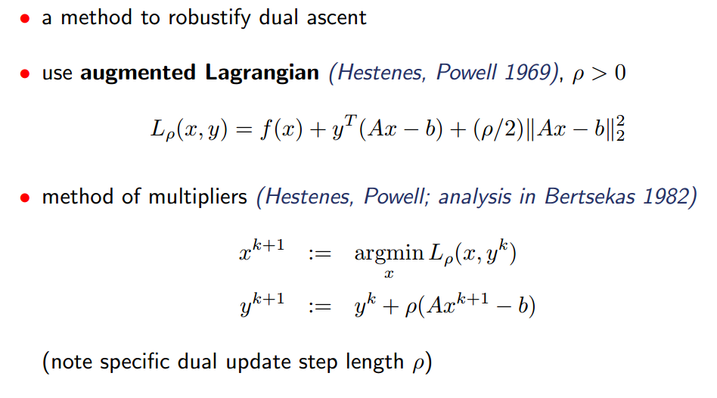
Augmented Lagrangian

Slide 8
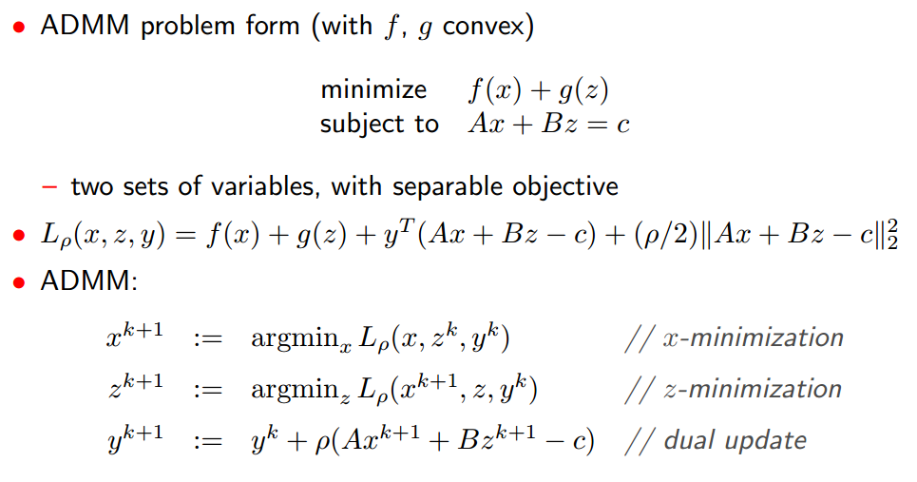
Alternating Direction Method of Multipliers

Slide 9
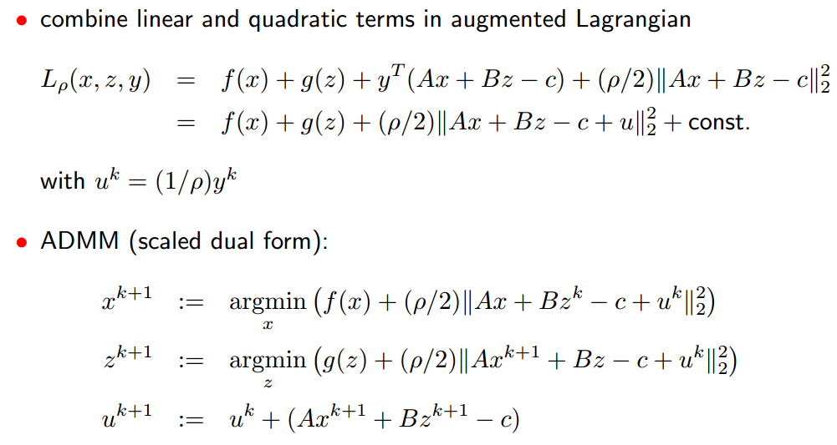
Alternating Direction Method of Multipliers(Cont.)

Slide 10

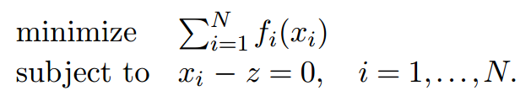

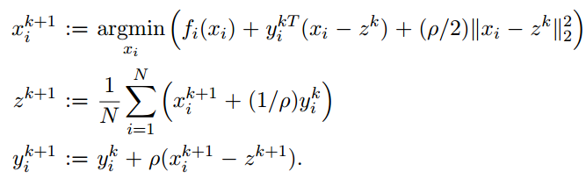
Consensus Problem

Slide 11
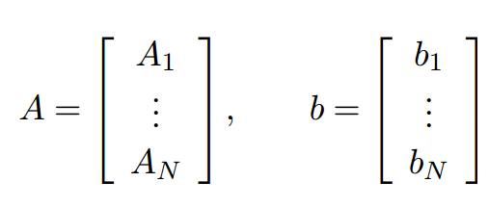
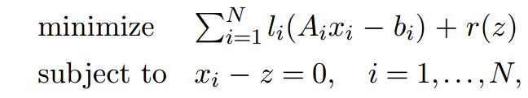
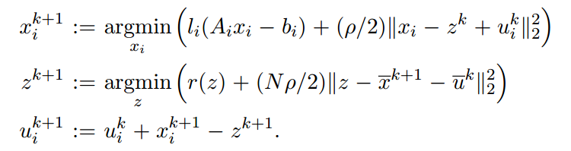
Splitting across Instances
(A_{i},b_{i}) is stored in a node
Loss function

Slide 12



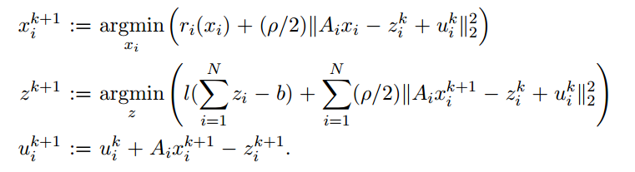
Splitting across Features

Slide 13
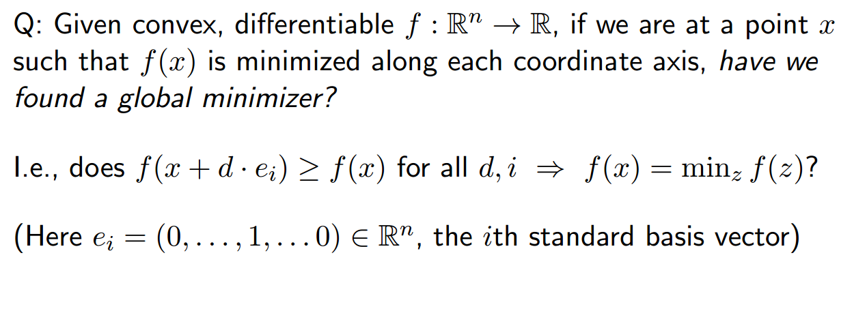
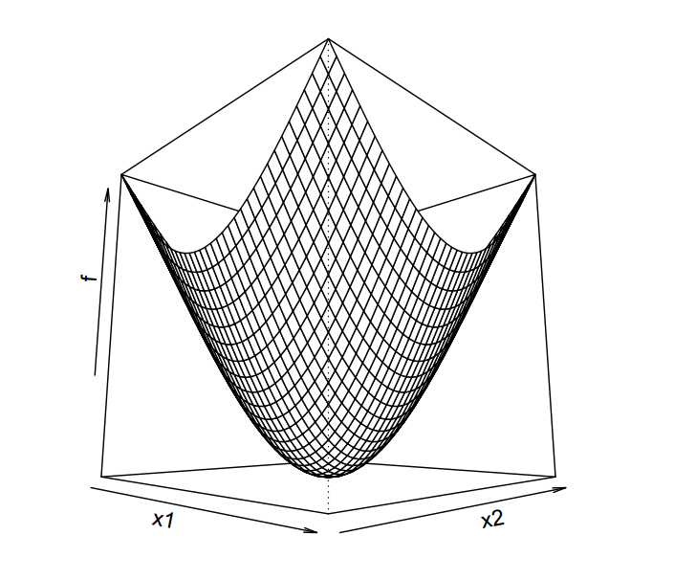
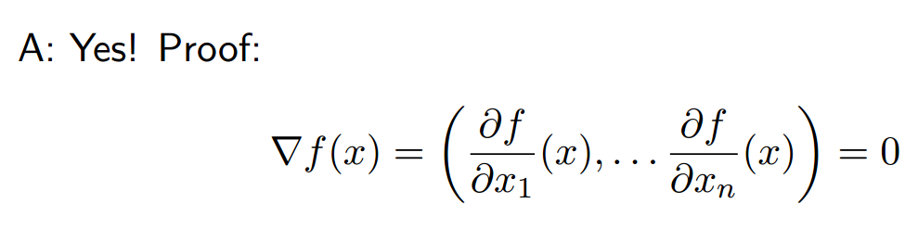
Coordinate Descent
Motivation: dimensionality is too high (>100M). We cannot load a weight vector(X) into the memory
Hill climbing

Slide 14
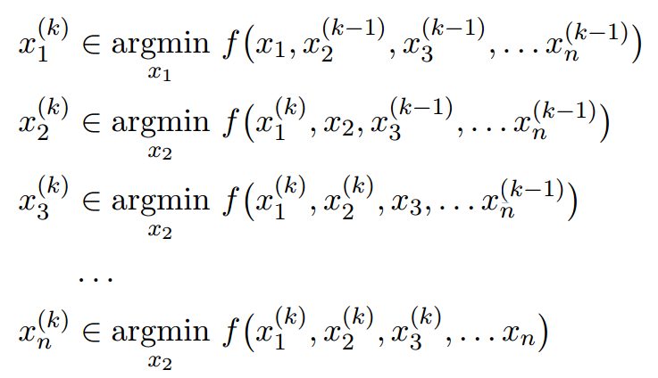
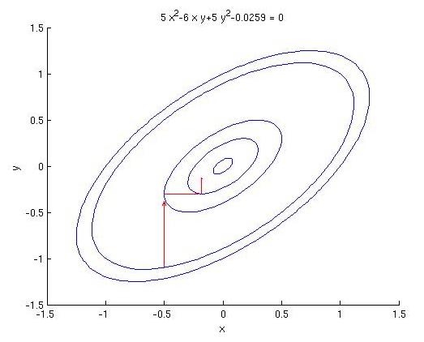
Coordinate Descent
Problem: minimize f(x)
x₃
x_{n}

Slide 15
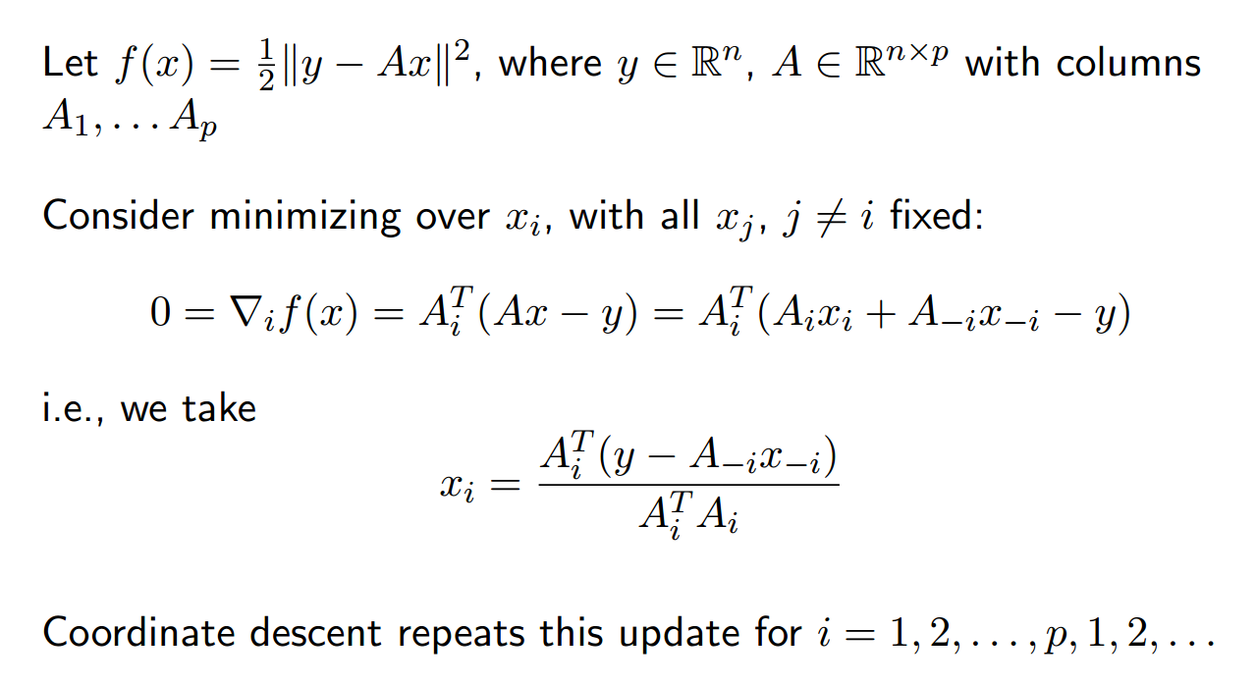
Linear Regression

Slide 16
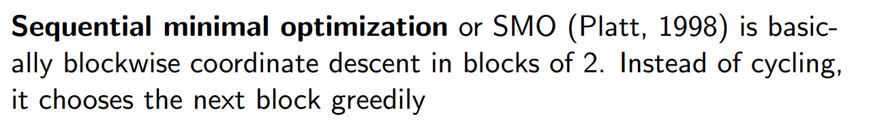
Sequential minimal optimization (SMO)
The advantage of SMO lies in
solving for two Lagrange multipliers can be done analytically.
no extra matrix storage at all. Thus, very large SVM training problems can fit inside of the memory

Slide 17

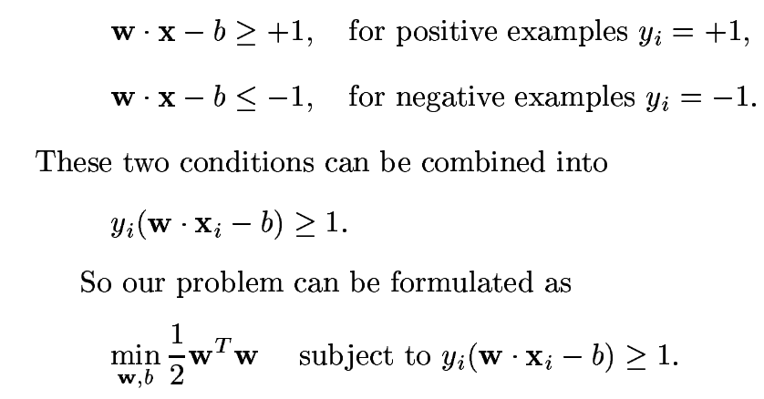
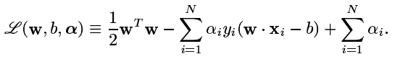
Support Vector Machine(Primal)
Recall Linear SVM:
By introducing Lagrange multipliers:
http://www.cs.iastate.edu/~honavar/smo-svm.pdf

Slide 18
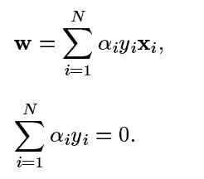
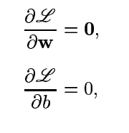
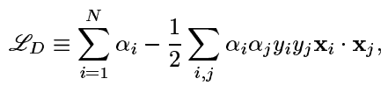
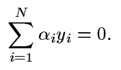

Support Vector Machine(Dual)
Recall Linear SVM:
Primal:
Dual:
http://www.cs.iastate.edu/~honavar/smo-svm.pdf

Slide 19
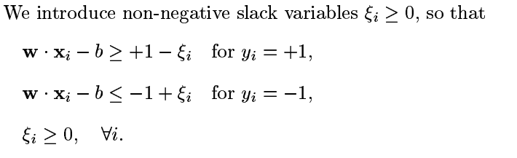
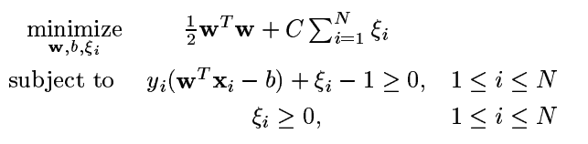
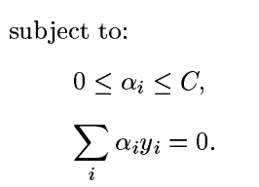

Support Vector Machine(Soft)
Recall Linear SVM:
Primal:
Dual:
http://www.cs.iastate.edu/~honavar/smo-svm.pdf

Slide 20


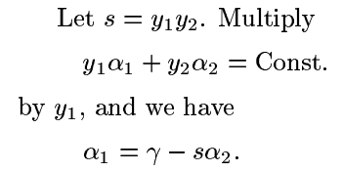
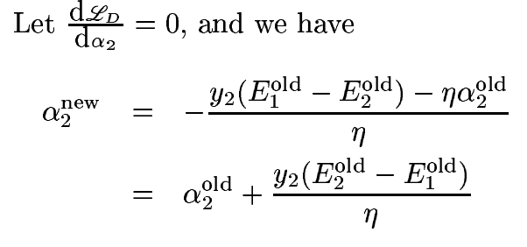



Sequential Minimize Optimization
a₁ vanishes, we only have one variable a₂
One step to get unconstrained optimal a₂
For detail, please see http://www.cs.iastate.edu/~honavar/smo-svm.pdf

Slide 21
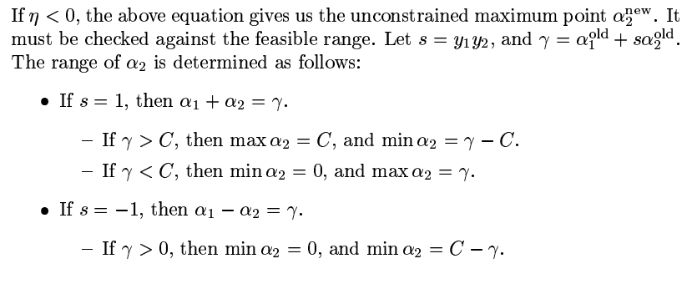
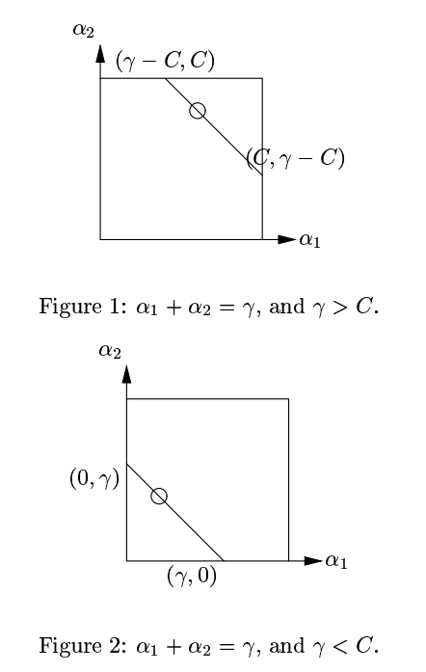
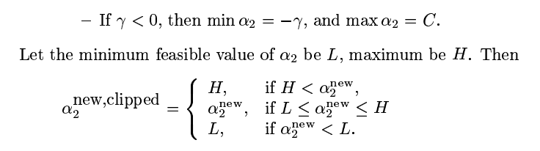
Sequential Minimize Optimization(Cont.)
H
L
H
L
For detail, please see http://www.cs.iastate.edu/~honavar/smo-svm.pdf

