Slide 1
Finding Significant Linear Correlations in Data sets
Liang Tang & Chao Shen

Slide 2
Finding Significant Correlations
Problem: finding significant correlations.
In the figure, we want to find hyperplanes: S₁ and S₂
Because many data points are in the two hyperplanes.

Slide 3
Finding Significant Correlations
Problem: finding significant correlations.
In the figure, we want to find hyperplanes: S₁ and S₂
Because many data points are in the two hyperplanes.

Slide 4
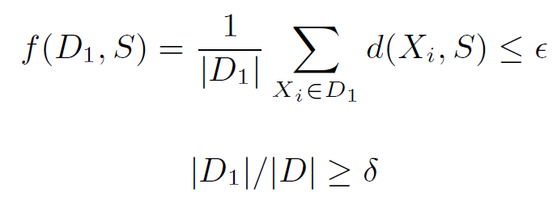
Problem Statement
Given a subspace S of a dataset D, S is a significant global correlation if there is a data subset D₁ ⊆ D satisfies following conditions:
where δ and ε are user-defined parameters.
Euclidean Distance

Slide 5
Problem Statement
Given a subspace S of a dataset D, S is a significant global correlation if there is a data subset D₁ ⊆ D satisfies following conditions:
where δ and ε are user-defined parameters.
Euclidean Distance

Slide 6
Approach & Related Work
Related work:
Subspace clustering methods: For instance, K-subspace, a EM-type algorithm similar to K-means.
Generalized Principle Component Analysis(GPCA): It formulates the subspace clustering problem as a polynomial factorization problem (In Computer Vision Area).
Hough-transform based algorithm: For instance, CASH.
Sampling based algorithm: LMCLUS.
Main Challenge:
How to find all significant linear correlations efficiently?
Our approach:
Divide and Conquer Strategy, to find correlation on data subsets and merge results.

