Slide 1
Ph.D. Defense Presentation
Topic: Event Mining for System and Service Management
Presented by
Liang Tang
Major Advisor: Dr. Tao Li
School of Computing and Information Sciences
Florida International University

Slide 2
Overall Presentation Goal and Primary Purpose
Investigate data-driven approaches for improving the quality and efficiency of IT service and system management.

Slide 3
Speaker’s Qualifications
Education
Obtain bachelor and master degrees in Sichuan University, P.R. China, 2006 and 209.
Ph.D. student from Fall 2009 to present in FIU, Major advisor: Dr. Tao Li.
Best Graduate Student Research Award in 2013.
Research Interest
Data mining and machine learning techniques on system/service management and recommendation.
Published 12 papers in the conferences (SIGKDD,CIKM, ICDM, NOMS, CNSM and so on) and journals (TKDE, KBS).
Research Experiences
2 summer internships in Service Management Department of IBM Watson Research Center.
1 summer internship in LinkedIn.

Slide 4
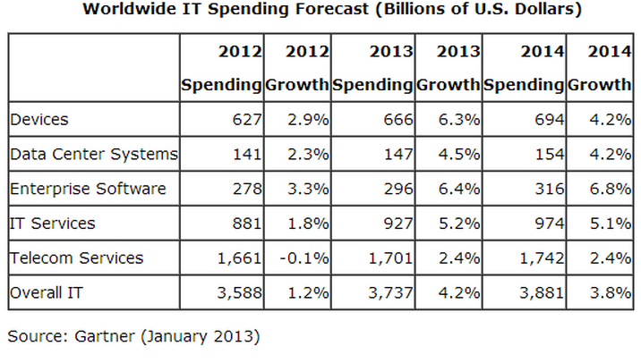
IT Service in Overall IT Industry
IT Service is the second largest cost over all IT industry.
IBM is the large IT service provider (7.1% market in 2010).

Slide 5
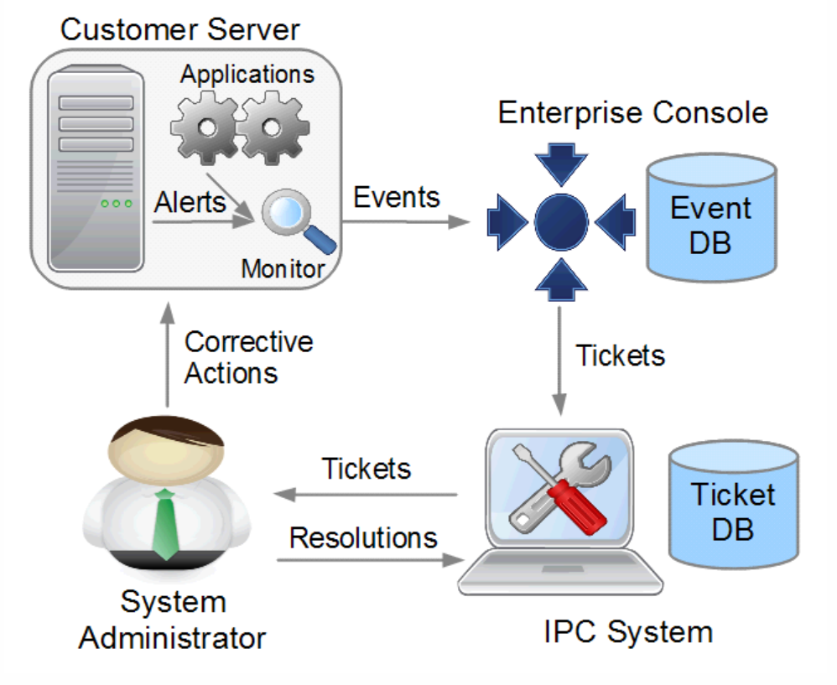
IT Service Background
The typical workflow of IT service mainly includes four components (Liang, Tao, Larisa, et al., 2012):
Customer Servers
Event DB
Ticketing System
System Administrators

Slide 6
How IT Service Works?
Checking Monitoring Situations (periodically):
If disk_name == “C:” and disk_free < 5%, then create a diskspace alert.
If CPU_util > 80% and duration > 20 minutes, then create a CPU alert
….
Store and Explore Events (diskspace, CPU alerts)
Automatically Generate Incident Tickets.
Resolving Incident Tickets:
See problem description, logon server, fix the problem.
Track Incident Tickets :
OpenDate, CloseDate, Resolver, Problem Description, Resolution.

Slide 7
Research Problems
Monitoring Configuration Optimization:
Reduce False positive (false alerts)
Reduce False negative (missed alerts)
Convert Raw Textual Logs into System Events
System Incidents Diagnosis :
Discover Event Dependencies.
Automatic Resolution Recommendation.
Locate Relevant Logs.

Slide 8
Outline
Monitoring Configuration Optimization:
Reduce False positive (false alerts)
Reduce False negative (missed alerts)
Convert Raw Textual Logs into System Events
System Incidents Diagnosis :
Discover Event Dependencies.
Automatic Resolution Recommendation.
Locate Relevant Logs.

Slide 9
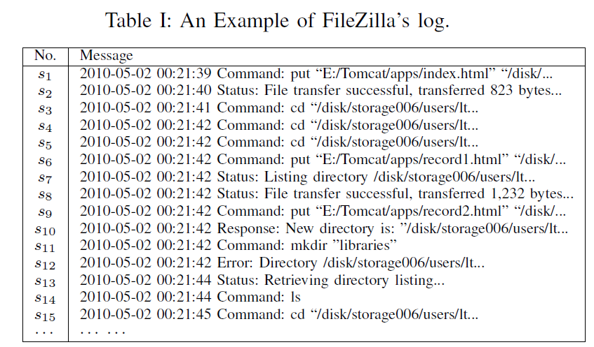
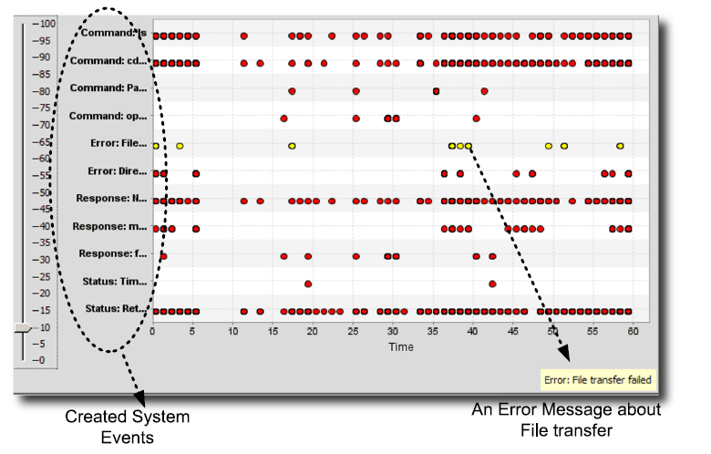
Why Convert Textual Logs to System Events?
System events are easier to analyze other textual logs.

Slide 10
Preliminary Work
Log Parser (W. Xu et al., 2008):
Parse the log messages
Limitation: Requires to understand all log messages
Information Extraction:
Conditional Random Field.
Limitation: Requires labeled training data
Clustering Based Methods:
Bag-of-Word model
cosine similarity, Jaccard Index…
Limitation: Low accuracy, short messages but large vocabulary
Log message matching (M. Aharon et al., 2009; A. Makanju et al, 2009)
Number of matched words in strings.
Edit distance of messages.
Limitation: Only work well for some types of logs.

Slide 11
Overview of Our Work
LogSig
Extract the common subsequence as the signature to categorize the log messages.
Utilize the order information of words not just the occurrences of words.
LogTree:
Use the similarity function based on a tree representation of log messages for achieving a higher accuracy.
Separate the clustering algorithm and format parsing.

Slide 12
Message Signature Based Clustering
A message signature is a common subsequence of one type of log messages.
One type of log messages is generated by one template with different parameters.
Permission denied
Message signature
[Thu Apr 01 00:07:31 2010] [error] [client 131.94.104.150] File does not exist: /opt/website/sites/users.cs.fiu.edu/data/favicon.ico
[Thu Apr 01 03:47:47 2010] [crit] [client 61.135.249.68] (13)Permission denied: /home/public_html/ke/.htaccess pcfg_openfile: unable to check htaccess file, ensure it is readable
[Thu Apr 01 01:41:18 2010] [error] [client 66.249.65.17] Premature end of script headers: preferences.pl
[Thu Apr 01 01:44:43 2010] [error] [client 207.46.13.87] File does not exist: /home/bear-011/users/giri/public_html/teach/6936/F03
File does not exist
Bad script

Slide 13
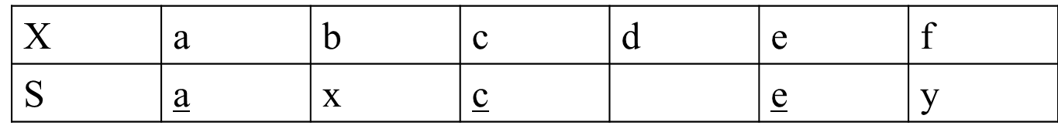
Message Signature based Clustering
Problem: Find k most representative message signatures.
Question: How to quantify the “representativeness” ?
Definition:
Given a message X and a message signature S, the match score is the number of matched terms minus the number of unmatched terms.
match(X,S) = |LCS(X,S)| - (|S| - |LCS(X,S)|) =2|LCS(X,S)|- |S|, LCS=Longest Common Subsequence.
Example:
X=“abcdef”, S=“axcey”, match(X,S)=|ace| - |xy| = 1

Slide 14
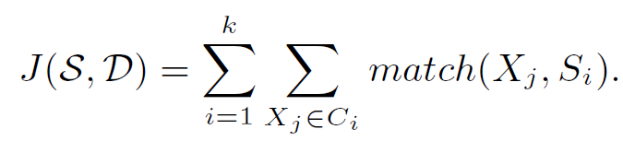
Problem Definition
Given a set of log messages D and an integer k, find k message signature S = {S₁,…,S_{k}} and a k-partition C₁,…,C_{k} of D to maximize:
Problem Analysis:
Similar to k-means problem, but NOT really.
Finding the Optimal Solution is NP-Hard, even if k=1.
Multiple Longest Common Subsequence Problem can be reduced to our problem.

Slide 15
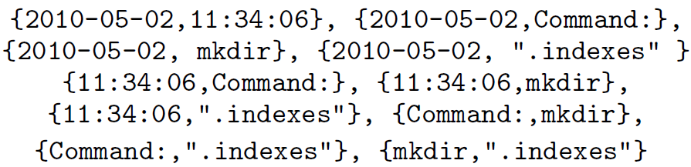
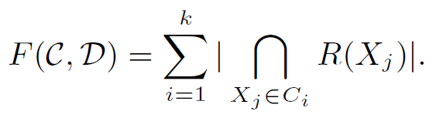
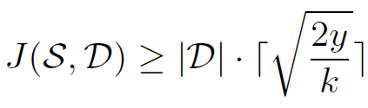
Approximation Problem 1
Convert each log message into Term Pairs:
Maximize
Lemma: If F(C,D) ≥ y, then
R(X_{j}): the set of term pairs of log message Xj.
C={C₁,…,C_{k}} is the partition of log messages
S is the set of signatures
However, F value can be changed by a series of updates of C (not smooth), not good for optimization algorithms.
Notes:
y is a constant. F value can be updated by multiple movements, not a single movement.

Slide 16
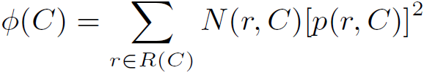
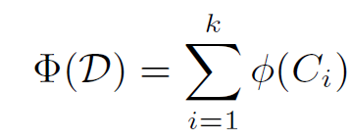

Approximation Problem 2
Potential for one message group
Given a message group C, the potential of C is defined as
N(r,C) is the number messages in C that contain pair r. p(r,C)= N(r,C)/|C| is the portion of messages in C having r.
Overall Potential
Sum of all message groups’ potentials.
Lemma: If F(C,D) ≥ y, then
Notes:
y is a constant

Slide 17
Local Search Algorithm
Randomly partition all log messages into k partitions.
For each log message, move it to another partition if the movement can increase the value of 𝚽.
To contain more common pairs
Yes
If partitions change?
No
End

Slide 18
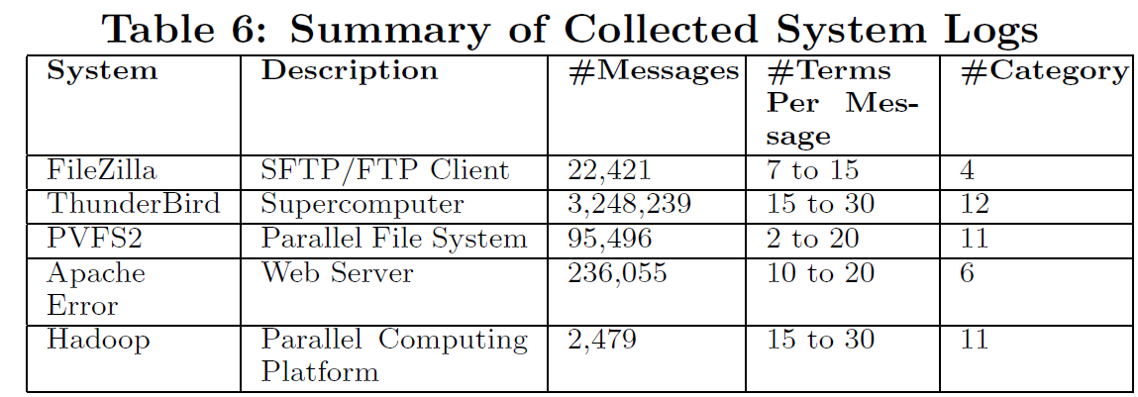
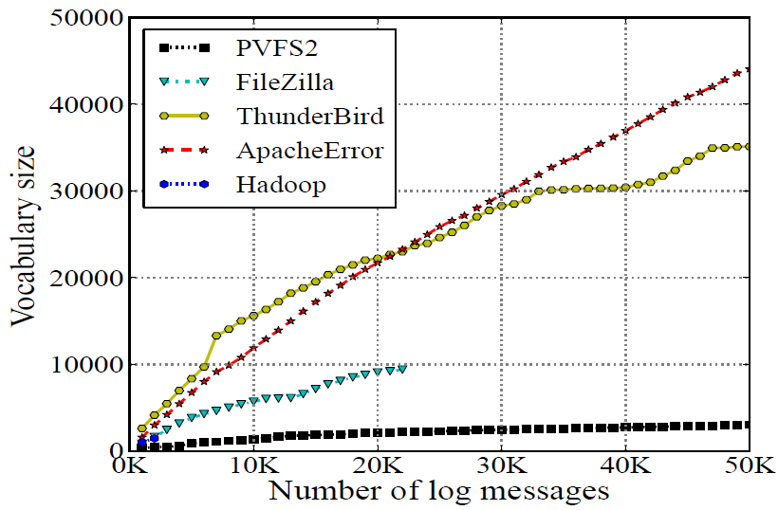
Experimental Data
Vocabulary sizes of Apache and ThunderBird are almost infinte, because lots of parameter terms.

Slide 19
Baseline Algorithms
IPLoM (A. Makanju et al, 2009)
Clustering log messages by some format features, such as the number of tokens.
StringMatch (M. Aharon et al., 2009)
Clustering log message by the number of common token at each token position.
Bag-of-Word + Cosine similarity
Bag-of-Word + Jaccard Index
StringKernel
Convert each log message into a vector of term pairs and discount their weights by the position distance of terms in string.
Notes:
There are five algorithms we compared. The first two algorithms are developed for clustering logs. The last three algorithms are widely used in text mining domain.

Slide 20
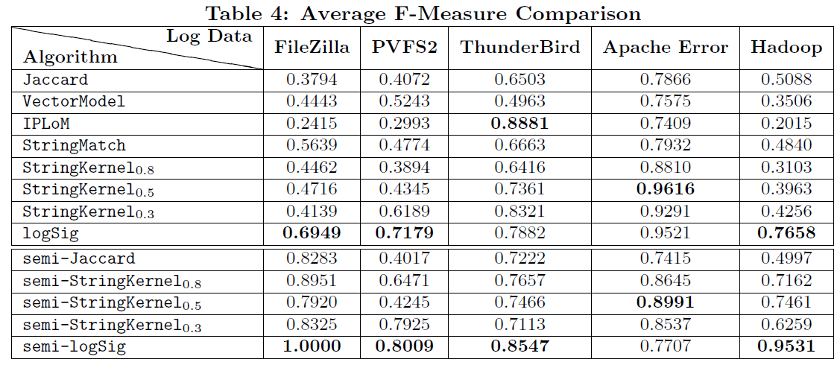
Accuracy (Avg F-Measure)
No algorithm can always be the best. LogSig is better than other on average.
IPLoM is good for special type of system log.

Slide 21
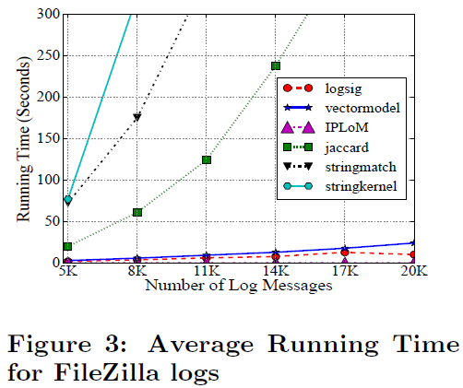
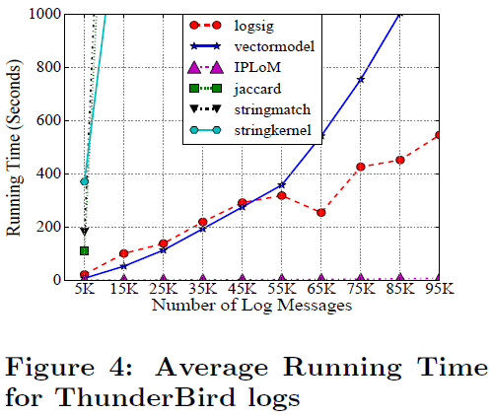
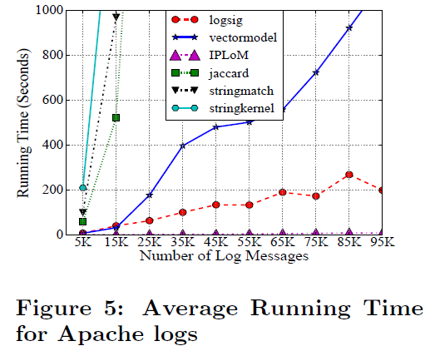
Efficiency
IPLoM is the most efficient algorithm, but its accuracy is not good.
StringKernel, StringMatch and Jaccard are slow to converge.

Slide 22
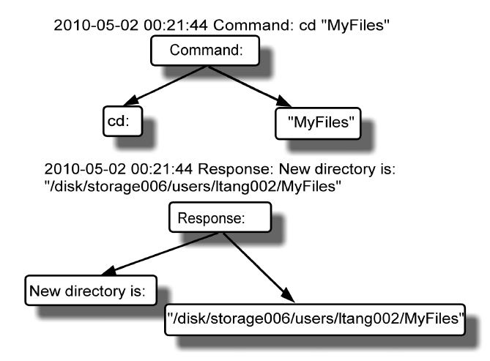
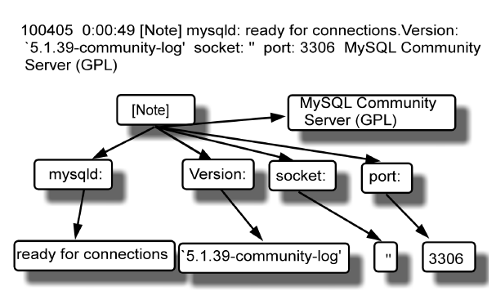
LogTree: Tree-Structure based Clustering
Idea
Convert the log messages into tree-structured data, where each node is a segment of message.
Do clustering based on tree-structured data.

Slide 23
Summary
LogTree
it converts log messages into semi-structural data and then does clustering.
This work has been published in IEEE ICDM 2010.
LogSig
it partitions the log messages based on the message signatures.
This work has been published in ACM CIKM 2011.

Slide 24
Outline
Monitoring Configuration Optimization:
Reduce False positive (false alerts)
Reduce False negative (missed alerts)
Convert Raw Textual Logs into System Events
System Incidents Diagnosis :
Discover Event Dependencies.
Locate Relevant Logs Efficiently.
Automatic Resolution Recommendation

Slide 25
What is False Positive (False Alarm)?
If PROCESS_CPU_UTILIZATION > 50% and duration > 10 minutes, then generates a CPU alert
“rtvscan.exe” scans the system periodically, it is CPU intensive but it is normal, so it triggers a lot of false positives (false alerts).
If PAGING_UTILIZATION_15min > 400, then generate a paging alert (default situation in IBM Tivoli monitoring)
Some customer servers have multiple CPU and huge memories. For those multi-CPU servers, it is normal for page swapping over thousands of times in 15 minutes.

Slide 26
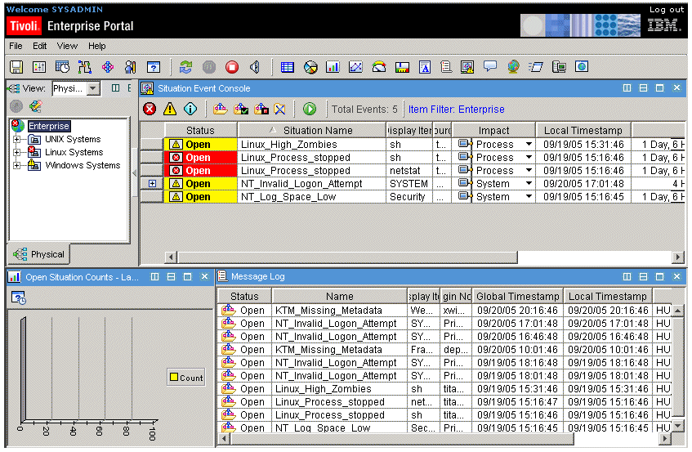
Why We Have False Positives?
Too Conservative Configurations
Missing a real alert would incur system crash, data loss.
Changes of Monitored Servers
New servers and more powerful device are installed.
Transient Alerts:
Temporal CPU, Paging, Disk Spike.
Restart of servers, processes, services, routers…
IBM Tivoli Monitoring
Configuration is complicated

Slide 27
Problem Statement & Challenge
Problem Statement
Eliminate false positives by refining the monitoring configurations
Challenge
Retain all real alerts. No real alert is allowed to miss.

Slide 28
Preliminary Work
Monitoring Products
IBM Tivoli, HP OpenView, Splunk
System Alert Detection
Heuristic Methods (codebook…).
Unsupervised Learning Methods
Outlier Detection (S. Agrawal et al., 2007, K. Xu et al., 2005)
Adaptive threshold (S.R. Kashyap et al., 2008)
Supervised Learning Methods (classification).
However, they do not guarantee NO real alert is missed.

Slide 29
Observation from Real Data
Most false positives are transient alerts and automatically disappear in a short time.
Most false alerts are transient alerts.
Some transient alerts may be indications of future real alerts and may be useful. But if those real alerts rise later on, the monitoring system will detect them even if the transient alerts were ignored.

Slide 30

Our Method for Eliminating Transient Alerts
Gather incident information
and create event
Abnormal behavior
Most false positive alerts are transient alerts ( automatically disappear in a short time).
Predict it is
“False”?
Is this alert
cleared?
Yes
Wait
Yes
Remove
this event
No
No
Create ticket
Waiting time is the maximum duration of covered false positives, but no longer than SLA specified.
$${wait}_{p}=min⁡\{\max_{e∈F_{p}}{e.duration,{SLA}_{time}\}}$$
$$F_{p}=\{e|e∈F, isCovered\left(p,e\right)=^{′}true^{′}\}$$

Slide 31
Implementation and Deployment
The rules generated by a classifier can be directly translated into monitoring situations
An example of the monitoring situation:
Prediction Rule
Condition | PROC_CPU_TIME > 50% and PROC_NAME = ‘Rtvscan’.
Polling Interval | 15 minutes
Waiting Time

Slide 32
Offline Evaluation on Historical Data
Ratio of the testing data size and training data size

Slide 33
Online Evaluation
Deployed on the IT infrastructure of a large financial company.
Deployed on an internal account in IBM.
We also did this evaluation on several other accounts.
Overall, they have 21% false alert reduction on average.

Slide 34
What is False Negative (Missed Alert) ?
False negatives are the missed alerts by the monitoring system.
False negatives are usually captured by human (customers, helpdesk, system administrators).
False negatives are not recorded in monitoring events, but only in manual tickets.

Slide 35
About False Negative
How to eliminate false negatives (missed alerts)?
False negative are quite few (less than 20-40 tickets for a situation).
No need an automatic approach to correct the misconfiguration.
False negatives are missed alerts. Where can we find them?
Manual Tickets (captured by human).
However, manual tickets contain other kinds of tickets, such as customer request.

Slide 36
Summary
The work of reducing false positives has been published in IEEE/IFIP NOMS (Network Operation and Management Symposium) 2012.
It is published in U.S. Patent: “Methods and Apparatus for System Monitoring”.
The work of reducing false negatives has been published in CNSM (International Conference on Network and Service Management), 2013.
The framework of two work has been published in ACM SIGKDD conference, 2013.

Slide 37
Outline
Monitoring Configuration Optimization:
Reduce False positive (false alerts)
Reduce False negative (missed alerts)
Convert Raw Textual Logs into System Events
System Incidents Diagnosis :
Discover Event Dependencies.
Automatic Resolution Recommendation
Locate Relevant Logs.

Slide 38
What are the temporal dependency and time lag?
Disk_Capacity ⟶ _{[5min,6min]} Database, [5min, 6min] is the lag interval.
Different lags can reveal different reasons for generating this temporal dependency.(We really want to know the reasons of dependencies, not just the dependencies themselves).

Slide 39
Why Temporal Dependencies?
Finding dependent system components
Identify the root cause of system problems
…
Finding correlated monitoring situations
Remove redundant situations
Event correlation
…

Slide 40
Preliminary Work
Predefine the lag or time window(H. Mannila et al., 1997)
No interleaved dependency (T. Li et al., 2005, K. Bouandas et al., 2007)
?
Disk_Capacity ⟶ _{[5min,6min]} Database, [5min, 6min] is the lag interval.

Slide 41
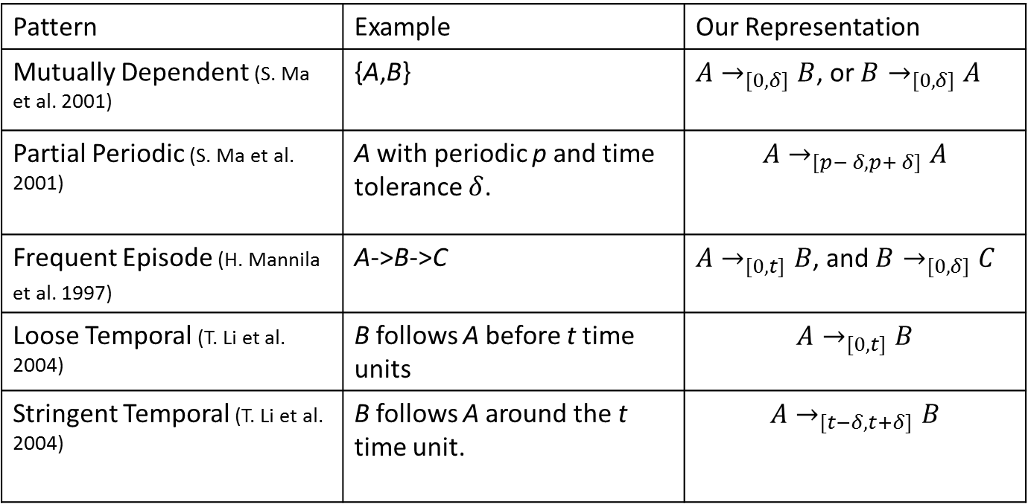
Relation with Other Temporal Patterns
Those temporal patterns can be seen as the temporal dependency with particular constraints on the time lag.
Pattern | Example | Our Representation
Mutually Dependent (S. Ma et al. 2001) | {A,B} | $A→_{[0, δ]}B$, or $B→_{[0, δ]}A$
Partial Periodic (S. Ma et al. 2001) | A with periodic p and time tolerance $δ$. | $$A→_{[p− δ,p+ δ]}A$$
Frequent Episode (H. Mannila et al. 1997) | A->B->C | $A→_{[0, t]}B$, and $B→_{[0, δ]}C$
Loose Temporal (T. Li et al. 2004) | B follows A before t time units | $$A→_{[0, t]}B$$
Stringent Temporal (T. Li et al. 2004) | B follows A around the t time unit. | $$A→_{[t−δ, t+δ]}B$$

Slide 42
Challenges for Finding Time Lag
Given a temporal dependency, A⟶_{[t1,t2]}B, what kind of lag interval [t1,t2] we want to find?
If the lag interval is too large, every A and every B would be “dependent”.
If the lag interval is too small, real dependent A and B might not be captured.
Time complexity is too high.
A⟶_{[t1,t2]}B, t1 and t2 can be any distance of any two time stamps. There are O(n⁴) possible lag intervals.

Slide 43
What is a Qualified Lag Interval
Idea (Statistical Testing):
If A and B are randomly and independently distributed, how many occurrences observed in a time interval r=[t₁,t₂]?
If random A and B have a probability (>5%) to observe this number of occurrences, it maybe caused by random.
What is the minimum number of occurrences (threshold)?
Consider the number of occurrences in a lag interval r to be a variable, n_{r}. Then, use the chi-square test to judge whether it is caused by randomness or not?
Test statistic is n_{r}.

Slide 44

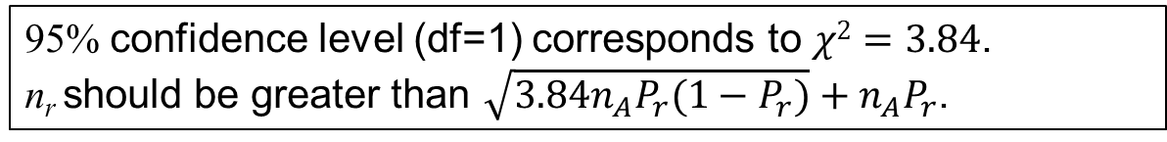
What is a Qualified Lag Interval
$$\left|r\right|=t2−t1$$
n_{B}: the number of B events
P_{r} is the probability of a B following A in lag r from a random sequence.
Total time length of the event sequence
n_{A}P_{r} is the expected number of n_{r} (in a random sequence).
Test statistic
variance of n_{r} (in a random sequence).
95% confidence level (df=1) corresponds to $χ2=3.84$.
n_{r} should be greater than $\sqrt{3.84n_{A}P_{r}(1−P_{r})}+n_{A}P_{r}$.

Slide 45
Time Complexity Lower Bound
The problem of finding all qualified time intervals is 3SUM-Hard, so the there is o(n²) algorithm in the worst case (A. Gajentaan et al., 1995).
3SUM problem
Given a set of n integers, are there three integers a,b, c in the set such that a+b=c?
No o(n²) algorithm can solve this problem in the worst case.

Slide 46
STScan Algorithm
Idea:
Avoid redundant scanning, store all time lags into a sorted table.
t(x₅)-t(x₃)=3030-3010=20.
E₂ is 20, so
insert 3 into IA₂,
insert 5 into IB₂.

Slide 47
STScan Algorithm (Cont.)
Every lag interval is represented as a sub-segment of the linked list.
For example: [20,120] is E₂E₃E₄, the number of occurrences is |IA₂ ∪ IA₃ ∪ IA₄ |
Time cost for creating this table is O(n²).
The number of elements is O(3n²)=O(n²).
Time cost for scanning is O(n²).

Slide 48
Experimental Data
Synthetic data: 7 data sequences. 8 event types. Average sample period is 100. Random generated with 3 embedded dependencies.
Embedded Dependency | support
I₁⟶_{[400,500]}I₂ | 0.1
I₂⟶_{[1000,1100]}I₃ | 0.12
I₄⟶_{[5500,5800]}I₅ | 0.15
Time lags are large. Dependent items are very likely to be interleaved.
Real data: Tivoli Monitoring system events from two large accounts in IBM service center.
Dataset | Time Frame | #Events | #Event Types
Account1 | 54 days | 1,124,834 | 95
Account2 | 32 days | 2,076,408 | 104

Slide 49
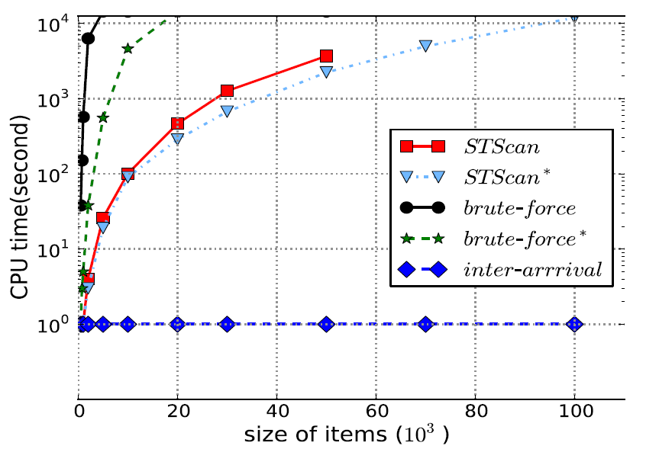
Results for Synthetic Data
Effectiveness:
brute-force, brute-force*,STScan, STScan* can find all embedded temporal dependencies if they can finish the running.
inter-arrivals fails.
Efficiency:
Memory consumption (in bytes)
Data size | 10³ | 10⁴ | 5∙10⁴ | 10⁵
STScan | 3∙10⁴ | 3∙10⁶ | 8∙10⁷ | OutOfMemory
STScan* | 10³ | 10⁴ | 5∙10⁴ | 10⁵
Brute-Force | 9∙10² | 10⁴ | 5∙10⁴ | 9∙10⁴
Brute-Force* | 9∙10² | 10⁴ | 5∙10⁴ | 9∙10⁴
Inter-arrival | <10² | <10² | <10² | <10²

Slide 50
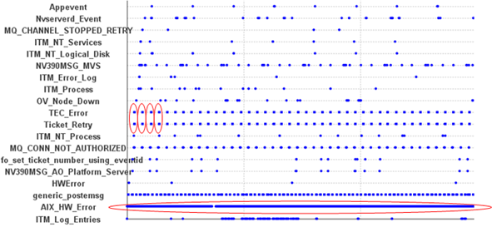
Results for Tivoli Monitoring System Events
Dataset | Discovered Dependencies
Account1 | MSG_Plat_APP ⟶_{[3600,3600]} MSG_Plat_APP
 | Linux_Process ⟶_{[0,96]} Process
 | SMP_CPU⟶_{[0,27]} Linux_Process
Account2 | TEC_Error ⟶_{[0,1]} Ticket_Retry
 | TEC_Retry ⟶_{[0,1]} Ticket_Error
 | AIX_HW_ERROR⟶_{[8,9]} AIX_HW_ERROR
previous clustering based lag discovery algorithm only find

Slide 51
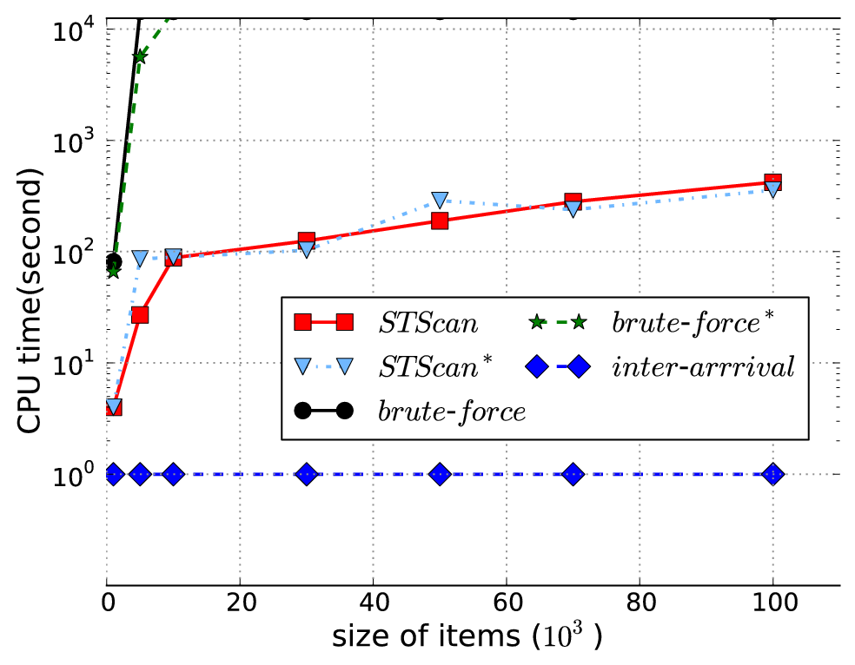
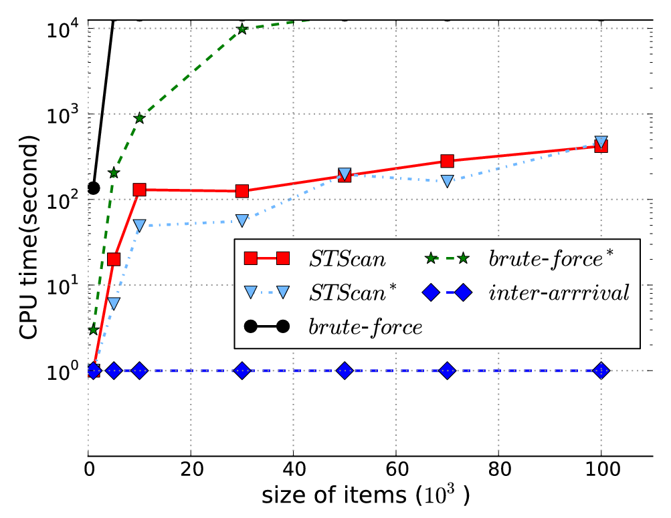
Results for Tivoli Monitoring System Events (Cont.)
Run times on Account1 data
Run times on Account2 data

Slide 52
Summary
Study the problem of discovering interleaved temporal dependencies.
Propose STScan and STScan* two algorithms, which are faster than brute-force search approaches, although their time complexities are still high O(n²).
Prove that the problem is 3SUM-Hard.
This work has been published in ACM SIGKDD conference 2012.

Slide 53
Outline
Monitoring Configuration Optimization:
Reduce False positive (false alerts)
Reduce False negative (missed alerts)
Convert Raw Textual Logs into System Events
System Incidents Diagnosis :
Discover Event Dependencies.
Automatic Resolution Recommendation
Locate Relevant Logs.

Slide 54
Recommending Resolutions for Problems Identified by Monitoring
Ticket ID | Resolver Name | Open Time | Problem Description | Solution Description | …
IBM-C102203 | John | May 7, 2012 6:51:49 AM EDT | Summary: MS SQL issue: database AEFA_DB very little log free space in … | *** Clearing Event Received. Event Follows *** | ….
IBM-C422013 | XC | May 6, 2012 9:06:40 AM EDT | MS SQL issue: bad server status: on server TMPD0371…. | Server reboots resolved_full | …
… | … | … | … | … | …
Observation: If the problem descriptions are similar, the solution descriptions are likely to be similar or identical.
Our Algorithm: Incorporating the falsity prediction of tickets into the KNN recommendation algorithm.
This work has been published in the IFIP/IEEE International Symposium on Integrated Network Management(IM'2013).

Slide 55
Searching Similar Segments over Textual Event Sequence
A textual event sequence is a sequence of events, where each event is a text message(e.g., system logs)
A segment
Motivations: Similar segments of logs describe similar system behaviors.
Challenge: Huge amount of log messages.
Our solution: Suffix Matrix (Locality sensitive hashing + Suffix Arrays).
This work has been published in the 22th ACM Conference on Information and Knowledge Management (CIKM 2013).

Slide 56
Conclusion
Monitoring Configuration Optimization:
Reduce False positive (false alerts)
Reduce False negative (missed alerts)
Convert Raw Textual Logs into System Events
System Incidents Diagnosis :
Discover Event Dependencies.
Automatic Resolution Recommendation
Locate Relevant Logs.

Slide 57
Limitations and Future Work(1)
Log Preprocessing
Only categorize the log messages into events, no attribute values are extracted(IP, host, utilization).
System Monitoring and Ticket Recommendation
Ticket resolutions are edited by humans, may not be consistent and accurate. Future work should consider the quality and noise of ticket resolutions.

Slide 58
Limitations and Future Work(2)
Temporal Dependency and Time lags
Time complexity O(n²) is too high for large data sets. The future work focuses on randomized algorithms.
Similarity Search Over Textual Event Sequence
Dynamic indexing data structure. Allow users to append new events and delete old ones without rebuilding the entire index.

Slide 59
References (1)
A. Gajentaan and M. H. Overmars, “On a class of O(n²) problems in computational geometry”, in Computational Geometry, 5:165-185, 1995.
A. Gionis, P. Indyk, and R. Motwani, “Similarity search in high dimensions via hashing”, in VLDB 1999.
A. Makanju, A. N. zincir-Heywood, and E. E. Milios, “Clustering event logs using iterative partitioning”, in KDD 2009.
A. Z. Broder, N. Charikar, A. M. Frieze, and M. Mitzenmacher, “Min-wise independent permutations” in STOC 1998.
H. Mannila, H. Tovionen, and A. I. Verkamo, “Discovery of frequent episodes in event sequences”, in DMKD, 1(3):259-289, 1997.
K. Bouandas and A. Osmani, “Mining association ruls in temporal sequences”, in CIDM 2007.
M. Aharon, G. Barash, I. Cohen, and E. Mordechai, “One graph is worth a thousand logs: Uncovering hidden strutures in massive system event logs”, in ECML/PKDD, 2009.
K. Xu, Z.-L. Zhang, and S. Bhattacharyya, “Profiling internet backbone traffic: behavior models and applications”, in SIGCOMM 2005.
L. Tang, T. Li, F. Pinel, L. Shwartz, and G. Grabarnik, “Optimizing system monitoring configurations for non-actionable alerts”, in IEEE/IFIP NOMS, 2012.

Slide 60
References (2)
S. Agrawal, S. Deb, K.V.M. Naidu, and R. Rastogi, “Efficient detection of distributed constraint violations”, in ICDE 2007.
S. Ma and J. L. Hellerstein, ‘Mining partially periodic event patterns with unknown periods”, In Proceedings of ICDE, pages 205–214, 2001.
S. R. Kashyap, J. Ramamirtham, R. Rastogi, and P. Shukla, “Efficient constraint monitoring using adaptive thresholds”, in ICDE 2008.
T. Li and S. Ma, “Mining temporal patterns without predefined time windows”, in ICDM 2004.
U. Manber and E. W. Myers, “Suffix arryas: A new method for on-line string searches”, in SIAM J. Comput., 22(5):935-948, 1993.
W. Xu, L. Huang, A. Fox, D. A. Patterson, and M. I. Jordan, “Mining console logs for large-scale system problem detection”, in SysML, 2008.

Slide 61
Publications (12 conference papers, 2 journal papers)
2013
Liang Tang, Romer Rosales, Ajit Singh, Deepak Agarwal. "Automatic Ad Format Selection via Contextual Bandits", in Proceedings of the 22th ACM Conference on Information and Knowledge Management (CIKM 2013), San Francisco, USA, Dec. 2013. (full paper, invited paper).
Liang Tang, Tao Li, Shu-Ching Chen, Shuzhi Zhu. "Searching Similar Segments over Textual Event Sequences", in Proceedings of the 22th ACM Conference on Information and Knowledge Management (CIKM 2013), San Francisco, USA, Dec. 2013. (full paper, acceptance rate: 143/848=16.8%).
Li Zheng, Chao Shen, Liang Tang, Chunqiu Zeng, Tao Li, Steve Luis, Shu-Ching Chen. "Data Mining Meets the Needs of Disaster Information Management", IEEE Transactions on Human-Matchine Systems, 2013.
Liang Tang, Tao Li, Larisa Shwartz, Genady Ya. Grabarnik. "Identifying Missed Monitoring Alerts based on Unstructured Incident Tickets", in Proceedings of the 9th International Conference on Network and Service Management (CNSM 2013), Zurich, Swizerland, Oct. 2013. (short paper).
Liang Tang, Tao Li, Larisa Shwartz, Florian Pinel, Genady Ya. Grabarnik. "An Integrated Framework for Optimizing Automatic Monitoring Systems in Large IT Infrastructures", in Proceedings of the 19th ACM SIGKDD Conference on Knowledge Discovery and Data Mining (KDD'13), Chicago, USA, Aug. 2013. (Industrial/Government Track, full presentation).

Slide 62
Publications (12 conference papers, 2 journal papers)
Liang Tang, Tao Li, Yexi Jiang, Zhiyuan Chen "Dynamic Query Forms for Database Queries", IEEE Transactions on Knowledge and Data Engineering(TKDE), 2013.
Liang Tang, Tao Li, Larisa Shwartz, Genady Grabarnik. "Recommending Resolutions for Problems Identified by Monitoring", in Proceedings of the IFIP/IEEE International Symposium on Integrated Network Management(IM'2013), 2013 (regular technical track, acceptance rate: 27.0%) .
2012
Li Zheng, Chao Shen, Liang Tang, Chunqiu Zeng, Tao Li, Steve Luis, Shu-Ching Chen and Jainendra K. Navlakha. "Disaster SitRep - A Vertical Search Engine and Information Analysis Tool in Disaster Management Domain", in Proceedings of the 13th IEEE International Conference on Information Integration and Reuse(IRI'12).
Liang Tang, Tao Li, Larisa Shwartz. "Discovering Lag Intervals for Temporal Dependencies", in Proceedings of the 18th ACM SIGKDD Conference on Knowledge Discovery and Data Mining (KDD'12), Beijing, China, Aug. 2012. (research track, full presentation, acceptance rate: 133/755=17.6%)
Liang Tang, Tao Li, Florian Pinel, Larisa Shwartz, Genady Grabarnik. "Optimizing System Monitoring Configurations for Non-Actionable Alerts", in Proceedings of IEEE/IFIP Network Operations and Management Symposium (NOMS'2012), 2012 (main technical paper, acceptance rate: 26.2%)

Slide 63
Publications (12 conference papers, 2 journal papers)
2011
Liang Tang, Tao Li, Chang-Shing Perng. "LogSig: Generating System Events from Raw Textual Logs", in Proceedings of the 20th ACM Conference on Information and Knowledge Management (CIKM'11), 2011 (Full paper, acceptance rate: 15%)
Li Zheng, Chao Shen, Liang Tang, Tao Li, Steve Luis, Shu-Ching Chen. "Applying Data Mining Techniques to Address Disaster Information Management Challenges on Mobile Devices", in Proceedings of the 17th ACM SIGKDD Conference on Knowledge Discovery and Data Mining (KDD'11), 2011 (Industrial/Government Track, full presentation, acceptance rate: 8%)
2010
Liang Tang, Tao Li. " LogTree: A Framework for Generating System Events from Raw Textual Logs", in Processdings of the 10th IEEE International Conference on Data Mining (ICDM'10), 2010 (Full paper, acceptance rate: 9%)
Li Zheng, Chao Shen, Liang Tang, Tao Li, Steve Luis, Shu-Ching Chen, Vagelis Hristidis. " Using Data Mining Techniques to Address Critical Information Exchange Needs in Disaster Affected Public-Private Networks ", in Proceedings of the 16th ACM SIGKDD Conference on Knowledge Discovery and Data Mining(KDD'10), 2010 (Industrial/Government Track, Full presentation, acceptance rate: 11%)

Slide 64
Acknowledgement
Thank my advisor, Dr. Tao Li, for guidance on my research and support all the work.
Thank every committee member for attending my defense and giving the feedback and comments.
Thank every colleague in our research lab for working with me to accomplish those work.

Slide 65
Q&A
Thank you!

