Slide 1
Progress Report of Dynamic Query Form for BCIN Mobile
Liang Tang

Slide 2
Motivation
Help users to construct queries for searching reports.
Data source: annotations of reports, which are from manually annotated by users or by information extraction.

Slide 3
Dynamic Query Form Demo
Evaluate the model of our dynamic query form.
Conduct experiments on standard data sets.
Web-based, easy to migrate to BCIN Mobile.
A probabilistic model, which can be seen as a measurement of the goodness of a query form.

Slide 4
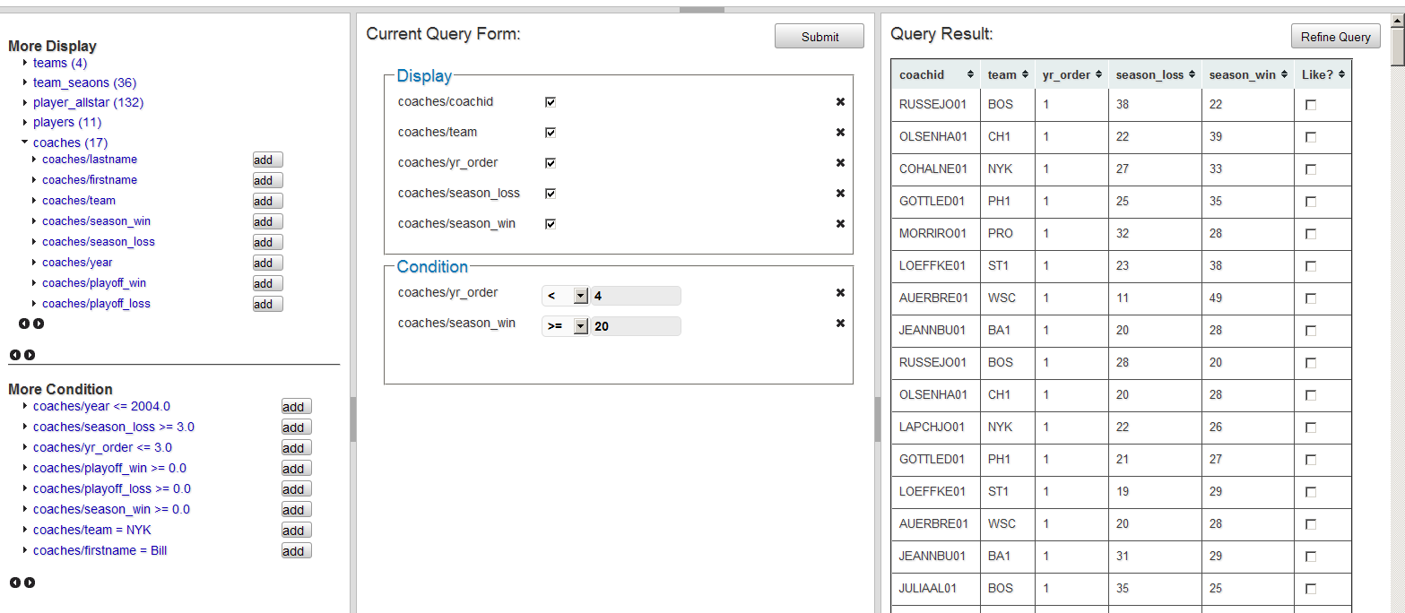
Screenshot

Slide 5
Screenshot
Suggested Projection Components
Query Refine
Current Query Form
Suggested Selection Components
Query Result

Slide 6
Try the Demo
http://persistent.ad.cs.fiu.edu:8080/dqf/index.jsp

Slide 7
Problems of migrating to Mobile
1. Problem: the layout is too wide for mobile screen.
Solution: Split the “Query Result” into another single web page.
2. Problem: the query result is a set of reports, not a table.
Solution: Add a column to display the titles of queried reports.
3. Problem: incorporate the community of users.

Slide 8
Next Steps
1. Discuss with Prof. Tao about the model of the dynamic query form.
2. Improve the efficiency of the computing the form component suggestion.

