Slide 1
Title: Extracting System Events from Raw Textual Log Messages
Course Project Report for Class ‘Advanced Data Mining’
Presenter: Liang Tang

Slide 2
Outline
Problem Statement
Our Approach
Practical Problems

Slide 3
Problem Statement
Convert the raw textual log messages to structural system events.
- 1131524071 2005.11.09 Nov 10 00:14:31 local@tbird-admin1 postfix/postdrop[10896]: warning: unable to look up public/pickup: No such file or directory
timestamp | username | module | msgtype | msg | event
2005.11.09 Nov 10 00:14:31 | local@tbird-admin1 | postfix/postdrop | warning | unable to look up public/pickup: No such file or directory | warning

Slide 4
Why this problem is important?
Log analysis helps to detect and prevent abnormal events for software and systems.
Raw textual log message is difficult to analyze.
Writing a log parser needs a lot of efforts and time.

Slide 5
Our approach(1)
Use data mining techniques to train a log parser.
IT experts manually label some log messages, then we customize a log parser for them.

Slide 6
Our approach(2)
Why not just use CRF?
Markov chain property does NOT hold? It has no grammar (adjective follows by noun)
timestamp | username | module | msgtype | msg | event
2005.11.09 Nov 10 00:14:31 | local@tbird-admin1 | postfix/postdrop | warning | unable to look up public/pickup: No such file or directory | warning

Slide 7
Our approach(3)
Why not just use CRF?
Markov chain property does NOT hold? It has no grammar (adjective follows by noun)
x1
x2
x3
?
?
y1
y2
y3

Slide 8

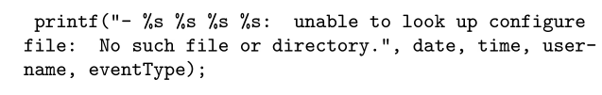
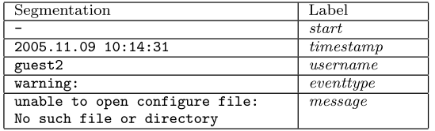
Template of Log Message
Message:
C source code:
Segmentation:

Slide 9
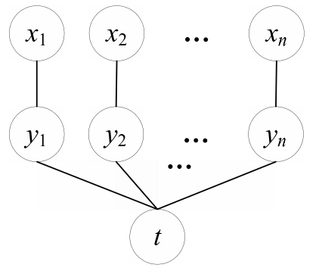
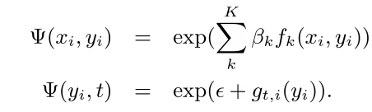
Graphical Model (1)
Segmentation
Labels
Template
Feature functions
Label distribution

Slide 10
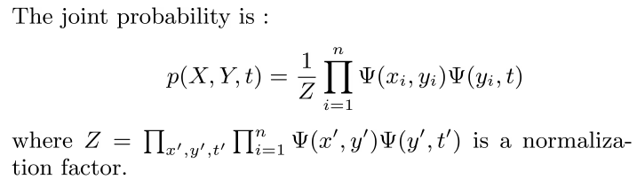
Graphical Model (2)
X=x₁x₂…x_{n} is a sequence of segmentations
Y=y₁y₂…y_{n} is a sequence of labels.
t is the template.

Slide 11
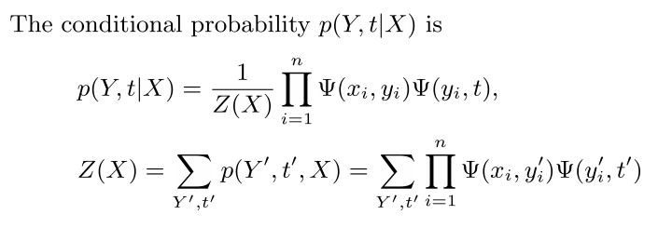
Graphical Model (3)
X=x₁x₂…x_{n} is a sequence of segmentations
Y=y₁y₂…y_{n} is a sequence of labels.
t is the template.

Slide 12
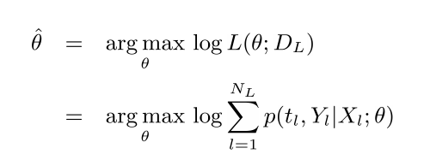


Model Training (1)
Step 1. Estimate parameters: β _{k}
Labeled Data
Like many log-linear models, we could use stochastic gradient decent, the first-order derivative is :

Slide 13
Model Training (2)
Step 2. Estimate label distribution for t : g_{t,i}(y)
It can be observed directly from the training data set.

Slide 14
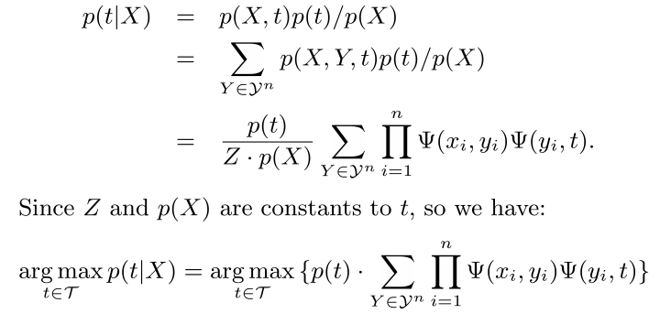
Template Estimation
X=x₁x₂…x_{n} is a sequence of segmentations
Y=y₁y₂…y_{n} is a sequence of labels.
t is the template.
The set of all label sequences with length n

Slide 15
Log Message Segmentation
First problem is: How to cut a log message?
Given a template t, the cut which leads to the maximum p(t|X) is the best cut.
However, there are m choose n ways to cut a sequence with length m to n segmentations.
Dynamic Programming can find the best cut by compute O(mn) times p(t|X). (Similarly to Matrix Multiplication Problem in “Intro. to Algorithm”).

Slide 16
Practical Problems I Want to Solve(1)
Argument:
Labeling a large amount of log messages is even harder than writing a simple log parser in Python !!!
Solution:
Semi-supervised Learning.

Slide 17
Semi-supervised Learning(1)
Problem: Don’t have much labeled data.
Consequence: Precision Low.
Compute p(t|X) to guess t.
if p(t|X) is high, then
Use p(Y|X,t) to guess Y.
If p(Y|X,t) is high, then
Use t and Y to update model.

Slide 18
Practical Problems I Want to Solve(2)
Argument:
Many log messages are strange and hard to label. Only the developers understand those meanings.
Solution:
Unsupervised Learning.
- 1131564691 2005.11.09 eadmin1 Nov 9 11:31:31 src@eadmin1 sendmail[27504]: jA9IVUvS027504: from=root, size=627554, class=0, nrcpts=1, msgid=<200511091831.jA9IVUvS027504@eadmin1>, relay=#7#@localhost
?

Slide 19
Semi-supervised Learning(2)
Problem: Don’t have enough segment labels.
Consequence: Cannot differentiate some templates.
For example, T1, T2, and T3 templates are both expressed by:
[TIME] [HOST] [USER] [PROC] [UNKNOWN]
How to differentiate T1,T2 and T3?

Slide 20
Semi-supervised Learning (2) (Cont.)
T1, T2, and T3 templates are both expressed by:
[TIME] [HOST] [USER] [PROC] [UNKNOWN]
-Solution:
Create new segment labels : UK_T1, UK_T2, UK_T3.
Create word distribution vectorsV_T1, V_T2, V_T3 for segments at T1,T2,T3.
Create new feature functions: f_T1, f_T2, f_T3 as follows:
If y_i ==UK_T1 then
return Cosine similarity between X_i and V_T1
Else
return 0

Slide 21
End

