Slide 1
LogSig: Generating System Events from Raw Textual Logs
Liang Tang¹, Tao Li¹, Chang-Shing Perng²
1 Florida International University
2 IBM T.J. Watson Research Center

Slide 2
Raw Textual System Logs
Most system logs are textual logs
  Describing the system internal operations, software configuration modifications, execution errors.
Features of Textual System Logs
  Textual and not fully structured.
  Short message, but large vocabulary (including parameter terms/words)
Hadoop logs generated by Log4J:
2011-01-26 13:02:28,335 INFO org.apache.hadoop.ipc. Server: IPC Server Responder: starting;
2011-01-27 09:24:17,057 INFO org.apache.hadoop.ipc. Server: IPC Server listener on 9000: starting;
2011-01-27 23:46:21,883 INFO org.apache.hadoop.ipc. Server: IPC Server handler 1 on 9000: starting;
Notes:
Most system logs are textual logs. They describes many system internal operations. These system logs are not natural language, but not fully structured. They are short, but have large vocabulary. Because the types of parameter terms can be almost infinite.

Slide 3
Converting Raw Textual Logs to Events
Goal
  Separate logs by different event types.
  Extract message signature for each event type.
Message signature
Permission denied
[Thu Apr 01 00:07:31 2010] [error] [client 131.94.104.150] File does not exist: /opt/website/sites/users.cs.fiu.edu/data/favicon.ico
[Thu Apr 01 03:47:47 2010] [crit] [client 61.135.249.68] (13)Permission denied: /home/public_html/ke/.htaccess pcfg_openfile: unable to check htaccess file, ensure it is readable
[Thu Apr 01 01:41:18 2010] [error] [client 66.249.65.17] Premature end of script headers: preferences.pl
[Thu Apr 01 01:44:43 2010] [error] [client 207.46.13.87] File does not exist: /home/bear-011/users/giri/public_html/teach/6936/F03
File does not exist
Bad script
Notes:
The goal of our work is to identify the event type for each log message, and partition log messages by event types. We also want to extract the message signature of each event type to describe each type of events. As for the message signature, I will discuss it later.

Slide 4
Why Need to Convert Raw Textual Logs to Events
A data preprocessing
  Lots of event mining, temporal mining algorithms can NOT handle textual messages.
Building a universal log parser is difficult
  Different systems have different log formats.
  Many existing systems have NO manual for their log formats.
  Analyzing source code is an approach to know log format, but many systems are not open-source or source code is too complex.
Notes:
Here is the motivation for our work. Why do we want to convert those textual log messages to events? The first reason is that, many existing temporal mining, event mining algorithms can only handle event data, NOT textual logs. Our work is a preprocessing for event mining. The second reason is that, we want a method to handle various type of system logs. Although many log parsers can perfectly generate events from log messages, those log parsers are only for one special system. In addition, there are practical issues for writing a log parser as follows.

Slide 5
Message Signature
Message signature
  Each log message is composed of a message signature and parameter terms.
  Message signature is hard coded in source code, it can be seen as a “Signature” for one type of log messages.
  It excludes the parameters. Parameters are not helpful to identify the event type.
  A good representation for an event type.
Message signature
Parameters
[Thu Apr 01 03:47:47 2010] [crit] [client 61.135.249.68] (13)Permission denied: /home/public_html/ke/.htaccess pcfg_openfile: unable to check htaccess file, ensure it is readable
Notes:
Our method convert log message to events based on the message signatures. The message signature is the hard coded part of a log messages. The other part is the parameter terms. Here is an example of Apache Error logs. The blue part is the message signature, the red part is parameter term. Parameter term is not helpful to identify the event type, because for the same event type, the log messages have different parameters.

Slide 6
Match Score for Message Signature
Definition:
  Given a message X and a message signature S, the match score is the number of matched terms minus the number of unmatched terms.
  match(X,S) = |LCS(X,S)| - (|S| - |LCS(X,S)|) =2|LCS(X,S)|- |S|, LCS=Longest Common Subsequence.
Example:
  X=“abcdef”, S=“axcey”, match(X,S)=|ace| - |xy| = 1
X | a | b | c | d | e | f
S | a | x | c |  | e | y
Notes:
How can we know a message signature is good or bad, for a log message? We define the match score as a measurement. The match score is the number of matched terms minus the number of unmatched terms. Formally, we can use the longest common subsequence to define it. Here is an example, X is a log message, S is a message signature. We can see that, a, c and e are matched. x and y are not matched. So the match score is |ace|-|xy|=1. The match score is maximized when all terms of the message signature are matched in the given log message.

Slide 7
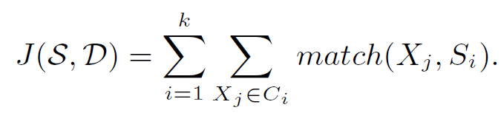
Problem Statement
Given a set of log messages D and an integer k, find k message signature S = {S₁,…,S_{k}} and a k-partition C₁,…,C_{k} of D to maximize:
Notes:
Based on the message signature, we propose the problem statement of our paper. It is to maximized the sum of the all match scores. It is similar to K-means, which maximizes the sum of all similarities. Not it has some difference.

Slide 8
About Problem Statement
Similar to k-means problem, but NOT really.
  For example, X1=“abcdef”, X2=“abghij”, X3=“xygphef”. LCS(X1,X2)=2, LCS(X2,X3)=2, LCS(X1,X3)=2. But there is NO common subsequence among X1,X2 and X3. Are they the same event type?
It is NP-Hard, even if k=1.
  Multiple Longest Common Subsequence Problem can be reduced to our problem.
Notes:
K-means look at the sum of all pair-wise similarities. But for our problem, we look at the all-wise similarities. Here is an example, X1=“abcdef”, X2=“abghij”, X3=“xygphef”. LCS(X1,X2)=2, LCS(X2,X3)=2, LCS(X1,X3)=2. But there is NO common subsequence or common term among X1,X2 and X3. Therefore, it is hard to believe that they are the same event type.
We can also prove that our problem is an NP-hard problem, event when k=1. It is reducible from another NP-Hard problem, the Multiple Longest Common Subsequence problem.

Slide 9
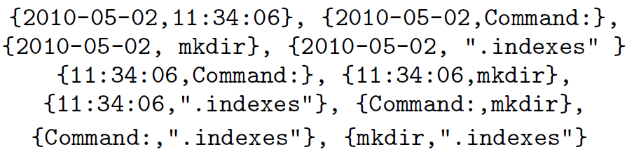
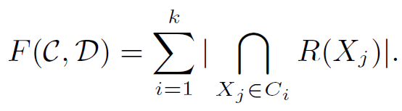
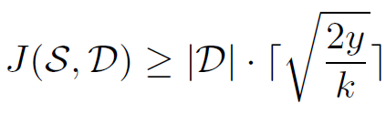
Approximated Problem
Convert each log message into Term Pairs:
Maximize
Lemma: If F(C,D) ≥ y, then
R(X_{j}): the set of term pairs of log message Xj.
Notes:
Since the problem is NP-Hard, we try some approximation to solve this problem. The approximation is only looking at the term pairs as shown, instead of the message signature. We define another objective function F. F is the total number of all common term pairs in each message group. We can also show that, if F(C,D) is greater than a constant, then the original objective function J must be greater than another constant about y.

Slide 10
Local Search Algorithm
Local search : iteratively changes each log message’s assignment to improve the objective function.
F(C,D) is not good to guide local search. Why?
  F(C,D) is NOT smooth.
  F(C,D) does not change for each single change.
  Therefore, F(C,D) is easy to lead the local search into a local optimum.
Notes:
To find the good k-partition, we apply the local search strategy. It is a classical optimization algorithm. But there the objective function F and J are not suitable to guide the local search. J is not suitable, because J needs to know the message signature in advance, but we do not know it. F is not smooth. F is very easy to make the local search fall into a local optimum. Because F only look at the number of common term pairs. However, making a uncommon term pair into a common pair needs several operations of the local search. Before that uncommon term pair becomes common, the value of F wouldn’t change.

Slide 11
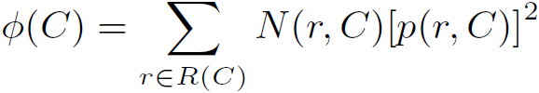
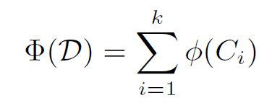
Potential Function
Potential for one message group
  Given a message group C, the potential of C is defined as
  N(r,C) is the number messages in C that contain pair r. p(r,C)= N(r,C)/|C| is the portion of messages in C having r.
Overall Potential
  Sum of all message groups’ potentials.
Notes:
To solve this problem, we propose the potential function as shown. It can be seen the potential value of F, so it is called potential function. The potential function is smooth. Every change of the partition will affect the overall potential value. Using this potential function, the local search algorithm is not likely to fall into local optimum as before.

Slide 12
Message Signature Construction
Once the partition is known, the optimal message signature can be extract from frequent terms in each partition.
Lemma : These terms of the optimal message signature at least appear one half of the messages in the message group.
Notes:
After we get the k-partition of log messages, we start to construct the message signature. We can prove that, the optimal message signature can only be constructed by frequent terms. Those frequent terms at least occur one half of all log messages in the partition. So in fact, the number of frequent terms is very small. We can enumerate the combinations of those frequent terms to find the best message signature.

Slide 13
Incorporating Domain Knowledge
Use category of terms/phrases to replace
Sensitive Terms/Phrases.
  Define a set of sensitive terms/phrases, such as “Error”, “Transfer”, “Failed”…
  Sensitive terms/phrases have higher probabilities to be included in Message Signature.
Notes:
This slide is to show how to incorporate some domain knowledge into our work. The first method is to use the category of terms or phrases to replace the original message terms. For example, 2010-05-02 and 11:34:05 ca be replaced by a timestamp term. “.indexes” can be replaced by a FilePath term. The second method is for some sensitive terms or phrases. For example, for some networking logs, you care more about those words “Error”, “Transfer”, “Failed”. You can define a set of sensitive terms. We put higher weights for those term pairs. Then, those sensitive terms have higher probabilities to be included in the Message Signature.

Slide 14
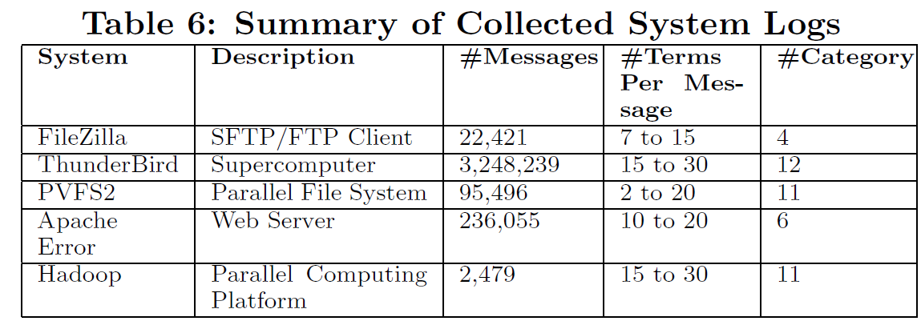
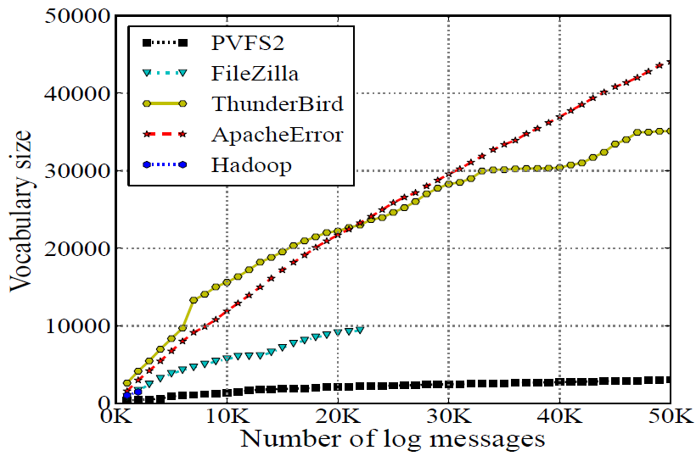
Experimental Log data
Vocabulary sizes of Apache and ThunderBird are almost infinte, because lots of parameter terms.
Notes:
Here is the data collection for the experiments. We did experiments on five different system logs. The figure shows the vocabulary size for each logs. This figure is to confirm the our claims that the log messages usually have very large vocabulary. It is a reason that why tradition text mining methods would fail on this type of data. We will discuss this later.

Slide 15
Compared Algorithm
IPLoM
  Clustering log messages by some format features, such as the number of tokens.
StringMatch
  Clustering log message by the number of common token at each token position.
VectorModel (In information retrieval)
Jaccard Index
StringKernel
  Convert each log message into a vector of term pairs.
Notes:
There are five algorithms we compared. The first two algorithms are developed for clustering logs. The last three algorithms are widely used in text mining domain.

Slide 16
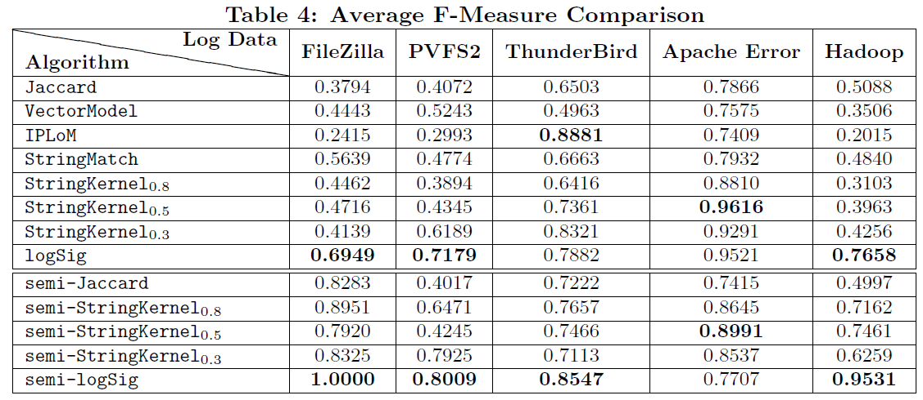
Accuracy Results
No algorithm can always be the best. LogSig is generally the best one.
IPLoM is good for special type of system log.
Notes:
The table shows the accuracy results. The accuracy is computed by F-Measure (F=2). For string kernel, we choose three lambda 0.8, 0.5, 0.3 as its parameter. Semi-Jaccard, Semi-StringKernel, Semi-logSig means we some incorporate domain knowledge for the three methods. The input domain knowledge for the 3 methods are the same. We can see that, IPLoM is only good for ThunderBird, because ThunderBird has a stricter log format for all log messages. VectorModel and Jaccard Index always performs bad because of the curse of dimensionality. Since the vocabulary size is large, the dimensionality is very high.

Slide 17

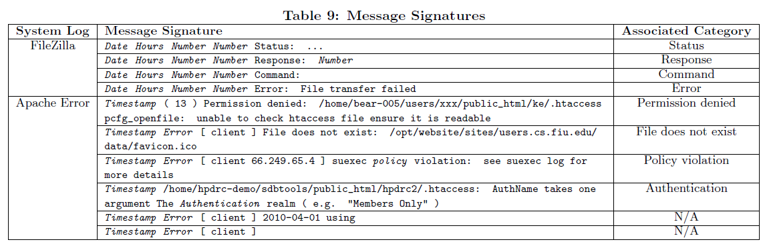
Message Signature Results
Notes:
Here shows examples of constructed message signatures. For FileZilla logs, Date hours and Number are the categories of terms. For FileZilla, all created message signature can associate with a real category of events. But for Apache Error, our algorithm only correctly create 4 of 6 real event categories.

Slide 18
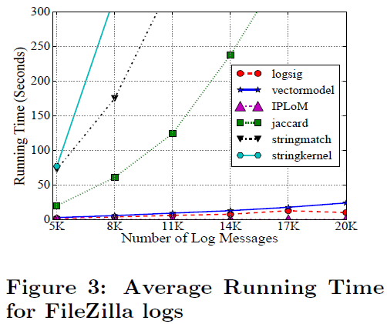
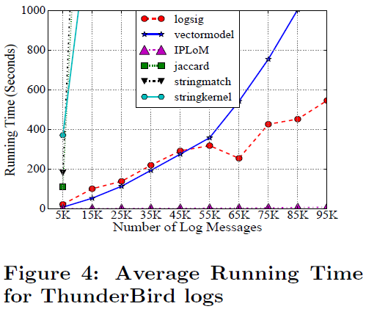
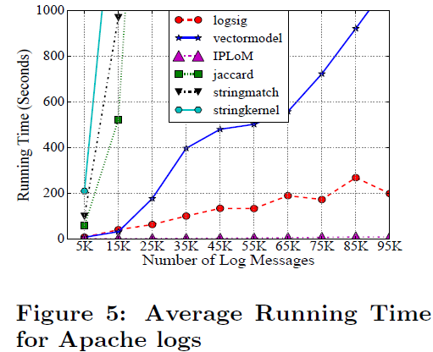
Efficiency Results
IPLoM is the most efficient algorithm, but its accuracy is not good.
StringKernel, StringMatch and Jaccard are slow to converge, because of the curse of dimensionality (Large vocabulary size).
Notes:
We also compared the efficiency of all algorithms. IPLoM is always the most efficient algorithm, because it directly partition log messages by some format features. Our algorithm LogSig the second most efficient algorithm. And StringKernel, StringMatch and Jaccard are very slow. It is also because the curse of dimensionality, they are not easy to converge.

Slide 19
Conclusions
Converting Raw Textual Logs to Events
  A preprocessing for event mining
LogSig Algorithm
  Traditional text mining algorithms do not work well for log messages.
  Extract Message Signatures and exclude parameter terms.
  Be able to handle various types of system logs.
Notes:
Here is the conclusion for our work

Slide 20
Thanks!
Any questions?
Notes:
Thanks.

