Slide 1
Searching Similar Segments over Textual Event Sequences
Liang Tang*, Tao Li*, Shu-Ching Chen* and Shunzhi Zhu⁺
*Florida International University
⁺Xiamen University of Technology

Slide 2
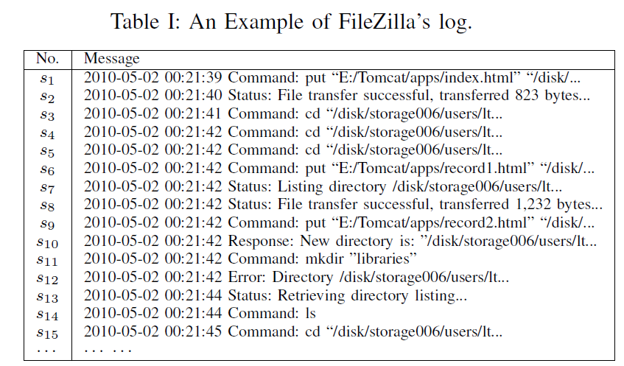
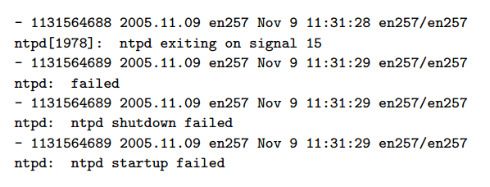
What is a Textual Event Sequence?
An event sequence, where each event is textual.
For instances, log sequence.
A textual log message

Slide 3
Why Searching Similar Segments?
In system diagnosis, analyzing logs is a common approach. But the log files are usually huge.
Compare similar segments to identify the abnormal (or “error”) operation.
2013-10-11 23:10:00 server process X starts with aa ….
2013-10-11 23:10:01 client process Y1 starts…
2013-10-11 23:10:20 client process Y1 started successfully…
2013-10-11 23:10:20 client process Y2 starts…
...
2013-10-23 05:59:00 server process X starts with bb ….
2013-10-11 05:59:01 client process Y1 starts…
2013-10-11 05:59:20 process Y1 is stopped by unknown exceptions…
2013-10-11 06:01:05 client process Y2 starts…
…
“error” operation

Slide 4
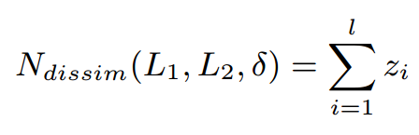
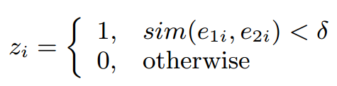
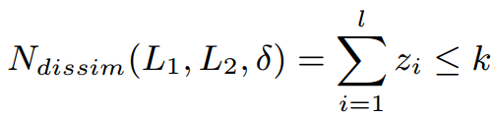
Problem Statement
Given a textual event sequence S and a query sequence Q, find all segments with length |Q| in S that are similar to Q.
Definition of Dissimilarity:
Definition of Similar segments:
, l = |Q|
, e_{1i}, e_{2i} are their i-th events.
In other words, similar segments have at most k dissimilar events, also called k-dissimilar.

Slide 5
Related Solutions
Text Similarity Search
Locality Sensitive Hash (A. Gionis et al., 1999)
Min-Hash(A. Z. Broder et al., 1998)
Substring Match
Suffix Tree
Suffix Arrays(U. Manber, 1993)
For unordered data sets
For code sequences or numeric sequences

Slide 6
Potential Solutions based on LSH
LSH-DOC: each segment is a small document, ignore the order information of events
LSH-SEP: each segment is a small document, but using different hash functions for different regions
Indexed segment length l. Q is given by users.
If |Q| >= |L|, split Q into multiple segments of length l.
If |Q| < |L|, does not work.

Slide 7
Suffix Matrix = LSH + Suffix Arrays
Suffix Tree/Arrays
hand variable-length queries for code sequences, such as DNA sequences, substring search.
Our idea
Combine LSH with suffix arrays (Suffix arrays are better than suffix tree because of smaller memory consumption).

Slide 8
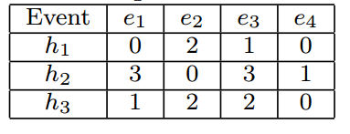
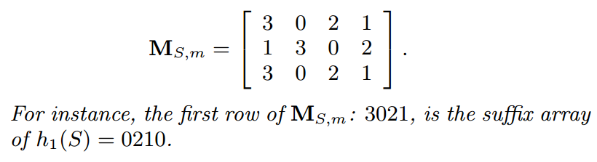
Example of Suffix Matrix
Offline Indexing:
Step 1. Construct m random hash functions
Step 2. For each hash function, compute the hash value of each event.
Step 3. For each hash value sequence, build the suffix array as a row of the suffix matrix.
Online Search:
Step 1. Use the m hash functions to hash query Q and get m hash value query sequences.
Step 2. Use every hashed query sequence to do binary search over suffix arrays and get candidate segment positions.
Step 3. If one segment appears in many candidate sets, pick it as the final candidate.
S = e₁e₂e₃e₄, is a textual event sequence.
h₁,h₂,and h₃ are 3 independent hash functions.
The i-th row of is the suffix array of the i-th hashed sequence.

Slide 9
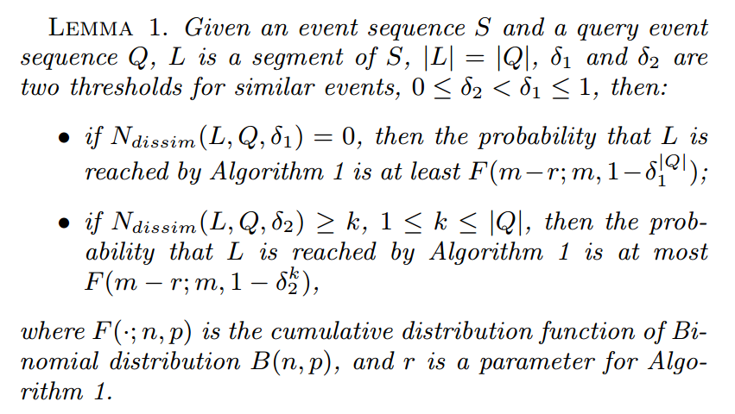
Reaching Probability & Collusion Probability
Cumulative probability of Binomial distribution
Lower bound for reaching probability
Upper bound for collusion probability

Slide 10
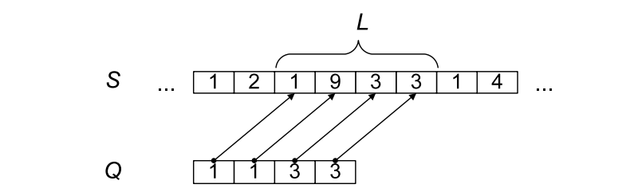
Problem of Dissimilar Events In Suffix Search
If the dissimilar event is at the middle of the segments, the binary search for suffixes will fail.
dissimilar event
9 is not equal to 1. L and Q are not in the same partition in suffix array. Binary search fails.
Why?
“1933” are in the interval [“1133”, “1134”]
How to solve it?
Ignore the second position of the segments.
However, we do not know which positions are placed dissimilar events.

Slide 11
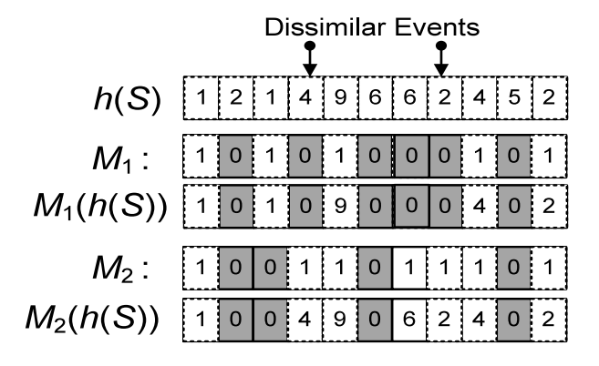
Random Mask
Idea: create hash-value sequences and randomly ignore some positions.
Done by Random Mask
Original Hash Value Sequence
Random Mask
Masked Hash Value Sequence
Using M₁(h(S)) will NOT hurt the binary searches for suffixes.

Slide 12
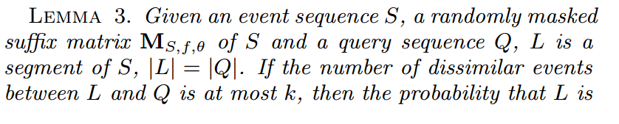
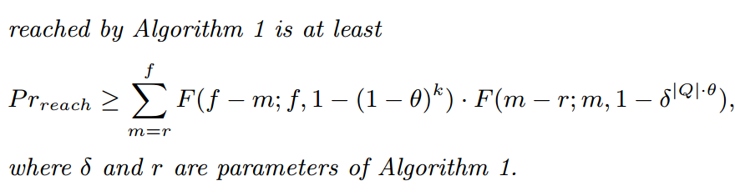
Reaching Probability for k-dissimilar segments
Lower bound for reaching probability
The upper bound for the collision probability can be obtained in the analogue way

Slide 13
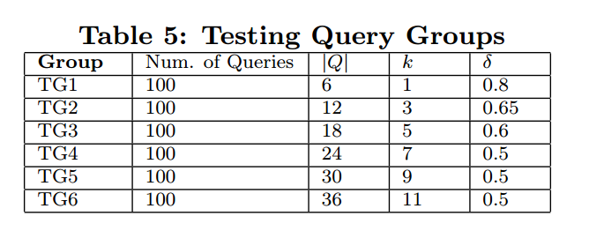
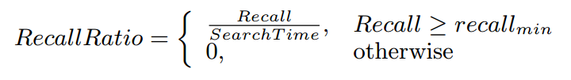
Experiments for online search
Compare with LSH-DOC and LSH-SEP
Indexed segment length = |Q|/(k+1)= 3
Datasets
Apache logs (236,055), ThunderBid Logs(350,000).
Measure
All methods can achieve 100% precision. They all have a validation step to validate all candidates by computing actual dissimilarity score
focuses on recall and time cost.
Ground truth is obtained by the brute-force algorithm.
0.5

Slide 14
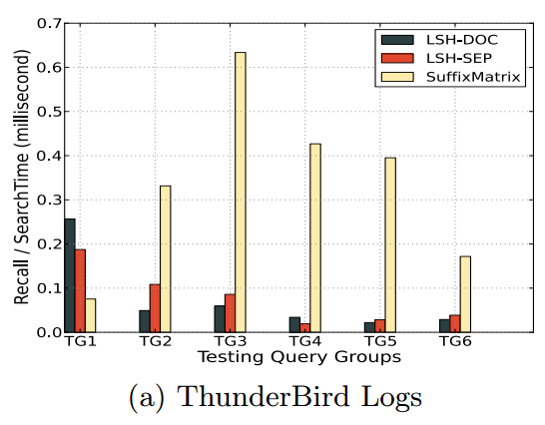
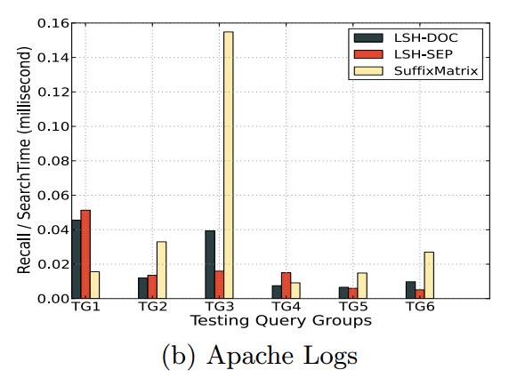
Recall/Search Time
The score is higher, the performance is better
When the query sequence is short, LSH-DOC, LSH-SEP can beat SuffixMatrix. But when query sequence is long, their performance is bad.

Slide 15
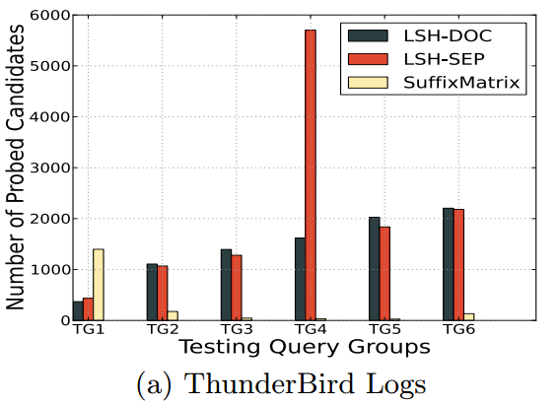
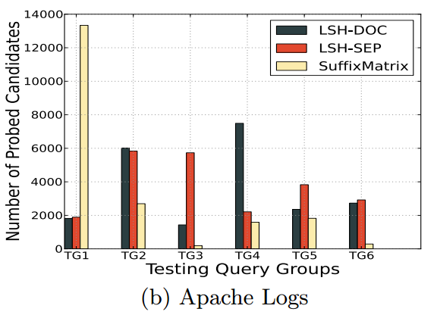
Number of Probed Segment Candidates
The number is smaller, the performance is better

Slide 16
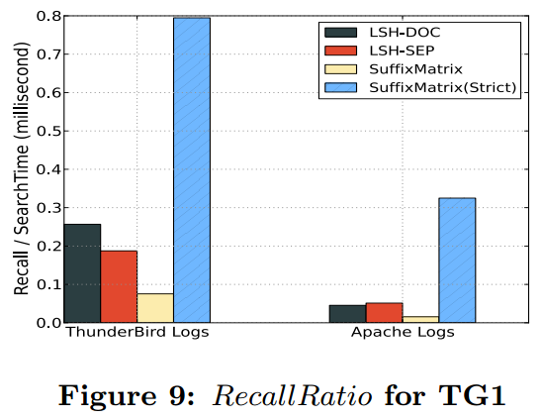
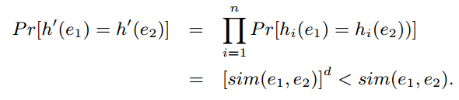
Using “stricter” hash function)
Use n independent hash function to construct a “stricter” hash function.
SuffixMatrix(Strict): use more hash functions and make the search condition “stricter” (from locality sensitive hashing)
The collusion probability becomes smaller.

Slide 17
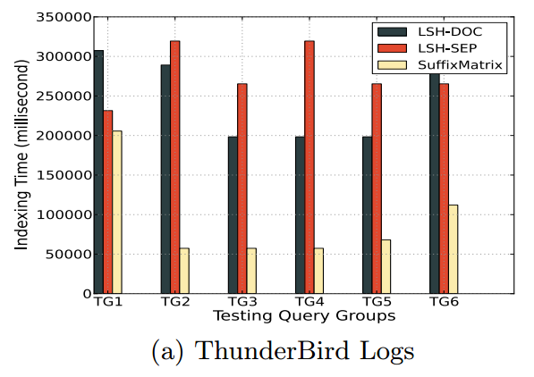
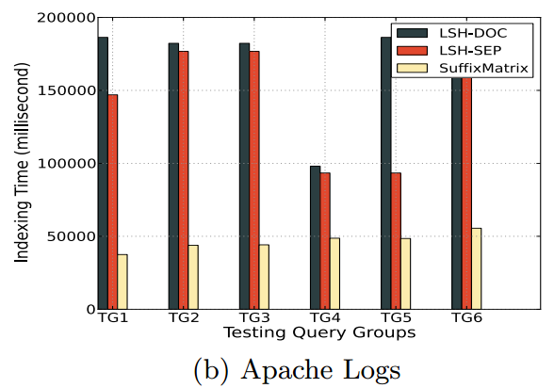
Time for building index
Indexed segments in LSH-DOC and LSH-SEP are overlapped. One event is indexed in multiple overlapped segments.

Slide 18
Summary
K-dissimilar segment search problem for textual event sequences
Suffix Matrix = LSH + Suffix Arrays
Random Mask for Suffix Matrix

Slide 19
End & Question
Thank you!

Slide 20
Suffix Array
A sequence S = 3200113$
Suffix Array
Suffix | Position
3200113 | 0
200113 | 1
00113 | 2
0113 | 3
113 | 4
13 | 5
3 | 6
$ | 7
Suffix | Position
$ | 7
00113 | 2
0113 | 3
113 | 4
13 | 5
200113 | 1
3 | 6
3200113 | 0
Substring match is done by a binary search on the suffix array.
sort
By using “string compare” method.
From the suffix array and the sequence S, we can retrieve all suffixes without additional space cost.

Slide 21
Locality Sensitive Hashing (LSH)
LSH family is a family of hash functions, such that those hash functions have relationships with the similarity score.
sim(p,q) > c, then h(p)=h(q) with probability at least P1.
sim(p,q) < c/k, then h(p)=h(q) with probability at most P2.
P1 > P2.
This kind of hash functions is an approximate representation of similarities.

Slide 22

Alignment Problem: Gap in Similar Events
Gap
Word methods (FASTA, BLAST)
Split the query sequence into a series of short, nonoverlapping subsequences(“words”) that are then matched to candidate database sequences.
Our problem is a sub-problem for handling gap=0.
Gap

