Slide 1
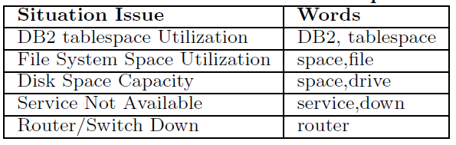
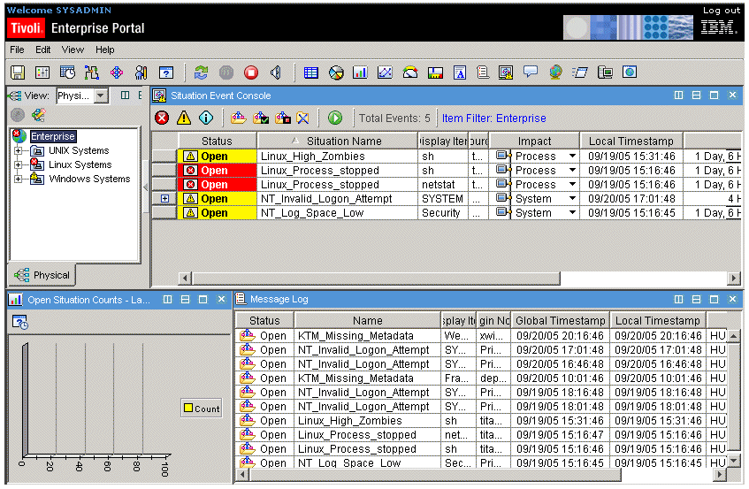
Identifying Missed Monitoring Alerts based on Unstructured Incident Tickets
Liang Tang, Tao Li
Larisa Shwartz
Genady Ya. Grabarnik
School of Computing and Information Sciences
Florida International University, Miami, FL, USA
IBM T.J. Watson Research Center
Yorktown, Heights, NY, USA
Dept. Math & Computer Science
St. John’s University, Queens, NY, USA
Introduction
Finding Missed Alerts in Unstructured Incident Tickets
Monitoring System: monitor those servers, notify the system administrator only when a problem happens.
Monitoring Alerts: alerts created by monitoring systems. A perfect monitoring system should capture all system alerts.
Data Source: Missed monitoring alerts will be captured by system admins in manual tickets, where are textual descriptions.
Solution: finding missed alerts in the tickets. Build a binary text classifier.
Challenges:
Highly imbalanced data (very few manual tickets are related system alerts)
Not enough labeled tickets (Too many manual tickets for labelling, labeling cost is huge)
Proposed Method
Use domain words to select a subset of tickets for labeling. Each ticket is scored by the number of contained domain words. High score ticket has a high probability to select. (A randomly selected ticket subset might only contain customer request tickets and it is bad for the classifier training)
Use SMOTE to do over-sampling on the false negative tickets.
Apply the SVM algorithm to train the classifier.
Why Some Monitoring Alerts are Missed?
The configuration of Monitoring Systems is complicated
Evaluation
Baseline: randomly select a subset of tickets for labelling and training.
Dataset: collected from a large customer account in IBM IT service center. This account consists of over 1,000 monitored servers and network devices.
Misconfiguration sometimes happens:
Example:
Installed a new web server, but forget to add it into the monitoring situation. If this web server has a problem, it would not be captured by the monitoring system.
What are the Unstructured Incident Tickets?
Ticket1 (disk space alert):
Please clear space from E drive xxxx-fa-ntfwwfdb Please clear space from E drive xxxx-fa-ntfwwfdb.it is having 2 MB free...
Ticket2 (service status alert):
RFS101681 E2 Frontier all RecAdmin services are down Frontier RecAdmin services are not running on the batch server Kindly
logon to the server : xxx.xxx.155.183/xxx ...
Ticket3 (database alert):
DB2 is not connectable from xxxxx Hi Team@Can you please look into why we are unable to connect to Porfolio XRef
DB.Server : xxxx12DB Instance : sec mastId : ipxrbtchWhile...

