Slide 1
LogTree: A Framework for Generating System Events from Raw Textual Logs
Liang Tang and Tao Li
School of Computing and Information Sciences
Florida International University
Miami, 33199, USA

Slide 2
Outline
Problem Statement
Motivation
Semi-structural Log Message Clustering
Message Segment Table
Evaluation

Slide 3
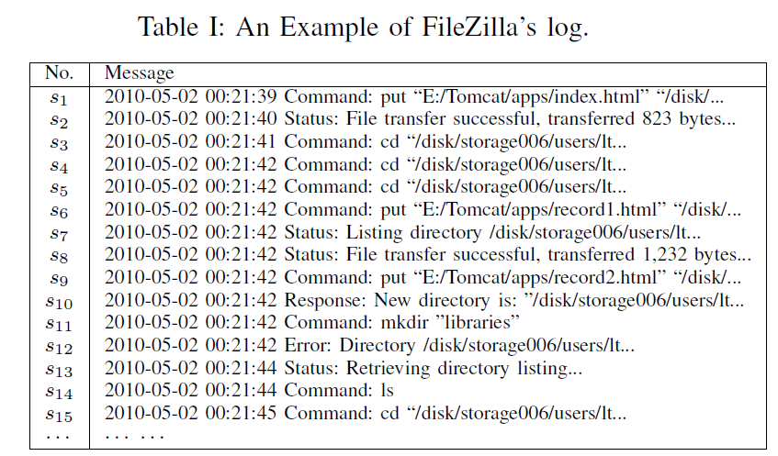
Problem Statement (1)
System log analysis is widely used for anomaly detection, fault prevention.
Many systems only generate textual log messages. Raw textual log messages are difficult to analyze.
Notes:
In this paper, we want to solve a data preprocess problem of the system logs.
As we know, system log analysis is useful for many critical applications, such as
anomaly detection and fault prevention. Many temporal pattern mining were
proposed for this problem.
However, many system only generate textual log message, which is unstructured text.
So those unstructured text is not easy to analyze.
Here is an example for a FTP client log messages, FileZilla.
We can know what happened in FileZilla from its log messages.

Slide 4
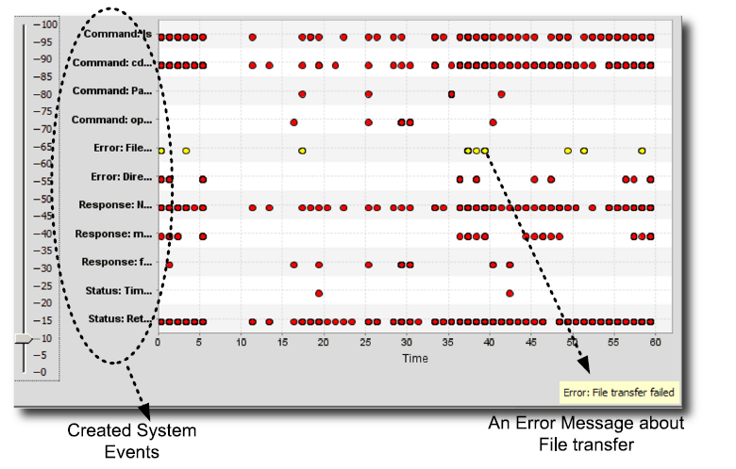
Problem Statement (2)
Most temporal pattern mining algorithms are based on system events. We try to generate events from system log messages.
Notes:
The problem we want to solve is convert the textual log messages into a sequence
of events.
Here is a screenshot of the toolkit we developed for this paper. It can automatically
convert the log messages into several system events.
Clearly, it is easier to discovery the patterns of the system.

Slide 5
Problem Statement (3)
Traditional solution : Writing a full log parser.
Weaknesses:
  Only famous systems, such as Apache Web Server, Microsoft IIS has well developed log parsers.
  Time consuming to read documents and understand each type of log messages to write a parser by our own.
  Many document is incomplete or only in the developer’s brain.
  System is constantly updated, its log is constantly updated as well.
Notes:
The problem we want to solve is convert the textual log messages into a sequence
of events.
Here is a screenshot of the toolkit we developed for this paper. It can automatically
convert the log messages into several system events.
Clearly, it is easier to discovery the patterns of the system.

Slide 6
Outline
Problem Statement
Motivation
Semi-structural Log Message Clustering
Message Segment Table
Evaluation

Slide 7
Motivation (1)
Similar log messages describe the same event.
We can use data clustering algorithm on log messages.
However, how to define the similarity between two log messages?
Notes:
Since similar log messages belong to the same event.
So we can use clustering algorithm to group those similar log messages into
one cluster. Each cluster can be seen as an event.
But, the problem is that, how can we define the similarity metric?

Slide 8
Motivation (2)
Similarity between two sequences of terms:
1. Cosine similarity on Tf-idf vector
2. Jaccard Index Similarity.
3. Word Sequence Matching.
Notes:
There are a lot of similarity metrics we can use:
For example, the TF-IDF which is widely used in information retrieval.
And jaccard index similarity is a also metric to look at how many identical terms
in two log messages.
Previous work in system event generation proposed a simple way. It just count
how man matched words in the two log messages.

Slide 9
Motivation (3)
Similarity between two sequences of terms:
1. Cosine similarity on Tf-idf vector
2. Jaccard Index Similarity.
3. Word Sequence Matching.
How if two log messages have two different sets of words(terms)?
Notes:
However, it is possible all those methods will fail. If none of terms are identical
of the two log messages. But the log messages are still of one event.

Slide 10

Motivation (4)
In PVFS2 log files, the two following log messages both belong to status event.
However, none of terms are identical !
Notes:
There is an example of this.
We collect log messages from PVFS2 system, which is a famous open-source
parallel file system. When its server starts, it will periodically check the I/O
operators.
The first log message describes how many read operations on each component.
The second log message describes how many metadata I/O operations on each
component.
Clearly, none of terms are identical. But they both belongs to the status event.

Slide 11
Motivation (4)
In PVFS2 log files, the two following log messages both belong to status event.
However, none of terms are identical !
But, they have similar format.
Format may be more useful than terms.

Slide 12
Outline
Problem Statement
Motivation
Semi-structural Log Message Clustering
Message Segment Table
Evaluation

Slide 13
Semi-structural Log Message Clustering (1)
Step 1: Convert into semi-structural log messages ( log tree).
Step 2: Compute similarities between pair-wise log trees.
Step 3: Apply data clustering on the similarity matrix.
Notes:
For our method, there are 3 steps….

Slide 14
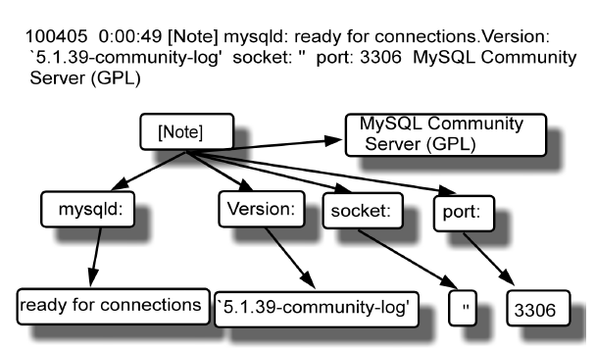
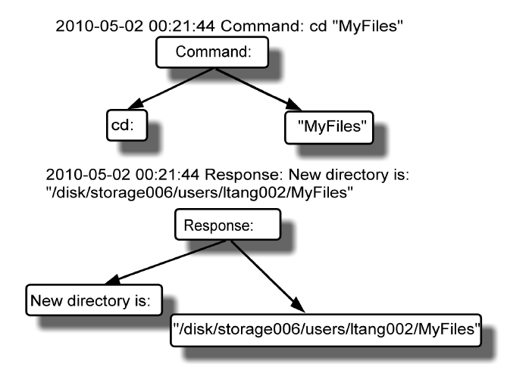
Semi-structural Log Message Clustering (2)
Step 1: Convert into semi-structural log messages ( log tree).
Notes:
The first step is to covert the textual log message into a tree structured data.

Slide 15
Semi-structural Log Message Clustering (2)
Step 1: Convert into semi-structural log messages ( log tree).
Accomplished by a simple log parser.
It is only a context-free grammar parser.
It separates log message by comma, TAB, etc.
It does NOT identify the meaning of terms (words).
It can be automatically created by JLex and JCup (or JAVACC) tools.

Slide 16
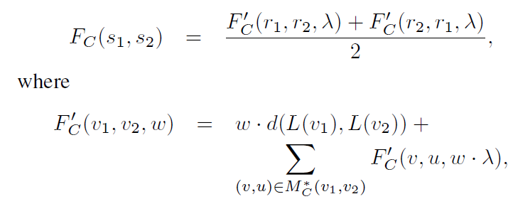
Semi-structural Log Message Clustering (3)
Step 2: Compute similarities between pair-wise log trees.
s₁, s₂ are two log messages.
Recursive Function for weight w

Slide 17
Semi-structural Log Message Clustering (3)
Step 2: Compute similarities between pair-wise log trees.
s₁, s₂ are two log messages.
Root node of s₁
Root node of s₂
Message Segment at node v₁
Message Segment at node v₂

Slide 18
Semi-structural Log Message Clustering (3)
Step 2: Compute similarities between pair-wise log trees.
s₁, s₂ are two log messages.
Root node of s₁
Root node of s₂
Message Segment at node v₁
Message Segment at node v₂
Best matching between subtree v₁’s nodes with subtree v₂’s nodes

Slide 19
Semi-structural Log Message Clustering (3)
Step 2: Compute similarities between pair-wise log trees.
s₁, s₂ are two log messages.
Root node of s₁
Root node of s₂
Message Segment at node v₁
Message Segment at node v₂
Decrease weight for lower layer
𝜆< 1
Best matching between subtree v₁’s nodes with subtree v₂’s nodes

Slide 20
Semi-structural Log Message Clustering (3)
Step 2: Compute similarities between pair-wise log trees.
s₁, s₂ are two log messages.
Root node of s₁
Root node of s₂
Message Segment at node v₁
Message Segment at node v₂
Distance of Message Segment
Decrease weight for lower layer
𝜆< 1
Best matching between subtree v₁’s nodes with subtree v₂’s nodes

Slide 21
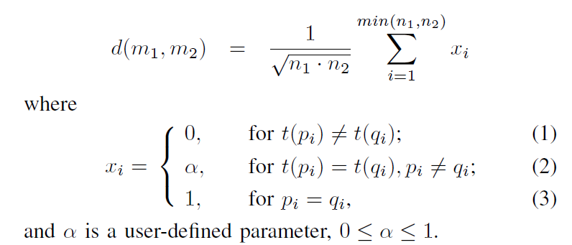
Semi-structural Log Message Clustering (3)
Two message segments: m₁=p₁…p_{n1} , m₂=q₁…q_{n2}
t(.) is the type of a term, types={number, separator, word, hostname…}
Distance of Message Segment m₁ and m₂
Type of a term

Slide 22
Semi-structural Log Message Clustering (4)
Why this similarity is better?
We use format information, take account the format similarity.
Similarity is computed based on best matched pair of message segments.
  For example, two message s₁ and s₂ both contain <hostname>, <username>.
  It is not fair to compute similarity of s₁’s <hostname> and s₂’s <username>.

Slide 23
Semi-structural Log Message Clustering (5)
Comparing to Tree Kernel:
Our similarity function is similar to tree kernel. However,
  Tree kernel doesn’t assign importance weights for different layers of nodes.
  Tree kernel compute every pair-wise nodes at each layer, very time-consuming. For our clustering, we don’t need similarity function to be a kernel function.

Slide 24
Outline
Problem Statement
Motivation
Semi-structural Log Message Clustering
Message Segment Table
Evaluation

Slide 25
Message Segment Table (1)
A lot of message segments are duplicated.
Duplicated computation for the similarity of two message segments have been seen before?
Therefore, we build a data structure in memory to maintain high frequent appeared message segments.

Slide 26
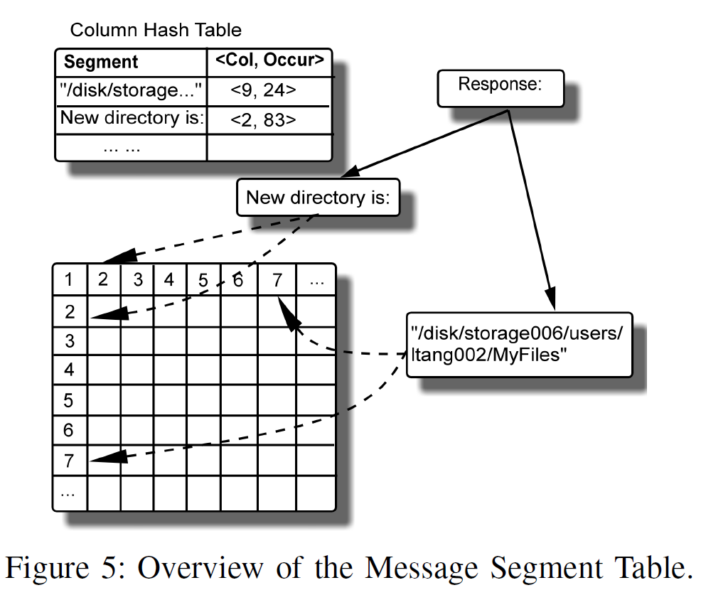
Message Segment Table (2)
Message Segment Table is composed by a hash table and a similarity matrix.
Column index
Occurrences
(For keeping track of the frequency)
Similarity Matrix

Slide 27
Message Segment Table (3)
See details in the paper
MST Building:
  Scan one pass, pick up high frequent message segments.
  Put into Column Hash Table and similarity matrix.
  Compute entries of the matrix.
  Looking up MST:
  Search Column Hash Table to find the column index.
  Extract the value from the similarity matrix by column index.
  Updating MST:
  Search Column Hash Table to find the occurrence.
  Insert/Remove Column Hash Table according to frequencies.
  Then, modify similarity matrix…

Slide 28
Outline
Problem Statement
Motivation
Semi-structural Log Message Clustering
Message Segment Table
Evaluation

Slide 29
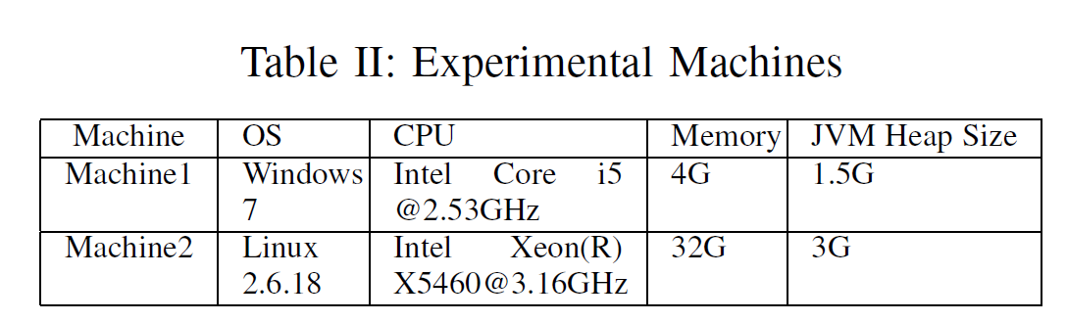
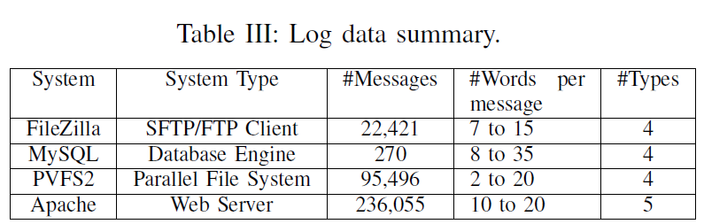
Evaluation (1)
Experiment Machines, Data Collection:

Slide 30
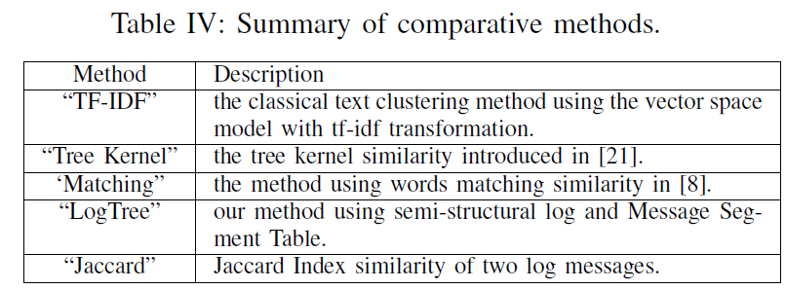
Evaluation (2)
Comparative Methods:
  Two traditional clustering algorithms: k-means and single-link hierarchical clustering.
  We implements all by Java 1.5
Comparing Metric:
  F1-Score

Slide 31
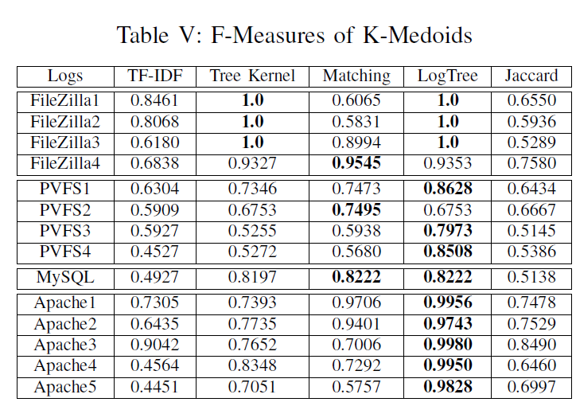
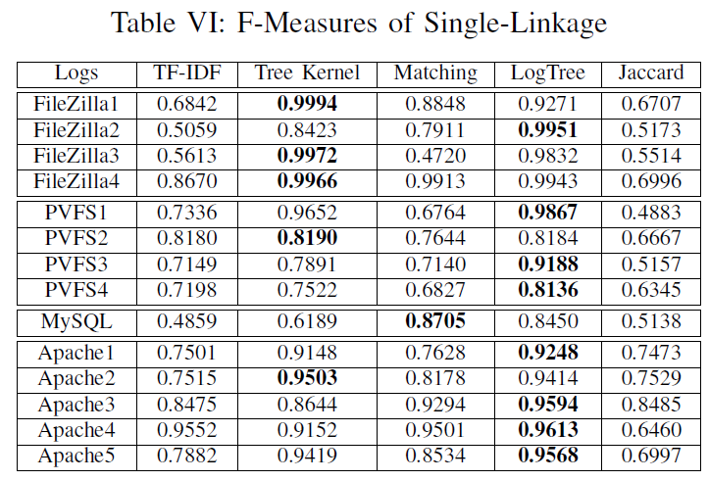
Evaluation (3)
Accuracy Result:
TF-IDF and Jaccard perform badly.
Sometimes, Tree kernel is better than LogTree. But, it is much slower.

Slide 32
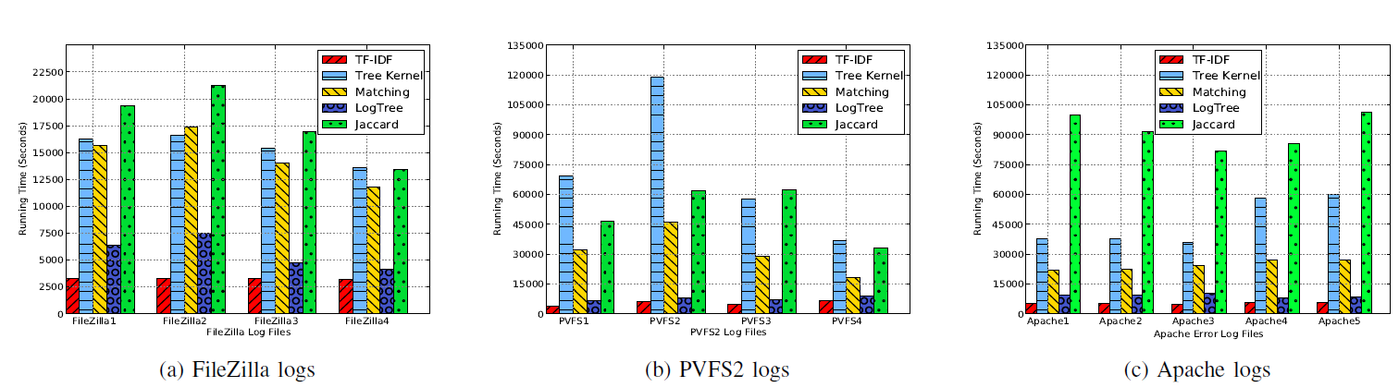
Evaluation (4)
Efficiency Result:
  Note the running time of LogTree includes the time for building Message Segment Table.
TF-IDF is fastest, but the accuracy is very bad.
Tree Kernel and Jaccard are slow.
LogTree is the second fastest one.

Slide 33
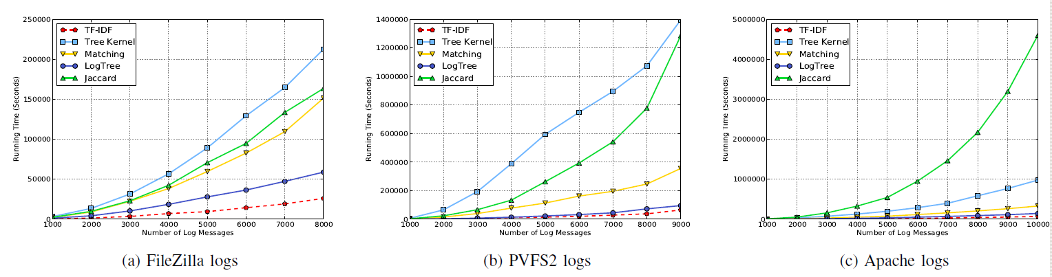
Evaluation (5)
Time Scalability:
  This experiment is done in the second machine ( 64-bits Linux server), and up to 10K log messages.

Slide 34
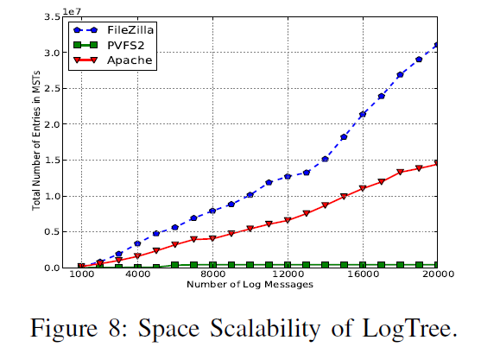
Evaluation (6)
Memory Space Scalability:
  f_{min}= 0.00001.
Number of Entries in Message Segment Table

Slide 35
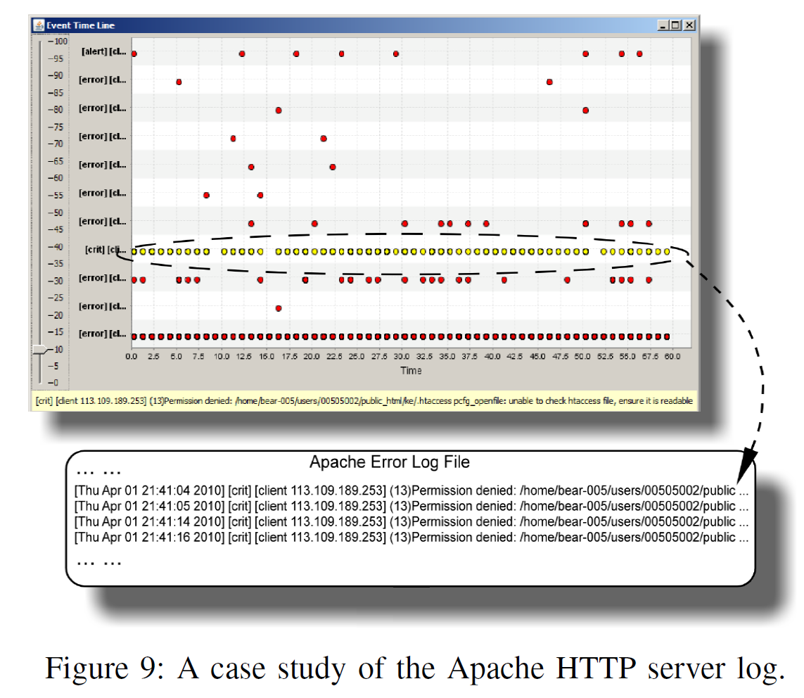
Evaluation (7)
A Case Study:
  for detecting configuration error in Apache Web Server.
An configuration error
will case a series of
continuous errors.

Slide 36
The End
Thank you!
Authors’ contact information:
Liang Tang: ltang002@cs.fiu.edu
Tao Li: taoli@cs.fiu.edu

