Slide 1
Recommending Resolutions for Problems Identified by Monitoring
Presenter: Laura Shwartz
T.J. Watson Research Center, IBM
Liang Tang, Tao Li
School of Computer Science Florida International University Miami, FL, USA
Genady Grabarnik
Dept. Math & Computer Science St. John’s University Queens, NY, USA

Slide 2
Summary
The goal of every service provider is to run a service in a fully automated operation environment
Employment of monitoring solutions is a first step towards this goal, automating problem resolution is the next one
We analyze historical event tickets from three production accounts and observe that their resolutions are recommendable for current event tickets on the basis of event information.
We propose two resolution recommendation algorithms for event tickets capable of eliminating misleading resolutions. An additional penalty is incorporated in the algorithms to minimize misleading resolutions.
We conducted extensive experiments for our proposed algorithms on real ticket data. Their results show that our algorithms achieve the same accuracy as the traditional k- nearest neighbor (KNN) based algorithms with less misleading information in the results.
Notes:
In this paper we apply recommendation approach to the resolution of incident tickets for maintaining service infrastructures. In addition, we extend the recommendation methodology to take into account possible falsity of the tickets. We focus on the event tickets, which are incident tickets generated by monitoring systems. We believe our work can help service providers to efficiently find appropriate problem resolutions and correlate related tickets resolved in the past. Most service providers keep track of a large amount of historical tickets with resolutions. The resolution is usually stored as a plain text which describes how this ticketed incident has been resolved. We analyzed historical event tickets collected from three different accounts managed by IBM Global Services. We consider an account as an aggregate of services using a common infrastructure. One observation is that many event tickets share the same resolutions. If two events are similar, then their triggered tickets probably have the same resolution. Therefore, we can recommend a resolution for an incoming ticket based on the event information and historical tickets.

Slide 3







Background
Events from the entire service infrastructure are accumulated in an enterprise console which uses rule-, case- or knowledge-based engines to analyze the monitoring events and decide whether to open an incident ticket in the ticketing system.
Additional tickets are created upon customer requests.
Each event is stored as a database record which consists of several related attributes with values describing the system status at the time when this event was generated. Typically, different types of events have different sets of related attributes.
The problem resolution of every ticket is stored as a textual description of the steps taken by system administrator to resolve this problem. A false ticket contains comments stating falsity and possibly the reason for it and how to identify it.
Customer Server
Applications
Enterprise Console
Alerts
Events
Monitor
Corrective Actions
Tickets
Tickets
Resolutions
System Administrator
IPC System
Notes:
For example, a CPU related event usually contains the CPU utilization and paging utilization information. A capacity-related event usually contains the disk name, and the size of disk used/free space.

Slide 4

Repeated Resolutions of Event Tickets
We analyzed ticket data from three different accounts man- aged by IBM Global Services.
One observation is that many ticket resolutions repeatedly appear in the ticket database. Unusual resolutions are very rare.
For example, for a low disk capacity ticket, usual resolutions are
deletion of temporal files,
backup data, or
addition of a new disk.
The collected ticket sets from the three accounts are denoted by “account1”, “account2” and “account3” respectively.
Notes:
Table above summarizes the three data sets. Figure on the left shows the numbers of tickets and distinct resolutions

Slide 5
Top repeated resolutions
The number of distinct resolutions is much smaller than the number of tickets - multiple tickets share the same resolutions.
Example: the first resolution, “No actions were...”, appears more than 14000 times in “account1”.

Slide 6


Basic KNN-based Recommendation
Given an incoming event ticket, the objective of the resolution recommendation is to find k-resolutions as close as possible to the the true one for some user-specified parameter k.
The recommendation problem is often related to that of predicting the top k possible resolutions.
A straightforward approach is to apply the KNN algorithm which searches the K nearest neighbors of the given ticket (K is a predefined parameter), and recommends the top k ≤ K representative resolutions among them.
In this paper, the representativeness is measured by the number of occurrences in the K neighbors.
The nearest neighbors are indicated by similarities of the associated events of the tickets.
There are three types of event attributes: categorical, numeric and textual. The similarity for events is computed as the summation of the similarities for all attributes.

Slide 7
Penalty for ‘Bad’ Recommendation
Traditional recommendation algorithms focus on the accuracy of the recommended results.
The resolutions of false tickets are short comments such as “this is a false alarm”, “everything is fine” and “no problem found”. If we recommend a false ticket’s resolution for a real ticket, it would cause the system administrator to overlook the real system problem. and besides, none of the information in this resolution is helpful.
Overlooking a real system problem may have serious consequences such as system crashes. Therefore, we consider incorporation of penalties in the recommendation results.
There are two cases meriting a penalty:
recommendation of a false ticket’s resolution for a real ticket (false negative prediction), and larger penalty
recommendation of a real ticket’s resolution for a false ticket (false positive prediction)
The objective of the recommendation algorithm is now maximized accuracy under minimized penalty.

Slide 8
Division Method
A straightforward solution consists in dividing all historical tickets into two sets comprising the real and` false tickets respectively. Then, it builds a KNN-based recommender for each set respectively.
Another ticket type predictor is created, establishing whether an incoming ticket is real or false, with the appropriate recommender used accordingly.
The division method works as follows:
it first uses a type predictor to predict whether the incoming ticket is real or false.
If it is real, then it recommends the tickets from the real historic tickets; if it is false, it recommends the tickets from the false historic tickets.
The historic tickets are already processed by the system admin, so their types are known and we do not have to predict them.
The division method is simple, but relies heavily on the precision of the ticket type predictor which cannot be perfect.
If the ticket type prediction is correct, there will be no penalty for any recommendation result. If the ticket type prediction is wrong, every recommended resolution will incur a penalty. For example, if the incoming ticket is real, but the predictor says it is a false ticket, so this method only recommends false tickets. As a result, all the recommendations would incur penalties.
Notes:
However, in automated service management, false alarms are unavoidable in both the historical and incoming tickets

Slide 9

Probabilistic Fusion Method
The framework of the basic KNN-based recommendation is retained and
The penalty and probability distribution of the ticket type are incorporated in the similarity function.
Let λ be the penalty for recommending a false ticket’s resolution for a real ticket, and (1−λ) is penalty for recommending a real ticket’s resolution for a false one.
λ can be specified by the system administrator based on the actual cost of missing a real alert, 0 ≤ λ ≤ 1. Larger λ indicates a greater importance of real tickets. The penalty function is
where t is the incoming ticket and t_{i} is the historical one whose resolution is recommended for t. Conversely, an award function can be defined as f_{t}(t_{i}) = 1 − λ_{t}(t_{i}). Since 0 ≤ λ_{t}(t_{i}) ≤ 1, 0 ≤ f_{t}(t_{i}) ≤ 1.
Let c denote the ticket type. c(t_{i}) = 1 for a real ticket; c(t_{i}) = 0 for a false ticket.
Using a ticket type predictor, we can estimate the probability of distribution of the ticket type denoted as P [c(t)]. The idea of this method is to incorporate the expected award in the similarity function.

Slide 10



Prediction of Ticket Type
Given an incoming ticket t, the probabilistic fusion method needs to estimate the distribution of P[c(t)].
The dividing method also has to predict whether t is a real ticket or a false ticket.
There are many binary classification algorithms for estimating P[c(t)]. In our implementation, we utilize another KNN classifier.
The features are the ticket attributes and the classification label is the ticket type.
The KNN classifier first finds the K nearest tickets in D, denoted as D_{K} = {t_{j1} , ..., t_{jk} }. Then, P [c(t) = 1] is the proportion of real tickets in D_{K} and P [c(t) = 0] is the proportion of false tickets in D_{K}. Formally,

Slide 11
Implementation
Redundancy Removal in Recommendation
Finding Nearest Neighbors
Parameter Selection

Slide 12
Implementation: Redundancy Removal in Recommendation
KNN-based recommendation algorithms recommend the top k representative resolutions in the K nearest tickets.
However, since all of these are similar to the incoming ticket, the resolutions of the K tickets may also be similar to each other, so that there may be some redundancy in the recommended results.
To avoid this, another validation step is applied.
First, the K nearest tickets’ resolutions are sorted according to their representativeness in descending order.
Then, we go through all K resolutions, and check whether or not each of them is redundant to any previously selected resolution. If it is, we skip this resolution and jump to the next one; otherwise, we add it to the selection.
Since the resolutions are textual descriptions, the redundancy of two resolutions is measured by the Jaccard index for bag of words model, frequently used to compute the similarity of two texts.
In practice, if the descriptions of two resolutions r(t1) and r(t2) have more than one half common words (i.e. Jaccard(r(t1),r(t2)) > 0.5), the two resolutions are quite likely to be the same.

Slide 13
Implementation: Finding Nearest Neighbors
Finding the K nearest neighbors in a large collection of historical tickets is time-consuming
Standard indexing search methods exist, such as k-d Tree, R-Tree, VP-Tree, cover tree.
Another heuristic solution is the attribute clustering based method:
Different system events have different system attributes, and the clustering algorithm can easily separate all tickets into categories based on their attribute names.
If two events share very few common attributes, their similarity cannot be high. Therefore, in most cases, the nearest neighbors search only needs to access these tickets in the same category.
We consider Locality Sensitive Hashing to be more practical, because the search space of our event tickets is not metric and the dimensionality is high
Notes:
Locality-sensitive hashing (LSH) is a method of performing probabilistic dimension reduction of high-dimensional data

Slide 14
Implementation: Parameter Selection
The best choice of K for the KNN algorithm depends on the data.
A larger K may reduce of the effect of noise, but makes the boundaries between related resolutions and unrelated resolutions less distinct.
Many heuristic approach are proposed for finding the best K.
A widely used approach is the Cross-Validation, which enumerates all possible K and tests the average accuracy. Both too small K and too large K would degrade the accuracy.
We choose K corresponding to the peak accuracy. k ≤ K, is the number of recommended resolutions for each incoming ticket.
In our recommendation system, we do not fix k for every ticket. A default k is provided by the system administrator, who can also enlarge the value of k for each ticket if more recommendations are needed.

Slide 15
Evaluation: Implementation and Testing Environment and Experimental Data
Implementation and Testing Environment
We implemented four algorithms: KNN, weighted KNN, the division method and the probabilistic fusion method.
Our proposed two algorithms, “Divide” and “Fusion”, are based on the weighted KNN algorithm framework. We choose the KNN-based algorithm as the baseline because it is the most widely used Top-N item based recommendation algorithm.
Certainly, we can use SVM to predict the ticket type to be false or real. But our core idea is to combine the penalty for the misleading resolution into the recommendation algorithm.
All algorithms are implemented by Java 1.6. This testing machine is Windows XP with Intel Core 2 Duo CPU 2.4GHz and 3GB of RAM.
Experimental Data
Experimental event tickets are collected from three ac- counts managed by IBM Global Services denoted later “ac- count1”, “account2” and “account3”. The monitoring events are captured by IBM Tivoli Monitoring. The ticket sets are summarized in Table below.

Slide 16
Evaluation: Accuracy
For each ticket set, the first 90% tickets are used as the historic tickets and the remaining 10% tickets are used for testing. Hit rate is a widely used metric for evaluating the accuracy in item-based recommendation algorithms.
Accuracy = Hit-Rate = |Hit(C)|/|C|,
where C is the testing set, and Hit(C) is the set for which one of the recommended resolutions is hit by the true resolution. If the recommendation resolution is truly relevant to the ticket, we say that recommended resolution is hit by the true resolution.
Since real tickets are more important than false ones, we define another accuracy measure, the weighted accuracy, which assigns weights to real and false tickets. The weighted accuracy is computed as follows:
Weighted Accuracy = λ · |Hit(Creal)| + (1 − λ) · |Hit(Cfalse)|, λ · |Creal| + (1 − λ) · |Cfalse|
where Creal is the set of real testing tickets, Cfalse is the set of false testing tickets, Creal ∪ Cfalse = C, λ is the importance weight of the real tickets, 0 ≤ λ ≤ 1, it is also the penalty mentioned in Section III-C. In this evaluation, λ = 0.9 since the real tickets are much more important than the false tickets in reality. We also test other large λ values, such as 0.8 and 0.99. The accuracy comparison results have no significant change.
We vary K and k from 1 to 20 to obtain different parameter settings.

Slide 17
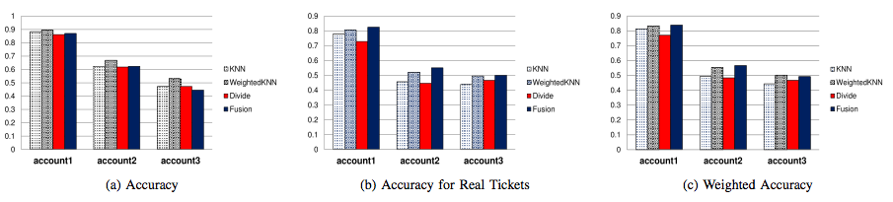
Test Results for K = 20, k = 5
Test Results for K = 10, k = 3
Notes:
Figures 4 and 5 are the testing results for K = 10,k = 3 and K = 20,k = 5. The comparison results for other parameter settings are similar to the two figures. It is seen that, the weighted KNN algorithm always achieves the highest accuracy in the three data sets. But for real tickets, our proposed probabilistic fusion method outperforms other algorithms (Figures 4b and 5b). As for the weighted accuracy in Figures 4c and 5c, the weighted KNN and the probabilistic fusion are still the two best algorithms, and neither of them outperforms the other in all data sets. Overall, the performances of all four algorithms are very close. For each comparison, the accuracy gap between the highest one and the lowest one is about 10%.

Slide 18
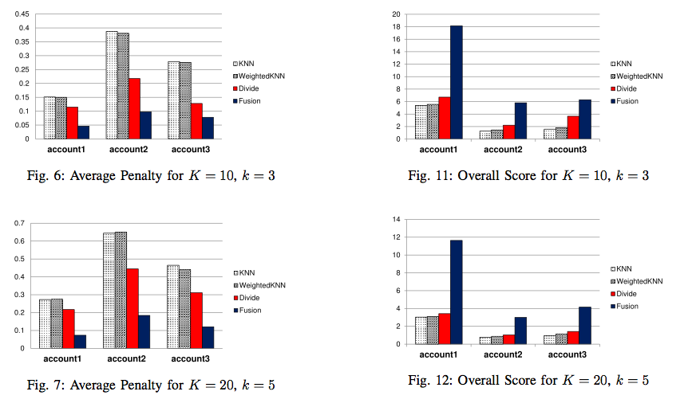
Evaluation: Penalty
Figures on the right show the average penalty for each testing ticket.
We assigned a higher importance to the real tickets, λ = 0.9.
Our proposed two algorithms have smaller penalties than the traditional KNN- based recommendation algorithms.
The probabilistic fusion method outperforms the division method, which relies heavily on the ticket type predictor.
Overall, our probabilistic fusion method only has about 1/3 of the penalties of the traditional KNN-based algorithms.

Slide 19
Evaluation: Overall Performance
An overall quantity metric is used for evaluating the recommendation algorithms, covering both the accuracy and the average penalty.
It is defined as overall score = weighted accuracy / average penalty. If the weighted accuracy is higher or the average penalty is lower, then the overall score becomes higher and the overall performance is better.
Figures on the left show the overall scores of all algorithms for two parameter settings.
It is seen that, our proposed algorithms are always better than the KNN-based algorithms in each data set.
Notes:
Y is scores calculated as == weighted accuracy/average penalty . Score is good when weighted accuracy is higher or a average penalty is lower.

Slide 20
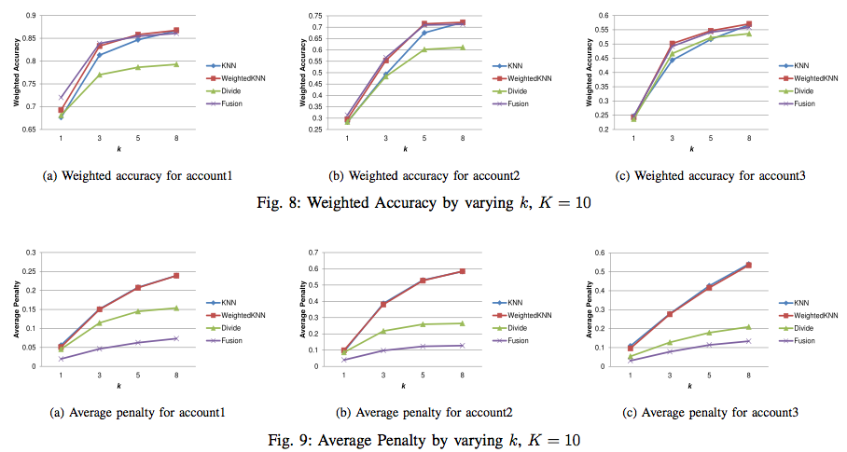
Evaluation: Variation of Parameters for Weighted Accuracy
To compare the results of each algorithm, we vary the number of each recommendation resolutions, k.
When we increase the value of k, the size of the recommendation results becomes larger. Then the probability of one recommended resolution being hit by the true resolution also increases. Therefore, the weighted accuracy becomes higher. Except for the division method, all algorithms have similar weighted accuracies for each k.
Notes:
Figures 8, 9 and 10 show the weighted accuracies, average penalties and overall scores by varying k from 1 to 8, with K = 10.
For other values of K, the comparison results are similar to the three figures.
As shown by Figure 8, when we increase the value of k, the size of the recommendation results becomes larger. Then the probability of one recommended resolution being hit by the true resolution also increases. Therefore, the weighted accuracy becomes higher. Except for the division method, all algorithms have similar weighted accuracies for each k. However, as k is increased and there are more recommended resolutions, there are more potential penalties in the recommended resolutions. Hence, the average penalty also becomes higher (Figure 9).
Finally, Figure 10 compares the overall performance by varying k. Clearly, the probabilistic fusion method outperforms other algorithms for every k.

Slide 21
Evaluation: Variation of Parameters for Average Penalty
To compare the results of each algorithm, we vary the number of each recommendation resolutions, k.
As k is increased and there are more recommended resolutions, there are more potential penalties in the recommended resolutions. Hence, the average penalty also becomes higher.
Notes:
Figures 8, 9 and 10 show the weighted accuracies, average penalties and overall scores by varying k from 1 to 8, with K = 10.
For other values of K, the comparison results are similar to the three figures.
As shown by Figure 8, when we increase the value of k, the size of the recommendation results becomes larger. Then the probability of one recommended resolution being hit by the true resolution also increases. Therefore, the weighted accuracy becomes higher. Except for the division method, all algorithms have similar weighted accuracies for each k. However, as k is increased and there are more recommended resolutions, there are more potential penalties in the recommended resolutions. Hence, the average penalty also becomes higher (Figure 9).
Finally, Figure 10 compares the overall performance by varying k. Clearly, the probabilistic fusion method outperforms other algorithms for every k.

Slide 22
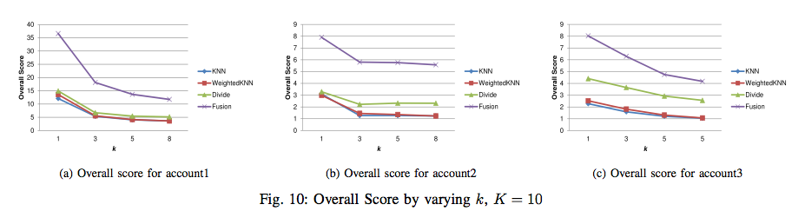
Evaluation: Variation of Parameters for overall score
The overall score = weighted accuracy / average penalty
The probabilistic fusion method outperforms other algorithms for every k

Slide 23
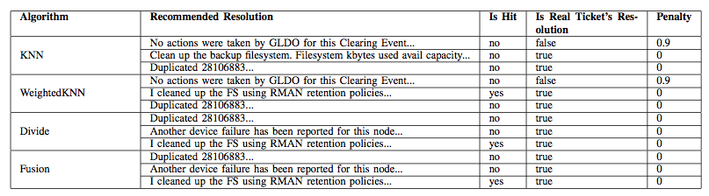
Case study and details
We select an event ticket in “account1” to illustrate why our proposed algorithms are better than the traditional KNN-based algorithms. Table shows a list of recommended resolutions given by each algorithm. The testing ticket is a real event ticket triggered by a low capacity alert for the file system. Its true resolution of this ticket is: “cleaned up the FS using RMAN retention policies...” RMAN is a data backup and recovery tool in Oracle database. The general idea of this resolution is to use this tool to clean up the old data.
WeightedKNN, Divide and Fusion all successfully find the true resolution of this testing ticket, but WeightedKNN has one false resolution, so its penalty is 0.9. Our proposed methods, Divide and Fusion, have no penalty for this ticket. Therefore, the two methods are better than WeightedKNN.
Notes:
As shown by Table IV, the first resolution recommended by KNN and WeightedKNN is a false ticket’s resolution: “No actions were taken by GLDO for this Clearing Event...” It might be caused by a temporal file generated by some application, which would clean up the temporal file automatically after its job was done. When the system administrator opened that ticket, the problem was gone, and that ticket is seen as false. However, the testing ticket is real and would not disappear unless the problem was actually fixed. This resolution from the false ticket would have misled the system administrator to overlook this problem. Consequently, a penalty of λ = 0.9 is given to KNN and WeightedKNN.

Slide 24
Related Work
There are many commercial products such as IBM Tivoli, HP OpenView and Splunk focusing on system monitoring.
Automated ticket resolution is much harder than automated system monitoring because it requires vast domain knowledge about the target infrastructure.
Some prior studies apply approaches in text mining to explore the related ticket resolutions from the ticketing database. Other works propose methods for refining the work order of resolving tickets and discovering the dependency of tickets.
With the development of e-commerce, a substantial amount of research has been devoted to the recommendation system.
Lots of recommendation algorithms are proposed for promoting products to online users.
Recommendation algorithms can be categorized as item-based and user-based algorithms.
The difference with our work is that, in e-commerce, products are maintained by reliable sellers. The recommendation algorithms usually do not need to consider the problem of fake or low- quality products. But in service management, false tickets are unavoidable. The traditional recommendation algorithms do not take into account the types of tickets and as a result would recommend misleading resolutions.

Slide 25
Conclusion
This paper studies recommendation of problem resolutions for event tickets in automated service management.
It analyzes three sets of event tickets collected from production service infrastructure, and identifies vast number of repeated resolutions for event tickets.
Based on this observation, this paper proposes two resolution recommendation algorithms for event tickets.
An additional penalty is incorporated in the algorithms to avoid misleading resolutions. In our future work, we will investigate and develop more advanced and efficient resolution recommendation algorithms with improved accuracy and efficiency.

Slide 26
Thank you and
Q?

