Slide 1
Discovering Lag Interval For Temporal Dependencies
Liang Tang, Tao Li
{ltang002,taoli}@cs.fiu.edu
Larisa Shwartz
lshwart@us.ibm.com

Slide 2
An Example for Time Lag
Disk_Capacity ⟶ _{[5min,6min]} Database, [5min, 6min] is the lag interval.
Why time lag is important?
If the time lag is close to 0, database is writing a huge log.
If the time lag is larger than 0, disk is really full.

Slide 3
Problem Definition
Our Problem:
Given a temporal dependency A⟶B: when event A happens, B will also happen. What is the time lag between dependent event A and B?
Why study this problem:
The time lag indicates the cause of the temporal dependency.

Slide 4
Related Work
Ask the user to predefine a time window for analyzing the event associations (The user may not know).
Assume the temporal dependency is not interleaved (Two dependent A and B has no other A and B between them).
Overlap (Interleaved)

Slide 5
Relation with Other Temporal Patterns
Those temporal patterns can be seen as the temporal dependency with particular constraints on the time lag.

Slide 6
Challenges for Finding Time Lag
Given a temporal dependency, A⟶_{[t1,t2]}B, what kind of lag interval [t1,t2] we want to find?
If the lag interval is too large, every A and every B would be “dependent”.
If the lag interval is too small, real dependent A and B might not be captured.
Time complexity is too high.
A⟶_{[t1,t2]}B, t1 and t2 can be any distance of any two time stamps. There are O(n⁴) possible lag intervals.

Slide 7
What Is a Qualified Lag Interval
If [t1,t2] is qualified, we should observe many occurrences for A⟶_{[t1,t2]}B.
Lag Interval | Number of Occurrences
[0,1] | 3
[5,6] | 4
[0,6] | 4
[0,+∞] | 4
Length of the lag interval is larger, the number of occurrences also becomes larger.

Slide 8
What Is a Qualified Lag Interval
Intuition:
If B is randomly and independently distributed, how many occurrences observed in a time interval [t1,t2]?
What is the minimum number of occurrences?
Consider the number of occurrences in a lag interval to be a variable, n_{r}. Then, use the chi-square test to judge whether it is caused by randomness or not?
Expected value
The number of As
Time frame for the event sequence

Slide 9
Brute-Force Algorithm
Algorithm: For A⟶_{[t1,t2]}B, for every possible t1 and t2, scan the event sequence and count the number of occurrences.
Time Complexity
The number of distinct time stamps is O(n).
The number of possible t1 and t2 is O(n²).
The number of possible [t1,t2] is O(n⁴).
Each scanning is O(n). The total cost is O(n⁵).
Cannot handle event sequences.

Slide 10
Maximum Length of Qualified Lag Interval
The length of a qualified lag interval cannot be very long.
When you increase the length of lag interval, the minimum threshold for the number of occurrences also increases.
Lemma 2: Any qualified lag interval’s length is less than T/N ∙ 1/minsup.
Event Sample Rate(polling interval in system monitoring, a small constant).

Slide 11
STScan Algorithm
Idea:
Avoid redundant scanning, store all time lags into a sorted table.
t(x₅)-t(x₃)=3030-3010=20.
E₂ is 20, so
insert 3 into IA₂,
insert 5 into IB₂.

Slide 12
STScan Algorithm
Every lag interval is represented as a sub-segment of the linked list.
For example: [20,120] is E₂E₃E₄, the number of occurrences is|IA₂ ∪ IA₃ ∪ IA₄ |
Time cost for creating this table is O(n²).
The number of elements is O(3n²)=O(n²).
Time cost for scanning is O(n²).

Slide 13
STScan* Algorithm
Problem of STScan: Space cost O(n²) is too big to run out of memory.
Observation: STScan only scans one sub-segment at one time and never goes back.
Solution: Incrementally create the sort table and scan.

Slide 14
STScan* Algorithm
A_{k} :the k-th A
B_{k} :the k-th B.
Sort events by time stamps.
We visited the lag interval of sub-segment: E₄E₅.
The next lag interval is sub-segment:E₅E₆
We need to first create E₆

Slide 15
STScan* Algorithm
A_{k} :the k-th A
B_{k} :the k-th B.
A₂, A₄’ pointed time lags have the smallest value, 24, so E₆=24.
Move A₂, A₄’ pointers to the next position.
Create links from E₆ to A₂ and A₄.

Slide 16
STScan* Algorithm
A_{k} :the k-th A
B_{k} :the k-th B.
For every A, only keep the pointer for the next index of B.
Merge time lag lists of each A (like merge-sort).
Only keep O(n·|r|_{max}) links, the space cost is O(n), where |r|_{max} is maximum length of qualified interval.

Slide 17
Time Complexity Lower Bound
The problem of finding all qualified time intervals is 3SUM-Hard, so the there is o(n²) algorithm in the worst case.
3SUM problem: Given a set of n integers, is there three integers a,b,c in the set such that a+b=c?
No o(n²) algorithm can solve this problem in the worst case.

Slide 18
Evaluation
Evaluation Objectives:
Effectiveness:
Is able to find the interleaved temporal dependencies?
The lag interval is correct?
Efficiency:
Run time cost
Memory space cost
Comparative Methods:
Inter-arrival: do clustering on time lags of A and its following B.
brute-force: try every possible t1,t2 for lag interval [t1,t2].
brute-force*: brute-force with pruning by |r|_{max} .
Testing Environment:
Linux 2.6, Intel Xeon 2.5G (8 core), Java VM Memory Heap: 12Gbytes

Slide 19
Data Sets
Synthetic data: 7 data sequences. 8 event types. Average sample period is 100. Random generated with 3 embedded dependencies.
Embedded Dependency | support
I₁⟶_{[400,500]}I₂ | 0.1
I₂⟶_{[1000,1100]}I₃ | 0.12
I₄⟶_{[5500,5800]}I₅ | 0.15
Time lags are large. Dependent items are very likely to be interleaved.
Real data: Tivoli Monitoring system events from two large accounts in IBM service center.
Dataset | Time Frame | #Events | #Event Types
Account1 | 54 days | 1,124,834 | 95
Account2 | 32 days | 2,076,408 | 104

Slide 20
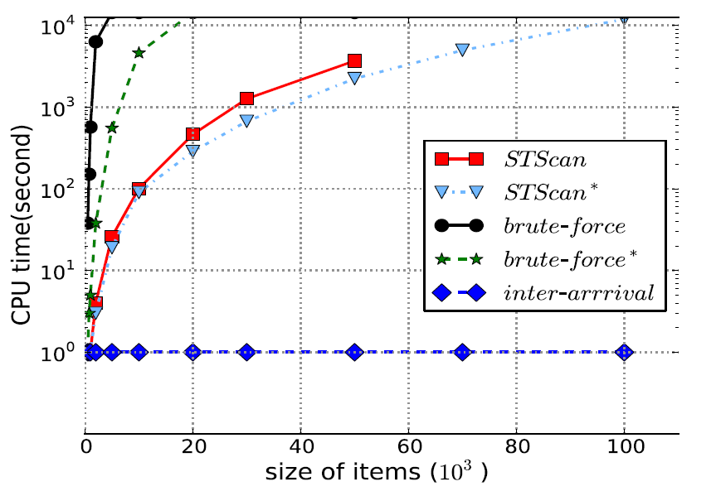
Synthetic Data
Effectiveness:
brute-force, brute-force*,STScan, STScan* can find all embedded temporal dependencies if they can finish the running.
inter-arrivals fails.
Efficiency:
Data size | 10³ | 10⁴ | 5∙10⁴ | 10⁵
STScan | 3∙10⁴ | 3∙10⁶ | 8∙10⁷ | OutOfMemory
STScan* | 10³ | 10⁴ | 5∙10⁴ | 10⁵
Brute-Force | 9∙10² | 10⁴ | 5∙10⁴ | 9∙10⁴
Brute-Force* | 9∙10² | 10⁴ | 5∙10⁴ | 9∙10⁴
Inter-arrival | <10² | <10² | <10² | <10²

Slide 21
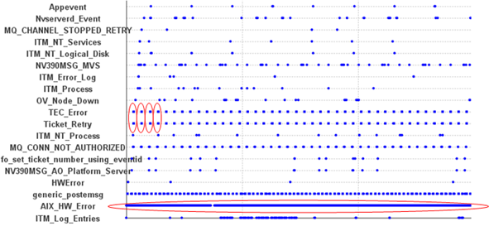
Tivoli Monitoring System Events
Dataset | Discovered Dependencies
Account1 | MSG_Plat_APP ⟶_{[3600,3600]} MSG_Plat_APP
 | Linux_Process ⟶_{[0,96]} Process
 | SMP_CPU⟶_{[0,27]} Linux_Process
Account2 | TEC_Error ⟶_{[0,1]} Ticket_Retry
 | TEC_Retry ⟶_{[0,1]} Ticket_Error
 | AIX_HW_ERROR⟶_{[8,9]} AIX_HW_ERROR
Inter-arrivals only find
Event Plot for Account2

Slide 22
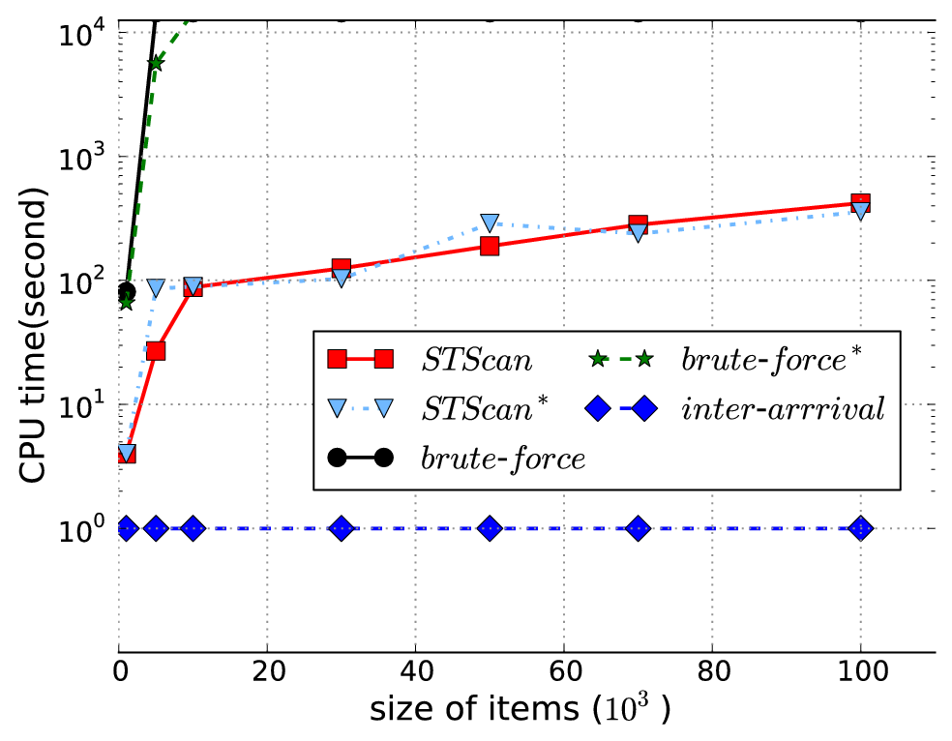
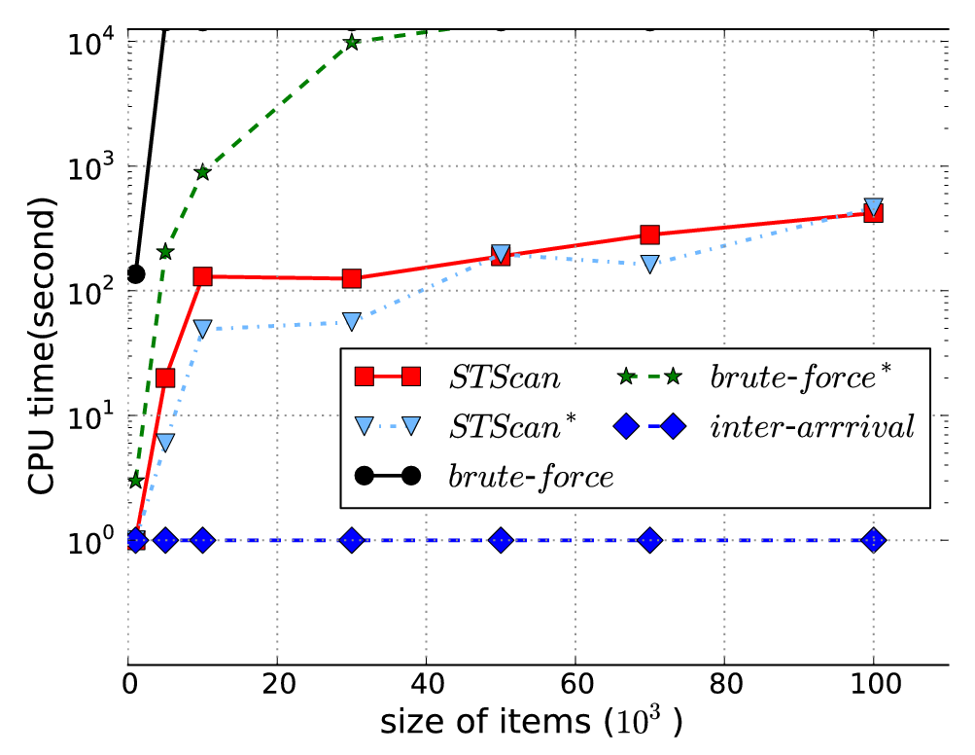
Tivoli Monitoring System Events
Run times on Account1 data
Run times on Account2 data

Slide 23
Conclusion and Future Work
Conclusion
Study the problem of discovering interleaved temporal dependencies.
Propose STScan and STScan* two algorithms, which are faster than brute-force search approaches, although their time complexities are still high O(n²).
Prove that the problem is 3SUM-Hard.
Future work
Develop an approximation algorithm which can solve the problem in a linear time complexity.

Slide 24
End
Thank you!
Any question?

