Slide 1
An Integrated Framework for Optimizing Automatic Monitoring Systems in Large IT Infrastructures
Liang Tang, Tao Li
{ltang002,taoli}@cs.fiu.edu
Larisa Shwartz, Florian Pinel
{lshwart,pinel}@us.ibm.com
Genady Ya. Grabarnik
grabarng@stjohns.edu

Slide 2
Manual System Monitoring
In large IT infrastructures, the system admin cannot manually monitor so many machines.

Slide 3
Automatic System Monitoring
IBM Tivoli Monitoring
HP OpenView
Monitoring system: monitor those servers, notify the system admin only when a problem happens.

Slide 4
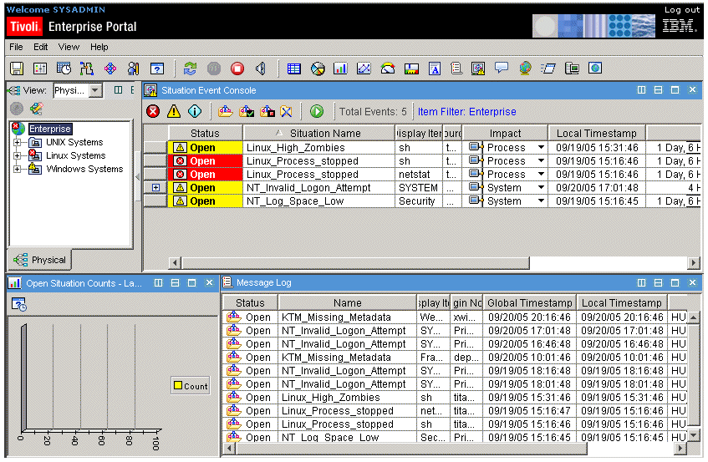
Configurations of Monitoring Systems are Complicated
In Large IT infrastructures, there are different machines, different software products…
IBM Tivoli monitoring defines a lot of monitoring situations for monitoring different alerts
High CPU utilization
Low disk space
Process offline
…
IBM Tivoli Monitoring

Slide 5
What is Misconfiguration? (1)
False Positive:
Too Conservative threshold (CPU utilization < 50%).
Transient Alert(Automatically disappear in a short time).
Where is the alert???

Slide 6
What is Misconfiguration? (2)
False Negative:
Installed a new database server, but forget to add it into the monitoring situation. If this server has a problem, it would not be captured by the monitoring system.

Slide 7
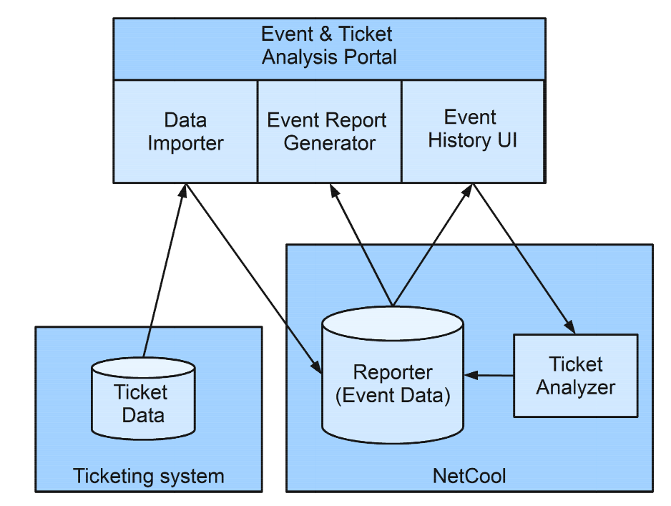
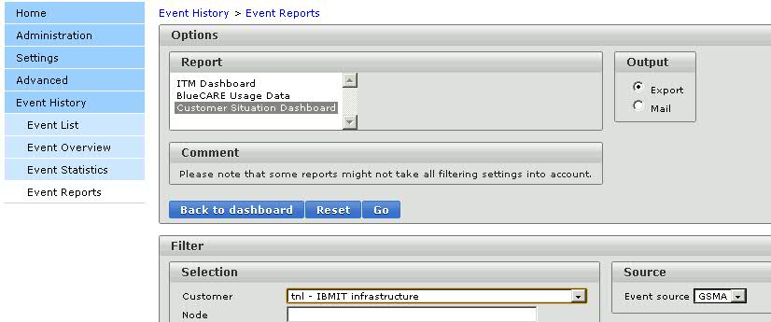
Event and Ticket Analysis Portal
Our solution: Develop a system module in Event & Ticket Analysis Portal to analyze the monitoring events with tickets and to help system admin to correct misconfigurations.

Slide 8
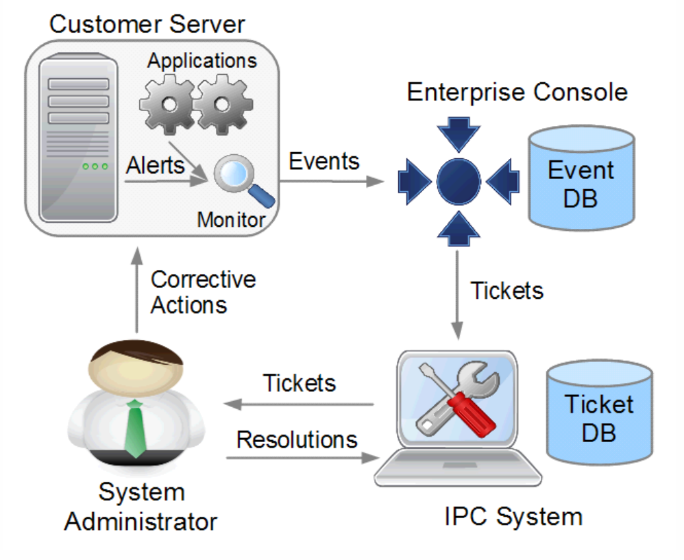
How to Detect False negative and False positive?
Ticket data is the ground truth (labeled data) and created by the human.
Human labor cost is very high!!!
Can we use their knowledge to improve the monitoring?

Slide 9
Eliminating False Positive (1)
A straightforward solution: Binary classifier
label “1” means a real alert, “0” means a false alert.
features are system event attributes
process name
CPU time
number of threads.
Limitations:
We can NOT miss any real alert (would cause system crash or data loss).
No classification algorithm can guarantee 100% accuracy.

Slide 10
Eliminating False Positive (2)
Most false positive alerts are transient alerts ( automatically disappear in a short time).

Slide 11
Eliminating False Positive (3)
The rules generated by a classifier can be directly translated into monitoring situations:
If PROC_CPU_TIME > 50% and PROC_NAME = ‘Rtvscan’, then it is false.
Waiting time is the polling interval of a monitoring situation in IBM Tivoli Monitoring.
We do NOT have to build another system to deploy our classifier

Slide 12
Offline Evaluation on Testing Data
Ratio of the testing data size and training data size

Slide 13
Online Evaluation
A large financial company.
An internal account in IBM.

Slide 14
Eliminating False Negative (1)
How to eliminate false negatives (missed alerts)?
False negative are quite few (less than 20-40 tickets for a situation). No need an automatic approach to correct it.
False negatives are missed alerts. Where can we track them?
Manual Tickets (captured by human).
However, manual tickets contain other kinds of tickets, such as customer request.

Slide 15
Eliminating False Negative (2)
Problem Definition: Find missed alerts from manual tickets
Challenges:
Not enough labeled data.
Highly Imbalanced data: few false negative alerts, large amount of other manual tickets.
We cannot hire an expert to label the ticket every day…
We randomly select a subset of tickets to label. Maybe none of them is false negative alert. It is bad for training.

Slide 16
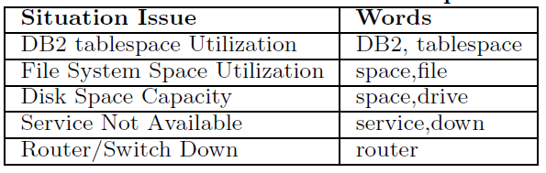
Selective Labeling in Highly Imbalanced Data
Use some domain words to narrow down the training ticket scope
Build a binary classifier (SVM) on selected tickets.
Given a ticket, label “1” means this ticket is a false negative. Label “0” means it is not.
These words can be obtained from system admins or system documents

Slide 17
Selective Labeling vs Random Labeling
Easy to learn!!! Not many variations of discriminative words

Slide 18
A Case Study
Discovered False Negatives (Missed alerts)
Situation | Ticket
dsp_3ntc_std | Please clear space from E drive xxxx-fa-ntfwwfdb Please clear space from E drive xxxx-fa-ntfwwfdb.it is having 2 MB free...
fss_rlzc_std | /opt file system is is almost full on xxx Hi Team@/opt file system is almost full. Please clear some space /home/dbasso>df -h /optFilesystem...
svc_3ntc_std | RFS101681 E2 Frontier all RecAdmin services are down Frontier RecAdmin services are not running on the batch server Kindly logon to the server : xxx.xxx.155.183/xxx ...
… | …
I will add these devices into Tivoli monitoring configuration.

Slide 19
Summary
Analyzed the main types of misconfiguration of monitoring systems in large IT infrastructures.
Proposed a framework to integrate system events and tickets for improving the configurations of monitoring systems (IBM Tivoli monitoring).
Conduct offline and online experiments for the proposed framework.
Develop and deployed the module in Event and Ticket Analysis Portal in IBM IT service platform.

Slide 20
End
Thank you!
Any question?

