Slide 1
SLICE: A Novel Method to Find Local Linear Correlations by Constructing Hyperplanes
Liang Tang, Changjie Tang, Lei Duan,
Yexi Jiang, Jun Zhu, Jie Zuo
School of Computer Science, Sichuan University
DB&KE
WAIM 09 Sichuan Univ.KE&DB Lab.

Slide 2
There may be some Chinese Chars in Page , You may ignore it。
Outline
Goal and Motivation 动机 目的
Structure of SLICE Algorithm 算法描述
Experimental Study 实验分析
Conclusion and Future Work 结论与未来工作
WAIM 09 Sichuan Univ.KE&DB Lab.

Slide 3
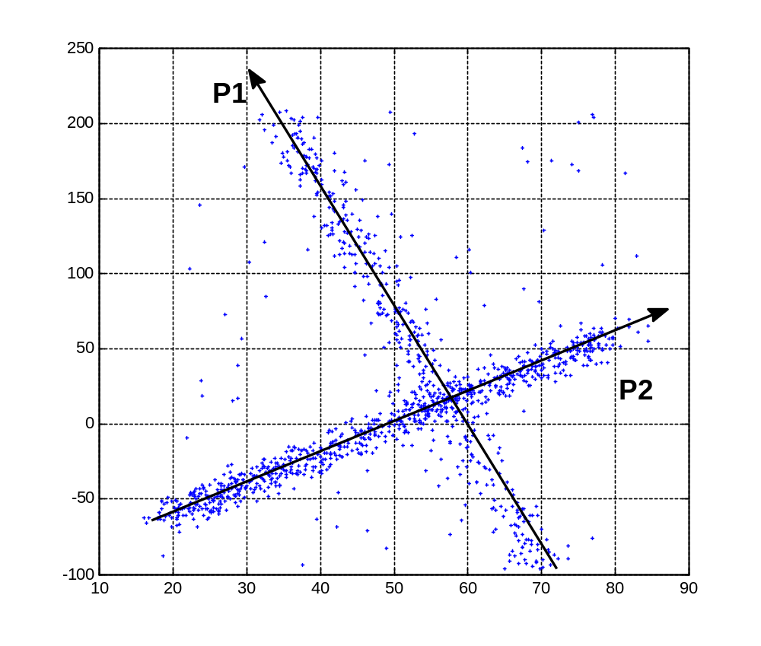
Goal and Motivation
Find the local linear correlations
Local linear correlations
局部线性相关模式
WAIM 09 Sichuan Univ.KE&DB Lab.
Notes:
In this paper, our goal is to find the local linear correlations. For example in this figure, P1 and P2 are the local linear correlations in dataset.

Slide 4
Goal and Motivation
Find the local linear correlations
Local linear correlations
局部线性相关模式
WAIM 09 Sichuan Univ.KE&DB Lab.

Slide 5
Related Works
The first kind of related work
1. Correlation Clustering Algorithms, such as 4C, COPAC. Those methods combine clustering and PCA .
2. CARE algorithm, which only can find the primary local linear correlation.
WAIM 09 Sichuan Univ.KE&DB Lab.
Notes:
As for this problem, there are two kinds of related works.
First one is the correlation clustering algorithms, like 4C, COPAC.

Slide 6
Related Works
1. Correlation Clustering Algorithms, such as 4C, COPAC. Those methods combine clustering and PCA .
2. CARE algorithm, which only can find the primary local linear correlation.
The second kind of related work
WAIM 09 Sichuan Univ.KE&DB Lab.
Notes:
The second kind of related work is CARE algorithm. The limitation of that is it can only find the primary local linear correlation.

Slide 7
About Correlation Clustering Algorithms
Take the 4C for example, most previous clustering algorithms consists of two steps.
Create the ε–neighborhoods, like DBSCAN.
Connect the ε–neighborhoods to a cluster, according to the linear correlation in the ε–neighborhoods
WAIM 09 Sichuan Univ.KE&DB Lab.
Notes:
First of all, take the 4C algorithm for example. Most previous correlation clustering algorithm consist the two steps.

Slide 8
About Correlation Clustering Algorithms
Take the 4C for example, most previous clustering algorithms consists of two steps.
Create the ε–neighborhoods, like DBSCAN.
Connect the ε–neighborhoods to a cluster, according to the linear correlation in the ε–neighborhoods
WAIM 09 Sichuan Univ.KE&DB Lab.
Notes:
The first step is to create ε–neighborhoods, like DBSCAN

Slide 9
About Correlation Clustering Algorithms
Take the 4C for example, most previous clustering algorithms consists of two steps.
Create the ε–neighborhoods, like DBSCAN.
Connect the ε–neighborhoods to a cluster, according to the linear correlation in the ε–neighborhoods
The connecting is based on the ε–neighborhood’s correlation
WAIM 09 Sichuan Univ.KE&DB Lab.
Notes:
The second step is to connect the ε–neighborhoods to become a cluster.

Slide 10
About Correlation Clustering Algorithms
Take the 4C for example, most previous clustering algorithms consists of two steps.
Create the ε–neighborhoods, like DBSCAN.
Connect the ε–neighborhoods to a cluster, according to the linear correlation in the ε–neighborhoods
The connecting is based on the ε–neighborhood’s correlation
WAIM 09 Sichuan Univ.KE&DB Lab.
Notes:
The connecting among clusters and points is based on the ε–neighborhood’s correlation

Slide 11
About Correlation Clustering Algorithms
Take the 4C for example, most previous clustering algorithms are the same.
Create the ε–neighborhoods, like DBSCAN.
Connect the ε–neighborhoods to a cluster, according to the linear correlation in the ε–neighborhoods
Problems about the ε–neighborhoods :
1) If there are More One linear correlations?
2) If there is NO linear correlation? Noise? Maybe Not!
WAIM 09 Sichuan Univ.KE&DB Lab.
Notes:
So, there may be some problems with these ε–neighborhoods.
The first problem is that if there are more one linear correlations in a ε–neighborhood?

Slide 12
About Correlation Clustering Algorithms
Take the 4C for example, most previous clustering algorithms are the same.
Create the ε–neighborhoods, like DBSCAN.
Connect the ε–neighborhoods to a cluster, according to the linear correlation in the ε–neighborhoods
Problems about the ε–neighborhoods :
1) If there are More One linear correlations?
2) If there is NO linear correlation? Noise? Maybe Not!
WAIM 09 Sichuan Univ.KE&DB Lab.
Notes:
The second problem is that if there no linear correlations in a ε–neighborhood? They may not be noise data.

Slide 13
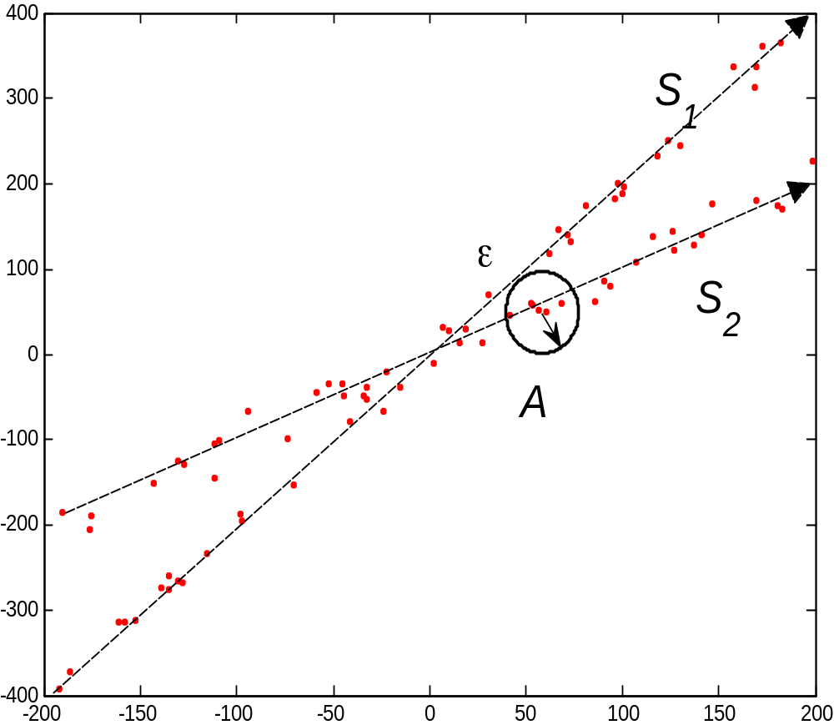
About Correlation Clustering Algorithms
small ε–neighborhood
WAIM 09 Sichuan Univ.KE&DB Lab.
Notes:
For example, in this situation, if the parameter ε is very small, there are too few points in the ε-neighborhood, like A. So the correlation may not exist in this kind of neighborhood.

Slide 14
About Correlation Clustering Algorithms
small ε–neighborhood
No Precise Correlations!
WAIM 09 Sichuan Univ.KE&DB Lab.

Slide 15
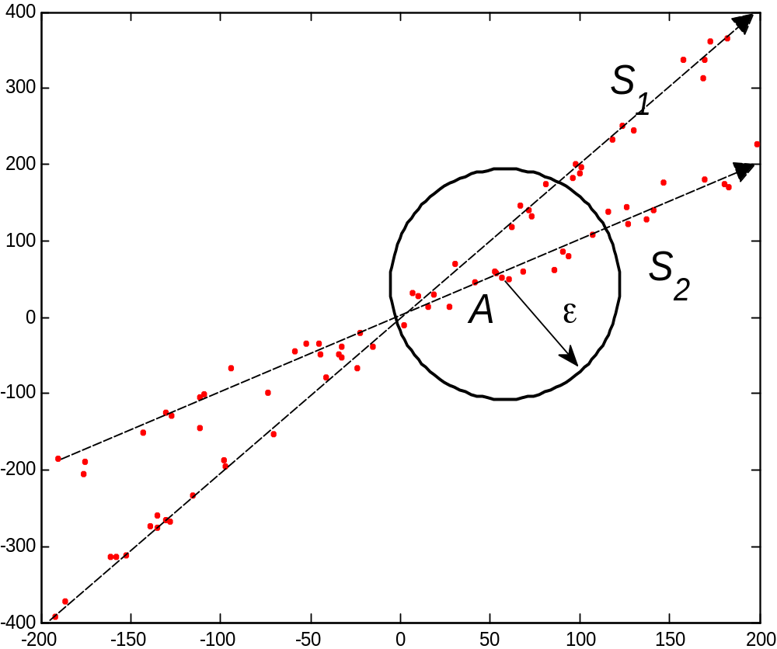
About Correlation Clustering Algorithms
large ε–neighborhood
small ε–neighborhood
WAIM 09 Sichuan Univ.KE&DB Lab.
Notes:
in this situation, if the parameter ε is large, there are more than one correlations in a ε-neighborhood.

Slide 16
About Correlation Clustering Algorithms
large ε–neighborhood
small ε–neighborhood
More than One Correlations!
WAIM 09 Sichuan Univ.KE&DB Lab.
Notes:
So the correlation got by these correlation clustering algorithm cannot be precise too, because the correlation contains many different correlations.

Slide 17
About CARE Algorithm
CARE algorithm only can find the primary local linear correlation.
Only One Correlation
WAIM 09 Sichuan Univ.KE&DB Lab.
Notes:
As for the CARE algorithm, the most limitation is that it can only find one correrlation.

Slide 18
There may be some Chinese Chars in Page , You may ignore it。
Outline
Goal and Motivation 动机 目的
Structure of SLICE Algorithm 算法描述
Experimental Study 实验分析
Conclusion and Future Work 结论与未来工作
WAIM 09 Sichuan Univ.KE&DB Lab.

Slide 19
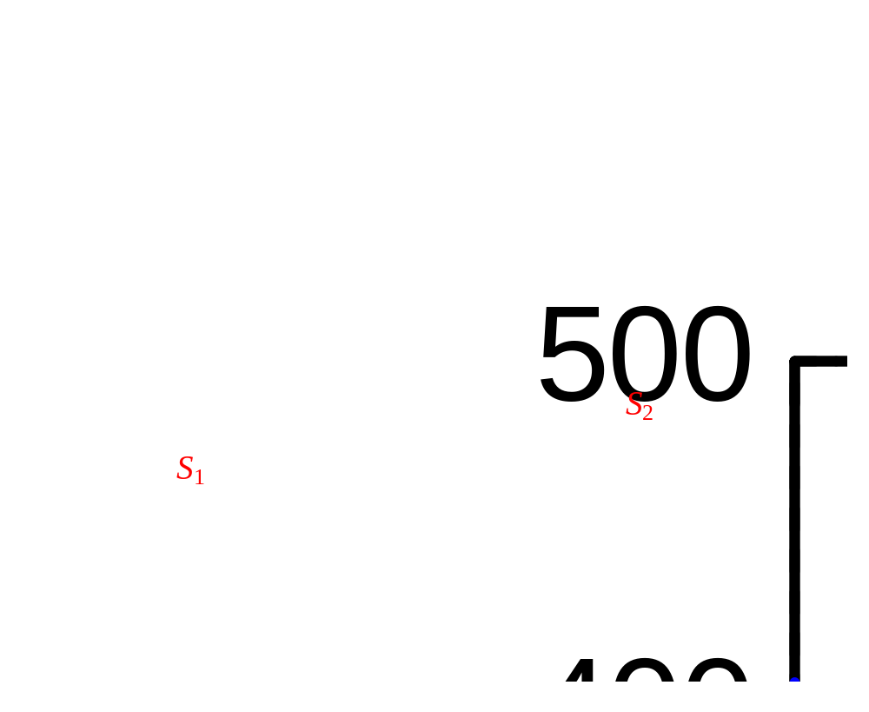
Significant Local Linear Correlation
WAIM 09 Sichuan Univ.KE&DB Lab.
Notes:
Before I introduce our algorithm, I should give the definition of the significant local linear correlations, which are meaningful to us. For example in this figure, there are two correlations: S1 and S2.

Slide 20
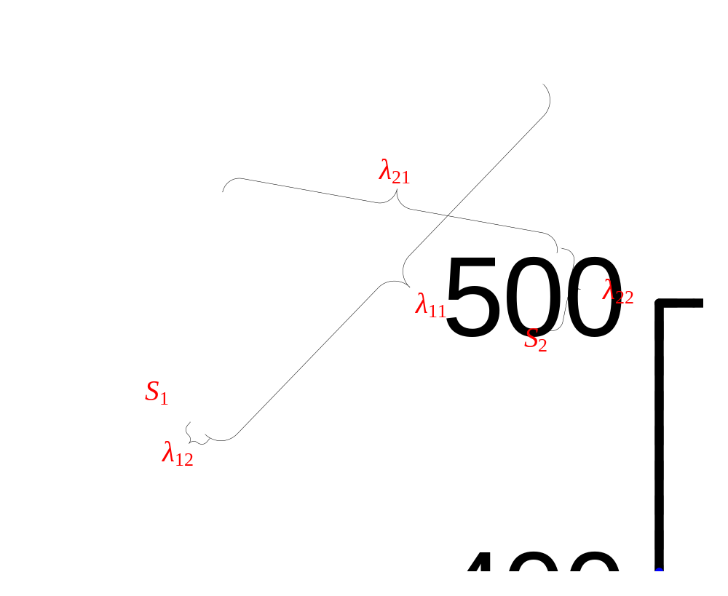
Significant Local Linear Correlation
WAIM 09 Sichuan Univ.KE&DB Lab.
Notes:
We can see that S1 is more precise and significant than S2. Then, we can get the variances on two directions of S1 and S2, λ11, λ12,λ22 and λ22.

Slide 21
Significant Local Linear Correlation
λ₁₂/(λ₁₁+λ₁₂)< λ₂₂/(λ₂₁+λ₂₂)
WAIM 09 Sichuan Univ.KE&DB Lab.
Notes:
From the inequation, we can compare the precisions and significances of S1 and S2. Obviously, S1 is better than S2.

Slide 22
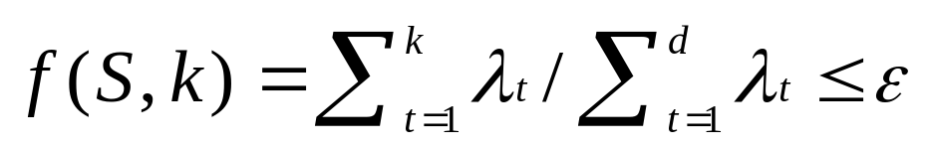
Significant Local Linear Correlation
Definition 1 Given a data matrix D containing M tuples, each tuple has d features. Let S = (0 ≤ j_{t} ≤ M, t = 1, 2, …, m) is the subset of D, {λ_{i}}(1≤ i ≤ d) be the eigenvalues of the covariance matrix of S, where λ₁ ≤ λ₂ ≤ … ≤ λ_{d}.
{λi} are the variances
m / M ≥δ
where ε, δ and k (k ≤d) are user defined parameters.
WAIM 09 Sichuan Univ.KE&DB Lab.
Notes:
From that figure and example, we use this definition to qualify the significant local linear correlation.

Slide 23
Significant Local Linear Correlation
Definition 1 Given a data matrix D containing M tuples, each tuple has d features. Let S = (0 ≤ j_{t} ≤ M, t = 1, 2, …, m) is the subset of D, {λ_{i}}(1≤ i ≤ d) be the eigenvalues of the covariance matrix of S, where λ₁ ≤ λ₂ ≤ … ≤ λ_{d}.
{λi} are the variances
m / M ≥δ
where ε, δ and k (k ≤d) are user defined parameters.
We use the definition in CARE algorithm
WAIM 09 Sichuan Univ.KE&DB Lab.
Notes:
Note that the {λi} are these variance as in previous figure.

Slide 24
Significant Local Linear Correlation
Definition 1 Given a data matrix D containing M tuples, each tuple has d features. Let S = (0 ≤ j_{t} ≤ M, t = 1, 2, …, m) is the subset of D, {λ_{i}}(1≤ i ≤ d) be the eigenvalues of the covariance matrix of S, where λ₁ ≤ λ₂ ≤ … ≤ λ_{d}.
m / M ≥δ
where ε, δ and k (k ≤d) are user defined parameters.
We use the definition in CARE algorithm
WAIM 09 Sichuan Univ.KE&DB Lab.
Notes:
This definition is similar to the definition in CARE algorithm.

Slide 25
The Challenge of Searching
Given a data matrix with M tuples, there are total 2^{M} data subsets to be tested, which is impractical for real dataset.
SLICE uses an approximate approach to find the significant linear correlations
WAIM 09 Sichuan Univ.KE&DB Lab.

Slide 26
The Challenge of Searching
Given a data matrix with M tuples, there are total 2^{M} data subsets to be tested, which is impractical for real dataset.
SLICE uses an approximate approach to find the significant linear correlations
WAIM 09 Sichuan Univ.KE&DB Lab.

Slide 27

SLICE Algorithm
Generate seed to search a hyperplane
while |C| > d
seed ←
while |seed| < d
p ← RANDOM(C, d)
seed ← seed∪{p}
end
S ← SEARCH(D, seed, ε, δ, k)
if |S| ≥ M∙ δ then
SS ← SS ∪{S}
end
C ← (C – S)
end
Input:
D: a d-dimensional data set D, ε, δ, k: user defined parameters.
Output:
SS: data subsets that are in a significant local linear correlation.
Begin
M ← |D|, C ← D
SS ←
WAIM 09 Sichuan Univ.KE&DB Lab.

Slide 28
SLICE Algorithm
Generate seed to search a hyperplane
while |C| > d
seed ←
while |seed| < d
p ← RANDOM(C, d)
seed ← seed∪{p}
end
S ← SEARCH(D, seed, ε, δ, k)
if |S| ≥ M∙ δ then
SS ← SS ∪{S}
end
C ← (C – S)
end
Input:
D: a d-dimensional data set D, ε, δ, k: user defined parameters.
Output:
SS: data subsets that are in a significant local linear correlation.
Begin
M ← |D|, C ← D
SS ←
Search a hyperplane by the seed
WAIM 09 Sichuan Univ.KE&DB Lab.

Slide 29
SLICE Algorithm
while |C| > d
seed ←
while |seed| < d
p ← RANDOM(C, d)
seed ← seed∪{p}
end
S ← SEARCH(D, seed, ε, δ, k)
if |S| ≥ M∙ δ then
SS ← SS ∪{S}
end
C ← (C – S)
end
Input:
D: a d-dimensional data set D, ε, δ, k: user defined parameters.
Output:
SS: data subsets that are in a significant local linear correlation.
Begin
M ← |D|, C ← D
SS ←
Search a hyperplane by the seed
WAIM 09 Sichuan Univ.KE&DB Lab.

Slide 30
SEARCH Subroutine
Given a seed consists of d tuples, and dataset D
Let S be set of the d tuples
D’←D
Find the nearest point p from D’ to S
if f(S∪{p}, k)> ε then
stop
else
S ← S∪{p}
delete p from D’.
goto 3
The distance from p to D’ is defined in Definition 2
WAIM 09 Sichuan Univ.KE&DB Lab.

Slide 31
SEARCH Subroutine
Given a seed consists of d tuples, and dataset D
Let S be set of the d tuples
D’←D
Find the nearest point p from D’ to S
if f(S∪{p}, k)> ε then
stop
else
S ← S∪{p}
delete p from D’.
goto 3
The distance from p to D’ is defined in Definition 2
WAIM 09 Sichuan Univ.KE&DB Lab.

Slide 32
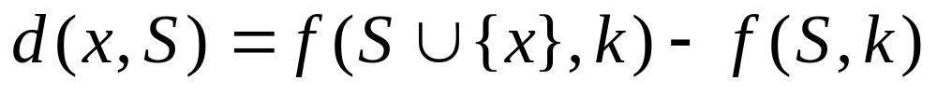
Distance from a tuple to a hyperplane
Definition 2 Given a d dimensional data subset S and a tuple x. The distance from x to the hyperplane established on S, denoted as d(x, S), is defined as follows.
f(S, k) is defined in Definition 1
WAIM 09 Sichuan Univ.KE&DB Lab.
Notes:
Here is the definition of the distance used in SEARCH subroutine

Slide 33
Distance from a tuple to a hyperplane
Definition 2 Given a d dimensional data subset S and a tuple x. The distance from x to the hyperplane established on S, denoted as d(x, S), is defined as follows.
f(S, k) is defined in Definition 1
WAIM 09 Sichuan Univ.KE&DB Lab.
Notes:
Here is the definition of the distance used in SEARCH subroutine

Slide 34
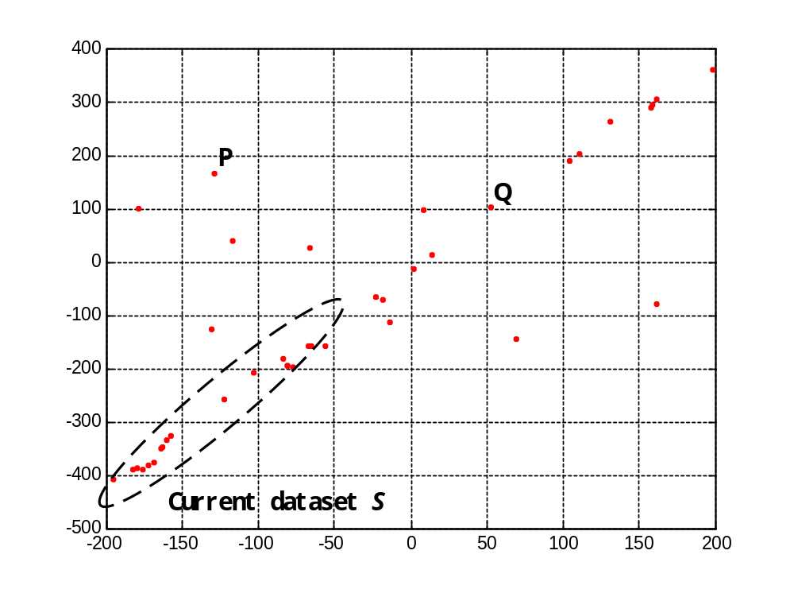
Distance from a tuple to a hyperplane
f(S∪{Q}, k) < f(S∪{P}, k)
d(Q,S) < d(P,S)
WAIM 09 Sichuan Univ.KE&DB Lab.
Notes:
Here is a example of the definition of the distance. The current dataset is S. There are two points P and Q.

Slide 35
Distance from a tuple to a hyperplane
f(S∪{Q}, k) < f(S∪{P}, k)
d(Q,S) < d(P,S)
WAIM 09 Sichuan Univ.KE&DB Lab.
Notes:
From the definition, Q is more close to the hyperplane of S, so the distance from Q to S is smaller.

Slide 36
Incremental Calculation for Covariance and Mean
Tip to accelerate the Calculation of f(S,k)
In SLICE algorithm, f(S∪{p}, k) is obtained from Cov(S∪{p}).
Cov(S∪{p}) can be obtained from Cov(S) and mean(S)
WAIM 09 Sichuan Univ.KE&DB Lab.
Notes:
There is a tips to accelerate the calculation of function f.

Slide 37
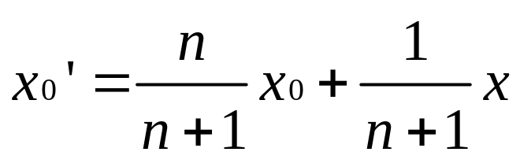
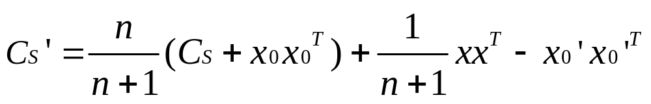
Incremental Calculation for Covariance and Mean
Lemma 1 Given a set of tuples S, let n = |S|, x₀ be the mean of S and C_{S} be the covariance matrix of S. When S absorbs a new tuple x, the new mean x₀’ and new covariance matrix C_{S}’ can be obtained by following equations.
WAIM 09 Sichuan Univ.KE&DB Lab.
Notes:
This tip is described in Lemma 1 like this。(简单跳过)

Slide 38
There may be some Chinese Chars in Page , You may ignore it。
Outline
Goal and Motivation 动机 目的
Structure of SLICE Algorithm 算法描述
Experimental Study 实验分析
Conclusion and Future Work 结论与未来工作
WAIM 09 Sichuan Univ.KE&DB Lab.

Slide 39
Evaluate the Effectiveness of SLICE in Synthetic datasets
Method
1. Conduct SLICE on these 500 synthetic datasets.
2. Compare the discovered correlations with predefined correlations in datasets. If SLICE finds all predefined correlations, we mark this run as a success.
3. Record the number of success times over all 500 synthetic datasets.
WAIM 09 Sichuan Univ.KE&DB Lab.
Notes:
这部分就是介绍实验的方法

Slide 40
Evaluate the Effectiveness of SLICE in Synthetic datasets
Result
5 groups of synthetic datasets, each group contains 100 datasets. The
Table 2. success rates of SLICE for each group of datasets
D300F3C3 | D400F3C4 | D600F3C4 | D600F4C4 | D500F4C5
100% | 95% | 99% | 97% | 100%
WAIM 09 Sichuan Univ.KE&DB Lab.

Slide 41
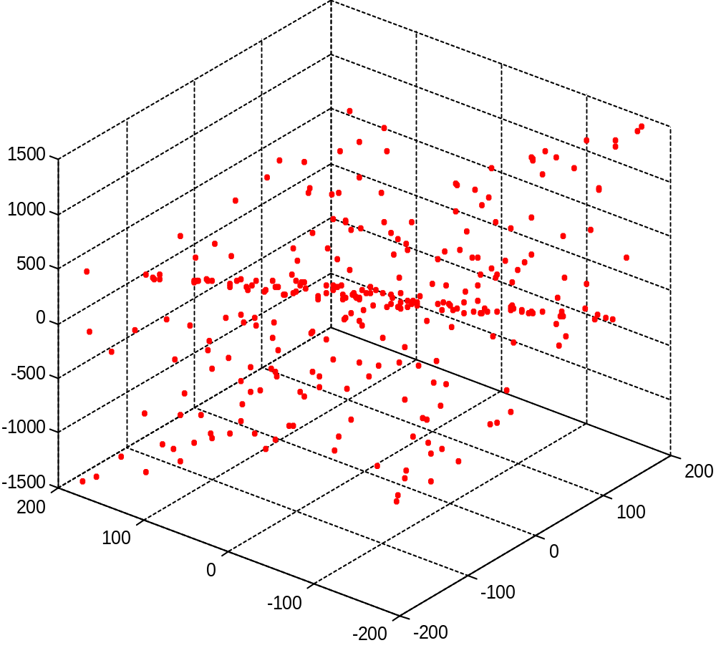
Compare with other algorithms on D300F3C3 dataset
D300F3C3 dataset
WAIM 09 Sichuan Univ.KE&DB Lab.
Notes:
This is the distribution of one synthetic dataset used in our experiements.

Slide 42
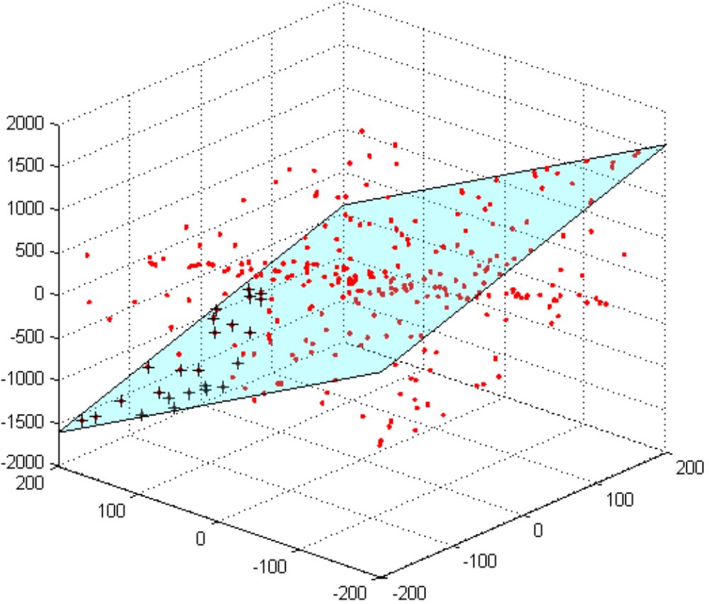
Result of Algorithms 4C
Correlated ε–neighborhoods
Predefined correlation
WAIM 09 Sichuan Univ.KE&DB Lab.
Notes:
We can see that, algorithm 4C only find part of the dataset under the predefined correlation.

Slide 43
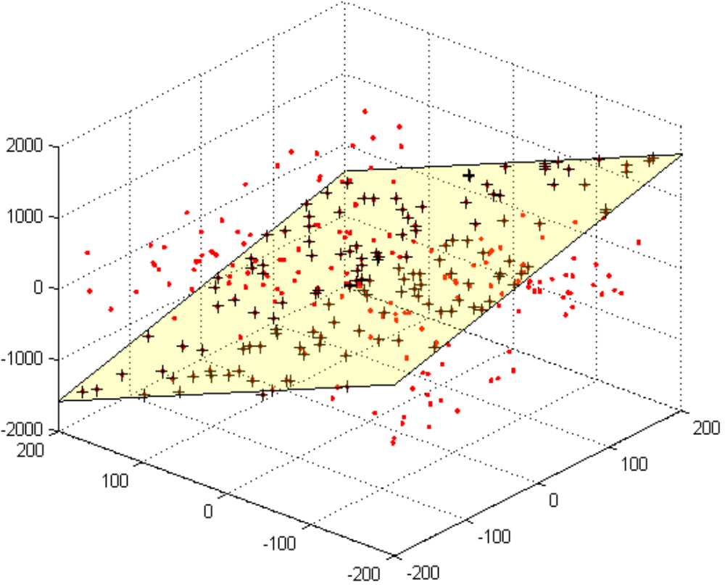
Result of Algorithms CARE
WAIM 09 Sichuan Univ.KE&DB Lab.

Slide 44
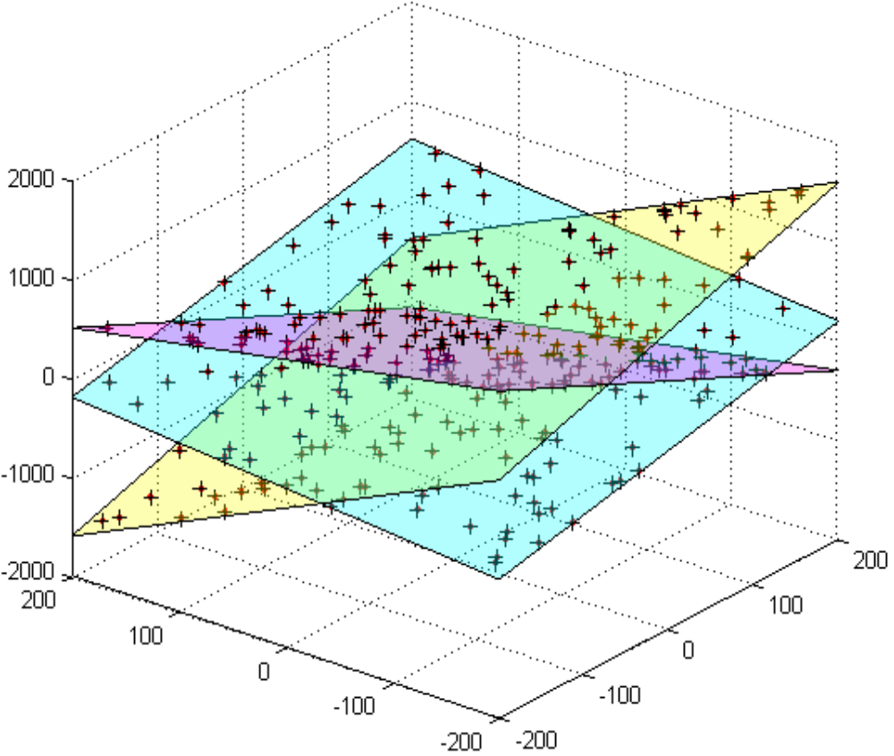
Result of Algorithms SLICE
WAIM 09 Sichuan Univ.KE&DB Lab.

Slide 45
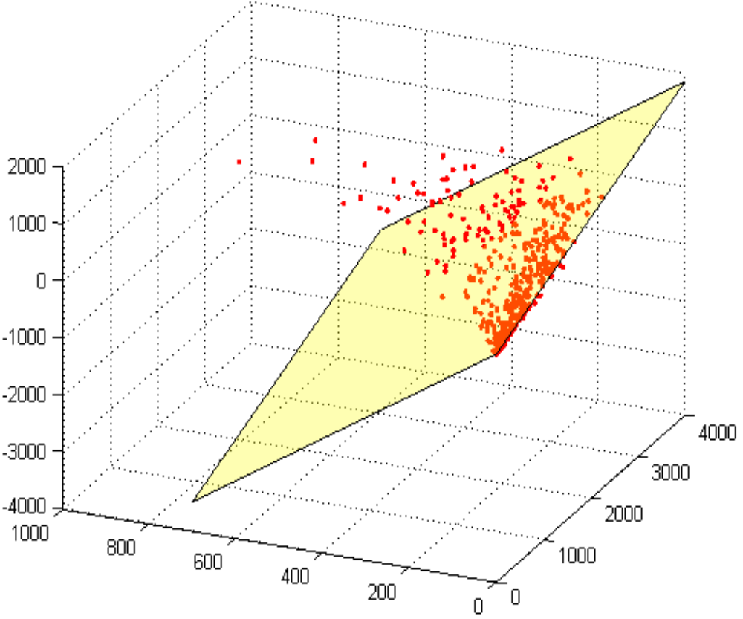
Result of Algorithms CARE on NBA Statistical dataset
0.090645 * minutes – 0.976344 * assists – 0.196303 * rebounds = 0.796832
Correlation
Minutes: 上场时间
Assists: 助攻数
Rebounds: 篮板球数
WAIM 09 Sichuan Univ.KE&DB Lab.

Slide 46
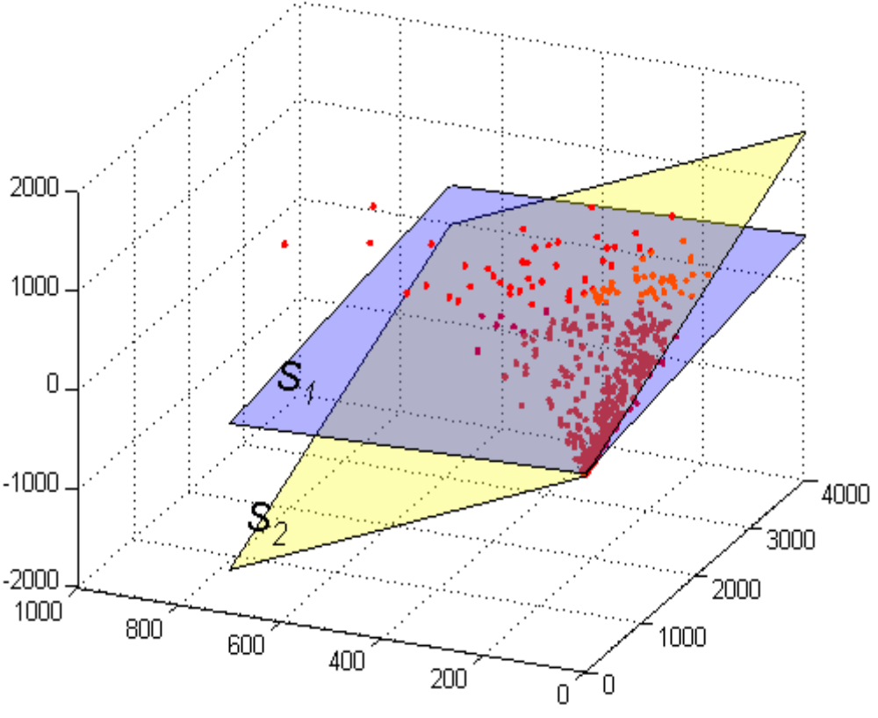
Result of Algorithms SLICE on NBA Statistical dataset
0.157510 * minutes – 0.898574 * assists – 0.409580 * rebounds = 8.273140
0.112557 * minutes – 0.121851 * assists – 0.986146 * rebounds = -8.695694
Correlation
WAIM 09 Sichuan Univ.KE&DB Lab.

Slide 47
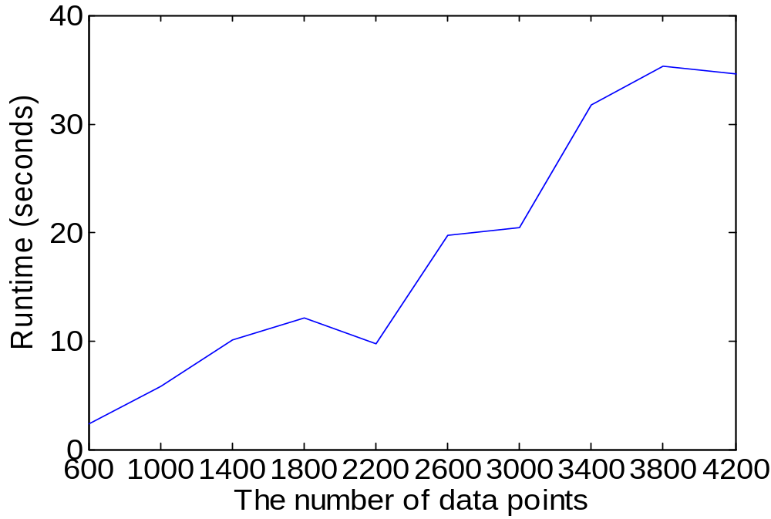
Efficiency evaluation
WAIM 09 Sichuan Univ.KE&DB Lab.

Slide 48
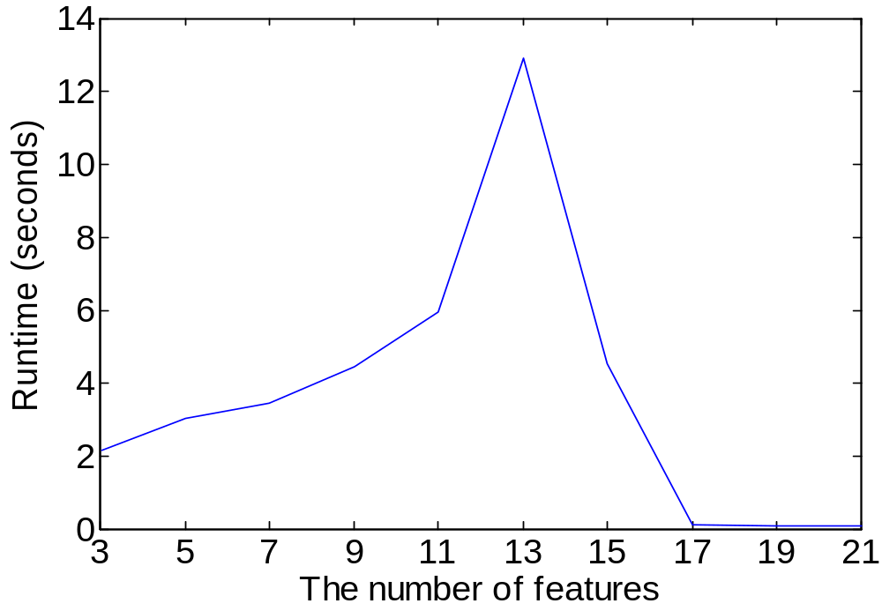
Efficiency evaluation
WAIM 09 Sichuan Univ.KE&DB Lab.

Slide 49
There may be some Chinese Chars in Page , You may ignore it。
Outline
Goal and Motivation 动机 目的
Structure of SLICE Algorithm 算法描述
Experimental Study 实验分析
Conclusion and Future Work 结论与未来工作
WAIM 09 Sichuan Univ.KE&DB Lab.

Slide 50
Main Contributions
(1) analyzing the limitations of applying current methods on finding linear correlations in data subsets;
(2) developing a novel algorithm to find multiple local linear correlations in data subsets. The basic idea is using a heuristic to construct hyperplanes that represent linear correlations;
(3) conducting extensive experiments to show that our algorithm is effective to find correct correlations in both synthetic and real-world datasets.
WAIM 09 Sichuan Univ.KE&DB Lab.

Slide 51
Future work
(1) Integrate user interests in our method to find interesting local linear correlations.
(2) developing a method that can guarantee to find all correct linear correlations in polynomial time complexity in each execution is a challenging work
WAIM 09 Sichuan Univ.KE&DB Lab.

Slide 52
Thank you
Any question ?
tangliang@cs.scu.edu.cn or tangl99@gmail.com
WAIM 09 Sichuan Univ.KE&DB Lab.

