Slide 1
Proposal Defense Presentation
Topic: Event Mining for System and Service Management
Presented by
Liang Tang
School of Computing and Information Sciences
Florida International University

Slide 2
Outline
Background and Overview
Research Problems
Converting Textual Log to System Events
Monitoring Configuration Optimization
False Positive
False Negative
Analysis on Detected System Issues
Temporal Dependencies of Events
Incident Resolution Recommendation
Textual Event Segments Search
Summary and Timeline

Slide 3
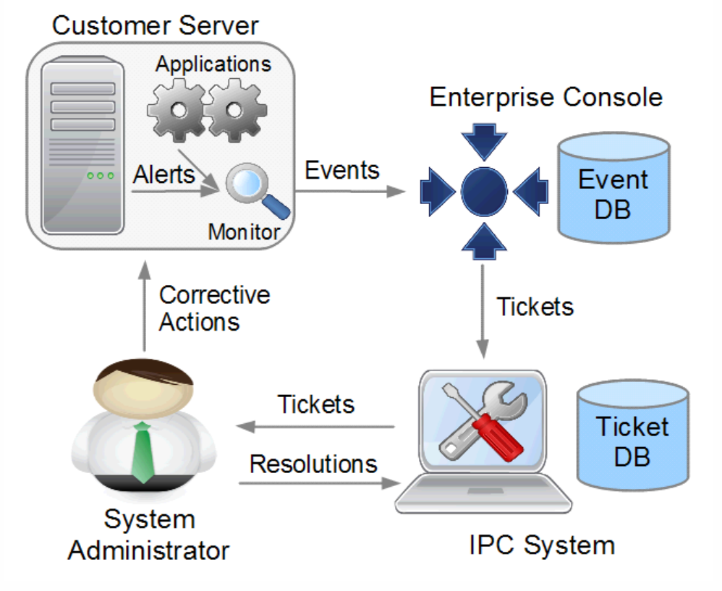
Background
The typical workflow of IT service mainly includes four components (Liang, Tao, Larisa, et al., 2012):
Customer Servers
Event DB
Ticketing System
System Administrators
Notes:
My research background is based on the workflow of the IT service. The modern IT service includes four components. Each component generate huge amount of data during its working. The research goal is to use the data to improve the performance of this workflow.

Slide 4
Background (Cont.)
Checking (periodically):
If disk_name == “C:” and disk_free < 5%
If CPU_util > 80% and duration > 20 minutes
….
Store and Explore Events, OLAP,
Automatically Generate Incident Tickets
Fix Problems
in Incident Tickets
Track Incident Tickets

Slide 5
Overview of Research Problems
Monitoring Configuration Optimization:
Reduce False positive (false alerts)
Reduce False negative (missed alerts)
Convert Raw Textual Logs into System Events
System Incidents Diagnosis :
Locate Relevant Logs Efficiently.
Discover Event Dependencies.
Automatic Resolution Recommendation

Slide 6
Outline
Background and Overview
Research Problems
Converting Textual Log to System Events
Monitoring Configuration Optimization
False Positive
False Negative
Analysis on Detected System Issues
Temporal Dependencies of Events
Incident Resolution Recommendation
Textual Event Segments Search
Summary and Timeline

Slide 7
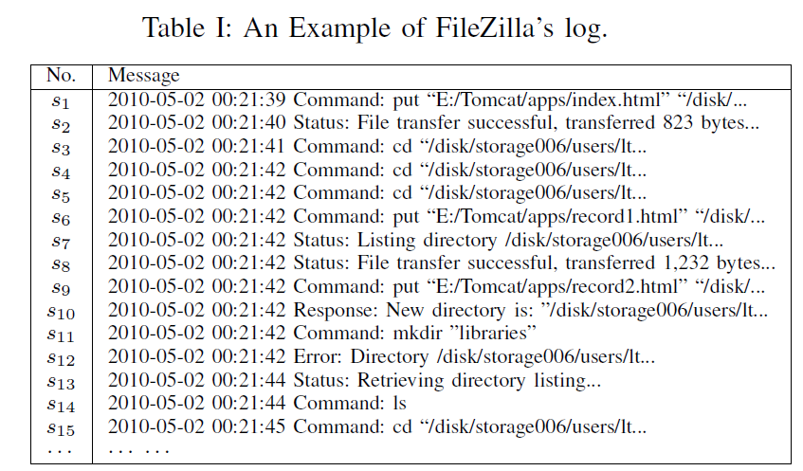
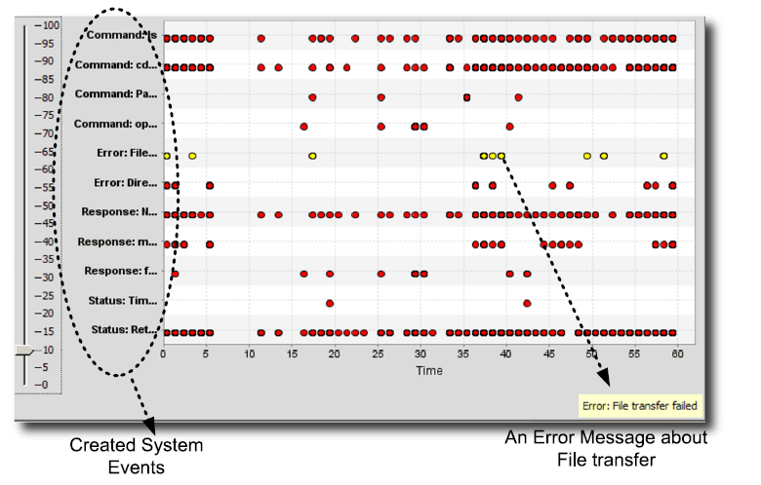
Why Convert Textual Logs to System Events?
System events are easier to analyze other textual logs.

Slide 8
Existing Solutions
Write a log parser (W. Xu et al., 2008):
Requires to understand all log messages.
Document or Source code are not available.
Implementation is time consuming.
Document clustering with Bag-of-Word model:
Short lengths of log messages but a Large vocabulary. Due to the curse of the dimensionality, the clustering result would be very poor.
Other clustering methods (M. Aharon et al., 2009; A. Makanju et al, 2009):
Extract structure features of log messages, but only work for some types of log messages.

Slide 9
Preliminary Work: Message Signature Based Clustering
Message signature is the signature of the template.
One type of log messages is generated by one template with different parameters.
Permission denied
Message signature
[Thu Apr 01 00:07:31 2010] [error] [client 131.94.104.150] File does not exist: /opt/website/sites/users.cs.fiu.edu/data/favicon.ico
[Thu Apr 01 03:47:47 2010] [crit] [client 61.135.249.68] (13)Permission denied: /home/public_html/ke/.htaccess pcfg_openfile: unable to check htaccess file, ensure it is readable
[Thu Apr 01 01:41:18 2010] [error] [client 66.249.65.17] Premature end of script headers: preferences.pl
[Thu Apr 01 01:44:43 2010] [error] [client 207.46.13.87] File does not exist: /home/bear-011/users/giri/public_html/teach/6936/F03
File does not exist
Bad script

Slide 10
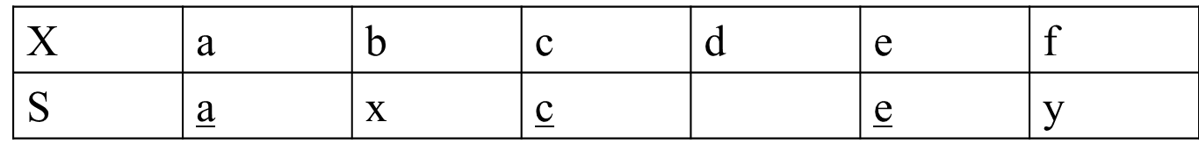
Message Signature based Clustering
Problem: Find k most representative message signatures.
Question: How to quantify the “representativeness” ?
Definition:
Given a message X and a message signature S, the match score is the number of matched terms minus the number of unmatched terms.
match(X,S) = |LCS(X,S)| - (|S| - |LCS(X,S)|) =2|LCS(X,S)|- |S|, LCS=Longest Common Subsequence.
Example:
X=“abcdef”, S=“axcey”, match(X,S)=|ace| - |xy| = 1

Slide 11
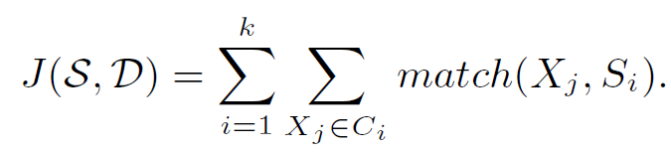
Problem Definition
Given a set of log messages D and an integer k, find k message signature S = {S₁,…,S_{k}} and a k-partition C₁,…,C_{k} of D to maximize:
Problem Analysis:
Similar to k-means problem, but NOT really.
Finding the Optimal Solution is NP-Hard, even if k=1.
Multiple Longest Common Subsequence Problem can be reduced to our problem.

Slide 12
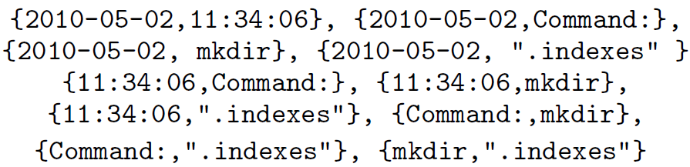
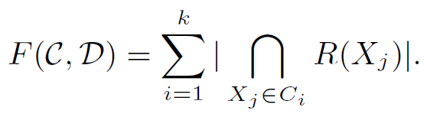
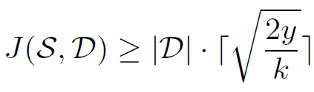
Approximate Problem 1
Convert each log message into Term Pairs:
Maximize
Lemma: If F(C,D) ≥ y, then
R(X_{j}): the set of term pairs of log message Xj.
C={C₁,…,C_{k}} is the partition of log messages
S is the set of signatures
However, F value can be changed by a series of updates of C (not smooth), not good for local search algorithms.
Notes:
y is a constant. F value can be updated by multiple movements, not a single movement.

Slide 13
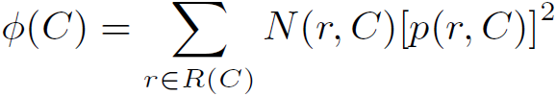
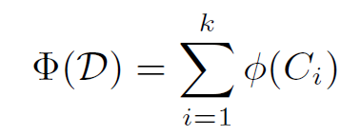

Approximate Problem 2
Potential for one message group
Given a message group C, the potential of C is defined as
N(r,C) is the number messages in C that contain pair r. p(r,C)= N(r,C)/|C| is the portion of messages in C having r.
Overall Potential
Sum of all message groups’ potentials.
Lemma: If F(C,D) ≥ y, then
Notes:
y is a constant

Slide 14
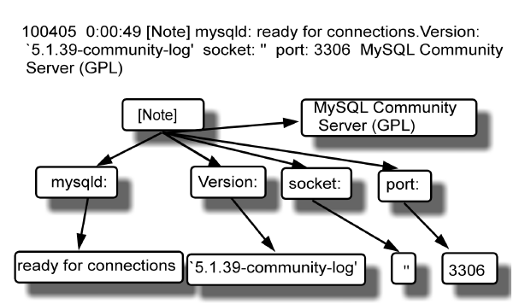
Tree-Structure based Clustering
Log messages are too short. Extracting the structural information can help the clustering by a context-free parser. (Most log messages have similar context-free grammars).
Computing the similarities of trees instead of the raw textual messages.

Slide 15
Outline
Background and Overview
Research Problems
Converting Textual Log to System Events
Monitoring Configuration Optimization
False Positive
False Negative
Analysis on Detected System Issues
Temporal Dependencies of Events
Incident Resolution Recommendation
Textual Log Segments Search
Summary and Timeline

Slide 16
What is False Positive (False Alarm)?
If PROCESS_CPU_UTILIZATION > 50% and duration > 10 minutes, then generates a CPU alert
“rtvscan.exe” scans the system periodically, it is CPU intensive but it is normal, so it triggers a lot of false positives (false alerts).
If PAGING_UTILIZATION_15min > 400, then generate a paging alert (default situation in IBM Tivoli monitoring)
Some customer servers have multiple CPU and huge memories. For those multi-CPU servers, it is normal for page swapping over thousands of times in 15 minutes.

Slide 17
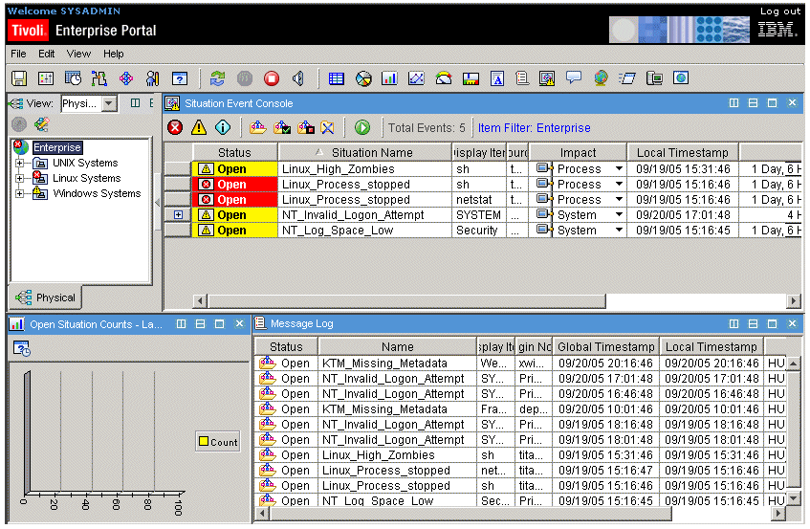
Why We Have False Positive?
Too Conservative Configurations
Missing a real alert would incur system crash, data loss.
Changes of Monitored Servers
New servers and more powerful device are installed.
Transient Alerts:
Temporal CPU, Paging, Disk Spike.
Restart of servers, processes, services, routers…
IBM Tivoli Monitoring
Complicated configurations for IBM Tivoli monitoring

Slide 18
Problem Statement
Eliminate false positives by refining the Monitoring configurations
Retain all real alerts. No real alert is allowed to miss.

Slide 19
Potential Approaches
Supervised Method
Build a predictor for predicting false positive.
Unsupervised Methods
Outlier detection (S. Agrawal et al., 2007, K. Xu et al., 2005)
Adaptive threshold (S.R. Kashyap et al., 2008)
…
However, they do not guarantee NO real alert is missed.

Slide 20
Preliminary Work
Most false positive alerts are transient alerts ( automatically disappear in a short time).
Most false alerts are transient alerts.
Some transient alerts may be indications of future real alerts and may be useful. But if those real alerts rise later on, the monitoring system will detect them even if the transient alerts were ignored.

Slide 21
Outline
Background and Overview
Research Problems
Converting Textual Log to System Events
Monitoring Configuration Optimization
False Positive
False Negative
Analysis on Detected System Issues
Temporal Dependencies of Events
Incident Resolution Recommendation
Textual Event Segments Search
Summary and Timeline

Slide 22
What is False Negative (Missed Alert) ?
False Negatives are the missed alerts by the monitoring system (not by humans).
False Negatives are usually captured by human (customers, helpdesk, system administrators).
False Negatives are NOT recorded in events, but only in manual tickets.

Slide 23
Why We Have False Negatives?
New devices and software are installed, but not added into the monitoring configurations
For example, the customer may install a new database by themselves. But the monitoring team does not know it. When the database has an incident, it cannot be captured by the monitoring system.
Other changes for existing systems.

Slide 24
Problem Statement
Eliminate false negatives by refining the monitoring configurations
It consists of two parts:
Scan the historical manual tickets and provide a short list of potential false negatives to the monitoring team (This is our work).
Change or add monitoring situations (This is monitoring team’s work).

Slide 25
Related Research and Challenges
Related research:
Improve the accuracy of the monitoring methodologies. No priori work that mentions how to utilize the ticket data.
A straightforward method: Build a binary classifier to classify the manual tickets
Label “1”: a missed alert
Label “0”: other issues, such as customer request.
Challenges
Highly Imbalance manual tickets. Most tickets’ labels are “0”. Only 1% or less are “1”.
Labeled data is rare.

Slide 26
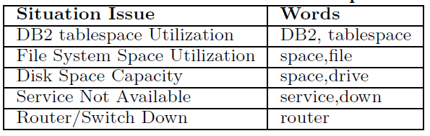
Proposed Method
Selective Labeling by domain words (labeled features)
Use coverage of domain words to rank all tickets.
Only select top ranked tickets for labeling and training
Build a binary SVM classifier.

Slide 27
Outline
Background and Overview
Research Problems
Converting Textual Log to System Events
Monitoring Configuration Optimization
False Positive
False Negative
Analysis on Detected System Issues
Temporal Dependencies of Events
Incident Resolution Recommendation
Textual Event Segments Search
Summary and Timeline

Slide 28
What is Temporal Dependency?
Disk_Capacity ⟶ _{[5min,6min]} Database, [5min, 6min] is the lag interval.

Slide 29
Why We Want to Find the Temporal Dependencies?
Finding dependent system components
Identify the root cause of system problems
…
Finding correlated monitoring situations
Remove redundant situations
Event correlation
…

Slide 30
Existing Approaches
Predefine the lag interval (H. Mannila et al., 1997)
No interleaved dependency (T. Li et al., 2005, K. Bouandas et al., 2007)
?
Disk_Capacity ⟶ _{[5min,6min]} Database, [5min, 6min] is the lag interval.

Slide 31
Relation with Other Temporal Patterns
Those temporal patterns can be seen as the temporal dependency with particular constraints on the time lag.

Slide 32
Challenges for Finding Time Lag
Given a temporal dependency, A⟶_{[t1,t2]}B, what kind of lag interval [t1,t2] we want to find?
If the lag interval is too large, every A and every B would be “dependent”.
If the lag interval is too small, real dependent A and B might not be captured.
Time complexity is too high.
A⟶_{[t1,t2]}B, t1 and t2 can be any distance of any two time stamps. There are O(n⁴) possible lag intervals.

Slide 33
What is a Qualified Lag Interval
If [t1,t2] is qualified, we should observe many occurrences for A⟶_{[t1,t2]}B.
Lag Interval | Number of Occurrences
[0,1] | 3
[5,6] | 4
[0,6] | 4
[0,+∞] | 4
Length of the lag interval is larger, the number of occurrences also becomes larger.

Slide 34
What is a Qualified Lag Interval
Intuition (Statistical Testing):
If A and B are randomly and independently distributed, how many occurrences observed in a time interval [t1,t2]?
What is the minimum number of occurrences (threshold)?
Consider the number of occurrences in a lag interval to be a variable, n_{r}. Then, use the chi-square test to judge whether it is caused by randomness or not?
Expected value
The number of As
Total time length of the event sequence

Slide 35
Straightforward Algorithms for Finding Qualified Lag Intervals
(Brute-Force) Algorithm: For A⟶_{[t1,t2]}B, for every possible t1 and t2, scan the event sequence and count the number of occurrences.
Time Complexity
The number of distinct time stamps is O(n).
The number of possible t1 and t2 is O(n²).
The number of possible [t1,t2] is O(n⁴).
Each scanning is O(n). The total cost is O(n⁵).
Cannot handle large event sequences.

Slide 36
Time Complexity Lower Bound
The problem of finding all qualified time intervals is 3SUM-Hard, so the there is o(n²) algorithm in the worst case (A. Gajentaan et al., 1995).
3SUM problem: Given a set of n integers, is there three integers a,b,c in the set such that a+b=c?
No o(n²) algorithm can solve this problem in the worst case.

Slide 37
Preliminary Work: STScan Algorithm
Idea:
Avoid redundant scanning, store all time lags into a sorted table.
t(x₅)-t(x₃)=3030-3010=20.
E₂ is 20, so
insert 3 into IA₂,
insert 5 into IB₂.

Slide 38
STScan Algorithm
Every lag interval is represented as a sub-segment of the linked list.
For example: [20,120] is E₂E₃E₄, the number of occurrences is |IA₂ ∪ IA₃ ∪ IA₄ |
Time cost for creating this table is O(n²).
The number of elements is O(3n²)=O(n²).
Time cost for scanning is O(n²).

Slide 39
Outline
Background and Overview
Research Problems
Converting Textual Log to System Events
Monitoring Configuration Optimization
False Positive
False Negative
Analysis on Detected System Issues
Temporal Dependencies of Events
Incident Resolution Recommendation
Textual Event Segments Search
Summary and Timeline

Slide 40
Incident Ticket with Resolution
Ticket ID | Resolver Name | Open Time | Problem Description | Solution Description | …
IBM-C102203 | John | May 7, 2012 6:51:49 AM EDT | Summary: MS SQL issue: database AEFA_DB very little log free space in … | *** Clearing Event Received. Event Follows *** | ….
IBM-C422013 | XC | May 6, 2012 9:06:40 AM EDT | MS SQL issue: bad server status: on server TMPD0371…. | Server reboots resolved_full | …
… | … | … | … | … | …
Observation: If the problem descriptions are similar, the solution descriptions are likely to be similar or identical.

Slide 41
Problem Statement
Build a recommendation model for recommending the relevant resolutions for new tickets.
When a new ticket arrives, recommends top K relevant resolutions

Slide 42
Why We Study this Problem?
Help administrators diagnose new tickets.
Many system problems are not isolated.
Share the knowledge between different administrators.
…

Slide 43
Related Work
User-based Recommendation Algorithms
Item-based Recommendation Algorithms
Constraint-based Recommender Systems
Multiple Objective Optimization…

Slide 44
Preliminary Work
User-based Top-K Recommendation
Find top K similar tickets based on problem descriptions
Incorporating the penalty of “wrong” recommendation
Recommending a false ticket’s resolution to a real ticket would mislead the administrators (may incur serious consequences).
However, we do not know a new ticket is real or false.
Combine the ticket prediction confidence with the ticket relevance.

Slide 45
Proposed Method
Measuring the quality of the resolutions
No explicit ratings of resolutions.
Many resolutions are not informative, like “solved”, “cleared”, “is fixed”.

Slide 46
Outline
Background and Overview
Research Problems
Converting Textual Log to System Events
Monitoring Configuration Optimization
False Positive
False Negative
Analysis on Detected System Issues
Temporal Dependencies of Events
Incident Resolution Recommendation
Textual Event Segments Search
Summary and Timeline

Slide 47
What is Textual Event Segment?
A textual event sequence is a sequence of events, where each event is a text (e.g., textual log sequence)
A segment
A textual event segment is a segment of the textual event sequence. For instance, s₂s₃s₄, but s₂s₃s₅ is not.

Slide 48
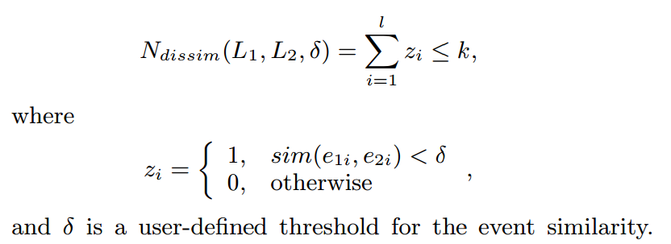
Problem Statement
Given an event sequence S and a query sequence Q, find all segments with length |Q| in S that are similar to Q.
What is the dissimilarity:
In other words, similar segments have at most k dissimilar events.

Slide 49
Why We Study This Problem?
Investigating historical logs is a common way to diagnose the system incident.
Similar event segments reveal similar system behaviors.
Comparing similar event segments help to find out the reason for a system problem.
We allow similar segments have some dissimilar events, because they may be the abnormal behavior.

Slide 50
Potential Solutions
Unordered Text Similarity Search
LSH(Locality Sensitive Hashing) (A. Gionis et al., 1999) + Min Hash Function(A. Z. Broder et al., 1998).
…
Code Sequence Match or Alignment
Suffix Tree, Suffix Array (U. Manber, 1993)
…

Slide 51
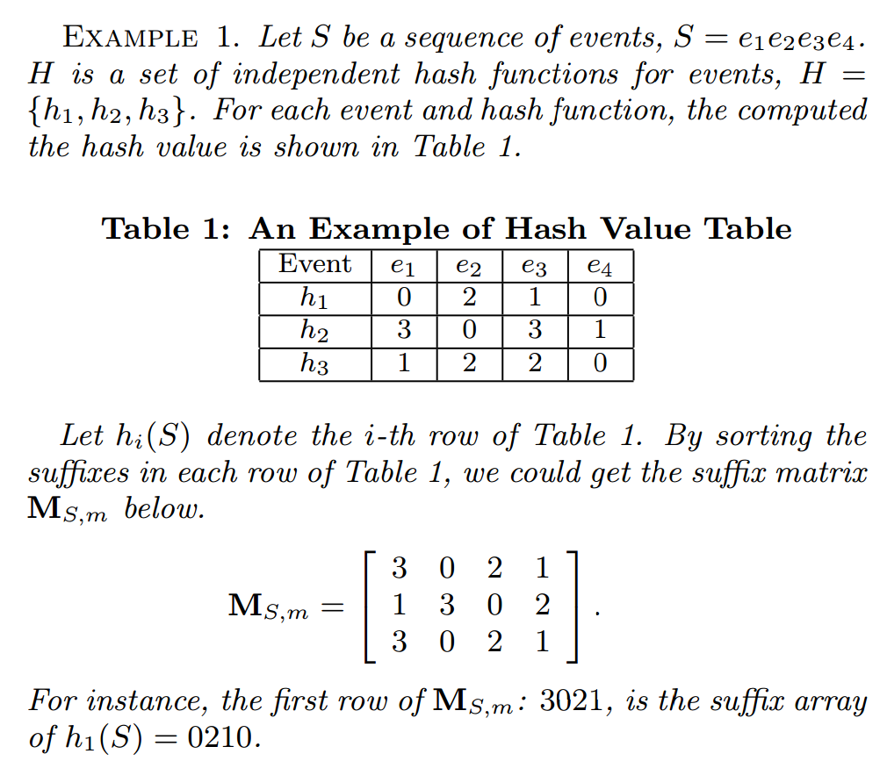
Preliminary Work
LSH + Suffix Array = Suffix Matrix
Offline Indexing:
Step 1. Construct m random hash functions
Step 2. For each hash function, compute the hash value of each event.
Step 3. For each hash value sequence, build the suffix array as a row of the suffix matrix.
Online Search:
Step 1. Use the m hash functions to hash query Q and get m hash value query sequences.
Step 2. Use every hashed query sequence to do binary search over suffix arrays and get candidate segment positions.
Step 3. If one segment appears in many candidate sets, pick it as the final candidate.

Slide 52
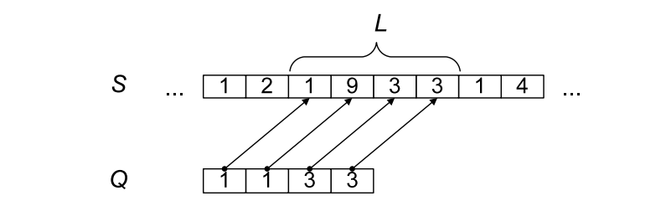
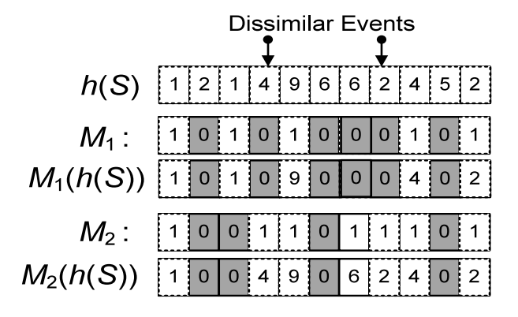
Handling Dissimilar Events
dissimilar event
9 is not equal to 1. L and Q are not in the same partition in suffix array. Binary search fails.
Idea: create more suffix arrays, but ignore some events (that could be the dissimilar events).
Original Hash Value Sequence
Random Mask
Masked Hash Value Sequence
Dissimilar events are masked in M₁(h(S)) and do NOT hurt the binary searches.

Slide 53
Outline
Background and Overview
Research Problems
Converting Textual Log to System Events
Monitoring Configuration Optimization
False Positive
False Negative
Analysis on Detected System Issues
Temporal Dependencies of Events
Incident Resolution Recommendation
Textual Event Segments Search
Summary and Timeline

Slide 54
Summary
Monitoring Configuration Optimization:
Reduce False positive (false alerts)
Reduce False negative (missed alerts)
Convert Raw Logs into System Events
Green one is already done.
Red one is ongoing.
System Incidents Diagnosis :
Locate Relevant Logs Efficiently.
Discover Event Dependencies.
Automatic Resolution Recommendation

Slide 55
Timeline
End of 2013 Fall
Finish “False Negative Discovery”.
Finish “Ticket Resolution Recommendation”.
2014 Spring
Defense and Finish Dissertation.
2014 Summer
Apply Graduation.

Slide 56
References
A. Gajentaan and M. H. Overmars, “On a class of O(n²) problems in computational geometry”, in Computational Geometry, 5:165-185, 1995.
A. Gionis, P. Indyk, and R. Motwani, “Similarity search in high dimensions via hashing”, in VLDB 1999.
A. Makanju, A. N. zincir-Heywood, and E. E. Milios, “Clustering event logs using iterative partitioning”, in KDD 2009.
A. Z. Broder, N. Charikar, A. M. Frieze, and M. Mitzenmacher, “Min-wise independent permutations” in STOC 1998.
H. Mannila, H. Tovionen, and A. I. Verkamo, “Discovery of frequent episodes in event sequences”, in DMKD, 1(3):259-289, 1997.
K. Bouandas and A. Osmani, “Mining association ruls in temporal sequences”, in CIDM 2007.
M. Aharon, G. Barash, I. Cohen, and E. Mordechai, “One graph is worth a thousand logs: Uncovering hidden strutures in massive system event logs”, in ECML/PKDD, 2009.
K. Xu, Z.-L. Zhang, and S. Bhattacharyya, “Profiling internet backbone traffic: behavior models and applications”, in SIGCOMM 2005.
L. Tang, T. Li, F. Pinel, L. Shwartz, and G. Grabarnik, “Optimizing system monitoring configurations for non-actionable alerts”, in IEEE/IFIP NOMS, 2012.
S. Agrawal, S. Deb, K.V.M. Naidu, and R. Rastogi, “Efficient detection of distributed constraint violations”, in ICDE 2007.
S. R. Kashyap, J. Ramamirtham, R. Rastogi, and P. Shukla, “Efficient constraint monitoring using adaptive thresholds”, in ICDE 2008.
T. Li and S. Ma, “Mining temporal patterns without predefined time windows”, in ICDM 2004.
U. Manber and E. W. Myers, “Suffix arryas: A new method for on-line string searches”, in SIAM J. Comput., 22(5):935-948, 1993.
W. Xu, L. Huang, A. Fox, D. A. Patterson, and M. I. Jordan, “Mining console logs for large-scale system problem detection”, in SysML, 2008.

Slide 57
Recent Publications (11 full conference papers, 1 short paper, 2 journal papers)
2013
Liang Tang, Romer Rosales, Ajit Singh, Deepak Agarwal. "Automatic Ad Format Selection via Contextual Bandits", in Proceedings of the 22th ACM Conference on Information and Knowledge Management (CIKM 2013), San Francisco, USA, Dec. 2013. (full paper, invited paper). Liang Tang, Tao Li, Shu-Ching Chen, Shuzhi Zhu. "Searching Similar Segments over Textual Event Sequences", in Proceedings of the 22th ACM Conference on Information and Knowledge Management (CIKM 2013), San Francisco, USA, Dec. 2013. (full paper, acceptance rate: 143/848=16.8%). Li Zheng, Chao Shen, Liang Tang, Chunqiu Zeng, Tao Li, Steve Luis, Shu-Ching Chen. "Data Mining Meets the Needs of Disaster Information Management", IEEE Transactions on Human-Matchine Systems, 2013, to appear. Liang Tang, Tao Li, Larisa Shwartz, Genady Ya. Grabarnik. "Identifying Missed Monitoring Alerts based on Unstructured Incident Tickets", in Proceedings of the 9th International Conference on Network and Service Management (CNSM 2013), Zurich, Swizerland, Oct. 2013. (short paper), to appear. Liang Tang, Tao Li, Larisa Shwartz, Florian Pinel, Genady Ya. Grabarnik. "An Integrated Framework for Optimizing Automatic Monitoring Systems in Large IT Infrastructures", in Proceedings of the 19th ACM SIGKDD Conference on Knowledge Discovery and Data Mining (KDD'13), Chicago, USA, Aug. 2013. (Industrial/Government Track, full presentation). Liang Tang, Tao Li, Yexi Jiang, Zhiyuan Chen "Dynamic Query Forms for Database Queries", IEEE Transactions on Knowledge and Data Engineering(TKDE), 2013. Liang Tang, Tao Li, Larisa Shwartz, Genady Grabarnik. "Recommending Resolutions for Problems Identified by Monitoring", in Proceedings of the IFIP/IEEE International Symposium on Integrated Network Management(IM'2013), 2013 (regular technical track, acceptance rate: 27.0%) .
2012
Li Zheng, Chao Shen, Liang Tang, Chunqiu Zeng, Tao Li, Steve Luis, Shu-Ching Chen and Jainendra K. Navlakha. "Disaster SitRep - A Vertical Search Engine and Information Analysis Tool in Disaster Management Domain", in Proceedings of the 13th IEEE International Conference on Information Integration and Reuse(IRI'12). Liang Tang, Tao Li, Larisa Shwartz. "Discovering Lag Intervals for Temporal Dependencies", in Proceedings of the 18th ACM SIGKDD Conference on Knowledge Discovery and Data Mining (KDD'12), Beijing, China, Aug. 2012. (research track, full presentation, acceptance rate: 133/755=17.6%) Liang Tang, Tao Li, Florian Pinel, Larisa Shwartz, Genady Grabarnik. "Optimizing System Monitoring Configurations for Non-Actionable Alerts", in Proceedings of IEEE/IFIP Network Operations and Management Symposium (NOMS'2012), 2012 (main technical paper, acceptance rate: 26.2%)
2011
Liang Tang, Tao Li, Chang-Shing Perng. "LogSig: Generating System Events from Raw Textual Logs", in Proceedings of the 20th ACM Conference on Information and Knowledge Management (CIKM'11), 2011 (Full paper, acceptance rate: 15%) Li Zheng, Chao Shen, Liang Tang, Tao Li, Steve Luis, Shu-Ching Chen. "Applying Data Mining Techniques to Address Disaster Information Management Challenges on Mobile Devices", in Proceedings of the 17th ACM SIGKDD Conference on Knowledge Discovery and Data Mining (KDD'11), 2011 (Industrial/Government Track, full presentation, acceptance rate: 8%)
2010
Liang Tang, Tao Li. " LogTree: A Framework for Generating System Events from Raw Textual Logs", in Processdings of the 10th IEEE International Conference on Data Mining (ICDM'10), 2010 (Full paper, acceptance rate: 9%) Li Zheng, Chao Shen, Liang Tang, Tao Li, Steve Luis, Shu-Ching Chen, Vagelis Hristidis. " Using Data Mining Techniques to Address Critical Information Exchange Needs in Disaster Affected Public-Private Networks ", in Proceedings of the 16th ACM SIGKDD Conference on Knowledge Discovery and Data Mining(KDD'10), 2010 (Industrial/Government Track, Full presentation, acceptance rate: 11%)

