Slide 1
GOAL: Establish in silico model of biparental care
QUESTIONS FOR THE FIRST MS:
What makes an incubation strategy good?
Are strategies good individually, or in combination?
How sensitive is incubation success to environmental change?
How does environmental degradation cause incubation to fail?

Slide 2
GOAL: Establish in silico model of biparental care

Slide 3
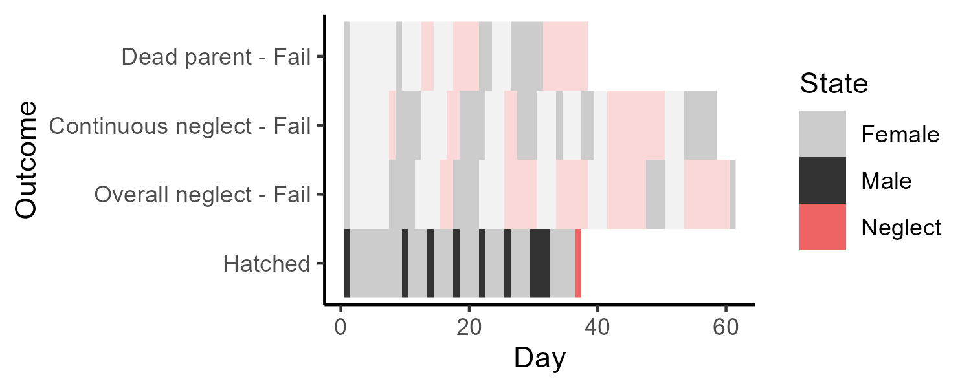

Slide 4
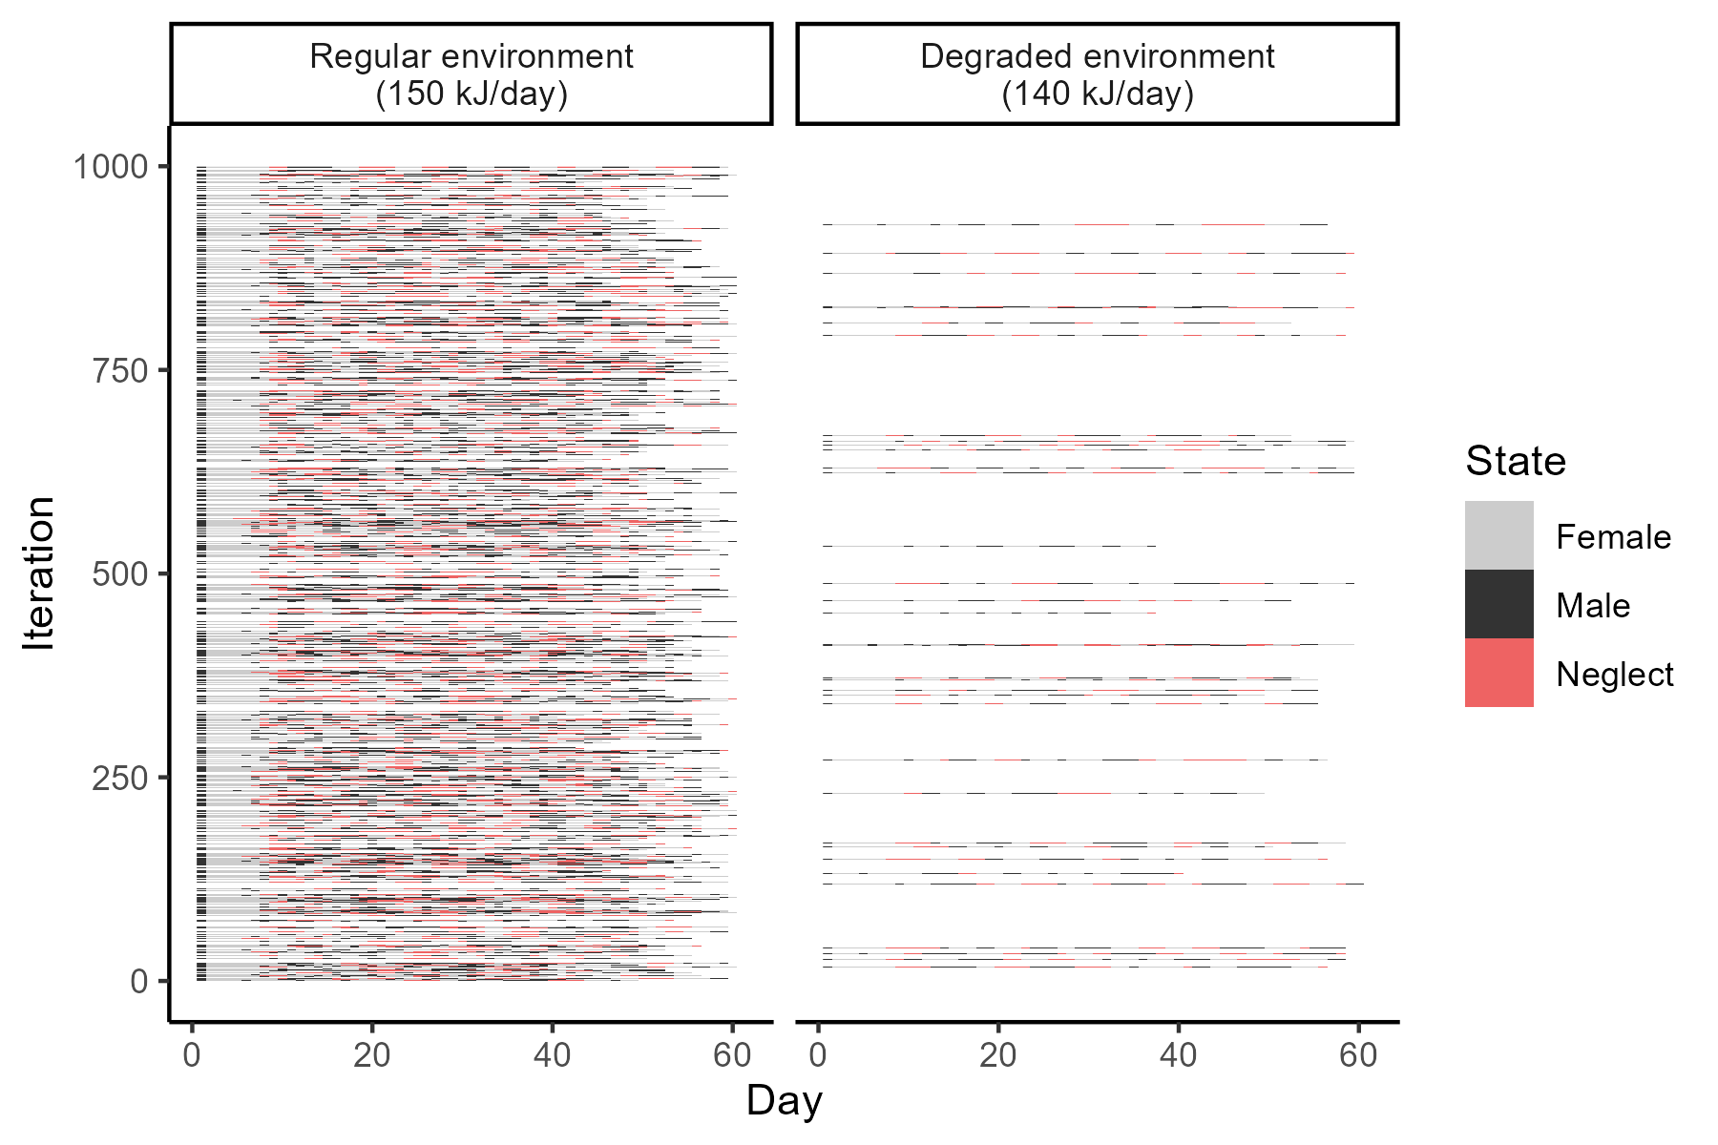

Slide 5
What makes an incubation strategy good?

Slide 6
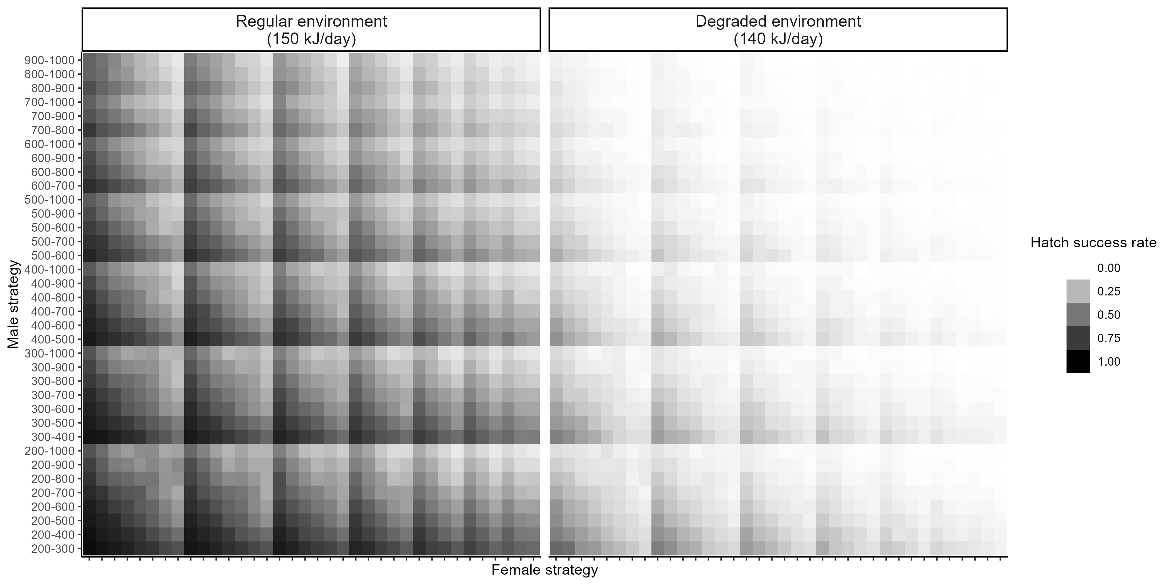

Slide 7
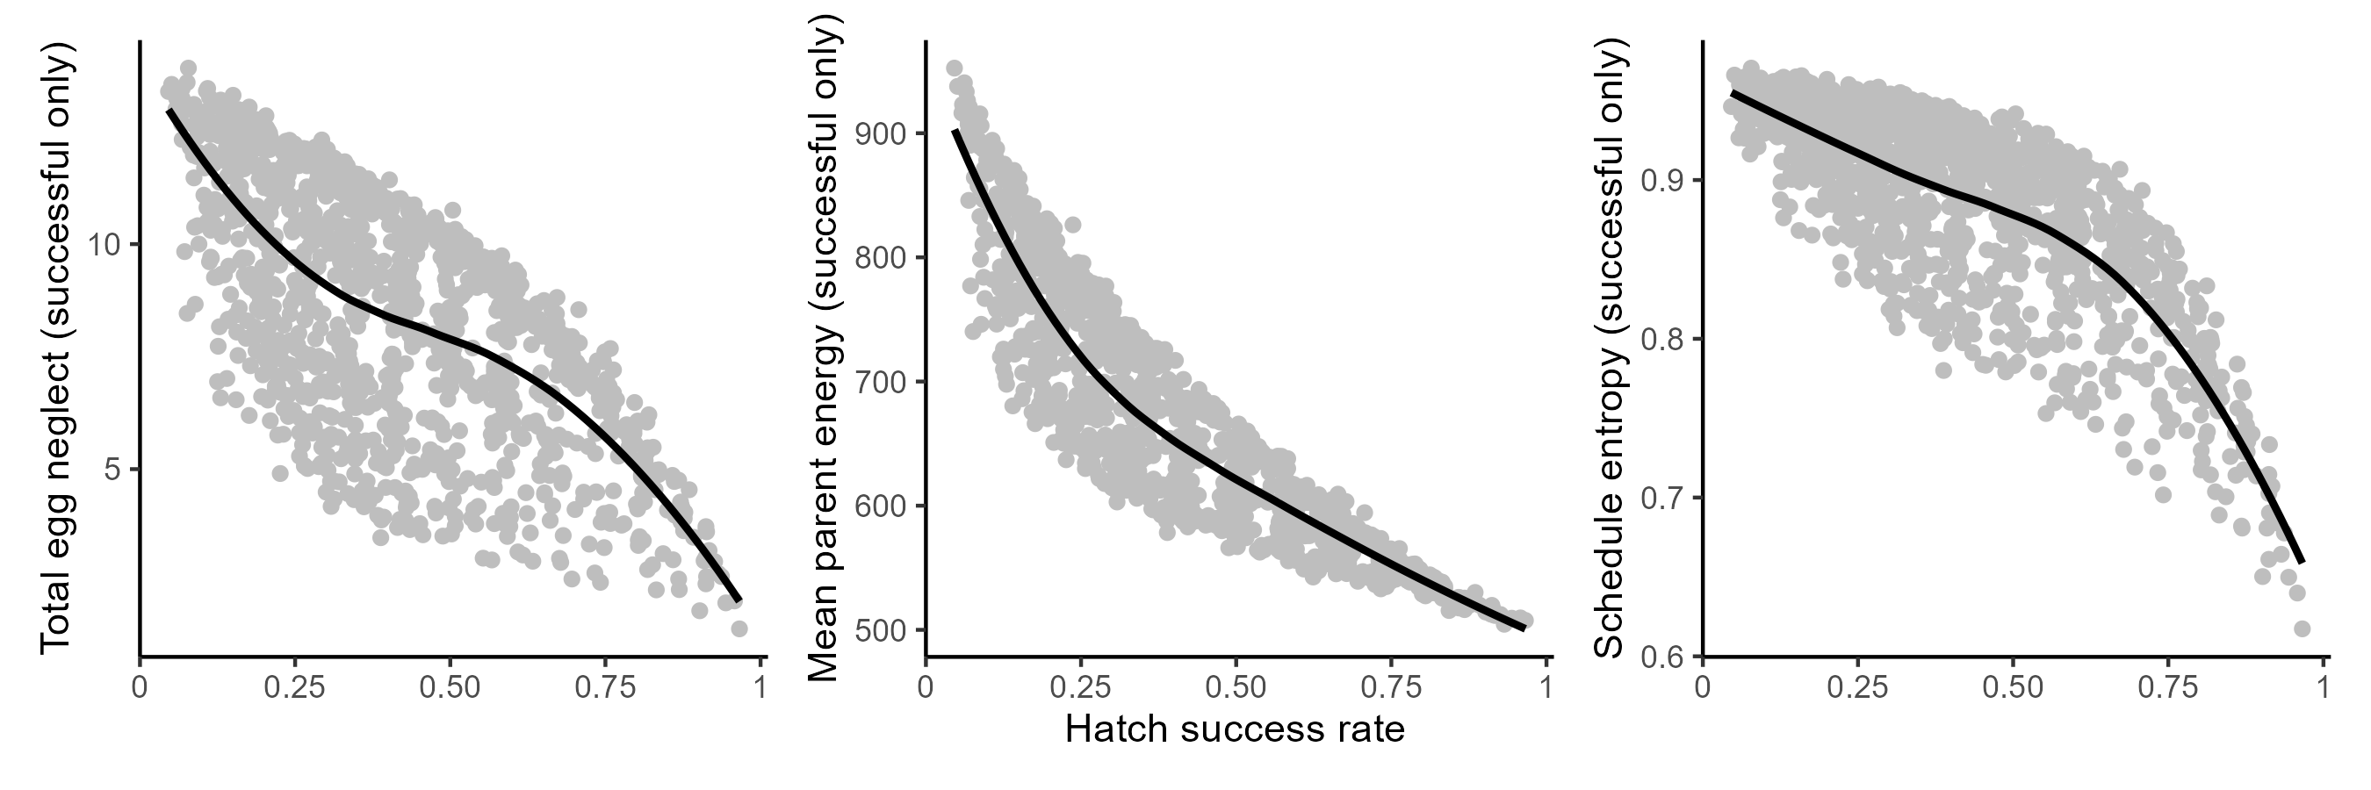
Different strategies in regular environment (150 kJ/day)

Slide 8
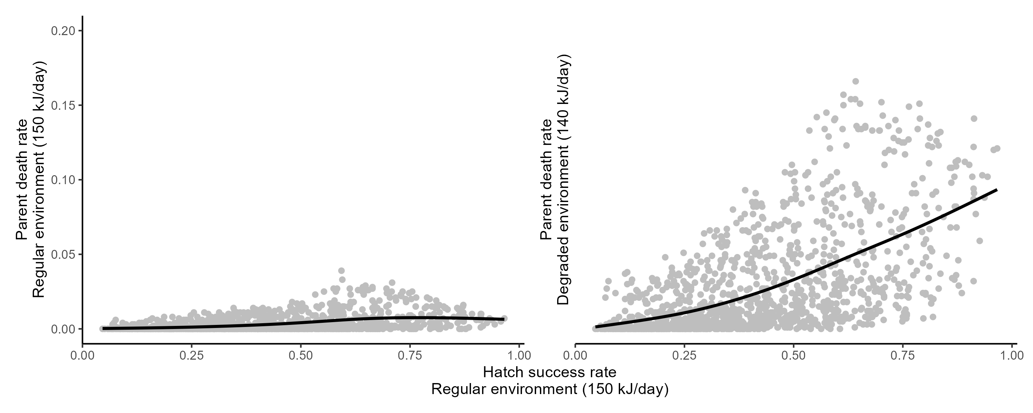

Slide 9
Are strategies good individually, or in combination?

Slide 10
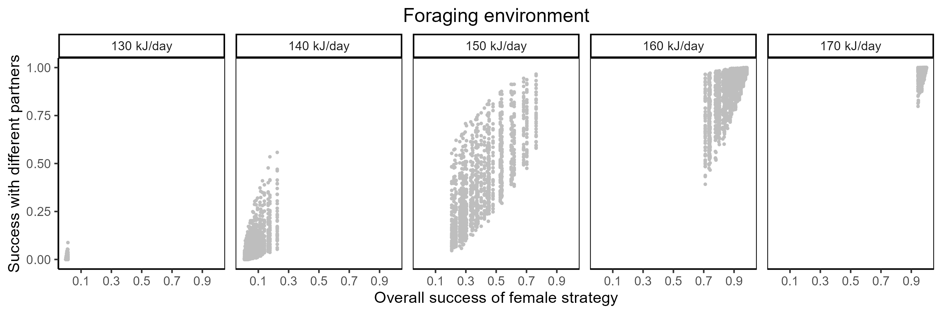

Slide 11
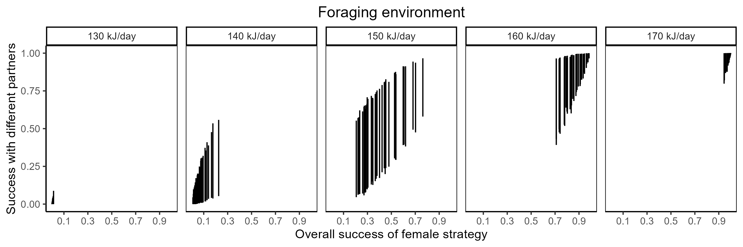

Slide 13
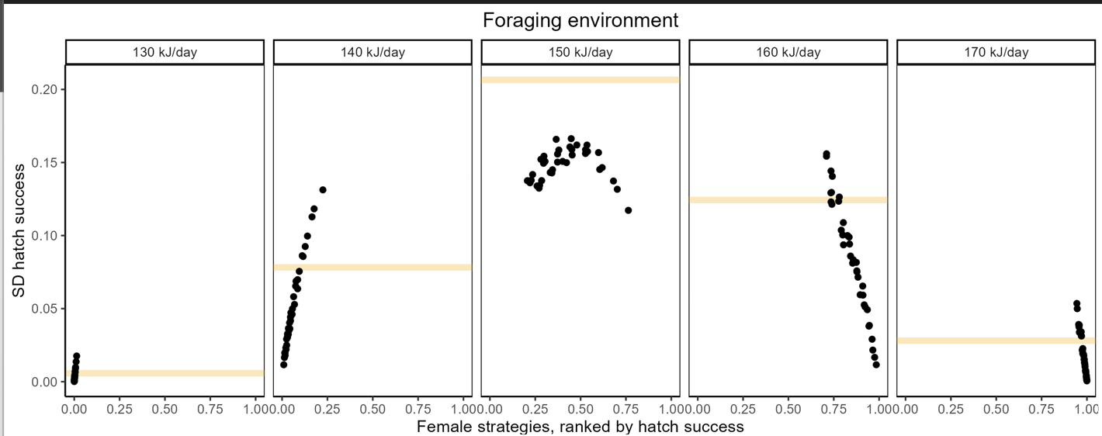

Slide 14
How sensitive is incubation success to environmental change?

Slide 15
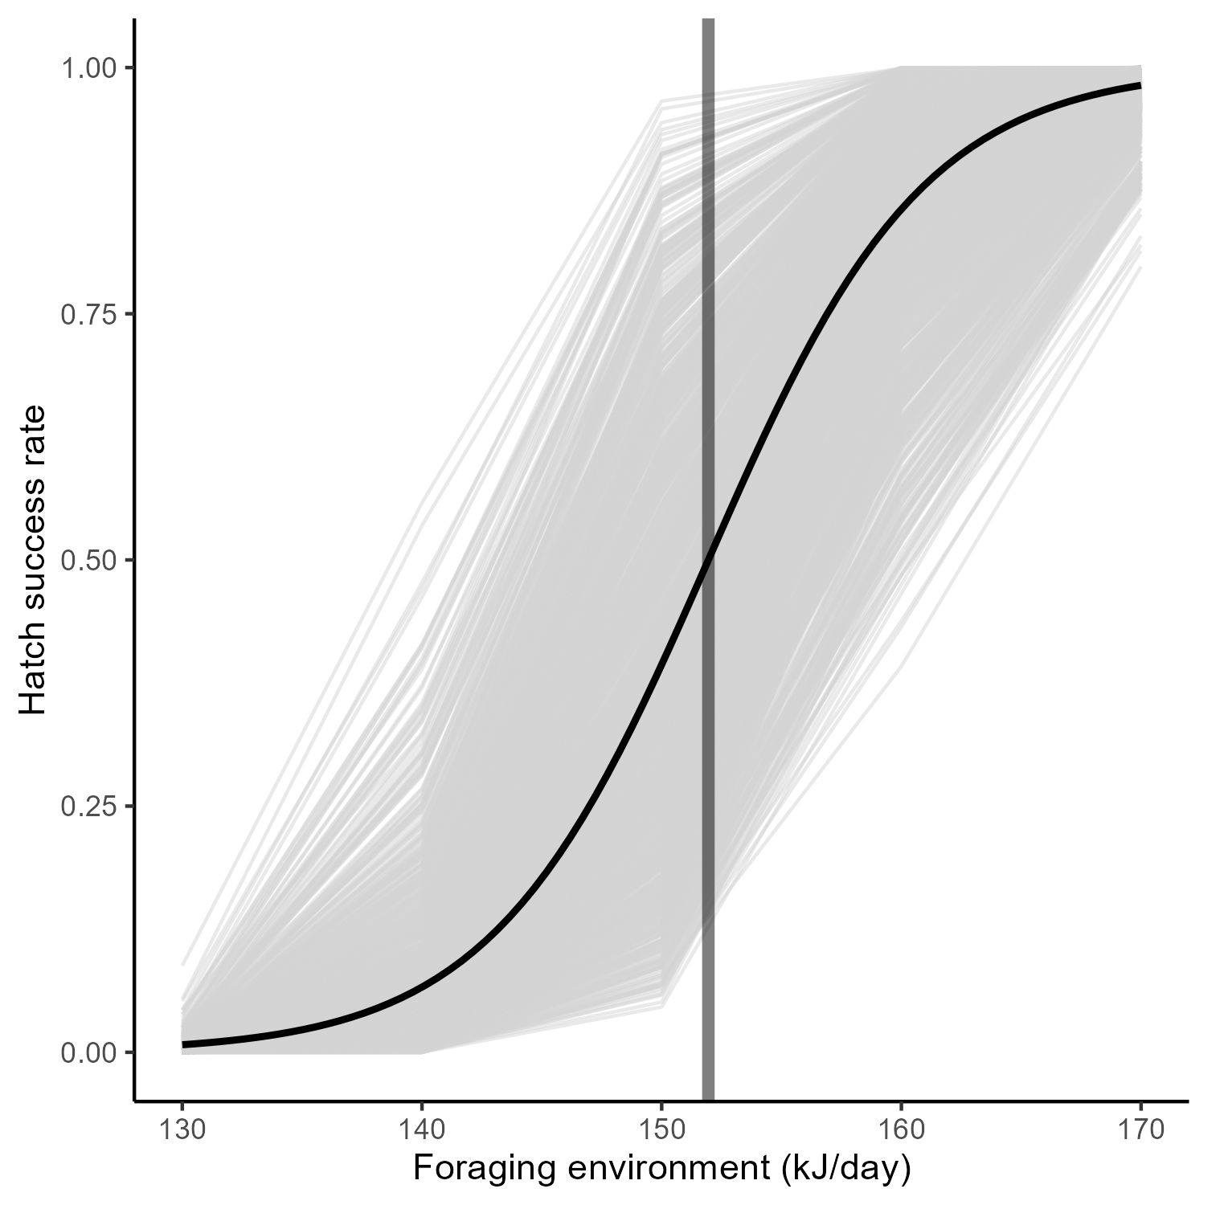

Slide 16
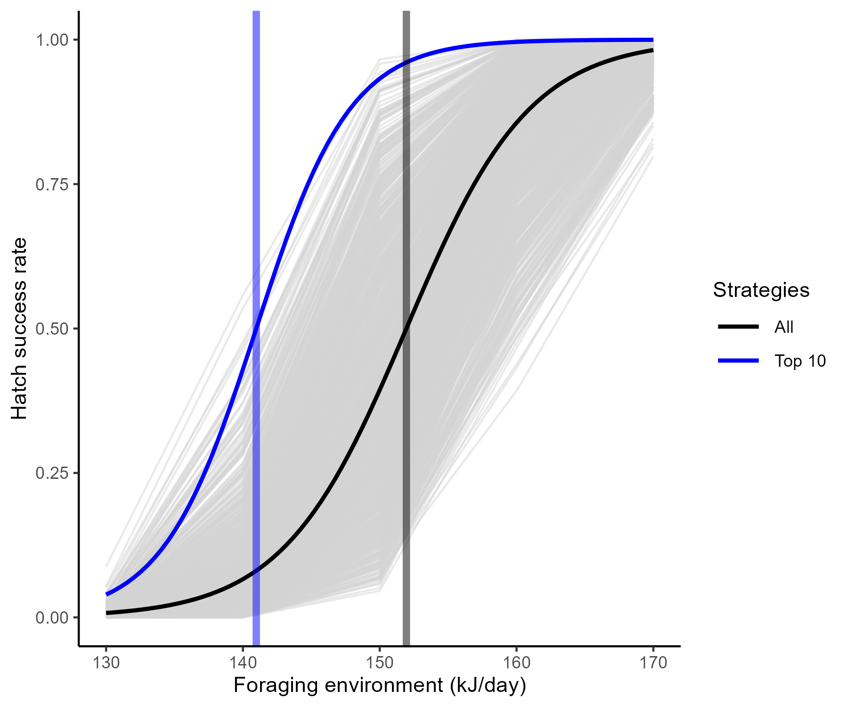

Slide 17
How does environmental degradation cause incubation to fail?

Slide 18
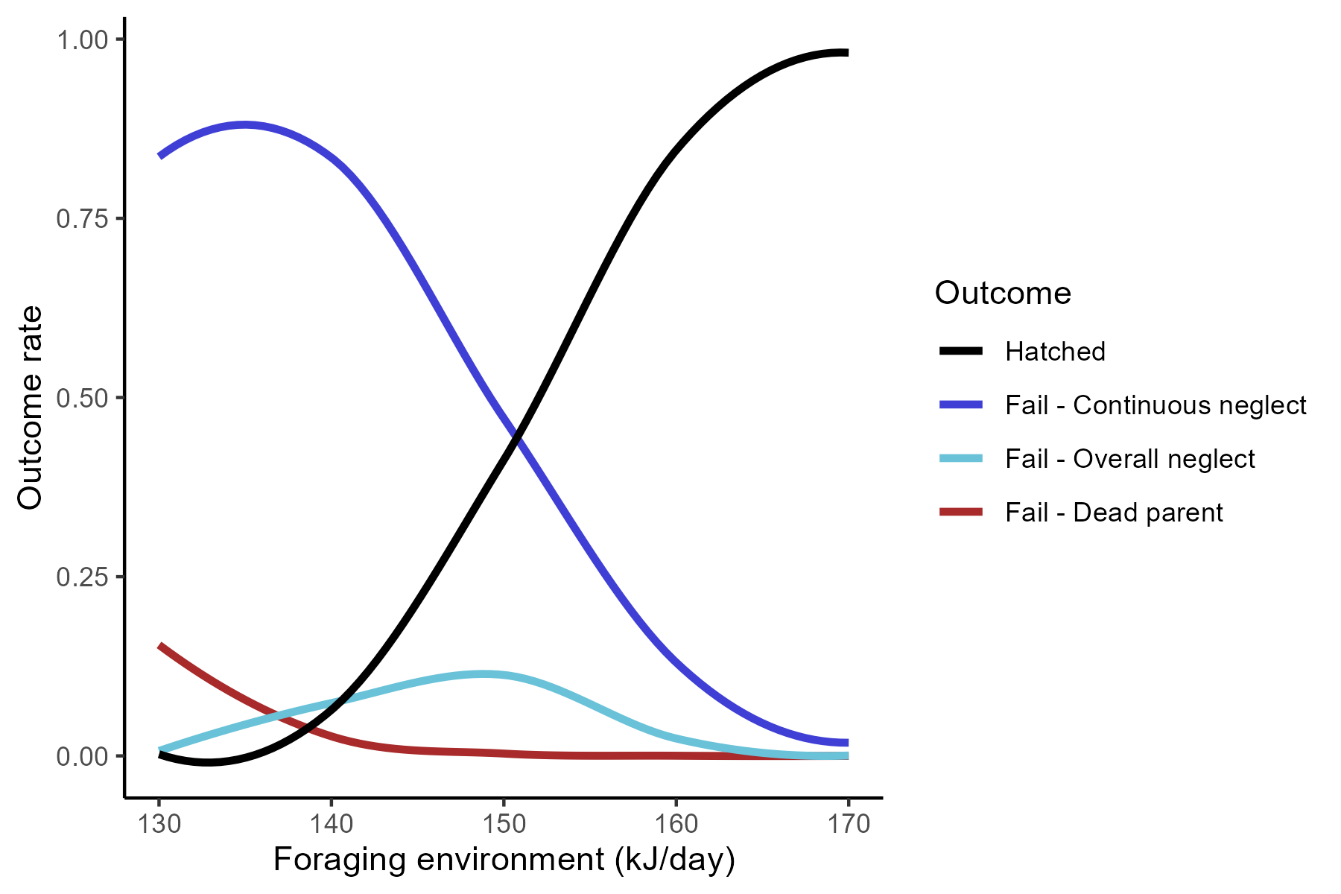

Slide 19
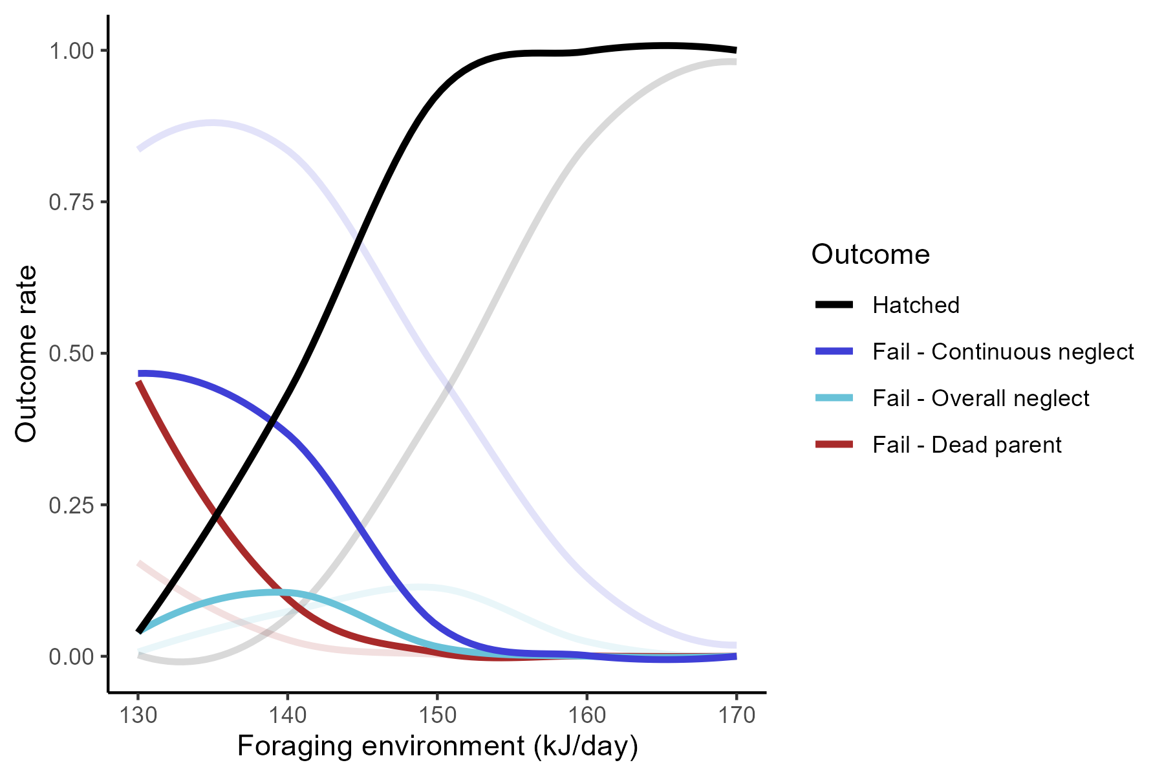
Top 10 strategies only

Slide 20
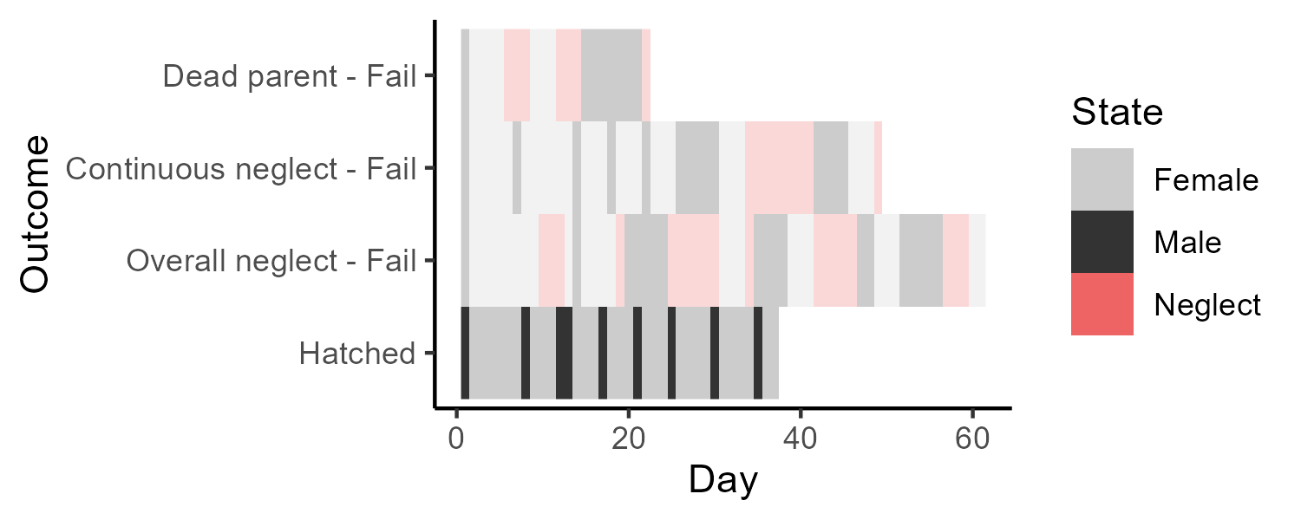

Slide 21
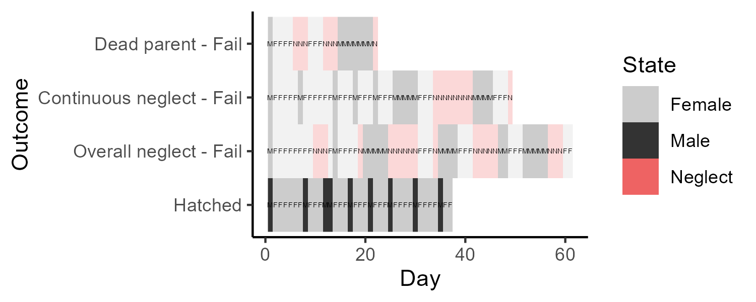

Slide 22
