Slide 1
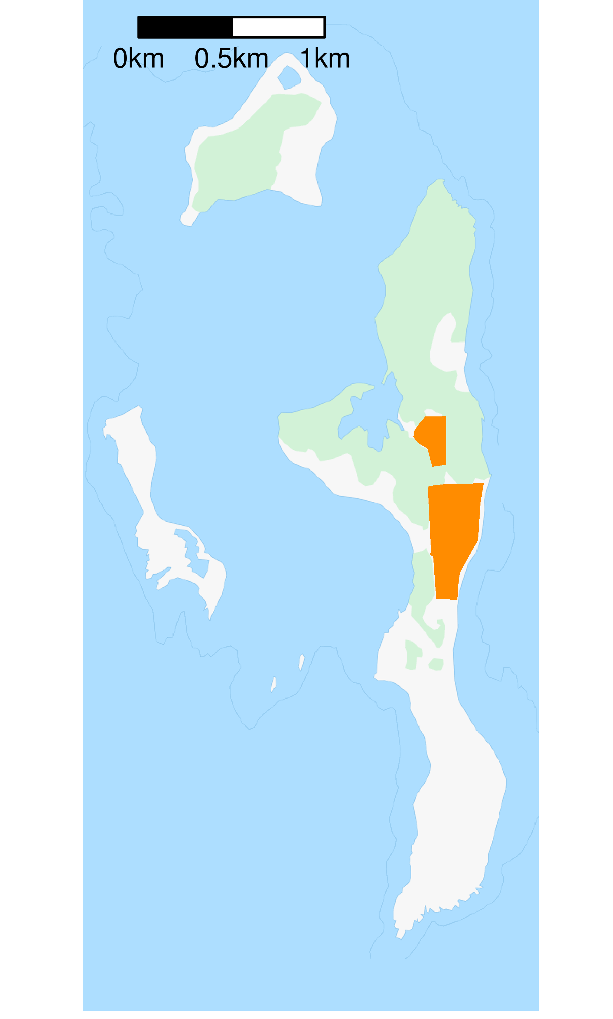
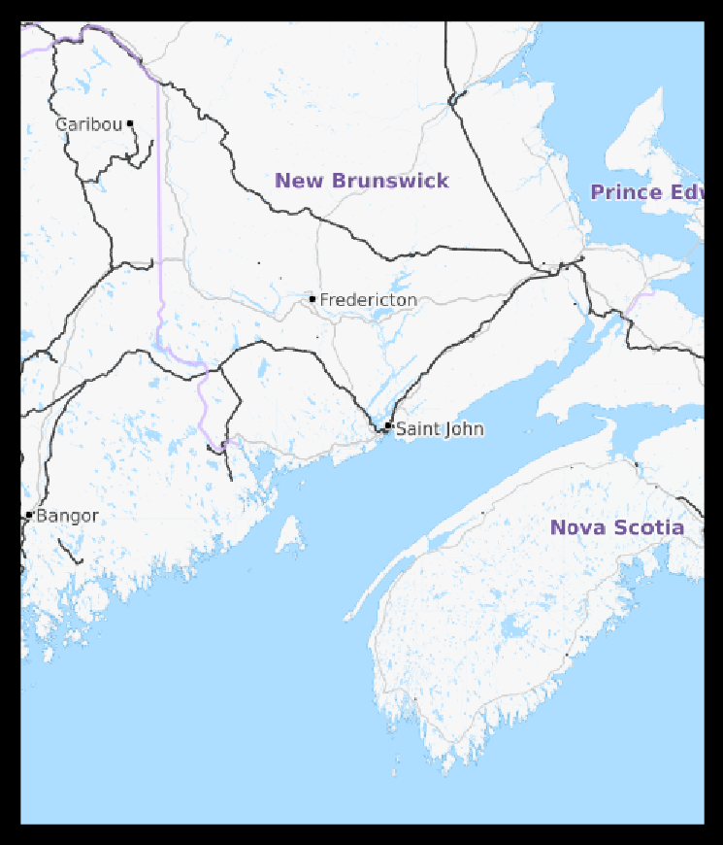
FIGURE 1
Hay Island
Kent
Island
Sheep
Island

