Slide 1
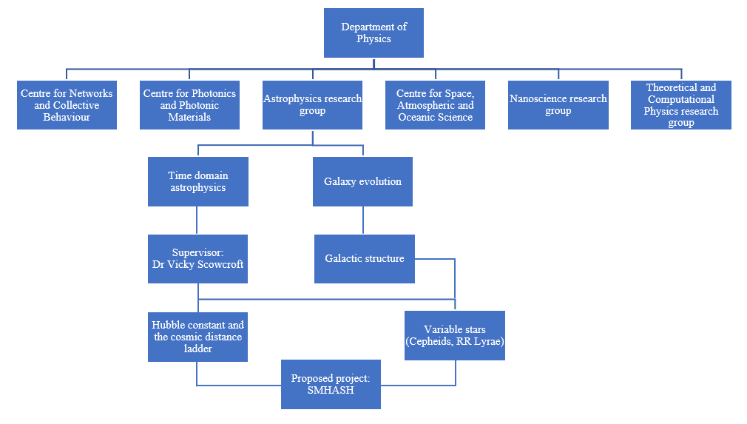
Astrophysics Research Group
Organisational chart of the Department of Physics at the University of Bath.
Detail showing the area of research in which this project resides (Proposed project: SMHASH).

Slide 2
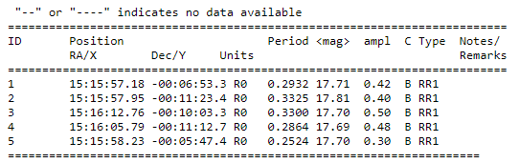
RR Lyrae catalogues
Positions (in RA and Dec) and periods of known RRLs obtained from star catalogues
Catalogue of Variable Stars in Galactic Globular Clusters maintained by Christine Clement
Region search in Gaia of stars flagged as variable in 10’ radius around the clusters to identify any extra RRLs within the epoch frames
140784 RRLs in Gaia Data Release 2 (DR2) searched and matched using source_ids from the region search to obtain more up to date periods as well as RRL type
Example of the Catalogue of RRLs in Pal 5:
Note- Periods in days and RR1 type RRLs designated here correspond to RRc type RRLs
Credit: Christine Clement

Slide 3
Research group and interests
Research interests of the project supervisor: Dr Victoria Scowcroft
Involved in the SMHASH program and CRRP
Interests surround scaling the cosmic distance ladder
Obtaining precise Hubble constant values
Worked on both Classical Cepheids and RR Lyrae variables
This particular project surrounds the bottom rungs of the cosmic distance ladder

Slide 4
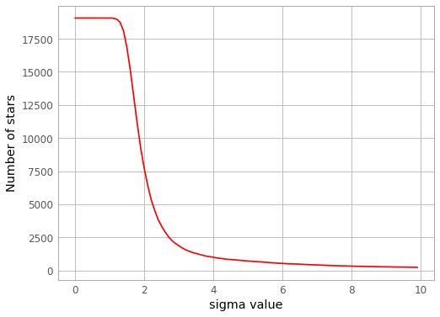
Source detection algorithm
Used a point source detection algorithm called DAOStarFinder, implements a version of DAOFIND as part of the DAOPHOT routine developed by Peter Stetson
Usage requires determining parameters to reduce the number of false positive (or false negative) detections
An optimisation problem!
Full width at half maximum (FWHM) of stars in the sample
Threshold value to consider if a source is a star
The roundness and sharpness of the sources

Slide 5
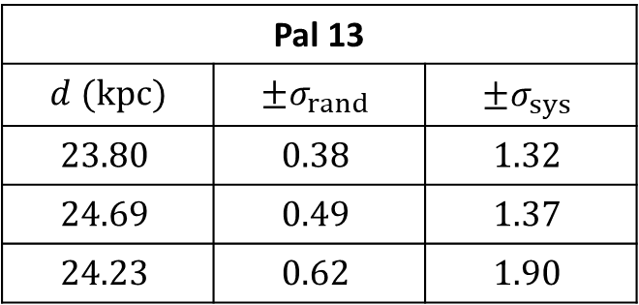
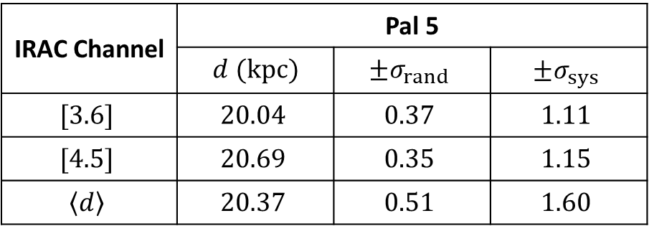
Results
IRAC Channel | Pal 5
 | $d$ $(kpc)$ | $$±σ_{rand}$$ | $$±σ_{sys}$$
$$[3.6]$$ | $$20.04$$ | $$0.37$$ | $$1.11$$
$$[4.5]$$ | $$20.69$$ | $$0.35$$ | $$1.15$$
$$\left\langle d\right\rangle$$ | $$20.37$$ | $$0.51$$ | $$1.60$$
Pal 13
$d$ $(kpc)$ | $$±σ_{rand}$$ | $$±σ_{sys}$$
$$23.80$$ | $$0.38$$ | $$1.32$$
$$24.69$$ | $$0.49$$ | $$1.37$$
$$24.23$$ | $$0.62$$ | $$1.90$$
$$\left\langle d\right\rangle$$ | $$20.37$$ | $$0.51$$ | $$1.60$$
$$24.23$$ | $$0.62$$ | $$1.90$$

