Slide 1
RetryVLA
World-model-guided synthetic recovery learning for VLAs
Progress M0–M5 · LIBERO-Recover Spatial · Oct 2026
Notes:
Progress update. Question: can a world model find recoveries from real VLA failure states, and can those be distilled into the VLA so it recovers without search at test time?

Slide 2
The question we are answering
Can a world model discover action sequences that recover from actual VLA failure states, and can those imagined recoveries be distilled into the VLA so it recovers without search at inference?
1
2
3
4
5
Failure states
Search
Verify
Distill
Evaluate
LIBERO-Recover scenes where SmolVLA failed
propose 50-step recovery segments, score them
run best candidates in the simulator + SmolVLA continuation
fine-tune SmolVLA on verified recoveries
recovery success on held-out failures, no search
Search is where the world model enters: it replaces the simulator as the thing that says which candidates are good.
Notes:
Stage 1-6 from the research plan. M1 uses the simulator as the scorer (oracle). M2/M3 replace it with a latent world model + critic.

Slide 3
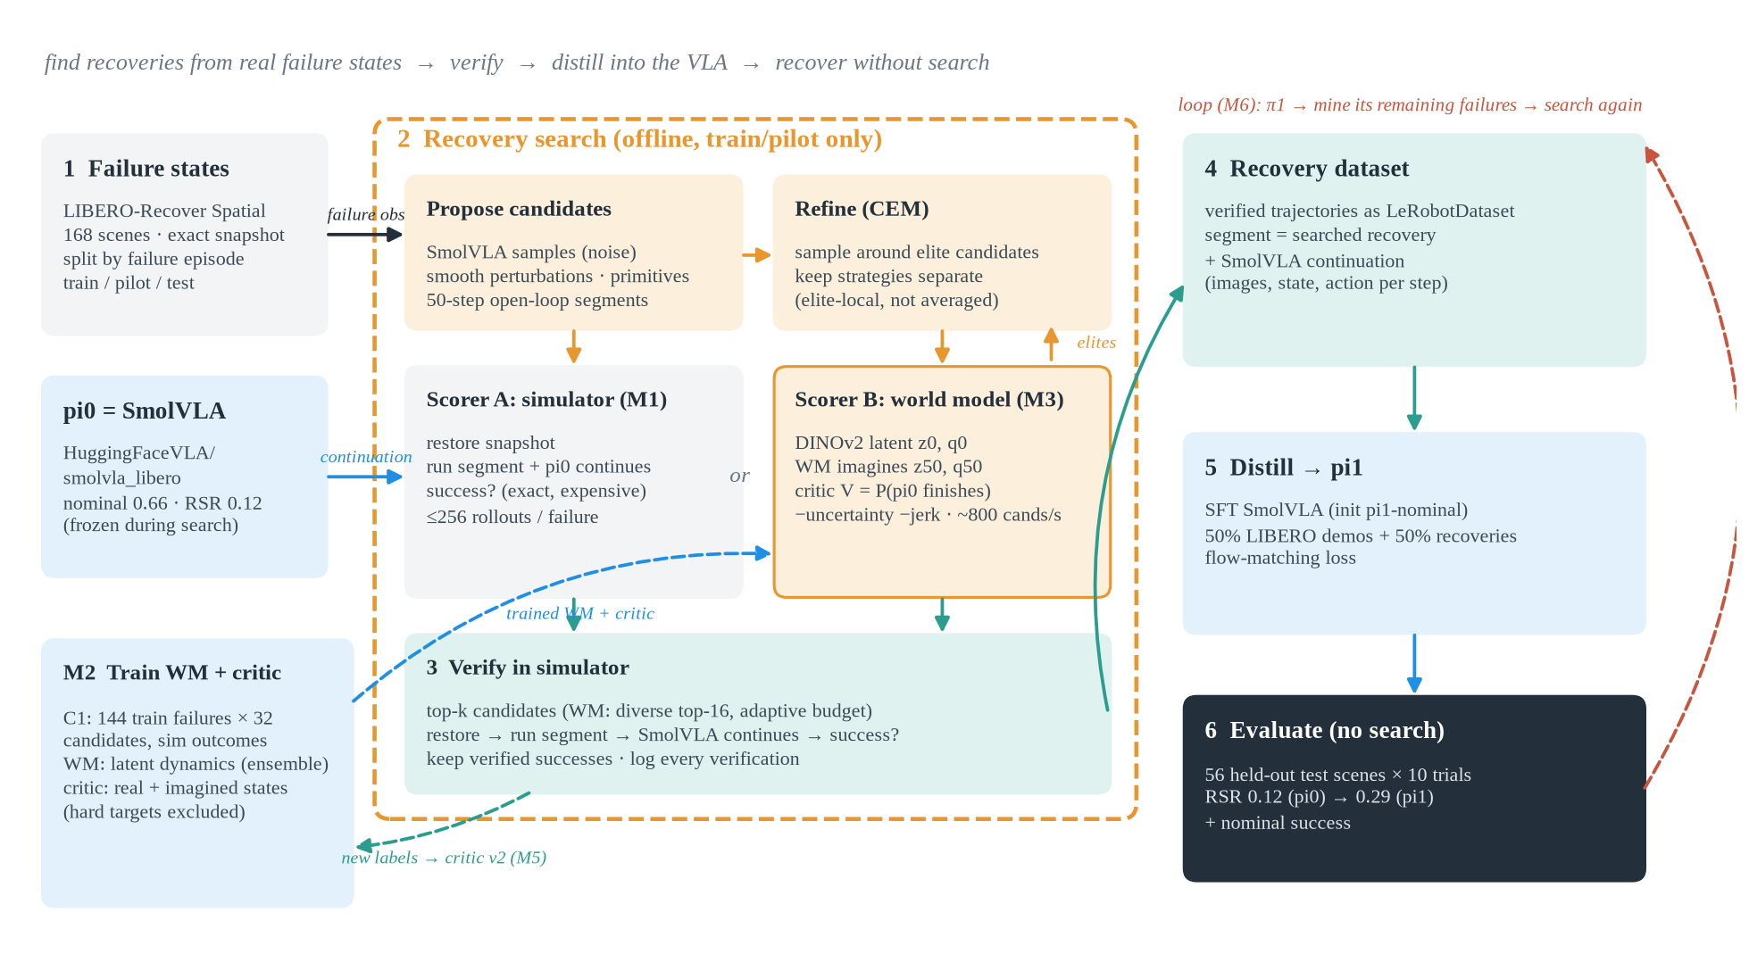
Pipeline overview
Notes:
1 failure states, 2 search (simulator scorer in M1, world model + critic in M3), 3 verify in simulator, 4 recovery dataset, 5 distill into SmolVLA, 6 evaluate on held-out failures without search. Dashed: WM training (M2), critic self-improvement (M5), iterative loop (M6).

Slide 4
Setting: benchmark, policy, compute
Benchmark
Policy
Compute
LIBERO-Recover, Spatial suite
168 failure scenes, 84 failed episodes, 9 tasks
official protocol: 5 closed-gripper + 5 open-gripper trials, ±2 cm object noise, 520 steps
metric: Recovery Success Rate (RSR)
SmolVLA, checkpoint HuggingFaceVLA/smolvla_libero (450M)
chunk 50 actions, replan every 10
7-D OSC delta actions, gripper ±1
pi0 = checkpoint as-is; pi1 = after recovery fine-tuning
1 local A100 + idle A100s borrowed from other shells (avoid-list)
MuJoCo rendered on GPU (user-local NVIDIA EGL), ~20 ms/step
bit-exact sim snapshots for branching
all runs tracked: config, git sha, metrics, registry
Notes:
Python 3.12, lerobot 0.5.1. Every eval uses the same seeds so arms see identical perturbations.

Slide 5
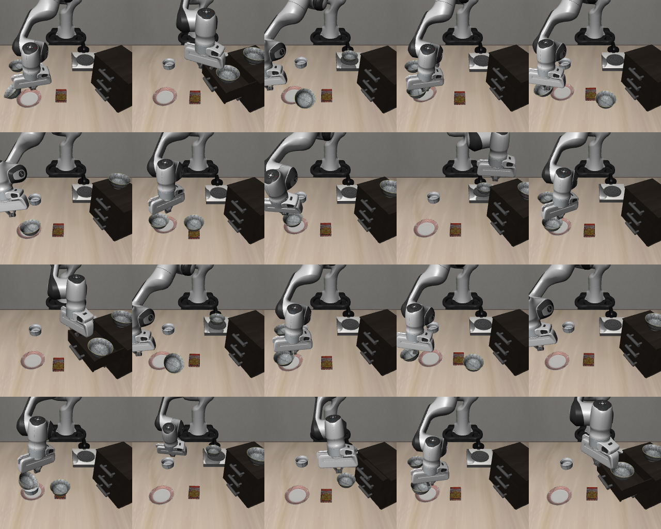
What a LIBERO-Recover failure state looks like
Each scene = a .bddl task + the exact physics state recorded when SmolVLA was failing
bowl half-grasped, pushed off the plate, stuck in a drawer, arm in an odd pose
the gripper is forced closed in half of the trials: an initial state SmolVLA never saw in training
restore is bit-exact: state, controller, observables. The same actions always give the same pixels
no L1-L4 difficulty labels released yet
20 restored failure states (agent camera), M0b check: 20/20 deterministic

Slide 6
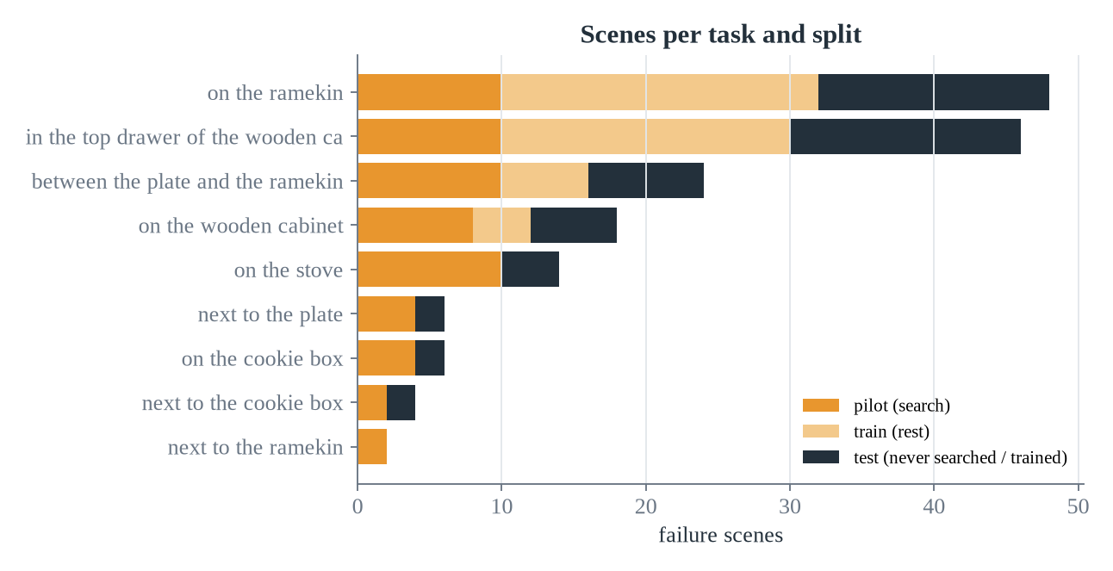
Train / pilot / test split, grouped by failure episode
112
train scenes (search, WM data, SFT)
60
pilot scenes (subset of train, search targets)
56
test scenes: never searched, never trained on
step_0180 and step_0200 of one failed episode are near-duplicates, so they always stay in the same split. Code asserts test scenes never enter search or training.

Slide 7
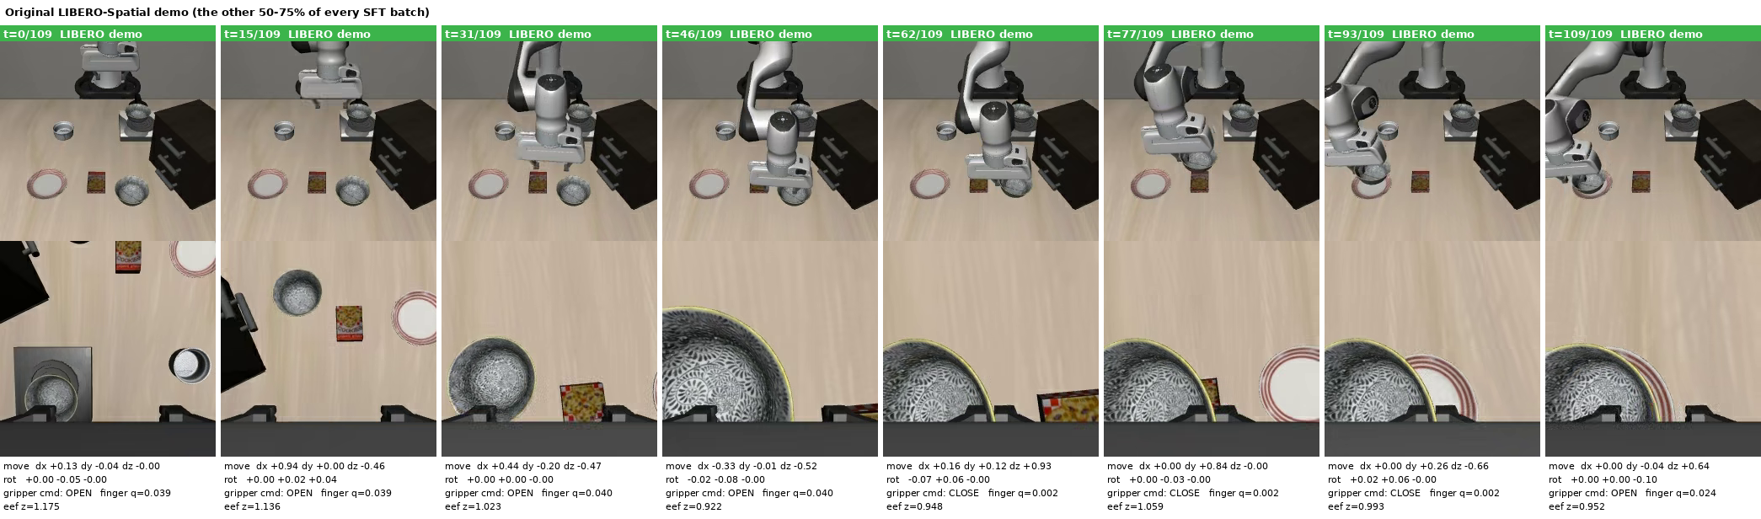
M0: SmolVLA is decent at nominal tasks, bad at recovery
0.66
nominal LIBERO-Spatial success (500 ep)
lerobot-eval cross-check: 0.68
0.12
recovery success (RSR) on 56 held-out failure scenes, 560 ep
Training data SmolVLA learned from: a nominal LIBERO-Spatial demo (agent + wrist camera, action per step)
5 / 160
checkpoint is weaker than the ~0.90 reported for SmolVLA, but our engine matches lerobot-eval, so the interface is correct
fine-tuning on the Spatial demos alone reaches 0.80 nominal. That checkpoint (pi1-nominal) becomes the control and the stronger base
replanning every step (n_action_steps=1) gives +5 points at 10x the cost, so we keep 10
drawer-task failures recovered

Slide 8
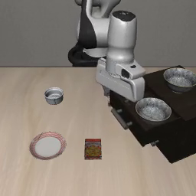
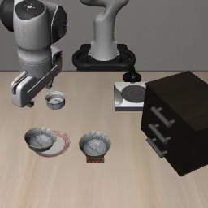
Video: SmolVLA on held-out failure states
VIDEO
VIDEO
Drawer failure: pi0 never recovers (26 s)
Ramekin failure: pi0 keeps trying the same grasp (26 s)
Official protocol, 520 steps. These are the 88% of test episodes we want to fix.

Slide 9
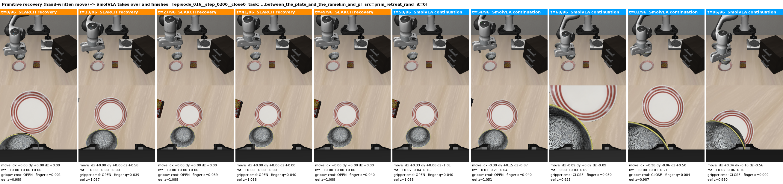
M1: how one recovery candidate is tried
Restore
Segment (50 steps)
SmolVLA continues
Judge
load the exact failure snapshot
open-loop actions from search: SmolVLA samples, smooth perturbations, primitives
frozen pi0 drives closed-loop up to 300 steps
simulator checks the BDDL goal: bowl on plate?
Orange = searched segment (here a hand-written 'open + lift' primitive). Blue = SmolVLA takes over and places the bowl. Competence-targeted: the segment does not solve the task, it returns the robot to a state SmolVLA can finish from.

Slide 10
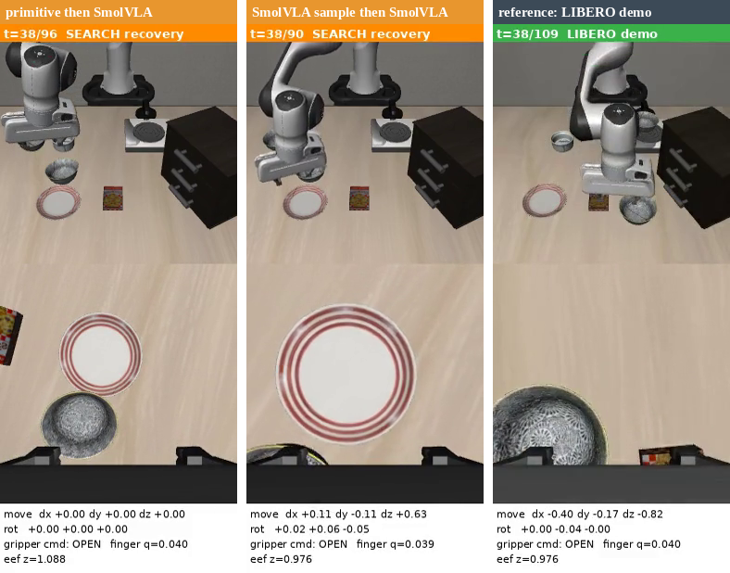
Video: oracle-search recoveries
VIDEO
Orange bar = searched 50-step segment, blue = SmolVLA continuing, green = nominal demo. Overlay: step, segment, action given to the policy, finger opening.

Slide 11
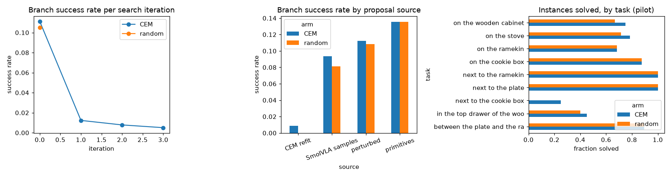
M1: search = propose, score in the simulator, refine
1
Propose 64
24 SmolVLA samples (different noise), 24 smooth perturbations, 16 primitives
2
Score
simulate each: success × speed + small goal-progress shaping − jerk
3
Keep elites
What we learned
8 best candidates
~70% of pilot failures have a recovery reachable in 50 steps
the first CEM was broken: averaging different strategies into one Gaussian drops success 11% → 1%
fix: refine around ONE elite at a time. On hard instances it then solves 68% vs 55% for random at equal budget
~1/3 of recoveries are trivial (bowl already over plate: just open)
4
Refine
CEM: sample around elites, up to 4 rounds (≤256 sims / instance)

Slide 12
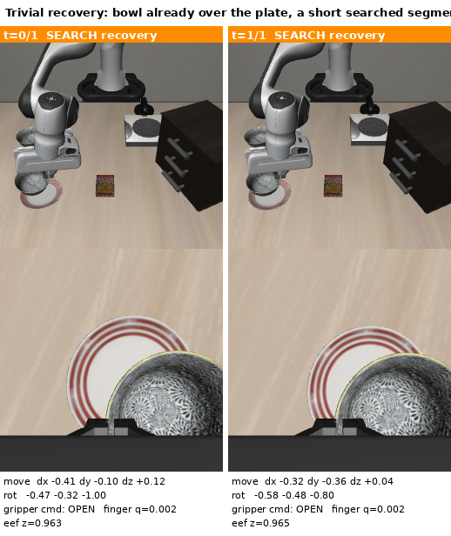
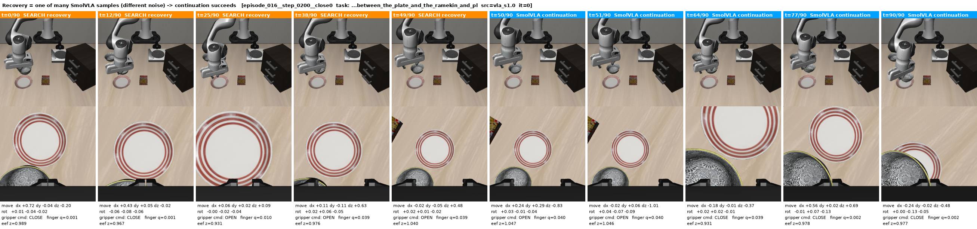
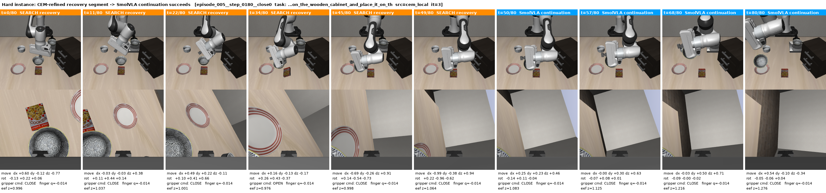
What the recovery training data looks like
One of 24 SmolVLA samples (different noise) happens to open and back off; continuation succeeds
Trivial
2 steps: release the bowl already above the plate. Removing these HURT RSR (0.254 → 0.220)
Old CEM on a hard instance: jerky, gripper chatter (3-4 flips / 50 steps vs 0.9 in demos). Searched segments are 4-6x jerkier than demos

Slide 13
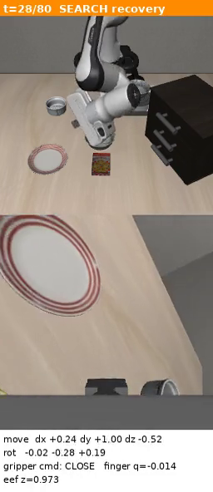
Video: why random-noise search proves little
VIDEO
Old CEM on a hard instance
arm thrashes, gripper flips open/closed with no effect on the fingers
it still 'succeeds' afterwards, so it lands in the training set
4-6× jerkier than demos: a likely reason recovery SFT costs nominal success
motivates: smoothness cost, elite-local refinement, and scoring by a model of what SmolVLA can finish

Slide 14
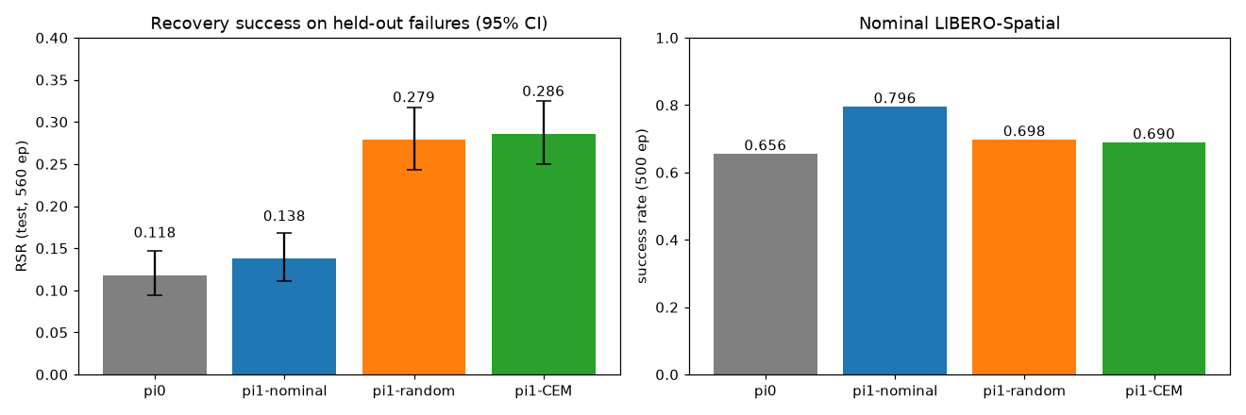
Distilling simulator-verified recoveries works
2.4×
test RSR vs pi0 (0.118 → 0.28), +14 pts over the fine-tune-only control
CEM ≈ random here: the old CEM's useful data all came from its random first round
cost: nominal 0.80 → 0.70 at a 50% mix. Trade-off set by the ratio
trivial recoveries are useful supervision
SFT arm | recovery data | test RSR | nominal
pi0 | - | 0.118 | 0.656
pi1-nominal (control) | demos only | 0.138 | 0.796
pi1-random | 241 random-search | 0.279 | 0.698
pi1-CEM | 241 CEM | 0.286 | 0.690
ratio 0.25 | 241 random | 0.254 | 0.726
ratio 0.25, no trivial | 170 random | 0.220 | 0.766

Slide 15
Replacing the simulator with a world model
M2: latent world model + competence critic · M3: search in imagination

Slide 16
Why a world model if we already have a simulator?
Oracle search (M1)
World-model search (M3)
scores a candidate by running it for real
up to 256 simulator rollouts per failure
exact, but only exists where a simulator of THIS scene exists
upper bound on what search can find
scores a candidate by imagining it in latent space
~800 candidates in a few GPU seconds
simulator only to verify the top 16 (later: real robot, or none)
needs: accurate dynamics on failure states + a critic that knows what SmolVLA can finish
Claim to test: at a fixed number of real rollouts, WM-guided search finds more recoveries than proposing at random.

Slide 17
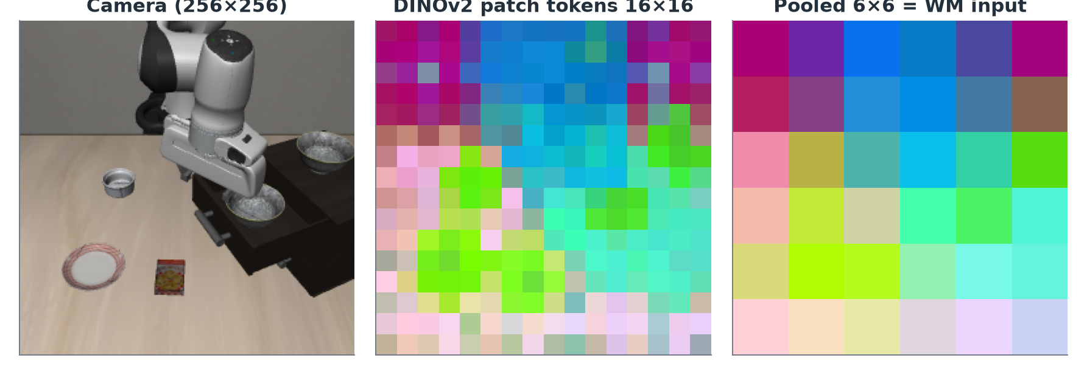
State = frozen DINOv2 patch tokens + robot state
h_t (per time step)
agent cam 6×6 tokens
wrist cam 6×6 tokens
robot state q (8-D): eef pos, axis-angle, finger
= 72 tokens × 384-D + 1 state token
spatial tokens, not one global vector: L3/L4 failures depend on where things are
Same drawer failure state. Token colors = first 3 PCA components: bowl, drawer, arm and table separate without any training
C1 training data for the WM and critic
144 TRAIN failure instances × 32 candidate segments = 4,608 simulated trajectories
latents every 5 env steps + the actions + outcome label (did SmolVLA finish afterwards?)
the failure episodes containing the 53 hard search targets are excluded: those failures stay UNSEEN

Slide 18
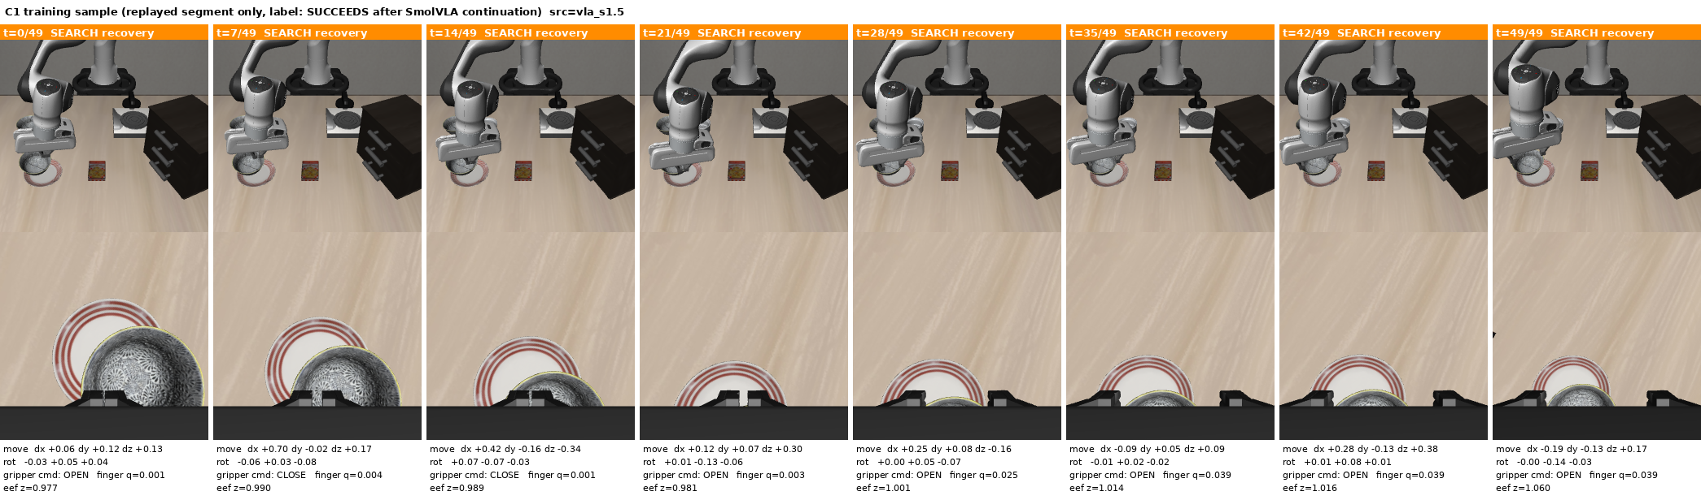
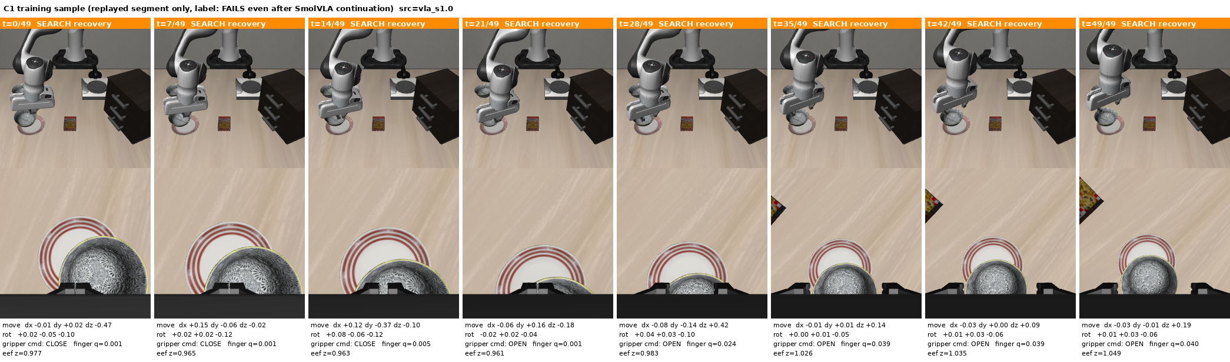
One failure state, two candidates, two labels
Label 1: opens at t=21 and lifts. The bowl stays on the plate and SmolVLA finishes
Label 0: also opens, but drags the bowl off the plate (t≥35), so SmolVLA cannot finish. The critic must tell these apart from latents alone

Slide 19
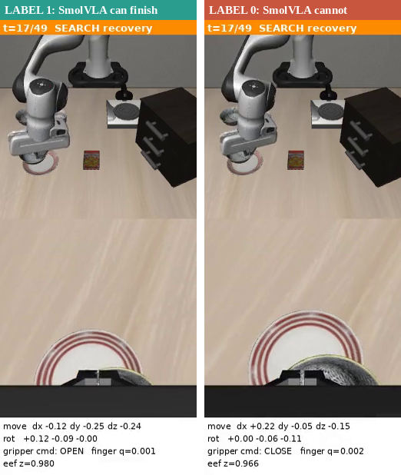
Video: WM data, same state, opposite labels
Same failure state, two candidate segments
left: opens and lifts, bowl stays on the plate, so SmolVLA can finish (label 1)
right: opens but drags the bowl off the plate, so SmolVLA cannot (label 0)
4,608 such segments teach the WM how latents move and the critic which end states are recoverable
replayed from the stored actions: bit-exact

Slide 20
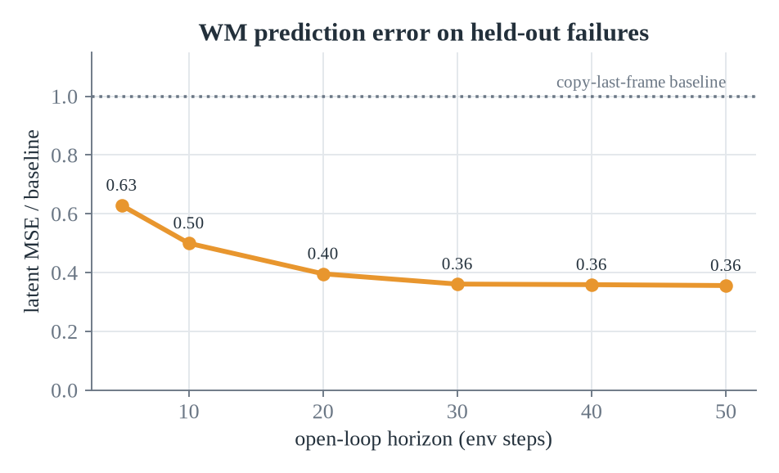
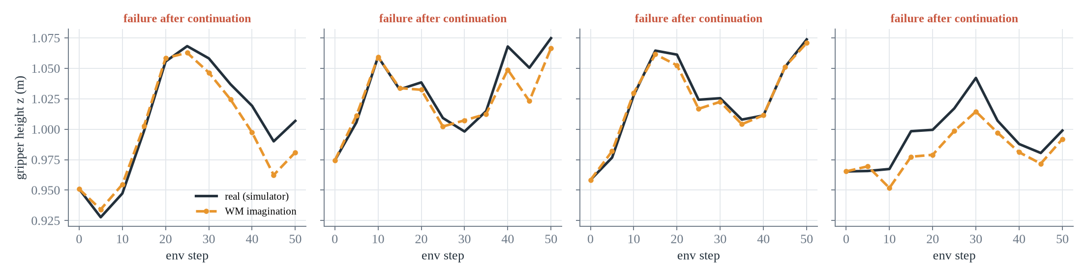
M2: latent dynamics h(t+1) = h(t) + F(h(t), 5 actions)
h_t
+ action token
Transformer
4 heads
72 patch + 1 state token
MLP(5 × 7-D actions)
6 layers, width 384
ensemble Δh: mean = prediction, spread = uncertainty
loss = 1-step teacher-forced + 10-step open-loop rollout (search needs 50-step imagination)
11.6M params, 20k steps, ~1.5 h on one A100
Held-out failures: gripper height, real (black) vs imagined from the start frame + actions only (amber). Error is 0.36-0.63× the copy-last-frame baseline

Slide 21
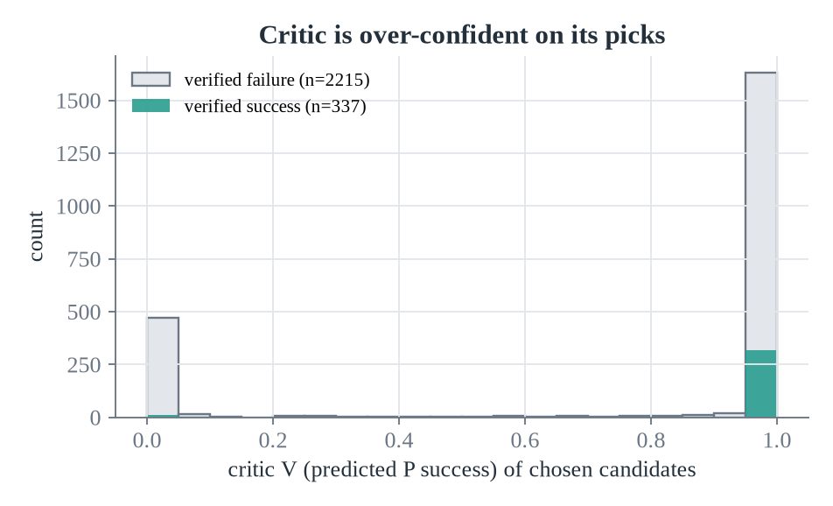
M2: the competence critic V(z, q, task)
“From this (possibly imagined) state, will frozen SmolVLA finish the task?”
small transformer over the same tokens + learned task embedding
trained on real AND WM-imagined end states (50/50), so it is calibrated for what search feeds it
competence-targeted: lifting out of a drawer scores high even though the bowl gets no closer to the plate
held-out AUC 0.71 real / 0.67 imagined; top-4 picks succeed 2.1× the base rate
Ranks well, calibrated badly
Almost every pick gets V≈1 while ~12% verify. Fine for ranking. Needs fixing before V can weight training (AWR).

Slide 22
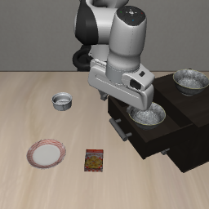
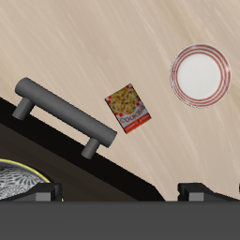
M3: how the world model searches
1
Encode
2
Propose 256
real failure frame → DINOv2 latent z0, robot state q0
same proposal pool as M1: SmolVLA samples, perturbations, primitives
3
Imagine
4
Score
WM rolls each 50-step candidate forward: z0 → z50 (10 steps of 5 actions)
S = V(z50) − λ·uncertainty − β·jerkiness
Input: one real failure observation (agent + wrist)
Fair comparison
5
Refine in imagination
6
Verify top-16
random arm: 16 candidates drawn from the same 256-proposal pool
both arms: exactly 16 simulator rollouts per instance
53 hard instances whose failure episodes the WM/critic never saw
2 rounds of elite-local CEM, ~800 candidates, zero simulator calls
only these touch the simulator; successes become training data

Slide 23
M3: 2× more recoveries on unseen hard failures
36% vs 17%
hard failures solved, same simulator budget (sign test p = 0.04)
35 / 45
recoveries found by latent CEM: plans the WM invented, never simulated before verification
Caveat
The gain is concentrated in the drawer task (WM 12/20 vs random 1/20). Other tasks: 7/33 vs 8/33. N = 53, one seed.
Picks are also smoother: jerk 0.017 vs 0.027

Slide 24
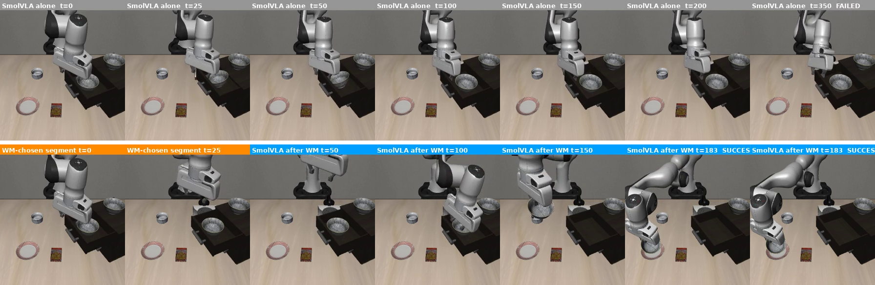
Same failure state: SmolVLA alone vs WM-guided
Top: SmolVLA alone hovers at the drawer mouth for 350 steps. 0/3 seeds, 0/4 pre-checks, random 0/16.
Bottom: the WM picks 'lift straight up' (orange). From there SmolVLA reaches in, grasps and places the bowl. 3/16 verified.

Slide 25
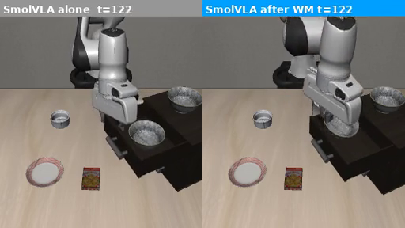
Video: SmolVLA alone vs WM-guided, same failure
VIDEO
Left: SmolVLA alone hovers at the drawer for 350 steps. Right: WM-chosen 50-step lift (orange) then SmolVLA grasps and places the bowl.

Slide 26
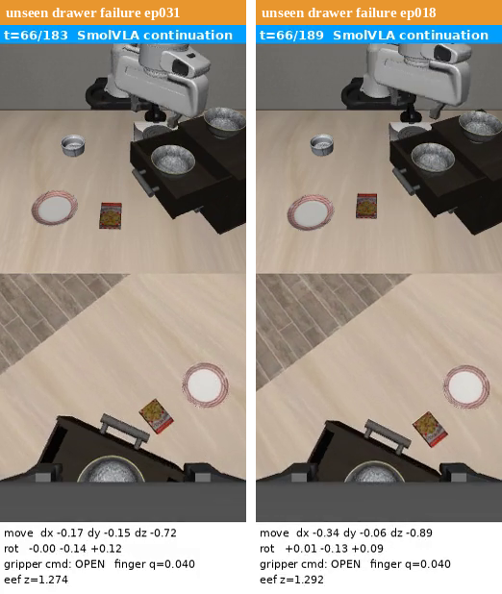
Video: WM-found recoveries on unseen failures
Picked by WM + critic, verified in sim
orange: the 50 steps the WM chose in imagination (lift clear of the drawer)
blue: SmolVLA reaches in, grasps, places the bowl
neither failure episode was in the WM's training data
same strategy found on different failures: the WM generalizes the 'get clear first' idea

Slide 27
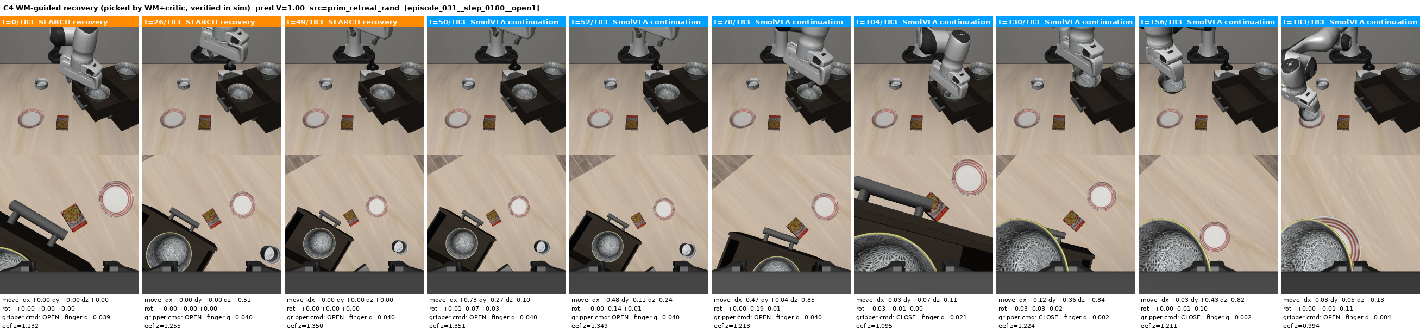
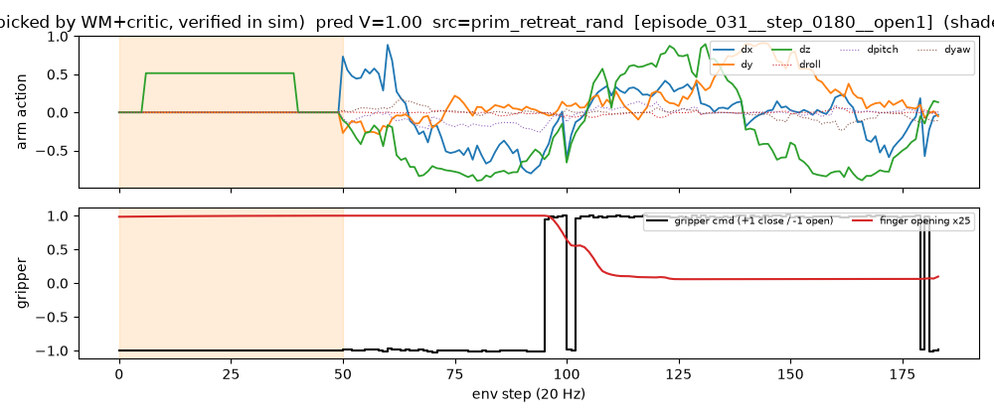
What the WM chose, step by step
shaded = the 50 steps the WM chose: one clean dz = +0.5 move, gripper open, no chatter
white = SmolVLA's own actions afterwards; finger closes at t≈95 (red), bowl placed at t=183
contrast with the jerky old-CEM segment in M1

Slide 28
M4: does WM-found data improve the VLA? Not yet measurable
policy (init) | recovery data | test RSR | drawer | nominal
pi1-random (pi0) | 241 random | 0.279 | 18/160 | 0.698
A (pi1-nominal) | 241 random | 0.293 | 24/160 | 0.756
B (pi1-nominal) | 241 random + 45 WM | 0.298 | 28/160 | 0.748
So M5 asks it properly
generate WM data on all 108 pilot failures (not just 53 hard)
same trajectory count WM vs random
WM-only vs random-only SFT, same init, same recipe
measure RSR, drawer, nominal
stronger init (pi1-nominal) recovers nominal 0.70 → 0.75 and nudges RSR up
+45 WM trajectories: +0.005 RSR, drawer 24 → 28. Paired episodes 61 vs 58: noise
the dose is tiny: 45 WM trajectories ≈ 8% of training samples

Slide 29
M5: WM data makes a better VLA
test RSR 0.25 (random data) → 0.44 (WM data), same #trajectories, nominal kept at 0.81
videos below are clickable: click to play in PowerPoint

Slide 30
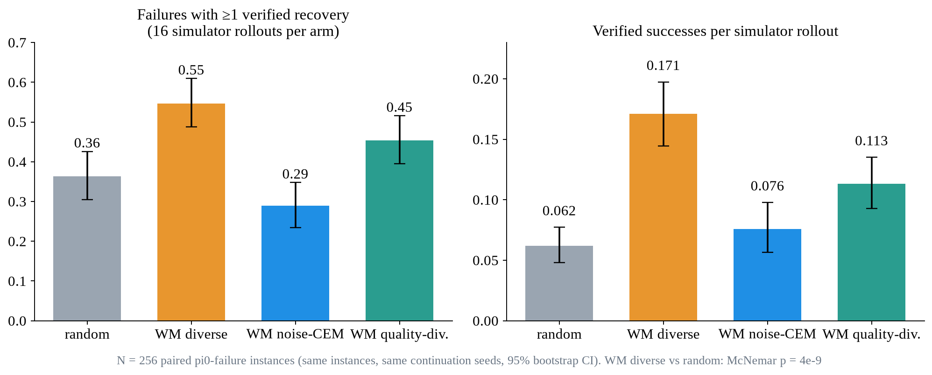
M5b: 4 search arms, 256 fresh failures, same 16 sims each
random
16 uniform picks from the proposal pool (no WM)
WM diverse
pool + latent CEM, k-means diverse top-16 (M5 default)
WM noise-CEM
NEW: CEM in SmolVLA's flow-matching noise: on-manifold by construction
WM quality-div.
NEW: MAP-Elites over 60 strategy cells (gripper × motion)
WM diverse: 2.8× more verified recoveries per simulator rollout than random (0.171 vs 0.062), p = 4e-9. Drawer: 0.43 vs 0.07 solved
noise-CEM is the smoothest and closest to SmolVLA, but WORSE than random: it inherits SmolVLA's 'keep grasping' habit (drawer 0.02)
quality-diversity: most distinct strategies per solved failure (4.0 vs 2.2), still beats random (p = 0.002)

Slide 31
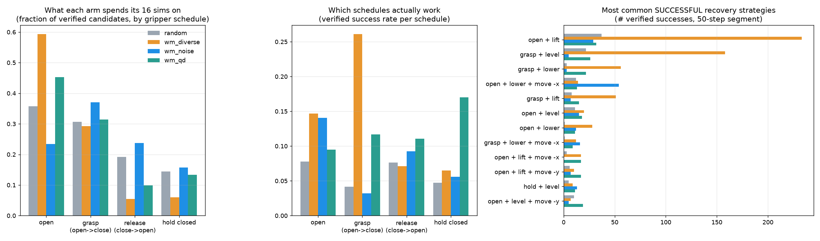
Which strategies the WM finds
Top recovery = open + lift: let go, get clear, let SmolVLA re-approach as from a normal start. WM found it ~230×, random ~35×.
Drawer: random spends 55% of sims on 'grasp again' (0 / 732 succeed); WM spends 83% on 'stay open, lift' (79 successes).

Slide 32
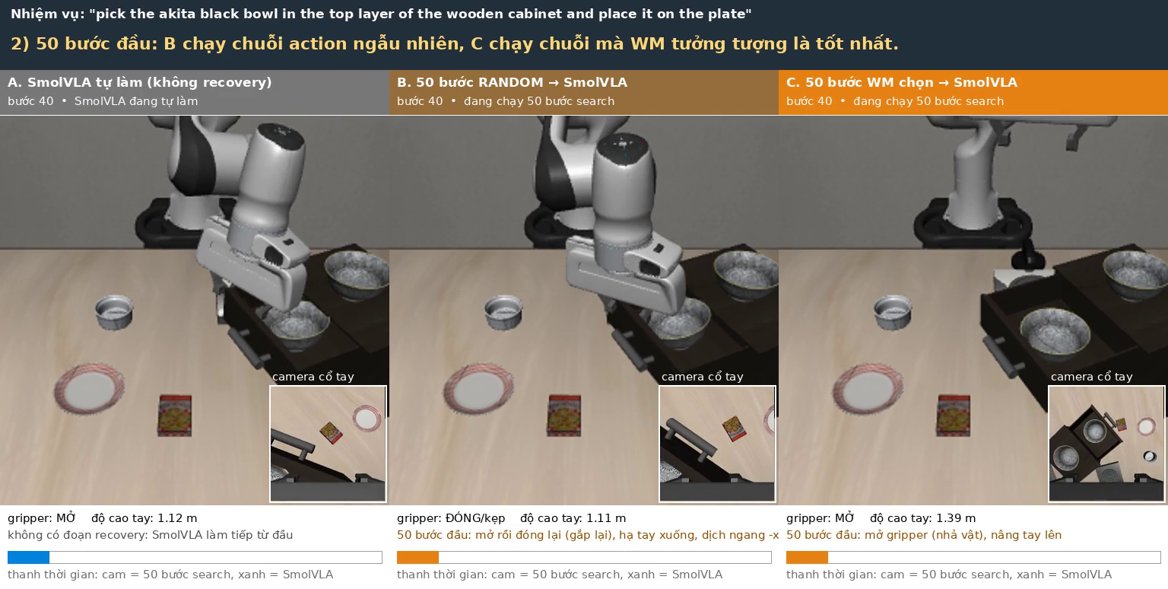
Video: drawer failure, A alone / B random / C WM
▶ VIDEO
All 3 columns start from the SAME failure state. Only the first 50 steps differ; after that SmolVLA drives every column. C lifts 1.13 → 1.38 m with the gripper open (orange bar), then SmolVLA re-approaches, grasps and places the bowl at step 198. A and B hover at the drawer for 360 steps.

Slide 33
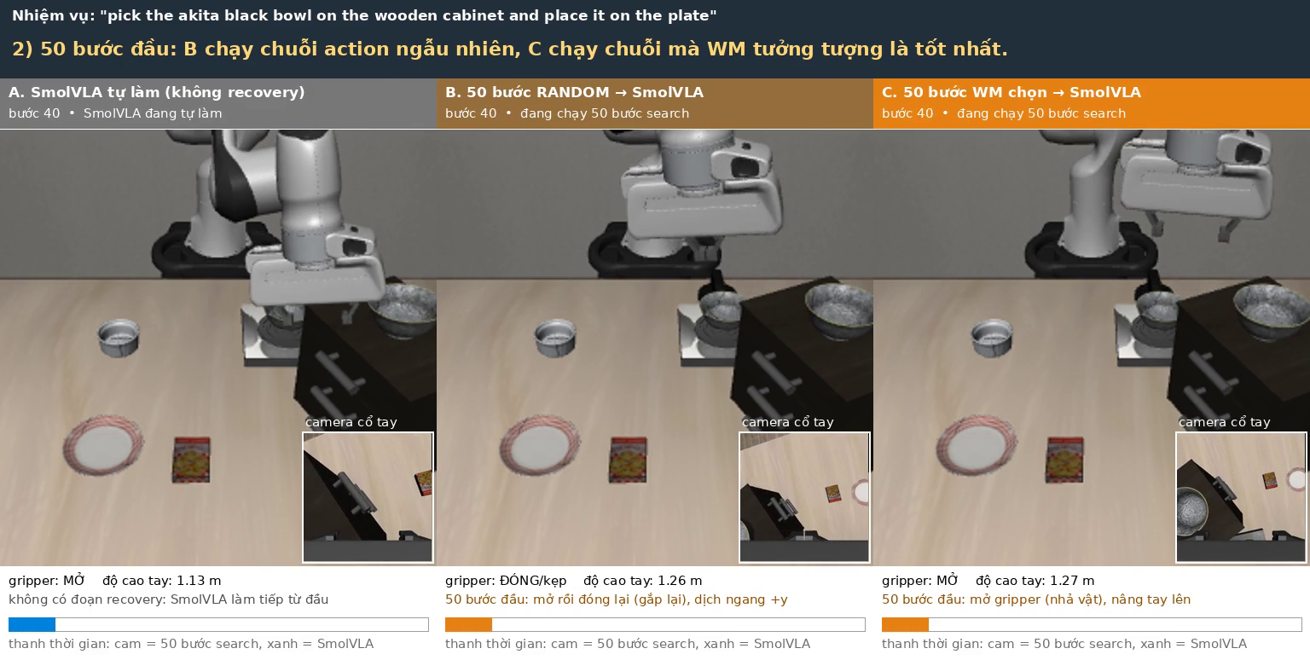
Video: cabinet failure, A alone / B random / C WM
▶ VIDEO
All 3 columns start from the SAME failure state. Only the first 50 steps differ; after that SmolVLA drives every column. B tries to re-grasp in place (open → close, shift +y) and fails. C lets go and lifts; SmolVLA then finishes at step 142.

Slide 34
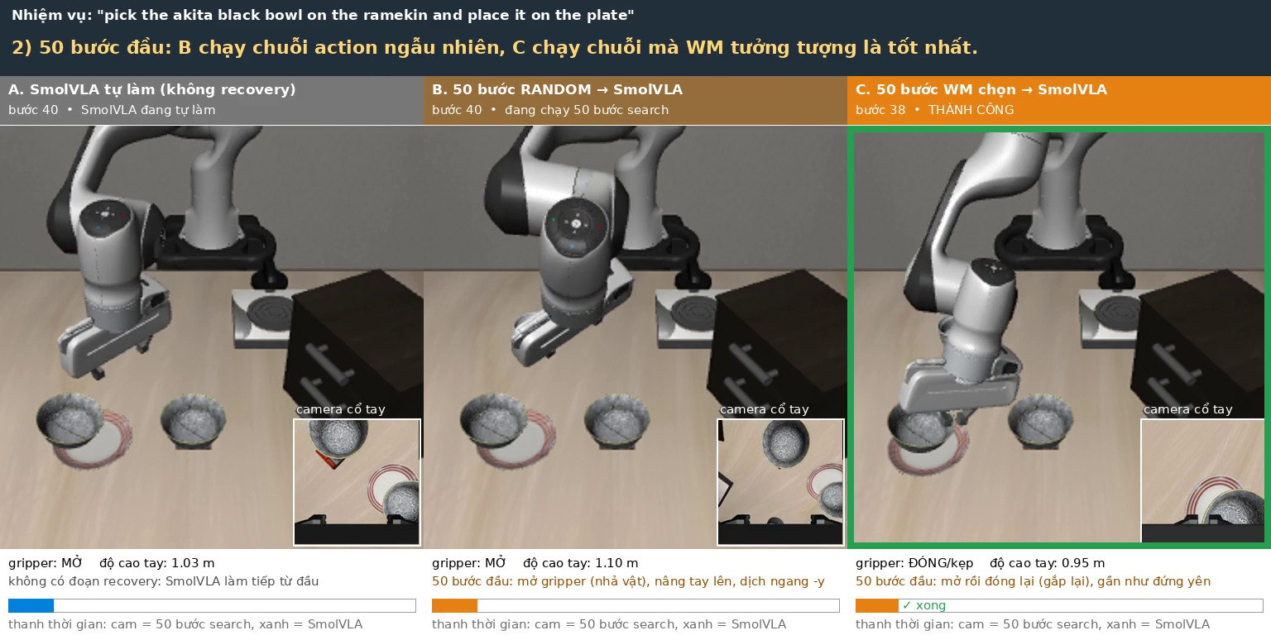
Video: ramekin failure, A alone / B random / C WM
▶ VIDEO
All 3 columns start from the SAME failure state. Only the first 50 steps differ; after that SmolVLA drives every column. Here the WM segment alone finishes the task (step 39): a short grasp-in-place the WM predicted to work. Random 0/16 on this failure.

Slide 35
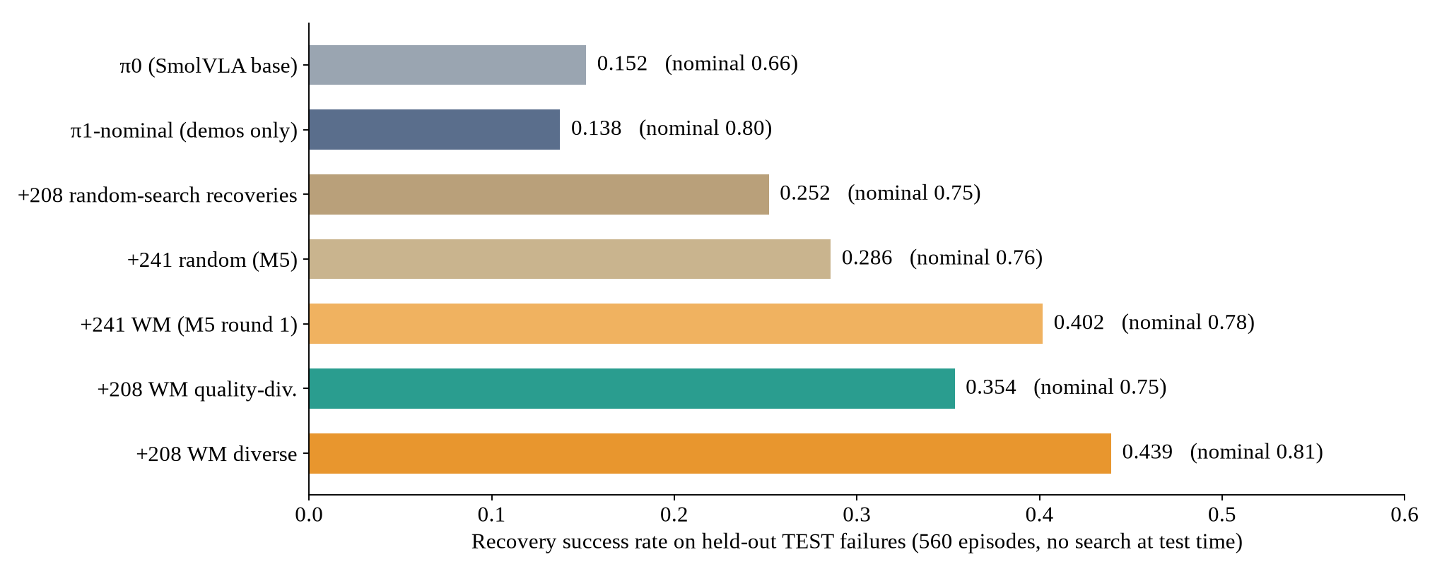
Distillation: WM data > random data for the VLA
0.439
test RSR, +208 WM recoveries (vs 0.252 random, same count, same init)
0.808
nominal SR: no longer lost (demo-only SFT: 0.796)
M5 (241 vs 241): WM 0.402 vs random 0.286, +0.116 [+0.045, +0.191] scene-bootstrap CI, paired McNemar p = 4e-7
M5c (208 vs 208, round-robin subset): WM diverse 0.439, quality-div. 0.354, random 0.252
more is not better: all 423 WM trajectories 0.389 < 208 balanced. One training seed per variant

Slide 36
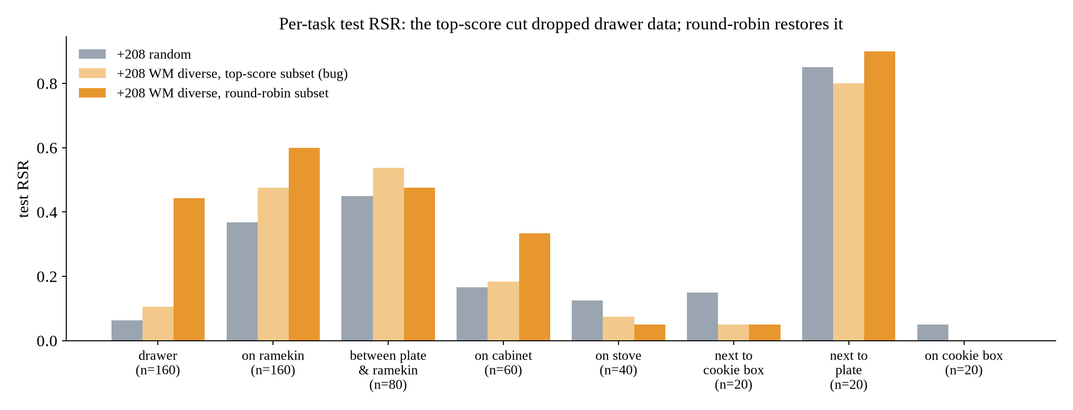
A data-selection bug that hid the gain
What went wrong
to match counts we kept the top-208 trajectories by critic score
the critic scores drawer recoveries low, so only 4 drawer trajectories survived (of 44)
drawer test RSR collapsed to 0.11
fix: round-robin per failure (each failure's best, then 2nd best, ...): drawer 0.44, overall 0.30 → 0.44
Lesson: the distribution of the distilled data matters as much as the search

Slide 37
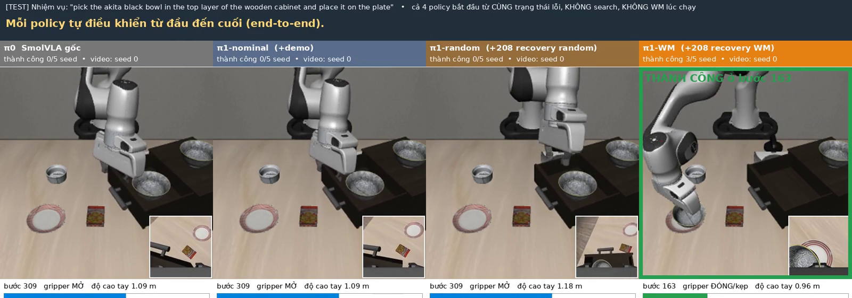
Video: end-to-end, no search, unseen TEST failure
▶ VIDEO
0/5
π0 SmolVLA
seeds solved
0/5
π1-nominal
seeds solved
0/5
π1-random
seeds solved
3/5
π1-WM
seeds solved

Slide 38
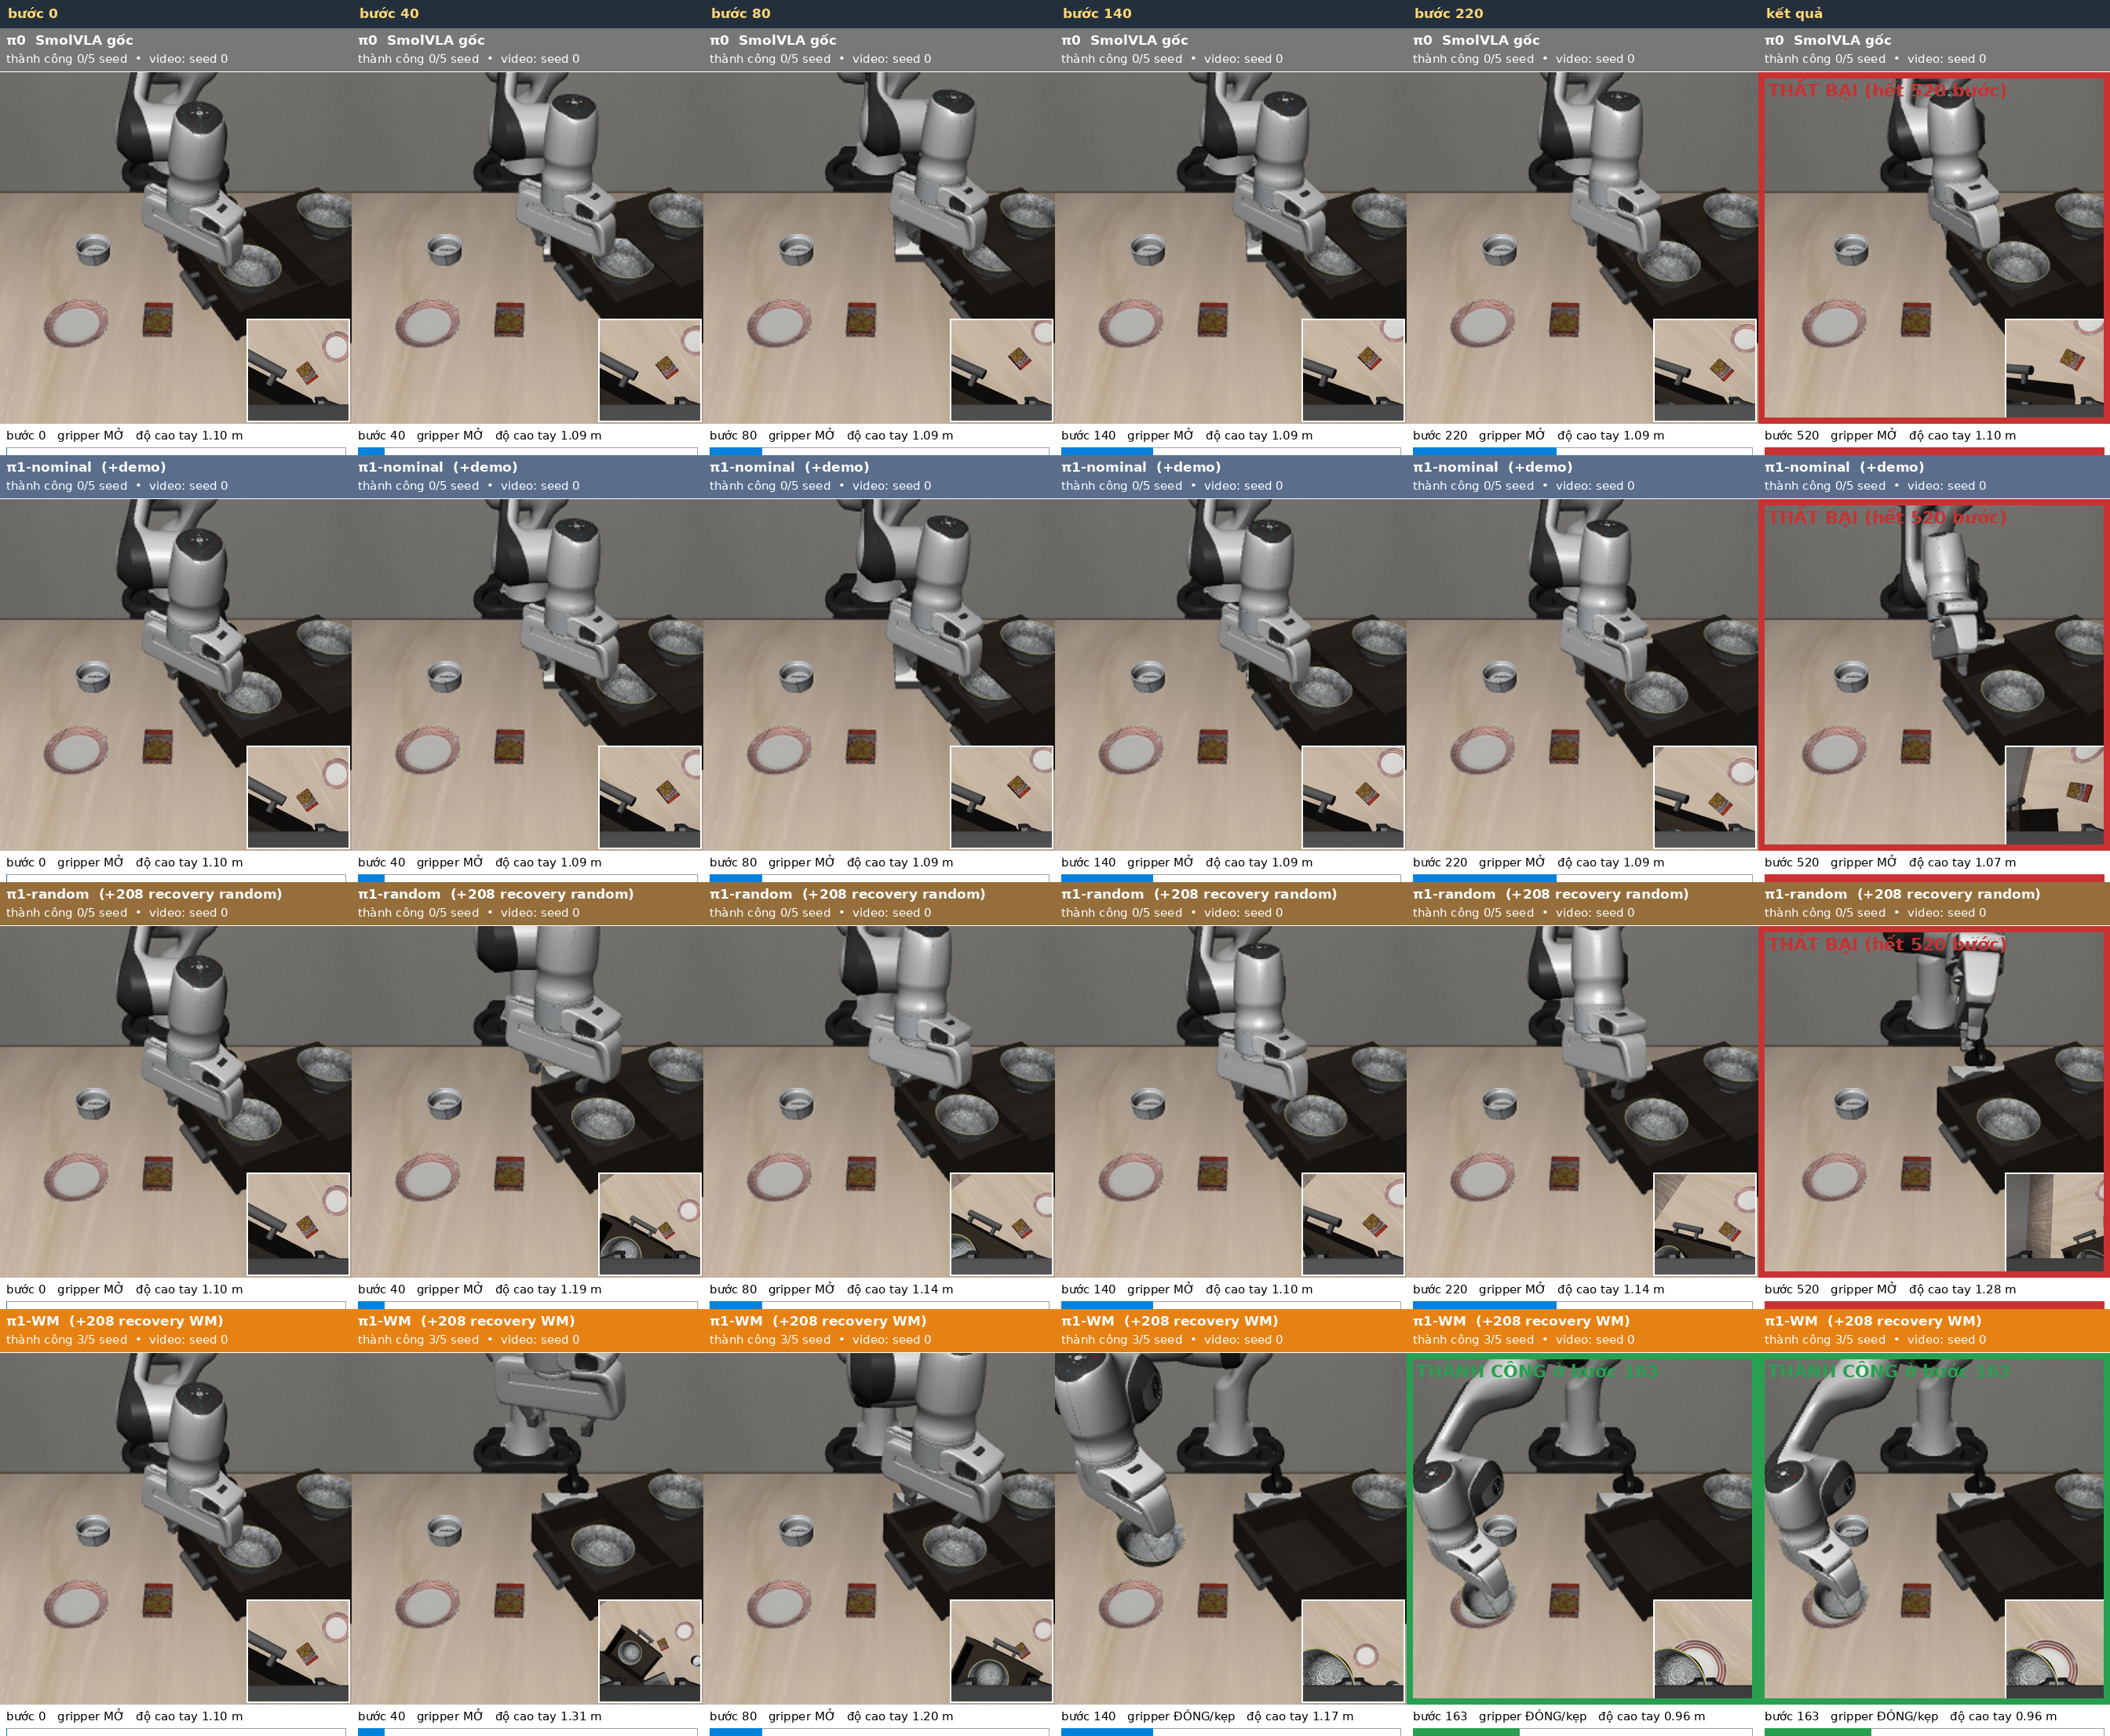
The VLA learned the WM's move: get clear, then retry
Same unseen drawer failure, seed 0 for every row
rows: π0, π1-nominal, π1-random, π1-WM
π0 / π1-nominal hover at 1.09-1.10 m for all 520 steps
π1-random moves a little higher (1.14-1.24 m), still stuck
π1-WM lifts itself to 1.31 m by step 40, comes back down, grasps at ~140, places at 163
no world model or simulator at test time: the behaviour was distilled
train-split episode (ep031): 0/5, 0/5, 0/5, 2/5

Slide 39
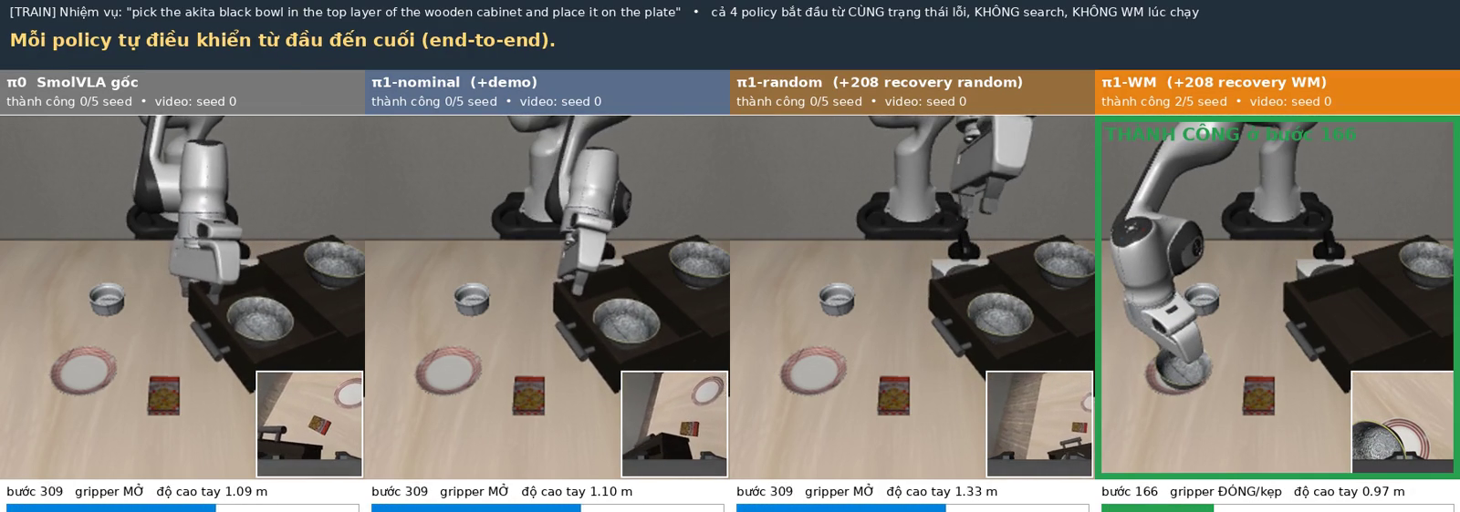
Video: end-to-end on the training-split drawer failure
▶ VIDEO
The same drawer failure as the A/B/C explainer (ep031 open6). π0 0/5, π1-nominal 0/5, π1-random 0/5, π1-WM 2/5 seeds. Still far from reliable: the next step is verifying each recovery under 2-3 continuation seeds and keeping only robust ones.

Slide 40
Where we stand
Supported so far
Open problems
recoveries exist and can be found: ~70% of failures, 50-step segments
WM + competence critic: 2.8× more verified recoveries per simulator rollout than random (N = 256, p = 4e-9)
WM data makes a better VLA: test RSR 0.44 vs 0.25 (random data, same count), nominal kept at 0.81
the distilled VLA performs the WM's 'get clear, then retry' by itself on unseen failures
one training seed per SFT variant; 56 test scenes, one suite
recoveries are stochastic: some verified ones fail on re-simulation
critic barely improved by its own labels (v2 yield 0.186 vs 0.161)
noise-space search inherits SmolVLA's failure habit
data selection is fragile (top-score cut dropped the drawer task)
weak base checkpoint (0.66 vs ~0.90 reported)

Slide 41
Long-term plan
M5
Done
WM data > random data for the VLA (0.44 vs 0.25); 4 search arms compared on 256 paired failures
M6
Next
robust data: verify each recovery under 2-3 seeds; 3 SFT seeds; then loop π1 → π2 on π1's own remaining failures
M7
Then
hybrid search (WM diverse + QD cells), parameterized primitives, multi-chunk / MCTS for multi-stage recoveries
M8
Scale
Object, Goal, LIBERO-10 suites; L1-L4 levels once released; 3 seeds; stronger base VLAs
V2
Stretch
neural video WM generates RGB for imagined recoveries (no simulator at all), then real-robot recovery

Slide 42
The paper story we are building toward
Competence-targeted world-model search generates recovery actions that restore the policy's ability to finish the task, and distilling them lets the VLA recover from unseen failures without search.
1
Goal-progress vs competence critic
2
Random vs oracle vs WM selection
does scoring by 'can SmolVLA finish' beat 'is the bowl closer'?
same #trajectories: is the gain from the WM, not just more data?
3
Sim-efficiency curve
4
Iterations π0 → π1 → π2
verified recoveries per simulator rollout: random, oracle CEM, WM
does the loop keep improving RSR on held-out failures?

Slide 43
Next decisions
WM data wins (0.44 vs 0.25). Next: robust multi-seed verification + 3 SFT seeds, then the π1 → π2 loop
and scaling to more suites

