Slide 1
ROACH2 RCU
Rover Control Unit - Systemdesign

Slide 2
Structure
System requirements
System design
Components

Slide 3
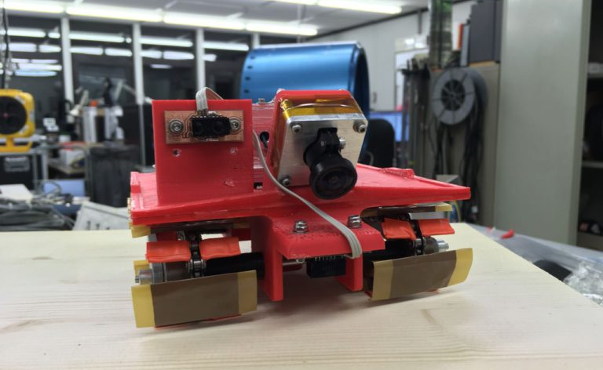
System requirements

Slide 4
Tasks
The following tasks are mandatory for the RCU:
Control HV generator(s) and engines => control of the rover movement
Measure distances to surroundings => check if to reverse movement direction
Measure acceleration
Measure temperature
Measure supply voltages of:
Engines
HV generator(s)
Processor system
Sensors
Memory/SD card reader (if implemented)
Communicate with OBC (Ethernet or USB/UART)

Slide 5
Tasks
3D localization using multiple ToF sensors
Camera (VGA with 30fps or CSI interface)
Onboard data storage (SD card or NAND flash)
Optional with error codes (CRC, FEC, …)

Slide 6
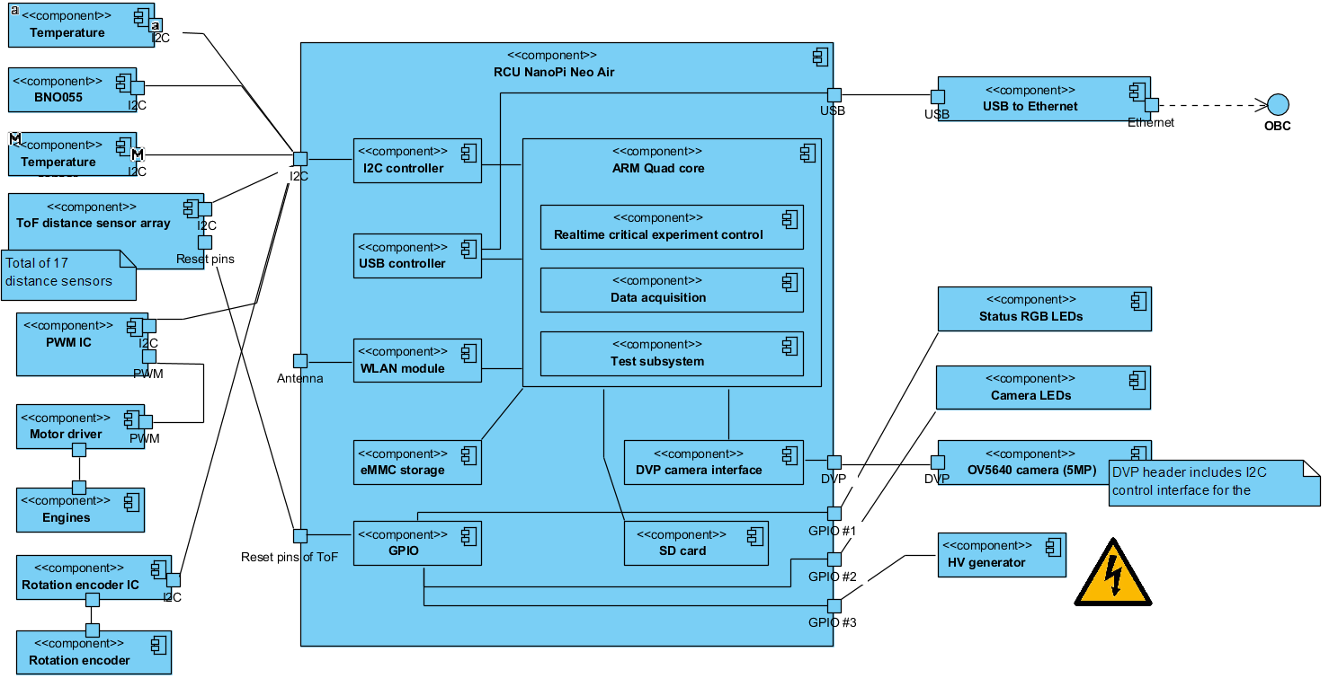
System design
Sensors, actors and interface to OBC

Slide 7
System design

Slide 8
System design: Sensors

Slide 9
System design: Actors

Slide 10
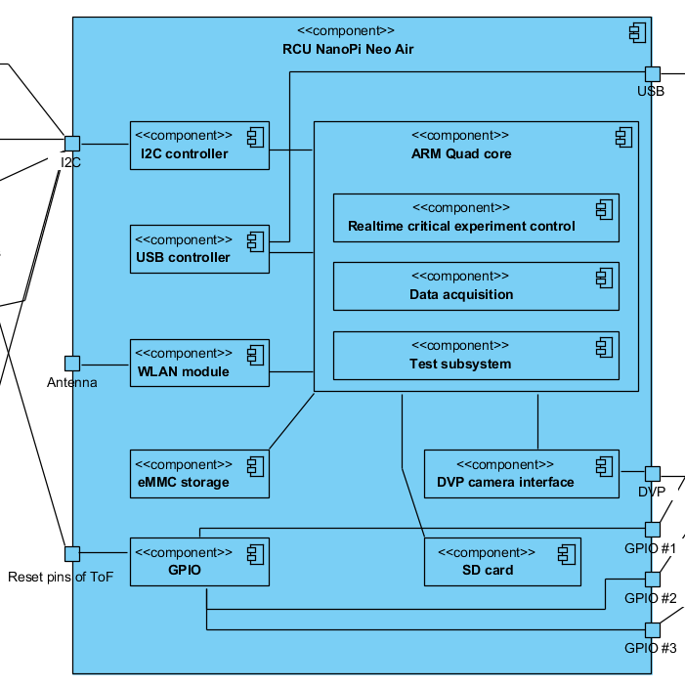
System design
Firmware:
Main applications
Experiment control
Data acquisition system
Test subsystem (not running in final experiment)
Driver
I2C
WLAN
USB-Ethernet
GPIO
USB-UART
SD card
DVP camera

Slide 11
System design
Requirements from proposal (aiming RCU directly):
Validation of the rover control unit (RCU) to track the movement and current rover status
Components used therefore:
Laser distance sensors (ToF distance sensor arrays)
IMU
Rotation encoder
Task: 3D position localization
Capturing and saving pictures with a rover mounted camera
Components used therefore:
DVP camera (5MP)
LEDs for illumination
Tasks: Camera image stream acquisition

Slide 12
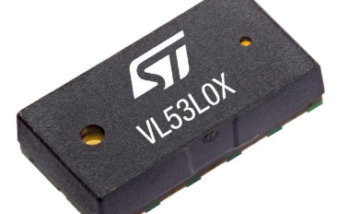
Components
Sensors, actors and interface to OBC

Slide 13
Sensors
Sensor | Task | Desired part | Units
IMU | Acceleration, orientation | Bosch Sensortec BNO055 | 1
Distance measurement sensor | Measure distance | ST VL5310X | 15+
Temperature sensor | Measure temperature | LM75AIMM | 1
Rotation encoder | Count rotations | ENX10 EASY 128IMP (?) | 1
ADC | AD conversion | MCP3426/7/8 | 1
Prices taken from Digikey and rounded up!

Slide 14
Actors
Actor | Task | Desired part | Units
Motor driver | Motor driver | TI DRV8871DDAR | 1
HV generator | ? | ? | 1

Slide 15


















Thank you for attention!
Please feel free to ask questions?

