Slide 1
ROACH2
Rover Control Unit (RCU) Version 2

Slide 2
Structure
System requirements
Tasks
Future upgrades
Components
Sensors
Actors
Interface to OBC
Processor options
Xilinx XUP
System design

Slide 3
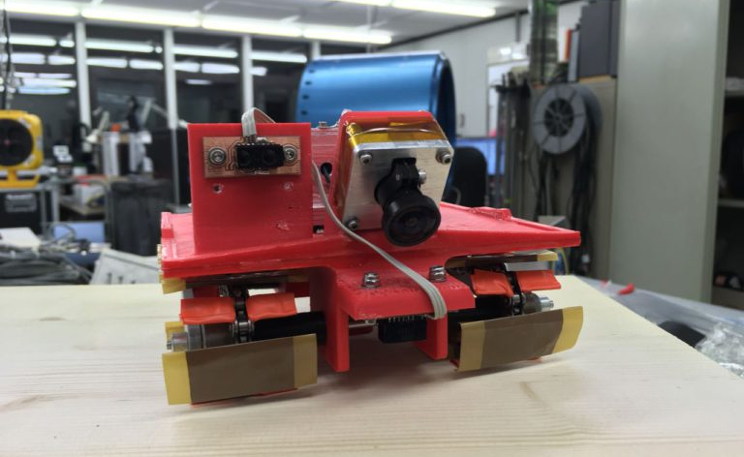
System requirements
System tasks and future upgrades

Slide 4
Tasks
The following tasks are mandatory for the RCU:
Control HV generator(s) and engines => control of the rover movement
Measure distances to surroundings => check if to reverse movement direction
Measure acceleration
Measure temperature
Measure supply voltages of:
Engines
HV generator(s)
Processor system
Sensors
Memory/SD card reader (if implemented)
Communicate with OBC (Ethernet or USB/UART)

Slide 5
Future upgrades
The following list will only be implemented if the basic functions are implemented and operational:
3D localization (either on OBC only or on both, so that the RCU can validate the sensor return data more precise)
Camera (VGA with 30fps or CSI interface)
Onboard data storage (SD card or NAND flash)
Optional with error codes (CRC, FEC, …)

Slide 6
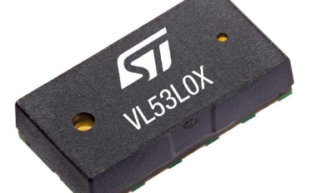
Components
Sensors, actors and interface to OBC

Slide 7
Sensors
Sensor | Task | Desired part | Units | Price per unit | Total
IMU | Acceleration, orientation | Bosch Sensortec BNO055 | 1 | 11€ | 11€
Distance measurement sensor | Measure distance | ST VL5310X | 15+ | 4€ | 60€
Temperature sensor | Measure temperature | LM75AIMM | 1 | 2€ | 2€
Rotation encoder | Count rotations | ENX10 EASY 128IMP (?) | 1 | 100€ | 100€
Total: |  |  |  |  | 173€
Prices taken from Digikey and rounded up!

Slide 8
Actors
Actor | Task | Desired part | Units | Price per unit | Total
Motor driver | Motor driver | TI DRV8871DDAR | 1 | 2€ | 2€
HV generator | ? | ? | 1 | 200€ (?) | 200€
Total: |  |  |  |  | 220€

Slide 9
Interface to OBC
Roach(1): USB UART
According to Paul: Problems with UART and Pi fixed
But: better solution desired
This may be: Ethernet
Flexibel cable (industrial cables etc.) => Structure&thermal + electronics input awaited
High performance: 100MBit/s
If only a „simple“ FPGA is used, two options:
Connect to FPGA internal Microblaze (requires IP license, test duration: 120days)
Or: AXI Ethernet Lite MAC
IEEE Std. 802.3 Media Independent Interface
100MBit/s
In case of a SoC: Ethernet directly to ARM core (maybe the best idea)

Slide 10
Processor options
Which processor to choose? ☺

Slide 11
Processor options
Idea from Cedric/Felix:
Pi Zero (approx. 6x3cm)
Idea from Matthias:
FPGA industrial processing board (approx 4x3cm or 4x5cm)
Request to Xilinx regarding Xilinx University Program (XUP)
Recommendation from Cathal (XUP): Zynq or Zynq Ultrascale SoC
Zynq Ultrascale is too expensive and too powerful (large FPGA + quad core ARM + dual core realtime ARM + GPU in one SoC, depending on modul)
Zynq maybe an interesting idea

Slide 12
Processor options
Category | Pi Zero | FPGA (Artix-7 35T or 100T) | Zynq SoC (Z-7020)
Processor | 1GHz single core | - (softcore Microblaze up to 200MHz) | 667MHz dual core
Programmable logic | - | 35T: 33280 logic cells, 90 DSP, 1,8MBit BRAM, 250 I/O pins max 100T: 101440 logic cells, 240 DSP, 4,860MBit BRAM, 300 I/O pins max | 85000 logic cells, 220 DSP, 4,9MBit BRAM, 200+128 I/O pins max
Board | Pi Zero | TE0710-02-35-2CF or TE0710-02-100-2CF | TE0724-02-20-1I
RAM | 512MB DDR2 | 512MB DDR3 | 1GB DDR3
Ethernet? | NO | YES (100MBit dual) | YES (1GBit single)
Costs | 6€ | 142€ / 214€ | 240€

Slide 13
Processor options
Pi Zero has NO Ethernet
External board required (via GPIO or USB)
No way to reach 1GBit
Additional hardware efforts (USB solution not feasible for integration in rover)
Artix-7 FPGA
Powerful and energy efficient solution (energy consumption depends heavily on frequency, FPGA operates in lower frequency as normal processor and is still faster through parallelization)
Microblaze microprocessor: programmed in C/C++
Hardware: VHDL, Verilog

Slide 14
Processor options
Xilinx XUP suggestions: Zynq
System on Chip (SoC) solution
Dual core ARM + FPGA fabric
1GBit Ethernet to ARM core
Interesting option (maybe Pi experience can be reused)
But: higher power consumption than normal FPGA
Conclusion:
Pi Zero has no direct ethernet support (only using additional module and with lower speed expected in case of GPIO)
Small FPGA already fulfils all requirements
Zynq processor might be interesting for KSat as dual core ARM is integrated (programming with C/C++, even a Python option is available)
Linux or FreeRTOS possible => keep it as simple as possible => NO Linux, better REAL realtime operation system

Slide 15
Processor options
Costs for FPGA or FPGA SoC option:
Expecting: two FPGA boards and one carrier board
Optional: one or two evalboards (depending on XUP output)
Option FPGA (Artix-7 35T):
2x 142€ + 180€
1x 72€
Gesamt: 536€ (Kosten FPGA Boards + Entwicklungsequipment)
Option FPGA (Artix-7 100T):
2x 214€ + 180€
1x 270€
Gesamt: 878€ (Kosten FPGA Boards + Entwicklungsequipment)
Option FPGA SoC (Zynq):
2x 240€ + 200€*
1x 200€
Gesamt: 880€ (Kosten FPGA SoC Board + Entwicklungsequipment)

Slide 16
Processor options
Costs for FPGA or FPGA SoC option:
Expecting: two FPGA boards and one carrier board
Optional: one or two evalboards (depending on XUP output)
Option FPGA (Artix-7 35T):
2x 142€ + 180€
1x 72€
Gesamt: 536€ (Kosten FPGA Boards + Entwicklungsequipment)
Option FPGA (Artix-7 100T):
2x 214€ + 180€
1x 270€
Gesamt: 878€ (Kosten FPGA Boards + Entwicklungsequipment)
Option FPGA SoC (Zynq):
2x 240€ + 200€*
1x 200€
Gesamt: 880€ (Kosten FPGA SoC Board + Entwicklungsequipment)
JTAG Adapter:
Original Xilinx: ~300€
Digilent adapter (fully compatible to Xilinx software and devices): ~50€
Before decision in next month: Try to order evaluation boards through XUP (which can take a few weeks)! Only possible after positive DLR decision!

Slide 17
Processor options
Existing equipment:
1x BASYS3
1x NEXSYS VIDEO
Both boards have Digilent JTAG on board (no Xilinx JTAG) and can be correctly detected, programmed and debugged from Vivado (so this would save us about 250€ on JTAG adapter costs)
Xilinx Vivado Design Suite is free of charge available at xilinx.com
No need for ModelSim (single license can cost a multiply of the whole Roach2 budget)
A limited ModelSim version for students is avaible
Limited to 10.000 lines of code (if we use a lot of IP cores or have HLS output, this limited maybe reached)
Xilinx Simulator is powerful enough and fully integrated in Vivado

Slide 18
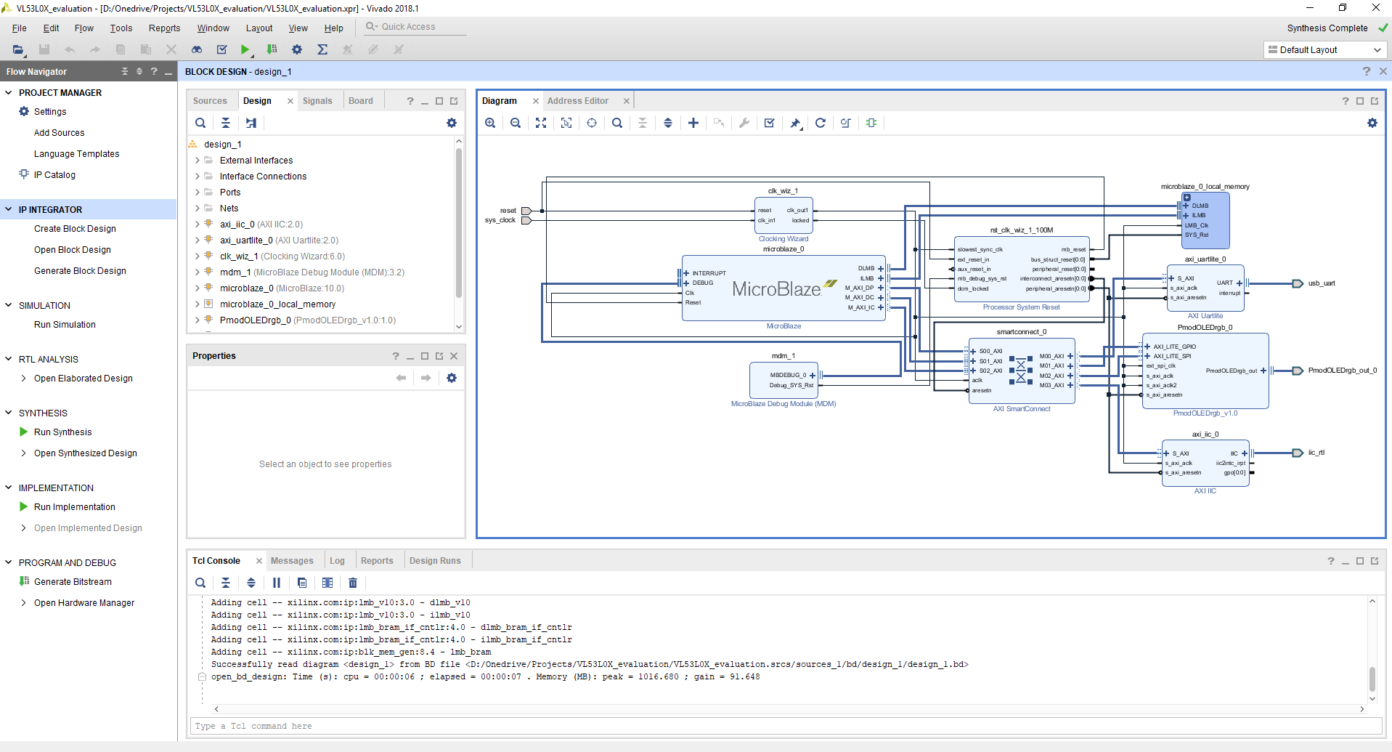
Processor options
Xilinx Vivado

Slide 19
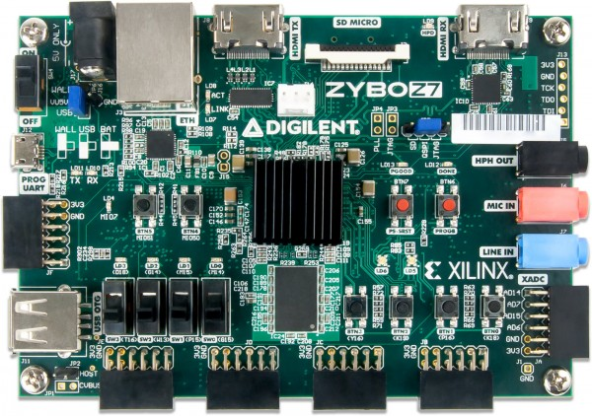
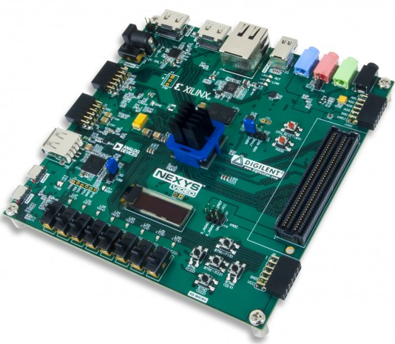
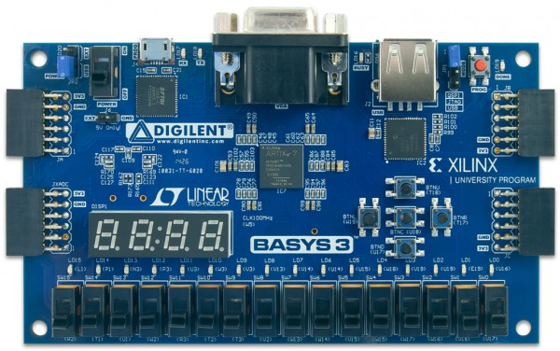
Xilinx XUP
Donation of boards possible, request has to be send from an IRS professor
Optional: Xilinx has it‘s own contest: OpenHardware 2019
Only open for students (so I can only be listed as advisor)
Should be possible to submit RCU
In case we get NO XUP donation, student prices:
Zynq Zybo Z7-20: ~200€
Camera interface (CSI)
1GB DDR3 RAM
Ethernet
Nexys Video (Artix-7 200T): ~270€
1GBit Ethernet
512MB DDR3 RAM
Large FMC connector
Basys 3 (Artix-7 35T): ~72€
No Ethernet (additional board required)
No RAM

Slide 20
System design
HV generator
Motor driver
Top
Left side
Front
Rear
Right side
Bottom
FPGA/SoC
SD Card
Rotation encoder
Temperature sensor
IMU
Ethernet
DDR3 RAM
Camera
Distance measurement sensor

Slide 21
System design
Sensor | Number of data fields | Size per data field (bit) | Total (bit) | Update rate (Hz) | Number of sensors | Expected data rate (Bit/s)
Laser distance sensor | 1 | 16 | 16 | 50 | 18 | 14400
IMU | 9 | 16 | 144 | 40 | 1 | 5760
Rotation encoder | 1 | 16 | 16 | 5000 | 1 | 80000
Temperature sensor | 1 | 16 | 16 | 2 | 1 | 32
ADC voltage control | 1 | 16 | 16 | 100 | 6 | 9600
Internal logging | 1 | 16 | 16 | 10 | 1 | 160
Total: |  |  |  |  |  | 109952
Optional: Camera modul
Assuming a standard 5MP camera: 1080p, RGB565 format, 30fps => 124,416MByte/s
As we only have a 100MBit Ethernet, we cannot send pictures at full step but every second e.g.
Assumed camera modul: https://reference.digilentinc.com/reference/add-ons/pcam-5c/reference-manual

Slide 22
System design
Data should be streamed to OBC with a full data rate of Ethernet (max. 100MBit/s)
Data rate without images is about 100KBit/s => no problem so far
Might be possible to use TCP instead of UDP without problems of package resend
Camera: only a small number of cameras can be used
In case of Pi: we need full driver support
In case of FPGA/SoC:
Digilent has a cheap solution with a 5MP camera (see link on previous page)
Required FPGA design and drivers are included (already complete for Zynq, Artix-7 would require more work)
See: https://github.com/Digilent/vivado-library/blob/feature/d-phy/ip/MIPI_CSI_2_RX/docs/mipi_csi_2_rx.pdf
Final decision for camera should wait until first RCU is implemented!

Slide 23
System design
OBC to RCU: Start
RCU: Self test
RCU (timer): Start experiment
RCU (timer): End experiment
End of power: End data acquisition

Slide 24


















Thank you for attention!
Please feel free to ask questions?

