Slide 1
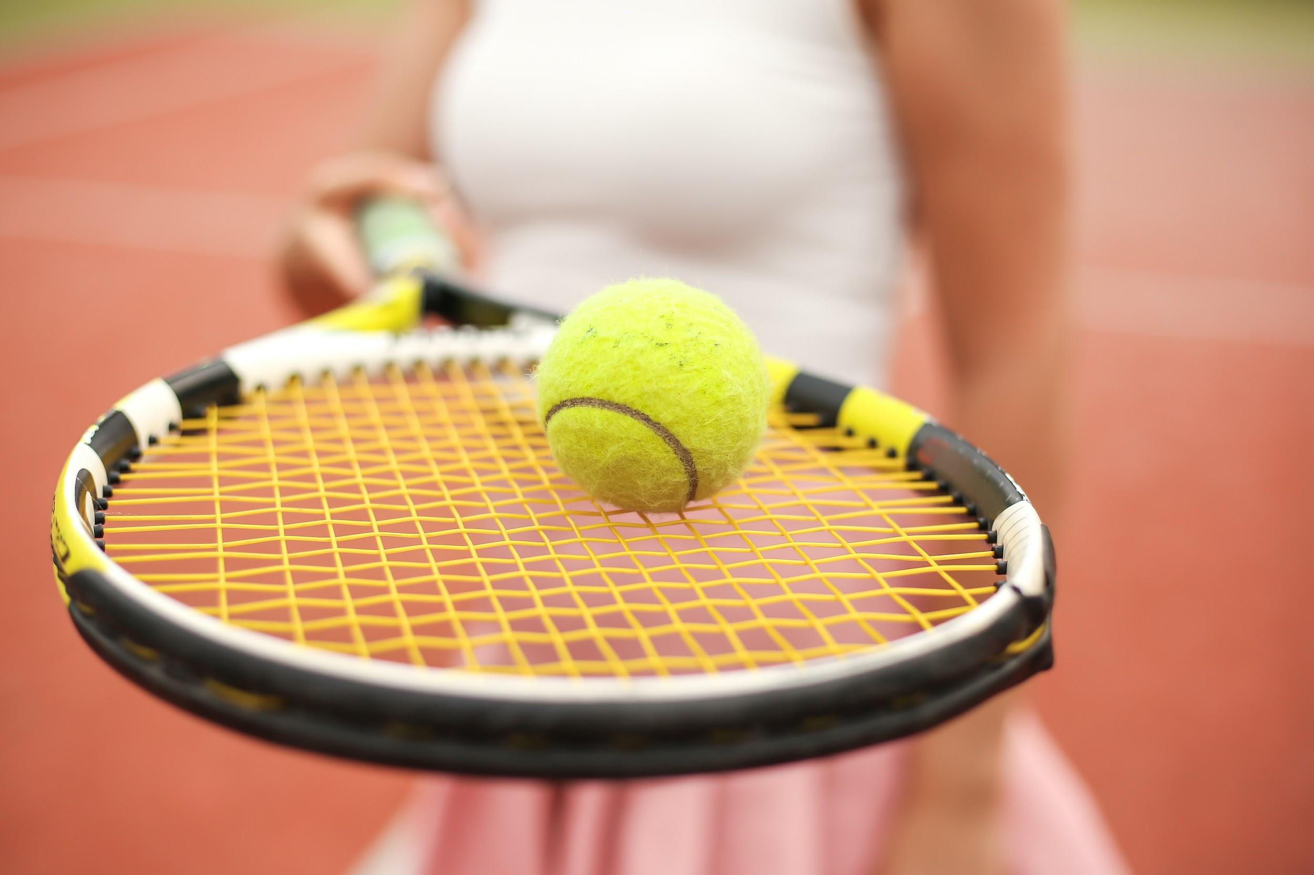
SMART TENNIS RACKET FOR TRAINING MONITORING
Electronic Technologies and Biosensors Laboratory A.A 2021/2022 - presentation 14/07/2022
Politecnico di Milano
Project 3
Natalia Ginghini Letizia Mozzorecchia Aurora Pierantozzi Adelaide Stucchi
Tutor: Matteo Rossi Professor: Pietro Cerveri

Slide 2
Goal
Classification of three of the fundamental tennis shots - forehand, backhand, serve -
by equipping a tennis racket with an IMU sensor.

Slide 3
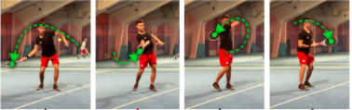
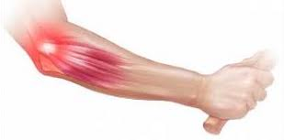
Needs addressed
Sport
Automatic evaluation of athletes’ performances, to understand strenghts and weakenesses, thus better targeting the training.
Clinical
Prevention for Epicondylitis: 10% to 50% of tennis players^{[1]} are at risk of tennis elbow, mainly due to an incorrect execution of the backhand.
^{[1]} source: T.K. Robinson PT, DSc, OCS, in Orthopaedic Physical Therapy Secrets (III Edition), 2017

Slide 4
Project Specifications
BT COMMUNICATION PSoC Programmer
between the PSoC and the PC to make the device pluggable on a real racket.
3D CASE PRINT Eagle, Fusion360
to be attached to the racket, in a way that does not interfer during the match.
1
2
to visualize in real-time the type of shots predicted during the match.
GUI Python: Tkinter, Threading
for real-time gesture recognition of the three tennis shots.
CLASSIFICATION ALGORITHM Python: Scikit-learn
4
3

Slide 5
Firmware: MPU-9250 settings
Sample rate = 1k Hz / (1 + 4) = 200 Hz
Full scale range
Accelerometer → ±2 g
Gyroscope → ±250 dps
Interrupt
Accelerometer & gyroscope registers read when the "Raw Data Ready" internal interrupt is triggered.

Slide 6
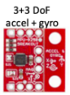

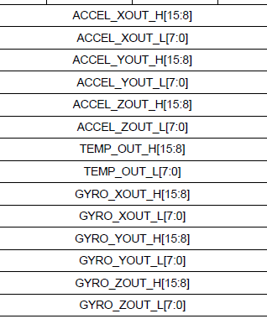
Firmware: Data collection
Registers raw data reading
Data encoding
Data decoding
header = 0xA0
10 frames
10*12 bytes
tail = 0xC0
40 packets
matrix (400,6)
400 rows → N frames * N packets
6 columns → IMU measurements
1 frame
12 bytes
1 packet
(10*12 + 2) bytes

Slide 7
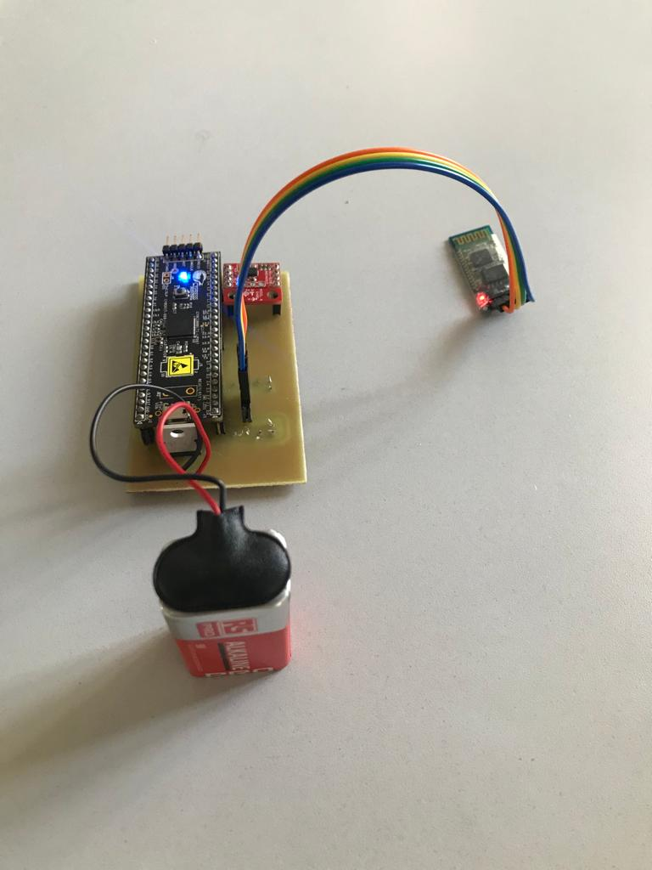
PCB: HW components
PSoC 5 microcontroller
5V
Battery
9V
Voltage regulator
9V - 5V
MPU-9250 9-axis IMU
5V
Bluetooth HC-06 module
5V

Slide 8
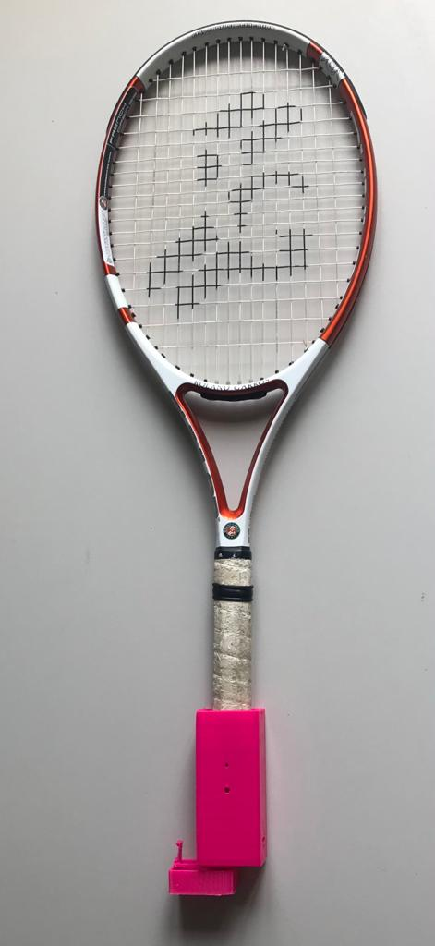
Case design: features
Ideal characteristics
Light & thin
As small as possible
Stable during the match
Protected from the strokes
Location
The case is attached at the bottom of the racket, so that it does not get hit by the ball during the game.

Slide 9
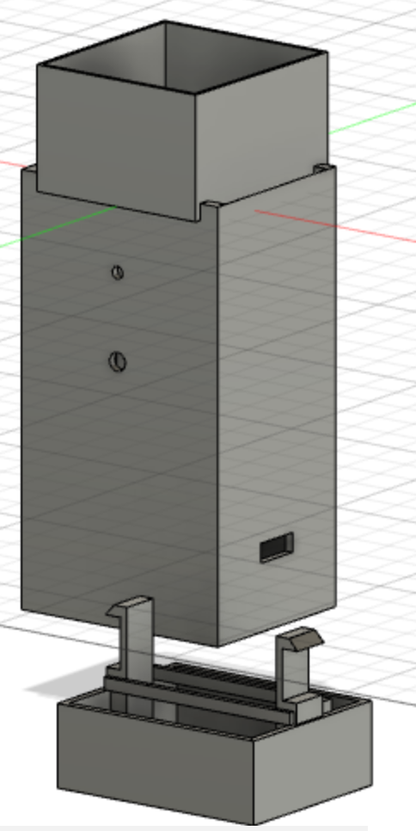
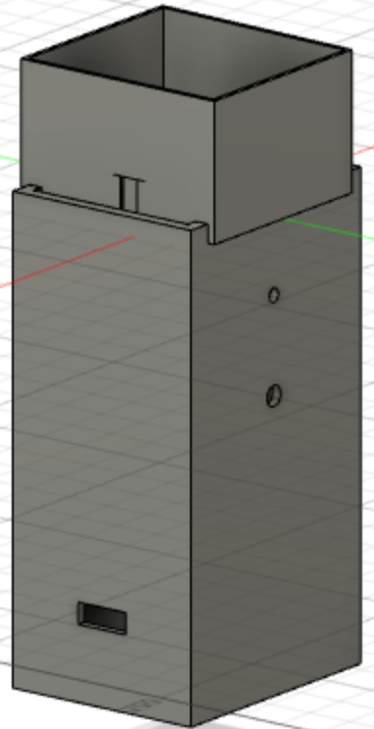
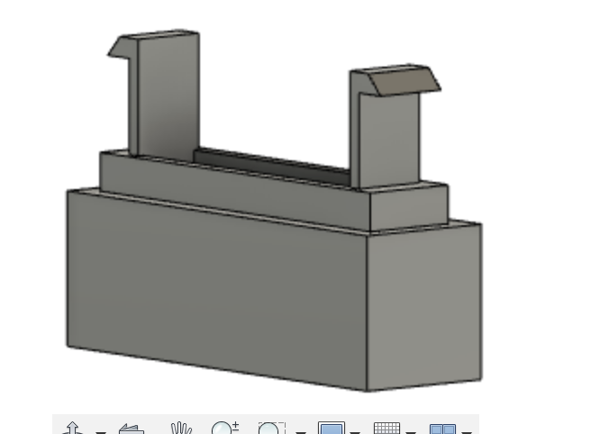
Case design: 3D project
BODY 1: PCB HOUSING
Attachment to the racket handle
Holes: for led and switch button ^{[2]}
PCB insertion
Cover, useful if we want to change the PCB or to replace the battery, stabilized through a tape
BODY 2: END CAP
^{[2]} not present in the final device

Slide 10
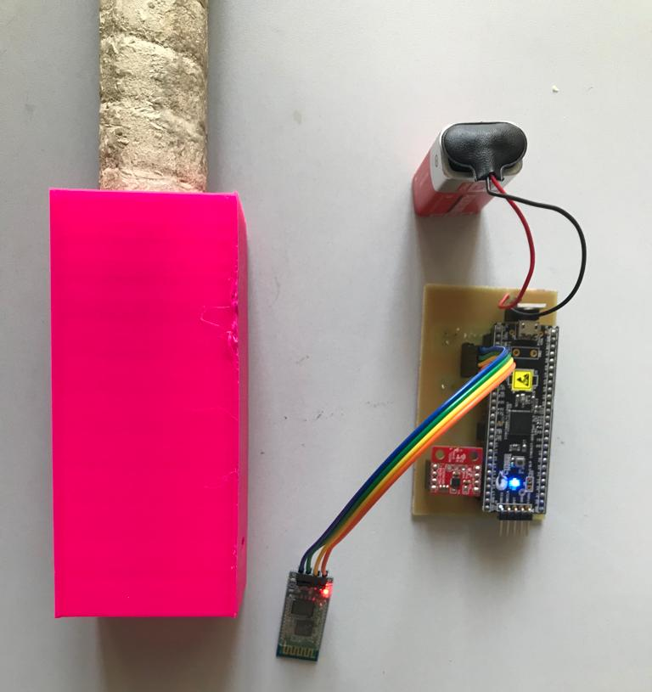
Acquisition protocol
Right-handed players only.
Position of the PCB within the case for acquisitions as shown in the picture.
Total number of subjects → 4
Duration of each acquisition → 4 sec
Gestures acquired and related labels:
Forehand → label = 0
Backhand → label = 1
Serve → label = 2
No-shot → label = 3

Slide 11


Classification
FEATURES ENGINEERING
TRAINING DATASET
TRAINING DATASET
SPLITTING DATASET
SPLITTING DATASET
MULTICLASS CLASSIFIERS
MULTICLASS CLASSIFIERS
1 target variable: type of shot → ‘label’.
18 explanatory variables: gyroscope and accelerometer quantiles.
Training: 70% of the entire dataset.
Test: 30% of the entire dataset.
Explanatory variables:
Before
IMU measurements: ACCX, ACCY, ACCZ, GYRX, GYRY, GYRZ
1 acquisition file → (400,7)
After
1° (0.25), 2° (median), 3° (0.75) quantiles of each IMU measurement: ACCX_25, ACCX_50, ACCX_75, … , GYRZ_25, GYRZ_50, GYRZ_75
1 acquisition file → (1,19)
4 x
4 x
4 x
1 x
forehand: 0
backhand: 1
serve: 2
no shot: 3
x 10
x 10
x 10
x 20
140 acquisition files
training_dataset → (140,19)
Trained classifiers:
Decision Tree, Logistic Regression, K-Nearest Neighbors, Support Vector Machine, Random Forest.

Slide 12
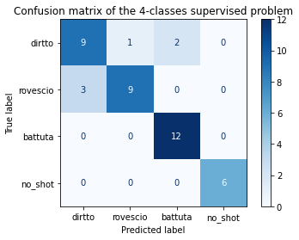
Classification algorithm: results
Decision Tree | f1 (train) | f1 (test)
 | 0.847222 | 0.857143
 | Confusion matrix
Log Reg | f1 (train) | f1 (test)
 | 0.806818 | 0.809523
 | Confusion matrix

Slide 13
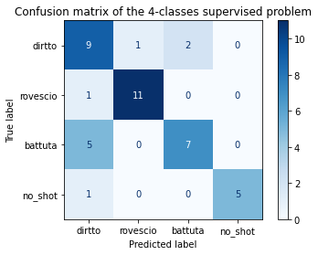
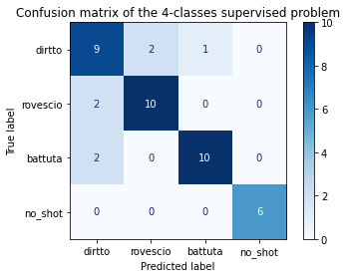
Classification algorithm: results
KNN | f1 (train) | f1 (test)
 | 0.704861 | 0.761905
 | Confusion matrix
SVM | f1 (train) | f1 (test)
 | 0.938447 | 0.833333
 | Confusion matrix

Slide 14
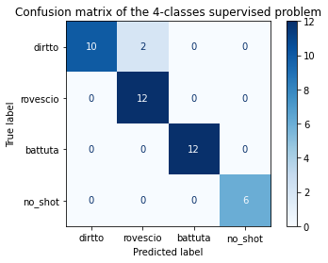
Classification algorithm: results
The best classifier is Random Forest
✔ High F1 score for both training and test sets.
✔ Similar F1 scores for training test and test set → no overfitting.
✔ Interpretability.
Random Forest | f1 (train) | f1 (test)
 | 0.949179 | 0.904761
 | Confusion matrix

Slide 15
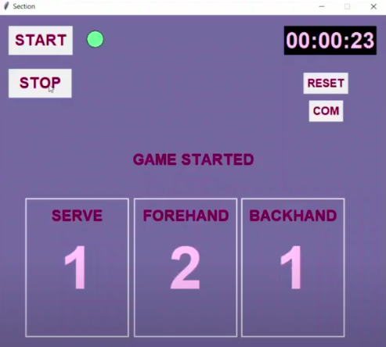
GUI
COM Open the serial port and build the Classifier.
START
Enable Timer and
start the threads.
STOP Disable Timer and block acquisitions.
RESET
Prepare Timer and Scoreboard for the next session.

Slide 16
Applications of our smart racket
Automatic, real-time classification of 3 tennis shots.
Evaluation and consequent improvement of the athlete’s style of play.
Identification of possible associations between the prevalence of a type of shot with joint pain.

Slide 17
Problems encountered
FIFO buffer → not used due to the cryptic MPU-9250 datasheet which made the FIFO implementation difficult and time consuming. We decided, then, to read the data from the IMU continuously by using another internal interrupt (‘Raw Data Ready’).
Switch button → not used due to the interrupt used to read data registers, that did not allow to read the button state. We partially fixed this problem by adding a button on the GUI.
LED → not used due to a problem with the PCB trace that linked the LED with the ground plane. We partially solved this problem by adding a LED on the GUI.

Slide 18
Future developments
Calculate meaningful parameters from accelerations through more in-depth data post-processing, useful for biomechanical analysis.
Combining the inertial measurements with dynamic force sensor measurements (e.g. FSR), so as to fully characterize the tennis shot.
Visualization of the obtained data plots on the GUI.
Have a larger acquisition dataset in order to obtain more accurate classifications.
Make the device suitable for left-handers.

Slide 19
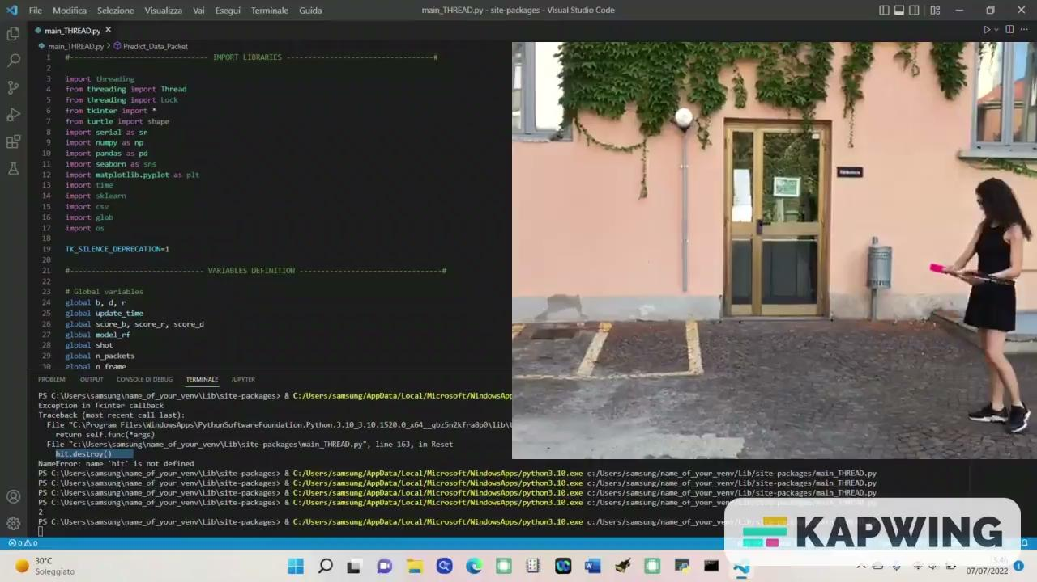
Virtual
Demo
Thanks for your attention.

