Slide 1
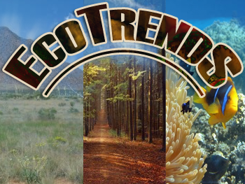
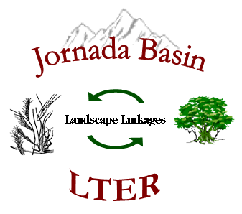







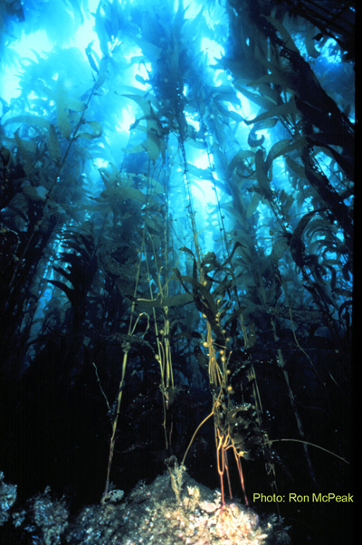
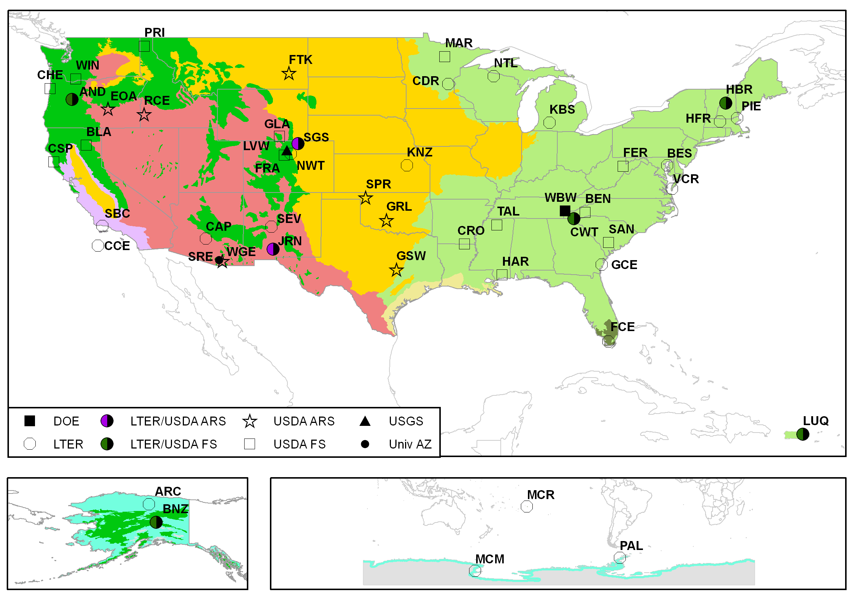
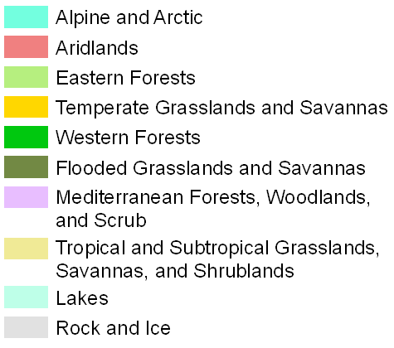
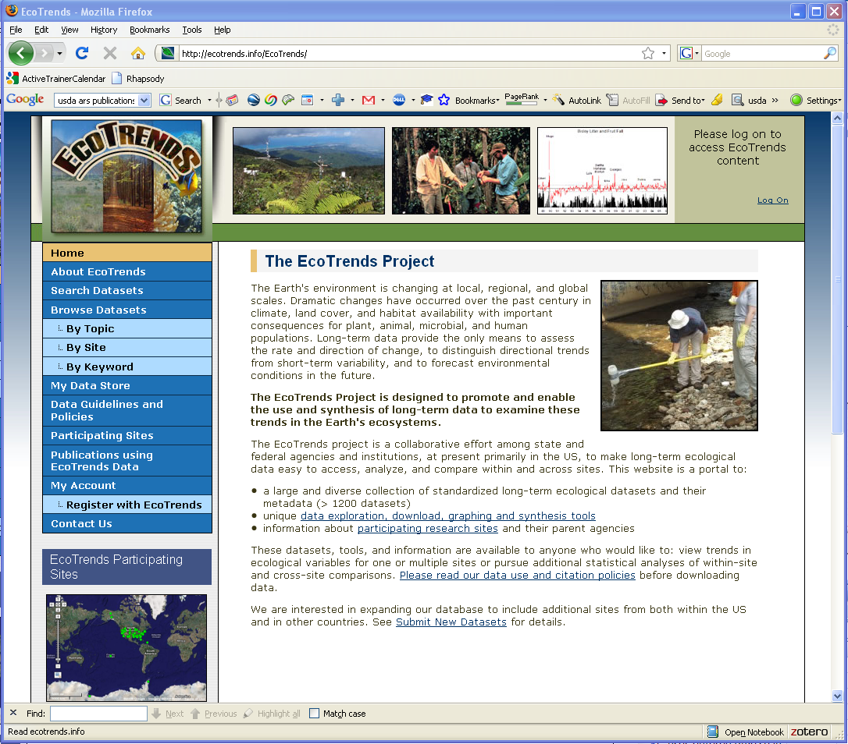
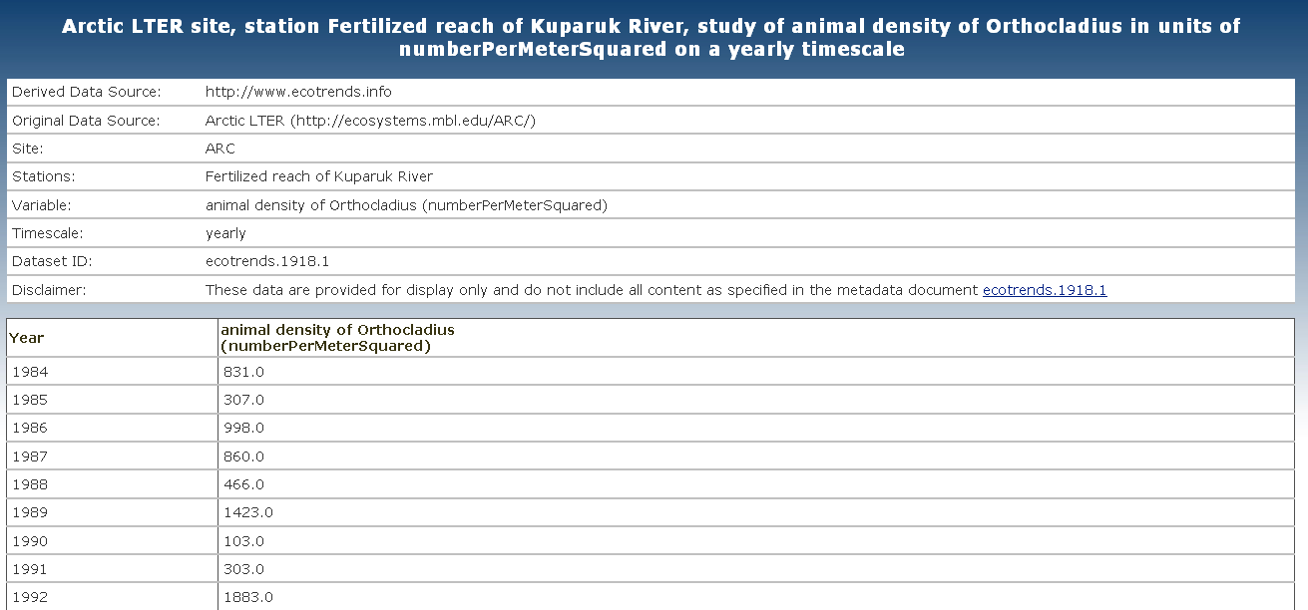
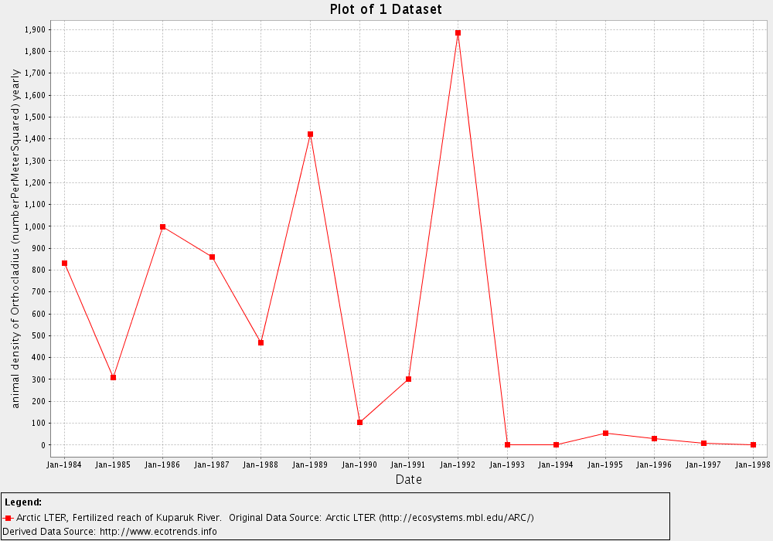
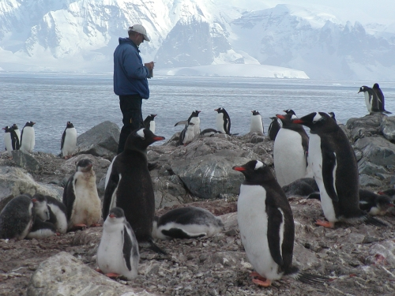
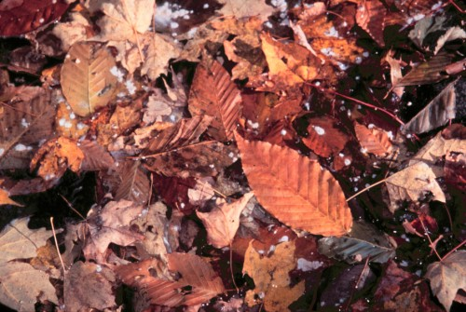
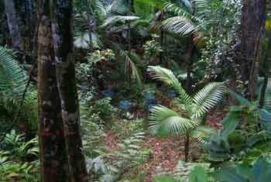
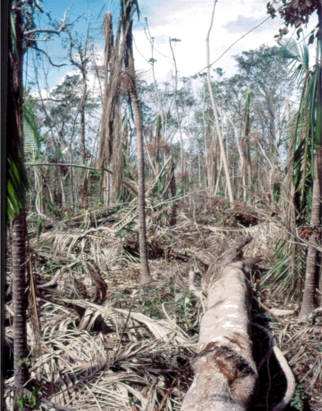
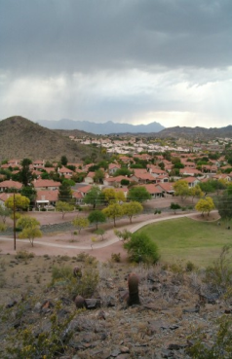
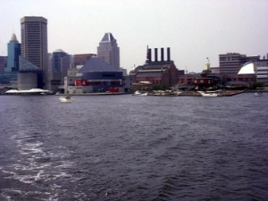
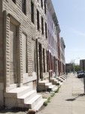
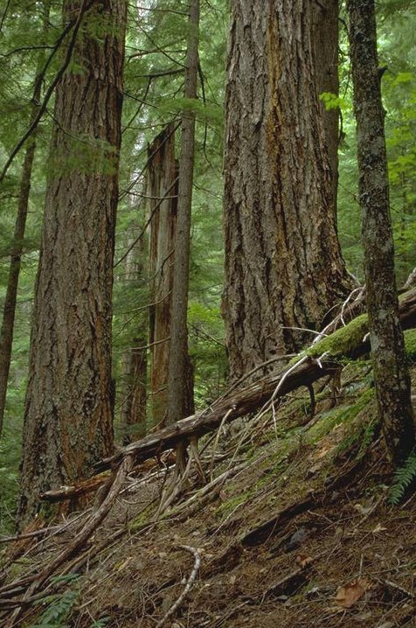
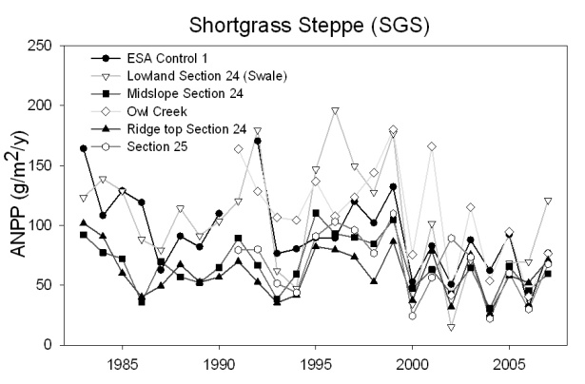
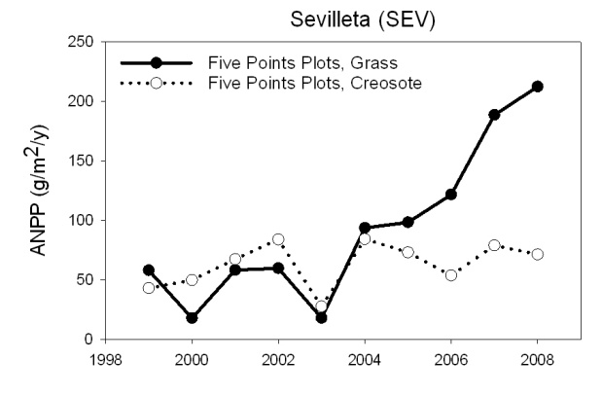
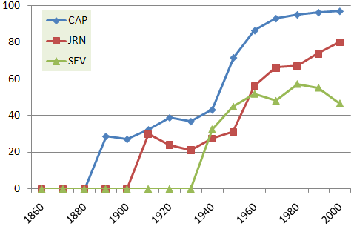
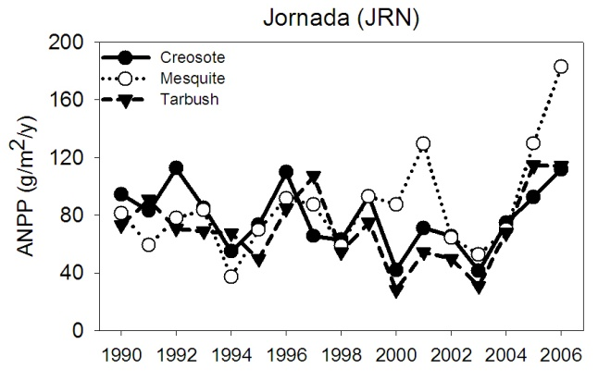
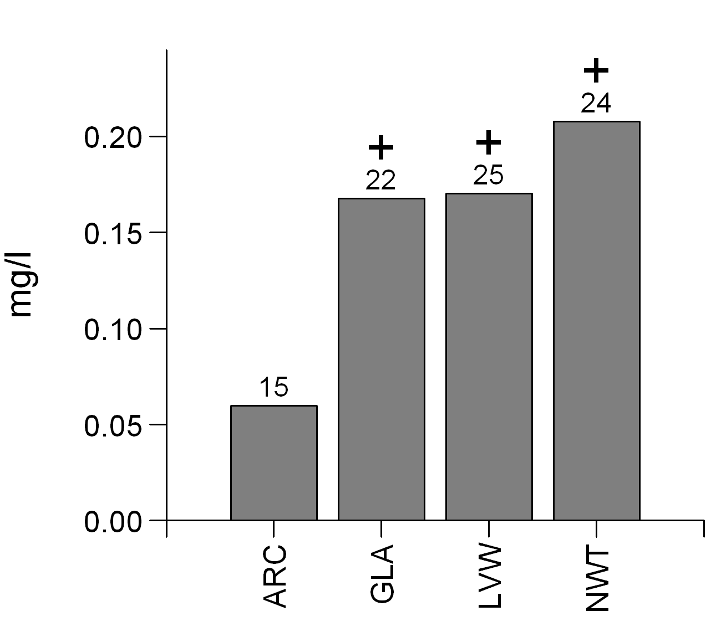
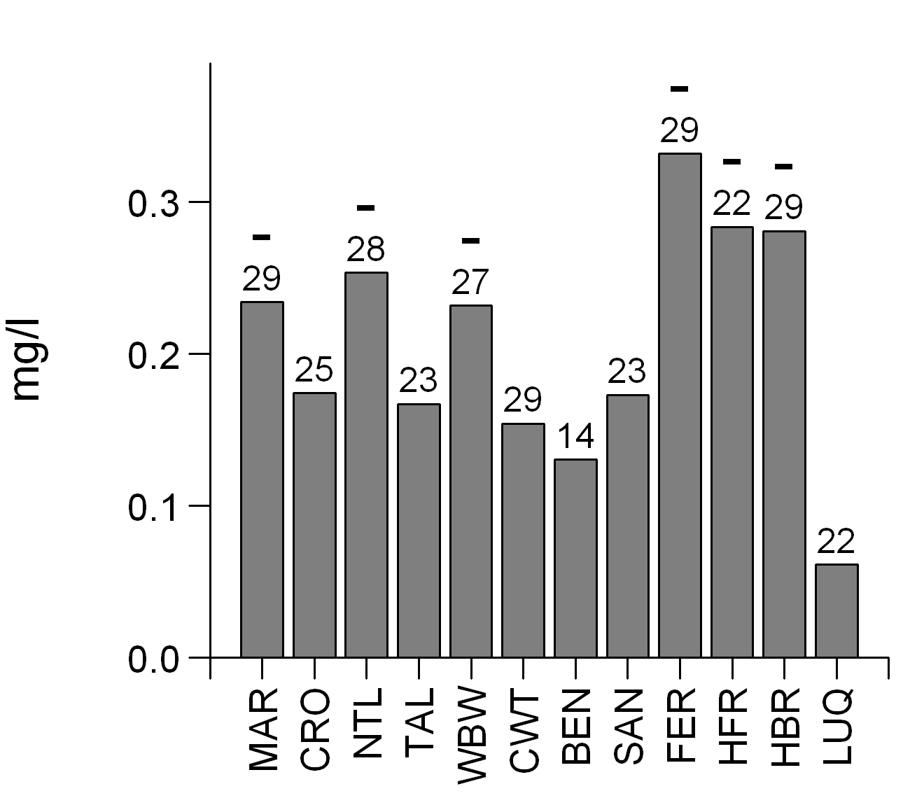
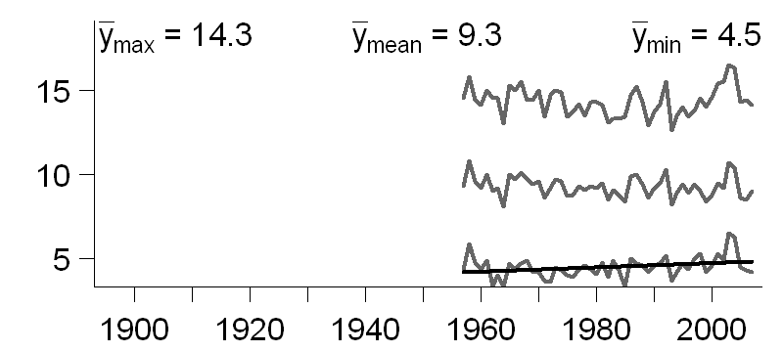
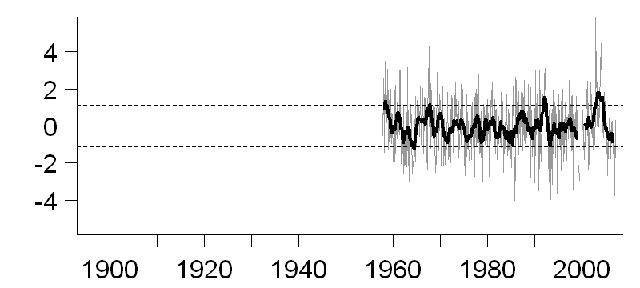
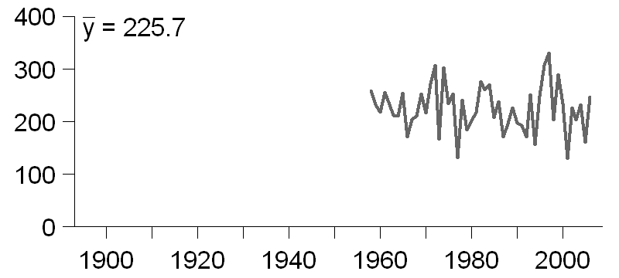
EcoTrends: synthesizing long-term ecological data from across the US and beyond
Project Leader: Debra Peters, USDA ARS, Jornada Experimental Range, Jornada Basin LTER & Sevilleta LTER, Las Cruces, NM USA
Project Coordinator: Christine Laney, New Mexico State University, Jornada Basin LTER, Las Cruces, NM USA
Introduction: Long-term ecological research sites within the U.S. date to 1902 when the Santa Rita Experimental Range and to 1911 when the Priest River Experimental Forest were set aside as research centers. By 1980 when the Long Term Ecological Research program was established, 78 experimental forests and > 10 rangeland research stations had been conducting research, in most cases for > 40 years. Currently this large suite of NSF and USDA supported sites, including 26 LTER sites, represents a wide range of ecosystem types, from forests to grasslands and shrublands, freshwater lakes and streams, near coastal marine and estuaries as well as urban areas and systems in the arctic and Antarctica. A variety of different kinds of data have been collected from these sites through time, ranging from primarily climatic and demographic data since the 1800s to more recent quantitative assessments of plant, animal, and microbial populations and communities, hydrological and biogeochemical cycles, biodiversity, and disturbance regimes.
As the LTER enters its “Decade of Synthesis”, the USFS enters its “New Century of Service”, the USDA ARS enters the time when “The Future Grows Here”, and new initiatives, such as the National Ecological Observatory Network (NEON) become operative, there is a critical need for a collection of highly accessible, up-to-date, and easy to use data sets that span the ecosystems and history of the U.S.
Goals: to create a platform for synthesis by making long-term data accessible, and to illustrate the utility of this platform in addressing within-site and network-level scientific questions.
Products: (1) a book (USDA ARS, 2010) to be published on trends in long-term data within and among sites, and examples that illustrate the value of long-term data in addressing important questions; (2) a web site containing derived data and metadata that can be easily explored, accessed, downloaded, and plotted for synthetic analyses.
Participating long-term research sites and agencies
Biomes
AND: H.J. Andrews Experimental Forest
ARC: Arctic LTER
BEN: Bent Creek Experimental Forest
BES: Baltimore Ecosystem Study
BLA: Blacks Mountain Experimental Forest
BNZ: Bonanza Creek
CAP: Central Arizona – Phoenix Urban LTER
CCE: California Current Ecosystem
CDR: Cedar Creek Ecosystem Science Reserve
CHE: Cascade Head Experimental Forest
CRO: Crossett Experimental Forest
CSP: Caspar Creek Experimental Watershed
CWT: Coweeta Hydrologic Laboratory
EOA: Eastern Oregon Agricultural Research Center
FCE: Florida Coastal Everglades
FER: Fernow Experimental Forest
FRA: Fraser Experimental Forest
FTK: Fort Keogh
GCE: Georgia Coastal Ecosystems
GLA: Glacier Experimental Forest
GRL: Grazinglands Research Laboratory
GSW: Grassland Soil and Water Research Laboratory
HAR: Harrison Experimental Forest
HBR: Hubbard Brook
HFR: Harvard Forest
JRN: Jornada Basin/ Exp. Range
KBS: Kellogg Biological Station
KNZ: Konza Prairie
LUQ: Luquillo Experimental Forest
LVW: Loch Vale Watershed
MAR: Marcell Experimental Forest
MCM: McMurdo Dry Valleys LTER
MCR: Moorea Coral Reef LTER
NTL: Northern Temperate Lakes LTER
NWT: Niwot Ridge LTER
PAL: Palmer Station LTER
PIE: Plum Island Ecosystem LTER
PRI: Priest River Experimental Forest
RCE: Reynolds Creek Experimental Watershed
SAN: Santee Experimental Forest
SBC: Santa Barbara Coastal
SEV: Sevilleta LTER
SGS: Shortgrass Steppe LTER
SPR: Southern Plains Range Research Station
SRE: Santa Rita Experimental Range
TAL: Tallahatchie Experimental Forest
VCR: Virginia Coast Reserve LTER
WBW: Walker Branch Watershed
WGE: Walnut Gulch Experimental Watershed
WIN: Wind River Experimental Forest
EcoTrends website (http://www.ecotrends.info; open access Oct 1, 2009)
The primary themes are
Biotic structure (top panel: left, penguins of Palmer Station LTER)
Biogeochemistry (top panel: right, calcium addition to litter at Hubbard Brook LTER),
Disturbance (middle panel: forest at Luquillo LTER, before (left) and after (right) a hurricane)
Human population and economy (bottom panel: left, Central Arizona-Phoenix Urban LTER; center & right, Baltimore Ecosystem Study LTER).
Climate & physical variability
Photos courtesy of the LTER network.
Website Features:
> 20,000 datasets from 50 research sites, aggregated to a monthly and/or yearly timestep, that can be discovered, explored, downloaded and plotted
Several ways to discover datasets
Search interface (select one or more sites, attributes, principal investigator names, and more)
Three browse interfaces (by topic, site, or keyword)
Several ways to explore datasets
View metadata about the derived data product
Link to the metadata of the original dataset
View the datasets as html or download them
Plot data on the fly from 1 or more datasets on a single graph
Store interesting data in your own personal Data Store for later review
View publications that used EcoTrends data
Examples of data
Acknowledgements: The EcoTrends project is funded by the National Science Foundation (NSF) and the USDA Agricultural Research Service (USDA-ARS) Jornada Experimental Range. Collaborators include: the Long-Term Ecological Research (LTER) Network Office, USDA-ARS, USDA Forest Service (USDA-FS), National Center for Ecological Analysis and Synthesis (NCEAS), Department of Energy (DOE), US Geological Survey (USGS), New Mexico State University (NMSU), and state institutions. This project would not be possible without the continued assistance and involvement of scientists, information managers, support staff, and students from each long-term site.
Collaborators:
LTER & LTER Network Office (LNO) USDA Forest Service
New Mexico State University USDA Agricultural Research Service
National Center for Ecological Analysis and Synthesis (NCEAS)
National Science Foundation (NSF)
Editorial Committee:
Ariel Lugo [LUQ, USFS] Scott Collins [SEV] Alan Knapp [SGS, KNZ]
Mark Ohman [CCE] Peter Groffman [HBR] Debra Peters [JRN, ARS]
Tim Kratz [NTL] Morgan Grove [BES, USFS] Christine Laney [JRN]
Charley Driscoll [HBR] Bob Waide [LUQ, LNO]
Charlene d’Avanzo [Hampshire College, Education Representative]
Technical support:
James Brunt, Duane Costa, Inigo San Gil, Mark Servilla, Marshall White [LNO]
Wade Sheldon [GCE] Ken Ramsey [JRN] Mark Schildhauer [NCEAS]
Don Henshaw [AND]
Aboveground net primary production at three western grassland/shrubland sites.
Urban population as a percent of total population at three southwestern sites.
cm ◦C ◦C
Meteorological data from the H.J. Andrews Experimental Forest (Climatic Station at Watershed 2).
Top: max., mean and min. temperature. Only min. temp. has a significant positive trend.
Middle: detrended anomalies from mean temperature.
Bottom: total annual precipitation
Precipitation volume-weighted concentration of nitrate (as mg N/L) in Alpine & Arctic sites (left: note positive trend over past 3 decades in Colorado’s Front Range) and in Eastern Forests (right: note negative trend over past 3 decades). Number above each bar indicates the number of years of data that are currently available.

