Slide 1

Data Access Server
The Water Cooler Session
Mark Servilla & Duane Costa
17/18 February 2009

Slide 2

Background
LTER Network Data Access Policy
  Approved 6 April 2005 by LTER Coordinating Committee
  Issues addressed:
    Release of LTER data products (along with metadata)
    User registration for accessing data, includes
      Obtaining Name, Affiliation, Email Address, and Full Contact Information
      Must accept User Agreement (General and/or Restricted)
      Provide statement of intended use of data
    License agreements specifying conditions for data use

Slide 3
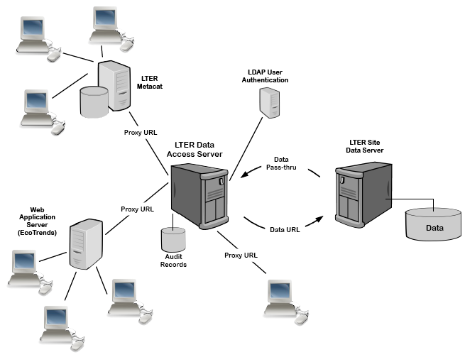
Data Access Server

Slide 4
DAS Service Goals
LTER Data Access Policy compliant service
  Registration
  Authentication
  Auditing
  Notification
  Reporting
Low impact on site Information Managers/ Administrators
  Minimal replacement of data URL paths
  Administrative interface for proxy URL to real URL mapping

Slide 5
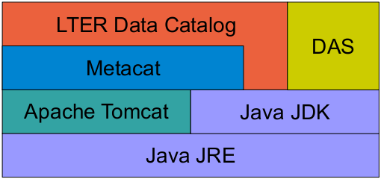
DAS Software Stack

Slide 6
User Registration & Authentication
Separate user table for registration specific information, including statement of intended use (all users)
Authentication
  LTER LDAP
  Local pass-phrase challenge for non-LTER users
Supports “cookies” for automatic login
By-pass for 3rd party applications (e.g. Kepler)
Filter for “search bots” or “web spiders”

Slide 7


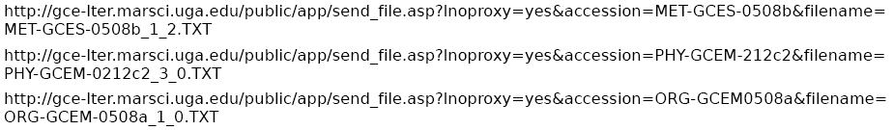
Data URLs
Arctic LTER
North Inlet LTER
Georgia Coastal Ecosystem LTER

Slide 8


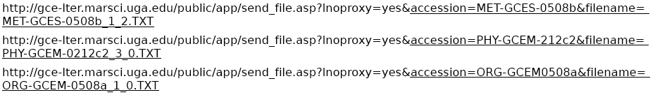
URL Heads and URL Tails
Arctic LTER
North Inlet LTER
Georgia Coastal Ecosystem LTER

Slide 9
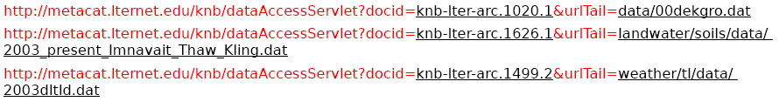
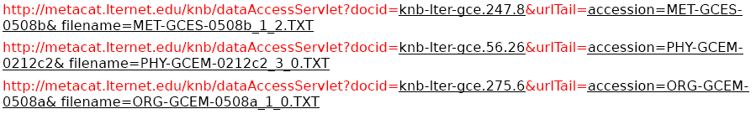
DAS Proxy URLs
Arctic LTER
North Inlet LTER
Georgia Coastal Ecosystem LTER

Slide 10
Generalized Use Case
Step 1: User selects DAS proxy URL located in metadata document

Slide 11

Generalized Use Case
Step 1: User selects DAS proxy URL located in metadata document
Step 2: DAS service verifies user has authenticated and has accepted LTER Data Access Policy

Slide 12
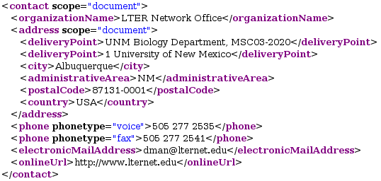
Generalized Use Case
Step 3: DAS uses document ID to obtain EML document for notification content
  Contacts, Creators, and Metadata Providers

Slide 13
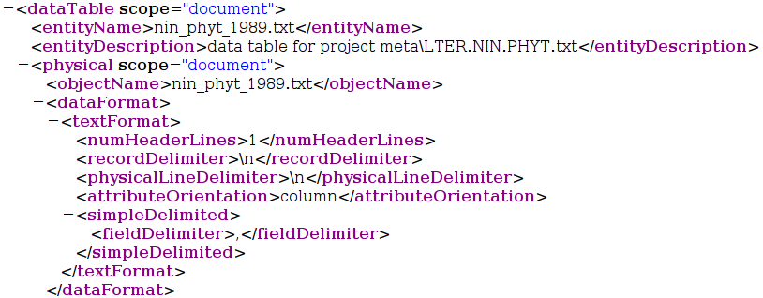
Generalized Use Case
Step 4: DAS uses document ID to obtain EML document for the data 'entity' name

Slide 14



Generalized Use Case
Step 5: DAS sends email notification to data owner and data user

Slide 15

Generalized Use Case
Step 5: DAS sends email notification to data owner and data user
Step 6: DAS records access in audit log

Slide 16
Generalize Use Case
Step 7: DAS uses document ID to determine the LTER site

Slide 17
Generalize Use Case
Step 7: DAS uses document ID to determine the LTER site
Step 8: DAS selects the URLHead value entered by the LTER site

Slide 18
Generalize Use Case
Step 9: DAS appends URLTail value from the proxy URL to the URLHead to re-form the original data URL
+

Slide 19

Generalize Use Case
Step 9: DAS appends URLTail value from the proxy URL to the URLHead to re-form the original data URL
Step 10: DAS uses original data URL to obtain data and pass-through to user
+

Slide 20
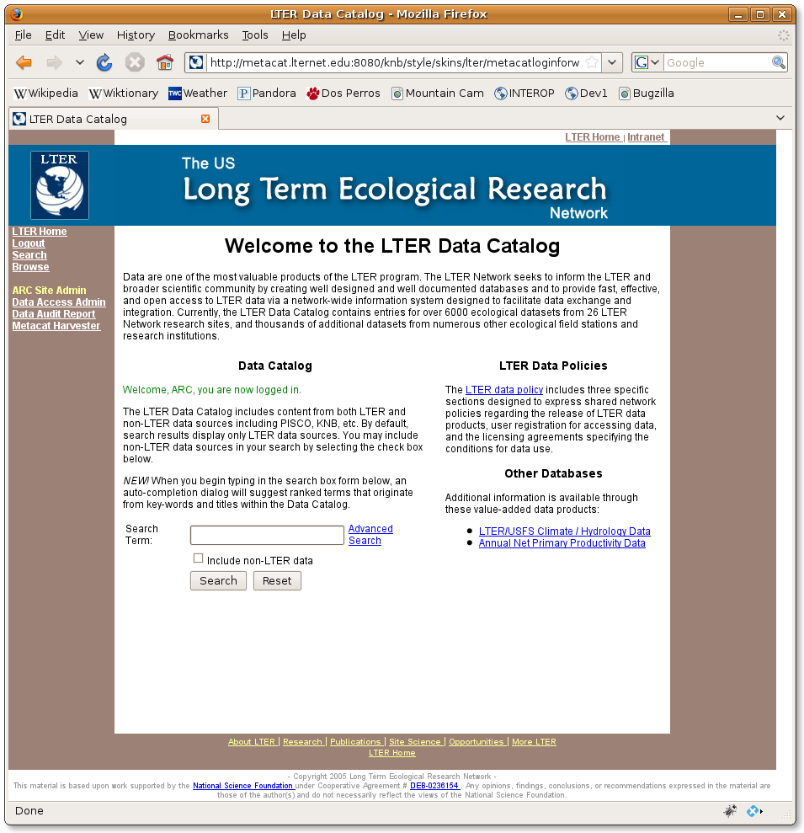
DAS Administration

Slide 21
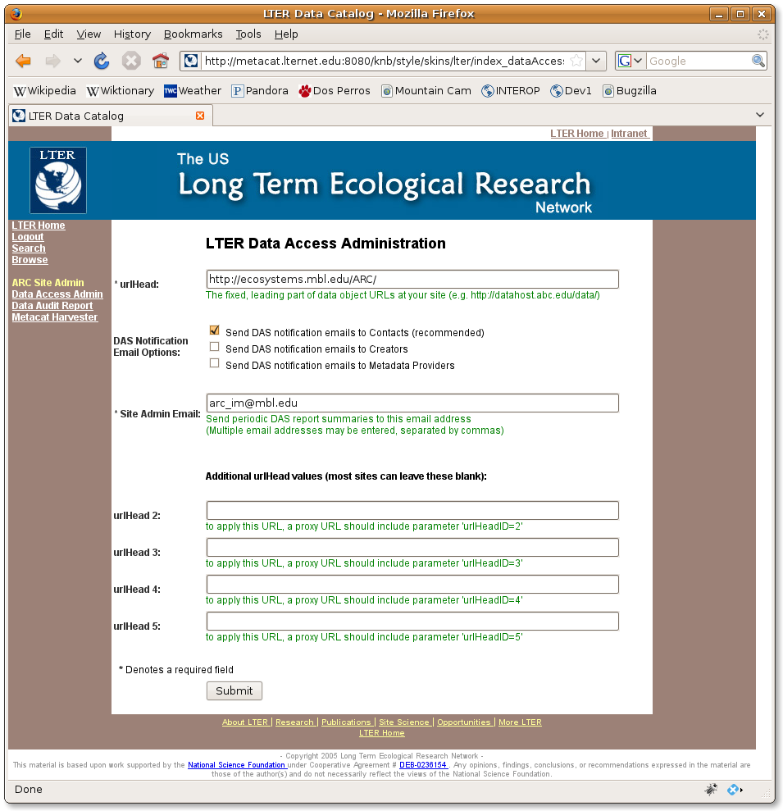
DAS Administration

Slide 22
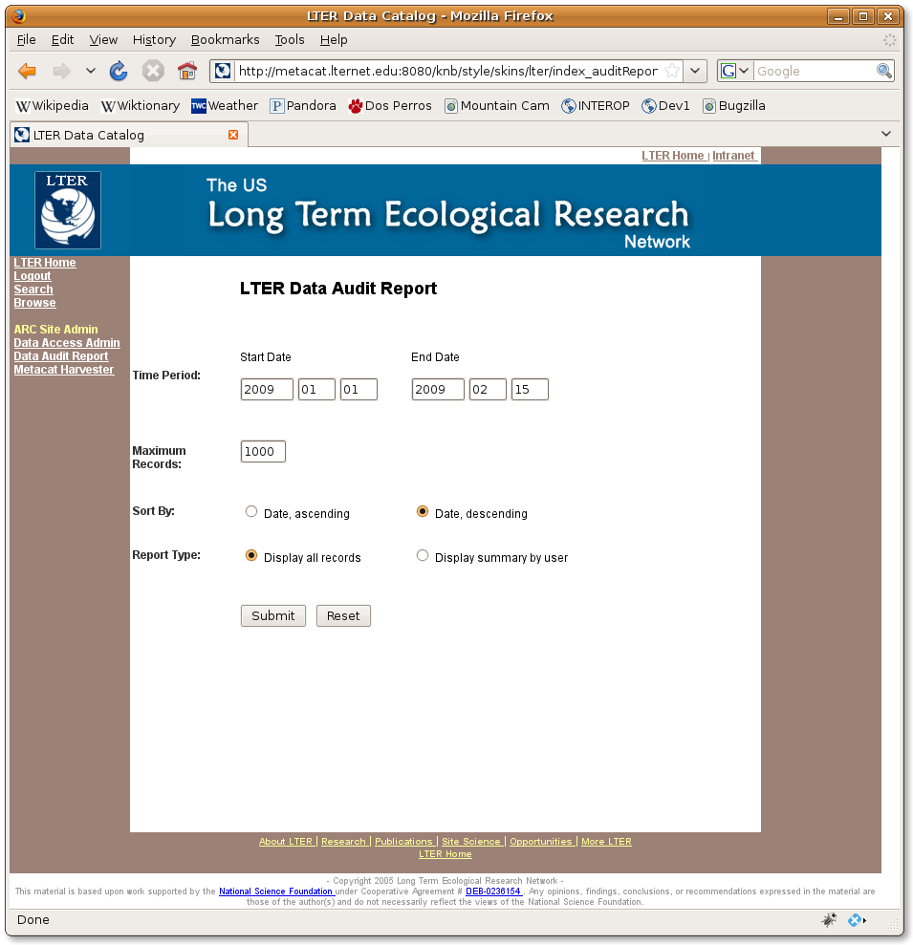
DAS Audit Report

Slide 23
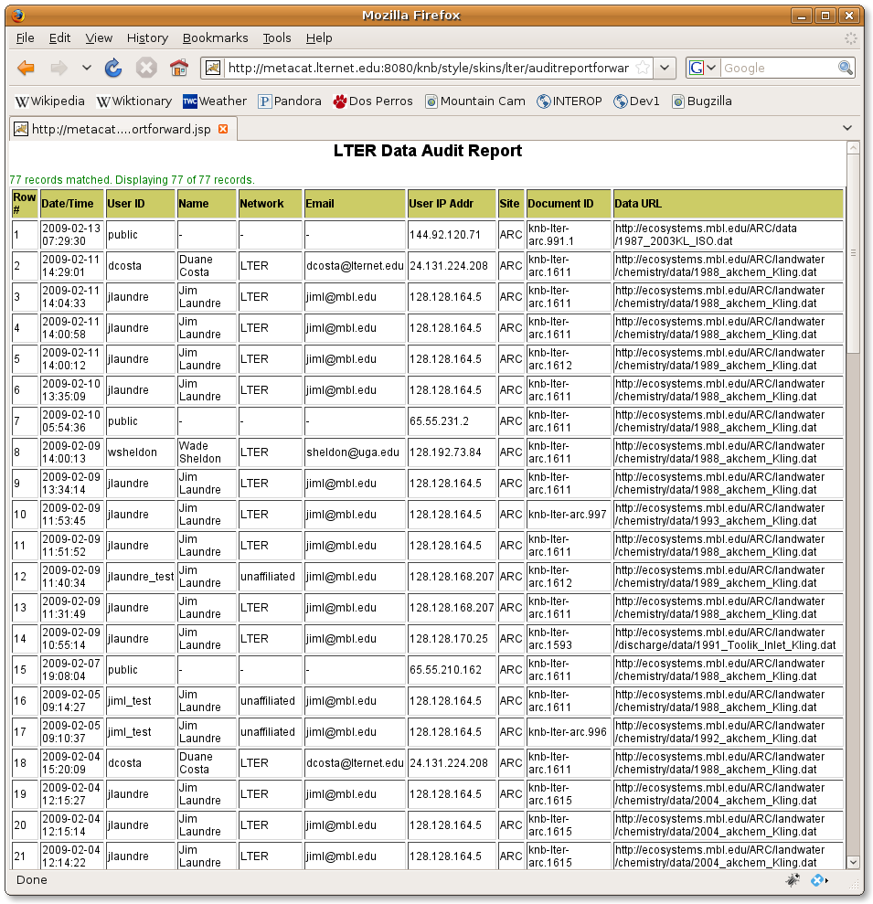
DAS Audit Report

Slide 24
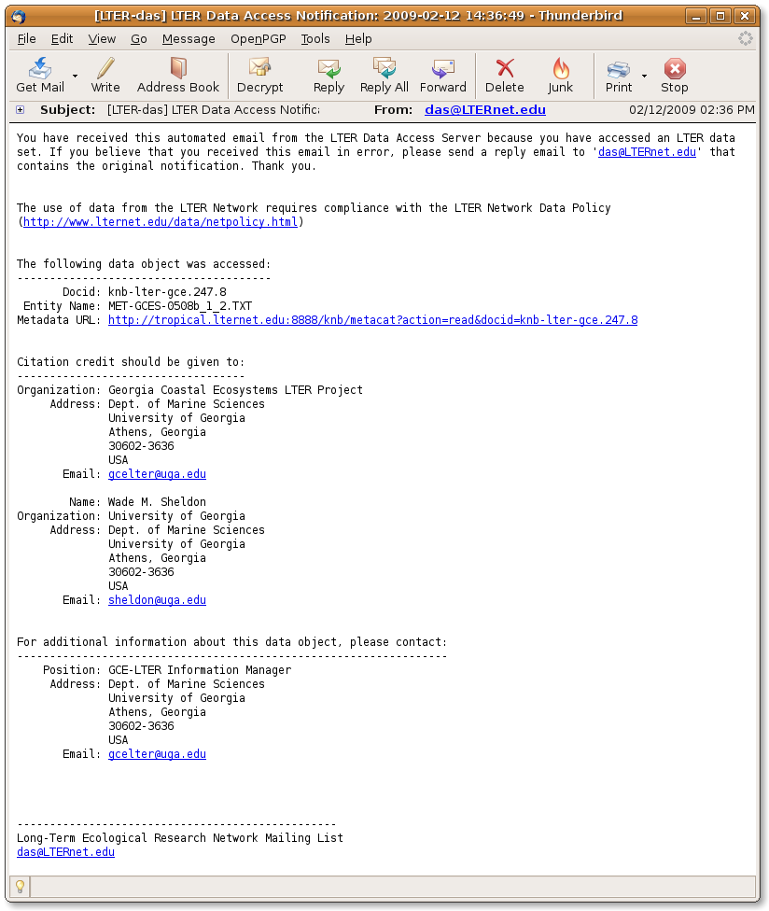
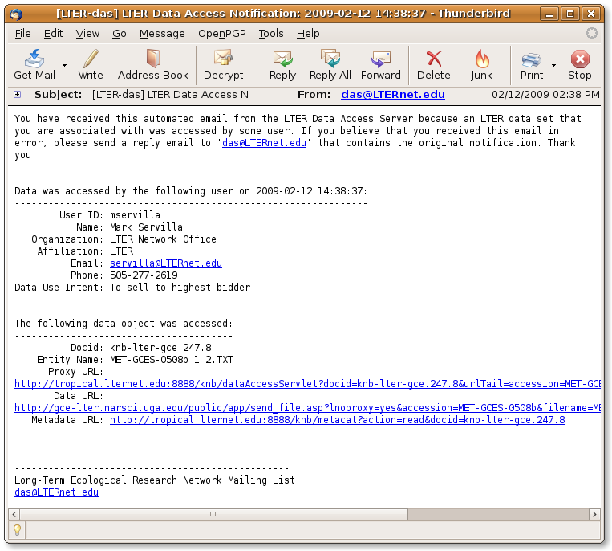
Email Notifications
Data Owner Email
Data User Email

Slide 25
Information about DAS
General Information and Status
  http://intranet.lternet.edu/im/forum/200
Project Plan
  http://urban.lternet.edu/viewvc/trunk/projects/DAS/docs/DAS-ProjectPlan.pdf?view=co&root=NIS
Project Management
  http://fire.lternet.edu/dotproject/index.php?m=projects&a= view&project_id=44
Project Bugzilla
  http://fire.lternet.edu/cgi-bin/bugzilla/buglist.cgi?query_format=specific& order=relevance+desc&bug_status=__open__&product= Data+Access+Server&content=

Slide 26

Thank you!

