Slide 1
Protecting Your Digital Research Data
7 “Mostly” Easy Steps to Data Security

Slide 2
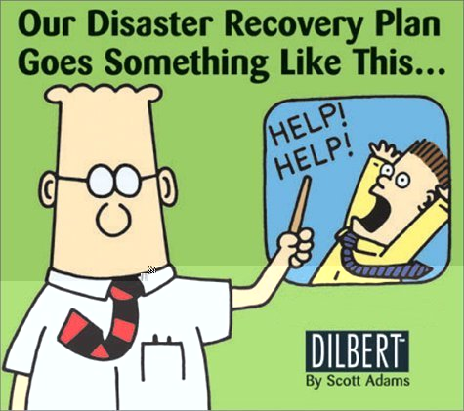

Slide 3
Step 1: Know the risks
Theft or physical damage to computer or media
Routine hardware or software failure
Data tampering or unauthorized access to data
Failure to use good practice

Slide 4
Step 2: Avoid the Single Point of Failure
Use the rule of 3
Follow Brunt’s Axiom

Slide 5
The Rule of 3:
Have a working version and at least two backup copies

Slide 6
Brunt’s Axiom:
Have your data in three separate physical places: Here, Near, and There

Slide 7
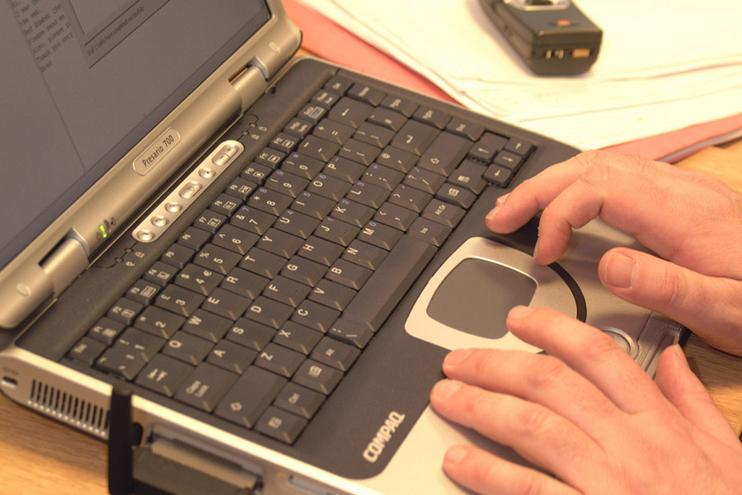
Here:

Slide 8
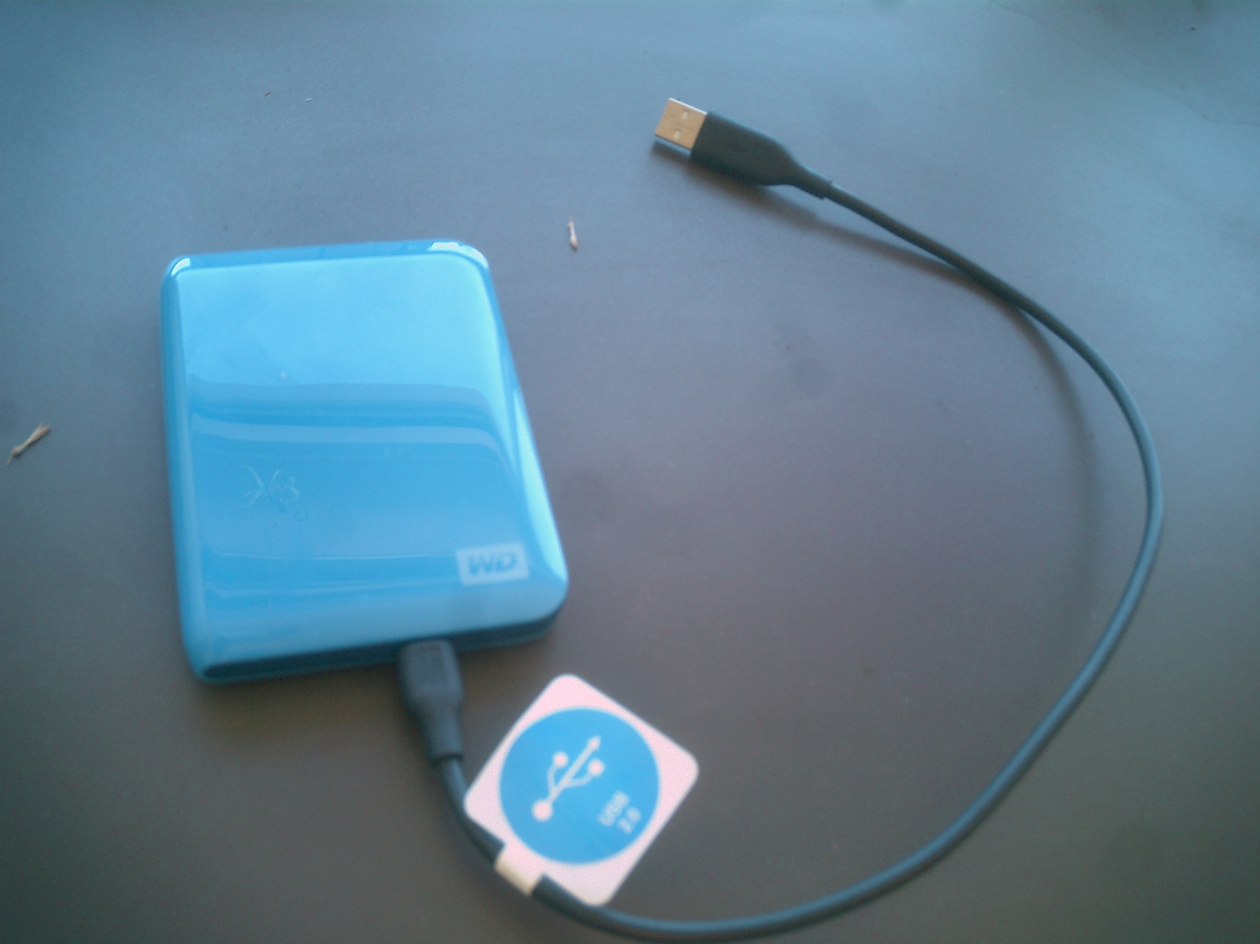
Near:

Slide 9




There:

Slide 10
Step 3: Use consistent file naming
Keep names short
Use names that are descriptive
Include a date
Include a version number

Slide 11
Example file names
c130_a792_20000916.csv
(From data set SAFARI 2000 C-130 Aerosol and Meteorological Data, Dry Season 2000)
WBW_veg_inventory_all_20050304.csv
(From data set Walker Branch Watershed Vegetation Inventory, 1967-1997)
bigfoot_agro_2000_gpp.zip
(From data set BigFoot GPP Surfaces for North and South American Sites, 2000-2004)
From Best Practices for Preparing Environmental Data Sets to Share and Archive. Les A. Hook, Suresh K. Santhana Vannan, Tammy W. Beaty, Robert B. Cook, and Bruce E. Wilson. September 2010

Slide 12
Step 4: Practice safe file handling
Avoid Concurrency
2 copies of a file are open for editing at the same time
Synchronize
Routinely or automatically copy your new file to near and there
Version
Using version numbers avoids overwriting of previous versions
Track Provenance
Record changes made to data

Slide 13
Step 5: Practice safe computing
Apply OS and application security updates
Enable firewall and high security settings
Use Anti-virus and Anti-malware software
Routinely do full backup and store away
Practice extra caution when travelling

Slide 14
On the road:
Keep computer in sight
Don’t put computer in checked luggage
Enable password protected startup
Make sure computer is labeled
Record serial number
Avoid public Wi-Fi and especially,
Avoid public computers

Slide 15

Step 6: Practice safe password management
Why?
Reason #1 - Your password is a foot in the door for bad guys
Reason #2 - Your password can be used to gain more of your personal information

Slide 16
Password “guidelines”
Categorize applications based on risk
Create appropriate strength passwords
Use a password manager

Slide 17
Categorize password risk
High – expose personal information or resources that can be exploited
Medium – expose personal information that is generally already available
Low – passwords that expose minimal personal information

Slide 18
Password fatigue
Long, complex passwords are more secure than short, simple ones – mostly true
Changing passwords frequently reduces risk – partly true
Users consistently fail in these password practices – definitely true

Slide 19
Step 7: Be Paranoid or try to walk the line between paranoia and rationality very carefully
Encrypt data
Use two-factor authentication
Never accept the “default”
Use pseudonyms for logins and email
Think like a network

Slide 20
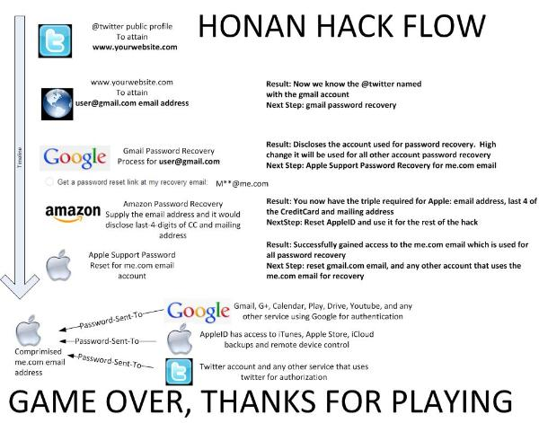

Slide 21
“Just because you're paranoid doesn’t mean they aren’t after you”
--Joseph Heller, Catch 22

Slide 22
Conclusion
Data security is broad and complex subject
There is a need for communities of practice to fill gaps in knowledge
You are all now qualified data security experts – go forth
Be cautious, be aware, be prepared, and

Slide 23

Don't Panic

