Slide 1
Data Manipulation
The Kepler Workflow System

Slide 2
Overview
Kepler is a scientific workflow management system
Software application for the analysis and modeling of scientific data.
Other examples:
Taverna http://www.taverna.org.uk/
VisTrails http://www.vistrails.org/
Pegasus http://pegasus.isi.edu/

Slide 3
Why Use
Data processing steps done in many different programs are gathered in one place
Documentation of data processing (provenance)
Exchange of workflow documentation across systems
Easy readability of workflow (communication, collaborative development)
Repeated execution of the same workflow
Limited coding knowledge necessary
Robust coding
Re-use of code

Slide 4
Download Kepler
Java Runtime Environment (jre6) http://www.java.com
Kepler https://kepler-project.org
R statistical package (optional) http://www.r-project.org/
Resources:
Documentation https://kepler-project.org/users/documentation
Examples https://kepler-project.org/users/sample-workflows
Mailing list http://www.keplerproject.org/en/Mailing_List

Slide 5
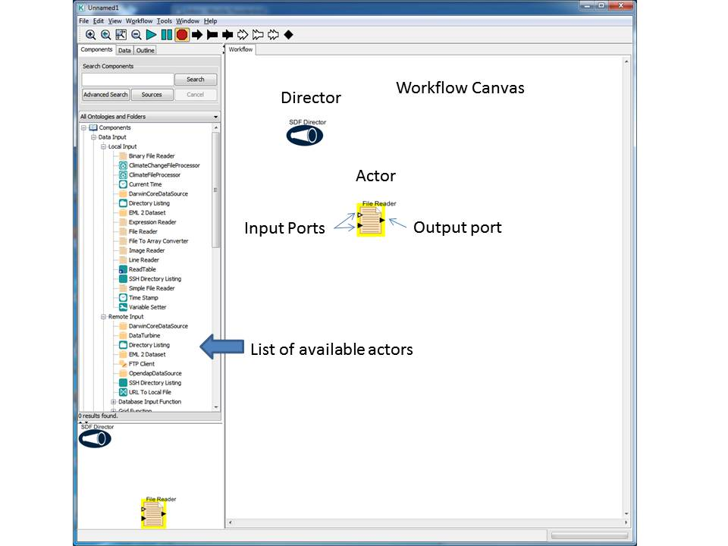
Terms and Concepts
Workflow canvas
drag and drop actors onto the workflow canvas to use
Director
controls the execution of the workflow (when)
Actor
actual programming steps (what)
Ports
determine the input and output for each programming step
Parameter
variables that can be used in the workflow

Slide 6
Directors
Control the execution of a workflow (specify when things happen)
SDF – simple linear synchronous workflows
PN – workflow components may run parallel
DDF – works well for database interactions

Slide 7



Actors
Specify what processing happens
Data Input (local, remote, workflow)
Data Operation (structure, image, mathematical)
Data Output (local, remote, workflow)
File System
General Purpose
Statistics
Specific (DataTurbine, Opendap, R, project specific)

Slide 8
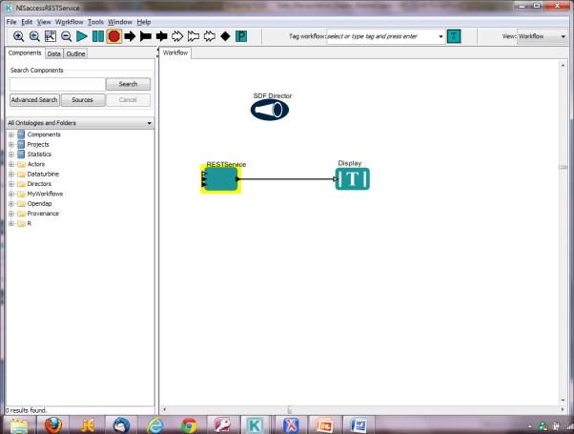
Exercise 1
Access data in the NIS
REST actor to get information
Configure to http://pasta.lternet.edu/package/eml

Slide 9
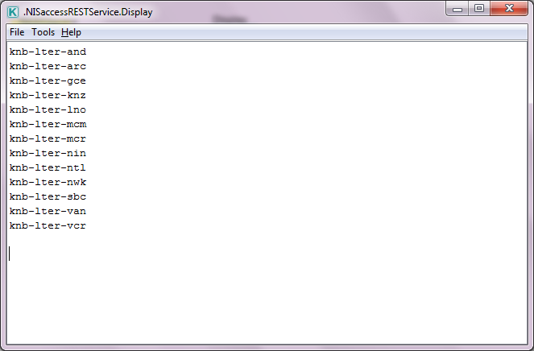
Domains returned

Slide 10
ID and version
Add domain after / in REST actor
http://pasta.lternet.edu/package/eml/knb-lter-van
Returns 10
http://pasta.lternet.edu/package/eml/knb-lter-van/10
http://pasta.lternet.edu/package/eml/knb-lter-van/10/1

Slide 11
Resource map
Return the data: http://pasta.lternet.edu/package/data/eml/knb-lter-van/10/1/HoboDataFile.csv
Return metadata: http://pasta.lternet.edu/package/metadata/eml/knb-lter-van/10/1
Return congruency report: http://pasta.lternet.edu/package/report/eml/knb-lter-van/10/1
Return resource map: http://pasta.lternet.edu/package/eml/knb-lter-van/10/1

Slide 12
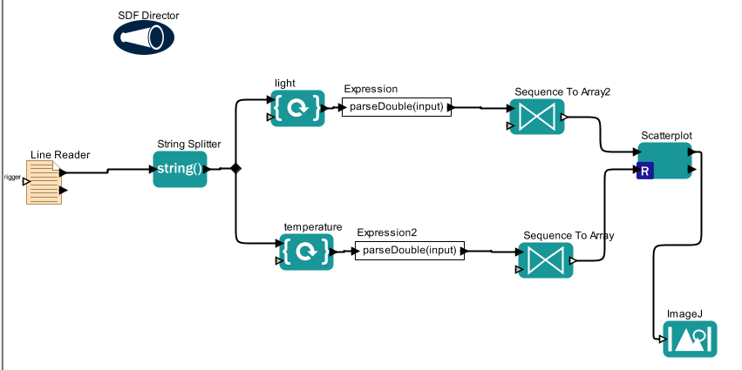
Exercise 2 – exploring data

Slide 13
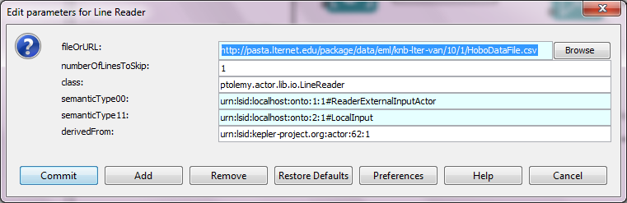
Exercise 2 - actors Line reader
http://pasta.lternet.edu/package/data/eml/knb-lter-van/10/1/HoboDataFile.csv
Number of lines to skip: 1

Slide 14
Exercise 2 - Actors
Array Element – location in array
Expression: parseDouble(input) (turn text into a double value)
Sequence to Array – number of records: 650
Scatter plot R
ImageJ to see the scatter plot

Slide 15
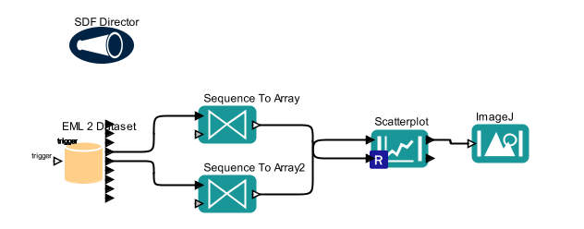
Exercise 3 – EML2dataset
EML2dataset
Sequence to Array
Scatterplot and ImagJ

Slide 16
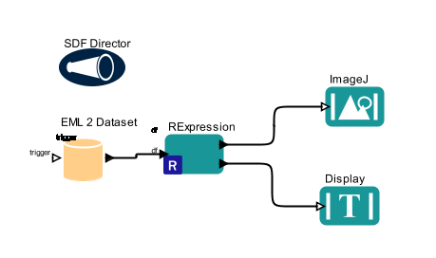
Exercise 4 - R
summary(df)
boxplot(df$temperature_c~df$ground_cover)

Slide 17
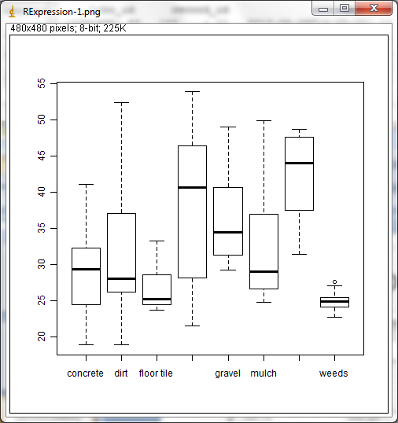
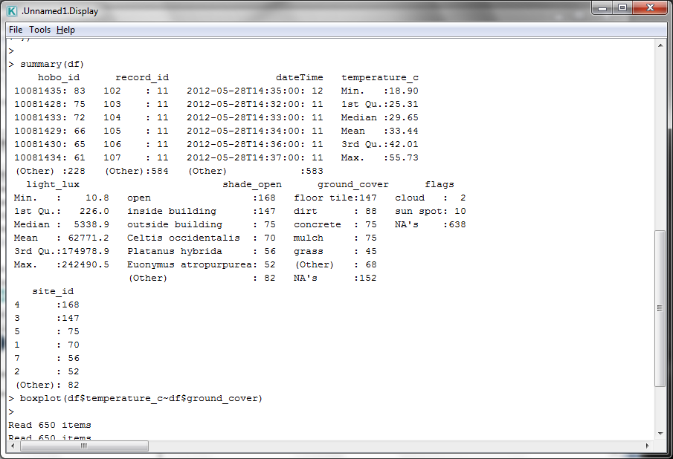
Exercise 4

