Slide 1

Data Preservation, archives, best practices

Slide 2

Archives

Slide 3
Why have data archives?
Data reuse increases our knowledge of the world
Mortality – no investigator lives forever
Even an investigator who carefully manages their data won’t be around to do that forever
Entropy – systems tend towards disorder
Highly organized systems such as data tend towards disorder faster
Only if work is expended to preserve data does it persist

Slide 4
Who Stores Data? and for How long?
Repositories
What: only links, no actual data
Examples: Data.gov, Global Change Master Directory
Individual investigators
What: Only their own or their students’ data
Duration: Typically for a decade or less
Research Projects
What: only data from the project itself or data used by the project
Duration: for the life of the project itself
Example: Individual LTER projects

Slide 5
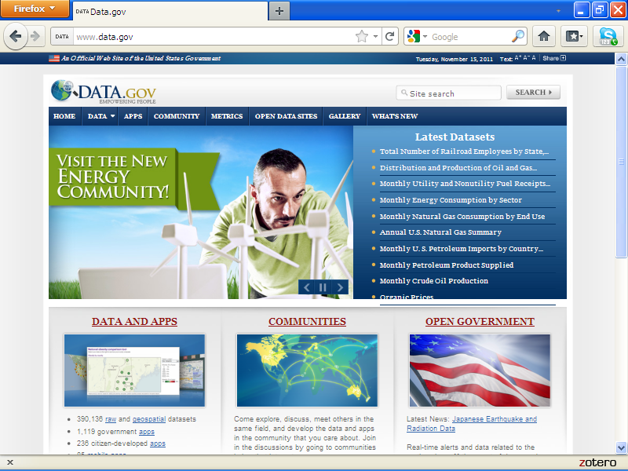

Slide 6
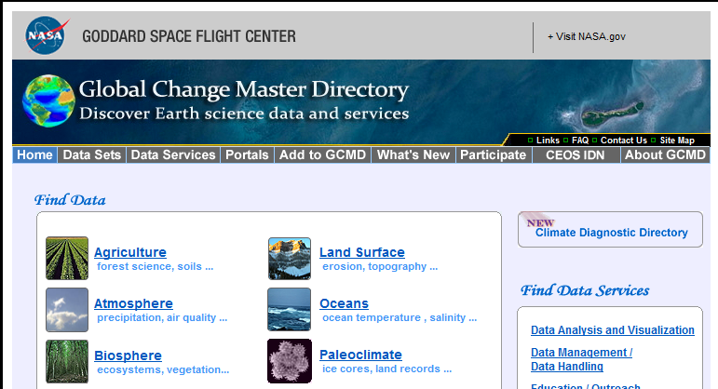

Slide 7
Who Stores Data? And for How long?
Multiproject Archives
What: Data from associated projects
Duration: indeterminate
Example: Knowledge Network for Biocomplexity (KNB)
Professional Societies
What: Peer-Reviewed Data papers, and Data appendices from society journals
Duration: While the Society persists
Example: Ecological Society of America publication Ecological Archives

Slide 8
Who Stores Data? and for How long?
Government-Funded Archives
What: Data relevant to a particular purpose, often collected with government funding
Duration: indeterminate, funding dependent
Examples: Oak Ridge National Laboratories Distributed Active Archive Center (ORNL DAAC), Genbank
Government Archives
What: Archive dependent
Duration: Forever(?)
Examples: U.S. National Archive, National Oceanographic Data Center

Slide 9
Archives and Communities of Practice
In the data context, “Communities of Practice” are groups that share similar data, approaches and tools
Remote sensing – large raster data layers
GIS – vector data layers
Climatological – time series and gridded data
Ecological – tabular data
Different archives tend to cater to different communities

Slide 10
Best Practices
For Tabular Data

Slide 11
Why this presentation?
The forms data take for analysis are often different than the forms data take for archival storage
Spreadsheets are widely used for simple analyses
But they have poor archival qualities
Different versions over time are not compatible
Formulas are hard to capture or display
They allow (encourage) users to structure data in ways that are hard to use with other software
Our goal with archived data is to store the data in ways that it can be used in automated ways, with minimal human intervention

Slide 12
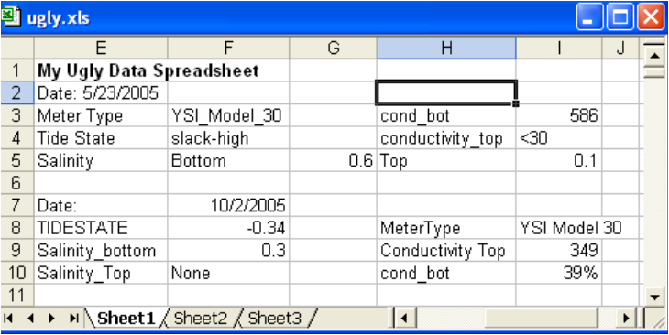
Data that can be automated
Below is a picture of a data spreadsheet that could NOT be easily automated….. Why not?

Slide 13
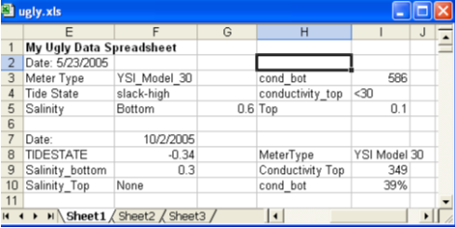
Ugly Data
Problems
Dates are not stored consistently
Sometimes date is stored with a label (e.g., “Date:5/23/2005”) sometimes in its own cell (10/2/2005)
Values are labeled inconsistently
Sometimes “Conductivity Top” others “conductivity_top”
For Salinity sometimes two cells are used for top and bottom, in others they are combined in one cell
Data coding is inconsistent
Sometimes YSI_Model_30, sometimes “YSI Model 30”
Tide State is sometimes a text description, sometimes a number
The order of values in the “mini-table” for a given sampling date are different
“Meter Type” comes first in the 5/23 table and second in the 10/2 table

Slide 14
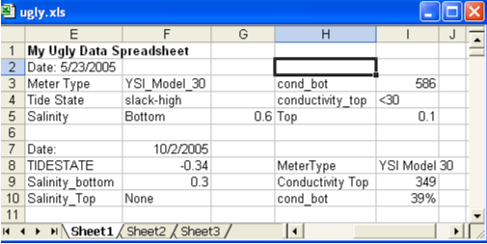
Ugly Data
Additional problems
Confusion between numbers and text
For most software 39% or <30 are considered TEXT not numbers (what is the average of 349 and <30?)
Different types of data are stored in the same columns
Many software products require that a single column contain either TEXT or NUMBERS (but not both!)
The spreadsheet loses interpretability if it is sorted
Dates are related to a set of attributes only by their position in the file. Once sorted that relationship is lost.

Slide 15
Best Practices
We’ve seen that a spreadsheet or word processor can create datasets that can only be interpreted by human intervention
The “ugly spreadsheet” example would be hard to analyze even in a spreadsheet, except with lots case-by-case human decisions
But what are some principles that characterize good archival data?
Keep in mind that good data formats for data and sharing may not be the ones you prefer for viewing or analysis!

Slide 16
Best Practices for Archiving
Many of these are taken from Cook et. al. 2001 Best Practices for Preparing Ecological Data Sets to Share and Archive, Ecological Bulletin 2001.
Data formats should be consistent over time
Adding new data should not add new columns to a data table, only new rows
Columns of data should be consistent. Each column should include only a single kind of data
Data columns should include the same type of data
Text or “string” data
Integer numbers
Floating point or real numbers

Slide 17
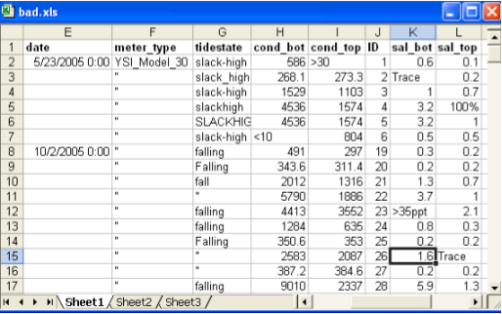
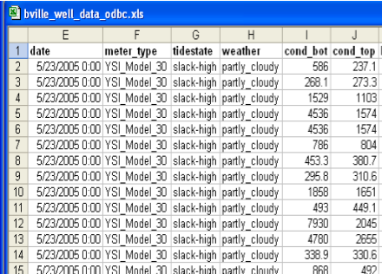


Best Practices for Archiving
Lines or rows of data should be complete
Designed to be machine readable, not human readable
Don’t Ever Sort this!!!!!!
Complete lines are OK to Sort

Slide 18
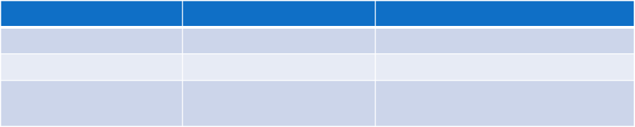
Best Practices for Archiving
Data are easiest to archive if each column in a data table has a single line at the top labeling the columns with a descriptive name
Column names should start with a letter and not include SPACES or Symbols (other than an underscore (e.g., My_Data) to take the place of a space)
+,-,*,&,^ are often treated as operators, and so should not be used in column names, because doing so causes confusion
Some software uses spaces to identify different columns
BAD
GOOD
Comment
Species Name
Species_name
No spaces!
Age-Class
Age_Class or AgeClass
No symbols!
30cm deep temperature
Temp_30_cm_deep
Start with a Letter and put what is being measured first

Slide 19
Best Practices for Archiving
Avoid storing data for separate sites or dates in separate worksheets within a single spreadsheet
Each worksheet is a separate data table, and so needs to be documented and processed separately, greatly increasing the work needed
Usually you can just add a column for “site” and combine all the data into a single (large) data table
OK because computers are good and dealing with large, consistent blocks of data
They don’t work as well with esoteric, segmented data

Slide 20
Special Issues
What should be done about Missing Data?
Often missing data values can be left blank, or a special value (e.g., 9999) inserted
Sometimes there are other special issues:
Example, in meteorological data, days that had some precipitation, but not enough to measure, were marked with a “T” for “trace” in data sheets
Problem – mixes numbers (rain amounts) with a text string
What is the average of 10, 5 , T and 3?
Solution(s)
Substitute a small amount (e.g., ½ of measureable value) so T becomes 0.005 if you can measure 0.01 cm of rain
Leave the rain column blank or 0, but add an additional column that contains “T” for trace, “N” for none, or “M” for measured
This is an example of using a “Data Flag” – a column that helps describe or qualify the data in another column

Slide 21
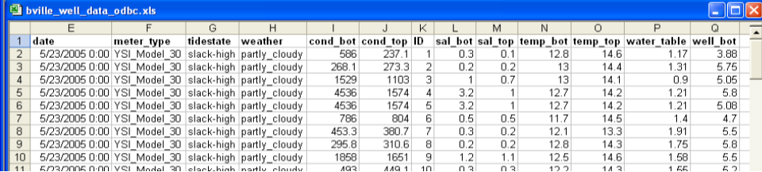
Summary of Best Practices
Descriptive column labels with no spaces or symbols
Stable columns each containing a single type of data
Complete lines of data in each row
Consistent codes are used for weather, tidestate etc.
Missing values left blank or filled with special codes
Use data flags to qualify or describe data when needed
All the data is in a single data table

Slide 22
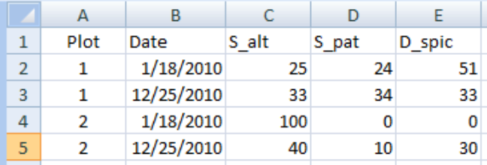
Transforming Data
Because often the best way to enter or view the data are not the best for archiving, we need to do transformations
Example – You have a set of permanent plots where you are tallying the ground cover of plants
You have set up a spreadsheet with a row for each date/plot with columns for cover of each of the species

Slide 23
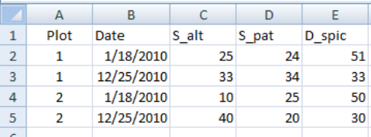
Good
Columns each with one kind of data
Good column labels
Problems
What happens if you encounter a new species in a plot?
The data format/structure needs to change by adding a new column – something we’d like to avoid!

Slide 24
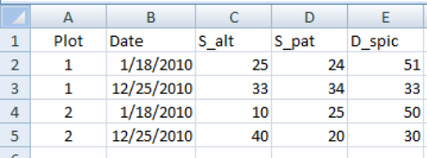
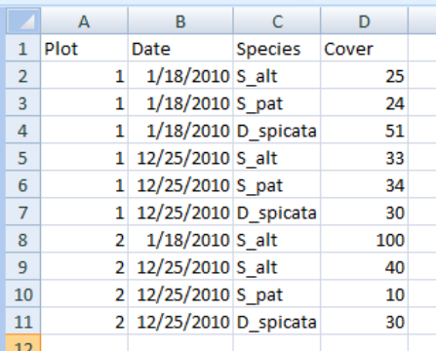
An Alternative Way
Uses a “species” column to indicate the species
Adding a new species is just a question of adding a new data code, rather than a new column
keeps data structures the same)
Optionally, you also don’t need data lines for species for which cover was zero.
VS

Slide 25
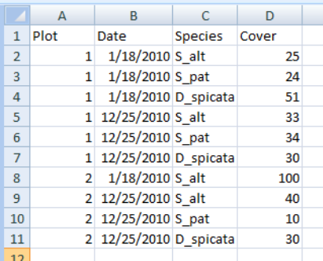
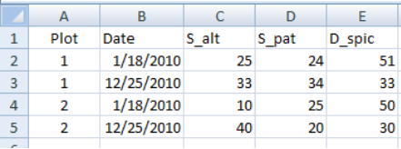

Transformations
Fortunately, these two formats are relatively easy to interconvert using Pivot Tables in Excel, or using external software (e.g., SPSS vars-to-cases)

Slide 26
Other Tools
There are other tools, such as Database Management Systems (DBMS) and statistical software (e.g., SAS, SPSS) that can also be used for managing data
Unlike spreadsheets the software enforces many of the best practices that are the responsibility of the user in spreadsheets
They have additional tools that help with quality control and quality assurance
They are more trouble to set up initially than a spreadsheet, but in the long run can save time and trouble

