Slide 1
Data Models for Ecological Databases
John Porter
Department of Environmental Sciences
University of Virginia

Slide 2
Characteristics of Ecological Data
Satellite
Images
High
GIS
Weather
Stations
Data
Volume
(per
dataset)
Business
Data
Biodiversity
Surveys
Primary
Productivity
Population Data
Gene Sequences
Soil Cores
Low
High
Complexity/Metadata Requirements

Slide 3
Choosing a DBMS
What tasks to do you want the DBMS to accomplish?
  query
  sorting
  analysis
Is there a type of DBMS whose structure best mirrors that of the underlying data?

Slide 4
Database Management System (DBMS) Types
File system-based
Hierarchical
Network
Relational
Object-oriented

Slide 5
Advantages and Disadvantages of using a DBMS
Advantages
  additional capabilities
    sorting
    query
    integrity checking
  easy access to data
Disadvantages
  few graphical or statistical capabilities
  proprietary formats may limit archival quality of data
  require expertise and resources to administer

Slide 6
File-System Based
Directory
Files
Files
Files
Filesystem-based
  very simple and easy to set up
  inefficient
  few capabilities

Slide 7
Hierarchical
Project
Hierarchical
  efficient
  not very general
  e.g. phylogenetic structures
  geographical images
Datasets
Investigators
Variables
Locations
Codes
Methods

Slide 8
Network Database
Projects
Links are hard-coded into
database. They are not a
property of the data
Datasets
Locations
Network Database
  very flexible
  unwieldy to modify
  not widely used

Slide 9
Relational Database
Linkages are through
the properties of the
data itself - not hard
coded
Projects
Location_id
Data_id
Datasets
Locations
Location_id
Relational
  widely-used, mature
  table-oriented
  restricted range of structures

Slide 10
Object Oriented
Object-oriented
  developing -few commercial implementations
  diverse structures
  extensible
Methods
Object Data
Structure

Slide 11
Data Modeling
Data modeling is used to develop the database structures used in a database
Your data model effects
  reliability of the data
  efficiency and speed of queries
  the complexity of the database
Data modeling is an art, not a science!

Slide 12
Some Vocabulary
Table – set of rows and columns
Column, field or attribute
Row, Tuple, observation, case
Entity Relationship Diagram
1:1 relationship
Table
1:many relationship
Field
∞

Slide 13
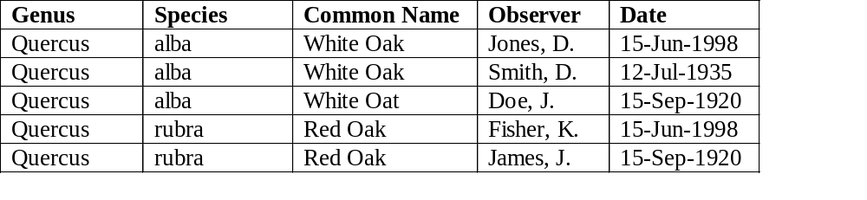
Flat-file
Species Observation
Date
Genus
Common Name
Observer
Species

Slide 14
Normalization
One widely-used approach for reducing errors within a database is to normalize your data structures
Normalization is the process of eliminating duplicate or redundant information

Slide 15
Levels of Normalization
There are many levels of normalization
  First Normal Form 1NF: no null rows or duplicate rows
  Third Normal Form 3NF: no piece of information can be determined based on other information in the row
  You can go up to 6NF!
  Note Normalization is a TOOL not a REQUIREMENT!
  http://databases.about.com/od/specificproducts/a/normalization.htm

Slide 16
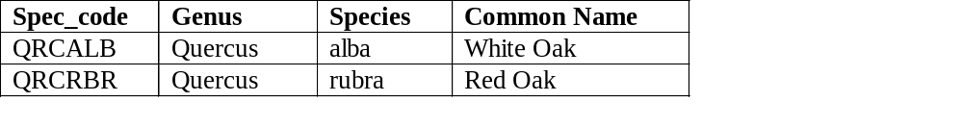
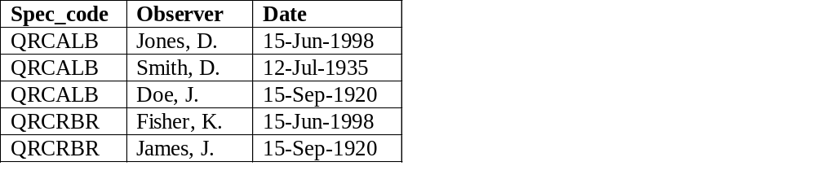
Two-table Relational Database
Species
Spec_code
Spec_code
Observation
Genus
Species
Common Name
Observer
Date

Slide 17
Complex Data Model
Species
Observations
Specimens
Images
Internet Links
Locations
Observers

Slide 18
Data Model for Metadata at VCR/LTER
Personnel
Projects
Mailing Lists
Dataset
Dataset
Locations
Variable
Variable
Codes
Optional Linkage
Mandatory Linkage

Slide 19
“Beanstalk”& “String of Pearls”
Metadata
methods
units
Location Table
Lat/Lon

Slide 20
Beanstalk / String of Pearls
Highly normalized
Extremely flexible - capable of handling many different kinds of data
Inefficient
  Querys can be very slow
  Can require large amounts of space

