Slide 1
Metadata

Slide 2
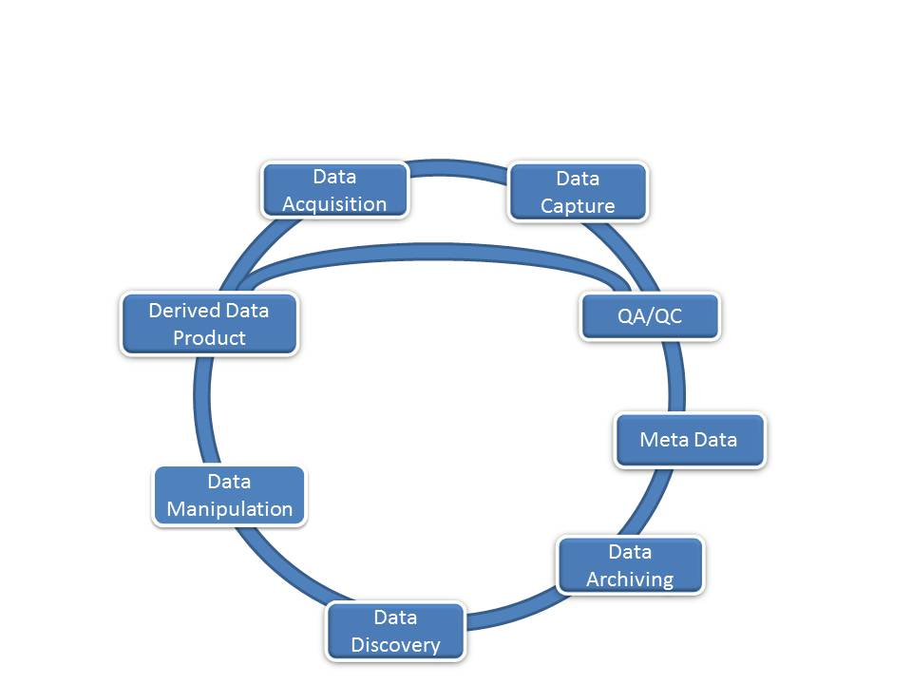
The Data Life Cycle

Slide 3
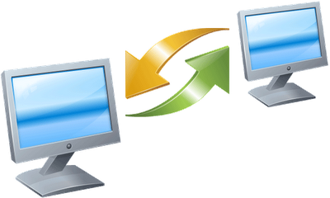
Working with Data
When you provide data to someone else, what types of information would you want to include with the data?
When you receive a dataset from an external source, what types of details do you want to know about the data?
Notes:
If you were to share your data, what type of information would be most useful to understand the data set?
Alternatively, when receiving data from an external source, what information is needed to understand the data set?
Metadata contains information about the dataset that allows it to be understood when shared amongst scientists.

Slide 4

Working with Data
Providing data:
Why were the data created?
What limitations, if any, do the data have?
What does the data mean?
How should the data be cited if it is re-used in a new study?
Receiving data:
What are the data gaps?
What processes were used for creating the data?
Are there any fees associated with the data?
In what scale were the data created?
What do the values in the tables mean?
What software do I need in order to read the data?
What projection are the data in?
Can I give these data to someone else?
Notes:
When sharing data, some considerations include:
- why the data was created;
- what limitations, if any, the data have;.
- what the data means; and who should be cited if someone publishes something that utilized the data.
When receiving data from an alternative source, consider:
What are the data gaps?
What processes were used for creating the current data?
Are there any fees associated with the data?
In what scale were the data created?
What do the values in the tables mean?
What software do I need in order to read the data?
What projection is the data in?
Can I give this data to someone else?
Metadata contain information about a data set, in a standardized format, such that it can be understood and re-used.

Slide 5
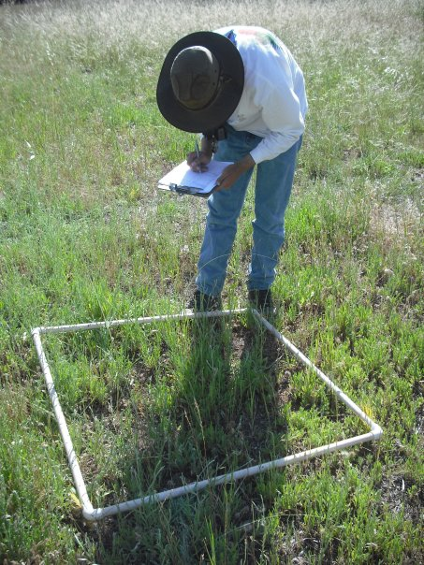
What is Metadata?
Metadata is: Data ‘reporting’
WHO created the data?
WHAT is the content of the data?
WHEN were the data created?
WHERE is it geographically?
HOW were the data developed?
WHY were the data developed?
Photo by Michelle Chang. All Rights Reserved
Notes:
Metadata is data about data. It describes the content, quality, condition, and other characteristics of a dataset.
Metadata records answer questions such as:
Why was the data set created?
What processes were used to create the data set?
What projection is the data in?
When was the data last updated?
Who created the data?
What scale was used?
What fields are in the table?
What do the values in those fields mean?
Who do I contact about getting more information about the data?
How do I obtain a copy of the data?
Do the data cost anything?
Are there any limitations to the data?
Metadata is a valuable tool. Metadata records preserve the usefulness of data over time by detailing methods for data collection and data set creation. Metadata greatly minimizes duplication of effort in the collection of expensive digital data and fosters the sharing of digital data resources.

Slide 6
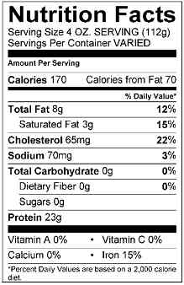
Metadata in Real Life
Metadata is all around…
Author(s) Boullosa, Carmen.
Title(s) They're cows, we're pigs /
by Carmen Boullosa
Place New York : Grove Press, 1997.
Physical Descr viii, 180 p ; 22 cm.
Subject(s) Pirates Caribbean Area Fiction.
Format Fiction
CC image by USDAgov on Flickr
Notes:
Metadata is all around us. . .from Mp3 players, to nutrition labels, to library card catalogues.
For example, a card catalogue tell us more information than just the title of the book, they also tells the user:
Who is the author?
Who published the book?
What subject area does the book fall in?
And finally, where is it located in the library?
Another example of metadata that we see in our daily lives is the nutrition and ingredient information on food labels.
Nutrition labels answer questions such as:
What ingredients were used?
Who made the food?
How many calories per serving?
How many servings in the can?
What percentage of daily vitamins are in each serving?

Slide 7
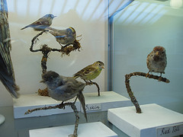
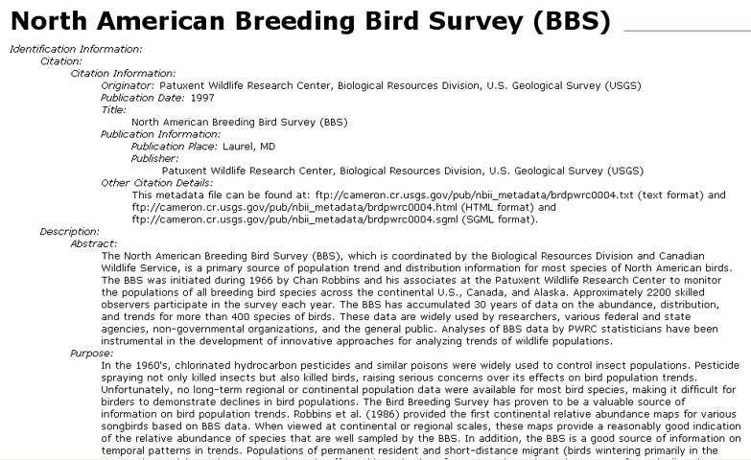
What Does a Metadata Record Look Like?
CC image by I like on Flickr
Notes:
This is an example of a metadata record using the Federal Geographic Data Committee (FGDC) standard.

Slide 8
The Value of Metadata
Data
developers
Data
users
Metadata
helps…
Organizations
Notes:
Metadata is useful to Data Users, Data Developers, and Organizations. In this era of data sharing, collaboration, and need for information organization, metadata can serve multiple purposes.

Slide 9
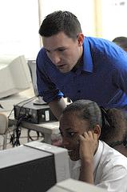
What is the Value to Data Developers?
Metadata allows data developers to:
Avoid data duplication
Share reliable information
Publicize efforts – promote the work of a scientist
and his/her contributions to a field of study
CC image by US Embassy Guyana on Flickr
Notes:
What value does metadata have to Data Developers?
Metadata records will help avoid data duplication because researchers can determine if data already exists. Scientists are able to share reliable information about a dataset by creating metadata and passing it along with the dataset. Scientists wishing to reuse a dataset can be confident of its origins, data quality, and other valuable information about the data. Metadata also allow data creators to publicize the valuable data they have collected by making the metadata available on clearinghouses and other publically available venues. Metadata can be used in citation practices, thus increasing the visibility of the data.

Slide 10
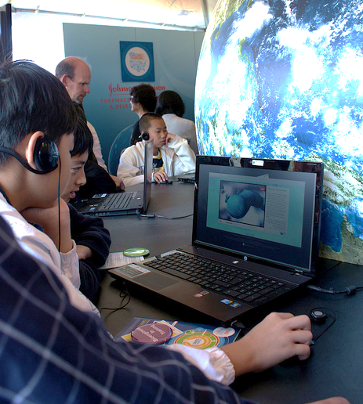
What is the Value to Data Users?
Metadata gives a user the ability to:
Search, retrieve, and evaluate data set information from both inside and outside an organization
Find data: Determine what data exists for a geographic location and/or topic
Determine applicability: Decide if a data set meets a particular need
Discover how to acquire the dataset you identified; process and use the dataset
CC image by ASEE on Flickr
Notes:
Metadata allows the user to search for and access data from a variety of sources. A search for metadata can be constricted to a geographic boundary, thus showing the user what data has been collected in a particular region. Metadata records help users determine whether the data will be applicable for use in a particular study. Finally, metadata records are of value to data users, because they determine how a dataset can be acquired, and if there are any restrictions on how the data can be used.

Slide 11
Metadata and Data Discovery
The descriptive content of the metadata file can be used to identify, assess, and access available data resources.
keywords
geographic location
time period
attributes
IDENTIFY
use constraints
access constraints
data quality
availability/pricing
ASSESS
online access
order process
contacts
ACCESS
Notes:
Metadata serves data discovery at multiple levels:
initial identification by query of keywords, location, time, and attributes
a quick assessment can be made by the scientist as to how useful the data is for a project by reading the access and use constraints; data quality measures of positional and attribute accuracy and sources used; and statements as to data availability, format and pricing
a user can find out how to access the by reading access instructions, any standard order process instructions, and contact information for the dataset.

Slide 12

What is the Value to Organizations?
Metadata helps ensure an organization’s investment in data:
Documentation of data processing steps, quality control, definitions, data uses, and restrictions
Ability to use data after initial intended purpose
Transcends people and time:
Offers data permanence
Creates institutional memory
Advertises an organization’s research:
Creates possible new partnerships and collaborations through data sharing
CC image by mambol on Flickr
Notes:
An organization that keeps current metadata can benefit in many ways. Metadata records help ensure the organization’s investment in the data by retaining information about how the data was collected, processed, and quality controlled. This creates a permanent record of the dataset –which is critical institutional memory. When researchers leave or retire, metadata allows the dataset to “live on” for the organization. The data may be reused in another research project in the future, and future researchers in the organization will need to know how the dataset was created. Finally, metadata advertises an organization’s research, creating new potential partnerships and collaboration thru data sharing.

Slide 13
Information Entropy
Time of data development
Specific details about problems with individual items or specific dates are lost relatively rapidly
General details about data set are lost through time
DATA DETAILS
Retirement or career change makes access to “mental storage” difficult or unlikely
Accident or technology change may make data unusable
Death of developer results in loss of remaining info
TIME
(From Michener et al 1997)

Slide 14
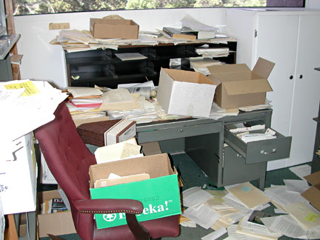
Information Entropy
Sound information management, including metadata development, can arrest the loss of dataset detail.
DATA DETAILS
TIME
Notes:
Sound data management is best achieved with making metadata creation a part of the workflow. Not only can it keep the individual scientist organized, but the data has a much better chance of being re-used by future scientists.

Slide 15
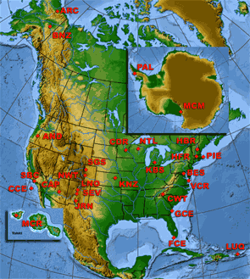
Long Term Ecological Research (LTER) Network
26 sites
2000 scientists
Since 1980
Research common themes across many ecosystems
Synthesize Data Across Sites

Slide 16
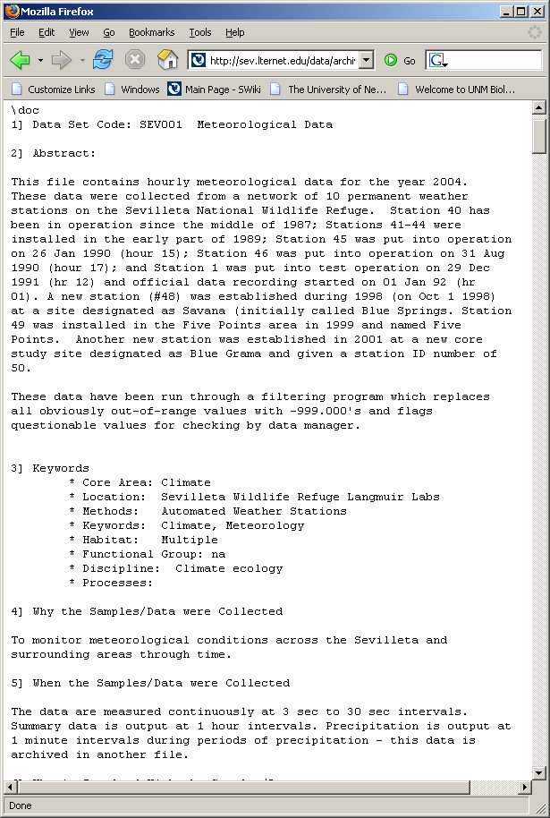
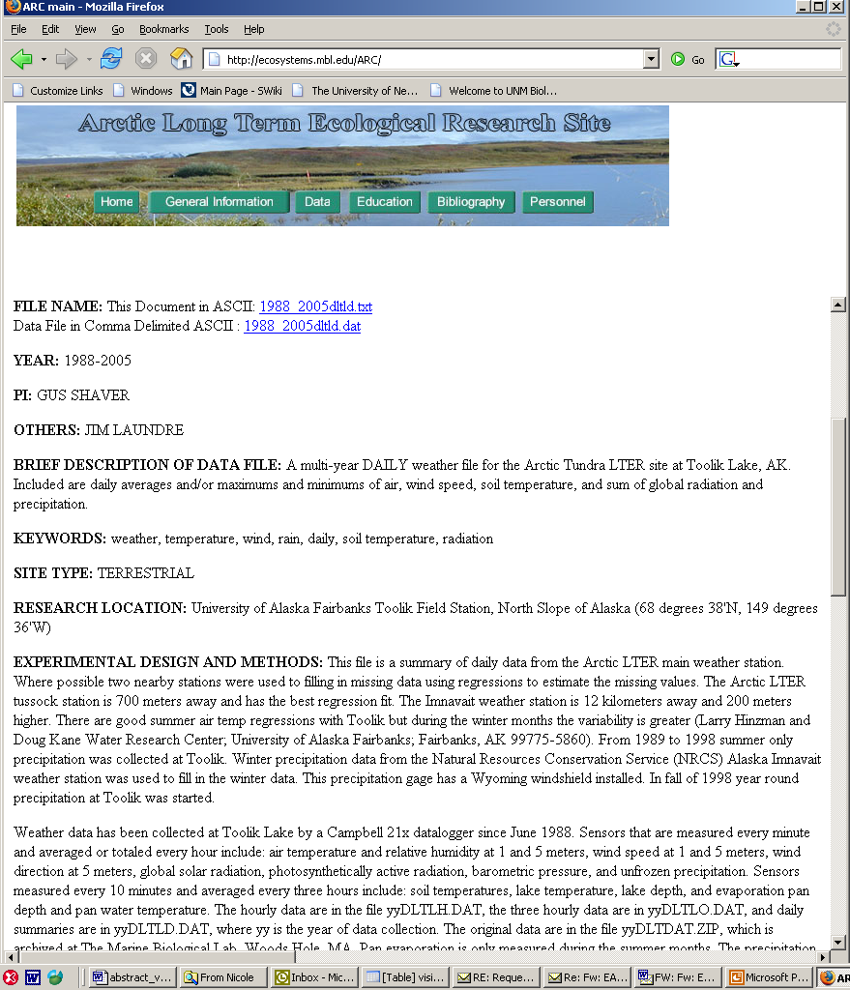

1990s: Metadata structure and content differed between LTER Sites
One Good Metadata Standard!

Slide 17
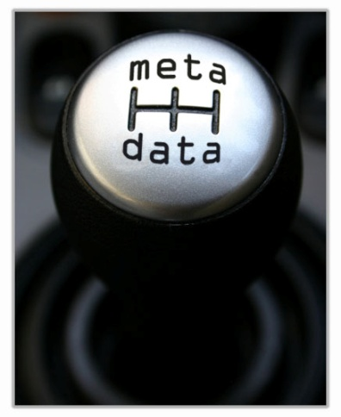
What is a metadata standard?
A Standard provides a structure to describe data with:
Common terms to allow consistency between records
Common definitions for easier interpretation
Common language for ease of communication
Common structure to quickly locate information
In search and retrieval, standards provide:
Documentation structure in a reliable and predictable format for computer interpretation
A uniform summary description of the data set
Notes:
16
An established standard provides common terms that are used universally, thereby allowing communication of information to become consistent.
A standard also provides the opportunity to create consistent definitions. When a user reads metadata they will become familiar with the standard and will know which sections provide certain information, regardless of who wrote the metadata.
A standard will also encourage a common language for metadata. This language will allow all metadata creators to use the same vocabulary, resulting in easier communication.
Finally a standard allows all creators to use a common structure. Structure is important for knowing where to find the required information that you need quickly and for cataloguing information online. All metadata structured in the same format allows the catalogues to be searchable.
Content Standard for Digital Geospatial Metadata (CSDGM)
The objective of the CSDGM standard is to provide a common set of terminology and definitions for the documentation of digital geospatial data.
Common terms and common definitions ensure that all users “speak the same language.” Creating this commonality helps increase communication and avoid errors.
The CSDGM standard establishes:
the names of data elements and compound elements (groups of data elements) to be used for these purposes,
the definitions of these data elements and compound elements, and
information about the values that are to be provided for the data elements.

Slide 18
Metadata Standards
Metadata standards tend to vary based on
Content
What elements are included?
How comprehensively are the elements populated?
Structure
How much structure is required?
How is structure communicated?

Slide 19
Metadata – Content & Structure – Two examples
Benson, Barbara
Trout Lake Temperature
Water temperature data was collected hourly at Trout Lake
Trout Lake Temperature
Water temperature data was collected hourly at Trout Lake from January 1, 2005 to December 31, 2005
Collected by Barbara Benson
Both metadata documents are readable by humans, can’t be processed by a computer into new forms because both the content and structure are different

Slide 20
Metadata – Content Standardized
Originator: Benson, Barbara
Trout Lake Temperature
Water temperature data was collected hourly at Trout Lake
Start Date: January 1, 2005
End Date: December 31, 2005
Trout Lake Temperature
Water temperature data was collected hourly at Trout Lake
Time period: January 1, 2005 to December 31, 2005
Originator: Benson, Barbara
Now both metadata documents have the same content – title, originator, etc. but it still can’t be automatically processed by a computer because the structure is different

Slide 21
Metadata – Structure Standardized
<title>Trout Lake Temperature</title>
<originator>
<namelast>Benson</namelast>
<namefirst>Barbara</namefirst>
</originator>
<abstract>Water temperature data was collected hourly at Trout Lake</abstract>
<date>
<start>January 1, 2005</start>
<end>December 31, 2005</end>
</date>
<title>Trout Lake Temperature</title>
<abstract>Water temperature data was collected hourly at Trout Lake </abstract>
<originator>
<namelast>Benson</namelast>
<namefirst>Barbara</namefirst>
</originator>
<date>
<start>January 1, 2005</start>
<end>December 31, 2005</end>
</date>
With standardized content and structure, computers can automatically extract information from the metadata.

Slide 22
Multiple Metadata Standards Exist
Dublin Core Element Set
Used to describe a full range of web resources: video, images, web pages etc. and physical resources such as books and objects like artwork
Content Standard for Digital Geospatial Metadata (CSDGM)
Federal Geographic Data Committee (FGDC)
Emphasis on geospatial data
ISO 19115 Geographic information: Metadata
Emphasis on geospatial data and services
Darwin Core
Emphasis on museum specimens
Geography Markup Language (GML)
Emphasis on geographic features (roads, highways, bridges)

Slide 23
Some Common Metadata Elements
Title
Creator
Key Words
Abstract
Resource type
Access Rights

Slide 24

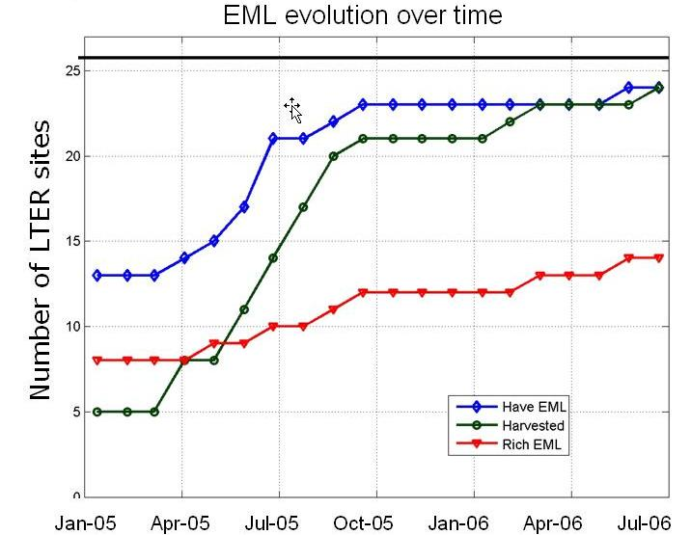
LTER adopted EML as its Metadata Standard in 2005

Slide 25
Ecological Metadata Language – LTER Standard
Metadata specification developed by the ecology discipline for the ecology discipline
Based on prior work of Ecological Society of America and others
Many years in development – many versions
EML 2.1.0
Implemented as an XML Schema
Notes:
Nongeospatial nature of ecological data facilitated the development and need for eml

Slide 26
Metadata Descriptors
Data set: What relevant data exist?
Research Origin: Why were those data collected and are they suitable for a particular use?
Access: How can these data be obtained?
Structure: How are the data organized and structured?
Supplemental: What additional information is available that would facilitate data use and interpretation?
Notes:
Basic attributes of the data set (title, associated scientists, abstract keywords)
All the relevant metadata that describe the research leading to the genesis of a particular data set (hypotheses, site characteristic, experimental design and research methods
The status of the data set and associated metadata as well as who can use the data (where data is located, Who is the contact person, How to access and use the data, Dates of when the data were accessed & modified)
All the attributes related to the physical structure of the data file (ie, data table: Data type, Data format, Data anomalies, Variable information, Units of measurement)
All other related information that may be necessary for facilitating secondary usage, publishing the data set or supporting an audit. (Data acquisition, Quality assurance, Supplemental materials, Computer programs, Archival info, Publications, History of usage)
What relevant data exist?
Why were those data collected and are they suitable for a particular use?
How can these data be obtained?
How are the data organized and structured?
What additional information is available that would facilitate data use and interpretation?

Slide 27
A bit of EML …
<eml>
<dataset>
<title> Sevilleta LTER Net Primary Productivity Data 2004</title>
<creator>
<individualName>
<salutation> Dr. </salutation>
<givenName> Esteban </givenName>
<surName> Muldavin </surName>
</individualName>
<eMailAddress> muldavin@sevilleta.unm.edu </eMailAddress>
</creator>
<abstract>Net primary production (NPP) is a fundamental ecological variable that measures rates of carbon consumption and fixation. </abstract>
<keywordSet>
<keyword>biomass</keyword>
<keyword>ANPP</keyword>
<keyword>LTER</keyword>
</keywordSet>
<contact>
<positionName> Information Manager </positionName>
<eMailAddress> data-use@sevilleta.unm.edu </eMailAddress>
</contact>
</dataset>
</eml>

Slide 28
GCE
LTER
AND
LTER
SEV
LTER
VCR
LTER
EML Database
CAP
LTER
SGS
LTER
HBR
LTER
KNZ
LTER

Slide 29
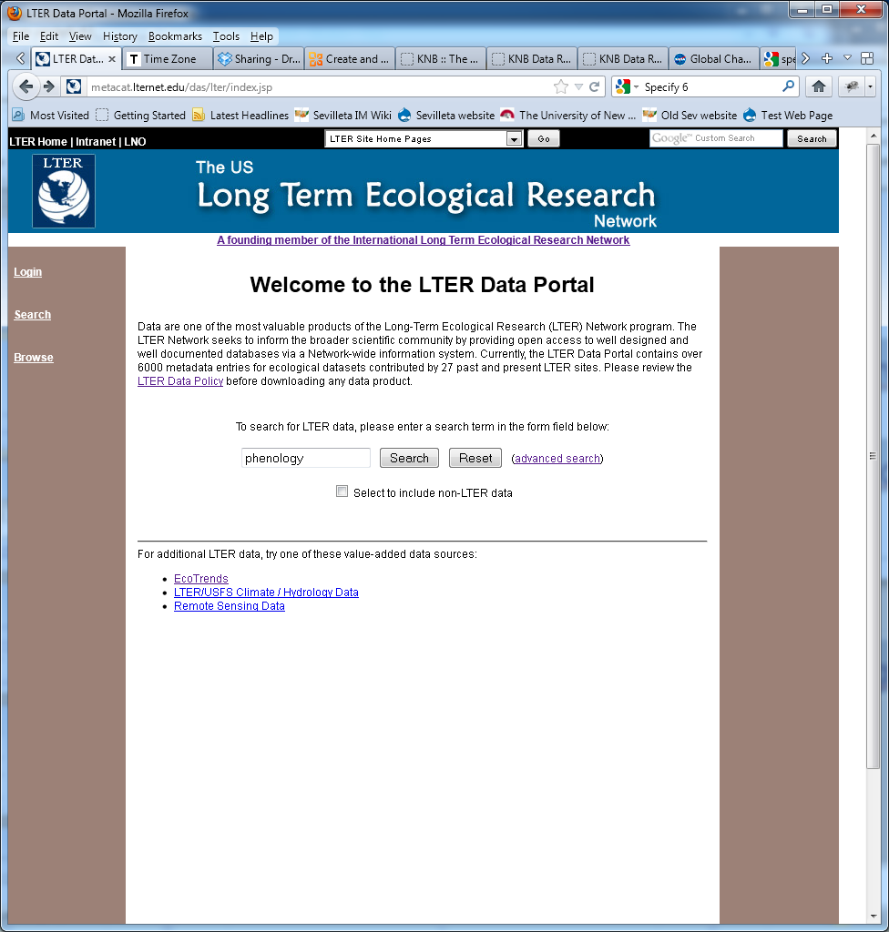

Slide 30
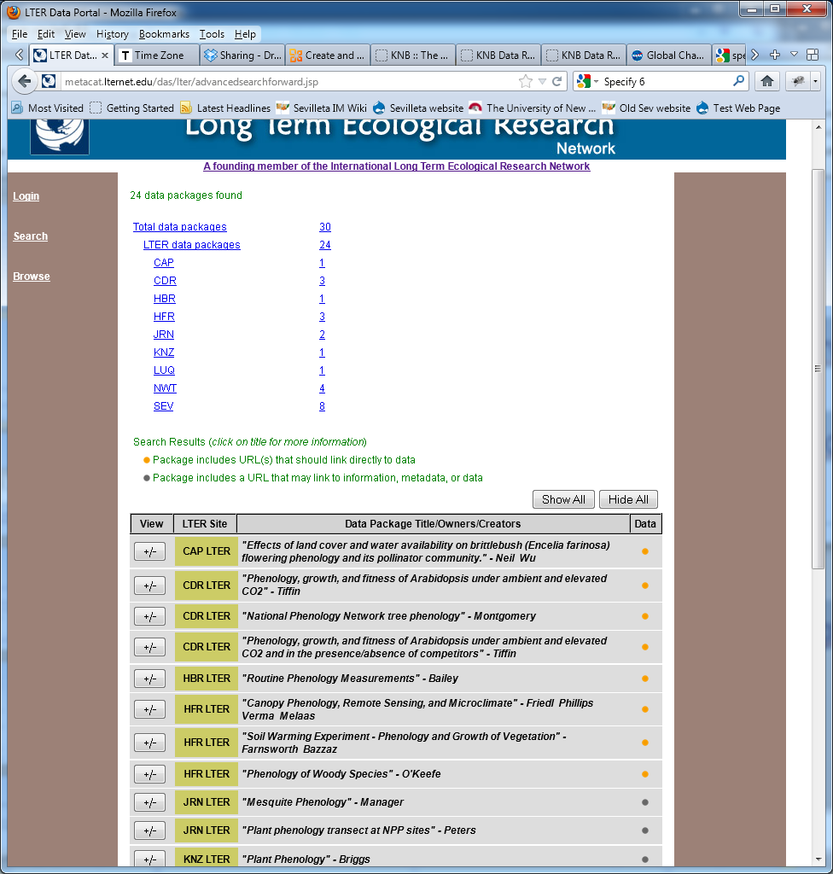

Slide 31
Translate EML Metadata into a Statistical Program
Metadata Document
<?xml version="1.0" encoding="UTF-8"?>
<eml:eml packageId="knb-lter-vcr.76.1" system="VCR" xmlns:ds="eml://ecoinformatics.org/dataset-2.0.1" xmlns:eml="eml://ecoinformatics.org/eml-2.0.1" xmlns:stmml="http://www.xml-cml.org/schema/stmml" xmlns:xsi="http://www.w3.org/2001/XMLSchema-instance" xsi:schemaLocation="eml://ecoinformatics.org/eml-2.0.1 http://gce-lter.marsci.uga.edu/lter/files/schemas/eml-201/eml.xsd">
<dataset id="76" system="VCR">
<alternateIdentifier>VCR00073</alternateIdentifier>
<title>Water Quality - physical data</title>
<creator>
<individualName>
<salutation>Dr.</salutation>
<givenName>Robert</givenName>
<surName>Christian</surName>
</individualName>
<address>
<deliveryPoint>East Carolina University, Department of Biology</deliveryPoint>
Statistical Program
Title1 ' Water Quality - physical data' ;
DATA WORK.data1;
%let _EFIERR_ = 0; /* set the ERROR detection macro variable */
infile 'PUT-LOCAL-PATH-TO-DATA-FILE-HERE' delimiter=","
TRUNCOVER DSD lrecl=32767 ;
input SITE
DATE
TIME
SCTTEMP
SCTSAL
SCTC0ND
TEMP
REFRSAL
DOTEMP
DO
SECCHI
DEPTH
WIND
;
if _ERROR_ then call symputx('_EFIERR_',1); /* set ERROR detection macro variable */
LABEL SITE ='SAMPLE SITE OR STATION-' ;
LABEL DATE ='DATE SAMPLE COLLECTED-' ;
LABEL TIME ='TIME SAMPLE COLLECTED-none' ;
LABEL SCTTEMP ='TEMPERATURE BY SCT-DEGREES C' ;
PROC MEANS ;
var SCTTEMP;
RUN;

Slide 32
Metadata tools
what’s out there to help?

Slide 33

A Smorgasboard of Metadata Tools
Proprietary
Non-proprietary
On-line
Standalone
Windows
ASCII
Unix
Notes:
Metadata tools are software programs that can facilitate metadata entry, search and retrieval, and submission of metadata to a clearinghouse or archive. Tools differ as to whether they only run under a particular software program (like a specific GIS package), operating system (e.g., Windows or UNIX), and whether they are on-line or standalone programs.

Slide 34
Tools for Creating Metadata
Text editors
Notepad (Windows)
Emacs, vi (UNIX, Linux, …)
XML Specific (XMLSpy, oXygen, …)
Custom software
Metavist FGDC Metadata Authoring Tool
Specify for museum collections
ESRI ArcCatalog
ecoinformatics.org Morpho
Notes:
Many of you are using text editors to document your data
This week we will work with Morpho which was designed through a consortium of biologist and ecologists working with computer scientists to meet the needs of how can we integrate

Slide 35
Morpho
Morpho enforces EML 2.10 standards
Stores EML in XML format within Metacat server
Allows searching of Metacat for data sets

Slide 36
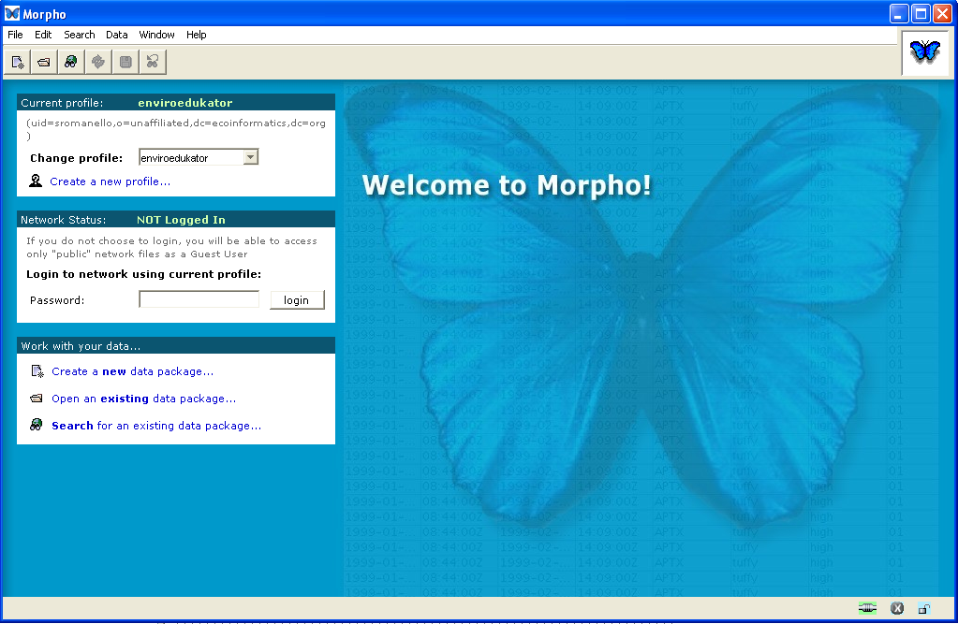
Morpho
Create & Edit Metadata
Search & Query Metadata Collections
Notes:
a data management tool for ecologists.
accessing and manipulating metadata and data (both locally and on the network).
allows ecologists to create metadata, (i.e. describe their data in a standardized format), and create a catalog of data & metadata upon which to query, edit and view data collections. In addition, Morpho provides the means to access network servers, in order to query, view and retrieve all relevant, public ecological data!
http://knb.ecoinformatics.org/software/morpho/
At this point I would have them open morpho and either access the data RCN training example using allison and cicchetti data or have them upload the data themselves and create a new data package. If you want them to upload the data themselves I have saved a version of the data that

Slide 37
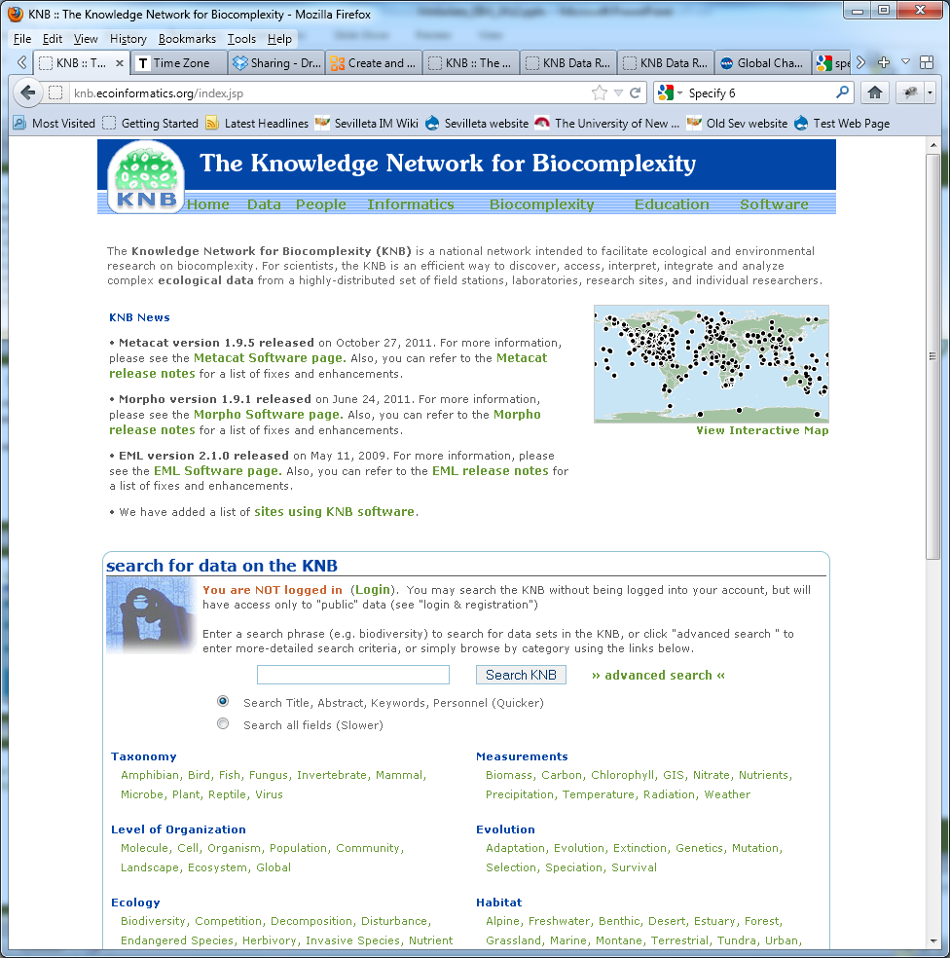
Morpho Exercise: Register with: http://knb.ecoinformatics.org

Slide 38
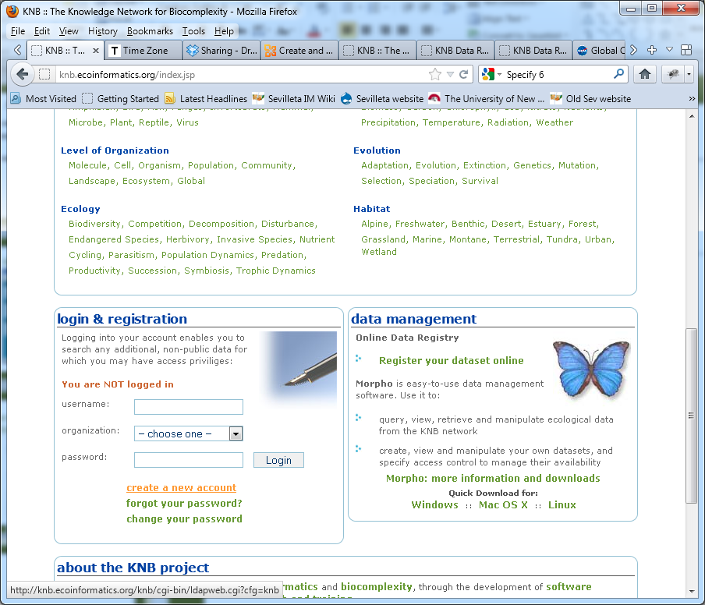
Create an Account

Slide 39
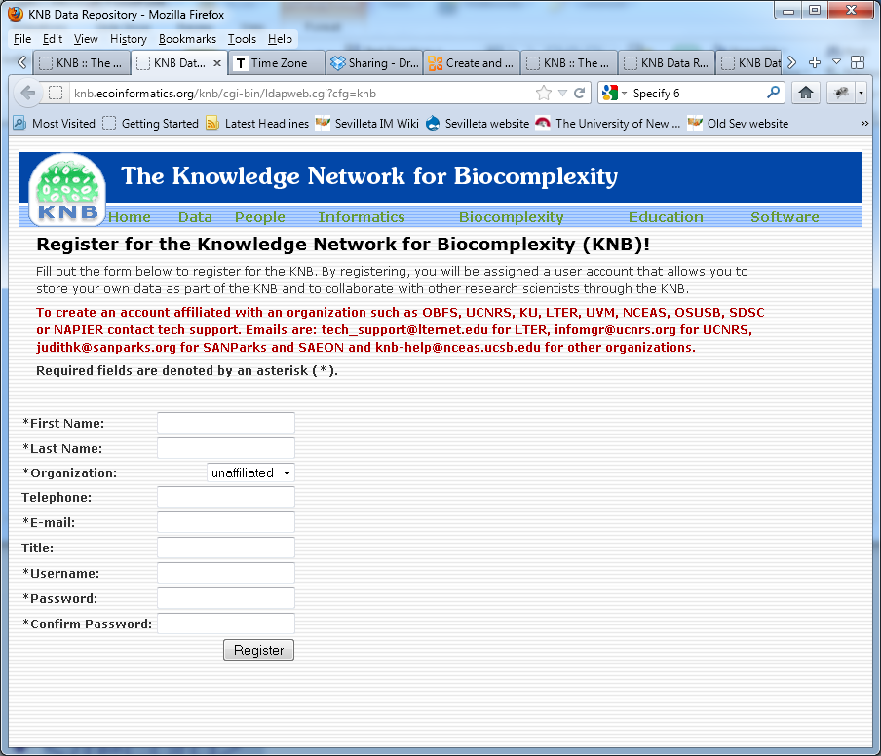
Choose Organization = Unaffiliated or LTER Write down your username and password!

Slide 40
Enter Hobo Metadata in to Morpho
Instructions at http://im.lternet.edu/node/946
The first thing you will do is create a profile, for which you will use the Username and Password from knb.ecoinformatics.org
Then you will create a new date package
Wizard will take you through the steps of entering metadata about
Title and abstract, keywords
People
Methods
When and Where
Table attributes

Slide 41
Summary
Metadata is documentation of data
A metadata record captures critical information about the content of a dataset
Metadata allows data to be discovered, accessed, and re-used
A metadata standard provides structure and consistency to data documentation
Standards and tools vary – select according to defined criteria such as data type, organizational guidance, and available resources
Metadata is of critical importance to data developers, data users, and organizations
Metadata completes a dataset.
Creating robust metadata is in your OWN best interest!
Notes:
Metadata is documentation of data
A metadata record captures critical information about the content of a dataset
Metadata allows data to be discovered, accessed, and re-used
A metadata standard provides structure and consistency to data documentation
Standards and tools vary – select according to defined criteria such as data type, organizational guidance, and available resources
Metadata is of critical importance to data developers, data users, and organizations
Metadata can be effectively used for:
data distribution
data management
project management
Metadata completes a dataset.

