Slide 1
Thesauri and Controlled Vocabularies

Slide 2
Outline
Why use
Valid input
Data search
Data integration
Definitions, uses, controlled vocabularies, thesauri, ontologies examples
taxonomic (EOL, ITIS, USDA plants, etc.)
spatial gazetteer (Alexandria, USGS GNIS,
date time format (time zone)
NBII, LTER, KNB, SWEET

Slide 3
Why use
Data quality and consistency
project determined
pulldown, autocomplete
Name | Count
Myrica cerifera | 4
Myr. Cer. | 3
M.c. | 5
Myrica | 2

Slide 4
Why use
Globally unique identifier
taxonomic name resolution
name changes, synonyms, taxnomic concept
spatial name resolution
ITIS Code | Name | Taxonomic Status
19261 | Myrica cerifera | synonym
507899 | Morella cerifera | accepted
510634 | Cerothamnus cerifera | synonym

Slide 5
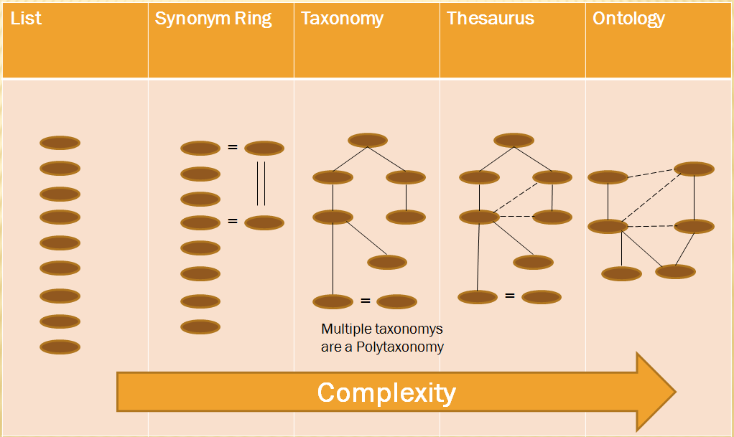
Definitions

Slide 6
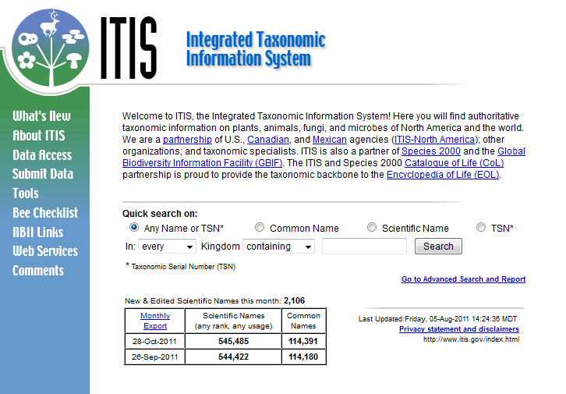
Taxonomic Authorities

Slide 7
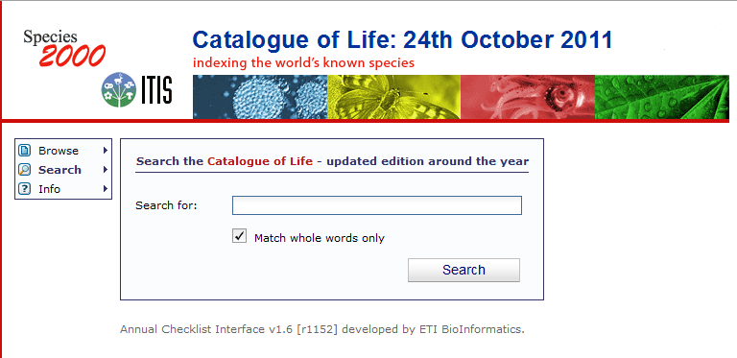
Taxonomic Authorities

Slide 8
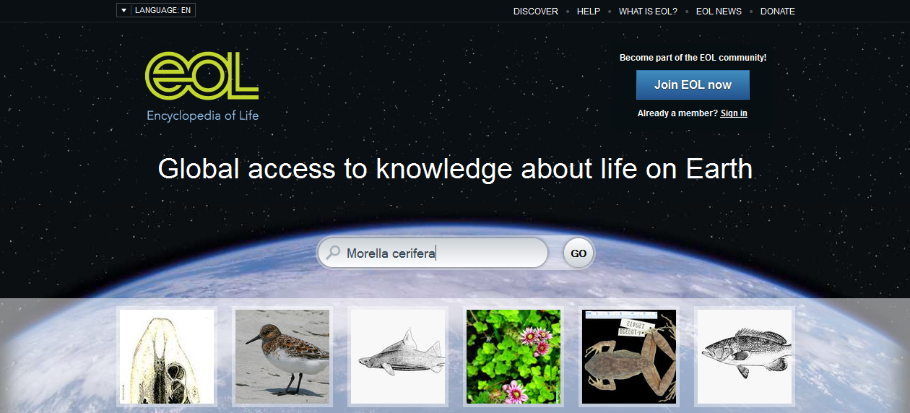
Taxonomic Authorities

Slide 9
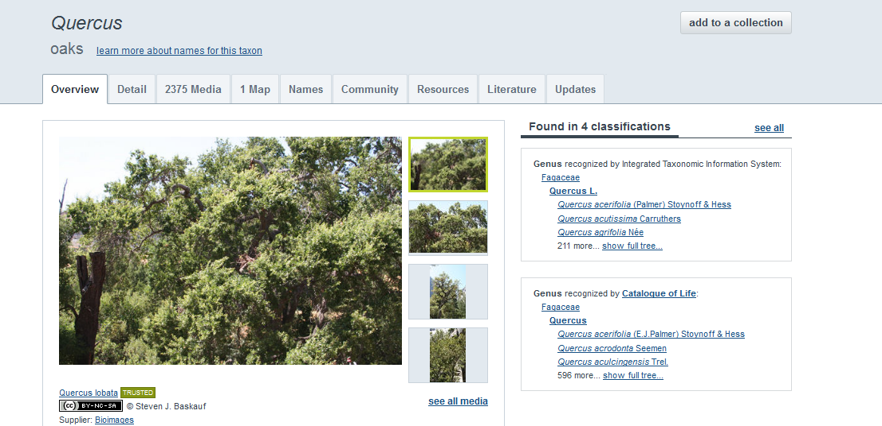
Taxonomic Authorities

Slide 10
How to Use
Search website for names
Download database and integrate
Automate with webservice access
http://www.itis.gov/ITISWebService/services/ITISService/searchByScientificName?srchKey=Myrica cerifera
http://www.itis.gov/ITISWebService/services/ITISService/searchByCommonName?srchKey=wax myrtle

Slide 11
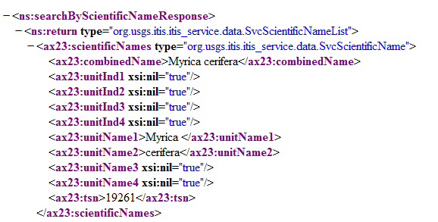
How to Use

Slide 12
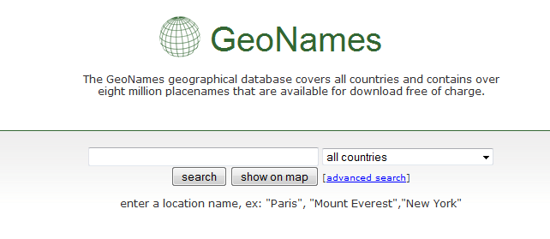
Geographic Gazetteers

Slide 13
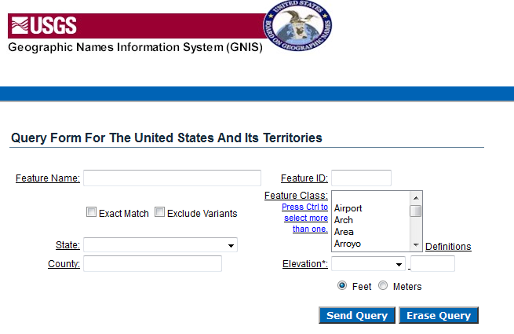
Geographic Gazetteers

Slide 14
How to Use
Search website for names
Download database and integrate
Automate with webservice access
http://api.geonames.org/search?q=london&maxRows=10&style=LONG&lang=es&username=demo

Slide 15
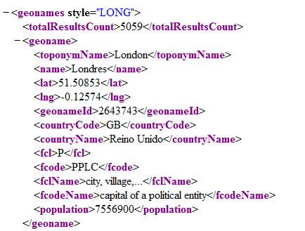
How to Use

Slide 16
Date and Time Format
Standard format
e.g. 02/04/03
2nd of April 2003 (European style)
4th of February 2003 (USA style)
3rd of April 2002

Slide 17
Date and Time Format
ISO 8601: YYYY-MM-DDThh:mm:ss(UTC)
2002-04-03T23:59:59(UTC)
2002-04-03T18:59:59(UTC-5)

Slide 18
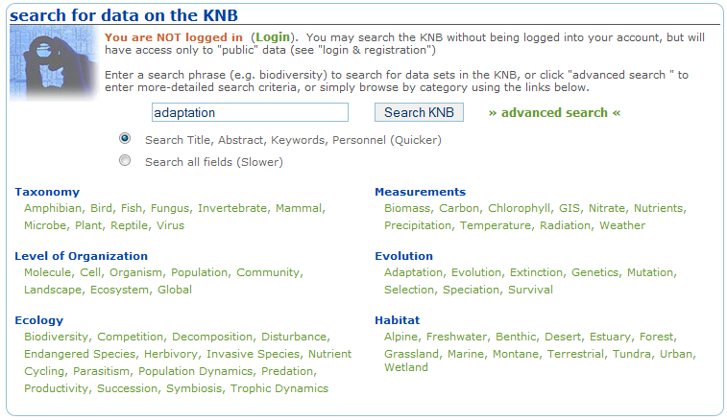
Keywords
Project controlled vocabulary
e.g. LTER, KNB

Slide 19
Controlled Vocabularies
LTER Metadata contained 2,711 distinct keywords with only 86 (3.2 %) used by 5 or more sites

