Slide 1
Data Manipulation, R
John Porter

Slide 2
Statistical Packages
“
R” is one of a number of “Statistical Packages”
Some others are:
SAS – Statistical Analysis System
SPSS – Statistical Package for the Social Sciences
S-Plus
Statistica
MATLAB
These are essential specialized computer languages that make performing analyses relatively easy
Often complex analyses are performed with a single command

Slide 3
Why use Statistical Packages
Support for a wide array of standard statistical procedures
Unlike spreadsheets, robust numerical techniques are used to reduce the chance of errors caused by round-off etc.
Saved programs allow analyses to be repeated or altered
Every step is documented
Especially important for scientific analyses

Slide 4
Some Caveats
The ease of use of many statistical packages makes them susceptible to misuse
If you don’t understand the underlying statistical test, don’t use it
Statistical packages can produce nice looking, accurate answers to the wrong questions!
It is easier to generate output than to interpret it
You may end up with 500 pages of output. Somewhere in it is the number you actually want! – Plan ahead!!!

Slide 5
What is distinct about “R”
R is distinguished from some of the other packages by:
COST – R is free! Many others cost hundreds to thousands of dollars to purchase.
EXTENSIBILITY – R is very easy to add functionality to. Literally thousands of “packages” that extend the capabilities of R are now available
R is most similar to S-Plus and MATLAB
User interface is relatively crude relative to SPSS or SAS or Statistica that have many more “point and click” functions

Slide 6
Why is it named “R”?
“R” replicates most of the functionality in the “S” statistical package developed by Bell Labs (now Lucent Technology) in the 1980s
The “S” name was proprietary -> S-plus
The first names of both of the original creators of “R” start with “R” (Ross Inhaka and Robert Gentleman)

Slide 7
EML and R
For EML-documented data, there are tools that will read metadata, and based on it write an R program for reading the data
For EML from a Metacat Server typically some minor editing is required to connect to data files and to add desired procedures
For datasets in PASTA, runnable R programs can be run directly using a web service and the “source” function in R

Slide 8
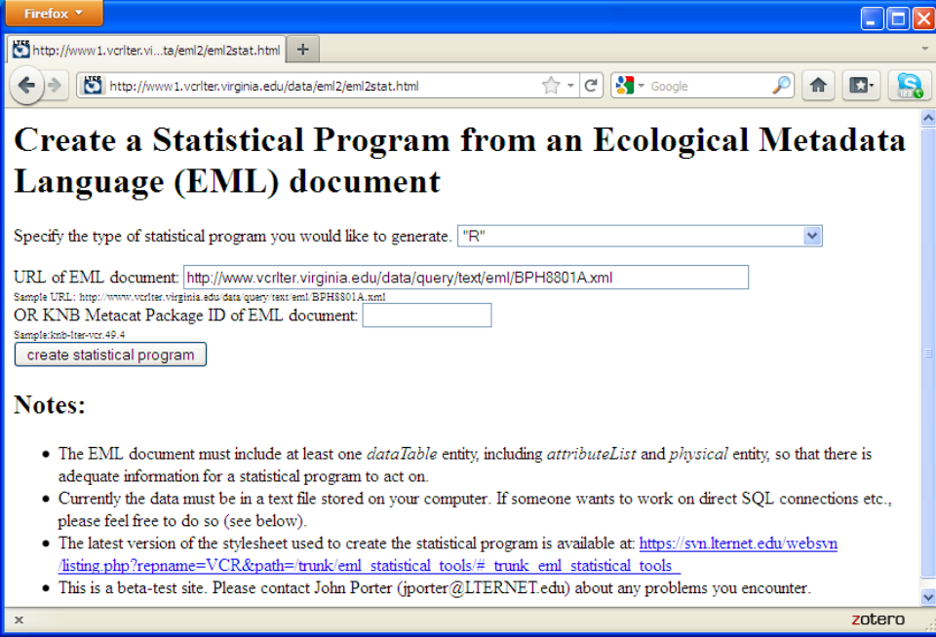
If you want to generate R code via a web page
Web Interface for generating programs from EML
http://vcr.lternet.edu/data/eml2

Slide 9
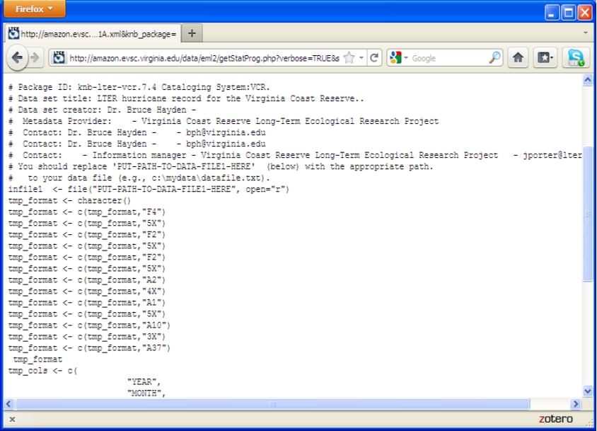


You still need to edit in where the data file is on your PC
Automatically-Generated R Program

Slide 10
Web Service Using PASTA & R
The web service address is:
http://vcr.lternet.edu/webservice/PASTAprog/
Follow it with the ID of the dataset, followed by an .r
for example: knb-lter-van.10.4.r
http://vcr.lternet.edu/webservice/PASTAprog/knb-lter-van.10.4.r

Slide 11
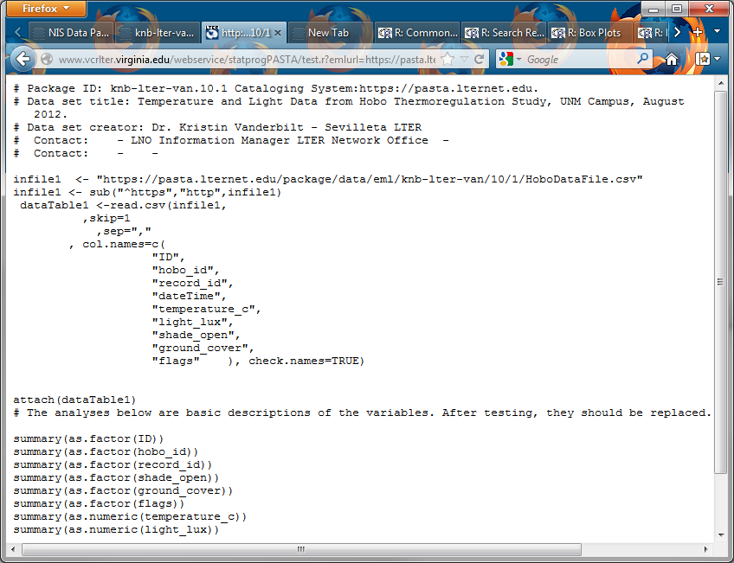

Slide 12
How does the web service work?
Secret: but Magic and Elves are clearly involved….

Slide 13
No Really! How the web service works:
EML Document
on server
Your Request
Extract Package ID
Fetch EML
“Stylesheet”
Rules for how to use elements from the XML document
Stylesheet Processor
“R” Program
You can see the stylesheet (s)at:
https://svn.lternet.edu/websvn/listing.php?repname=VCR&path=%2Ftrunk%2Feml_statistical_tools

Slide 14
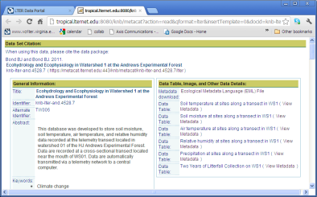
Isn’t there a simpler description?
Yes, there is…..
XML is designed so computers can pull out selected pieces of data upon request
A stylesheet or template provides the “rules” regarding how the extracted data should be displayed
An example is display pages in the LTER Metacat – where the EML data has been reformatted into an attractive web page
Here we simply reformat the contents of the EML file into an R program instead…..

Slide 15
Some “R” Basics

Slide 16
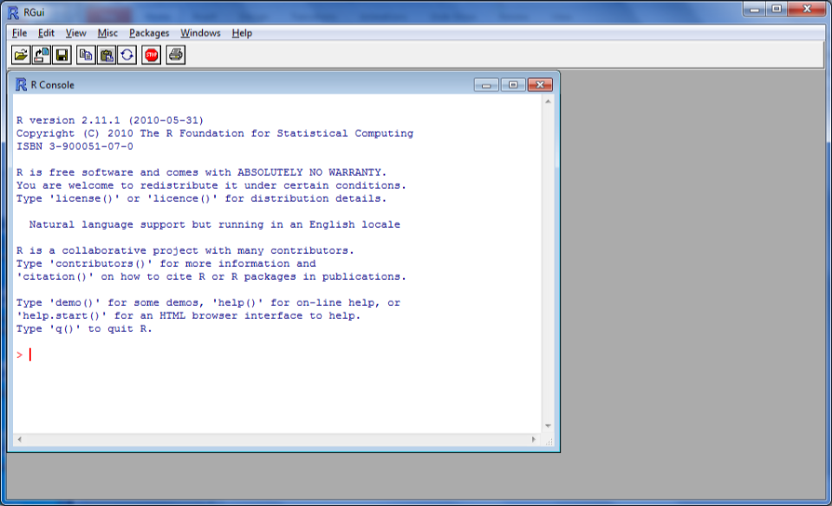


R
R Graphical User Interface
You can type in R commands into the Console to run them immediately

Slide 17
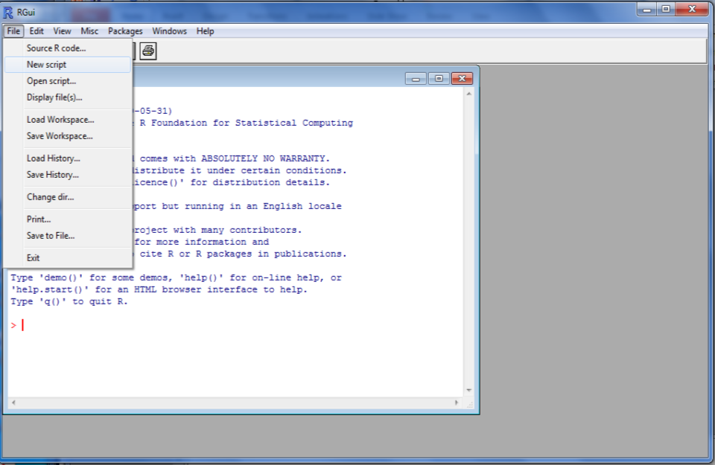

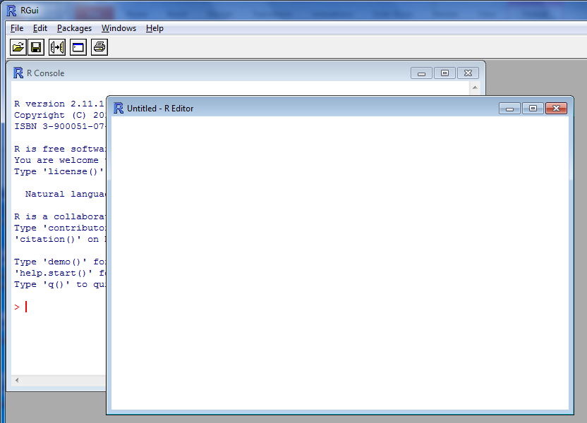

Using an Editor window lets you easily save your commands for review or reuse

Slide 18
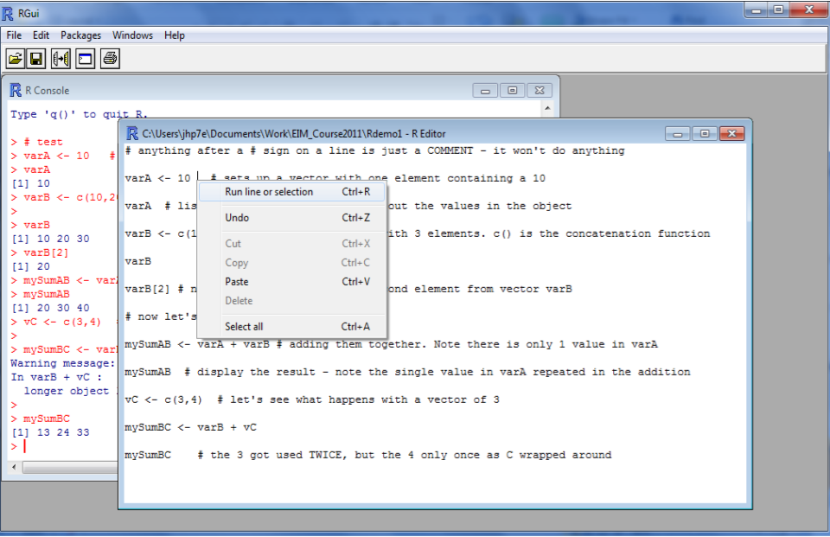

We can run the commands we’ve typed in by moving to a line, or selecting with the mouse, then RIGHT CLICKING to get this menu, or hitting CTRL-R

Slide 19
Mini Exercise
Start the “R” GUI using icon on the desktop
Open a “new script“ to record your commands
Put these commands in your new script window
V1 <- c(10,20,30)
print(V1)
V2 <- c(30,20,10)
print(V2)
var3 <- V1*V2
summary(var3)
print(var3)
Use control-R to run the commands one at a time an inspect the results

Slide 20
Congratulations!
Now that you have successfully mastered “R” by successfully running those commands we will try using the web service to import and display some real data
We COULD use the PASTA web service and “cut-and-paste” the R code from our web browser to our R script window and run it
Instead, let’s make “R” do all the work of fetching the program from the web service using the “source()” function – which reads R commands from a file – or a URL (e.g., the web service!)

Slide 21
Integrating with R
Example R program using PASTA:
source("http://vcr.lternet.edu/webservice/PASTAprog/knb-lter-van.10.4.r", echo=T)
table(hobo_id,ground_cover)
tapply(temperature_c,hobo_id,mean)
tapply(temperature_c,ground_cover,summary)
boxplot(temperature_c~ground_cover)
This program reads package knb-lter-van.10.4, converts the metadata to an R program and runs it, then does some additional statistics and a plot

Slide 22
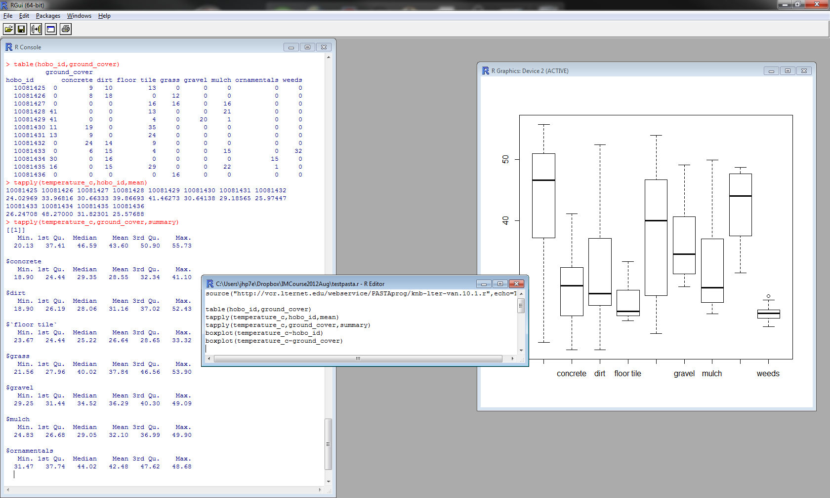

Slide 23
Mini-Exercise
Try adding the command to your script window (on one line) and running it:
source(
"http://vcr.lternet.edu/webservice/
PASTAprog/knb-lter-van.10.4.r", echo=T)
The first part in quotes is the URL to the web service, specifying the package ID to select followed by “.r” to indicate an R program is needed
The “echo=T” or “echo=TRUE” tells R to echo the commands to the display as they run so that we can see them

Slide 24
Additional Commands to Try:
# Ingest the data, run basic summaries
source("http://vcr.lternet.edu/webservice/PASTAprog/knb-lter-van.10.4.r", echo=T)
# view the contents of the ingested dataTable1
View(dataTable1)
# summarize all the column vectors in dataTable1
summary(dataTable1)
# extract the summary statistics for groups
tapply(light_lux,shade_open,summary)
# do a boxplot for light levels for the same groups
boxplot(light_lux~shade_open)

Slide 25
Additional Web-Based Tool
A server that allows you to create and run R code, even if you don’t have “R” installed on your computer is at:
http://ngis.tfri.gov.tw/modules/modules_en/
Various tools allow:
Generation of R code
Uploading and checking of data using R
Mapping dataset locations

Slide 26
Possible Issues
Dates and Times
Date and time formats are sufficiently variable that most dates and times will be read in as R Factors or character strings rather than as dates
Solution: Create a new date-time vector that uses R’s POSIXct date type
myDateTime<-as.POSIXct(as.character(origDateTime), format="%m/%d/%Y %H:%M",tz='MST')
# the Factor was called origDateTime

Slide 27
Sample Code
source("http://vcr.lternet.edu/webservice/PASTAprog/knb-lter-van.10.1.r",echo=T)
#save date and time as a POSIX structure
myDateTime<-as.POSIXct(as.character(dateTime),format="%m/%d/%Y %H:%M",tz='MST')
#add the new column to the data frame and sort by date/time
detach(dataTable1)
df1<- cbind(dataTable1,myDateTime)
df1<- df1[order(myDateTime),]
rm(myDateTime)
# Select specific logger and times
df2 <- subset(df1,((df1$hobo_id == 10081435) &
(df1$myDateTime >= as.POSIXct("2012-05-28T14:25","%Y-%m-%dT%H:%M",tz='MST')) &
(df1$myDateTime <= as.POSIXct("2012-05-28T15:20","%Y-%m-%dT%H:%M",tz='MST'))

Slide 28
Possible Issues
Numerical data misread as an R Factor
Sometimes columns of numerical data include non-numerical data
Errors
Missing Value Codes
R then reads the column as a Factor (treats it as if it were categorical or nominal data, rather than a number). However, since R Factors have a numerical index, they can be used in statistical calculations – BUT THE ANSWERS WILL BE WRONG!
Solution: convert factors back to numeric
f<-as.numeric(as.character(f)) or
f<- as.numeric(levels(f))[as.integer(f)] (faster, but more complicated)

Slide 29
Some Basic R Concepts
Almost everything in R is an “object” that has certain properties and methods
Most data is stored in vector objects (a list of values), and multiple vectors can be combined to create a matrix or “data frame” (a rectangular table)
There are a variety of ways of extracting individual data values from vectors and data frames
R makes heavy use of functions (e.g., sqrt(2) gives the square-root of 2)

Slide 30
Quick Exercise – Run these
# anything after a # sign on a line is just a COMMENT - it won't do anything
varA <- 10 # sets up a vector with one element containing a 10
varA # listing an object's name prints out the values
varB <- c(10,20,30) # sets up a vector with 3 elements. c() is the concatenation function
varB
varB[2] # now let's display ONLY the second element
# now let's do some math!
mySumAB <- varA + varB # adding them together.
# Note there is only 1 value in varA
mySumAB
# note the single value in varA repeated in the addition
vC <- c(3,4) # let's see what happens with a vector of 3
mySumBC <- varB + vC
mySumBC # the 3 got used TWICE, but the 4 only once

Slide 31
R Help
R has a number of ways of calling up help
??sqrt - does a “fuzzy” search for functions like “sqrt”
?sqrt – does an exact search for the function sqrt()
There are also manuals and extensive on-line tutorials

Slide 32
R Data Structures
A lot of the “magic” in R is because of the object-oriented approach used
R objects contain a lot more than just the data values
A command that does one thing to a scalar (single value) does something else with a vector (a list of values) – all because R functions “understand” the difference!

Slide 33
Atomic R structures
Like atoms make up matter, “atomic” structures form the building blocks for more complex objects
Scalars (i.e., single values), Vectors
Modes (types):
Numeric
Logical
Character
Complex
Raw (binary)

Slide 34
Conversions
Conversions are possible between different modes or types of objects using conversion functions
as.numeric(varA)
makes varA a number – if it can!
as.integer( )
as.character( )
as.factor()
as.matrix()
as.data.frame()

Slide 35
When Conversions Go Wrong
What happens when you try to convert a character string (e.g., “A”, “my text”) into a numeric value?
A special value is stored – NA
NA is a MISSING VALUE
Note NA does not have quotes, it is not a character value, it is a special type of value
In numerical operations (e.g., mean( ) ), NA either causes the result to be NA, or if an option is selected, are just ignored

Slide 36
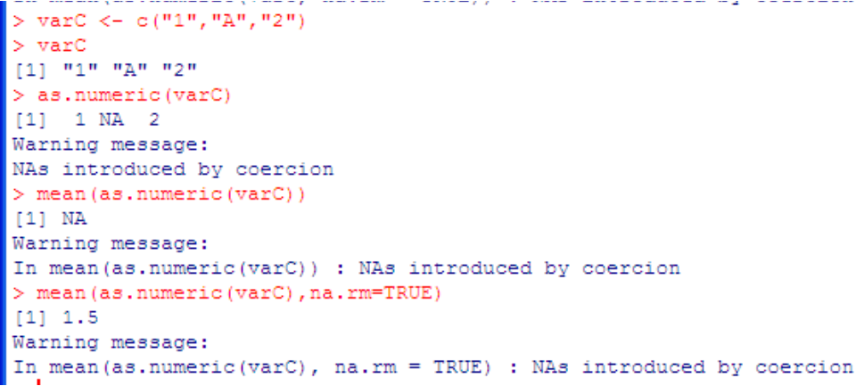

Missing Value Example
NA automatically generated in place of “A”
Mean set to NA if NA included in the data
The na.rm option “removes” the NA’s before calculating the mean if it is set to TRUE, so we get a mean of the other values.

Slide 37
Common R Objects
“List” type objects are like vectors, but are not restricted to a single data “mode”
“Factor” type objects are used for categorical or ordinal data
E.g. FactA <- as.factor(c(‘A’, ‘B’, ‘C’))
“Matrix” type objects take the form of a TABLE with ROWS and COLUMNS
all of the same basic type (e.g., all integers, all real numbers, all factors)
The similar ARRAY type object can have more than 2 dimensions
“Data Frames” type objects are like matrices but each column can be of a different mode
Data Frames are one of the most common structures used for ecological data

Slide 38
Factors
Factors are the way R deals with categorical or nominal data (e.g., typically, non-numeric data)
Internally Factors are made up of two vectors:
Values – the actual values stored in the factor – often referred to as “levels”
Indexes – an integer vector containing numbers that are used to specify the ORDERing of the values
DANGER – sometimes when you read in data from a file, errors in the data will cause R to read a column of (mostly) numbers as a Factor instead of as a numeric vector!

Slide 39
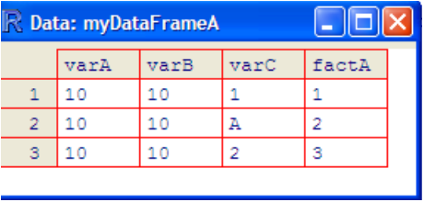
Data Frames
Data Frames are one of the most frequently used objects for ecological analyses
A data frame looks a lot like a spreadsheet
Multiple columns and rows – each with a column name and a row name
Different: Each column contains only one type of object

Slide 40
Data Frames - Creating
You can create a data frame by binding existing vectors together using the cbind (column-bind) function
myDataFrameA <- cbind(varA,varB,varC,factA)
Additional columns can be added to a data frame using cbind() as well.
myDataFrameA <- cbind(myDataFrameA,varD)

Slide 41
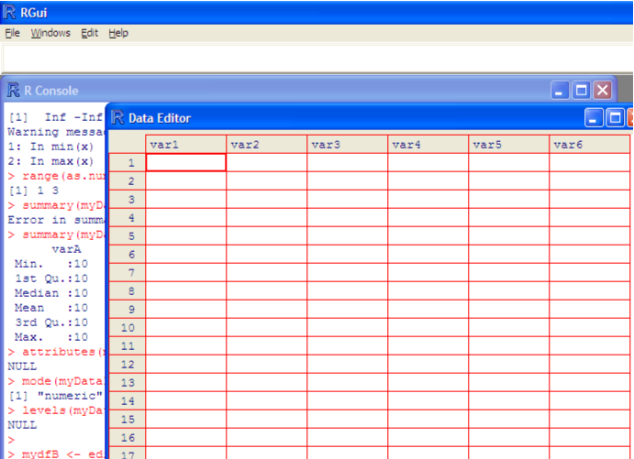

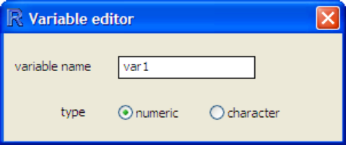
Data Frames – Creating in an Editor
mydfB <- edit(data.frame())
Clicking on a collumn heading lets you set the column name

Slide 42
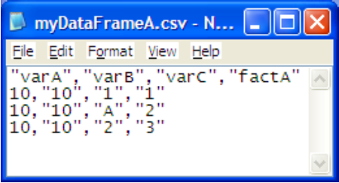
Reading Data Frames from Files
myDataFrameA <- read.csv("c:/myFile.csv")
Note: The file path has FORWARD slashes (“/”) not the back slashes windows normally uses (“\”)
You CAN use back slashes, but they must be doubled (“\\”)

Slide 43
Data Frames
How do you call back the values of a vector once it has been stored in a Data Frame?
myDataFrameA$varA
Refers to the vector named varA stored in data frame myDataFrameA
To save typing “myDataFrameA$” we can use the command:
attach(myDataFrameA)
Now, if we just type in “varA” it lists out the value of varA from the data frame, unless there is an existing vector named varA, in which case it overrides the varA in the data frame

Slide 44
Selecting Data
We saw earlier that a subscript in square brackets can be used to access a particular row of a vector
varB <- c(1,10,100)
varB[2] is 10
But you can also put SEQUENCES or LOGICAL statements into the brakets to select data
varB[2:3] would return a vector of 10, 100
varB[varB > 10] would yield 100
varB[varB == 10] would yield 10
varB[varB > 1] would yield a vector of 10,100

Slide 45
Selecting Data in Data Frames
Data frames have two dimensions (rows and columns), so we always need to give two indexes
DF[1:10,1:3] returns the first 10 rows for the first 3 columns. The list of rows and columns are separated by a comma
DF[1:10, ] returns the first 10 rows, all columns
NOTE THE TRAILING comma after the 10
DF[,1:3] returns the first 3 columns for all rows
Again, note the leading comma
You can also use logical statements
DF[DF$col1 >1, ] - shows all columns for rows where the value of the “col1” column are greater than 1

Slide 46
R Analysis Functions
So far, we’ve been primarily concerned with getting data into R and understanding how to describe it – this is the hard work!
The payoff is that now that we have gotten the data arranged the way we want it, a large number of complex analyses, including graphics, are available to us

Slide 47
Useful Descriptive Statistics
table()
Summarized frequencies
mean()
Generates the mean value of numeric vectors
range()
Returns the minimum and maximum values of numeric vectors
summary()
Generates a number of basic statistics (mean, max, std. dev.) for numeric variables
Tallys frequencies of factors (categorical variables)

Slide 48
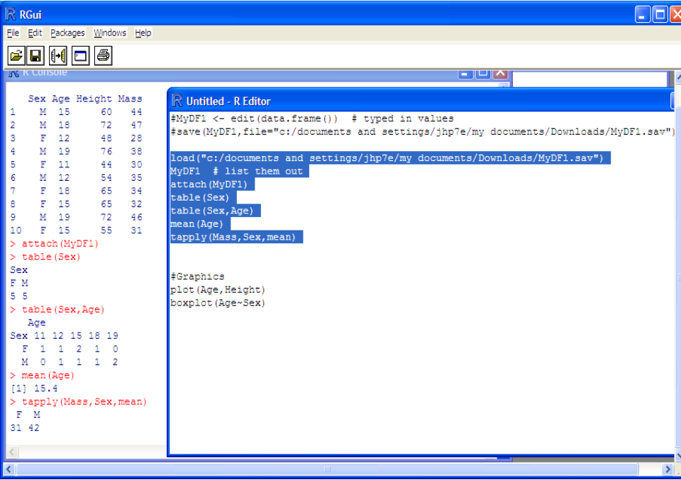
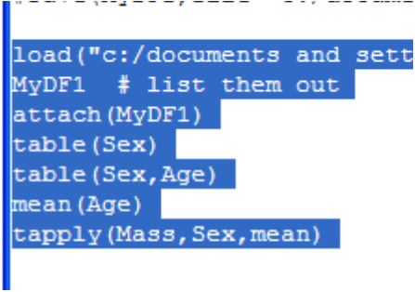

The “tapply” function lets you get results broken down by groups here
tapply(Mass,Sex,mean)
Gives us the mean mass for each sex

Slide 49

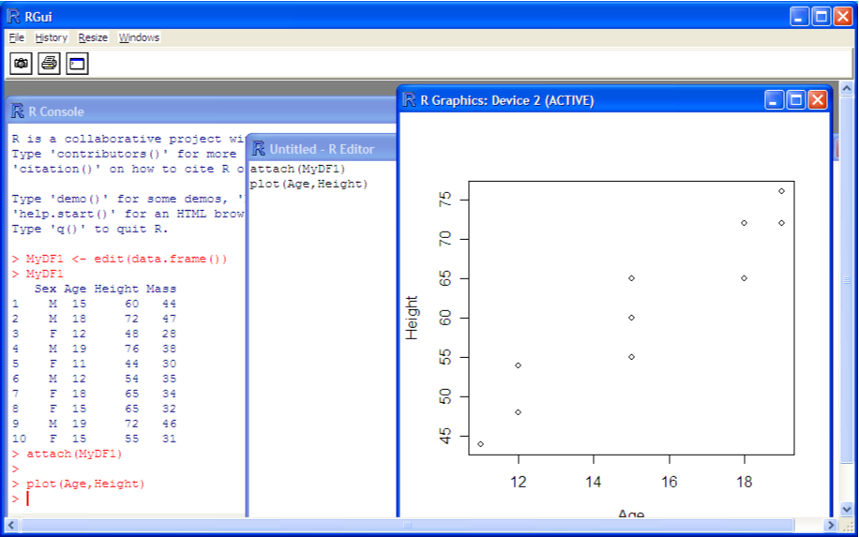
Simple Graphics
plot(Age,Height)
R has powerful graphing capabilities

Slide 50
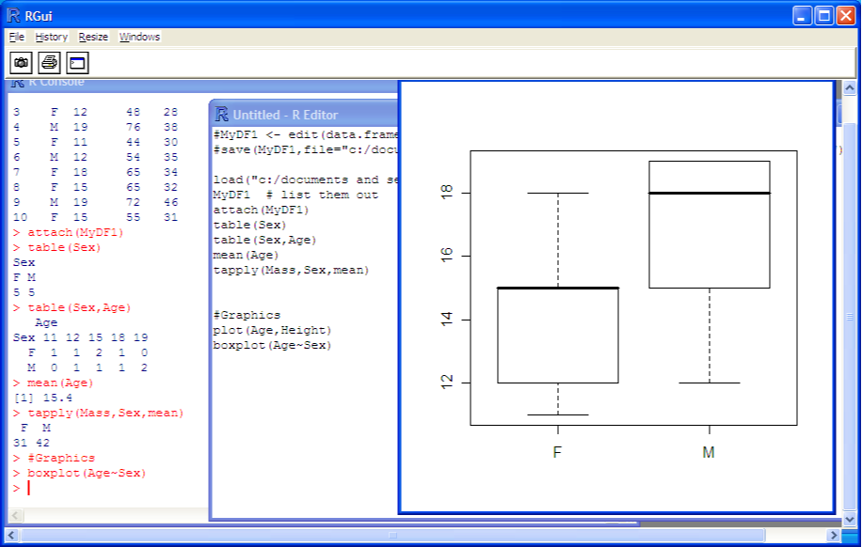

boxplot(Age~Sex)

Slide 51
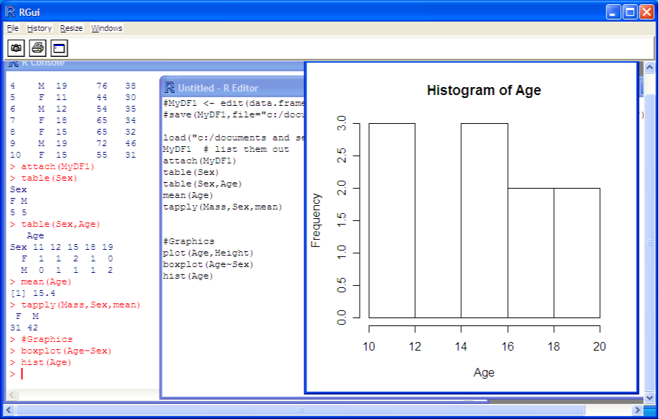
hist(Age)

Slide 52
Assignment
Acquire some data (from the web, your data, data from exercises)
It should have at least two numerical columns and possibly additional alphanumeric columns
Either read the data into R, or enter a copy of it (or a portion of it)
Use R to calculate a new vector based on the existing vectors
Use R to summarize the data
Use R to plot the data

Slide 53
Useful Resources
A printable quick reference page: http://cran.r-project.org/doc/contrib/refcard.pdf
R-tutorial: http://www.r-tutor.com/
Quick-R, a quick way to look up ways to do things, with lots of examples: http://www.statmethods.net/
Comprehensive R Archive Network (CRAN), source for R modules and more: http://cran.r-project.org/

Slide 54
Some Useful Commands
DATA FRAMES
myframe <- read.csv(infileorURL, header=TRUE) - reads a CSV file into a dataframe
names(myframe) - lists names of vectors in the data frame
cbind(myframe,newvector) - adds newvector to myframe
myframe$myvector - accesses myvector from frame myframe (not needed if use attach)
attach(myframe) - use vectors from myframe
edit(myframe) - spreadsheet-style editor for values
myframe <-edit(data.frame()) to create a new dataframe and edit it.
View(myframe) - like edit, but all you can do is look (note, capital V)
cnames(myframe) <- mynames Set the column names from mynames

Slide 55
DATA FRAME OPERATIONS
subset1 <- subset(myframe, A < 2) # select lines
m1 <- merge(authors, books, by.x = "surname", by.y = "name") # merge dataframes by keys
ranks <- rank(myframe$var2) cbind(myframe,ranks) # add a ranks for var2 to your data frame
colnames <- c("col1","col2") # Set names for data frame columns
names(df)[names(df)=="oldvarname"] = "newvarname“ #Rename a vector in a data frame:

Slide 56
Quick Review
R typically stores data in vectors of “mode” numeric and character
There are higher-level structures such as data.frames, factors and matrices
When vectors are stored in data.frames, they are addressed as: myFrame$myVector
Where myFrame is the name of my data frame
Where myVector is the name of the vector I want
If you use attach(myFrame) then you can just use myVector, unless there was already a vector named “myVector” (in which case it takes precedence)

Slide 57
Other R Topics
Packages
Sequences
Dates
Functions

Slide 58
Packages
The basic R installation includes the basic functions that you need, ,but not the specialized ones
If everything was included R would be huge and much slower
The specialized functions are stored in “packages”
Packages are installed from CRAN using either the GUI or the install.packages() function
E.g., install.packages(“lattice”)
To keep R from running slowly, installed packages are loaded into the workspace using the library() function
E.g., library(lattice)

Slide 59
Sequences
In R a sequence of numbers can be generated using 1:10 where 1 is the first member of the sequence and 10 is the last
vecA <- c(1:10) # puts 1,2,3…. 10 into vecA
Sequences come in handy for accessing specific rows or columns in your data

Slide 60
Dates
The storage of dates tends to vary widely among software packages
Decimal Days Since Jan 1, 1900 (Excel)
Seconds since Jan. 1, 1970 (POSIX)
Text strings “2011-05-24 10:15:00 MDT”,”12/25/10”
Examples of conversions
library(date)
myDate<- as.Date(welldata$datelev,format="%Y-%m-%d")
welldata <- cbind(welldata,myDate)
Posixltdatetime <- strptime(datetimestr,format=
"%Y-%m-%d %H:%M:%S")

Slide 61
Functions
One of the real power in R is how easy it is to define your own functions. In addition to being handy, some built-in functions (e.g., tapply) expect you to provide the name of a function as an argument
A simple function to convert inches to cm
inch2cm <- function(inchVal){
cmVal <- inchVal*2.54
return(cmVal)
}
inch2cm(5) returns 12.7

