Slide 1
Management of Streaming Data
John Porter

Slide 2
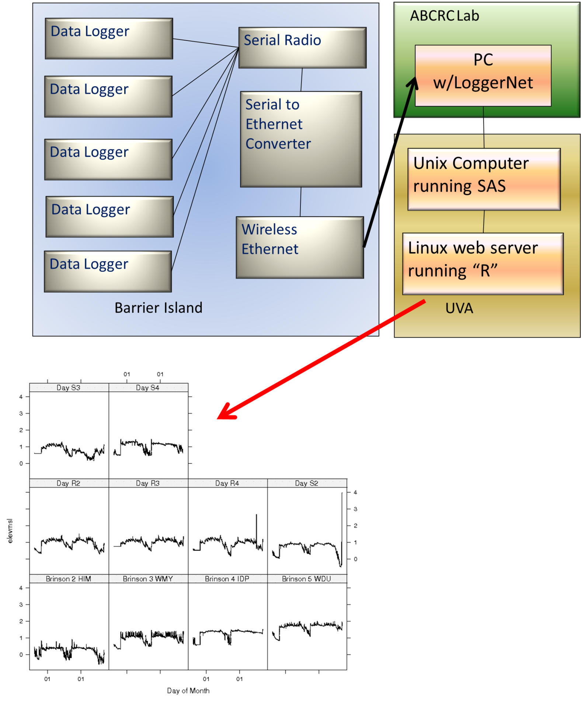
Streaming data from a network of ground-water wells

Slide 3
What is Streaming Data?
Streaming data refers to data:
That is typically collected using automated sensors
Collected at a frequency more than one observation per day
Often at a frequency of once per hour or higher (sometimes much higher)
Collected 24-hours per day, 365 days per year
Often streaming data is collected by wirelessly networked sensors, but that is not always the case.

Slide 4
Why Streaming Data?
Some phenomena occur at high frequencies and generate large volumes of data in a relatively short time period
Visits of birds to nests to feed chicks
Changes in wind gusts at a flux tower
Some data may be used to dictate actions that need to occur in short time periods
Detection of rain event triggers collection of chemical samples
Notification of problems with sensors

Slide 5
Steaming Data
Wireless
Sensor Networks
100 km
10 km
Spatial
Extent
1 km
100 m
10 m
1 m
10 cm
Annual
Monthly
Weekly
Daily
Hourly
Min. Sec.
Frequency of Measurement
=Paper in 2003 Ecology
Porter et al. 2005, Bioscience

Slide 6
Challenges for Streaming Data
Data volume – high frequency of data collection means lots of data
Challenges for transport (hence wireless networks)
Challenges for storage
Challenges for processing
Providing adequate quality control and assurance
Detection of corrupted data
Detection of sensor failures
Detection of sensor drift

Slide 7
Challenges
Lots of the tools and techniques used for less voluminous data just don’t work well for really large datasets
“Browsing” data in a spreadsheet is no longer productive (e.g., scrolling down to line 31,471,200 in a spreadsheet is an all-day affair
Some software just “breaks” when datasets get to be too large
Memory overflows
Performance degradation
Notes:
FYI 31,471,200 is the number of seconds in a year.

Slide 8
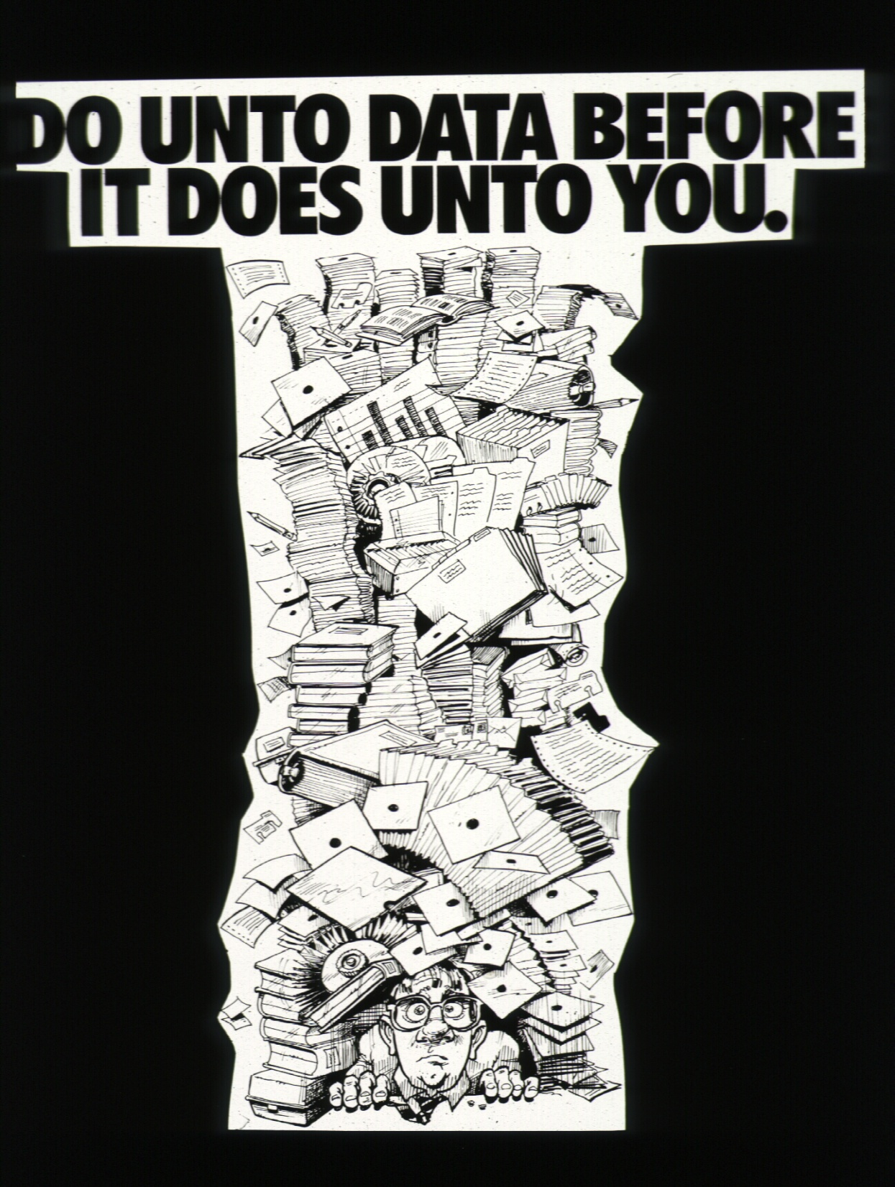
Slide from Susan Stafford

Slide 9
Storage - High Data Volumes
Some sensors or sensor networks are capable of generating many terabytes of information each year
E.g., the DOE ARM program generates 0.5 TB per day!
Databases can run into severe problems dealing with such huge amounts of data
Often data needs to be stored on tape robots
Frequently data is kept as text or in open source standard files (e.g., netCDF, openDAP)
Data is Segmented based on
Time
Location
Sensor
File naming conventions are used to make it easy to extract the right “chunk” of data

Slide 10
Common Streaming Data Errors
Corrupted Date or Time
Can be corrected – IF it is noticed before the clock is reset
Sensor Failures
Relatively easy to detect
May be impossible to fix
But sometimes estimated data can be substituted
Sensor Drift
Difficult to detect – especially over short time periods
Limited correction is possible, if the drift is systematic

Slide 11
Browsing your data to look for errors is not an option!
The data is simply too voluminous for you to scan the data by eye!
Need: Statistical Summaries, Graphics or Queries to identify problems

Slide 12
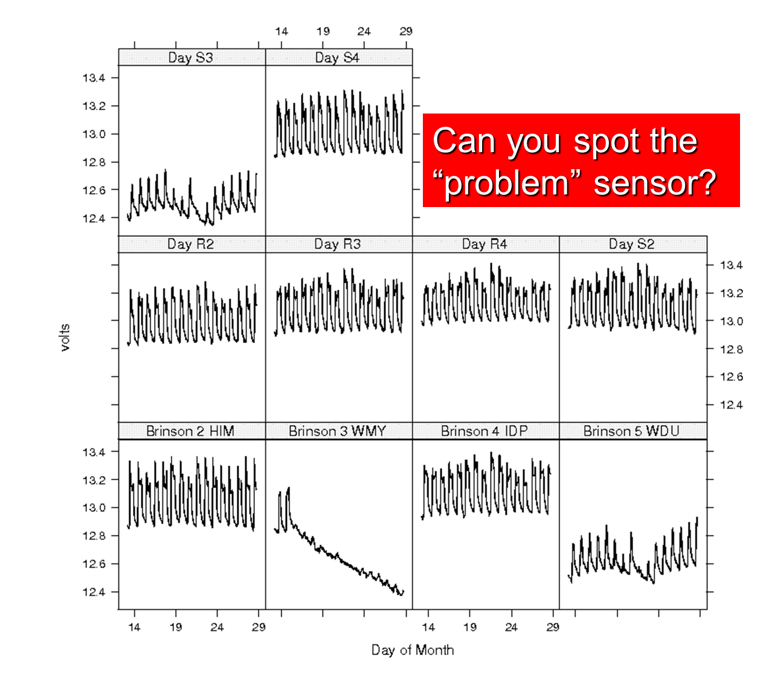

Slide 13
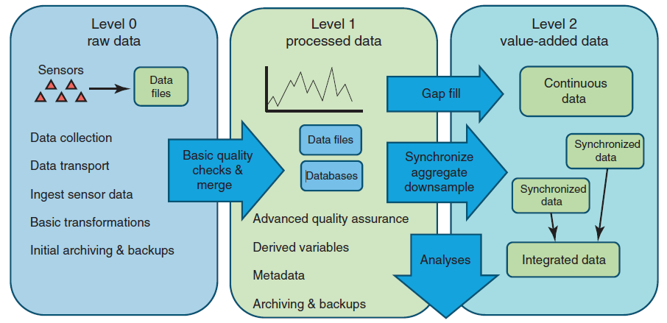
Archiving and Publishing Data
Porter, Hanson and Lin, TREE 2012
Notes:
Most field ecologists are focused on “level 0” data – but the greatest opportunities for shared data are for higher-level data products. The Level 1 and Level 2 data are what are likely to be most in demand.

Slide 14
Some Best Practices
ALWAYS preserve copies of your “Level 0” raw data
Cautionary tale: Ozone data
“Hole” over Antarctica was initially listed as missing data due to unexpectedly low values in processed data
Alterations to data should be completely documented
Easiest way to do this is to use programs for data manipulation
Very difficult to do if you edit files or spreadsheets – requires very detailed metadata
It is not unusual for data streams to be completely reprocessed using improved QA/QC tools or algorithms

Slide 15
Some simple guidelines for effective data management*
Use a scripted program for analysis.
Store data in nonproprietary software formats (e.g., comma delimited text file, .csv); proprietary software (e.g., Excel, Access) can become unavailable, whereas text files can always be read.
Store data in nonproprietary hardware formats.
Always store an uncorrected data file with all its bumps and warts. Do not make any corrections to this file; make corrections within a scripted language.
Use descriptive names for your data files.
Include a “header” line that describes the variables as the first line in the table.
Use plain ASCII text for your file names, variable names, and data values.
When you add data to a database, try not to add columns; rather, design your tables so that you add only rows.
All cells within each column should contain only one type of information (i.e., either text, numerical, etc.).
Record a single piece of data (unique measurement) only once; separate information collected at different scales into different tables. In other words, create a relational database.
Record full information about taxonomic names.
Record full dates, using standardized formats.
Always maintain effective metadata.
* Borer et al. 2009. Bulletin of the Ecological Society of
America 90(2):205-214.

Slide 16
Some simple guidelines for effective data management*
Use a scripted program for analysis.
Store data in nonproprietary software formats (e.g., comma delimited text file, .csv); proprietary software (e.g., Excel, Access) can become unavailable, whereas text files can always be read.
Store data in nonproprietary hardware formats.
Always store an uncorrected data file with all its bumps and warts. Do not make any corrections to this file; make corrections within a scripted language.
Use descriptive names for your data files.
Include a “header” line that describes the variables as the first line in the table.
Use plain ASCII text for your file names, variable names, and data values.
When you add data to a database, try not to add columns; rather, design your tables so that you add only rows.
All cells within each column should contain only one type of information (i.e., either text, numerical, etc.).
Record a single piece of data (unique measurement) only once; separate information collected at different scales into different tables. In other words, create a relational database.
Record full information about taxonomic names.
Record full dates, using standardized formats.
Always maintain effective metadata.
Maintain information needed for the “provenance” of the data. Allows you to backtrack, reprocess etc.

Slide 17
Some simple guidelines for effective data management*
Use a scripted program for analysis.
Store data in nonproprietary software formats (e.g., comma delimited text file, .csv); proprietary software (e.g., Excel, Access) can become unavailable, whereas text files can always be read.
Store data in nonproprietary hardware formats.
Always store an uncorrected data file with all its bumps and warts. Do not make any corrections to this file; make corrections within a scripted language.
Use descriptive names for your data files.
Include a “header” line that describes the variables as the first line in the table.
Use plain ASCII text for your file names, variable names, and data values.
When you add data to a database, try not to add columns; rather, design your tables so that you add only rows.
All cells within each column should contain only one type of information (i.e., either text, numerical, etc.).
Record a single piece of data (unique measurement) only once; separate information collected at different scales into different tables. In other words, create a relational database.
Record full information about taxonomic names.
Record full dates, using standardized formats.
Always maintain effective metadata.
Store data in forms that will be slow to become obsolete
* Borer et al. 2009. Bulletin of the Ecological Society of
America 90(2):205-214.

Slide 18
Some simple guidelines for effective data management*
Use a scripted program for analysis.
Store data in nonproprietary software formats (e.g., comma delimited text file, .csv); proprietary software (e.g., Excel, Access) can become unavailable, whereas text files can always be read.
Store data in nonproprietary hardware formats.
Always store an uncorrected data file with all its bumps and warts. Do not make any corrections to this file; make corrections within a scripted language.
Use descriptive names for your data files.
Include a “header” line that describes the variables as the first line in the table.
Use plain ASCII text for your file names, variable names, and data values.
When you add data to a database, try not to add columns; rather, design your tables so that you add only rows.
All cells within each column should contain only one type of information (i.e., either text, numerical, etc.).
Record a single piece of data (unique measurement) only once; separate information collected at different scales into different tables. In other words, create a relational database.
Record full information about taxonomic names.
Record full dates, using standardized formats.
Always maintain effective metadata.
Make the data easy to use for people and a wide variety of software
* Borer et al. 2009. Bulletin of the Ecological Society of
America 90(2):205-214.

Slide 19




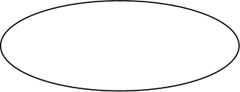




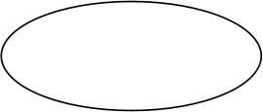
Processing of Streaming Data
Previous Data
Integrated
Data
New Data
Transformations & Range Checks
Merge Data
Analysis
Visualization
“Problem” Observations
Eliminate Duplicates

Slide 20
Workflows for Processing Streaming Data
The previous diagram describes a “workflow “ for processing streaming data
The workflow needs to be able to be run at any time of the day or night – whenever new data is available
The workflow needs to be able to be completed before new data is available
What tools are available for use?

Slide 21
Tools for Streaming Data
Typically spreadsheets are a poor choice for processing streaming data
They are oriented around human operation, not automated operation
They work poorly when you are dealing with millions, rather than thousands, of observations
Statistical Packages (R, SAS, SPSS etc.)
Database Management Systems (DBMS)
Proprietary software from vendors (e.g., Loggernet, LabView etc.)
Scientific Workflow Systems (e.g., Kepler)

Slide 22
Quality Control and Assurance
QA/QC is critical for streaming data
If you have 2 million data points and they are 99.9% error free that still means that you have 2000 bad points!
Especially serious for detection of extreme events (maximum and minimum are often seriously affected)

Slide 23
Standard QA/QC Checks
Does the variable type match expectations?
Expect a number, but get a letter
Ranges – are maximum and minimum values within possible ( or expected) ranges?
Can be conditional, such as season-specific ranges
Spikes – impossibly abrupt changes

Slide 24
QA/QC
Quality Assurance and Quality Control for streaming data often involves “tagging” data with “flags” that indicate something about the quality of the data
“Flagging” systems tend to be dataset-specific
Var1 | Var1_Flag | Meaning
10.3 |  | OK value
15.9 | R | Value exceeds expected range
11.3 | E | Estimated value used to fill a gap in the data
 | M | Value is missing or null
15.0 | Q | Questionable value, sensor may be experiencing drift

Slide 25
Advanced QA/QC
When streaming data includes lots of different, but correlated variables
Predict values for a variable based on other variables
Look for times when the predicted values are unusually poor – that is observed and predicted values don’t agree

Slide 26
Streaming data: A Real-world Example
Here is an outline of how meterological data has processed at the VCR/LTER since 1994
Campbell Scientific “Loggernet” collects raw data to a comma-separated-value (CSV file) on a small PC on the Eastern Shore via a wireless network
Every 3 hours , MSDOS BATCH file copies the CSV file to a server back at the Univ. of Virginia
Shortly thereafter, a UNIX shell-script
combines CSV files from different stations into a single file, and compresses and archives the original CSV files, stripping out corrupted lines
Runs a SAS statistical program that performs range checks and merges with previous data
Runs another SAS job that updates graphics and reports for the current month

Slide 27
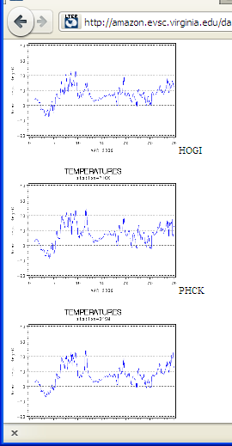
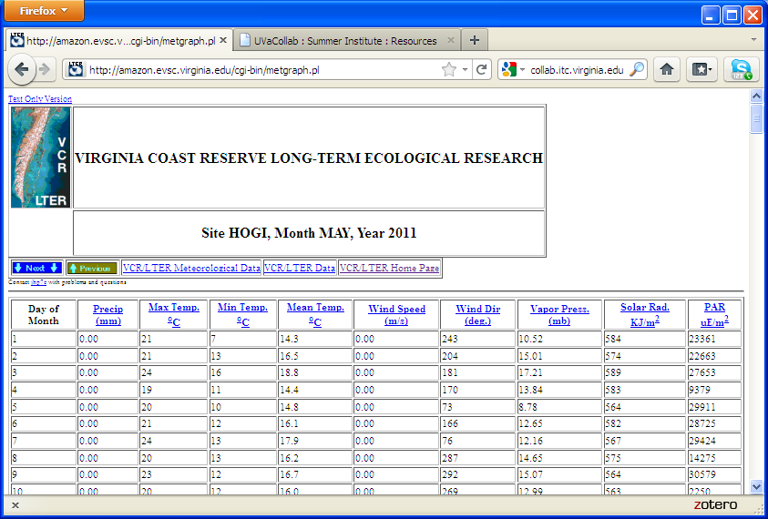
Workflow output

Slide 28
A “Manual” Workflow
The previous example spanned a variety of:
Computer operating systems
Windows /MSDOS
Unix/Linux
Software
Proprietary software (Loggernet)
MSDOS Batch file, Windows Scheduler
Unix/Linux Shell / Crontab scheduler
SAS
It required that configurations be set up on several systems, and a significant amount of documentation
Is there a better way?

Slide 29
Scientific Workflow Systems
Scientific Workflow Systems such as Kepler, Taverna, Vis-trails and others integrate diverse tools into a single coherent system, with a graphical interface to help keep things organized
Individual steps in a process are represented by boxes on the screen that intercommunicate to produce a complete workflow
Kepler has good support for the “R” statistical programming language

Slide 30
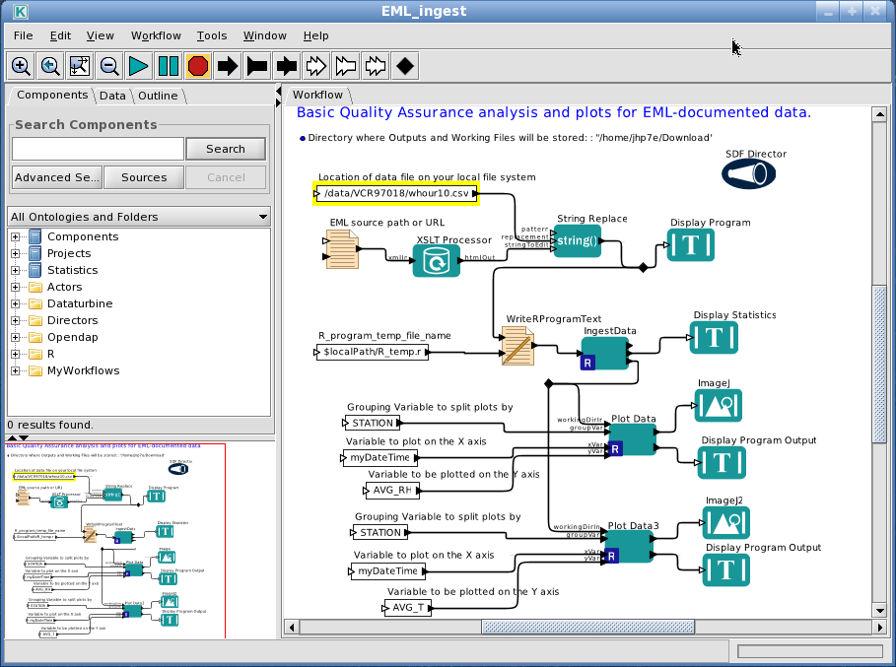
Sample Kepler Workflow for QA/QC

