Slide 1
Introduction to Databases

Slide 2
When use a database
Advantages
additional capabilities
sorting
query
integrity checking
easy access to data
Disadvantages
few graphical or statistical capabilities
proprietary formats may limit archival quality of data
require expertise and resources to administer

Slide 3
Types – relational databases
Desktop – MS ACCESS, Paradox
Server
Enterprise level – Oracle, MS SQLServer, PostgreSQL , MySQL
Notes:
LTER information management is site based
Each site is responsible for managing data coming from its researchers
Sites differ in their requirements and capabilities
Different types of data and experimental designs
Different computational environments
Locations of researchers can be centralized or dispersed
LTER Network Office
Network-wide databases (personnel, data catalog)
Shared Tools
Ecological Metadata Language (EML) helps tie sites together

Slide 4
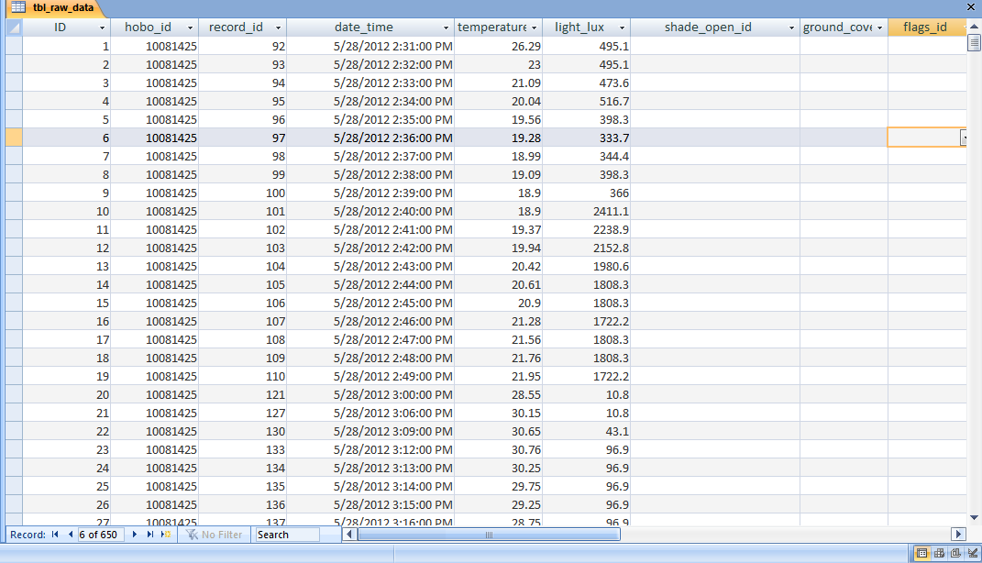
Raw data

Slide 5
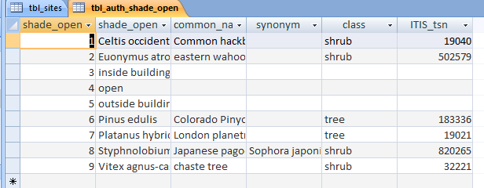
Tables
Data Normalization
E.g. Shade_open clumn

Slide 6
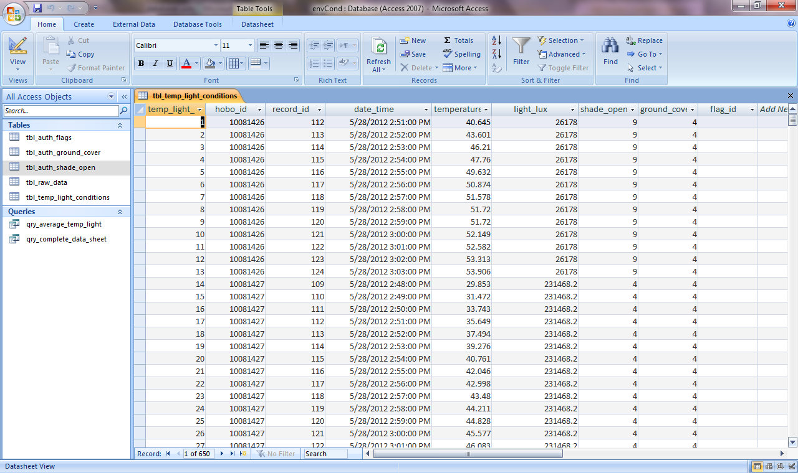
Tables

Slide 7
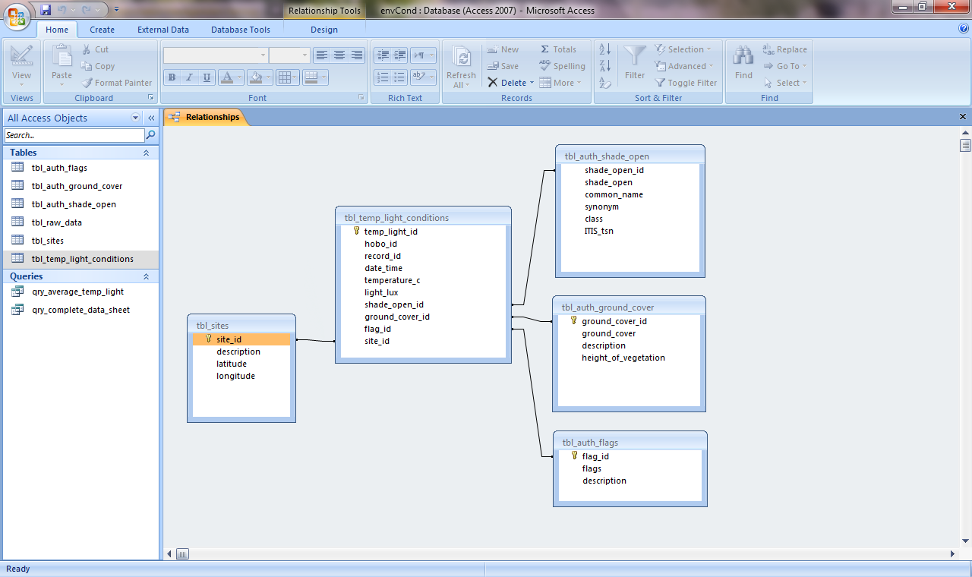
Tables and Relationships => Data Model

Slide 8
Date and Time Format
Standard format
e.g. 02/04/03
2nd of April 2003 (European style)
4th of February 2003 (USA style)
3rd of April 2002

Slide 9
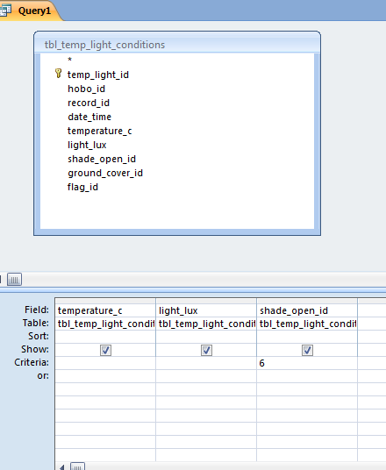
SQL
Structured Query Language
SELECT tbl_temp_light_conditions.temperature_c,
tbl_temp_light_conditions.light_lux,
tbl_temp_light_conditions.shade_open_id
FROM tbl_temp_light_conditions
WHERE (((tbl_temp_light_conditions.shade_open_id)=6));

Slide 10
Best practices
Data normalization – consistency
Unique record ID
Use authority information (Globally Unique Identifiers)
Taxonomic names (ITIS)
Geographic place names
Use Community Standards
Keywords
Units

Slide 11
GUID
http://www.itis.gov/

Slide 12
Exercise – load data
External data – text
Wizard
Format date_time column (advanced)
Allow AccessID

Slide 13
Exercise – create authority tables
Create table query
Edit table

Slide 14
Meta data
As column descriptions
In table fields

Slide 15
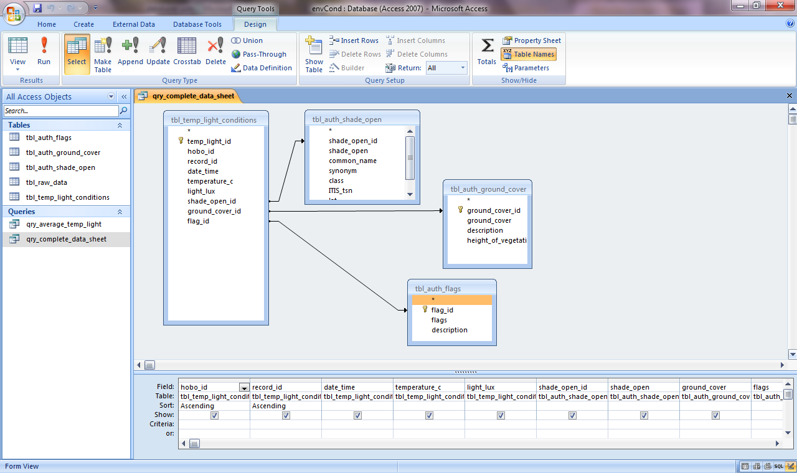
Exercise – query and export

