Slide 1
Documenting Spatial Data
Theresa Valentine
Andrews LTER

Slide 2
Documenting Spatial Data
GeoSpatial Metadata Formats
ESRI metadata editor
Automating Processes
Editing metadata help
Editing for EML
Exporting to FGDC Format
FGDC to EML Stylesheet

Slide 3
Metadata Formats
Federal Geographic Data Committee (FGDC)
http://www.fgdc.gov/metadata
ISO 19139 (international)
http://www.iso.org/iso/iso_catalogue/catalogue_tc/catalogue_detail.htm?csnumber=32557
North American Profile of ISO 19115 2003
http://www.fgdc.gov/metadata/geospatial-metadata-standards#nap
esri Metadata (ArcGIS metadata)
Ecological Markup Language (EML)
EML Best Practices: http://im.lternet.edu/node/910
EML specification: http://knb.ecoinformatics.org/software/eml/

Slide 4
esri Metadata Editor
Metadata travels with the data
Many elements are automatically populated
Geoprocessing history follows along with data (processes)
Can import and export other formats
Access though ArcCatalog, description tab.
Searchable through expanded esri search tools
You can document any object
GIS layer, model, table, document, mxd file, image, etc.

Slide 5
Editing Metadata..before you start
Open the Options dialog box for your ArcGIS Desktop application.
In ArcMap, click Customize > ArcMap Options.
In ArcCatalog, click Customize > ArcCatalog Options.
In ArcGlobe, click Customize > ArcGlobe Options.
In ArcScene, click Customize > ArcScene Options.
The Options dialog box appears.
Click the Metadata tab.
Click the drop-down arrow and click the style of metadata you want to create. (FGDC)
If you're using the Description tab when you choose a new metadata style, you won't immediately see the results of that change. Click another tab in ArcCatalog or the Item Description window, such as the Preview tab, then click theDescription tab again for the new metadata style to take effect.

Slide 6
Automating Processes
Setting up template for repeating information
text file
contact info, distribution, specific information that will be the same for each record
You can also import an existing file (say you have 12 files, one for each month) then go and edit to make changes.
Beware: Once you import, you will write over the file.

Slide 7
Automatic Update of Metadata
Open the Options dialog box for your ArcGIS Desktop application.
In ArcMap, click Customize > ArcMap Options.
In ArcCatalog, click Customize > ArcCatalog Options.
The Options dialog box appears.
Click the Metadata tab.
Choose when metadata is automatically created and updated.
Check occur when metadata is viewed to synchronize metadata when you look at it in the Description tab.
Uncheck occur when metadata is viewed so metadata will not be synchronized when you look at it in the Description tab.
You can synchronize metadata updates when you like by using the Synchronize Metadata geoprocessing tool

Slide 8
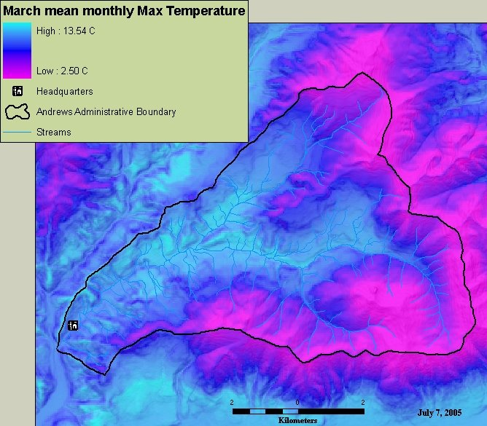
Creating Thumbnails
Create image: 200 pixels wide by 133 pixels high
Add to thumbnail for the file

Slide 9
Editing: ArcGIS help
http://help.arcgis.com/en/arcgisdesktop/10.0/help/index.html#/A_quick_tour_of_creating_and_editing_metadata/003t00000007000000/

Slide 10
Editing for EML
LTER Best Practices http://im.lternet.edu/project/Esri2Eml/docs
Zip up shapefile/.e00 file/kmz and put in location available over the web (ftp) and document the URL location for the data:
Under <distribution><digital transfer options><online resources><linkage>

Slide 11
Exporting to FGDC Format
From description tab
From the metadata toolbar in ArcToolbox
Conversion tools>metadata
Export metadata
Export metadata multiple (lets you do many objects at one time)

Slide 12
Arc Metadata Editing Demo
Add FGDC editor
Edit button
Automatic updates
Attribute data
On-line linkage
Import metadata
Export metadata
Using the toolbar tools

Slide 13
FGDC to EML Stylesheet
Process for creating LTER EML
Edit the stylesheet to meet your site needs (oxygen)
Use exported FGDC xml file
Creates new xml file
Run through the EML parser
Submit to Metacat or other search engine

Slide 14
Exercise:
Open ArcCatalog
Customize editor for FGDC
Create template
Repeating information: sample:
Import template
Edit Metadata
Create Thumbnail
Create image in arcmap, save and import
Export to FGDC xml file
Run through esri2eml stylesheet
Use EML parser to check for errors

