Slide 1
IM for Multi-Investigator Collaborations
Corinna Gries
NTL LTER

Slide 2
Information Management for Communication
Within one project
Between sites
Between disciplines
For field site management

Slide 3
Situations
One sample different measurements by different people
One measurement different people over time
One measurement different people in different places
Many measurements different people in one place and time
Many measurements different people in one place over long time

Slide 4
One sample different measurements by different people
Chemical analysis on sample
Bottle ID, sample ID, Barcode
Date, time, sample protocol, sample taker
Tracking sheet
LIMS (laboratory information management system)
Protocols
Calibrations
Notes:
LIMS: requesting vs. authorizing
Scheduling
Which analyses have been done
Integration with instruments and final database

Slide 5
One measurement different people over time
Typical LTER situation
Protocol versioning system
Instruments
Calibrations
Field sheets/data entry application
Keeping track of who made observation or measurement
Database keeping track of protocol versions for each data point or data series

Slide 6
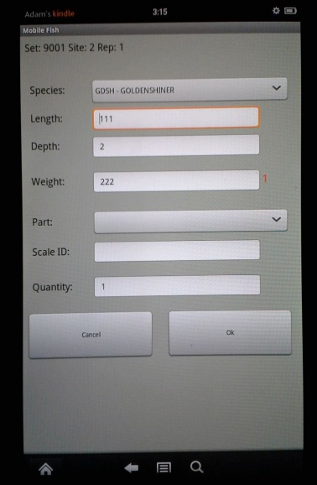

Slide 7
value_id | value | variable_id | method_ id | calibration_id | quality_ control_ level
5467889 | 7.5 | 2 | 6 | 9 | 1
variable_id | description | unit
2 | Dissolved oxygen | ppm
method_id | description
6 | sonde XYZ
calibration_id | date | description
9 | 2012-05-24 | …..
quality_control_level | description
1 | Raw data

Slide 8
One measurement different people in different places
Cross site experiments
Protocols
Sampling
Data handling
Field sheets
Central database
Data model
Flags
Training for database use or service
Notes:
Data model for highest data quality control
General good data base design practices (normalization, authority tables)
Don’t discard data – flag them
Agree on meaning of flags

Slide 9
date | location | species | count
2012-05-01 | 12 | 536 | 5
2012-05-01 | 12 | 674 | 10
2012-05-01 | 12 | 865 | 20
2012-05-01 | 12 | 657 | 4
date | location | species 1 | species 2 | species 3 | species 4
2012-05-01 | 12 | 5 | 10 | 20 | 4

Slide 10
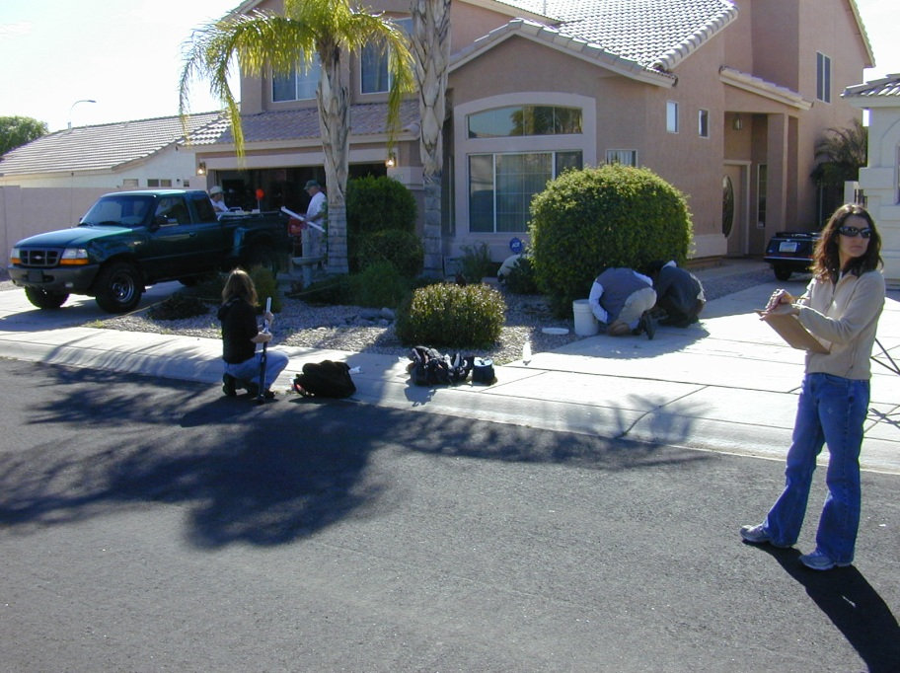
Many measurements different people in one place
Multi-investigator field campaign
Research cruises
Field sheets
Event tracking in multiple places
IM to communicate between disciplines
E

Slide 11
Many measurements different people in one place over long time
Typical field station/site
Project management
Event tracking
Locality tracking
Cleanup management
Notes:
One experiment should not destroy another
burning schedule
Co-locating for comparable data
Equipment no longer in use?

