Slide 1
LTER GIS Working Group Update
Adam Skibbe and Theresa Valentine
2012 June Water Cooler

Slide 2
Working Group Activities
Terms Of Reference
LTERmapS workshop (Nov 2011)
GeoNIS workshop (Feb 2012)
Databits GIS edition (May 2012)
ASM workshops
Data and Tools for the LTER (resources)
GeoNIS (during IM meeting)
Training proposal
Geospatial Analysis Committee Coordination

Slide 3
Terms Of Reference
Draft on-line
Provides recommendations on geospatial issues, develop workshop plans, identifies training and data/software/hardware needs, and develops cross site supplement plans in support of the GeoNIS.
Reporting: meeting notes are documented on IM portal, regular reports are communicated to the IMExec representative, and annual report given to IMC via VTC water cooler and at annual IMC meeting.
Coordinates with the LNO staff and the Geospatial Analysis Committee.

Slide 4
LTERmapS Workshop
Highlights:
Met with Mark Servilla and came up with a conceptual diagram of where the GeoNIS fits into the PASTA framework:
Settled on a front end application framework and started building template.
Core data: worked on getting DEM data into a common format and set up image service to provide data in web service.
Converted LTERmapS version 1 to latest Google Maps version (Travis Duce from GCE did this work).
Sandbox server up and running at LNO with appropriate software and permissions
Developed plan for next steps.
Meeting report on line@ http://im.lternet.edu/sites/im.lternet.edu/files/Report%20from%20the%20LTERMapS%20Product%20Oriented%20Workshop.docx

Slide 5
GeoNIS
The LTER NIS (Network Information System) PASTA framework is intended to be a repository for all network datasets, harvested via EML, and stored on centralized servers. The PASTA framework is tabular centric. The GeoNIS, a module to the NIS, is intended to specifically address geospatial data. Using a similar framework to PASTA, the GeoNIS will properly store data, as well as offer a series of value added products that can assist in their use.

Slide 6
GeoNIS Workshop
11 sites represented
Further conceptualized GeoNIS
Detailed look at each component in workflow
Developed best practices for documenting LTER spatial data
Sites worked on creating EML valid documents
Began development of workflows for ingesting site data into the GeoNIS

Slide 7
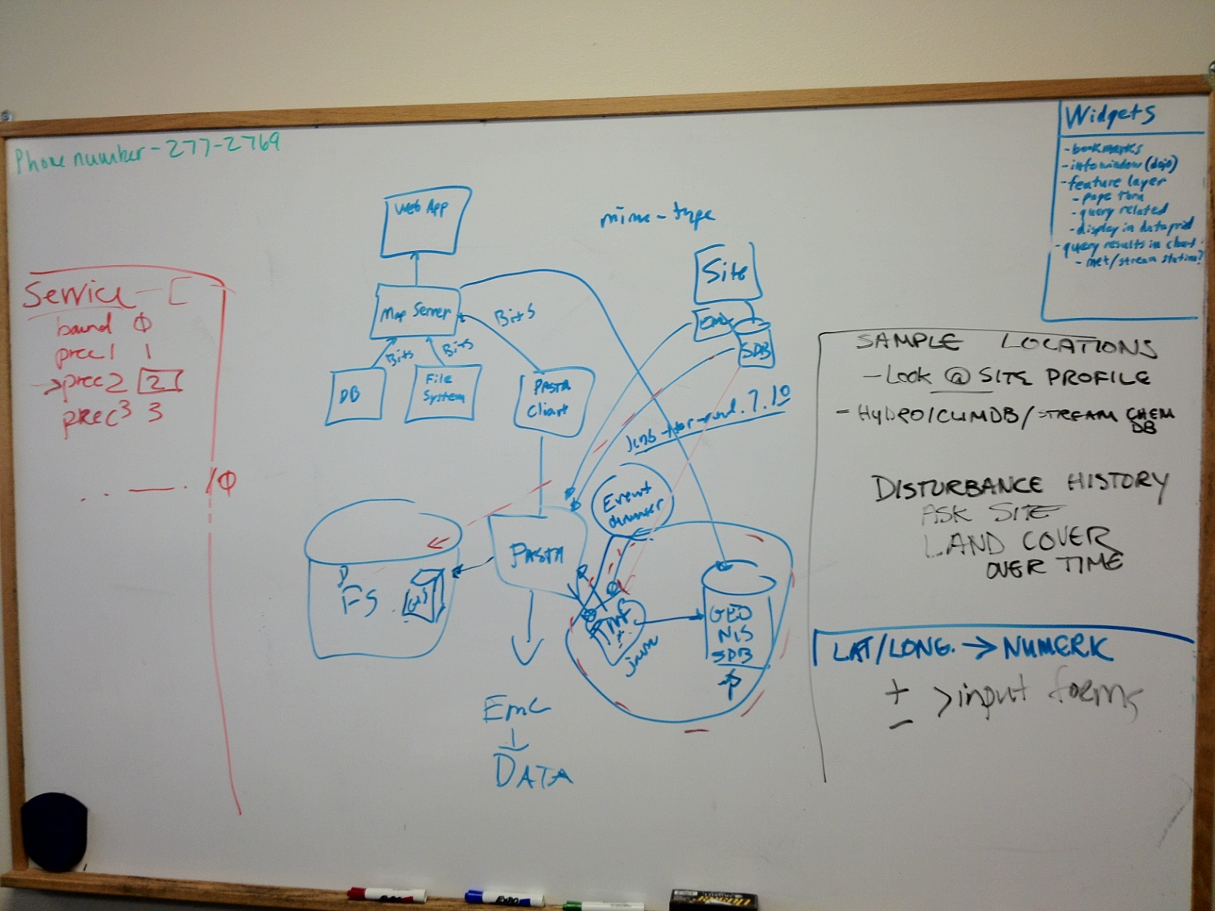
GeoNIS Progression

Slide 8
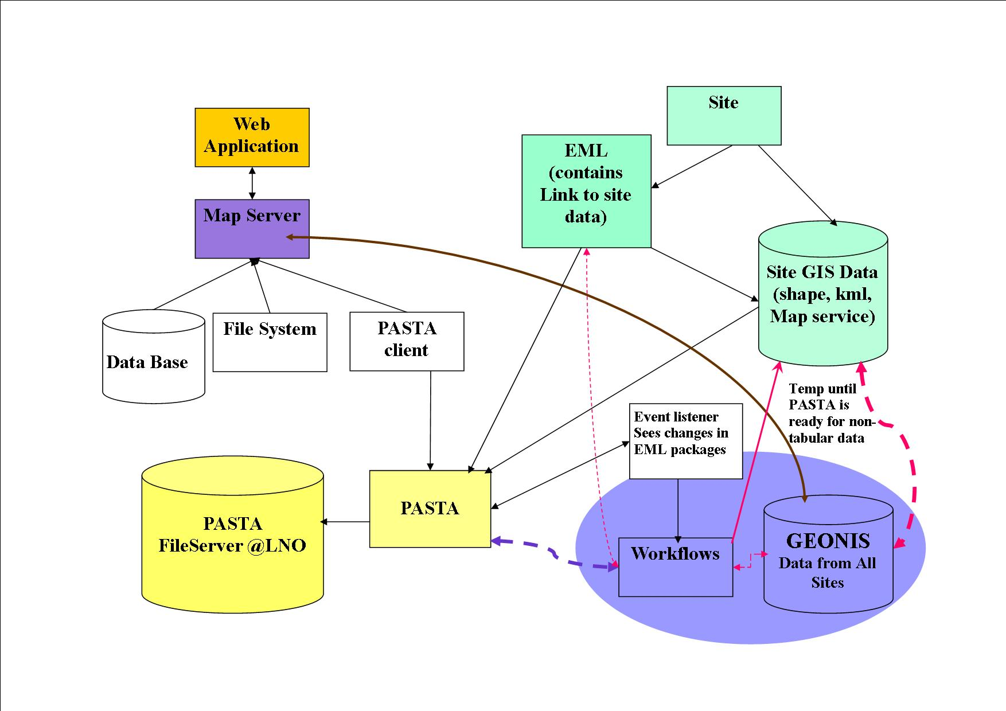

Slide 9
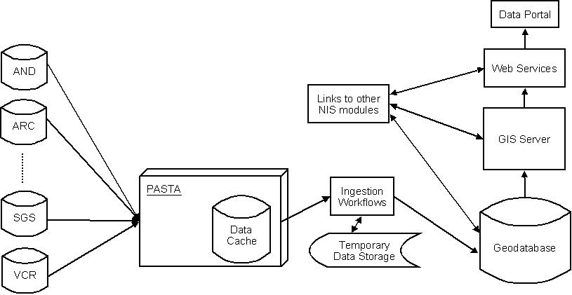
GeoNIS with Pasta

Slide 10
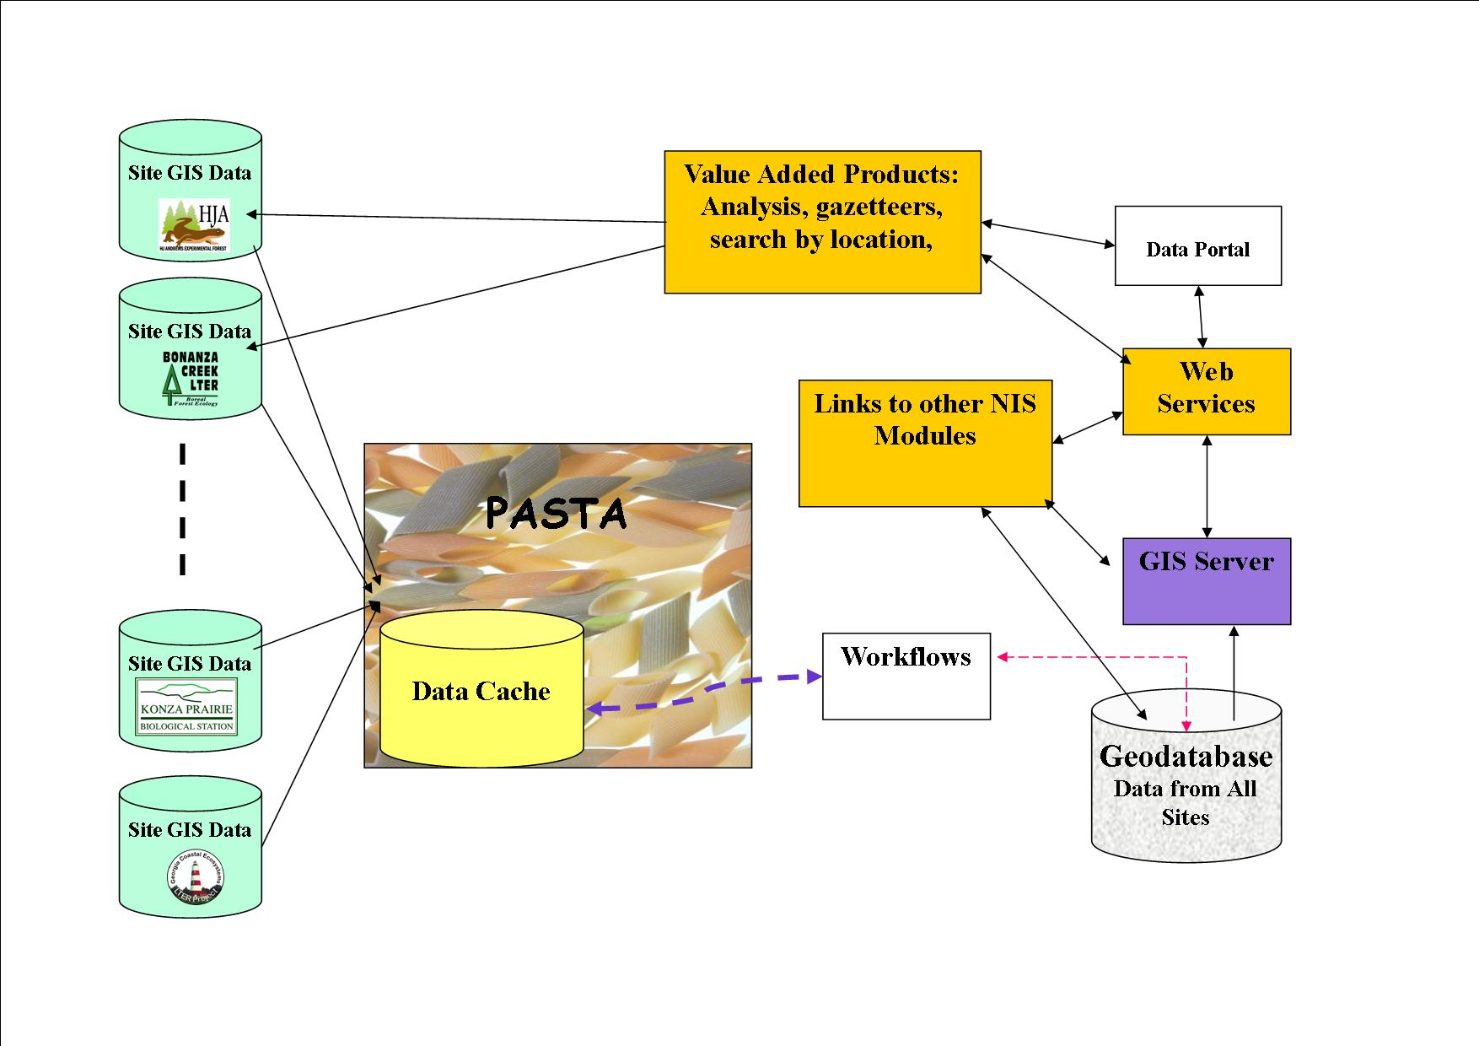
With a Little More Color

Slide 11
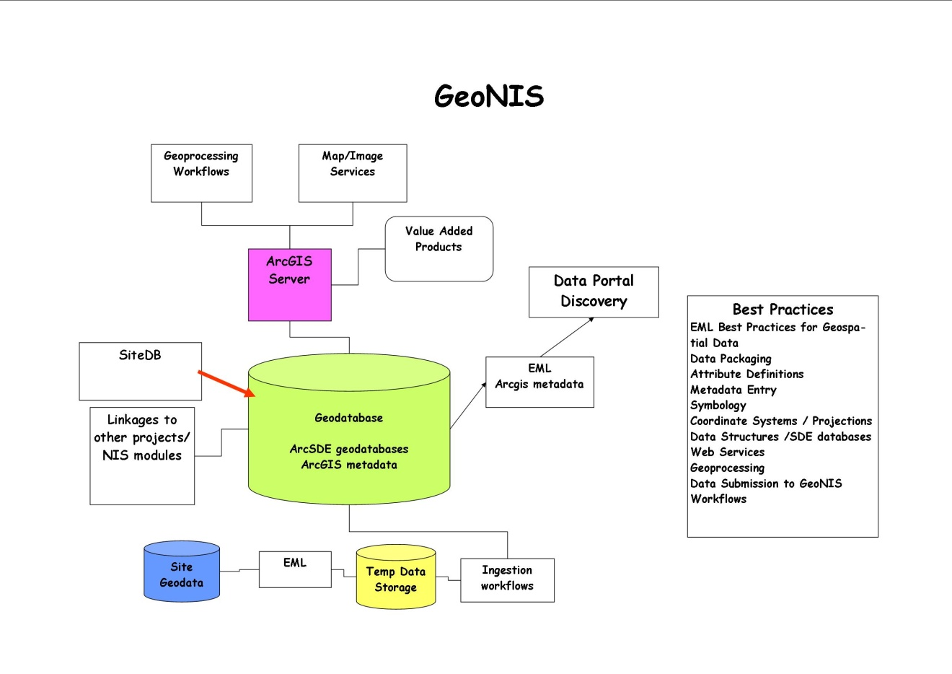

Slide 12
DataBits Geospatial Edition
Geospatial Content from
Hope Humphries and Patrick Bourgeron,
Ken Ramsey
Theresa Valentine
Inigo San Gil
Adam Skibbe
Aaron Stephenson
Jamie Hollingsworth
Hard copies distributed at science council
Released May 2012 to much anticipation and rave reviews

Slide 13
ASM Workshops
GIS Data and Tools for the LTER: resources for site research and synthesis
Discussion on available LTER and non-LTER data
Available and common tool for access and use
Gauge interest and need of community on data products and accessibility
Working group would like time on IM meeting agenda for discussion on GeoNIS with IMC, and working group time.
Spatial Analysis Committee will be proposing a workshop, most likely on LiDAR

Slide 14
Training Proposal
Will be submitting a training proposal on web services (access to the GeoNIS database), perhaps in connection with web services group.
(Fall 2012 proposal period)
Other suggestions welcome (and encouraged!)

Slide 15
Geospatial Analysis Committee Coordination
Theresa Valentine co-chair with unknown at this time…
Looking at a cross site project using LiDAR to calculate biomass
Expect to have a workshop at ASM.

Slide 16
Coordination Efforts
Met with Stream ChemDB group to talk about geographic framework for their project.
2 members on SiteDB committee
GeoNIS component of IM supplement to further develop various components of project
Each site involved allocated funds for a particular task
Participation in LTER Precipitation Uncertainty synthesis workshop @ Andrews in May (Adam)

Slide 17
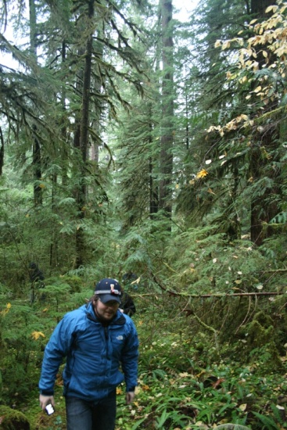
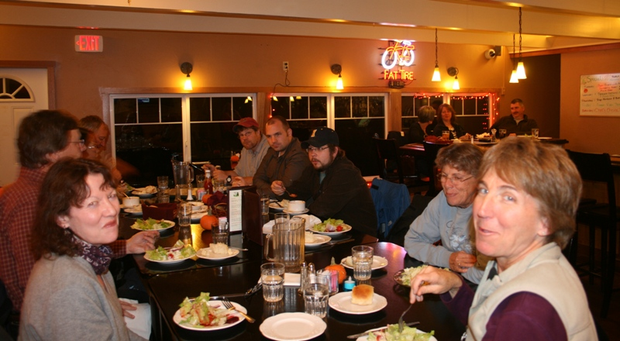
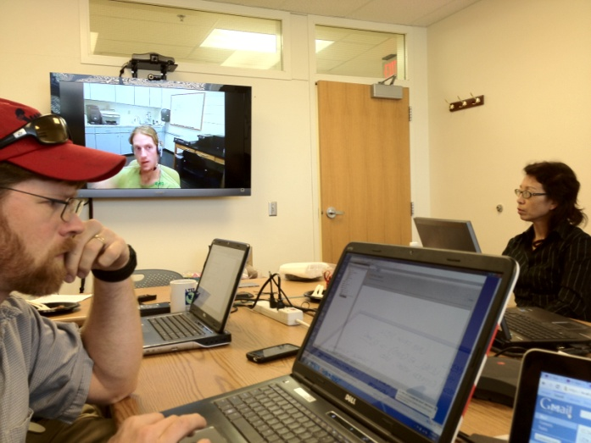
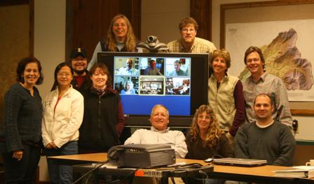
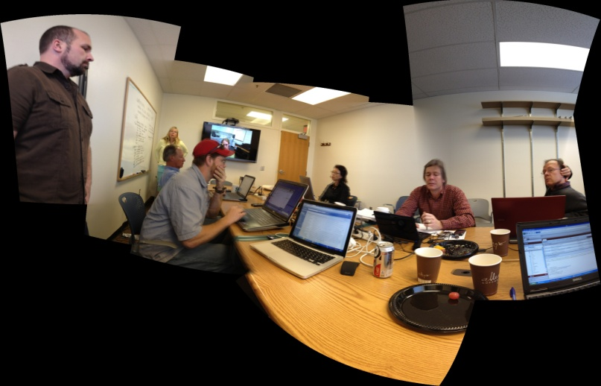
Encourage site GIS/Remote Sensing staff involvement in working group

Slide 18
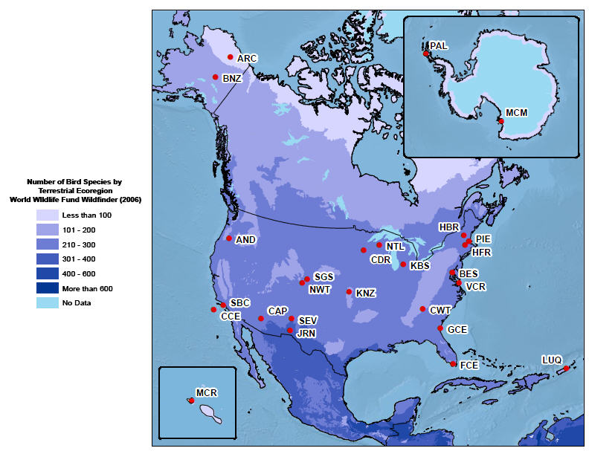
Questions/Suggestions/Ideas?

