Slide 1

LTER, PASTA, and persistent identifiers
LTER IMC Water Cooler Series
10-11 January 2011

Slide 2
Water Cooler Objectives
  Inform
  Discuss
  Listen

Slide 3
What is a persistent identifier?
  Persistent identifiers are used to uniquely identify a resource (digital object) on the Internet or other network
    "Persistent" such that the resource is addressable regardless of its physical location (notwithstanding security issues)
    "Unique" such that the identifier addresses only a single resource within a given scope

Slide 4
Persistent identifier schemes
  Handle System/Digital Object Identifiers (DOIs)
    protocol:prefix/suffix
    e.g., DOI:10.1045/193 or http://dx.doi.org/10.1045/193
  Life Science Identifiers (LSIDs)
    urn:lsid:authority:namespace:object:revision
    e.g., urn:lsid:gdb.org:GenomicSegment:GDB132938
  Persistent Uniform Resource Locators (PURLs)
    Uses HTTP response code 302 (simple redirect) and redirect to source URL
    e.g., http://purl.publisher.com/journal/article_id

Slide 5
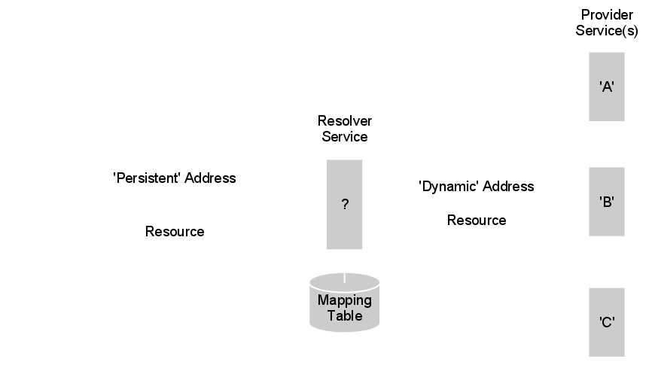
Similar approach in all schemes

Slide 6
Persistent Identifiers and LTER
EML PackageID = Scope.Identifier.Revision
  Scope: a string that logically binds the EML document to a particular namespace
  Identifier: a positive integer that is used as an 'accession number' to uniquely identify the EML document as describing a specific data set within a particular namespace
  Revision: a positive integer that represents the state of an EML document

Slide 7
Persistent Identifiers and PASTA
  Decompose the EML PackageId into RESTful URI patterns
<context>/<scope>/<identifier>/<revision>/[entity_name]
  Full URI pattern with service
Metadata: metadata/eml/<scope>/<identifier>/<revision>
Data: data/eml/<scope>/<identifier>/<revision>/<entity_name>

Slide 8
Persistent Identifiers and PASTA
1. Read an EML document with packageId "knb-lter-lno.235.4":
https://pasta.lternet.edu/metadata/eml/knb-lter-lno/235/4
2. List all revisions for EML document "knb-lter-lno.235":
https://pasta.lternet.edu/metadata/eml/knb-lter-lno/235
3. List all revisions for EML document "knb-lter-lno":
https://pasta.lternet.edu/metadata/eml/knb-lter-lno
4. Read data entity "my_data" associated with packageId
"knb-lter-lno.235.4":
https://pasta.lternet.edu/data/eml/knb-lter-lno/235/4/my_data
5. List all data entities associated with packageId
"knb-lter-lno.235.4":
https://pasta.lternet.edu/data/eml/knb-lter-lno/235/4

