Slide 1
Concept Classification
John Porter
With special thanks to Jennifer Roper, UVA Librarian

Slide 2
Goal
Improve Searching & Browsing
Reliability (of all the suitable target documents, what percentage did you find)
Efficiency (of the documents your search returned, what percentage were suitable)
A truism: about the best you can do is 60:40, either way
Valuable Resource: Guidelines for the Construction, Format, and Management of Monolingual Controlled Vocabularies - ANSI/NISO Z39.19-2005
http://www.bib.ub.edu/fileadmin/fdocs/ansiz39.pdf

Slide 3
Structures
List | Synonym Ring | Taxonomy | Thesaurus | Ontology
=
=
=
=
Complexity

Slide 4
Types of Structures
Lists
Synonym Rings
Deal with equivalence for the purposes of searching: tree=trees
Taxonomy
Hierarchical relationships – broader and narrower terms – parent-child relationships
Multiple taxonomys comprise a polytaxonomy
Thesaurus
Add related terms (brother and sister terms)
Ontology
Complex relationships

Slide 5
Taxonomys – Rules of the Road
Relationships should be independent of context
Each taxonomy should include only one type of entity (listed in Z39.19 2005 section 6.3.2)
Things and their physical parts (birds, trees, leaves)
Materials (wood, nitrogen, sand)
Activities or processes (acidification, production)
Events or occurrences (germination, death)
Properties or states of persons, things, materials or actions (age, speed, nitrogen content)
Disciplines or subject fields (ecology, ornithology)
Units of measurement (m, km, miles)
Unique entities (LTER,HJ Andrews Forest)
You can get into trouble if you start “mixing and matching” things within a single taxonomy

Slide 6
Examples
Good | Bad
Forests Boreal Forest Hardwood Forest Grassland Tallgrass Praire Tundra | Forests Fire Ecology
OK – these are all the same type of entity | Mixing THINGS and PROCESSES and DISCIPLINES
Rodents Mice Rats | Desert Plants Cacti Grasses
OK – Is not dependent on context. Mice and rats are ALWAYS rodents | Problem: Context dependent, not all cacti or grasses are desert plants. Some occur in other systems. Fails “Some-not-all” test.

Slide 7
LTER Controlled Vocabulary
Currently a list
EML keywords used at two or more LTER sites
We would like to create a polytaxonomy, with associated synonym rings (non-preferred terms) to link these keywords into a browseable structure that will also help enhance searches

Slide 8
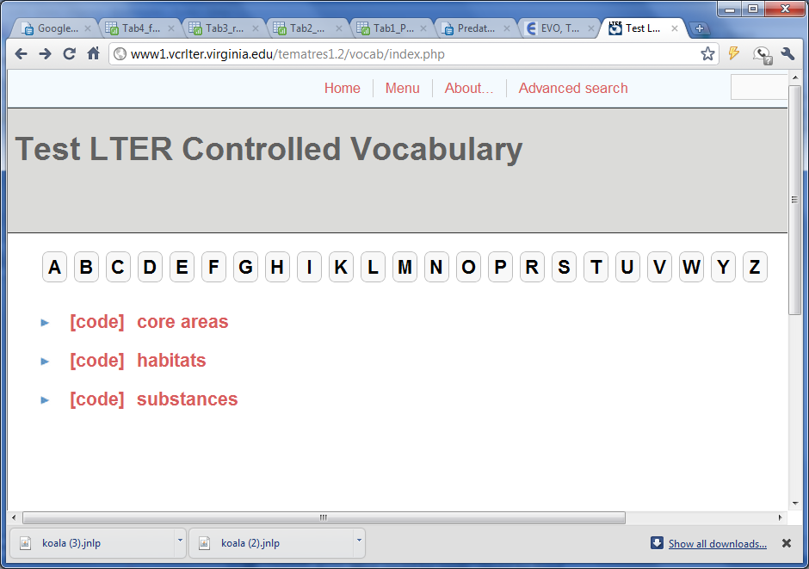
A variety of tools of varying cost and complexity are available. “TemaTres” is an open-source, web-based tool we are currently using to start developing a simple polytaxonomy

