Slide 1
LTER Controlled Vocabulary Virtual WaterCooler - July, 2018

Slide 2
VTC - Objectives
Set stage for working groups and panel discussions of lexical tools (including the controlled vocabulary) at the 2018 LTER All-Scientists’ Meeting
Goal: “Scientists seeking data should be able to efficiently and reliably locate Ecological datasets through searching, and browsing …“

Slide 3
Why not be Eclectic? Pick your own words?
Eclectic use of terms to used for discovering data makes it difficult to perform reliable or efficient searches
Often several terms for one concept
One site uses CO2 another Carbon Dioxide, another Carbon-dioxide
Carbon to Nitrogen Ratio, C:N, C:N Ratio, Carbon-to-nitrogen Ratio
No way to relate broader terms with narrower terms
Searching on “Landscape Change” doesn’t find data sets related to “desertification” even though desertification is a kind of landscape change

Slide 4
Goals for Development of THE LTER THeSAURUS
Identify a list of preferred terms that would be used by sites in creating metadata documents
Focused on LTER-wide searches
Want to facilitate cross-site synthesis
People searching EDI rather than individual sites are interested in relevant data from multiple sites
Wanted to hit the “sweet spot” for the number of terms (currently have ~700 terms)
Too many terms make keywording documents difficult, and results in searches with too few datasets
Too few terms make it hard to locate usably small numbers of datasets

Slide 5
Steps Taken (2011 & 2013)
Assembled list of words already in LTER Metadata (EML documents)
Selected using criteria:
Keywords shared with GCMD and NBII, or
Keywords used at more than one LTER site
Reviewed by Information Managers
Removals and additions were suggested
Edited based on voting

Slide 6
Some STATISTICS (new)
96% of LTER Data Packages contain one or more terms found in the thesaurus
Important for browsing! Only 4% can’t be browsed
9X Data - Simple searches using terms in the thesaurus return a median of 18 datasets (non-thesaurus terms return only 2)
5X Sites - Searches using terms in the thesaurus retrieve data from a median of 5 sites (non-thesaurus terms return data from only a median of 1 site)
Of the 824 terms used for 5 or more data packages at 2 or more site, 632 (77%) are in the Thesaurus

Slide 7
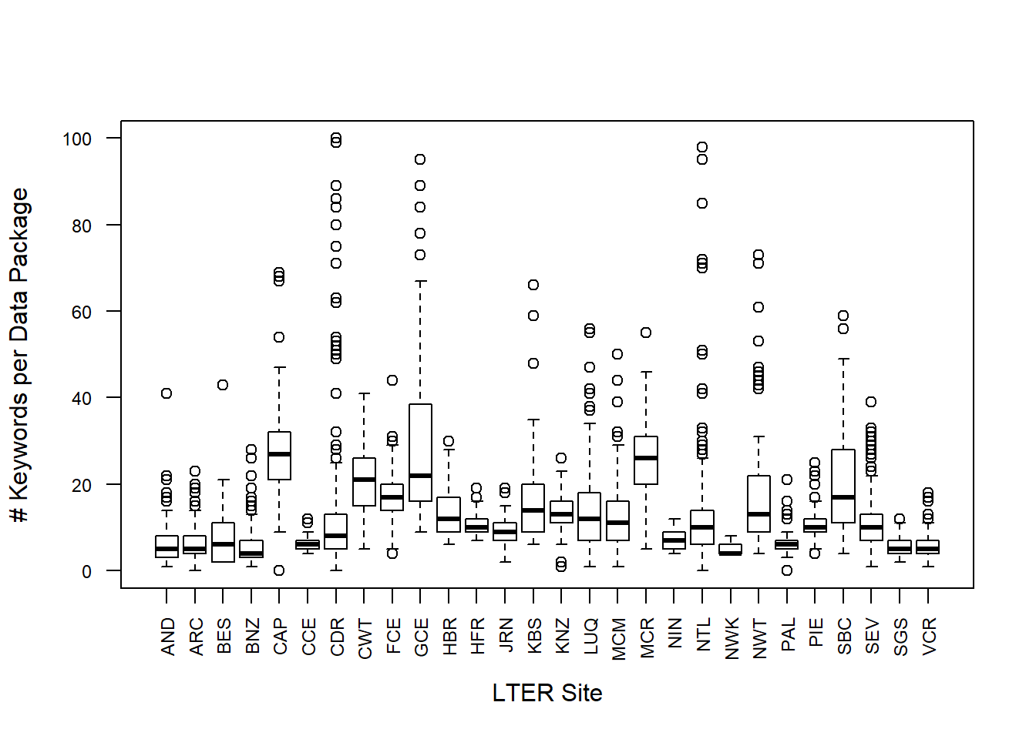
KEYWORDS USED ACROSS SITES
Truncated at 100, the max is 295 (mostly species names)

Slide 8
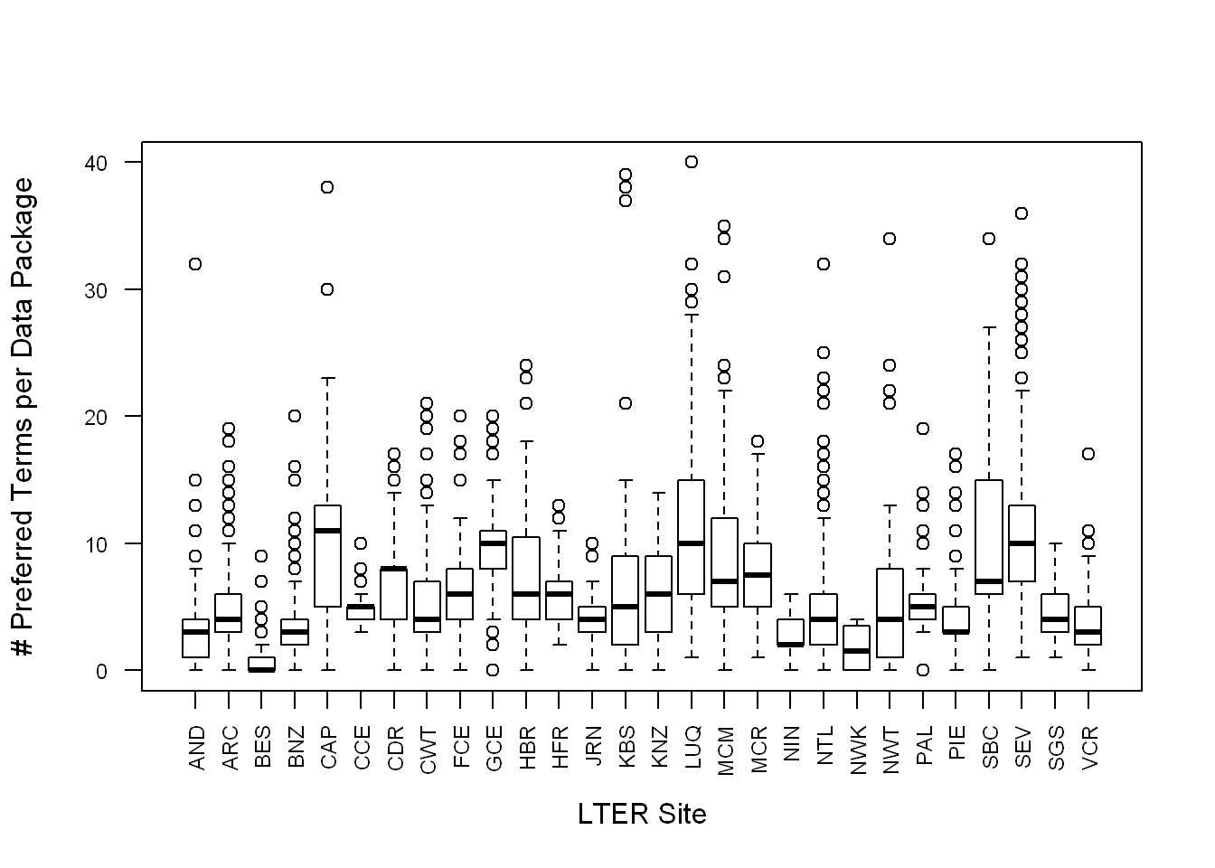
Preferred Terms Across Sites
The median number of preferred terms per dataset is 5

Slide 9
Recent Activities
Statistical Analysis of Keywords in LTER documents
Survey requesting information on how keywords are incorporated into LTER Data Packages
IM’s play lead role 77% of the time, researchers 23%
Identification of additional candidate terms
Only 192 frequently used terms are NOT in the Thesaurus
Many are synonyms of terms that are already in the thesaurus, or places or taxonomic terms

Slide 10
Lexical Structures
Goal: Improve Searching & Browsing
Reliability (of all the suitable target documents, what percentage did you find)
Efficiency (of the documents your search returned, what percentage were suitable)
A list alone is not sufficient to support browsing and sophisticated searching of data – more structure is needed

Slide 11
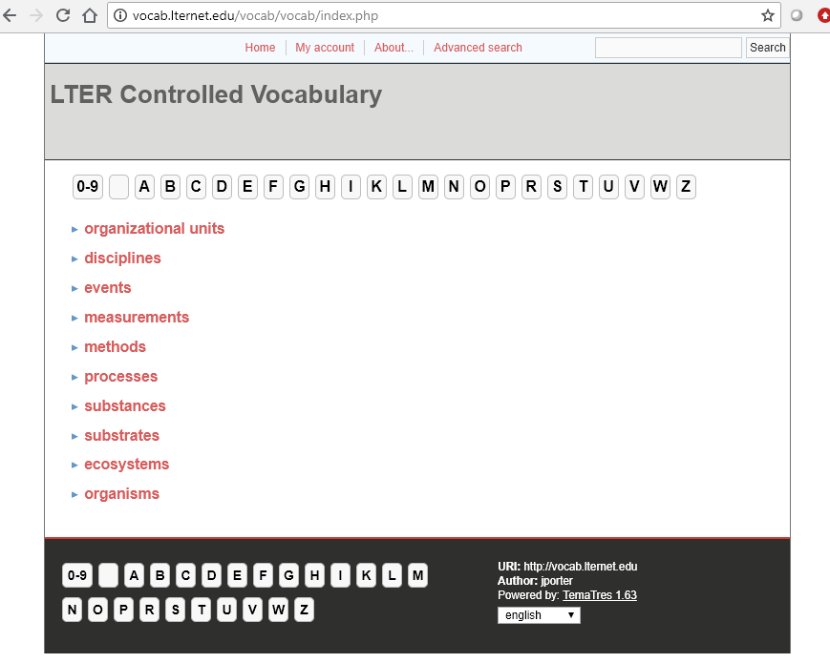
Currently the LTER Controlled Vocabulary is contained in a Thesaurus
Synonyms (use-for terms)
Broader -> Narrower
A few non-hierarchical relationships
Integrated into PASTA
Browse search
Advanced searches
Has been incorporated into EnvThes and some other thesauri
Web services for aiding searching and selecting terms are available

Slide 12
Structures
List | Synonym Ring | Taxonomy | Thesaurus | Ontology
LTER Status
=
=
=
=
Multiple taxonomys are a Polytaxonomy
Complexity

Slide 13
ISSUES FOR THE ALL-SCIENTISTS’ MEETING
Do we need to move to use of an Ontology or other lexical structure?
Should we abandon the LTER Controlled Vocabulary in favor of another, existing resource?
If not, what upgrades are needed (updated software, additional terms)
How do we deal with place names (Gazeteer), and Taxonomic Names as Keywords?

Slide 14
THANKS!
Members of the Controlled Vocabulary Working Group have all made major contributions to the work of the group.
Henshaw, Donald; Jones, Julia; Laundre, James; Ruess, Roger;
Downing, Jason; Costa, Duane; Servilla, Mark; San Gil, Inigo; Brunt, James; Melendez-Colom, Eda; Crowl, Todd; Gries, Corinna; O'Brien, Margaret; Vanderbilt, Kristin; and Porter, John

