Slide 1
EML Dataset Congruency Checker
Congruence: agreement between data and metadata
2009 ASM
2010 IMC Annual meeting
Data Manager Library (code)
Part of PASTA Data Manager module, first iteration web services accepted by Tiger Team, July 2011
Other checks to be part of Metadata Manager module
IM Buy-out 2011 to create first reports for all sites
Projects> Congruency Checker > Meeting Notes > 2011 plan
(http://im.lternet.edu/node/894)

Slide 2
EML Metrics
Classification:
System
KNB: any package
LTER: apply only to LTER
Type
Data
Metadata
Congruence
Status
Valid
Error
Warn
Info
A Google-doc collects
the list of EML features to check ("requirements"):
Requested by developers
Requested by the IMC
Refined by the Tiger Team
Totals ~35 to date

Slide 3
Five checks in V 0.1
1. data URL is 'live'
2. display data from the URL
3. database table can be generated
4. Data can be loaded into the database table
5. Compare number of rows loaded to number specified in metadata

Slide 4
PASTA - ready?
Data can be read automatically from the EML metadata

Slide 5
EML Dataset Qualification
Error-free Metadata-data congruence
Error-free data
PASTA ready
Complete Metadata
2011: any EML data package

Slide 6
ECC v0.1
Error-free Metadata-data congruence
Error-free data
ECC
V0.1

Slide 7
Errors must be defined case-by-case
First: Structural
Later: Scientific
Error-free Metadata-data congruence
Error-free data
PASTA ready
2014 | PASTA production system
2012 | PASTA functional prototype
2011 | First checks of congruence
<=2011 | Any EML data package
Synthesis | QA/QC Std Attributes Units
Evaluation | Abstract Methods
Discovery | Keywords Coverage
Complete Metadata
2011: any EML data package

Slide 8
ECC V 0.1 Capabilities
Reads dataTables
- from a URL at the entity-level only (SBC)
- URL from the DAS (GCE) - ECC server is white-listed (MCR)
Cannot yet read:
1. data <inline>
2. data specified by <connection>
3. a URL at the dataset level

Slide 9
DataManager Reports
DataManager web service has 2 modes
Default mode: submit a data package for cataloging
evaluate mode: data package not cataloged
cURL: command line tool for exchanging files using URL syntax
Send the web service a data package:
curl -i -X POST -d 'http://metacat.lternet.edu/knb/metacat/knb-lter-mcr.8.19' http://data.lternet.edu/data/eml?mode=evaluate
Retrieve the report:
curl -G http://data.lternet.edu/data/eml/NIS-knb-lter-mcr/8/19/Percent+cover/report?mode=evaluate

Slide 10
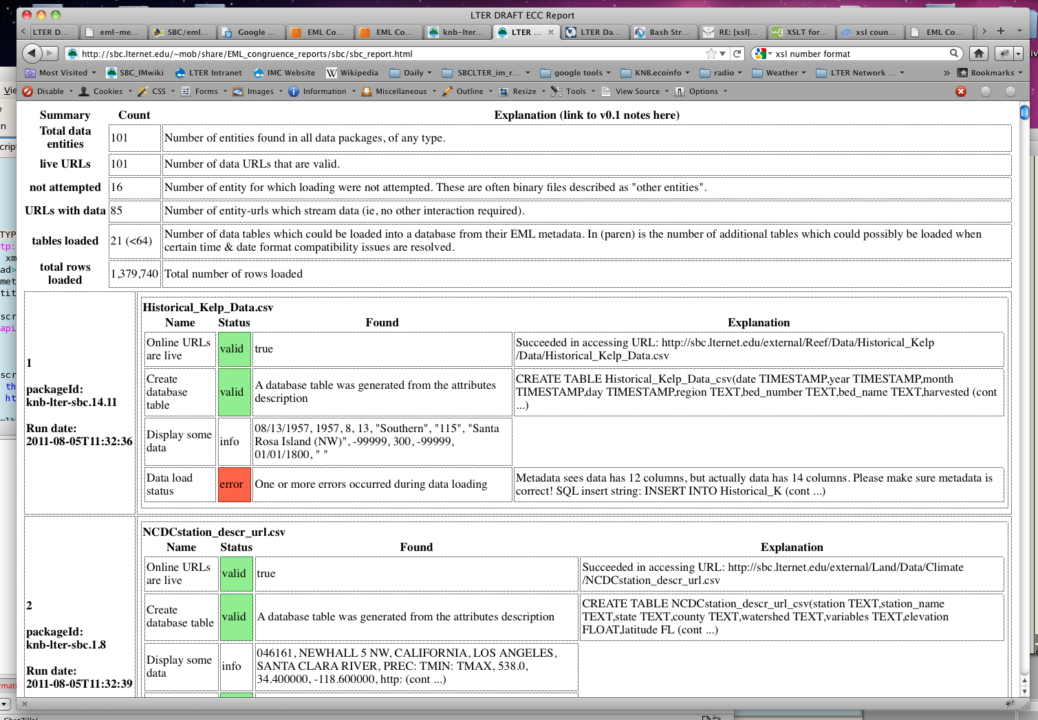
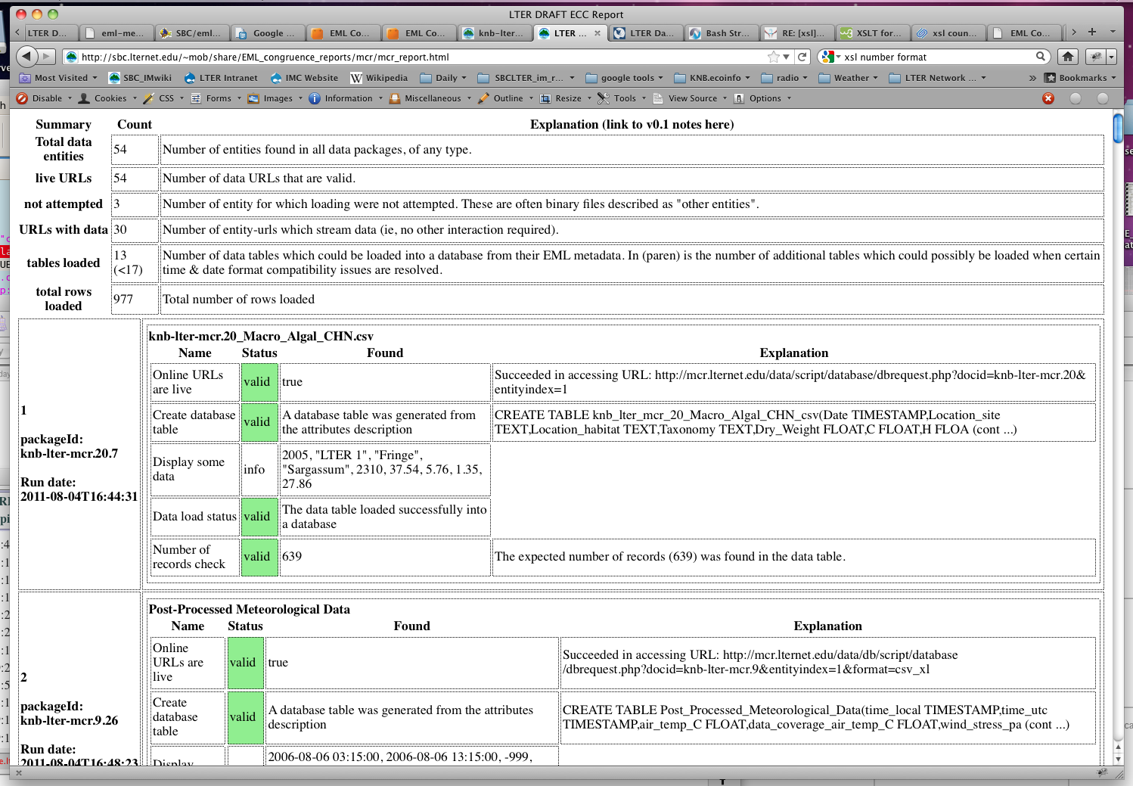
Sample reports:
http://sbc.lternet.edu/~mob/share/EML_congruence_reports/sbc/sbc_report.html
http://sbc.lternet.edu/~mob/share/EML_congruence_reports/mcr/mcr_report.html

Slide 11
Report Schedule - 2011
August:
access data URLs in EML metadata currently in the NIS Metacat catalog
Sept 1:
draft baseline reports sent to both the Network and sites
Sept, IMC meeting:
report and/or break out session for feedback or discussion
Dec 31:
final baseline report sent to network and sites

Slide 12
Code
Two bash scripts:
1. for a list of docids, create reports in evaluate mode, store the "report URL" that the web service returns (one URL for each data entity)
2. retrieve a report for each data entity URL, combine into one report ("report.xml" file)
One XSL stylesheet:
create HTML report for all data entities in the report.xml

Slide 13
Anticipated Process
Query Metacat for docids
For each site
1. alert site that reports will be created (apologies to Wade)
2. create reports (can be very slow)
3. retrieve reports
4. process report XML to HTML
Send to site (SIM and LPI)
1. xxx_report.html
2. xxx_report.xml
3. list of docids checked

Slide 14
To be determined:
1. "Baseline reports"
-- Baseline for what?
2. Aggregated Metrics
-- What features of datasets should be summarized for all sites and reported to the network?
-- What level of privacy?
-- Timing?
Policy issues belong with the EB/NISAC
- with IMC input -

