Slide 1
EcoTrends
THE GOOD,
THE BAD AND
THE UGLY
(and lessons learned along the way)
OR
THE GOOD,
THE BETTER AND
THE BEST
(as JP might say)
Christine Laney

Slide 2
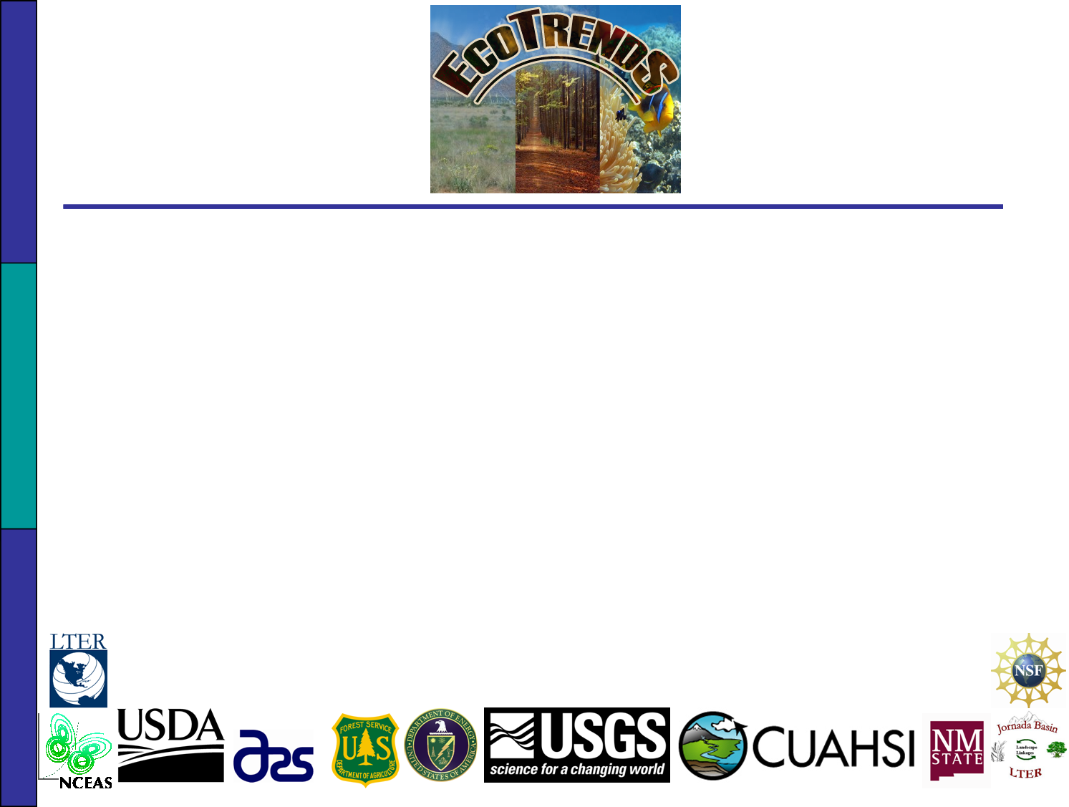
The Cast
Multiple agencies, 50 research sites
PIs and IMs, and anyone else invited to participate within each site
Editorial and technical committees
Jornada: Debra Peters, Ken Ramsey, students
LNO: Mark Servilla, Duane Costa, James Brunt, Inigo San Gil

Slide 3
EcoTrends: A recap
Goal: Make long-term ecological data from several agencies available and quickly comparable via two individual but complementary resources – a book and a website (http://www.ecotrends.info).
Opportunity to display the breadth and depth of LTER long-term data to researchers and NSF.
Audience: ecologists and other scientists, educators, college students, land managers and policy makers (or staffers).
Half of the participants are LTER sites, providing ~85% of the data.

Slide 4
EcoTrends: A recap
Asked sites (via PIs) to submit datasets under 5 themes – any format, any level of documentation.
Additional data from other resources (NADP, NCDC, CLIMDB, socioeconomic data)
Aggregate ‘raw’ data to standard time steps and store in same format with standardized file names (using R).

Slide 5
EcoTrends: A recap
Store information about the sites/stations, data and metadata documents, PIs/owners and the derivation processes in Jornada-based database.
Maintain communications between Jornada and LNO servers; import derived data into database and generate EML for derived data products using a combination of the file name nomenclature and information in Jornada-based EcoTrends database
Communicating with PIs and IMs at sites to address questions/problems.
Notes:
Tables in the relational database keep track of information about and relationships between
Source data files
Source data documentation files
Derived data files
Scripts used to generated the derived data files from the source data files
Information about sites, stations or locations, PIs/data owners, etc.
Other information important to the book (plots and plot generation scripts, etc)

Slide 6
EcoTrends: A recap
Generating standard time-plots, maps, summary tables, and specialized summary plots. Formatting book layout.
Thematic chapters written by subgroups of editorial committee.
Checking work with PIs and IMs:
  Write 2-page site descriptions with site-specific figure
  Check for major errors in book introduction
  Check off on biotic and disturbance chapters – specialized plots
  Check off on standardized climate, biogeochemistry and human population/economy plots & associated information.
Future schedule: meeting Feb/March to finalize book layout/content (publish summer 2009) and line up next steps for website.

Slide 7
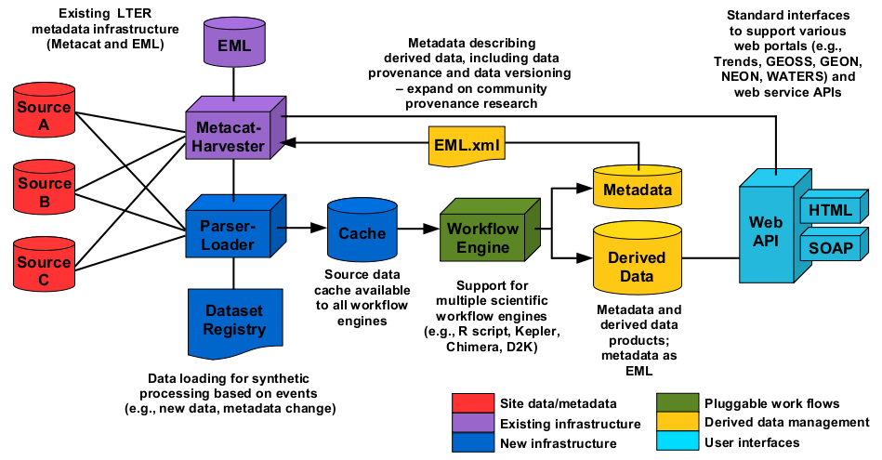
PASTA Framework

Slide 8
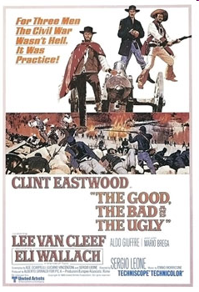
It’s not hell, it’s practice!
Collaborative synthesis work is increasing as are the number of data repositories that hold significant amounts of data from across large regions
Where are our strengths and weaknesses among and between all 26 LTER systems?
What can we learn from this process, and how can we make future projects or extensions of EcoTrends better and more efficient?
What are the most important implementation steps that can be taken right now?
Notes:
John Porter: if you were a computer scientist, you wouldn’t have taken this project on.

Slide 9
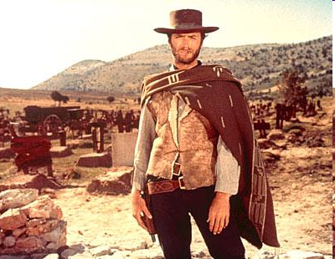
The Good
“Two hundred thousand dollars is a lot of money. We're gonna have to earn it.” - Blondie
Lots of data from across the US and beyond
LTER data is most available and well-documented, and access is improving all the time.
CLIMDB has been useful
Provided an opportunity to pull together population and economy data: 2 websites and ways of viewing the data, 800 counties (to date), 32 variables.
The website is up and running, >23000 datasets, with positive feedback & helpful suggestions
Teachers like it!: quick, efficient, and clear
We have great tools to help with data processing and communication
Notes:
Teachers: ~25 undergrad educators – ESA-NEON workshop, Oct 2008
We have a better sense of what the network has (and doesn’t have). EML is working by providing a framework to produce complete metadata, not random bits of information. I’ve noticed that without a standardized framework like EML, there are lots of gaps in the metadata – methodology, people involved, definition of variables and units, etc.
– started building modules and are interested in developing an online portal to sites where teachers can find long-term data.
Tools: R, MS SQL server,

Slide 10

The Bad (or better opportunities)
You're smart enough to know that talking won't save you. - Angel Eyes
Data documentation: still incomplete and error-prone (and difficult to communicate these problems back to the sites)
Problems with using CLIMDB data: lack of updating and/or documentation
Problems with site data: awkward formats, errors, changes, etc.
Data derivation still incomplete
Juggling and organizing:
  files and associated information within and between Jornada & LNO
  changes to source data/websites/data systems
  inter-site communications
Intra-site communications (PIs – IMs – other researchers)
Researchers and teachers want more: customizable plots, inclusion of spatial data, easy access to the source data
Errors made in data derivation process due to lack of foresight here, lack of complete information, or errors in data.
Notes:
CLIMDB data often not as well documented or as frequently updated
- logistical challenge. Solution: database, dotproject, ??. Challenge: keep the project updated, transparent, useful, relevant, flexible.
Communicating with sites and keeping track of these communications (checking off work, asking questions about the data and metadata, dealing with rotations of PIs and IMs)
Researchers and teachers want more: customizable plots, inclusion of spatial data, easy access to the source data (comparability, teach both data manipulation/ecoinformatics and ecological concepts)

Slide 11
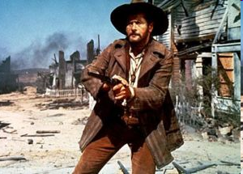
The Ugly (or really great challenges)
If I get my hand on the two hundred thousand dollars, I'll always honor your memory. I swear. - Tuco
We’re in overtime
Data checking, correction & data set removal time intensive
Non-LTER site data is generally not well documented & communication pathways not as clear
Biotic data is more complex
Current database and PASTA framework have limited flexibility
  Generating complete EML, including derivation process
  Handling more complicated biotic datasets
  Making the source data that was used easily available
Need more long-term data, particularly biotic.
Need to find ways to automate the process – have been manually reading EML and other documentation files, creating scripts to deal with every data contingency.
Notes:
Data checking & corrections take time; removing data that sites don’t want included is almost harder than putting it in.
Woefully short of data. No spatial data, biodiversity data, genomic data, even some climate data are lacking. This really is more of a tool for LTER scientists.
Need to find ways to automate the process: allow sites to upload data & EML. Allow for more data documentation formats. Require standardize data formats. Provide tools that check data prior to uploading. Provide tools that direct researchers on how their data can fit into EcoTrends. Continue work on automated data harvesting.

Slide 12
Suggestions & help welcome
Communication tools (blog, online calendar, special websites?) – progress made, problems with datasets, reports on changes to site websites, changes to locations of datasets, EML progress reports, etc.
Reports on what other agencies are doing – reduce overlap, increase collaboration, stay on top of technological advances
Browse the website; find errors, critique, submit ideas
Book draft reviews
EML: improvement of schema, ontologies, tools to read EML into other programs, completion of level 5 EML documentation.
Set up systems allowing automated harvesting of source data and documentation over time.

