Slide 1
ClimDB/HydroDB A web harvester and data warehouse for hydrometeorological data
Yang Xia (LTER Network Office, University of New Mexico )
Don Henshaw (Andrews LTER, USDA Forest Service )
Suzanne Remillard (Andrews LTER, Oregon State University)
James Brunt (LTER Network Office, University of New Mexico)
2011 StreamChemDB Oct 13-14

Slide 2
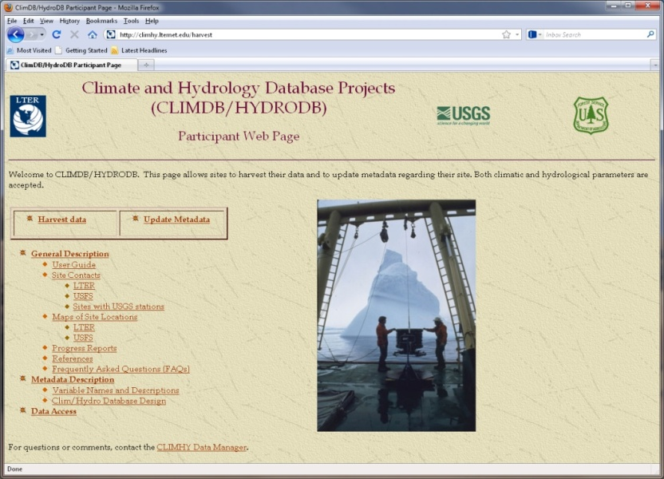
ClimDB/HydroDB Objectives
Climatic and hydrological data are critical to synthetic research efforts (LTER, USFS, other networks)
multi-site comparisons
modeling studies
land management-related studies
Use web technologies to facilitate synthetic research
single portal accessibility to current, multi-site climate and streamflow databases
http://climhy.lternet.edu
Notes:
1997-2002

Slide 3
ClimDB/HydroDB Harvester – Database - Web Interface
Data Providers
Central Site
Public User
LTER Data
USFS Data
Centralized ClimDB/HydroDB Database
Web Page
display, graph, download
Exchange Format
Triggers
on-demand
auto-harvest
HTTP Post
Harvester
Query
interface
Access Tools
site-specific data mining
Data Warehouse
USGS Data
NWS
Data
Web Services
SOAP, WSDL
The ClimDB/HydroDB approach is an effective bridge technology between older, more rigid data distribution models and modern service-oriented architectures.
Notes:
Individual sites maintain local control of data in local information systems
Data harvesting system
Central cross-site database
Web interface to display, graph, and download data

Slide 4

ClimDB/HydroDB Webpages
ClimHy has been migrated from AND to LNO
Public page (http://climhy.lternet.edu/)
Participant page (http://climhy.lternet.edu/harvest)
Database schema (http://climhy.lternet.edu/schema.html)

Slide 5
What’re we now? ClimDB/HydroDB Status
Status of current participation (Sep 2011)
45 sites participating
26 LTER sites participating
3 ILTER sites (Taiwan)
21 USFS sites participating
15 sites with USGS gauging stations
364 total stations
171 total met stations
193 total gauging stations
2011 StreamChemDB

Slide 6
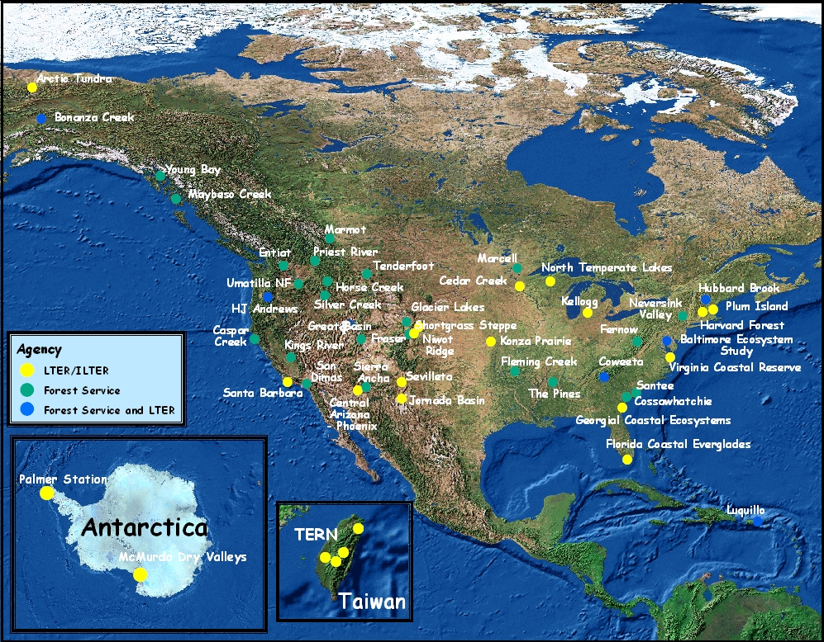
Notes:
(what year of this???)

Slide 7
21 variables are currently available
Maximum, minimum, and mean air temperature
Mean atmospheric pressure
Mean dewpoint temperature
Global radiation total
Daily precipitation total
Mean relative humidity
Snow depth
Soil moisture
Maximum, minimum, and mean soil temperature
Daily mean stream discharge
Maximum, minimum, and mean water temperature
Water vapor pressure
Wind speed and direction measured two ways
2011 StreamChemDB

Slide 8
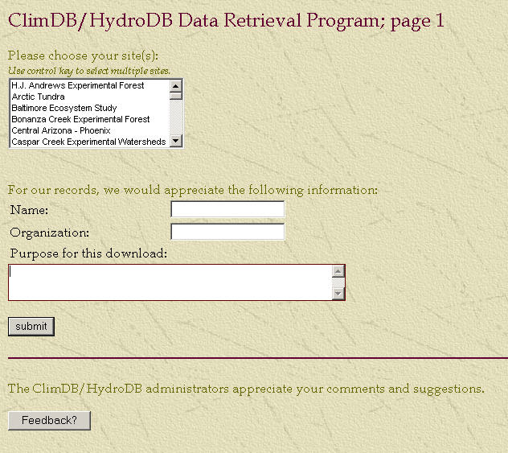
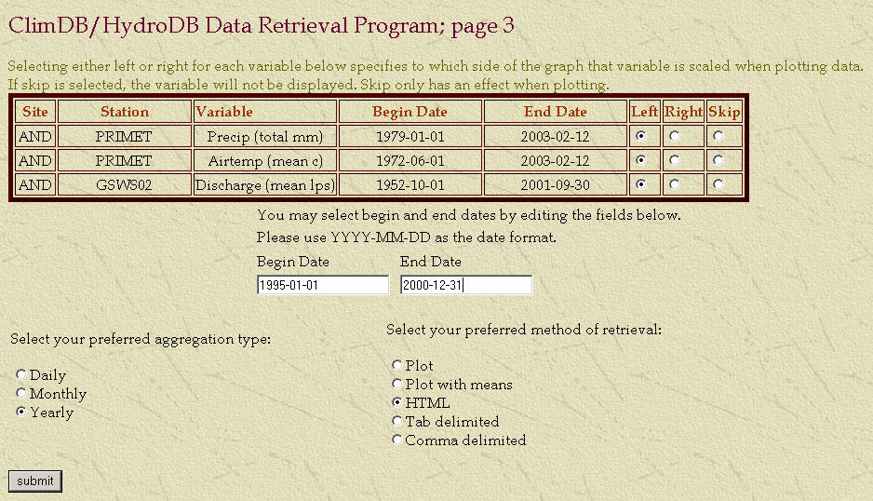
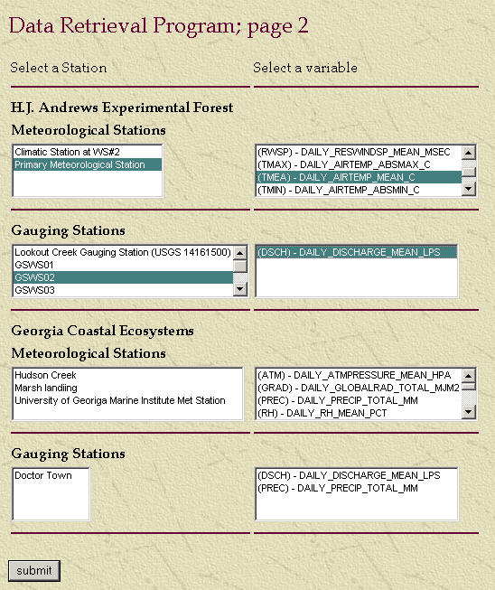
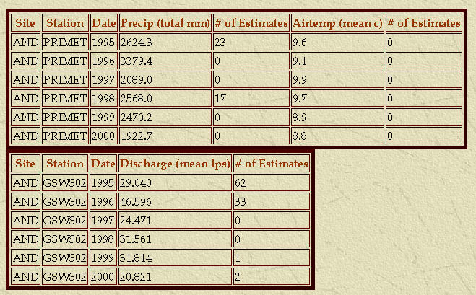
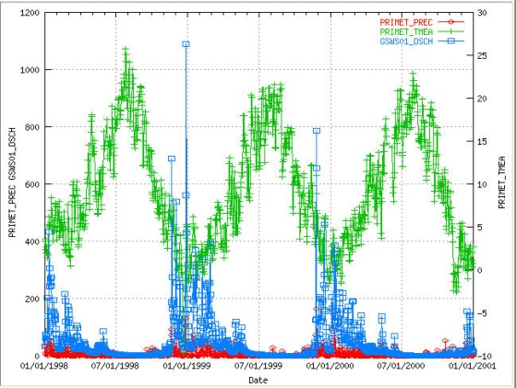
Public Data Access
Download, Plot or View Data

Slide 11
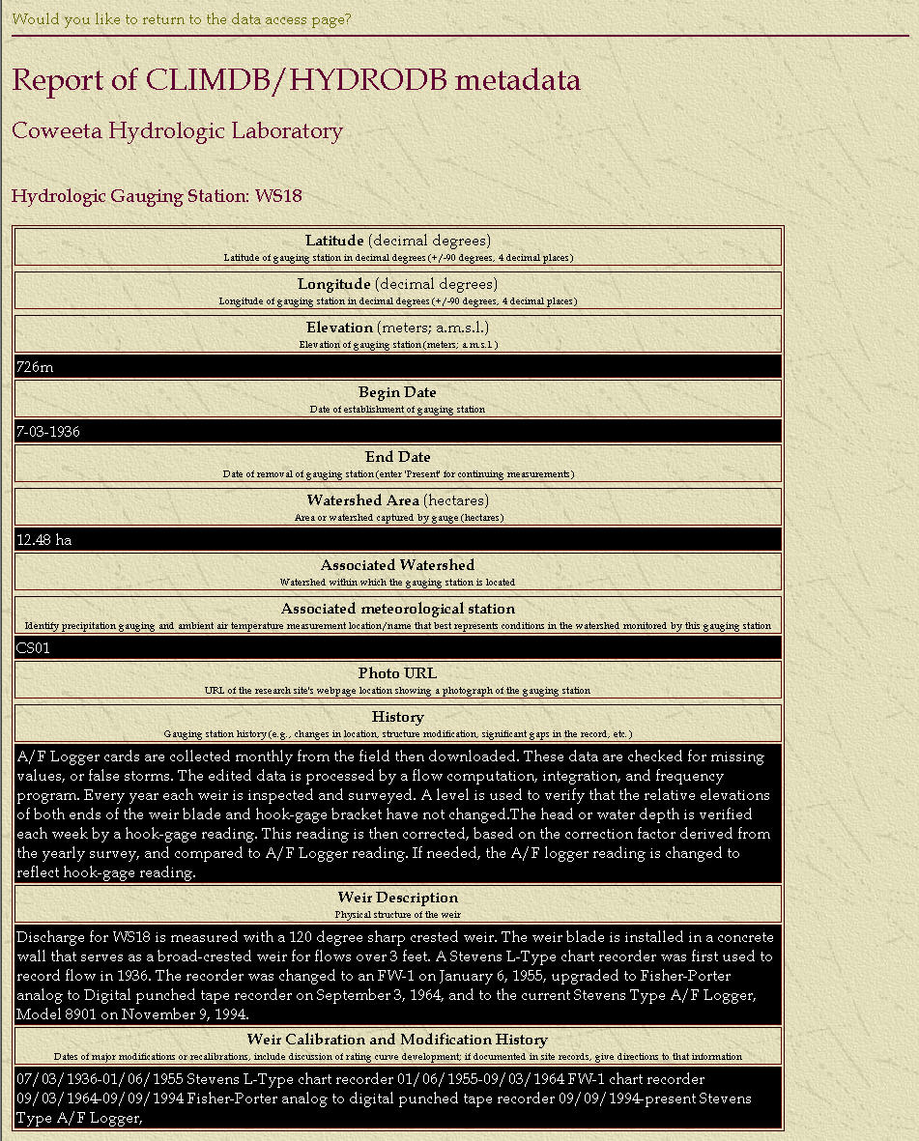
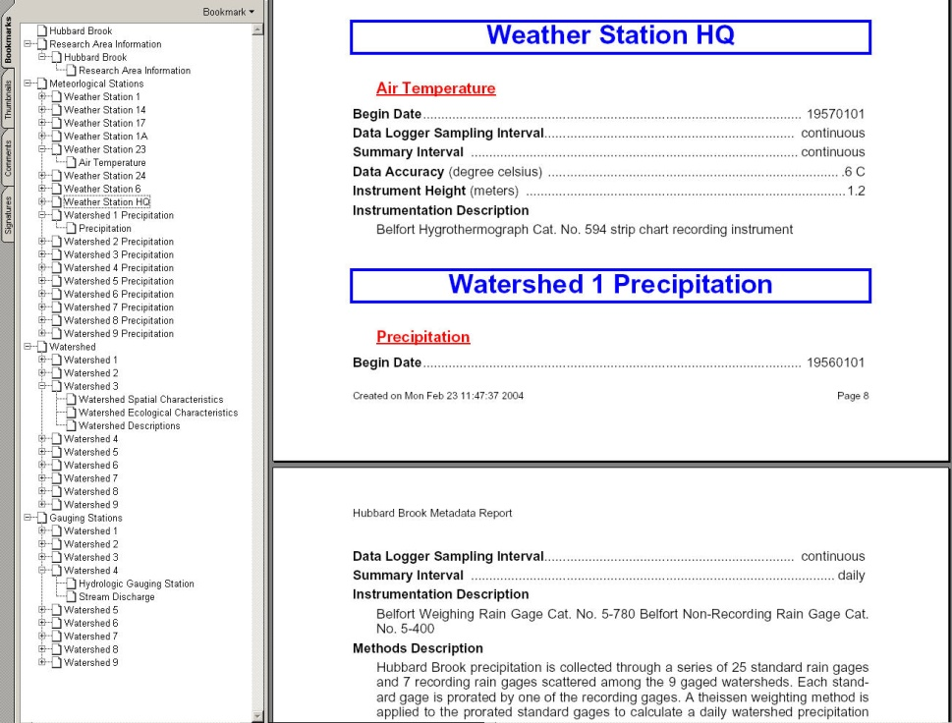
Descriptive Metadata
Detail information for
Overall Site
Individual Stations
Each measurement parameter
Metadata descriptions can also be downloaded as a PDF

Slide 12
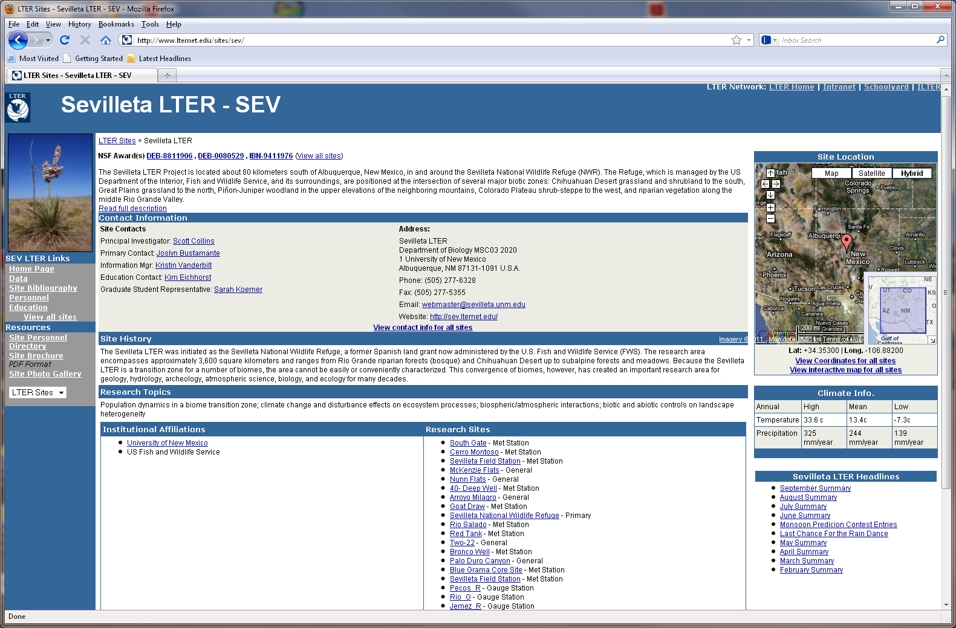
SiteDB for 26 LTER Sites
Sevilleta LTER example

Slide 13
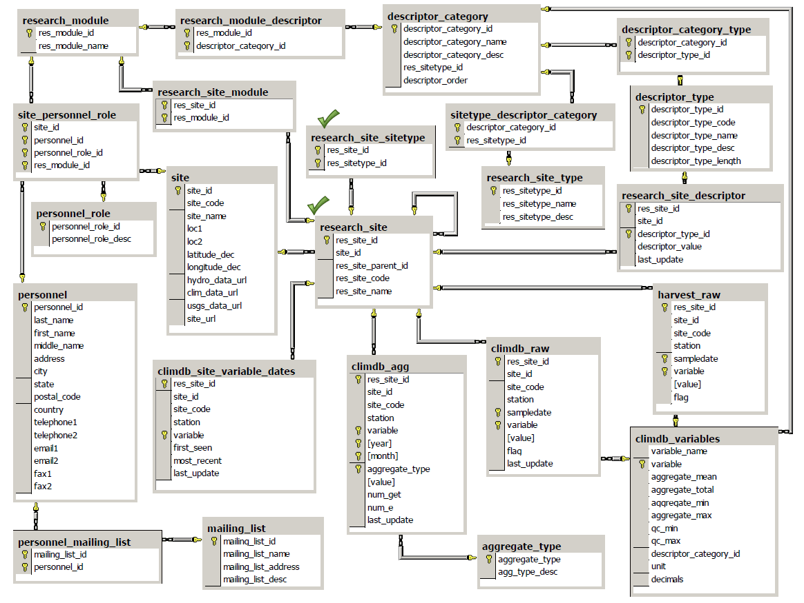
Current ClimDB/HydroDB Database Design

Slide 14
SiteDB
Use SiteDB for persistent storage of extended metadata for use with cross-site, synthetic databases
Share site descriptions and coordinate information with value-added databases and applications
Store data in one place
AND
SiteDB
LTERMaps
…
Web services
VCR
ClimDB
HydroDB
Stream
ChemDB

Slide 15
ClimDB/HydroDB Weaknesses
Many sites do not keep their data up-to-date
particularly EFR sites where IM resources are limited
Only daily data has been populated
primarily only mean, min, max air temperature, precipitation, and streamflow
Metadata are incomplete, inconsistent, not searchable
Research area and watershed descriptions, ecological characteristics, station history, measurement methods, instrumentation, sensor history and calibration
Spatial coordinates are inconsistent
Outdated technology
Harvest of fixed, comma-delimited exchange format is at odds with emerging LTER architecture
Generally the exchange format is easy to prepare and effective but must be specially constructed
Web page technology (e.g., graphics) is dated

Slide 16
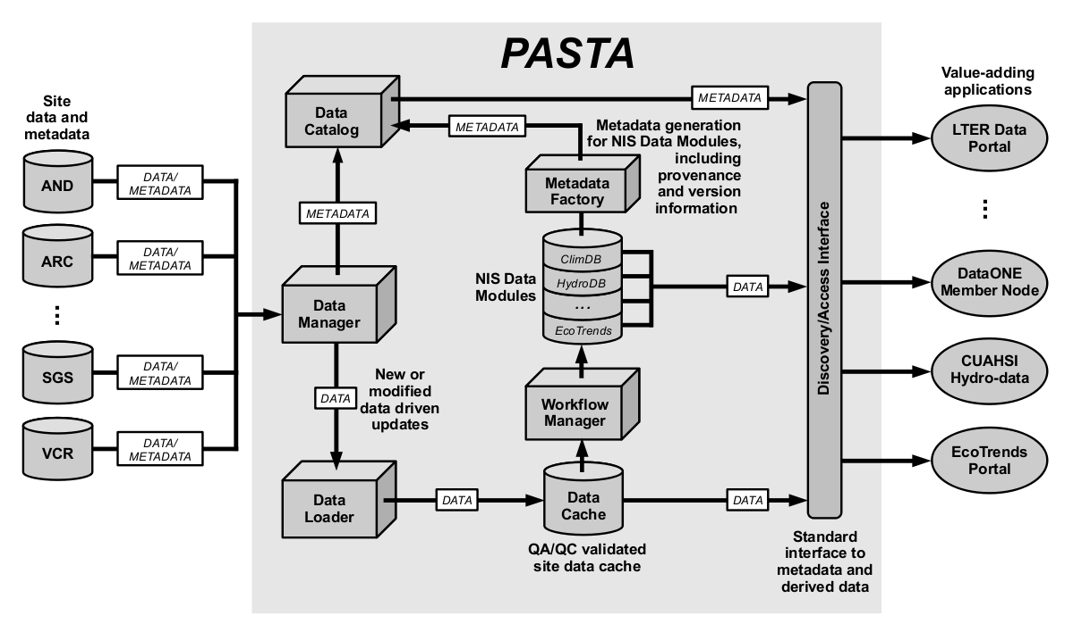
LTER Network Information System

Slide 17
Lessons Learned
Scientific interest is driver
Scientist/modeler demand for current and comparable data
Demand for synthetic data products
Organizational commitment
Commitment to building network databases
Information management (15% LTER site budget)
Data access / release policies
Data collection standards
Participation incentives
Financial incentives
Value-added products returned to participating sites

Slide 18
Questions?

Slide 19
PASTA Provenance Aware Synthesis Tracking Architecture
Build common derived data products from independent site collections
Middleware applications register and harvest site metadata and data
Data Cache makes site-based data available to synthesis projects
Workflows perform synthesis and document processing steps for derived data products
Web Discovery/Access Interface (community API) provides LTER data through value-adding applications
2011 StreamChemDB

