Slide 1
ClimDB/HydroDB Objectives
Don Henshaw
Improve access to long-term collections of climatic and hydrological data
  Long-Term Ecological Research (LTER)
    26 NSF-funded sites
  U.S. Forest Service Research
    Experimental Forests / Experimental Watersheds
Use web technologies to facilitate synthetic research
  Maintain a current data warehouse of multi-site, multi-network, long-term climate and streamflow data
  Provide single portal accessibility and a query interface to download and graphically display data
Notes:
Science, im’s, modelers – address problem with accessibility. Agreement on met stds and agreement to share data

Slide 2
ClimDB/HydroDB
Harvester / Database/ Query Interface
Data Providers
Central Site
Public User
LTER Data
USFS Data
Centralized ClimDB/HydroDB Database
Web Page
display, graph, download
Exchange Format
Triggers
on-demand
auto-harvest
HTTP Post
Harvester
Query
interface
Access Tools
site-specific data mining
Data Warehouse
USGS Data
NWS
Data
Web Services
SOAP, WSDL
Notes:
Centralized architecture: web harvester, data loader middleware in conjunction with RDBMS
HTTP request to web harvester – programmatic trigger - Allows deployment of other middleware services to harvest other agency data (e.g., USGS, NWS)

Slide 3
ClimDB Harvest File Naming Convention
Example of measurement parameter and associated quality flag names
LTER_Site | LTER/Research Area site code (3-letter acronym)
Station | Local site name for the weather station or gauging station
Date | 8 character field (yyyymmdd)
Daily_AirTemp_Mean_C | Mean daily air temperature
Flag_Daily_AirTemp_Mean_C | Data quality flag for mean daily air temperature.
Daily_AirTemp_AbsMax_C | Daily absolute maximum air temperature.
Flag_Daily_AirTemp_AbsMax_C | Data quality flag for daily absolute maximum air temperature
Daily_AirTemp_AbsMin_C | Daily absolute minimum air temperature
Flag_Daily_AirTemp_AbsMin_C | Data quality flag for daily absolute minimum air temperature
Daily_Precip_Total_mm | Daily total precipitation
Flag_Daily_Precip_Total_mm | Data quality flag for daily total precipitation
Daily_Discharge_Mean_Lps | Mean daily discharge
Flag_Daily_Discharge_Mean_Lps | Data quality flag for mean daily discharge
Notes:
Controlled vocabulary – parameters, time resolution, aggregation, units

Slide 4
ClimDB Data Quality Flags
G or blank | Value is a good value (blank is preferred)
E | Value is estimated
Q | Value is questionable
M | Value is missing (in this case, it is preferred to leave value field null or blank with the data quality flag = “M”. It will be allowed to assign the value of “9999” to the data field with the data quality flag = “M”, but not preferred.)
T | Trace value (For precipitation only. Values must be assigned to the data field (e.g., assign a zero or 0.1). DO NOT leave the data field null or blank.

Slide 5
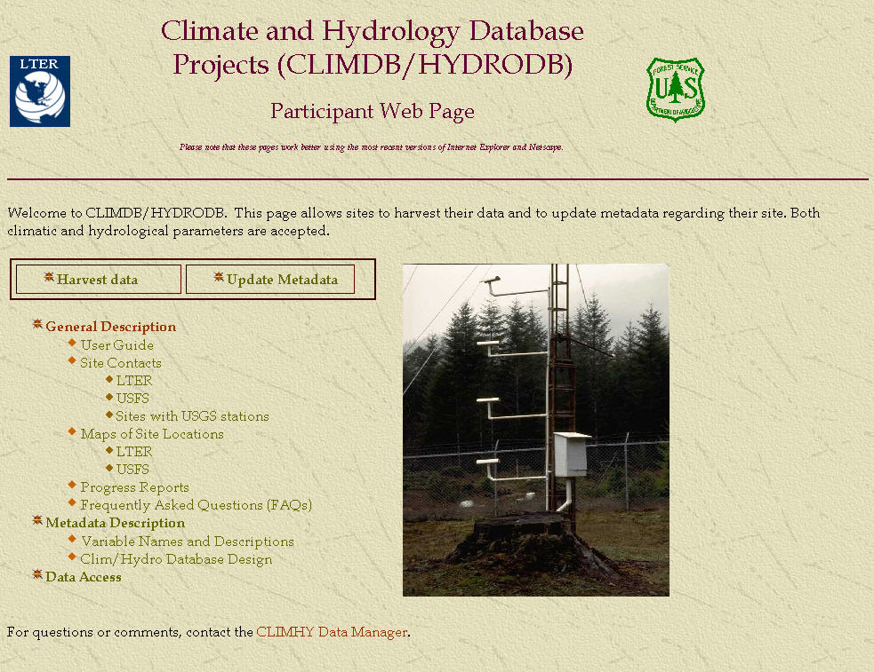
Participant Web Page
http://www.fsl.orst.edu/climhy/harvest/harvest.htm
Notes:
Harvest data or enter metadata

Slide 6
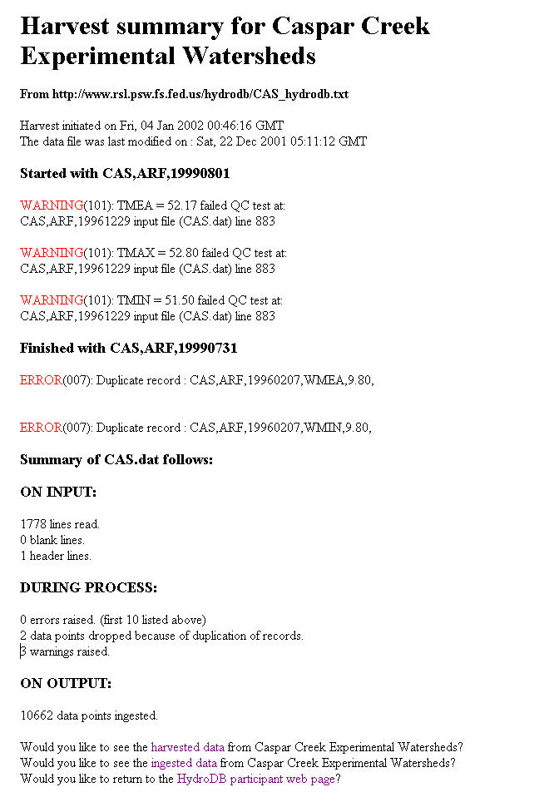
Duplicate records found
Notes:
Example of *.LOG file that is the feedback from HydroDB harvester.
Caspar Creek with QC warnings.

Slide 7
ClimDB General Harvest QA/QC
FATAL ERROR(901): Missing quality assurance flag
  Description: All variables require that a flag_variable directly follow
FATAL ERROR(906): Duplicate found
  Description: Duplicate record by site, station, parameter, and date
ERROR(002): Illegal flag character - [flag] not recognized
  Description: Illegal flag. Data point is ignored.
WARNING(100): Unknown Variable
  Description: Variable name is not listed as valid in the central variable database. All values listed for that variable are ignored.
WARNING(101): [variable] = [value] Failed QC test (data limits check)
  Description: Data value fails general data limits check. Data is still accepted.
WARNING(106): Failed (min < mean < max) relationship
  Description: Quality assurance failure. Data record is still accepted.
WARNING(104): Trace value error: Flag = T; data = null. Flag set to 'M'
  Description: Flag indicates trace value. Data point is considered missing.

Slide 8
Data Warehouse Content
Parameter (Daily values) | % by Measured Parameter
Stream Discharge | 29
Precipitation | 26
Air Temperature | 22
Relative Humidity | 4
Global Radiation | 4
Soil Temperature | 3
Resultant Wind Speed | 3
Resultant Wind Direction | 2
Other | 7
Primary emphasis
Observations:
Coverage of precipitation, discharge, and air temperature data is strong across sites.
We encourage sites to contribute relative humidity, soil temperature, wind speed & direction, and global radiation in datasets.
Secondary emphasis
Notes:
P:\FSDB\ADMIN\SQL\climdb\reports\participants_0106.xls

Slide 9
ClimDB Temporal Coverage – LTER Sites
Air temperature and precipitation
1869
1914
1920
1983-2003
14 sites
(54%)
1989-
2003
21
sites
(81%)
1994-2003
22 sites
(85%)
1927
1931
1937
1955
1957
1957
20 years
Air temperature
and precipitation
15 years
10 years
28 August 2006
1869
1960
1965
1970
1975
1980
1985
1990
1995
2000
2005
Notes:
Mention Taiwan sites… Build EML, engage climate committee, multiple sensors, high temporal resolution data

Slide 10
HydroDB Temporal Coverage – 28 Sites
1927
1930
1931
1936
1940
1940
1949
1951
1952
1956
1957
1958
1958
Streamflow
USGS
Small watersheds
28 August 2006
1869
1960
1965
1970
1975
1980
1985
1990
1995
2000
2005
Notes:
Mention Taiwan sites… Build EML, engage climate committee, multiple sensors, high temporal resolution data

Slide 11
Characterization of quality flags in ClimDB LTER only: No USFS only and no USGS
Flag | # Values | % of Total | # Absent Values | % All Missing
Null or “G”ood | 1,199,440 4,141,646 | 88.02%
“E”stimated | 145,365 | 2.40%
“M”issing | 553,237 | 9.12% | 507,227 | 16.13%
“Q”uestionable | 17,981 | 0.30%
“T”race | 10,341 | 0.17%
Total | 6,068,010 | 100.00%

Slide 12
Characterization of quality flags in ClimDB
All Data: LTER, USFS, and USGS
Flag | # Values | % of Total | # Absent Values | % All Missing
Null or “G”ood | 1,781,391 4,655,391 | 87.94%
“E”stimated | 178,027 | 2.43%
“M”issing | 671,135 | 9.17% | 604,539 | 16.10%
“Q”uestionable | 19,425 | 0.27%
“T”race | 13,739 | 0.19% | # Precip Values 1,344,951 | % Trace flag 1.02%
Total | 7,318,966 | 100.00%

Slide 13
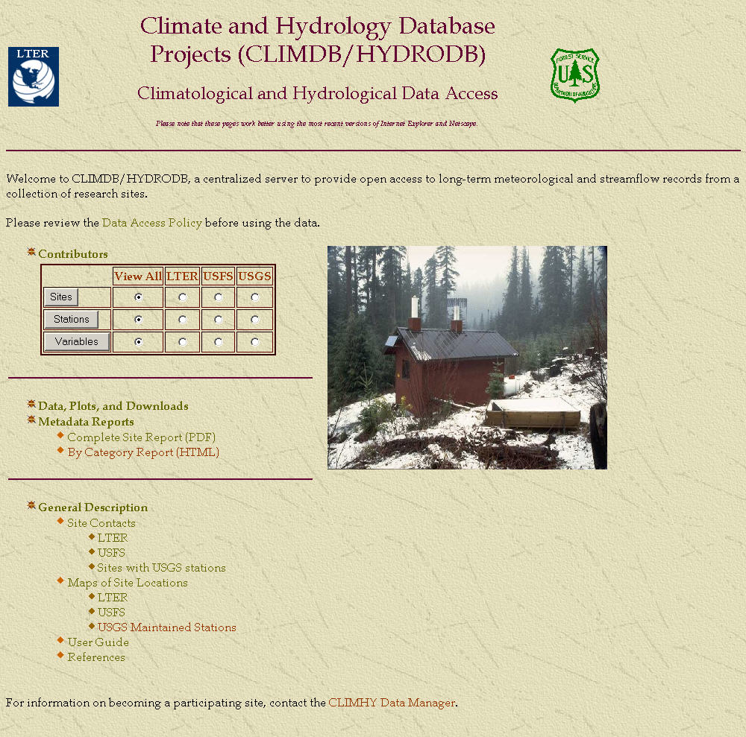

Slide 14
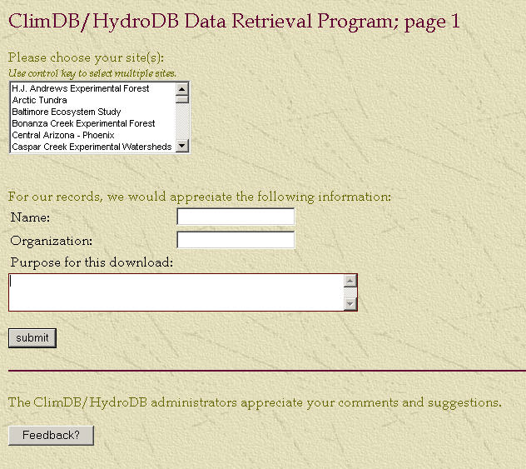
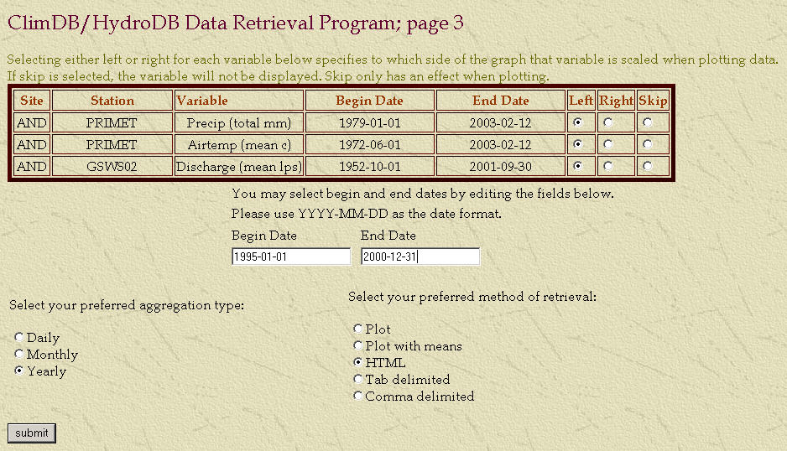
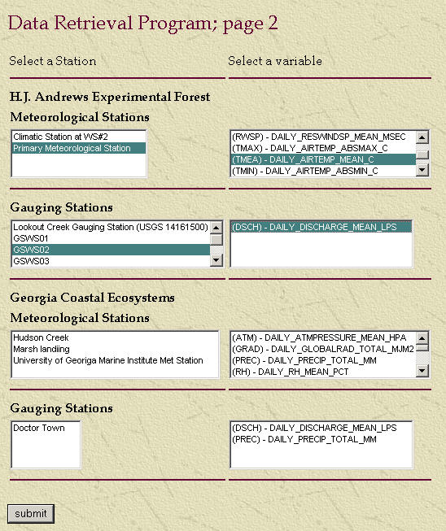
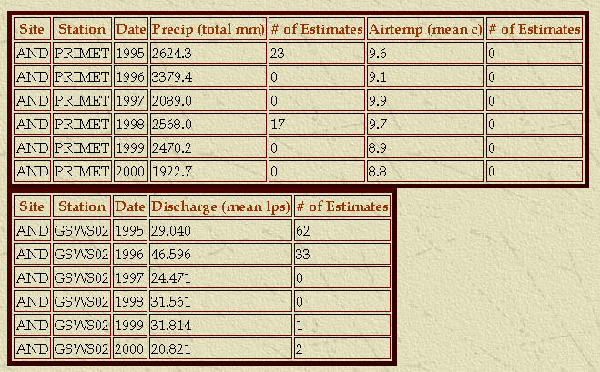
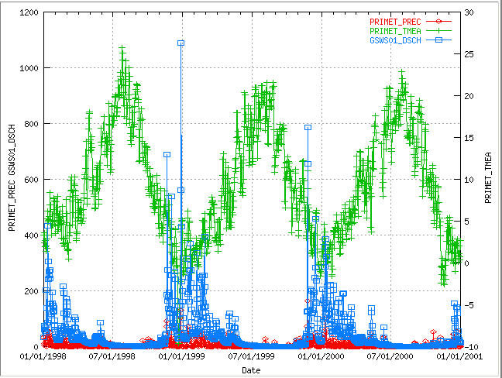
Data Acquisition
Download or Graphical Display

Slide 15
Data Acquisition

Slide 17
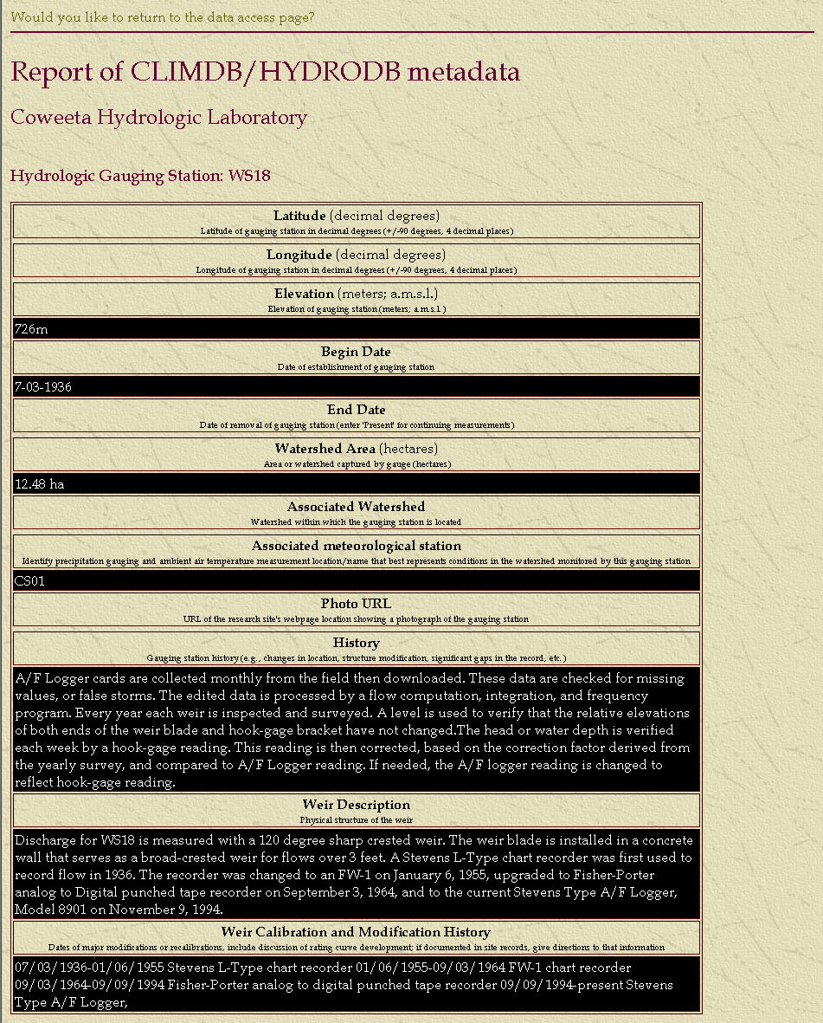
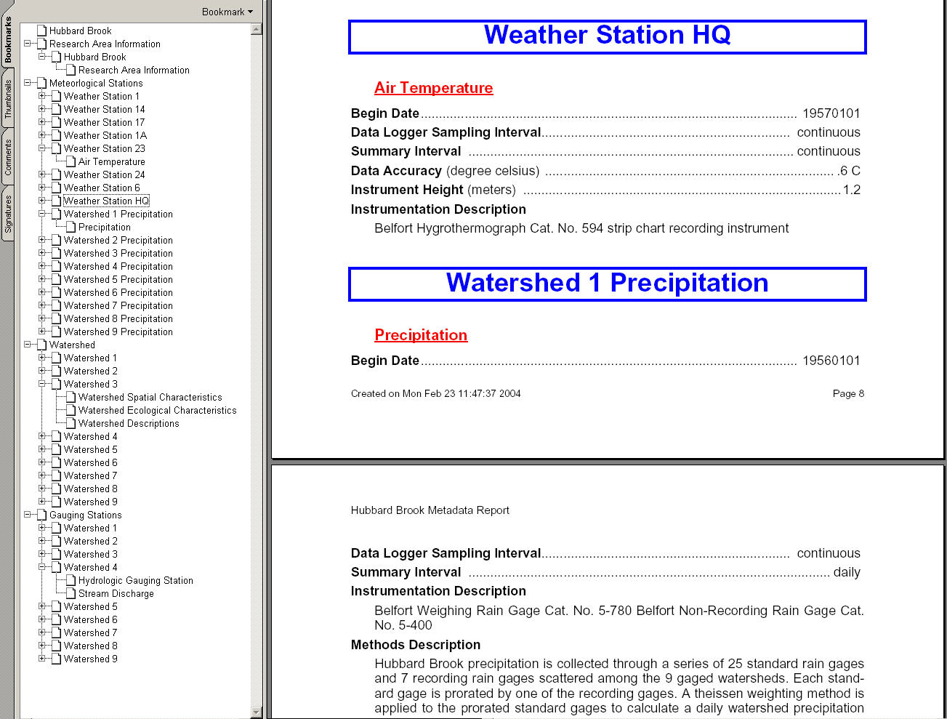
Metadata Reports
Detail information for the general site, all stations, and all parameters.
Metadata descriptions can also be downloaded as a PDF

Slide 18
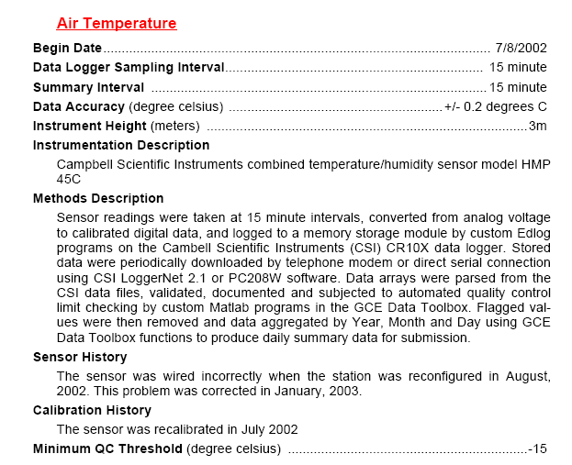
Air Temperature Instrumentation Metadata

Slide 19
ClimDB Improvements/Issues
Designate metadata attributes for describing QA procedures, or for describing missing or questionable data problems
Tally and list the number of records in monthly and annual aggregations. Optionally include questionable data?
Output EML specific to each data download of a derived data product
Develop web services to accommodate CUAHSI or other standard interfaces

