Slide 1
CUAHSI HIS
Features of Observations Data Model

Slide 2
National Server
Workgroup Server
NAWQA
Storet
Observatories
Trends
PI Field Site
NCDC
NCAR
Agency
Sites
Ameriflux
LTER Sites
NWIS
CUAHSI Web Services
Excel
Visual Basic
ArcGIS
C/C++
Matlab
Fortran
Access
SAS
Some operational services

Slide 3
CUAHSI Hydrologic Information System Levels
National HIS – San Diego Supercomputer Center
Map interface, observations catalogs and web services for national data sources
Workgroup HIS – research center or academic department
HIS Server
Map interface, observations catalogs and web services for regional data sources; observations databases and web services for individual investigator data
Personal HIS – an individual hydrologic scientist
Application templates and HydroObjects for direct ingestion of data into analysis environments: Excel, ArcGIS, Matlab, programming languages; MyDB for storage of analysis data
HIS Analyst

Slide 4
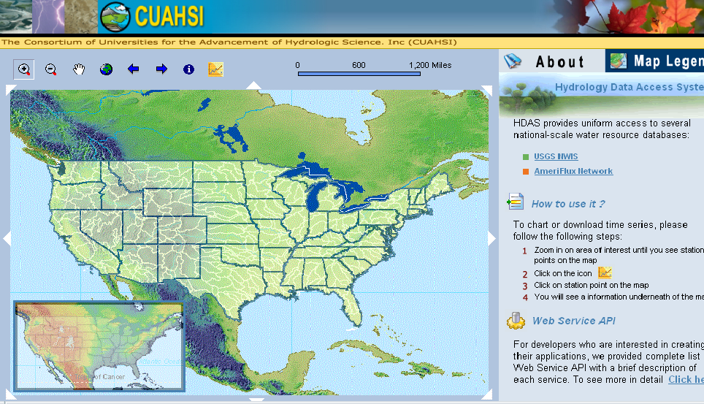
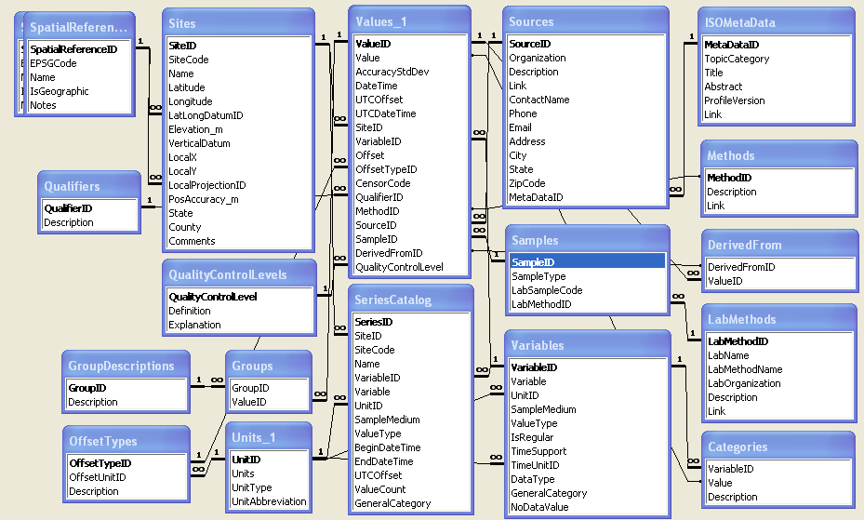

HIS Server Architecture
Map front end – ArcGIS Server 9.2 (being programmed by ESRI Water Resources for CUAHSI)
Relational database – SQL/Server 2005 or Express
Web services library – VB.Net programs accessed as a Web Service Description Language (WSDL)

Slide 5
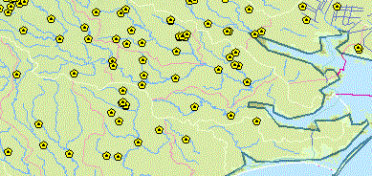
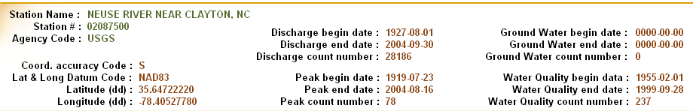
National and Workgroup HIS
National HIS
Workgroup HIS
National HIS has a polygon
in it marking the region of
coverage of a workgroup HIS
server
Workgroup HIS has local
observations catalogs for coverage of national data sources in its region. These local catalogs are partitioned from the national observations catalogs.
For HIS 1.0 the National and Workgroup HIS servers will not be dynamically connected.

Slide 6
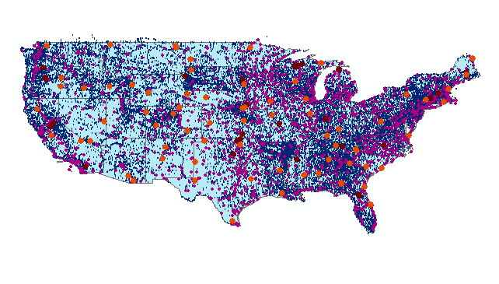
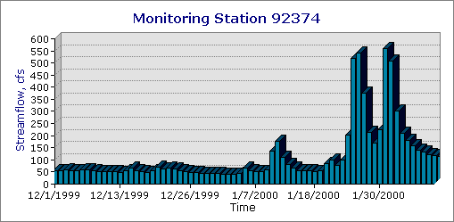
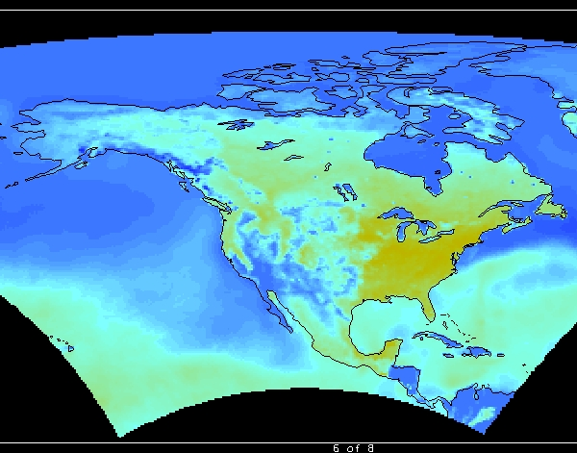
Series and Fields
Features
Series – ordered sequence of numbers
Point, line, area, volume
Discrete space representation
Time series – indexed by time
Frequency series – indexed by frequency
Surfaces
Fields – multidimensional arrays
Continuous space representation
Scalar fields – single value at each location
Vector fields – magnitude and direction
Random fields – probability distribution
Notes:
Doug: Could you please add a point, line, area symbols or something generic that represents features.

Slide 7
Data Types
Hydrologic
Observation
Data
Geospatial
Data
(GIS)
(Relational database)
Digital
Watershed
Weather and Climate
Data
Remote Sensing
Data
(NetCDF)
(EOS-HDF)
http://www.cuahsi.org/his/documentation.html

Slide 8
Point Observations Information Model
USGS
Data Source
Streamflow gages
Network
Neuse River near Clayton, NC
Sites
Observation
Series
Discharge, stage, start, end
(Daily or instantaneous)
Values
206 cfs, 13 August 2006
{Value, Time, Qualifier}
A data source operates an observation network
A network is a set of observation sites
A site is a point location where one or more variables are measured
A variable is a property describing the flow or quality of water
An observation series is an array of observations at a given site, for a given
variable, with start time and end time
A value is an observation of a variable at a particular time
A qualifier is a symbol that provides additional information about the value

Slide 9
ODM Value Data Table
Value
Site
Date-Time
Offsets
Censor
Qualifier
Method
Source
Sample
Derived From
Quality Control Level

Slide 10
Qualifiers
Censor: Censored values (<, >)
Qualifiers: E, etc.

Slide 11
Quality Control Levels
0: Raw Data as measured
1: Quality Controlled data subject to “std” QC procedure
2: Derived Product scientific/technical interpretation, including multisensor products (e.g., averages)
3: Interpreted Products model-based interpretation, using other data, strong prior assumpations (e.g., radar precipitation, fluxes)
4: Knowledge Products model-based, multidisciplinary, less standard, stronger assumptions (e.g., old/new water interpretations based on stable isotopes)

Slide 12
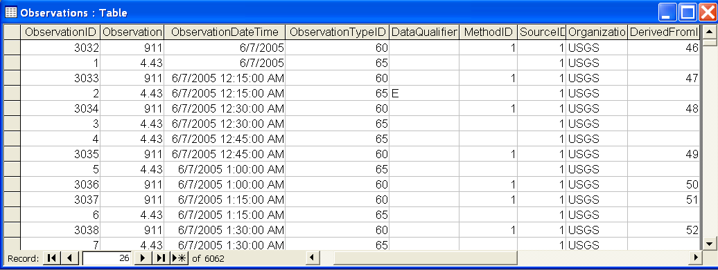
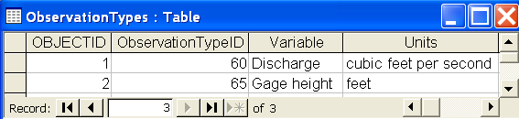
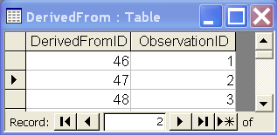
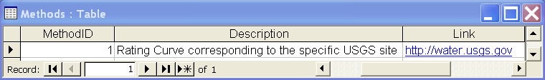
Stage and Streamflow Example

Slide 13
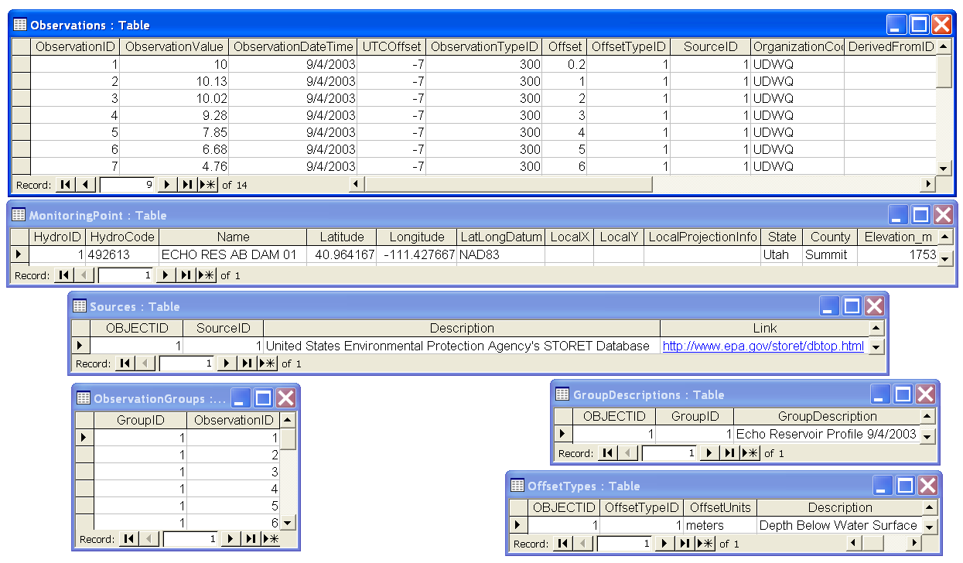
Water Chemistry from a profile in a lake

Slide 14
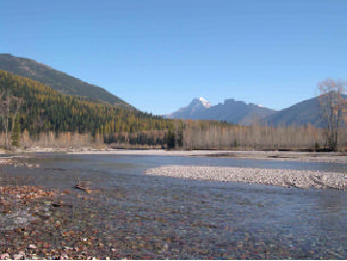
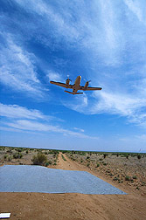
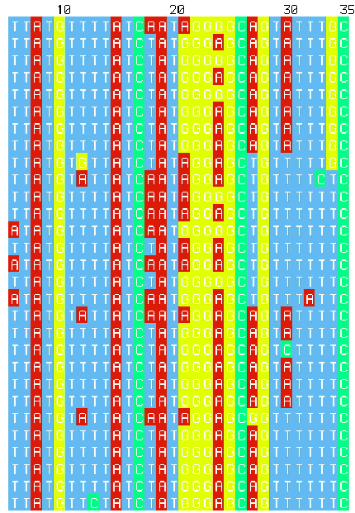
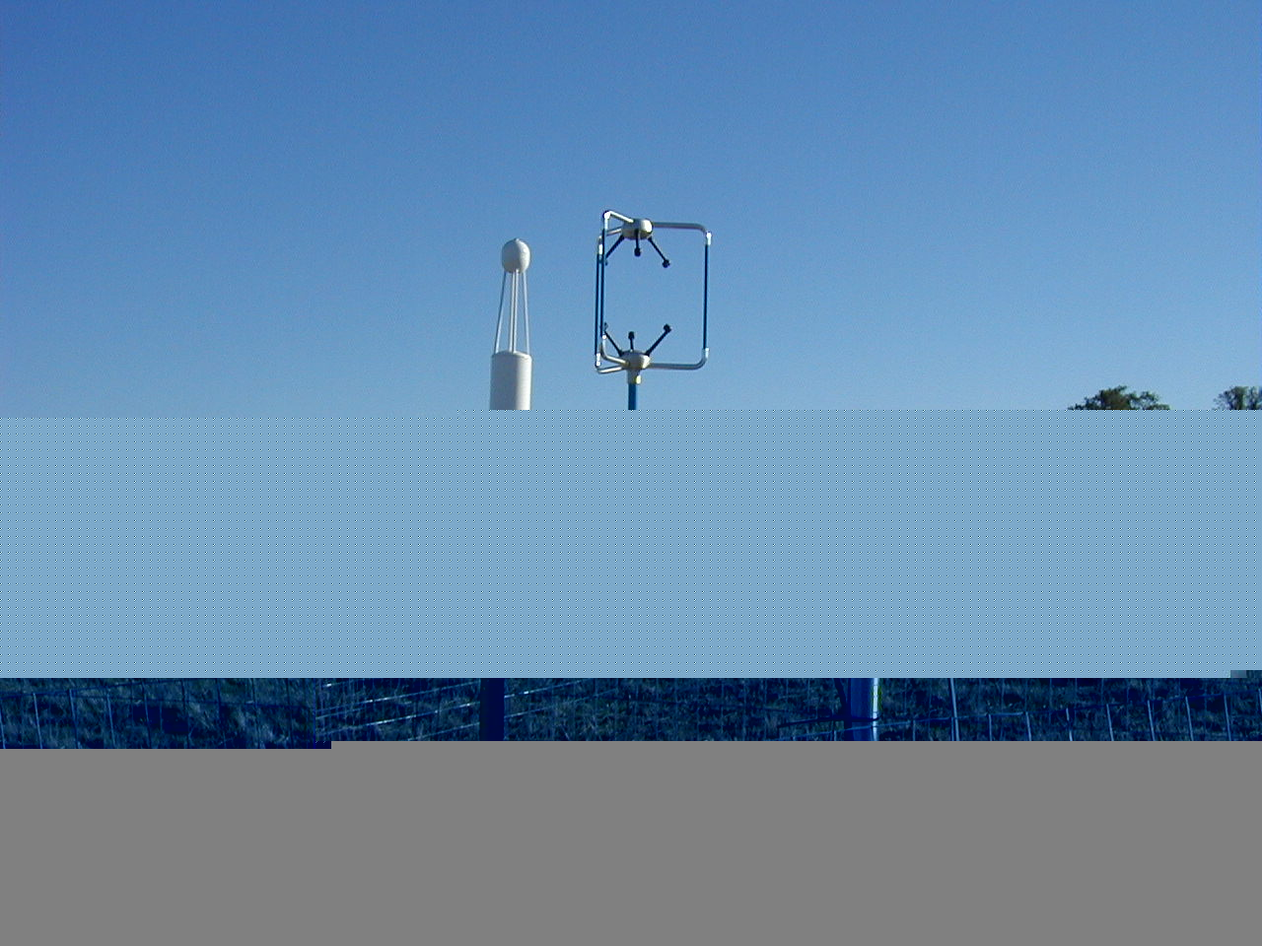
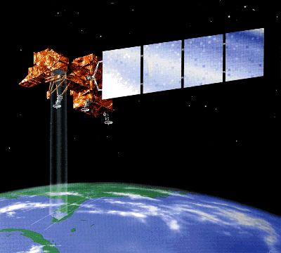
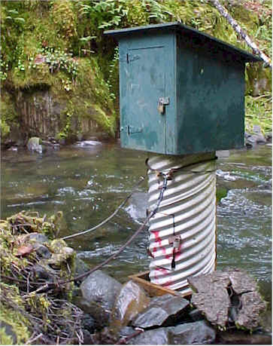
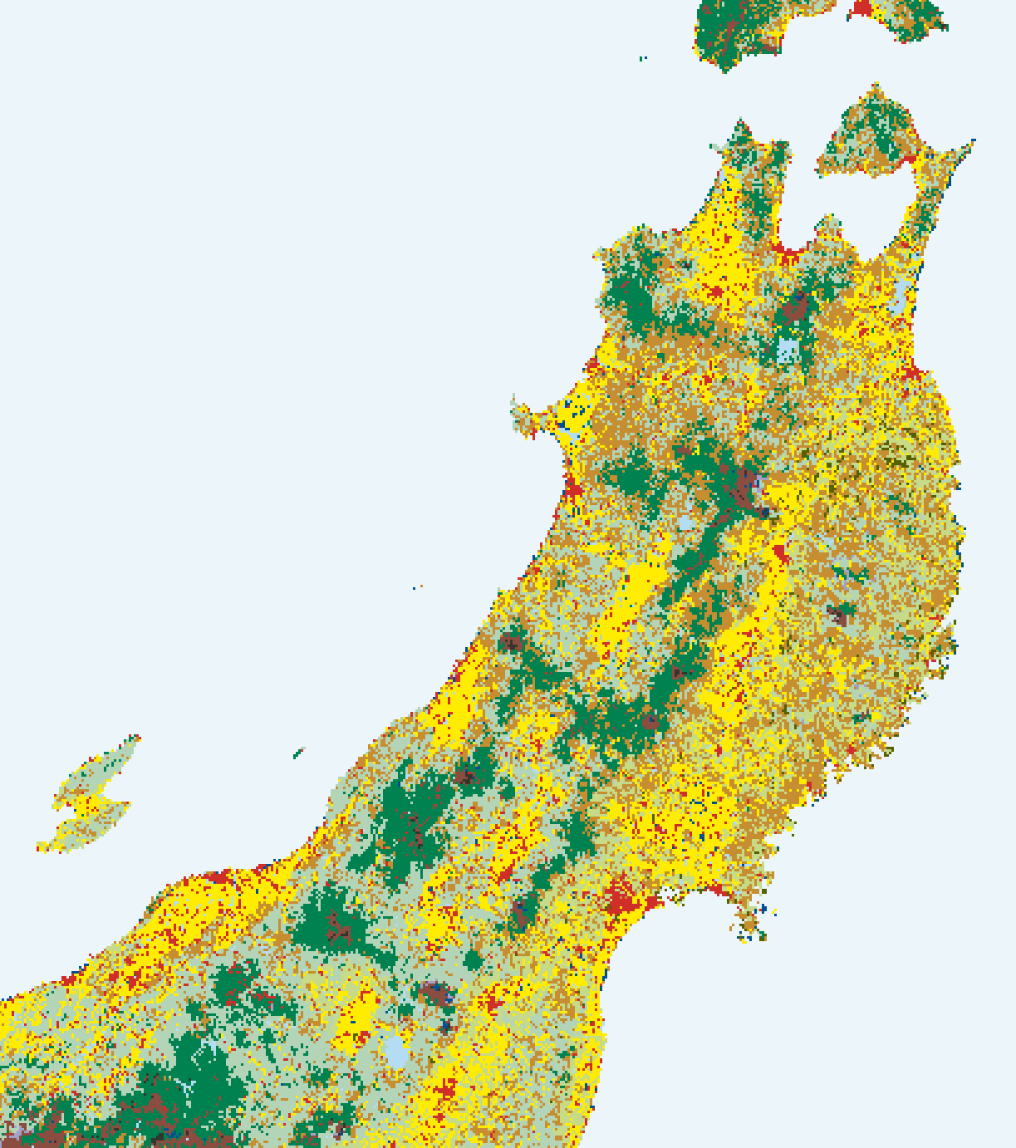
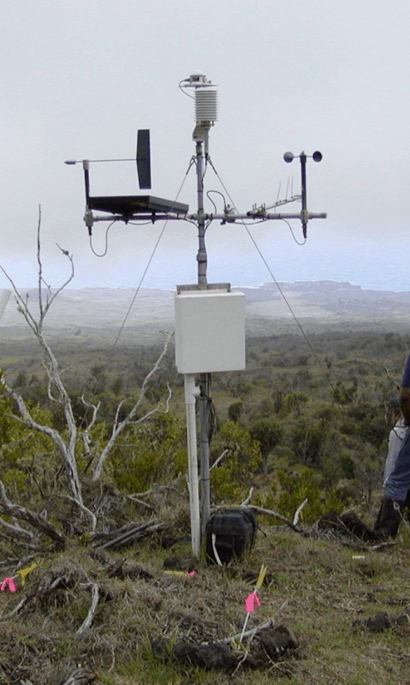
Abstractions in Modeling
Real World
“Digital Environment”
DNA Sequences
Water quantity
and quality
Geomorphologist
Meteorology
Hydrologist
Remote sensing
Aquatic Ecologist
Biogeochemist
Vegetation Survey
Conceptual
Frameworks
Snowmelt
Processes?
Glaciated Valley
Groundwater
Contribution?
Physical World
Model
Representations
-Mathematical Formulae
-Solution Techniques
Mapping
Geographically
Referenced
DOC Quality?
Perifluvial
Oligotrophic?
Carbon source?
Backwater habitat
Redox Zones?
Hyporheic exchange?
Q, Gradient, Roughness?
Data
Representation
Theory/Process Knowledge
Perceptions of this place
Intuition
Substrate Size, Stability?
Benthic Community
Validation
Thalweg?
Mineralogy?
Well sorted?
Chemistry?
Wetted Perimeter
Measurements

