Slide 1
Trends Vision
Long-term time series of climate, biogeochemical, biotic & population data
Create an “atlas” of these data in graphical (graphs & maps) & tabular form
Provide clean, well-documented data (including provenance) in some kind of aggregated, summarized form (monthly or yearly) and graphs/graphing tools available online.

Slide 2
Data sources
5 agencies (LTER, ARS, FS, USGS, DOE), 50 sites
  Agency-wide systems
  Site specific systems
  PI-held spreadsheets
  Utilize external data sources (WRCC, NOAA, etc)
  Submit data to external data sources (CLIMDB/HYDRODB)

Slide 3
Metadata formats
Range:
  Few lines at top of ascii file/excel spreadsheet
  Huge sections of metadata in separate or in same file as data
  Sparse to almost complete EML
Notes:
Eoarc, sev

Slide 4
Methodology
Read metadata/skim data – do data and metadata match?
Read data into R using parameter values noticed in first read.
Look at and solve problems with reading dataset IF possible with code - don’t save new data file.
  Change import data type if necessary
  Filter out or flag missing, questionable, out-of-range, etc. data. Follow CLIMDB scheme (M,Q,E,T, but not G) and add invalid(I). Use site-specific flags to determine which flags to use.

Slide 5
Methodology
Aggregate data in required form, standardized for each variable. Save new data file. Aggregate flags in terms of counts of flag types.
Write script to plot data – often find problems not found during data reading and aggregation, or from reading the metadata.
Use database to track location of datafile, metadata file, scripts, access URLs of data/metadata if possible, attributes used, relationships between all files (a type of metadata system).

Slide 6
Constraints not limited to data
Deadlines to have a working product (book, website) –
  Choose any 2:
    Fast Accurate
    Error-free Unbiased
Time to read & understand metadata
Incomplete metadata - common (even seemingly complete EML)
  May not describe methodology thoroughly
  Attribute-detail level often missing or incomplete
Errors in metadata often has errors
  columns described incorrectly
  methods and data don’t match, etc.
Data warehouses (e.g., CLIMDB or WRCC):
  Often lack site-specific data/metadata – how crucial is this missing info?
  But can usually use a single script to summarize data from many sites.
Site-specific data: each dataset/attribute combination requires a separate script.

Slide 7
Incomplete data series
Gaps – single data point to several years. Solution: unless gaps are severe (several gaps of a year or more), keep but plot such that gaps are apparent.
Most time series data are not true time series, which begs the question of how to analyze. Can’t do simple linear regression, can’t do full time-series analysis. PROC AUTOREG in SAS can handle some of this but is time-consuming.

Slide 8
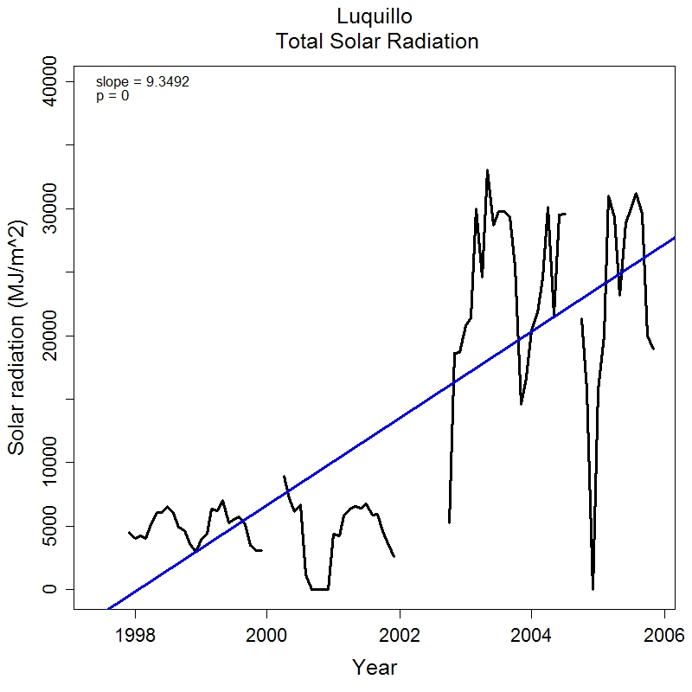
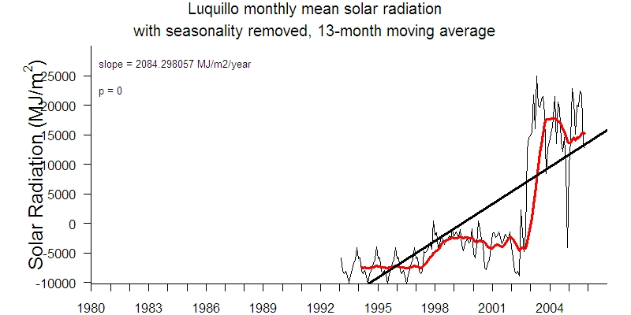
Best efforts at checking the quality of the data – proof of work is not accomplished until after the data is visualized.

Slide 9
Communication of missing values
Flagging: multitudes of options depending on site, agency & type of data recorded
  Sometimes oversimplified - not enough information (estimated how? Why questionable?
  Flagging is mostly clear, then limitations of flagging systems are unaddressed. Example: WRCC monthly precip & temp data: # missing values indicated by letters a-z, so that a=1 and z=26 or more.
CLIMDB
  Flagging system relatively simple & clear
  Loss of information related to the flags. Difficult to trace provenance.
Heavy reliance on “comments” – freeform or standardized
  Hard to understand because there is no supporting metadata
  Difficult to automate a filtering or recoding process: endless variety of options
  Simple delimited data often compromised by complex format of comments.
  Often missing values are completely undocumented

Slide 10
Solutions for Trends project
Classify data into categories similar to CLIMDB: missing, questionable, estimated, trace. Added invalid. Coerce existing flags if possible into this system. Problem: loss of immediately accessible information.
During data aggregation (daily -> monthly, etc.):
  Count # for each code type.
  Search for missing but non-flagged data.
  If no information about the data, flag column is left blank (NULL or NA)
  Any numbers (including 0) means it is known that there are no missing values, Daily -> monthly is quite intuitive. Question: what does a number mean if you don’t know upfront the frequency of the original data? Perhaps recording proportion is better.

Slide 11
Imputation/Estimation Issues
Responsibility of data quality lies (for most part) on shoulders of participating sites. Very important to track provenance of original data.
Try to preserve the integrity of the data as it was submitted & not promote specific inferences.
No estimation done in-house due to limitations of time and resources to understand site-specific systems
Define responsibilities of users for exploring the validity of the data, for using data appropriately, and for communicating with data contacts.

Slide 12
Questions
What do we do with critical comments regarding data quality (i.e., a randomly-missing value vs. a method or mechanism-cause missing value that can cause bias)
  how to flag in “raw” data
  How to summarize and communicate in a “derived” dataset (i.e., monthly/annual data)
How to report aggregation of not-good values
What are “standard” thresholds of reporting monthly/annual means/totals – i.e., how many missing/questionable/estimated etc. values are tolerated? Or are users always allowed to make their own decisions

