Slide 1
Provenance in Scientific Workflows on SEEK
Mark Schildhauer
National Center for Ecological Analysis and Synthesis
LTER Data QA session, Las Cruces, Feb. 1, 2007

Slide 2


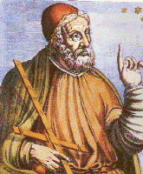


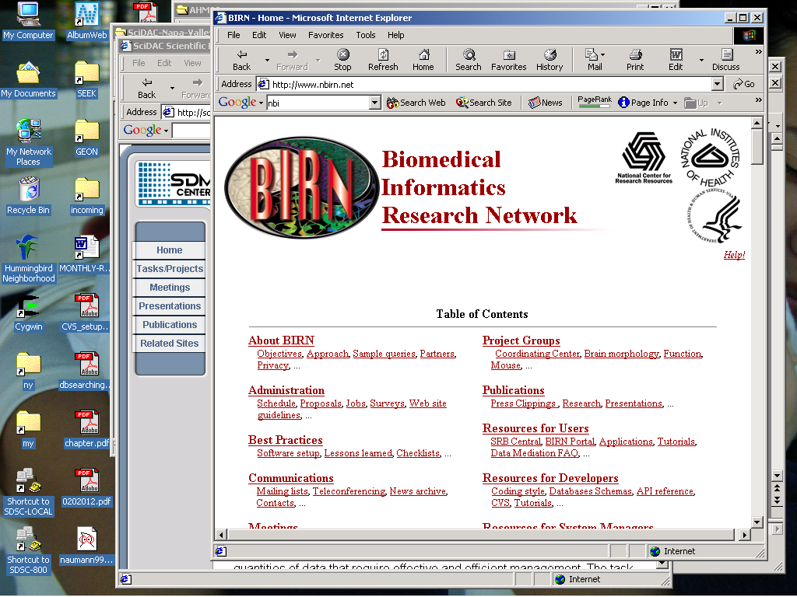





Kepler Collaboration
Open-source
  Builds on Ptolemy II from UC Berkeley
Collaborators
  SEEK Project
  SciDAC SDM Center
  Ptolemy Project
  GEON Project
  ROADNet Project
  Resurgence Project
Goals
  Create powerful analytical tools that are useful across disciplines
  Ecology, Biology, Engineering, Geology, Physics, Chemistry, Astronomy, …
Ptolemy II

Slide 3
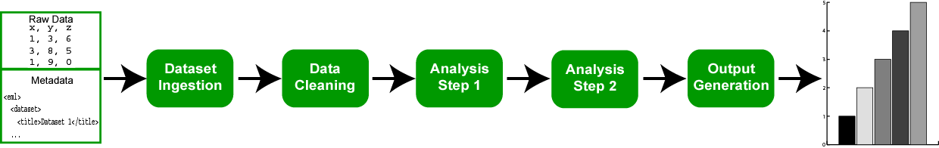
Scientific Workflow approach
Think of ecological analysis and modeling as a sequence of “steps”– or modules (indicating data and analytical processes), which are joined by arrows (which indicate “flow”):
Resembles traditional “flow chart” approach to documenting analyses
But modern Scientific Workflow applications are very different, because you can execute these workflows

Slide 4
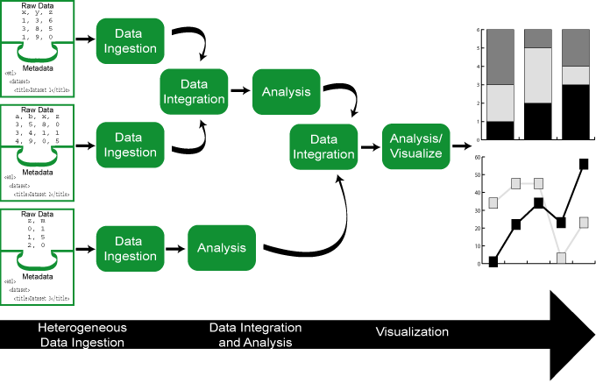
Scientific Workflow approach
Complex analyses and models can be constructed and executed using scientific workflow tools:

Slide 5
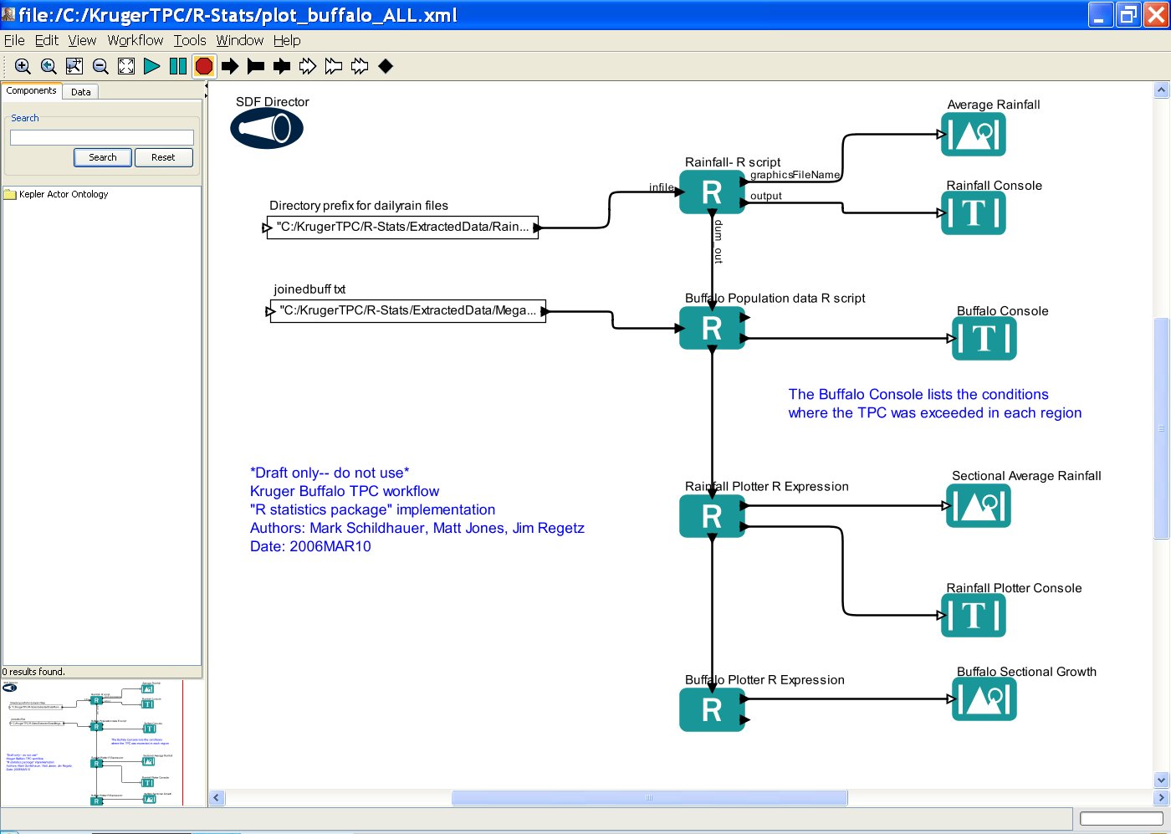
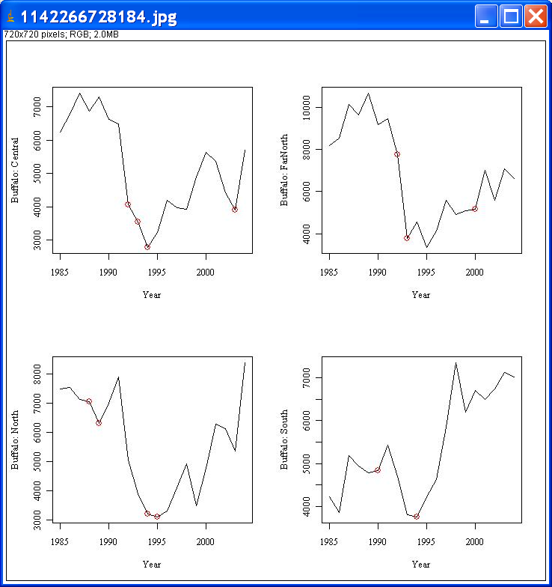
Kruger Park Buffalo Thresholds
Reports and graphics are depicted as
they are calculated, and can be saved
for later review or distribution

Slide 6
Initial Work on Provenance Framework
(next 4 slides from Altintas, SDSC)
Provenance
  Track origin and derivation information about scientific workflows, their runs and derived information (datasets, metadata…)
Need for Provenance
  Association of process and results
  reproduce results
  “explain & debug” results (via lineage tracing, parameter settings, …)
  optimize: “Smart Re-Runs”
Types of Provenance Information:
  Data provenance
    Intermediate and end results including files and db references
  Process (=workflow instance) provenance
    Keep the wf definition with data and parameters used in the run
  Error and execution logs
  Workflow design provenance (quite different)
    WF design is a (little supported) process (art, magic, …)
    for free via cvs: edit history
    need more “structure” (e.g. templates) for individual & collaborative workflow design

Slide 7
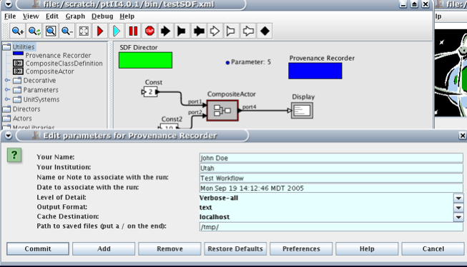
Kepler Provenance Recording Utility
Parametric and customizable
  Different report formats
  Variable levels of detail
    Verbose-all, verbose-some, medium, on error
  Multiple cache destinations
Saves information on
  User name, Date, Run, etc…

Slide 8
Provenance: Possible Next Steps
More Provenance Meeting
  Deciding on terms and definitions
  .kar file generation, registration and search for provenance information
  Possible data/metadata formats
  Automatic report generation from accumulated data
  A GUI to keep track of the changes
  Adding provenance repositories
  A relational schema for the provenance info in addition to the existing XML
  Storage syntax: MOML? EML? Hybrid?

Slide 9
What other system functions does provenance relate to?
Failure recovery
Smart re-runs
Semantic extensions
Kepler Data Grid
Reporting and Documentation
Authentication
Data registration
Re-run only the updated/failed parts
Guided documentation generation and updates

Slide 10
Acknowledgements
This material is based upon work supported by:
The National Science Foundation under Grant Numbers 9980154, 9904777, 0131178, 9905838, 0129792, and 0225676.
Collaborators: NCEAS (UC Santa Barbara), University of New Mexico (Long Term Ecological Research Network Office), San Diego Supercomputer Center, University of Kansas (Center for Biodiversity Research), University of Vermont, University of North Carolina, Napier University, Arizona State University, UC Davis
The National Center for Ecological Analysis and Synthesis, a Center funded by NSF (Grant Number 0072909), the University of California, and the UC Santa Barbara campus.
The Andrew W. Mellon Foundation.
Kepler contributors: SEEK, Ptolemy II, SDM/SciDAC, GEON, RoadNet, EOL, Resurgence

