Slide 1
“P” stands for Provenance
Data Quality in LTER
February 2007
Mark Servilla
Network Information System
LTER Network Office
University of New Mexico

Slide 2
What’s in a name?
Provenance
Aware
Syn-
Thesis
Architecture

Slide 3
Provenance
Wikipedia (http://en.wikipedia.org/wiki/Main_Page) defines “provenance” as “the origin or source from which anything comes.” Further, Wikipedia states that “scientific research is generally held to be of good provenance when it is documented in detail sufficient to allow reproducibility.”

Slide 4
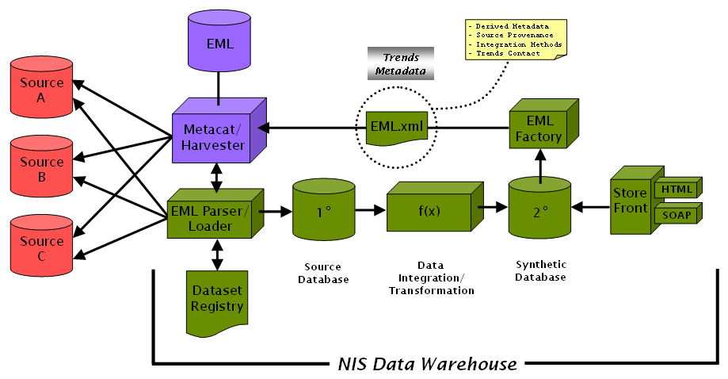
PASTA Architecture

Slide 5
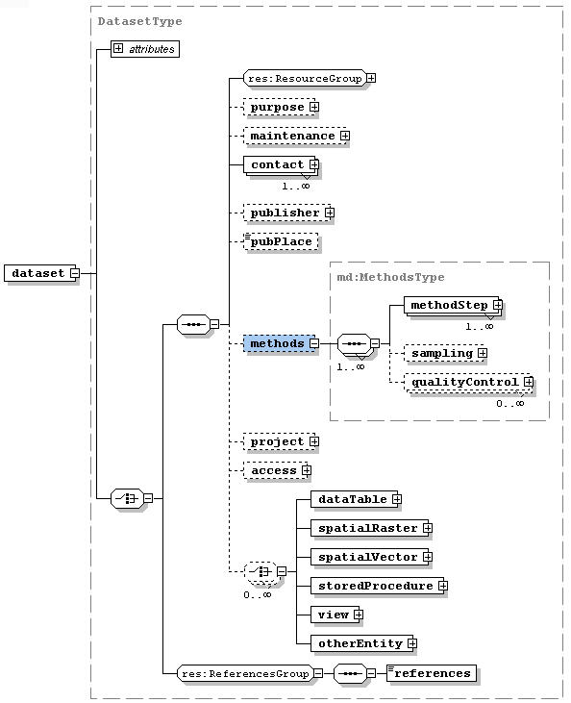
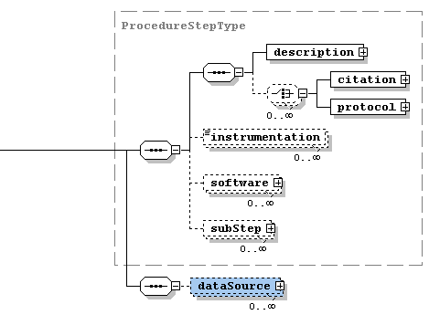

Slide 6
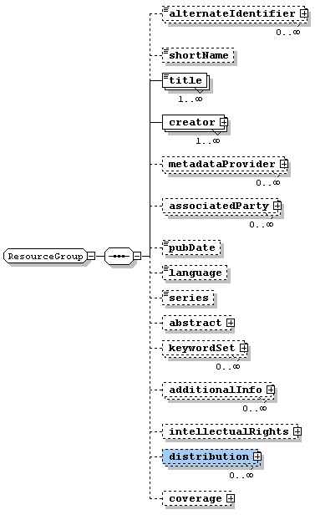
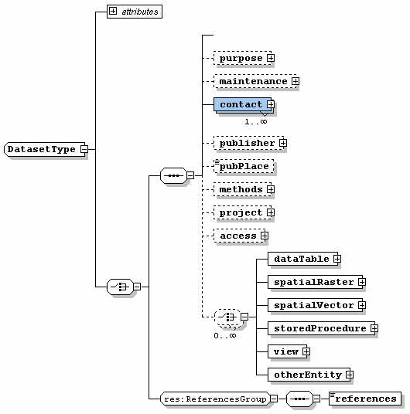
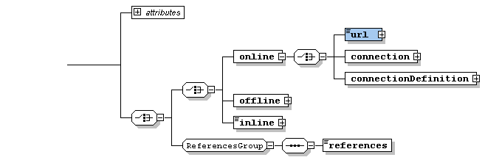

Slide 7
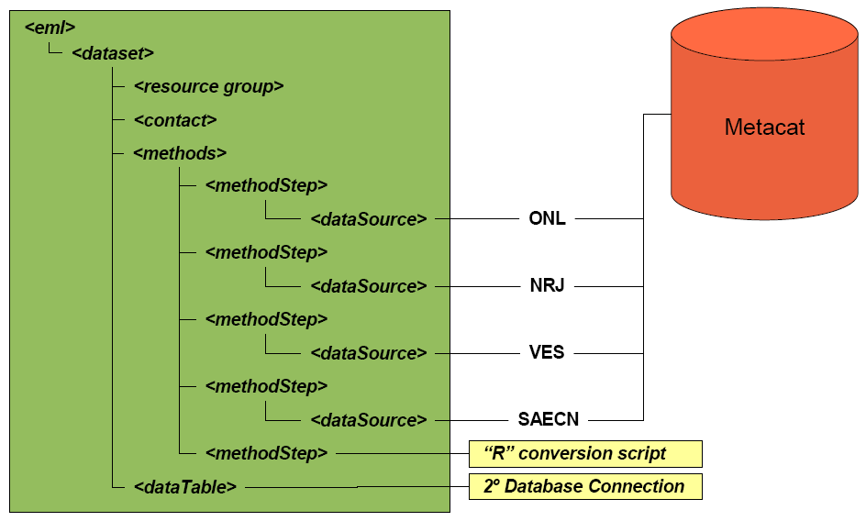
An example

Slide 8
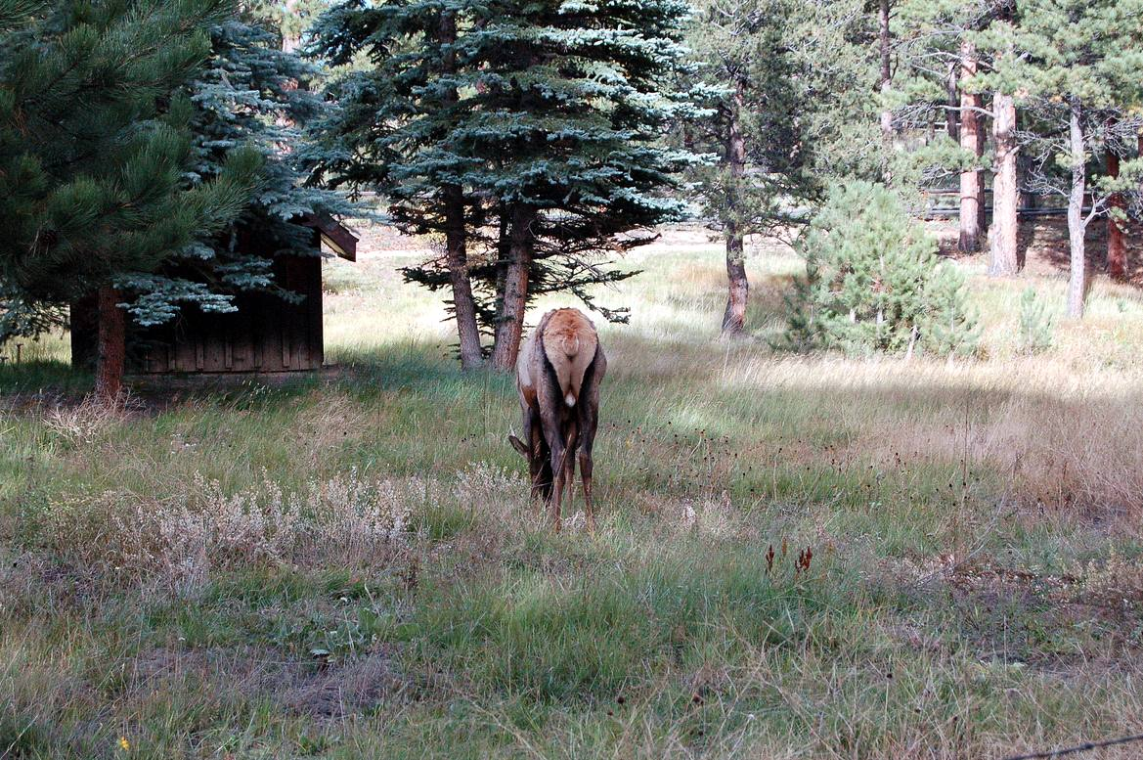
The End

